Slide 1
Leaf Recognition Based on Elliptical Half Gabor and Maximum Gap Local Line Direction Pattern
X. Wang, W. Du, F. Guo and S. Hu
IEEE Access, vol. 8, pp. 39175-39183, 2020.

Slide 2
Abstract
Plant identification via leaf images is very meaningful to agricultural information.
Existing methods are based on one or two kinds of three distinct characteristics in leaf images including leaf contours, textures and veins.
This paper describes a counting-based leaf recognition method
Combine all of the three kinds of significant characteristics in leaf images.
Elliptical half Gabor
Convoluted with raw grayscale leaf images to obtain stable and independent local line responses from leaf contour, texture and vein
Maximum gap local line direction patterns
Extracted from local line responses and normalized in direction by cyclically right shifting these patterns until the most numerous bit plane with a value of 1 to the left bit

Slide 3
Abstract (Cont’d)
The histogram of the normalized patterns is calculated and regarded as the counting-based local structure descriptor, and support vector machine is utilized as the classifier.
The proposed approach yields a better performance in terms of the classification accuracy, applicability and feasibility
INDEX TERMS
Counting-based descriptor, elliptical half-Gabor filters, maximum gap local line direction pattern, plant identification, support vector machine.

Slide 4
Introduction - Methodology
Automatic plant identification systems are very meaningful to agricultural information and ecological protection
Biological or phytochemical property-based techniques such as morphological anatomy, molecular biology and phytochemistry require complex processing, so they are not suitable for online applications
Plant recognition based on image analysis can extract plant features directly from living plants, and is suitable for online applications
Images from flowers, fruits, roots and leaves can be used for plant recognition
Leaf images are the most feasible ones
Popular leaf image recognition works pay attention to shape features
Leaf contours are firstly determined by a pre-processing course
Then the curvature scale space, inner distance shape context or multiscale distance matrix approaches are utilized to extract global shape features invariant to position, scale and direction variations

Slide 5
Introduction – Previous Works based on Leaf Contours
Kumar et al. [2] design a mobile application for plant identification
Extract curvature features from the pre-processed leaf images
Use a nearest neighbor classier with histogram intersection as the distance metric for classification
Ling and Jacobs [4], [5] propose a shape classification method called inner distance shape context.
Sample points along the boundary of a shape, and build a 2D histogram descriptor at each point.
This histogram represents the distance and angle from each point to all other points, along a path restricted to lie entirely inside the leaf shape
Belhumeur et al. [6] present an automatic plant identification system using inner distance shape context and a nearest neighbor classier
Hu et al. [7] construct a leaf image recognition method with the multiscale distance matrix and the nearest neighbor rule with Euclidean distance
These methods yield a good identification performance for the plants with significantly different leaf contours, but they are generally sensitive to the quality of the pre-processing results.
In practice, there are many different plant species with similar overall contours, and the same kind of plant species possesses leaves with different overall shapes
Hence, their discriminability not strong enough for all plant recognition applications

Slide 6
Introduction – Previous Works based on Leaf Texture
Casanova et al. [8] calculate the energies of the responses for Gabor filters as texture features
Liu et al. [9] propose a leaf classification method using wavelet transforms and support vector machine
In our early work [10], we combine dual-scale decomposition with local binary descriptors for plant leaf recognition
Naresh and Nagendraswamy [11] extract the local texture structure using a modified Local Binary Patterns (LBP) approach
Tang et al. [12] combine Gray Level Co-Occurrence Matrix (GLCM) with LBP for tea leaf classification

Slide 7
Introduction – Previous Works based on Leaf Vein
Fu and Chi [13] combine a thresholding approach with neural network for extracting vein patterns from leaf images
Park et al. [14] classify vein structures with the pattern of end points and branch points
Larese et al. [15] extract vein patterns using hit or miss transform from legume leaves

Slide 8
Introduction – Comparison
Compared with the contour-based methods, these texture or vein based methods are less sensitive to the quality of the pre-processing results
Achieve reasonable results in the case of different plant species with similar overall contours or the same kind of plant leaves with different overall shapes,
Their classification accuracies are generally lower than the state of the art contour-based methods for the universal plant recognition.
These works adequately demonstrate that texture and vein patterns are very helpful to leaf identification.

Slide 9
Introduction – Deep learning techniques
Grinblat et al. [18] train a convolutional neural network with vein morphological patterns for leaf identification.
Lee et al. [19] design a multiscale fusion convolutional neural network to fuse the features extracted from leaf images with different scales.
Hu et al. [20] learn useful leaf features directly from the raw leaf image data using a convolutional neural network, and quantify the learned features based on a deconvolutional network for species identification.
They also analyze and justify the subset of features that are most important to describe leaf data via feature visualization techniques, and find that venation structure is a very important feature for identification especially when shape feature alone is inadequate

Slide 10
Introduction – Deep learning techniques summary
These methods have reported a promising recognition performance.
Moreover, some of them start directly from the raw leaf images and free of the pre-processing course.
However, it is well known that deep convolutional neural networks require very large amounts of training data, the number of samples in existing leaf image databases is still far from matching the scale and variety of existing general major databases for images, videos or languages.
So, to efficiently train a deep architecture to recognize plant leaf images, much larger datasets are required, preferably with more than a million images and higher category variability

Slide 11
Introduction – Counting
Zhao et al. [21] find that it is better to count the number of certain shape patterns rather than to match the extracted global shape features in a point-wise manner.
Based on this idea, they propose a counting-based shape descriptor for identifying plant species
Cerutti et al. [22] utilize a sequence-like structured representation to track the spatial information from curvature space and present a smartphone application for identifying plant species.
Zhang et al. [23] apply Warshall algorithm [24] to label propagation of leaf contours to obtain a label matrix, and then the matrix is dealt with discriminant neighbors to form an optimum projecting to low dimensionality, the resultant descriptors are classified by the nearest neighbor classifier
Counting methods generally outperform over the conventional contour-based methods in terms of classification accuracy and applicability,
but they extract counting-based shape features only from the boundaries of leaves, and neglect other useful characteristics such as veins and textures in the leaf images.
their sensitivity to the quality of the pre-processing results is in line with the conventional contour-based methods

Slide 12
Introduction – the proposed method
Take advantage of the three kinds of significant characteristics in leaf images
including shape, venation and main texture in leaf images
Make leaf recognition free of the pre-processing course
Leaf identification including importance of venation structure
Counting the number of local shape patterns over matching global shape features point by point
Elliptical half Gabor wavelet
Highlight the local dominant orientation information of leaf contours, veins and main textures
Maximum Gap Local Line Direction Pattern (MGLLDP)
Local line direction coding
Extract local dominant orientation structure patterns
The histogram of the normalized local dominant orientation structure patterns is regarded as the counting-based local structure descriptor,
Support vector machine is utilized as the classier.

Slide 13
Introduction – Paper Structure
Section II provides a brief review of local line direction pattern and support vector machine.
Section III describes the proposed counting-based local structure descriptor
Section IV presents experimental results
Section V provides concluding remarks

Slide 14
Local Line Direction Pattern And Support Vector Machine
Local Line Direction Patterns
Support Vector Machine

Slide 15
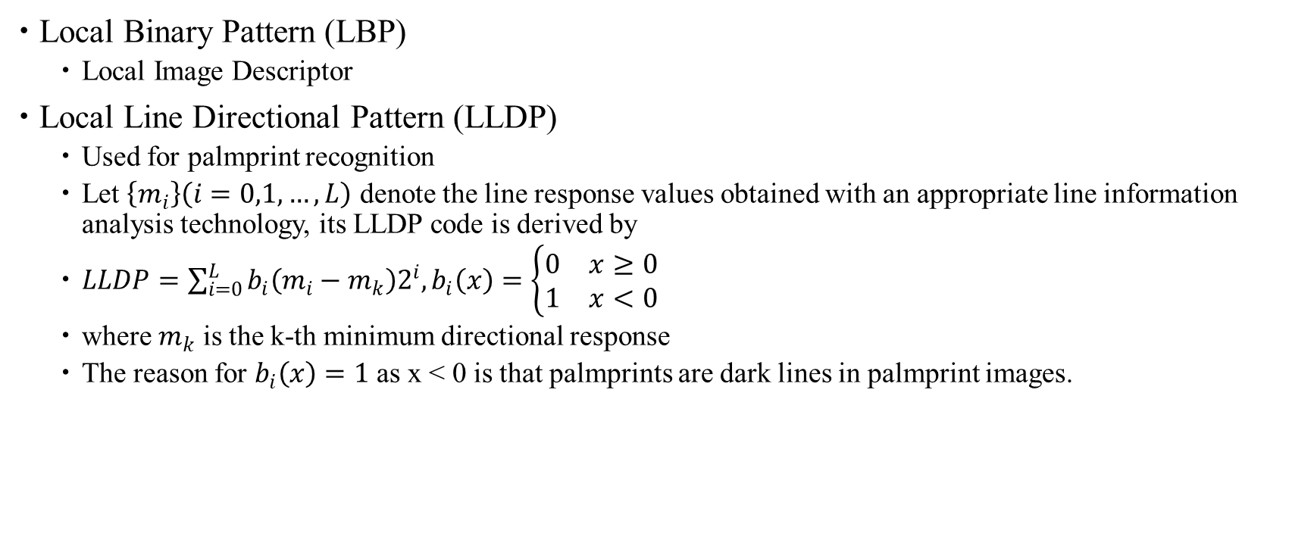
Local Line Direction Patterns(LLDP)
Local Binary Pattern (LBP)
Local Image Descriptor
Local Line Directional Pattern (LLDP)
Used for palmprint recognition
Let $\left\{m_{i}\right\}\left(i=0,1,…,L\right)$ denote the line response values obtained with an appropriate line information analysis technology, its LLDP code is derived by
$LLDP=\sum_{i=0}^{L}{b_{i}\left(m_{i}−m_{k}\right)2^{i},b_{i}\left(x\right)=\left\{\begin{aligned}\begin{matrix}0 & x≥0\end{matrix} \\ \begin{matrix}1 & x<0\end{matrix}\end{aligned}\right.}$
where $m_{k}$ is the k-th minimum directional response
The reason for $b_{i}\left(x\right)=1$ as x < 0 is that palmprints are dark lines in palmprint images.

Slide 16
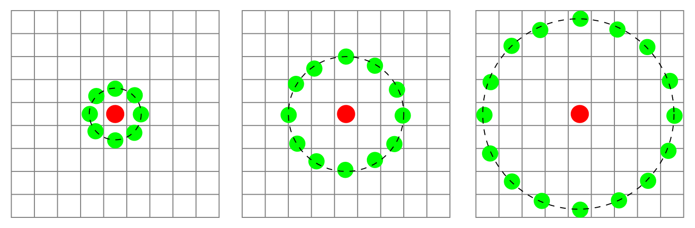

Local Binary Pattern (LBP)
75 | 88 | 90
91 | 92 | 94
95 | 94 | 77
0 | 0 | 0
0 |  | 1
1 | 1 | 0
 | 22
$${\left(00010110\right)}_{2}$$

Slide 17
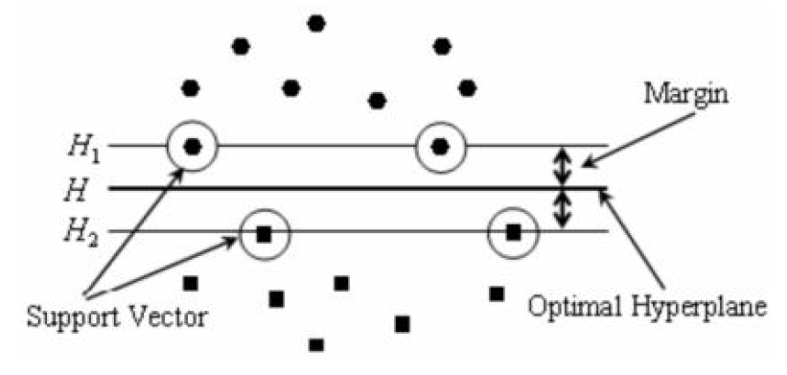
Support Vector Machine(SVM)
A frequently-used classier developed by Vapnik [31] based on statistical learning theory
H represents the optimal separating hyperplane to be determined, H1 and H2 are two hyperplanes parallel to H and no training sample falls between them
H should be the separating hyperplane which can separate the two categories with the maximum margin so that structural risk can be minimized

Slide 18

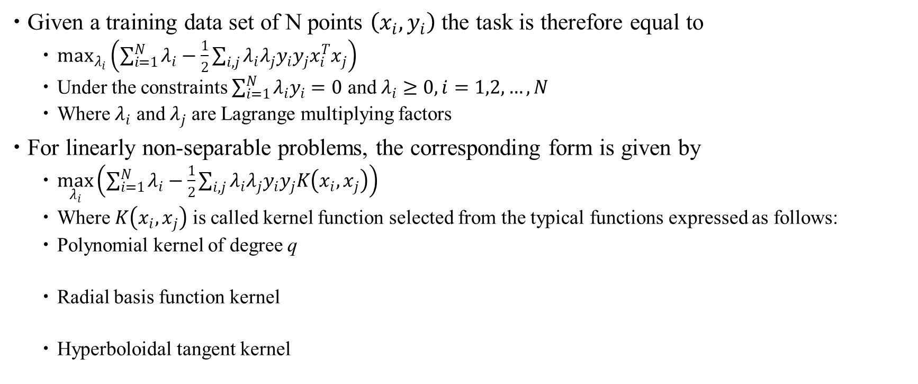


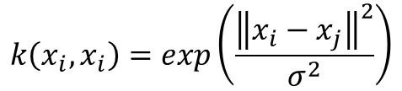
Support Vector Machine(SVM)
Given a training data set of N points $\left(x_{i},y_{i}\right)$ the task is therefore equal to
$\max_{λ_{i}}\left(\sum_{i=1}^{N}{λ_{i}−\frac{1}{2}}\sum_{i,j}{λ_{i}λ_{j}y_{i}y_{j}x_{i}^{T}x_{j}}\right)$
Under the constraints $\sum_{i=1}^{N}{λ_{i}y_{i}=0}$ and $λ_{i}≥0,i=1,2,…,N$
Where $λ_{i}$ and $λ_{j}$ are Lagrange multiplying factors
For linearly non-separable problems, the corresponding form is given by
$\max_{λ_{i}}\left(\sum_{i=1}^{N}{λ_{i}−\frac{1}{2}}\sum_{i,j}{λ_{i}λ_{j}y_{i}y_{j}K\left(x_{i},x_{j}\right)}\right)$
Where $K\left(x_{i},x_{j}\right)$ is called kernel function selected from the typical functions expressed as follows:
Polynomial kernel of degree q
Radial basis function kernel
Hyperboloidal tangent kernel
$$k\left(x_{i},x_{i}\right)={\left(x_{i}^{T}x_{j}+1\right)}^{q},q>0$$
$$k\left(x_{i},x_{i}\right)=exp\left(\frac{{\left\|x_{i}−x_{j}\right\|}^{2}}{σ^{2}}\right)$$
In this work, we select the radial basis function with
$$σ=6.28$$
as the kernel function for support vector machine.
$$k\left(x_{i},x_{j}\right)=\tanh\left(βx_{i}^{T}x_{j}+γ\right)$$

Slide 19
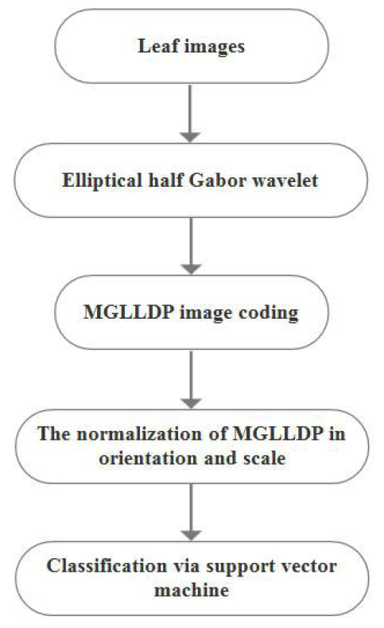
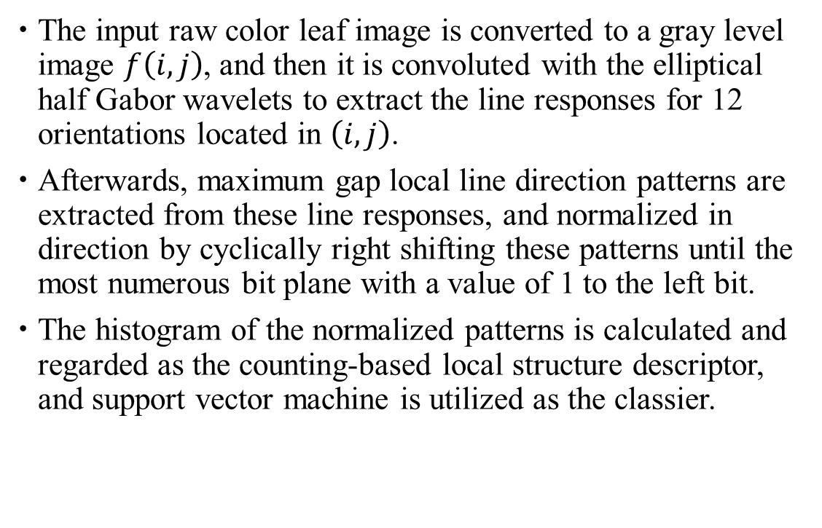
The Proposed Method
The input raw color leaf image is converted to a gray level image $f\left(i,j\right)$, and then it is convoluted with the elliptical half Gabor wavelets to extract the line responses for 12 orientations located in $\left(i,j\right)$.
Afterwards, maximum gap local line direction patterns are extracted from these line responses, and normalized in direction by cyclically right shifting these patterns until the most numerous bit plane with a value of 1 to the left bit.
The histogram of the normalized patterns is calculated and regarded as the counting-based local structure descriptor, and support vector machine is utilized as the classier.

Slide 20
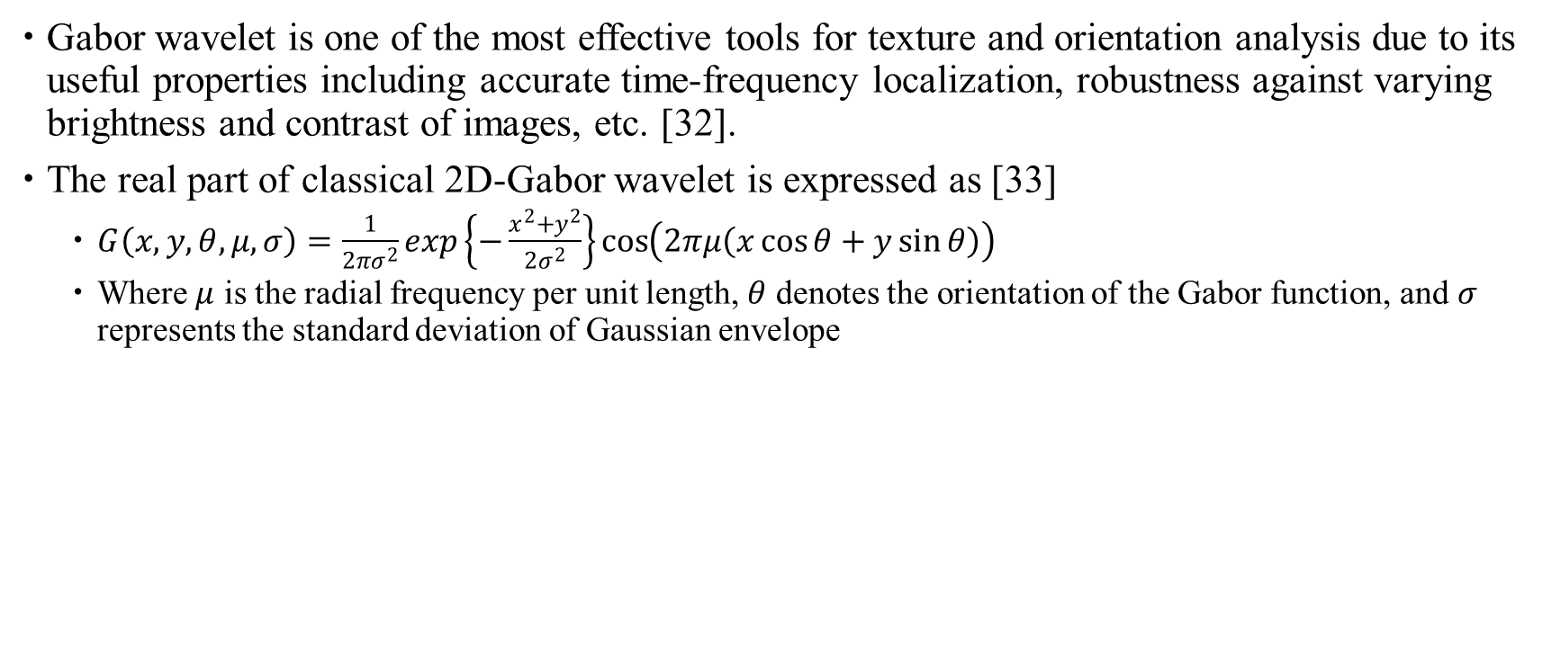
Elliptical Half Gabor Wavelet
Gabor wavelet is one of the most effective tools for texture and orientation analysis due to its useful properties including accurate time-frequency localization, robustness against varying brightness and contrast of images, etc. [32].
The real part of classical 2D-Gabor wavelet is expressed as [33]
$G\left(x,y,θ,μ,σ\right)=\frac{1}{2πσ^{2}}exp\left\{−\frac{x^{2}+y^{2}}{2σ^{2}}\right\}\cos\left(2πμ\left(x\cos{θ+y\sin{θ}}\right)\right)$
Where $μ$ is the radial frequency per unit length, $θ$ denotes the orientation of the Gabor function, and $σ$ represents the standard deviation of Gaussian envelope

Slide 21
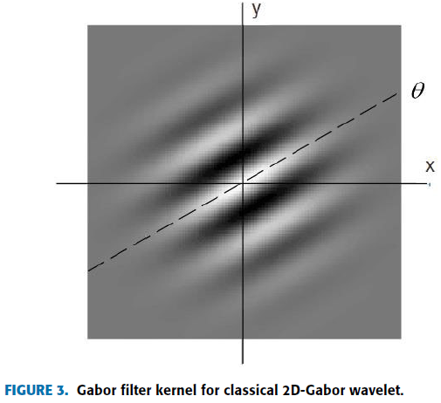
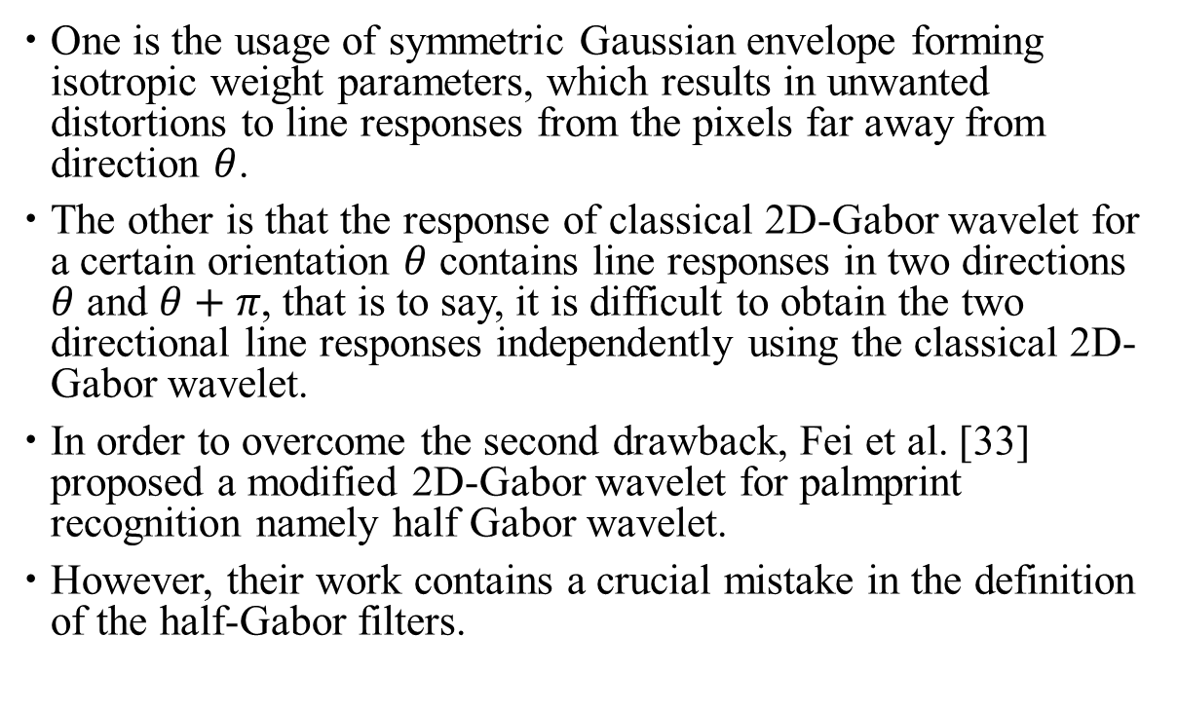
The classical 2D-Gabor wavelet has two drawbacks in line response analysis
One is the usage of symmetric Gaussian envelope forming isotropic weight parameters, which results in unwanted distortions to line responses from the pixels far away from direction $θ$.
The other is that the response of classical 2D-Gabor wavelet for a certain orientation $θ$ contains line responses in two directions $θ$ and $θ+π$, that is to say, it is difficult to obtain the two directional line responses independently using the classical 2D-Gabor wavelet.
In order to overcome the second drawback, Fei et al. [33] proposed a modified 2D-Gabor wavelet for palmprint recognition namely half Gabor wavelet.
However, their work contains a crucial mistake in the definition of the half-Gabor filters.

Slide 22
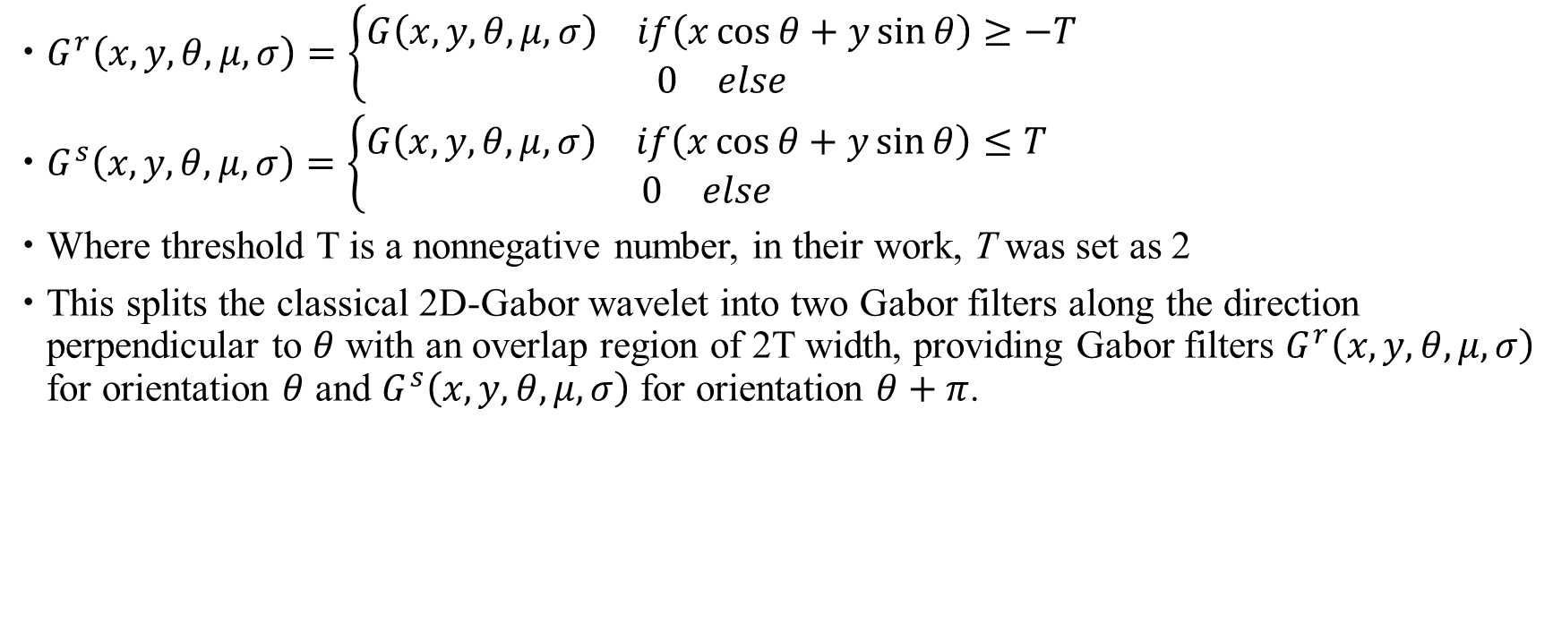
The correct version of half Gabor wavelet proposed in [33], defined in [34]
$G^{r}\left(x,y,θ,μ,σ\right)=\left\{\begin{aligned}\begin{matrix}G\left(x,y,θ,μ,σ\right) & if\left(x\cos{θ+y\sin{θ}}\right)≥−T\end{matrix} \\ \begin{matrix}0 & else\end{matrix}\end{aligned}\right.$
$G^{s}\left(x,y,θ,μ,σ\right)=\left\{\begin{aligned}\begin{matrix}G\left(x,y,θ,μ,σ\right) & if\left(x\cos{θ+y\sin{θ}}\right)≤T\end{matrix} \\ \begin{matrix}0 & else\end{matrix}\end{aligned}\right.$
Where threshold T is a nonnegative number, in their work, T was set as 2
This splits the classical 2D-Gabor wavelet into two Gabor filters along the direction perpendicular to $θ$ with an overlap region of 2T width, providing Gabor filters $G^{r}\left(x,y,θ,μ,σ\right)$ for orientation $θ$ and $G^{s}\left(x,y,θ,μ,σ\right)$ for orientation $θ+π$.

Slide 23
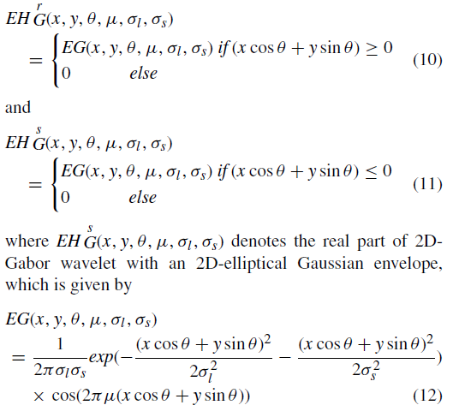
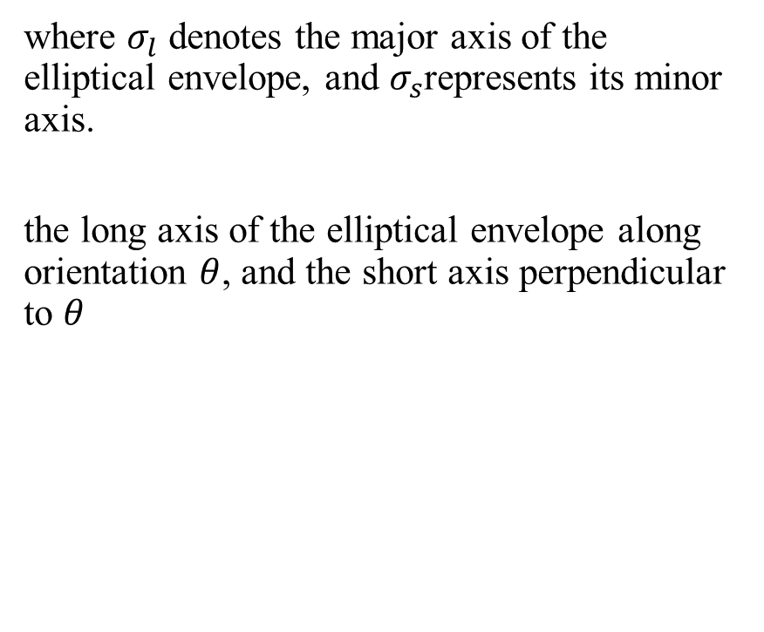
The proposed elliptical half Gabor wavelet
where $σ_{l}$ denotes the major axis of the elliptical envelope, and $σ_{s}$represents its minor axis.
the long axis of the elliptical envelope along orientation $θ$, and the short axis perpendicular to $θ$

Slide 24
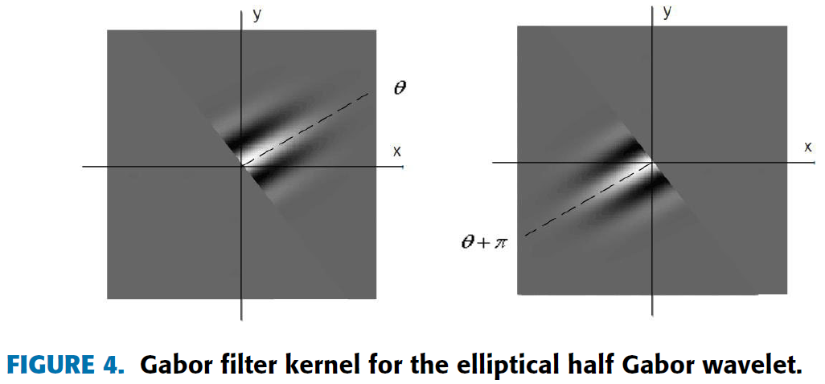

Slide 25
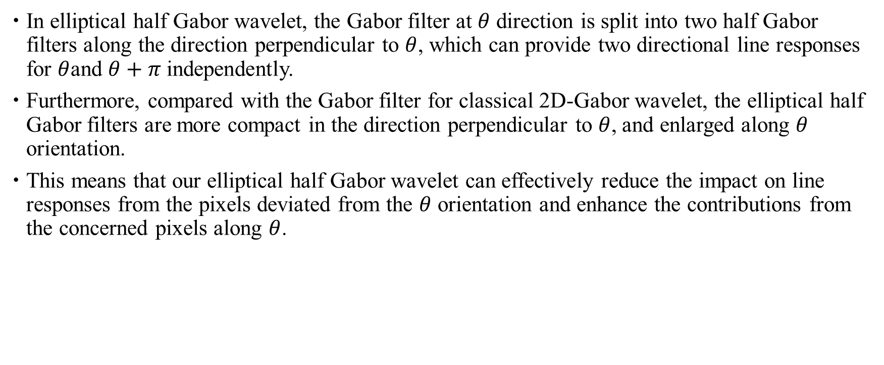
The proposed elliptical half Gabor wavelet
In elliptical half Gabor wavelet, the Gabor filter at $θ$ direction is split into two half Gabor filters along the direction perpendicular to $θ$, which can provide two directional line responses for $θ$and $θ+π$ independently.
Furthermore, compared with the Gabor filter for classical 2D-Gabor wavelet, the elliptical half Gabor filters are more compact in the direction perpendicular to $θ$, and enlarged along $θ$ orientation.
This means that our elliptical half Gabor wavelet can effectively reduce the impact on line responses from the pixels deviated from the $θ$ orientation and enhance the contributions from the concerned pixels along $θ$.

Slide 26
Weaknesses in the original definition of LLDP
LLDP outperforms over the LBP-like codes based on edge gradients or pixel intensities [20], but there are still some weaknesses in the original definition of LLDP
The first shortcoming comes from the determination of m_{k} which was simply set to the third minimum directional response in reference [20] i.e. only the first two dominant orientations were encoded as 1.
This will cause to omit part of principal direction information for pixels with a number of principal directions greater than 2 such as point a, and bring unwanted clutters for pixels with a number of principal directions less than 2 such as point c
The second shortcoming is that in the light of the original definition of LLDP, a non-zero LLDP code will be generated for each pixel even if the pixel is located in smooth region like pixel c.
This is unreasonable, and the non-zero LLDPs from pixels located in the smooth region will disturb and degrade overall discriminability of LLDP.

Slide 27
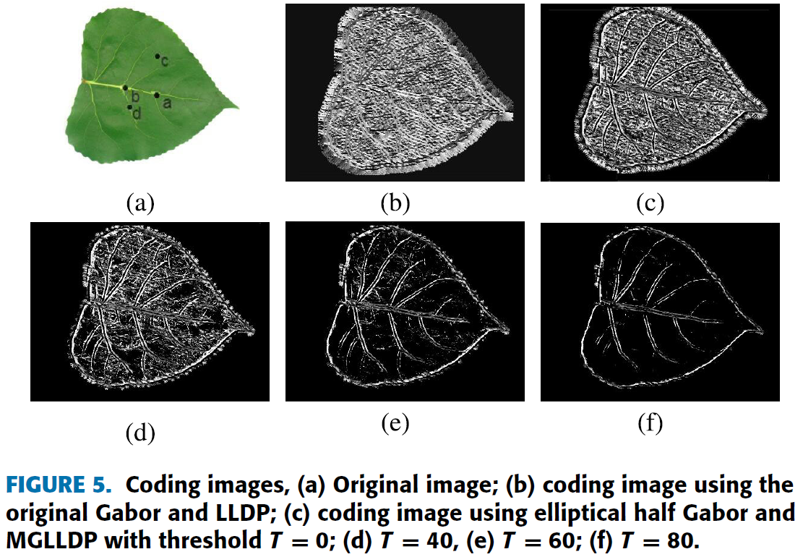

Slide 28
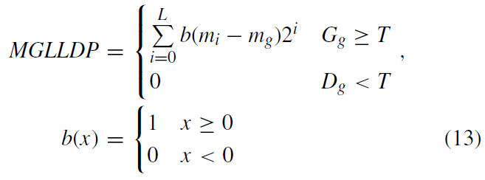

Maximum Gap Local Line Direction Patterns(MGLLDP)
Given a line response set $\left\{m_{i}\right\}\left(i=0,1,…,L\right)$, MGLLDP is defined as
where T is a threshold, Dg denotes the maximum gap in $\left\{m_{i}\right\}\left(i=0,1,…,L\right)$, and mg represents the superior of the two line responses associated with the maximum gap Dg

Slide 29
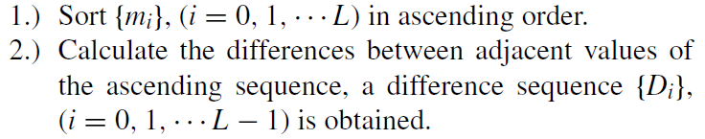
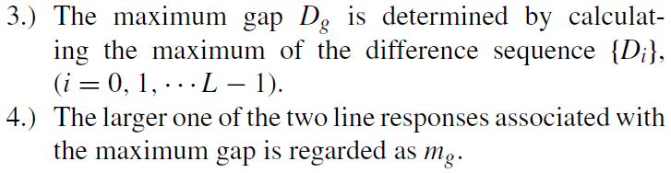

The Maximun Gap $D_{g}$can be obtained by

Slide 30
The advantages of MGLLDP over the original LLDP
The number of principal directions for each pixel center can be adaptively determined, as a result, all principal directions can be properly encoded, no principal direction is neglected and no unwanted clutter is pulled in.
For the pixels located in smooth region, which maximum gaps are less than the threshold T , their MGLLDPs equal zero.
This can alleviate the distortions from the pixels without principal direction.
Furthermore, by varying the threshold T , one can balance extracting the weak principal direction information with filtering the distortions.

Slide 31
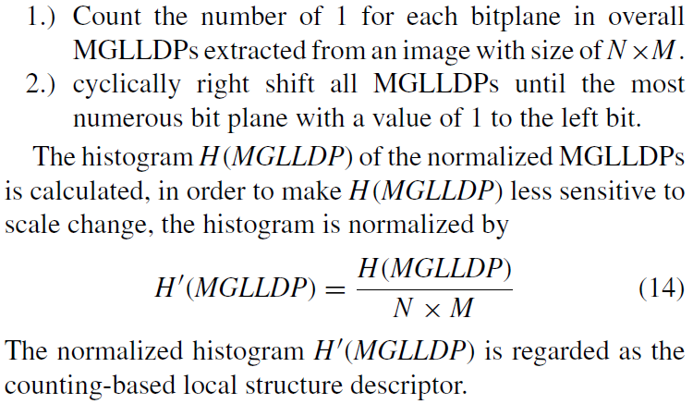
The Normalization Of Mglldp In Orientation And Scale
In order to improve the robustness of MGLLDP to orientation changes, we provide a directional normalization method for MGLLDP, which is described as

Slide 32
Simulation Results And Performance Analysis
Conduct experiments on three frequently used leaf databases: Swedish, Flavia and ICL
In comparison with half Gabor and LLDP version and eight representative methods including
two contour-based methods i.e. Inner Distance Shape Context (IDSC) [4] and Multiscale Distance Matrix (MDM) [7],
two texture-based methods namely Gabor based method [8] and Wavelet based method [9],
two deep learning-based methods named as deep learning on veins [18] and multiscale fusion convolutional neural network [20],
two recent counting-based methods i.e. pattern counting approach [21] and Label propagation projection [23].
Intelligent Computing Laboratory (ICL) of institute of intelligent machines, Chinese academy of sciences
Contains 17,032 leaf images from 221 plant species

Slide 33
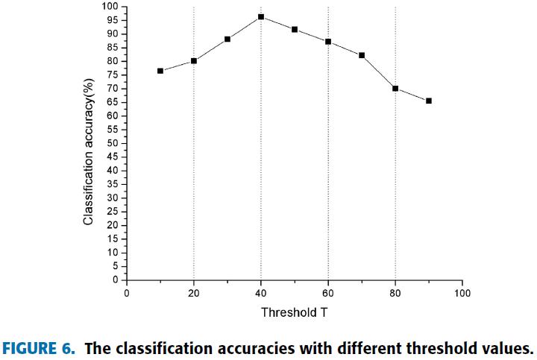
Selection Of Threshold T And Preparation Of Leaf Images
30 plant species are randomly selected from ICL leaf database, the first ten leaf images for each plant species are regarded as training samples and the remainders are used for testing. The threshold T changes from 10 to 90 with 10 increments
Based on this figure, threshold T is set to 40 in subsequent experiments.

Slide 34
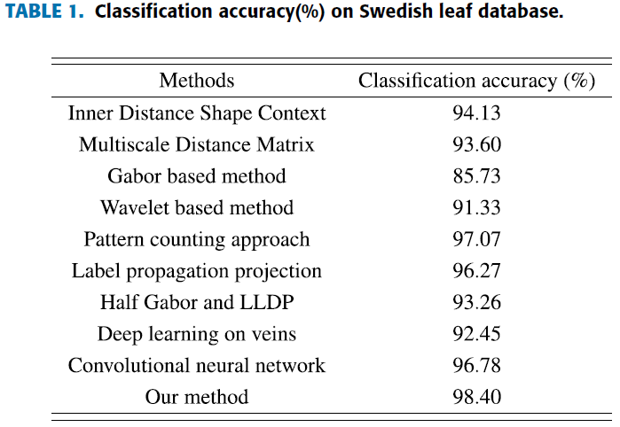
Performance On Swedish Database
The Swedish leaf database contains 1125 leaf images from 15 different Swedish trees with 75 images per species.
We randomly select 25 leaf images per species for training and the rest 50 images were used for test.

Slide 35
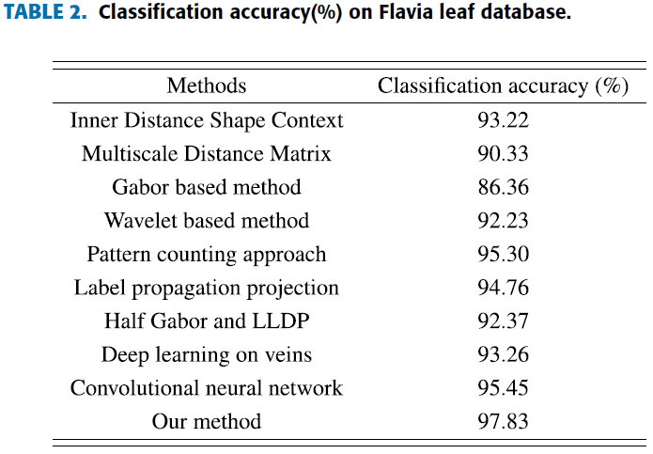
Performance On Flavia Database
Flavia database downloaded from [36] contains 1907 leaf images of blades without petioles from 32 different species.
The first 25 leaf images per species are used as the training set and the other as the test set.

Slide 36
Performance on ICL Database
The ICL leaf database contains 17,032 leaf images from 221 plant species. Three datasets are obtained by carefully selecting the samples with specific characteristics from ICL database.
Dataset A consists of all samples of ICL database.
The species in dataset B are carefully selected and most of them without vein and texture or with weak veins and textures, which contains 3390 leaf images from 44 plant species.
Dataset C consists of 2312 leaf images from 30 species, most of them with similar overall contours and different veins or textures.
For the three datasets, the first 15 leaf images per species are used as the training set and the other as the test set.

Slide 37
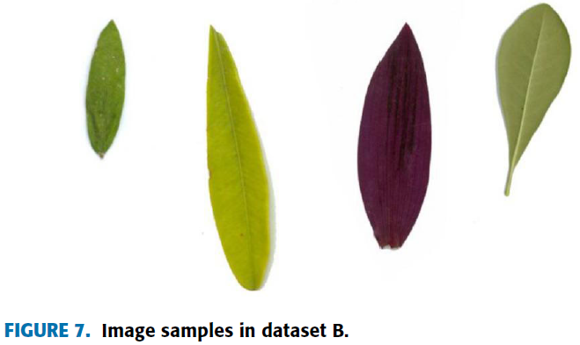
ICL Dataset B
The species in dataset B are carefully selected and most of them without vein and texture or with weak veins and textures

Slide 38
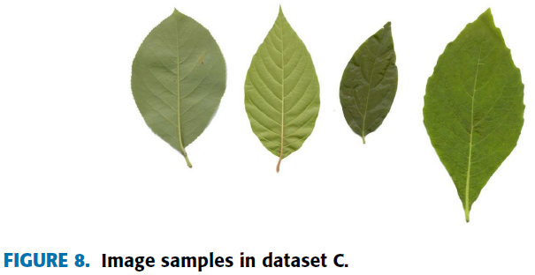
ICL Dataset C
Dataset C consists of 2312 leaf images from 30 species, most of them with similar overall contours and different veins or textures.

Slide 39
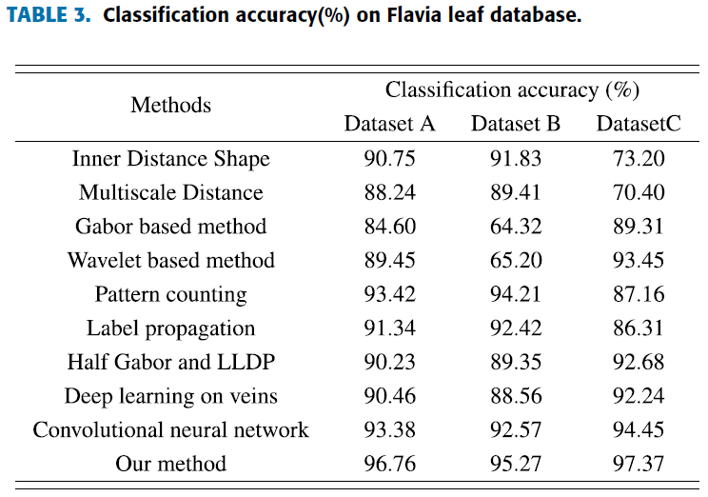
Performance on ICL Database

Slide 40
Conclusion
A novel counting-based leaf recognition method based on the elliptical half Gabor wavelet and maximum gap local line direction patterns.
The advantages of our methods over the state of the art leaf recognition methods are
1.) direct and effective combination of all three kinds of significant characteristics in leaf images;
2.) high adaptability for various complicated conditions and diversified characteristics;
3.) high feasibility due to working directly on raw grayscale leaf images without the need for a preprocessing process.
The experimental results on three frequently-used benchmark databases demonstrate the advantages of our method over the representative leaf recognition methods.

Slide 41
Future works
Consider the automatic identification of plant diseases and insect pests using leaves.
Another interesting topic would be to solve the problem of how to identify plants via multiple or overlap leaves,
The possible extension applications of elliptical half Gabor and maximum gap local line direction pattern would be included.

