Slide 1
資訊安全 Chapter 4 Access Control 存取控制
Joseph Deng
josephdeng@g2.usc.edu.tw

Slide 2
Outline 大綱
Access Control Principles
Subjects, Objects, and Access Rights
Discretionary Access Control
Example: Unix File Access Control
Role-Based Access Control
Attribute-Based Access Control
Identity, Credential, and Access Management
Trust Frameworks
Case Study: RBAC System for a Bank

Slide 3
Learning Objectives 學習目標
How access control fits into the broader context that includes authentication, authorization, and audit.
The three major categories of access control policies.
Distinguish among subjects, objects, and access rights.
The UNIX file access control model.
The principal concepts of role-based access control.
The RBAC model.
The principal concepts of attribute-based access control.
Identity, credential, and access management model.
The concept of identity federation and its relationship to a trust framework.

Slide 4
Access Control Definitions
NISTIR 7298 (Glossary of Key Information Security Terms , May 2013)
The process of granting or denying specific requests to:
(1) obtain and use information and related information processing services; and
(2) enter specific physical facilities
RFC 4949, Internet Security Glossary
A process by which use of system resources is regulated according to a security policy and is permitted only by authorized entities (users, programs, processes, or other systems) according to that policy

Slide 5
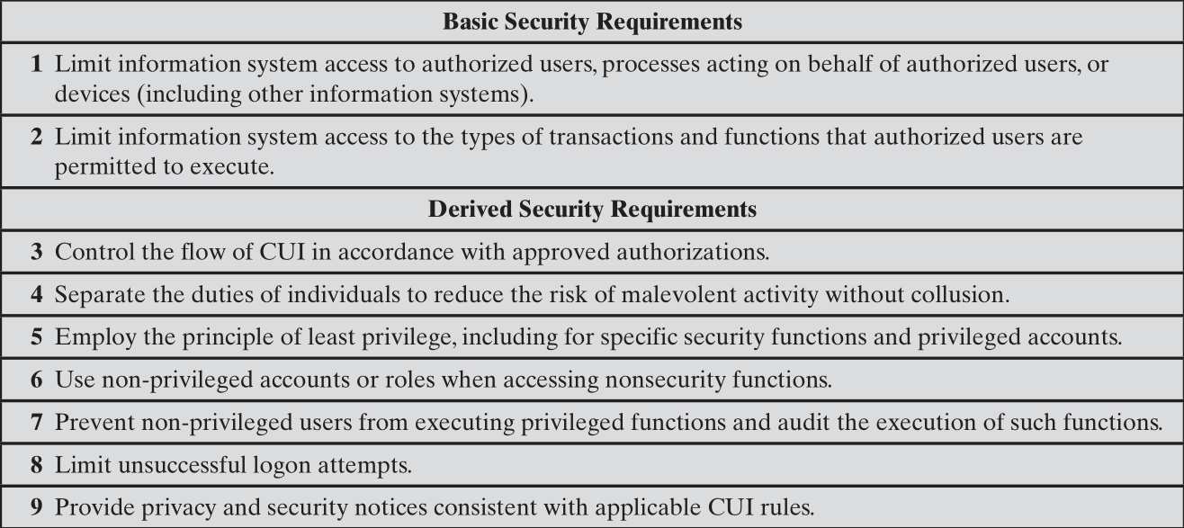
NIST SP 800-171 (Protecting Controlled Unclassified Information in Nonfederal Information Systems and Organizations, August 2016) 1/2
對象
流動
分權
最低權限
Fail2Ban
稽核
知會
CUI = controlled unclassified information 未分類的管制資訊

Slide 6
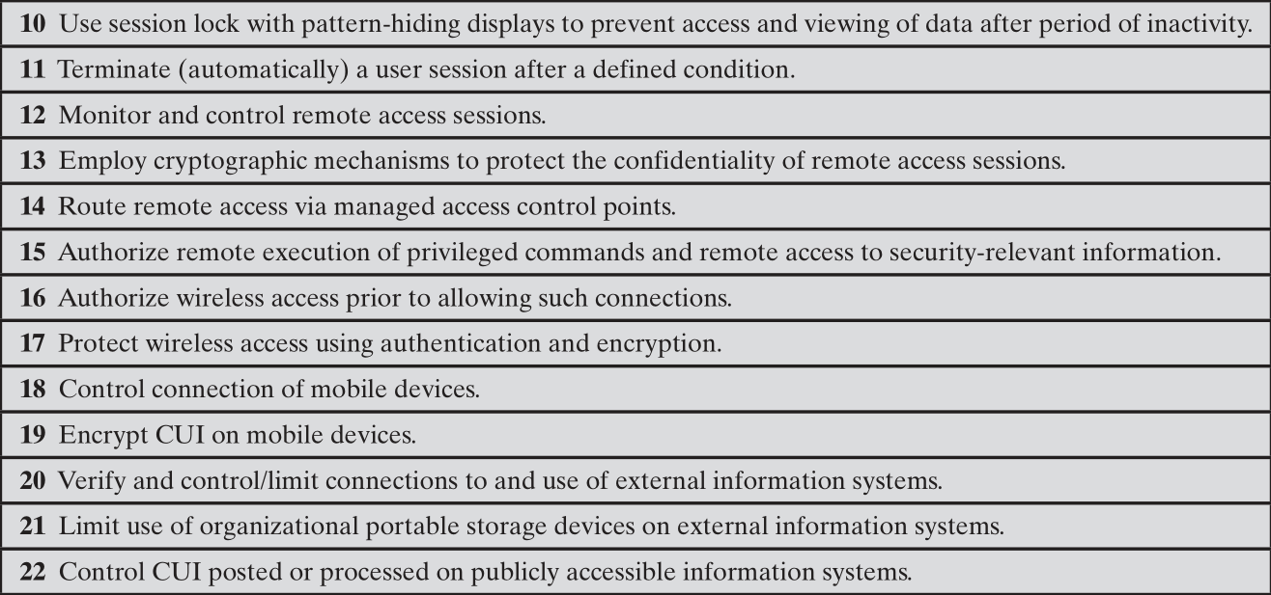
NIST SP 800-171 (Protecting Controlled Unclassified Information in Nonfederal Information Systems and Organizations, August 2016) 1/2
逾時自動登出
Session Lock
遠端登入
加密
嚴密管理存取控制點
遠端執行程式、存取機密資料
無線網路
行動裝置
外部資訊系統
防止接觸傳染

Slide 7
Access Control Principles
In a broad sense, all of computer security is concerned with access control 所有的資訊安全都是在做存取控制
RFC 4949 defines computer security as:
Measures that implement and assure security services in a computer system, particularly those that assure access control service

Slide 8
Access Control Context
Authentication 認證
Verification that the credentials of a user or other system entity are valid.
Authorization 授權
The granting of a right or permission to a system entity to access a system resource.
This function determines who is trusted for a given purpose.
• Audit 稽核
An independent review and examination of system records and activities in order
to test for adequacy of system controls, 充分控制
to ensure compliance with established policy and operational procedures, 合規
to detect breaches in security, and 捉漏
to recommend any indicated changes in control, policy, and procedures. 改進

Slide 9
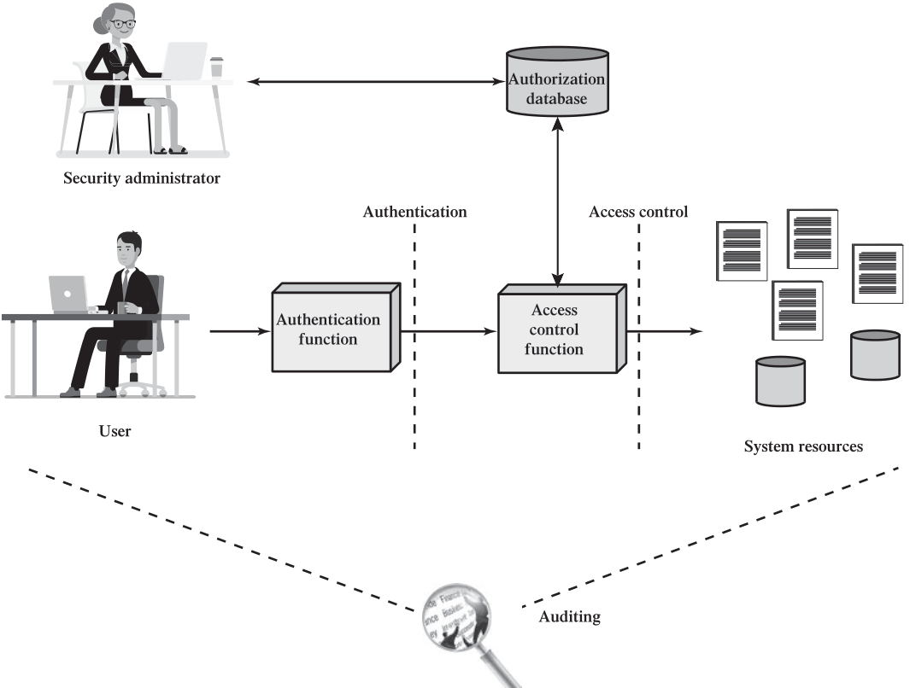
Figure 4.1 Relationship Among Access Control and Other Security Functions
Relationship Among Access Control and Other Security Functions

Slide 10
Access Control Policies
Discretionary access control (DAC): 個別
Controls access based on the identity of the requestor and on access rules (authorizations) stating what requestors are (or are not) allowed to do.
Mandatory access control (MAC): 強制
Controls access based on comparing security labels (which indicate how sensitive or critical system resources are) with security clearances (which indicate system entities are eligible to access certain resources).
Role-based access control (RBAC): 角色
Controls access based on the roles that users have within the system and on rules stating what accesses are allowed to users in given roles.
Attribute-based access control (ABAC): 屬性
Controls access based on attributes of the user, the resource to be accessed, and current environmental conditions.

Slide 11
Discretionary Access Control (DAC)
Scheme in which an entity may be granted access rights that permit the entity, by its own violation, to enable another entity to access some resource
Often provided using an access matrix
One dimension consists of identified subjects that may attempt data access to the resources
The other dimension lists the objects that may be accessed
Each entry in the matrix indicates the access rights of a particular subject for a particular object

Slide 12
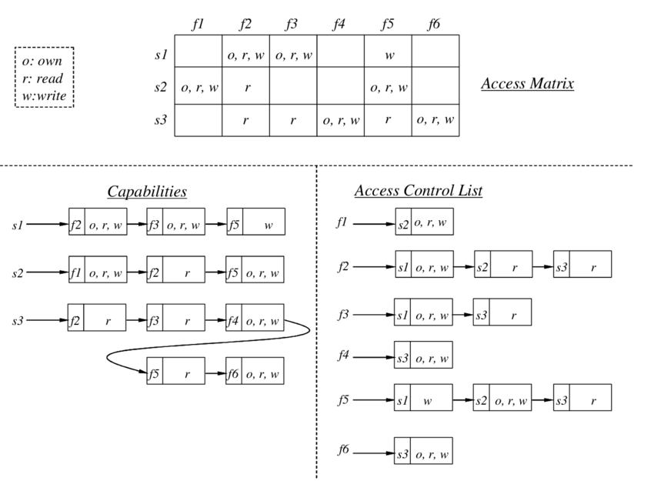
Access Control Structure
Object
Subject
Access Right

Slide 13
Subjects, Objects, and Access Rights
Subject 主體
An entity capable of accessing objects
Three classes
Owner
Group
World
Object 客體
A resource to which access is controlled
Entity used to contain and/or receive information
Access right 存取權
Describes the way in which a subject may access an object
Could include:
Read 讀
Write 寫/改
Execute 執行
Delete 刪除
Create 建立
Search 搜尋

Slide 14
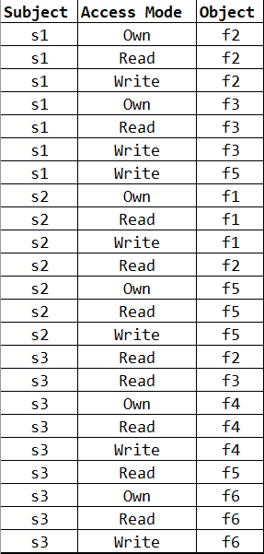
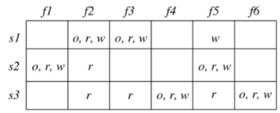
Authorization Table

Slide 15
An Access Control Model
A general model for DAC developed by Lampson, Graham, and Denning
The protection state of a system
The set of information, at a given point in time, that specifies the access rights for each subject with respect to each object
3 requirements:
Representing the protection state
Enforcing access rights
Allowing subjects to alter the protection state

Slide 16
Representing The Protection State
Processes:
Access rights: Delete, Stop (Block), Wake up
Devices:
Access rights: Read/Write, Control(e.g., disk seek), Block/Unblock
Memory locations or regions:
Access rights: Read/Write, Disallow Access
Subjects:
Access rights: Grant or Delete access rights

Slide 17
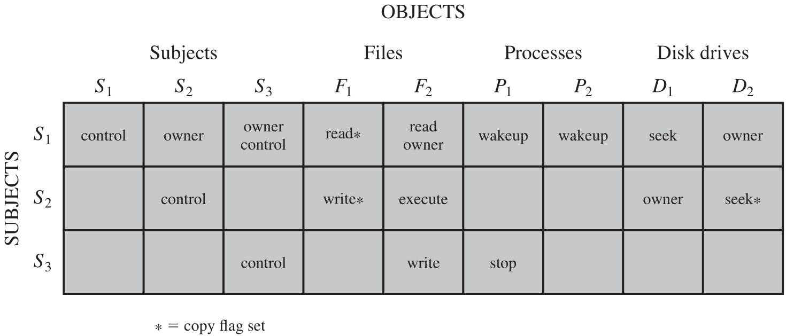
Extended Access Control Matrix
Access Attribute A[S,X]
The access rights of subject S to object X
The right can be transferred

Slide 18
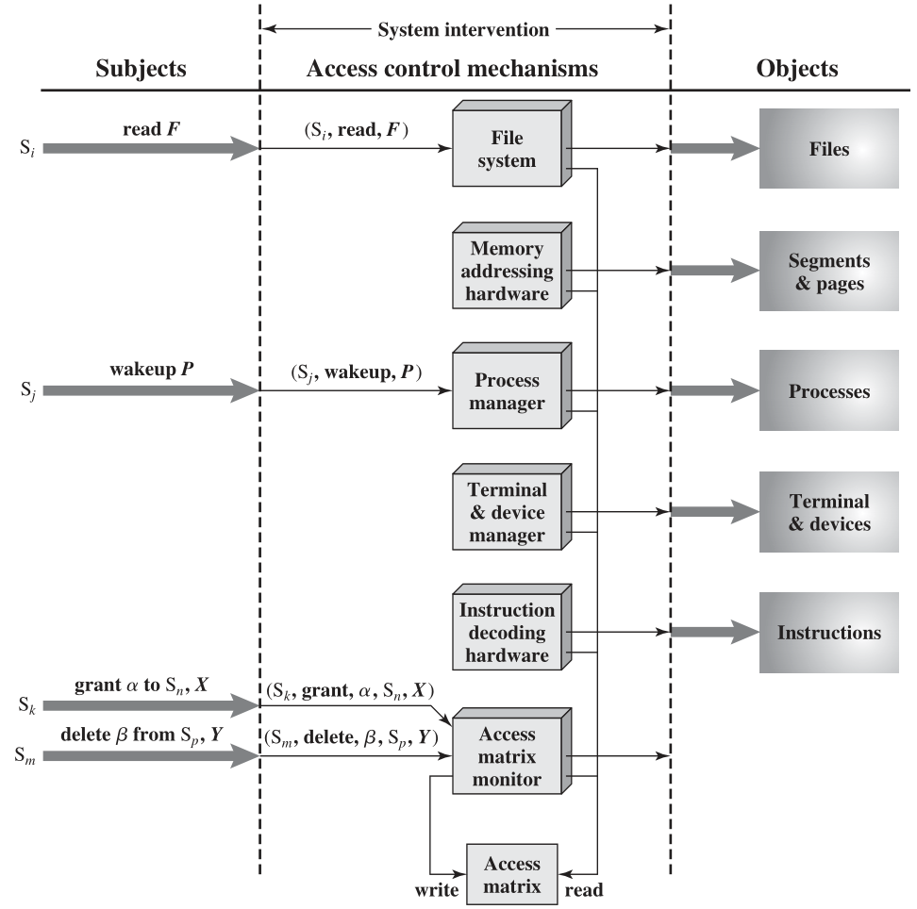
An Organization of the Access Control Function

Slide 19
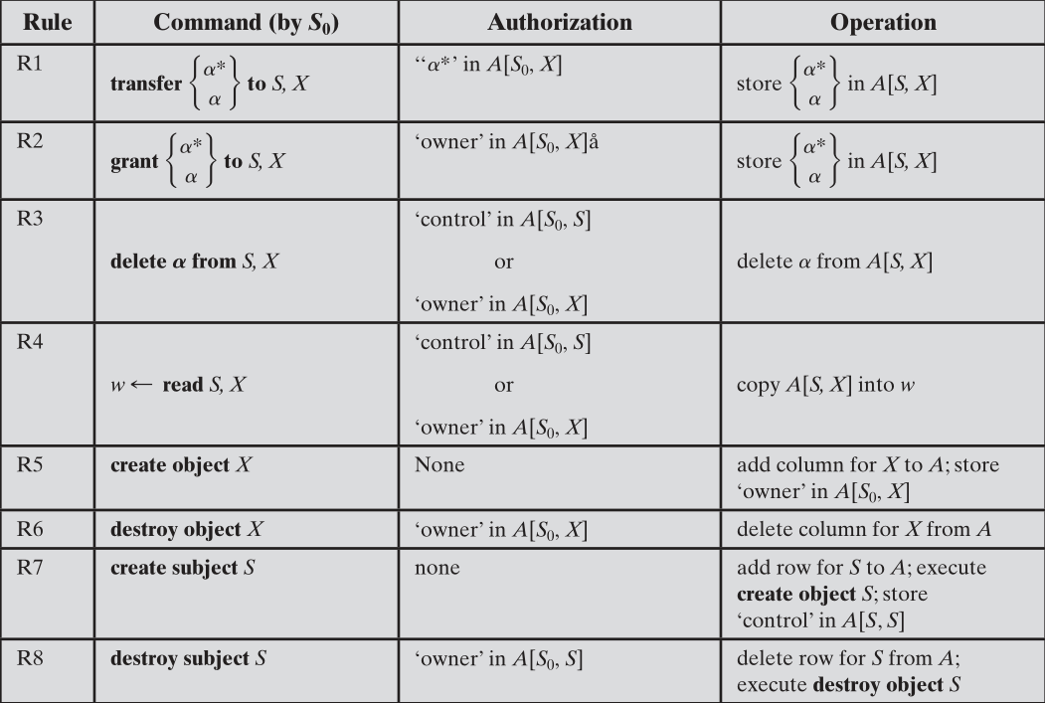
Access Control System Commands

Slide 20
Protection Domains
A set of objects together with access rights to those objects
More flexibility when associating capabilities with protection domains
In terms of the access matrix, a row defines a protection domain
User can spawn processes with a subset of the access rights of the user
Association between a process and a domain can be static or dynamic
In user mode certain areas of memory are protected from use and certain instructions may not be executed
In kernel mode privileged instructions may be executed and protected areas of memory may be accessed

Slide 21
Example: UNIX File Access Control
UNIX files are administered using inodes (index nodes)
Control structures with key information needed for a particular file
Several file names may be associated with a single inode
An active inode is associated with exactly one file
File attributes, permissions and control information are sorted in the inode
On the disk there is an inode table, or inode list, that contains the inodes of all the files in the file system
When a file is opened its inode is brought into main memory and stored in a memory resident inode table
Directories are structured in a hierarchical tree
May contain files and/or other directories
Contains file names plus pointers to associated inodes

Slide 22
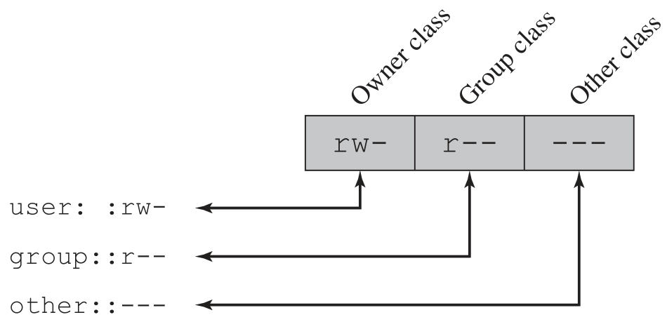
Traditional UNIX File Access Control
r Read
w Write, Move, Rename, Delete
x Execute

Slide 23
SetUID, SetGID, Sticky Bit
Set user ID (SetUID) 以檔案 owner 的身份執行程式
Set group ID (SetGID)
System temporarily uses rights of the file owner/group in addition to the real user’s rights when making access control decisions 以檔案 群組 的身份執行程式
Enables privileged programs to access files/resources not generally accessible
Sticky bit 目錄中的檔案只有 owner 具備 w 權限
When applied to a directory it specifies that only the owner of any file in the directory can rename, move, or delete that file
Superuser
Is exempt from usual access control restrictions
Has system-wide access

Slide 24
Access Control Lists (ACLs) in UNIX
Modern UNIX systems support ACLs
FreeBSD, OpenBSD, Linux, Solaris
FreeBSD
Setfacl command assigns a list of UNIX user IDs and groups
Any number of users and groups can be associated with a file
Read, write, execute protection bits
A file does not need to have an ACL
Includes an additional protection bit that indicates whether the file has an extended ACL
When a process requests access to a file system object two steps are performed:
Step 1 selects the most appropriate ACL
Step 2 checks if the matching entry contains sufficient permissions

Slide 25
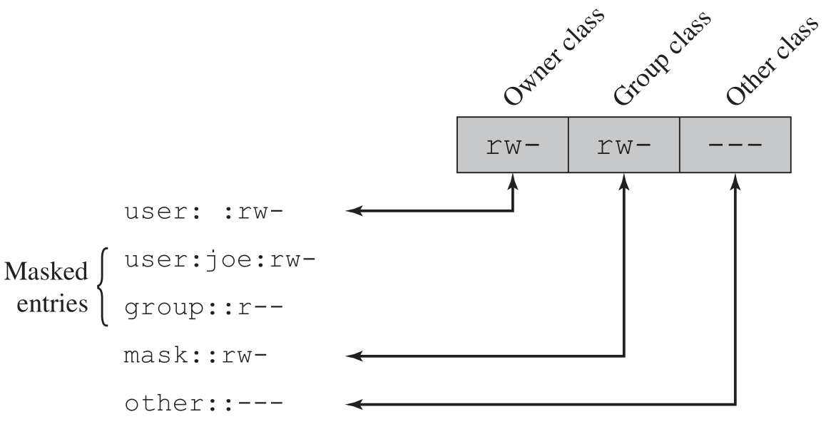
Extended Access Control List

Slide 26
Role-Based Access Control (RBAC)
Based on the roles that users assume in a system rather than the user’s identity
Define a role as a job function within an organization
Assign access rights to roles instead of individual users

Slide 27
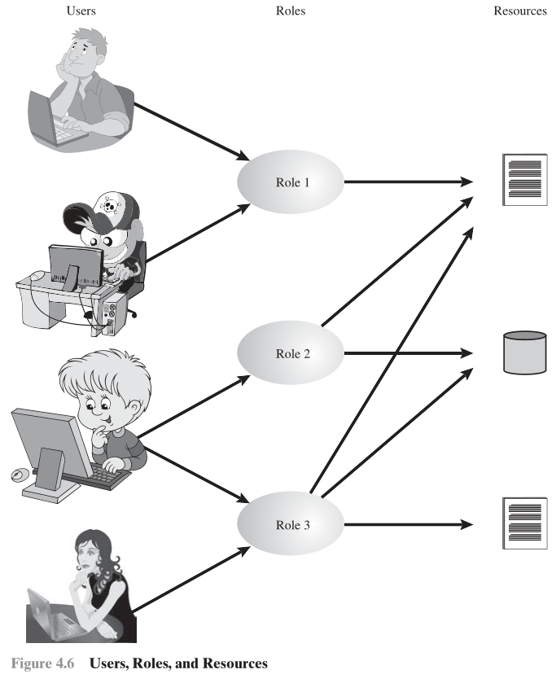

Slide 28
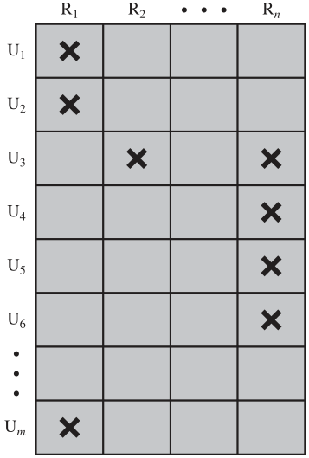
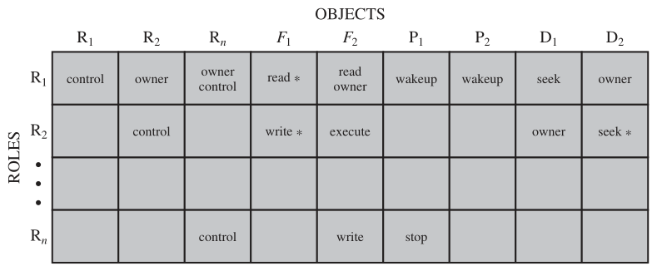
Access Control Matrix Representation of RBAC

Slide 29
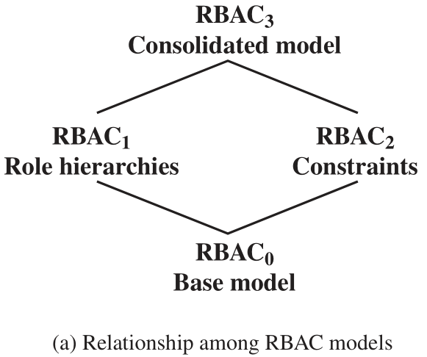
RBAC Reference Models
RBAC0 is the minimum requirement for an RBAC system.
RBAC1 adds role hierarchies and RBAC2 adds constraints.
RBAC3 includes RBAC1 and RBAC2.
Role Hierarchies: enable one role to inherit permissions from another role
Constraints: restrict the ways in which the components of an RBAC system may be configured

Slide 30
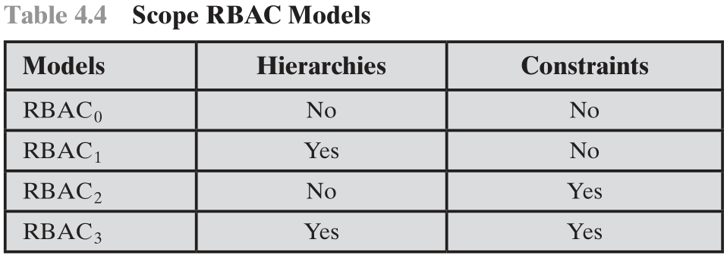

Slide 31
Base Model—RBAC₀
User:
An individual that has access to this computer system.
Each individual has an associated user ID.
Role:
A named job function within the organization that controls this computer system.
Typically, associated with each role is a description of the authority and responsibility conferred on this role, and on any user who assumes this role.
Permission:
An approval of a particular mode of access to one or more objects.
Equivalent terms are access right, privilege, and authorization.
Session:
A mapping between a user and an activated subset of the set of roles to which the user is assigned.

Slide 32
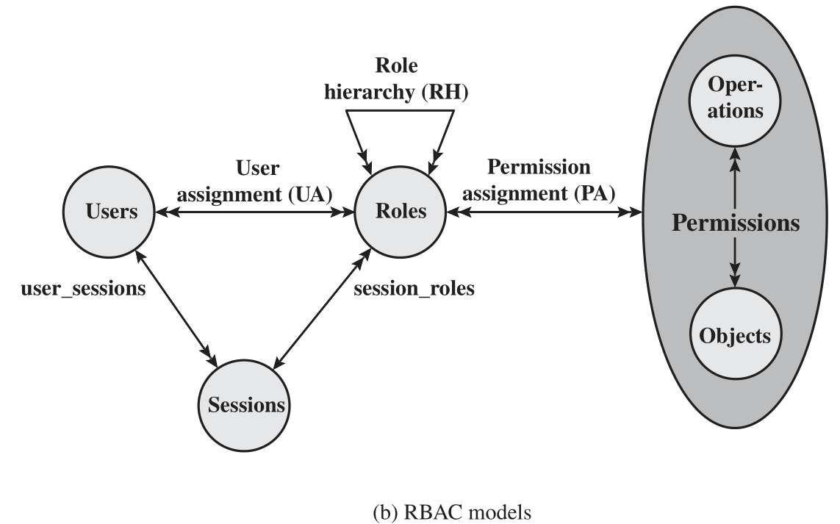

Slide 33
Role Hierarchies—RBAC₁
Reflecting the hierarchical structure of roles in an organization
Job functions with greater responsibility have greater authority to access resources.
A subordinate job function may have a subset of the access rights of the superior job function.
Role hierarchies make use of the concept of inheritance to enable one role to implicitly include access rights associated with a subordinate role.

Slide 34
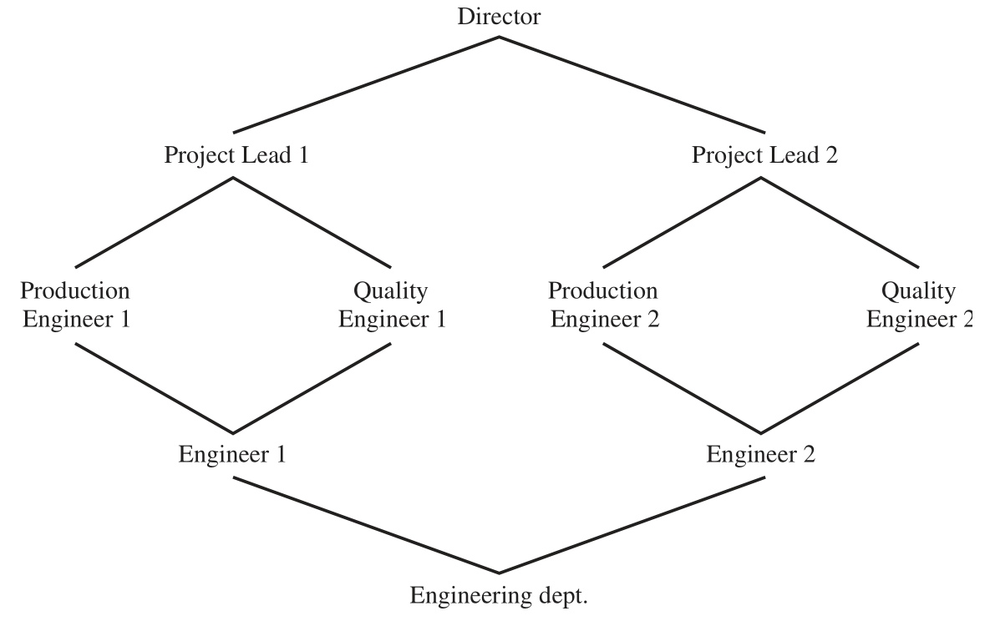
Example of Role Hierarchy

Slide 35
Constraints—RBAC₂
Provide a means of adapting RBAC to the specifics of administrative and security policies of an organization
A constraint is a defined relationship among roles or a condition related to roles
Types:
Mutually exclusive roles: no overlapping permissions
A user can only be assigned to one role in the set (either during a session or statically)
Any permission (access right) can be granted to only one role in the set
Cardinality
Setting a maximum number with respect to roles
Prerequisite roles
Dictates that a user can only be assigned to a particular role if it is already assigned to some other specified role

Slide 36
Attribute-Based Access Control (ABAC)
Can define authorizations that express conditions on properties of both the resource and the subject
Strength is its flexibility and expressive power
Main obstacle to its adoption in real systems has been concern about the performance impact of evaluating predicates on both resource and user properties for each access
Web services have been pioneering technologies through the introduction of the eXtensible Access Control Markup Language (XAMCL)
There is considerable interest in applying the model to cloud services

Slide 37
ABAC Model: Attributes
Subject attributes
A subject is an active entity that causes information to flow among objects or changes the system state
Attributes define the identity and characteristics of the subject
Object attributes
An object (or resource) is a passive information system-related entity containing or receiving information
Objects have attributes that can be leverages to make access control decisions
Environment attributes
Describe the operational, technical, and even situational environment or context in which the information access occurs
These attributes have so far been largely ignored in most access control policies

Slide 38
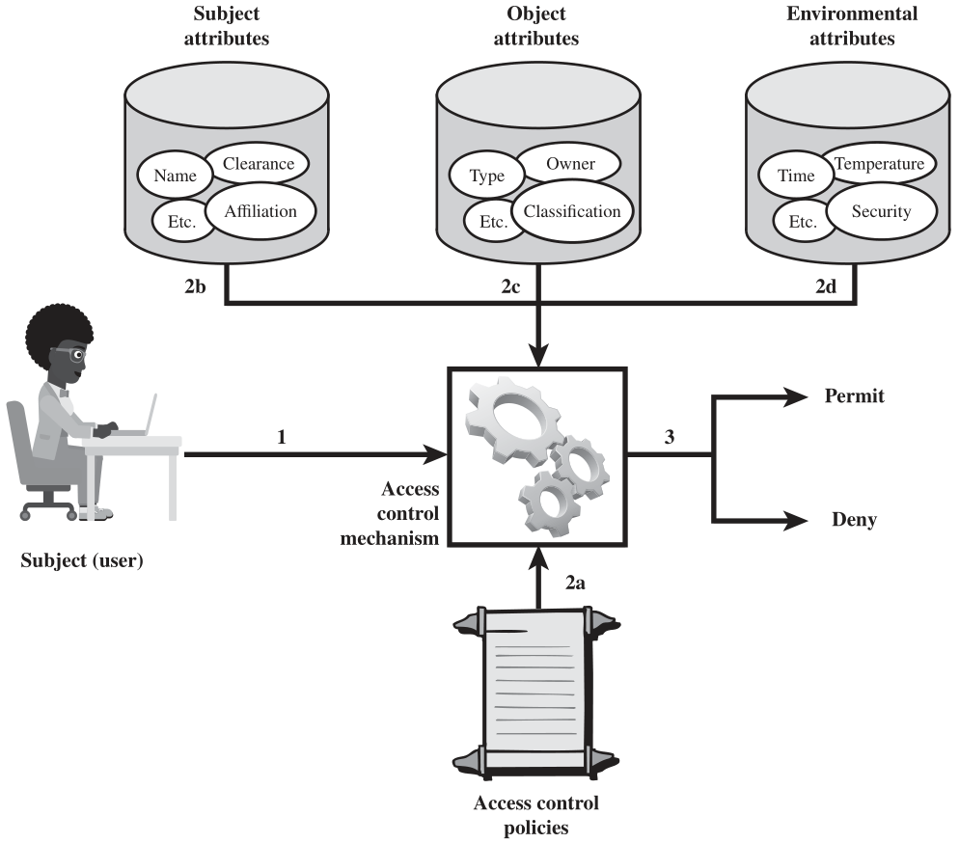
ABAC Logical Architecture

Slide 39
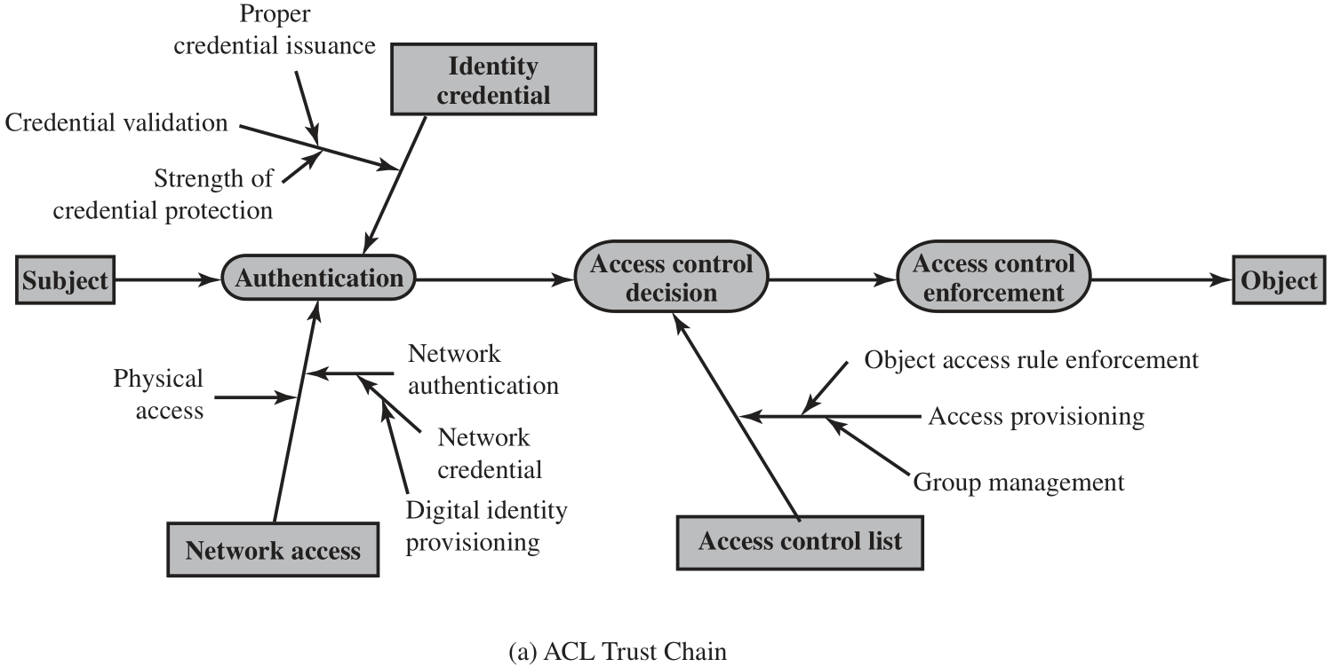
ACL and ABAC Trust Relationships

Slide 40
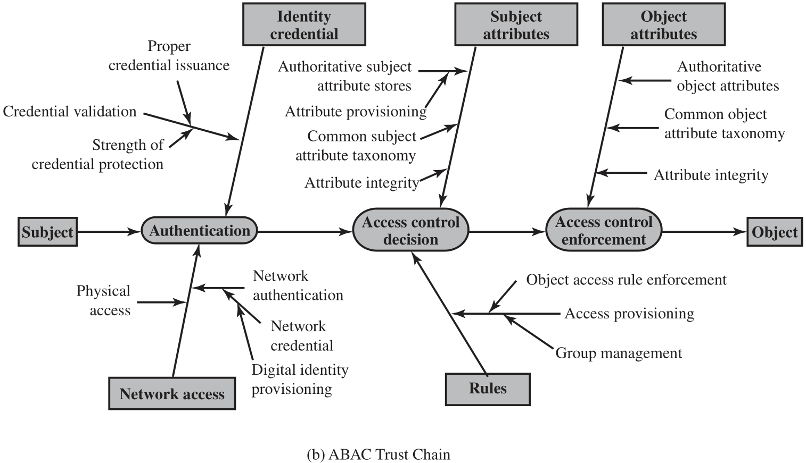

Slide 41
ABAC Policies
A policy is a set of rules and relationships that govern allowable behavior within an organization, based on the privileges of subjects and how resources or objects are to be protected under which environment conditions.
In turn, privileges represent the authorized behavior of a subject; they are defined by an authority and embodied in a policy.
Other terms that are commonly used instead of privileges are rights, authorizations, and entitlements.
Policy is typically written from the perspective of the object that needs protecting, and the privileges available to subjects.

Slide 42
ABAC
Distinguishable because it controls access to objects by evaluating rules against the attributes of entities, operations, and the environment relevant to a request
Relies upon the evaluation of attributes of the subject, attributes of the object, and a formal relationship or access control rule defining the allowable operations for subject-object attribute combinations in a given environment
Systems are capable of enforcing DAC, RBAC, and MAC concepts
Allows an unlimited number of attributes to be combined to satisfy any access control rule

Slide 43
Identity, Credential, and Access Management (ICAM)
A comprehensive approach to managing and implementing digital identities, credentials, and access control
Developed by the U.S. government
Designed to:
Create trusted digital identity representations of individuals and nonperson entities (NPEs)
Bind those identities to credentials that may serve as a proxy for the individual of NPE in access transactions
A credential is an object or data structure that authoritatively binds an identity to a token possessed and controlled by a subscriber
Use the credentials to provide authorized access to an agency’s resources

Slide 44
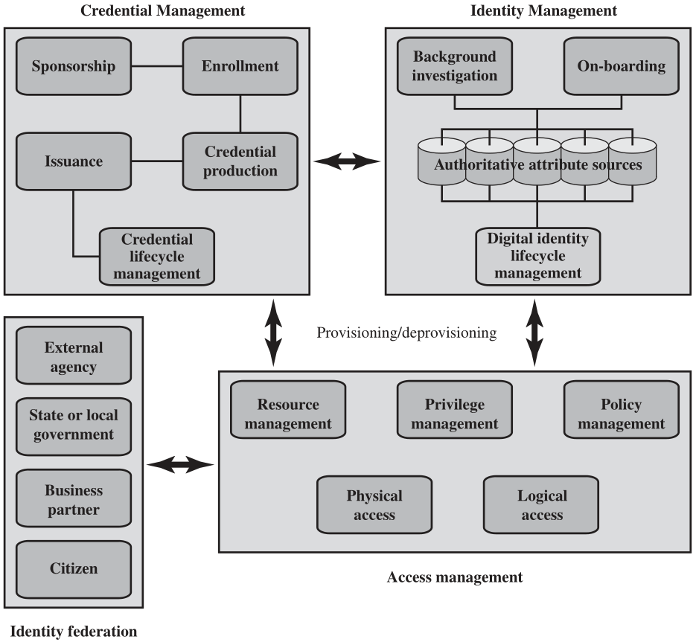

Slide 45
Identity Management
Concerned with assigning attributes to a digital identity and connecting that digital identity to an individual or NPE
Goal is to establish a trustworthy digital identity that is independent of a specific application or context
Most common approach to access control for applications and programs is to create a digital representation of an identity for the specific use of the application or program
Maintenance and protection of the identity itself is treated as secondary to the mission associated with the application
Final element is lifecycle management which includes:
Mechanisms, policies, and procedures for protecting personal identity information
Controlling access to identity data
Techniques for sharing authoritative identity data with applications that need it
Revocation of an enterprise identity

Slide 46
Credential Management
The management of the life cycle of the credential
Examples of credentials are smart cards, private/public cryptographic keys, and digital certificates
Encompasses five logical components:
An authorized individual sponsors an individual or entity for a credential to establish the need for the credential
The sponsored individual enrolls for the credential
Process typically consists of identity proofing and the capture of biographic and biometric data
This step may also involve incorporating authoritative attribute data, maintained by the identity management component
A credential is produced
Depending on the credential type, production may involve encryption, the use of a digital signature, the production of a smart card or other functions
The credential is issued to the individual or NPE
A credential must be maintained over its life cycle
Might include revocation, reissuance/replacement, reenrollment, expiration, personal identification number (PIN) reset, suspension, or reinstatement

Slide 47
Access Management
Deals with the management and control of the ways entities are granted access to resources
Covers both logical and physical access
May be internal to a system or an external element
Purpose is to ensure that the proper identity verification is made when an individual attempts to access a security sensitive building, computer systems, or data
Three support elements are needed for an enterprise-wide access control facility:
Resource management
Privilege management
Policy management

Slide 48
Three support elements are needed for an enterprise-wide access control facility:
Resource management
Concerned with defining rules for a resource that requires access control
Rules would include credential requirements and what user attributes, resource attributes, and environmental conditions are required for access of a given resource for a given function
Privilege management
Concerned with establishing and maintaining the entitlement or privilege attributes that comprise an individual’s access profile
These attributes represent features of an individual that can be used as the basis for determining access decisions to both physical and logical resources
Privileges are considered attributes that can be linked to a digital identity
Policy management
Governs what is allowable and unallowable in an access transaction

Slide 49
Identity Federation
Term used to describe the technology, standards, policies, and processes that allow an organization to trust digital identities, identity attributes, and credentials created and issued by another organization
Addresses two questions:
How do you trust identities of individuals from external organizations who need access to your systems
How do you vouch for identities of individuals in your organization when they need to collaborate with external organizations

Slide 50
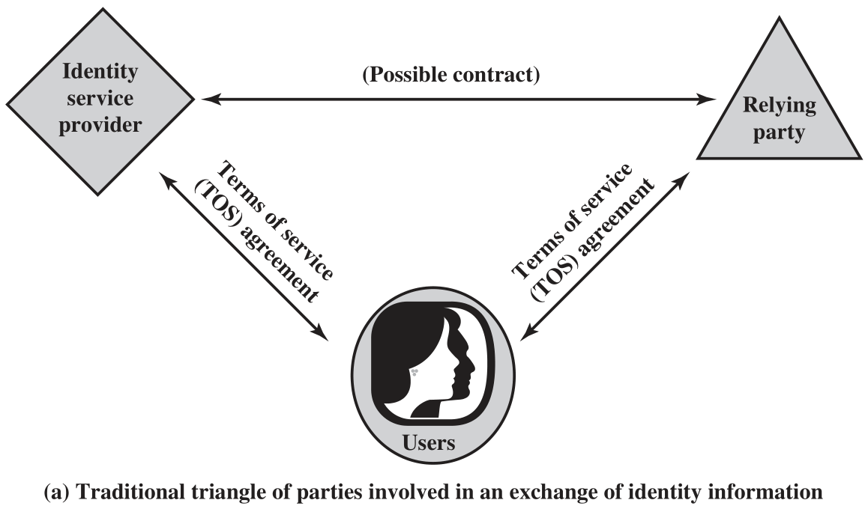

Slide 51
Open Identity Trust Framework
OpenID
An open standard that allows users to be authenticated by certain cooperating sites using a third party service
OIDF
OpenID Foundation is an international nonprofit organization of individuals and companies committed to enabling, promoting, and protecting OpenID technologies
ICF
Information Card Foundation is a nonprofit community of companies and individuals working together to evolve the Information Card ecosystem

Slide 52
Open Identity Trust Framework
OITF
Open Identity Trust Framework is a standardized, open specification of a trust framework for identity and attribute exchange, developed jointly by OIDF and ICF
OIX
Open Identity Exchange Corporation is an independent, neutral, international provider of certification trust frameworks conforming to the OITF model
AXN
Attribute Exchange Network is an online Internet-scale gateway for identity service providers and relying parties to efficiently access user asserted, permissioned, and verified online identity attributes in high volumes at affordable costs

Slide 53
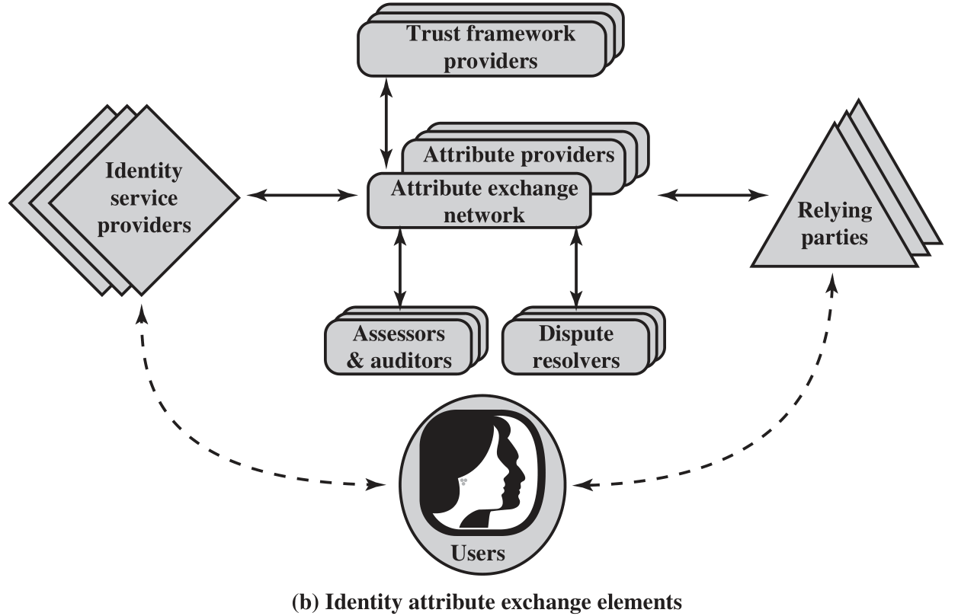

Slide 54
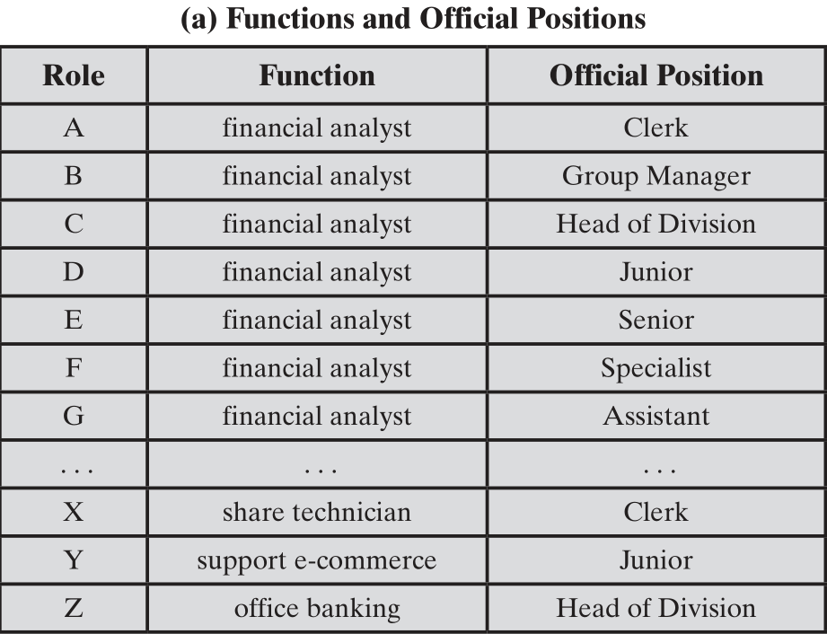
Functions and Roles for Banking Example

Slide 55
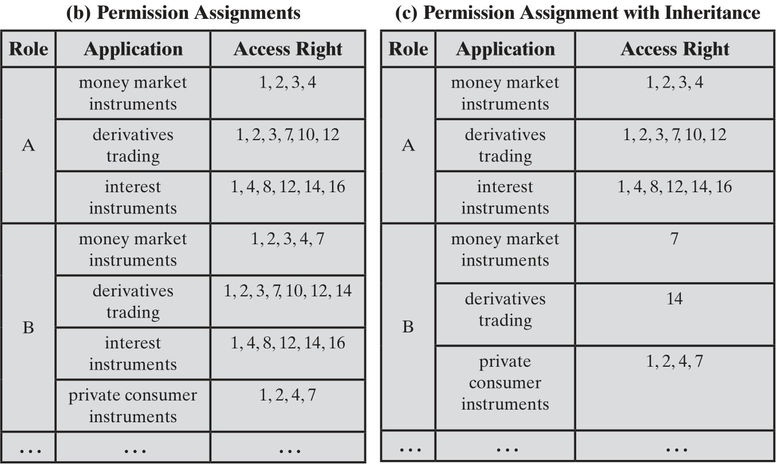

Slide 56
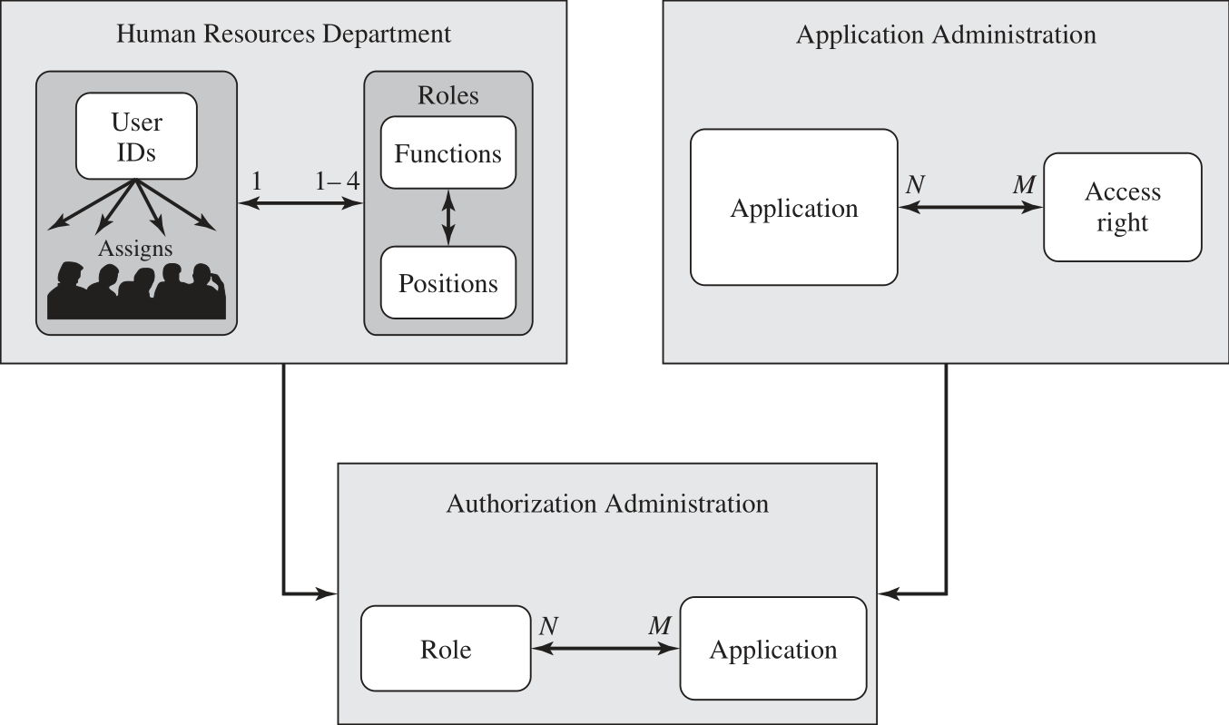
Example of Access Control Administration

Slide 57
Summary
Access control principles
Access control context
Access control policies
Subjects, objects, and access rights
Discretionary access control
Access control model
Protection domains
UNIX file access control
Traditional UNIX file access control
Access control lists in UNIX
Role-based access control
RBAC reference models
Attribute-based access control
Attributes
ABAC logical architecture
ABAC policies
Identity, credential, and access management
Identity management
Credential management
Access management
Identity federation
Trust frameworks
Traditional identity exchange approach
Open identity trust framework
Bank RBAC system
Notes:
Chapter 3 summary.

