Slide 1
專案範疇管理 Project Scope Management
Joseph Deng
josephdeng@g2.usc.edu.tw

Slide 2
大綱
規劃範疇管理 Plan Scope Management
蒐集需求 Collect Requirements
定義範疇 Define Scope
建立工作分解結構 Create WBS
驗證範疇 Validate Scope
管制範疇 Control Scope

Slide 3
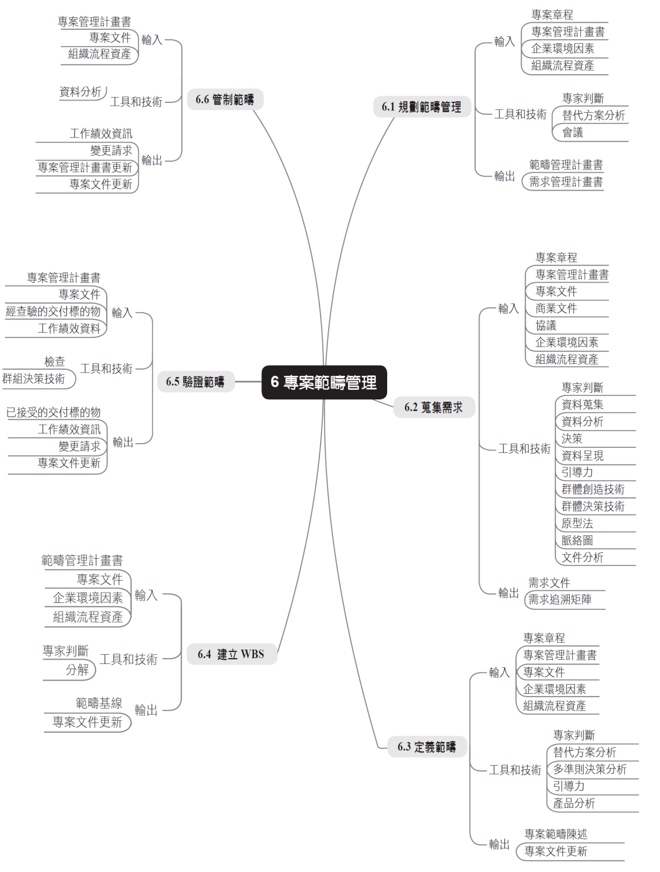

Slide 4
前言
專案範疇管理是指
用以確保專案所有需要的工作，以及只有所需的工作才能成功完成專案之所有過程。
The process required to ensure that
The project includes all the work required, and
Only the work required,
To complete the project successfully
範疇蔓延（Scope Creep）源於專案成員私下任意接受顧客擴增變更之請求，這些變更請求並未經過變更管制委員會審查核准，使得專案範疇慢慢地擴張，最後導致專案失敗。
範疇鍍金（Gold Plating）是指專案經理為取悅顧客或利害關係人，增加原先不在範疇定義中一些花俏的特徵（Features）。

Slide 5
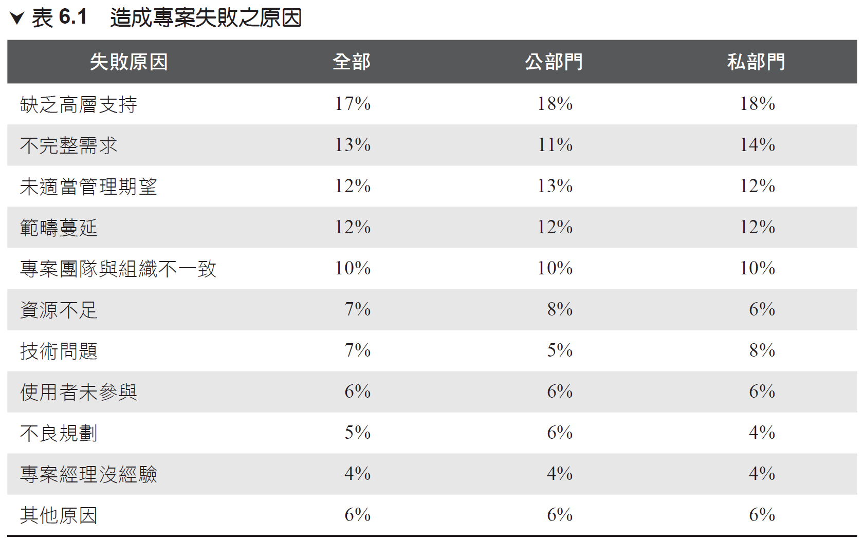
造成專案失敗的原因
Notes:
資料來源： Arras People. Project Management Benchmark Report 2010, Feb. 2010, http:// www.arraspeople.co.uk/, accessed 2013/9/20.

Slide 6
專案範疇和產品範疇 Project Scope vs Product Scope
專案範疇 Project scope
產品範疇 Product scope
為獲得最終產品所需工作的範疇
聚焦在交付產品或服務所採取各種不同的步驟。
為產出一個具有明確特徵（Characteristics）和功能（Functions）的產品、服務、或結果所必須完成的工作。
偏向於工作導向（Work-oriented），偏重在 How。
產品、服務、結果的特徵和功能
有形產品：
如何運作、如何製作、和如何在未來反覆中改善。
無形產品（例如服務）：
實際工作和遞送這些服務人員的責任。
偏向於功能需求導向，偏重在 What。

Slide 7
Scope Baseline 範疇基準
Project Scope Statement
Describe project scope, major deliverables, assumptions and constraints
Covers both project scope and product scope
Work Breakdown Structure(WBS) 圖形化/視覺表達
Visualization of all project work, broken down into individual pieces of work, including identifying and control information
WBS Dictionary 文字詳細描述
Sister document to WBS including more detailed information related to work attributes, requirements and assumptions

Slide 8
Scope Baseline 範疇基準
Includes all the work that must be done on a project
Used as point of comparison for many controlling processes
Must only be modified via formal change control methods
Must be updated when changes are approved

Slide 9
專案範疇未來趨勢和興起的實務 Emerging Practices in Scope Management
Predictive Life Cycles
Adaptive Life Cycles
Deliverables defined at beginning of the project
Changes managed as needed(should be minimized)
Scope validated at end of project/project phase
Scope baseline used to validate and control scope
Deliverables defined and refined over several iterations
Changes inherent to progress(should be embraced)
Sponsor or customer consistently involved
Backlogs indicate remaining/current scope needs

Slide 10
專案範疇未來趨勢和興起的實務 Emerging Practices in Scope Management
需求（Requirement）一直是專案管理最關注的議題
隨著全球環境日趨複雜，企業組織已開始認知到如何使用商業分析以定義、管理、管制變更需求活動，來改善其競爭優勢。
新的發展趨勢是與專業商業分析師（Business Analyst）共同合作，執行下列活動：
確認問題和識別商業需要（Business Needs）。
引導（Elicit）、記錄、管理利害關係人的需求（Stakeholder Requirements）以滿足商業和專案目標。
為滿足需求，識別和建議（Recommend）實際可行的解決方案（Viable Solutions）。
Facilitate Implementation 協助推動各項工作
商業分析師（Business Analyst）可能必須在專案經理之前預先開始工作
Collaborative relationship is the key

Slide 11
量身訂做的考量 Tailoring Considerations 每個專案都是獨特的，專案經理有責任依專案特徵調整專案範疇管理應用方式，考量因素包括
知識和需求管理 Knowledge and requirements management
組織是否有正式或非正式知識和需求管理系統？為達到需求，專案經理應建立未來可以重複使用的指引。
驗證和管制 Validation and control
組織是否有現存的，正式或非正式的驗證和管制相關政策、規定、和指引？
開發手法 Development approach
組織採用敏捷手法管理專案？開發手法是反覆的或是增量的？或是傳統專案管理手法？或是混合式手法較具生產力？
需求是否穩定 Stability of requirements
專案是否有不穩定需求的領域？這些不穩定需求是否必要採用精實、敏捷或其他適應性手法，直到需求趨於穩定和清楚定義？
治理 Governance
組織是否有正式或非正式的稽核和治理之政策、規定、和指引？

Slide 12
Developing a Scope Management Strategy 發展範疇管理策略
Consider organizational approach to
Knowledge management
Requirements management
Validation efforts
Control process
Determine whether a predictive, adaptive or hybrid approach best suits project needs
Consider how likely requirements are to change as project work progresses

Slide 13
Agile/Adaptive Considerations 敏捷／適應環境的考量
專案在早期階段可採敏捷手法以較少時間於定義範疇，而花費較多時間於建立進行中之探索和修正過程。
在需求不斷變化的環境，常發現原先所陳述的商業需求和最後實際的需求有明顯的落差。
敏捷手法有目的性地建立和審查雛形（Prototype）並釋出版本以推敲修正需求。在專案過程中客戶和開發團隊共同摸索、持續地定義和再定義專案範疇。

Slide 14
專案範疇管理包括下列六個過程
規劃範疇管理(Plan Scope Management)
蒐集需求(Collect Requirements)
定義範疇(Define Scope)
建立WBS(Create WBS)
驗證範疇(Validate Scope)
管制範疇(Control Scope)

Slide 15
規劃範疇管理 Plan Scope Management
研擬一份範疇管理計畫書，記載專案範疇如何定義、驗證、和管制的過程。
Define project boundaries
Direct how control of scope will be managed throughout project, as well as how changes are to be implemented

Slide 16
蒐集需求 Collect Requirements
規劃、蒐集、定義、記載利害關係人需求以符合專案目標的過程。
Determines, documents, manages project requirements and stakeholder needs
Leads to requirements documentation and project responsibilities being established

Slide 17
定義範疇 Define Scope
發展一份關於專案和產品詳細描述的文件
Refines requirements into a clear description of the project and its product
Leads to development of project scope statement, including acceptance criteria, constraints and assumptions

Slide 18
建立WBS Create WBS
將專案交付標的物和專案工作分解成較小且更易於管理的構成要素的過程。
Develops a work breakdown structure (WBS) used to decompose project work into discrete activities
Establishes a scope baseline, including the project scope statement, WBS and the WBS dictionary

Slide 19
驗證範疇 Validate Scope
正式接收專案已完成的交付標的物的過程。
Formalizes acceptance of completed deliverables
Utilizes established requirements information and inspections to approve a project’s completion and request any needed changes

Slide 20
Verify vs Validate 驗證及確認
Verify / Verification
Validate / Validation
是否達成規格需求
產出是否符合規格
Confirmation that work products properly reflect the requirements specified for them.
Ensures that “you built it right.”
是否達成目的
產出是否合用
Confirmation that the product or service, as provided (or as it will be provided), will fulfill its intended use.
Ensures that “you built the right thing.”

Slide 21
管制範疇 Control Scope
監視專案和產品的範疇狀態，管理範疇基線變更的過程。
Ensures project work remains in alignment with project scope
Utilizes a variety of assets created in other Project Scope Management processes

Slide 22
規劃範疇管理 Plan Scope Management

Slide 23
規劃範疇管理 Plan Scope Management
建立範疇管理計畫（scope management plan）
如何定義計畫範疇（how the project and product scope will be defined）？
如何驗證計畫範疇（ how the project and product scope will be validated）？
如何管制計畫範疇（ how the project and product scope will be controlled）？
對於傳統專案 TPM
只做一次
對於敏捷專案 APM
每一個反覆（Iteration）做一次
對於適應性專案 Adaptive
每一個循環（Cycle）做一次

Slide 24
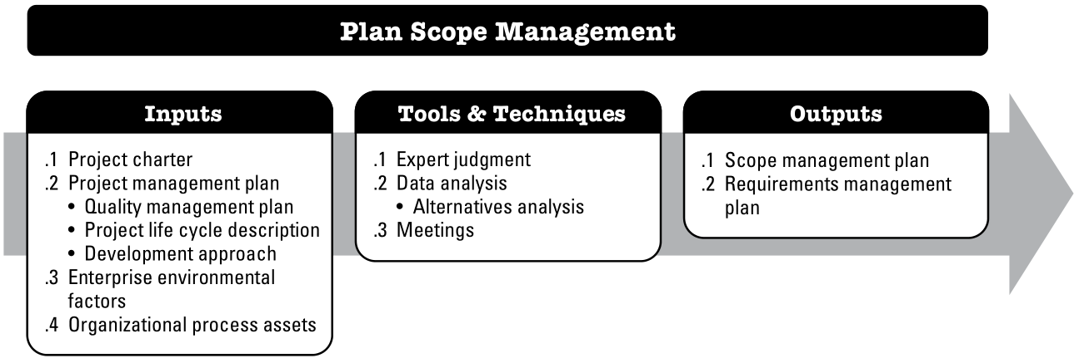
規劃範疇管理 Plan Scope Management

Slide 25
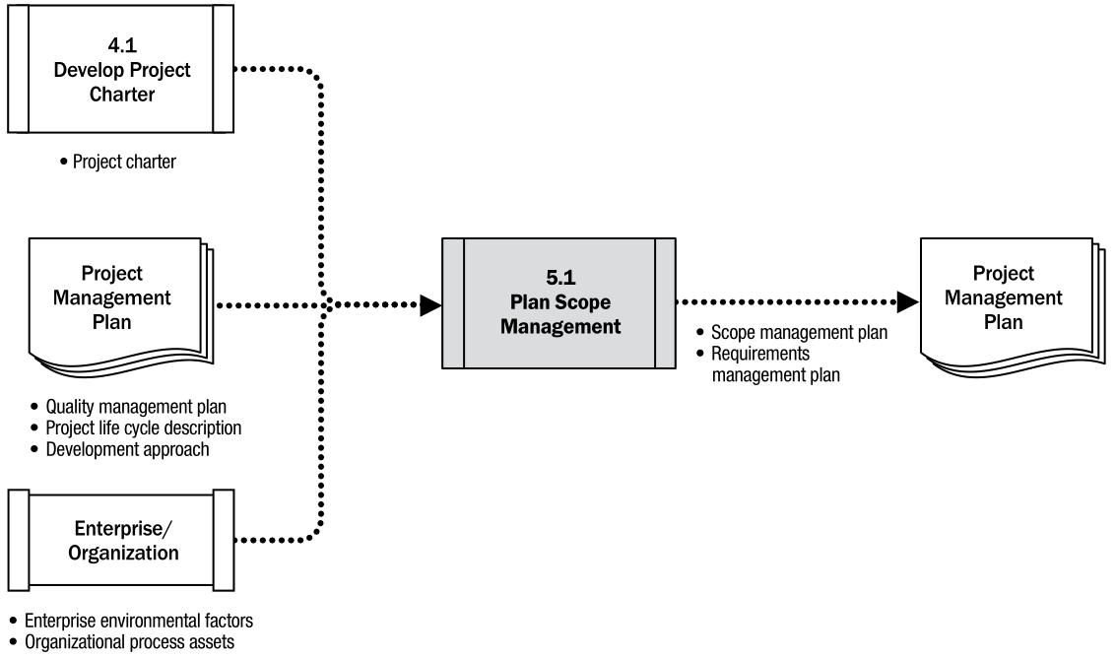
Plan Scope Management: Data Flow Diagram

Slide 26
輸入： Project Management Plan
Subsidiary plans help define project scope, assist in creation of scope management plan
Influences how scope is planned and managed, and to what degree

Slide 27
輸入： Project Charter
Provides necessary perspective and context for planning scope management
Includes high-level descriptions and attributes of project and its deliverables

Slide 28
輸入： Enterprise Environmental Factors
Organization’s culture
Infrastructure
Personnel administration
Marketplace conditions

Slide 29
輸入： Organizational Process Assets
Policies and procedures
Historical information
Lessons learned knowledge base

Slide 30
工具與技術： Expert Judgment
May be called upon to help develop scope management plans
Key stakeholders
Consultants
Professional and technical associations 協會
Industry groups
Subject matter experts 領域專家
Project management office

Slide 31
工具與技術： Data Analysis
Considering alternative approaches to scope management can lead to more effective results
Collecting requirements
Detailing project and product scope
Validating and controlling scope

Slide 32
工具與技術： Meetings
Useful in reaching consensus（共識） about scope management plans
Project manager
Project sponsor
Team members
Key stakeholders
Others with scope responsibility

Slide 33
輸出：範疇管理計畫書 Scope Management Plan
說明專案範疇如何被定義（Define）、發展（Develop）、監視（Monitor）、管制（Control）、驗證（Validate）
How to prepare a project scope statement;
How to create the WBS from the detailed project scope statement;
How to establish the scope baseline
How the scope baseline will be approved and maintained
How formal acceptance of the completed project deliverables will be obtained
How requests to scope changes will be processed

Slide 34
蒐集需求 Collect Requirements

Slide 35
蒐集需求 Collect Requirements
The process of determining, documenting, and managing stakeholder needs and requirements to meet project objectives.
需求係指發起人、客戶和其他利害關係人已量化且記錄下來的需要與期望。
蒐集需求的目的在於定義和管理顧客的需要與期望，
專案成功與否取決於是否能夠掌握管理並滿足利害關係人的需求。
無法明確地了解和定義需求，就無法清楚地定義範疇以及有效地管制範疇。
Serves as foundation for defining and managing project and product scope
這個過程對TPM專案而言只執行一次，對APM專案而言則是發生在幾個預定反覆、週期或循環開始時。

Slide 36
蒐集需求 Collect Requirements
High level of stakeholder involvement key to…
Discovery of needs
Formalization of needs into requirements
Care must be taken in determining, documenting and managing requirements

Slide 37
What are Requirements? 什麼是需求
Quantified（量化） and documented（文件） needs（需要） and expectations（期望） of the project sponsor, customer and the key stakeholders
Conditions（狀態） or capabilities（能力） that fulfill an agreement or align with a formally declared specification
Must be understood and documented at a high enough level of detail to be…
Included in the scope baseline 範疇基準
Used for control measurements 控制衡量

Slide 38
Needs → Requirements 把需要變成需求
Needs
Requirements
"We want the car to feel fast.“
"We want the car to be affordable for our customers."
"We want this to be a family friendly vehicle."
"We want to bring this to market quickly."
0-100 must be < 5.0 seconds
Base package must be < $20,000; average < $25,000
Vehicle must comfortably accommodate 4 passengers
Expected to reach production within 24 month

Slide 39
The Importance of Requirements 需求的重要性
Requirements are the foundation of the Work Breakdown Structure
Many factors affected by the way scope is determined and described:
Planning 規劃
Cost 成本
Schedule 時程
Quality 品質
Procurement 採購

Slide 40
Types of Project Requirements 需求的分類
Business Requirements
Technical Requirements
Stakeholder Needs
How to Fulfill Stakeholder Needs

Slide 41
Types of Project Requirements 需求的分類
Business 商業
Describe organization’s higher level needs
Strategic opportunities
Purpose of project
Business value
Stakeholder 利害關係人
Describes needs of key stakeholders or key stakeholder groups
Functional 功能性
Characteristics and features of the end product, solution or project result
Nonfunctional 非功能性
Environmental conditions or qualities that must exist for the functional requirements to be effective
Transition 過渡
Any training, conversion or improvement activities that must occur in order to be ready for the project’s result
Project 專案
Actions, processes or other conditions imposed on the project
Quality 品質
Validation conditions and criteria to confirm successful fulfillment of project requirements
Notes:
Business
•Describe organization’s higher level needs
•Strategic opportunities
•Purpose of project
•Business value
•“We must develop a product that reverses our course of ceding market share to the competition.”
•“There’s an opportunity to expand our services into a new international market and grow the business.”
•“We must improve our call center’s productivity via new IT development so as to improve customer satisfaction and lower costs.”
Stakeholder Requirements
•Describes needs of key stakeholders or key stakeholder groups
•“Marketing needs a prototype for debut in six months.”
•“Sales wants us to leave enough margin for a negotiated discount from the initial proposal.”
•“Legal wants to make sure we steer well clear of these regulatory areas.”
Functional Requirements
•Characteristics and features of the end product, solution or project result
•“This device must be able to connect to the newest 802.11 standard networks.”
•“We expect the final product to weigh less than one pound.”
•“A screen no smaller than 9.7 inches measured diagonally must be used in the final product.”
Nonfunctional Requirements
•Environmental conditions or qualities that must exist for the functional requirements to be effective
•“Device battery life must be at least six hours under rigorous use.”
•“The product must use high-quality materials that can withstand normal use over several years.”
•“The product must be safe for use by all ages.”
Transition Requirements
Any training, conversion or improvement activities that must occur in order to be ready for the project’s result
•“Support staff must be effectively trained in how to use the new platform before delivery is considered complete.”
•“A new manufacturing facility must be completed before operations can move the end result into production.”
•“We must convert our old data archives to a new format before most project work can begin in earnest.”
Project Requirements
•Actions, processes or other conditions imposed on the project
•“We can only spare two members of our department for the project.”
•“We need to leverage existing internal forms and processes for our integrated change control system.”
•“The PMO must be given weekly updates on project status.”
Quality Requirements
•Validation conditions and criteria to confirm successful fulfillment of project requirements
•“The manufacturing process must result in an unresolvable defect rate no higher than 0.001%”
•“Product performance as benchmarked must meet this full list of technical requirements.”
•“Servers must be able to withstand large spikes in active user count.”

Slide 42
Gathering Requirements from Others 從其他來源蒐集需求
Interviews 訪談
May be formal or informal, one-on-one or involving several parties
Spontaneous and prepared questions
Aids in identifying and defining features and functions of deliverables
Good for gaining confidential information
Focus Groups 焦點小組
Trained moderator leads a conversational, participatory discussion
Brings together key stakeholders and subject matter experts(SMEs)
Learn about expectations and attitudes related to proposed project and its result

Slide 43
Gathering Requirements from Others 從其他來源蒐集需求
Facilitated Workshops 促進會
Sessions with key stakeholders focused on defining product requirements
Efficient way to…
Define cross-functional requirements
Quickly identify and reconcile conflicts
Useful in building trust, fostering relationships and improving communications
Helps project teams discover issues and potential risks more quickly

Slide 44
Facilitated Workshops 促進會
Joint Application Design/Development (JAD) 聯合應用設計/開發
Brings business SMEs together with development team
Improves development process by ensuring the right work is done
Quality Function Deployment (QFD) 品質機能展開
Collects customer needs, presented as the “Voice of the Customer” (VOC) 客戶的聲音
User stories are developed to better describe needs in a narrative fashion
Needs prioritized and goals set accordingly
Popular in Agile environments in particular

Slide 45
引導力 Facilitation
聯合應用設計/開發 Joint application design/development (JAD)
用於軟體開發
將商業主題領域的專家和開發團隊聚集在一起，蒐集需求，改善軟體開發過程
品質機能展開 Quality function deployment (QFD)
用於製造業
決定新產品的關鍵特性（critical characteristics）
先蒐集客戶需求（客戶的的聲音 voice of the customer , VOC），然後將客戶需求轉換成技術者的聲音（voice of engineer, VOE）
使用者故事 User stories
User stories describe the stakeholder role, who benefits from the feature (role), what the stakeholder needs to accomplish (goal), and the benefit to the stakeholder (motivation).

Slide 46
Group Creativity Techniques 群體創意
Brainstorming 腦力激盪
Useful in generating requirements and potential steps to define them
Doesn’t include voting or prioritization
Often combined with other techniques
Nominal Group Technique 名義歸類技巧
Follows up brainstorming with a voting process that ranks ideas
Prioritizes ideas for continued thought and refinement

Slide 47
Group Creativity Techniques 群體創意
Idea/Mind Mapping 心智圖
Ideas from individual brainstorming sessions are consolidated into a visualization
Map reflects interrelations and differences, helps to generate further ideas
Affinity Diagram 親和圖
Filters ideas into groups to be reviewed and analyzed
Helps place similar ideas together for further consideration
Can be useful in spotting potential synergies and determining the best of several similar options

Slide 48
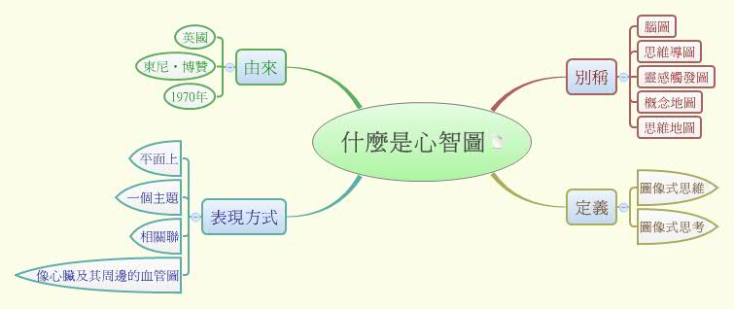
心智圖 Mind Mapping

Slide 49
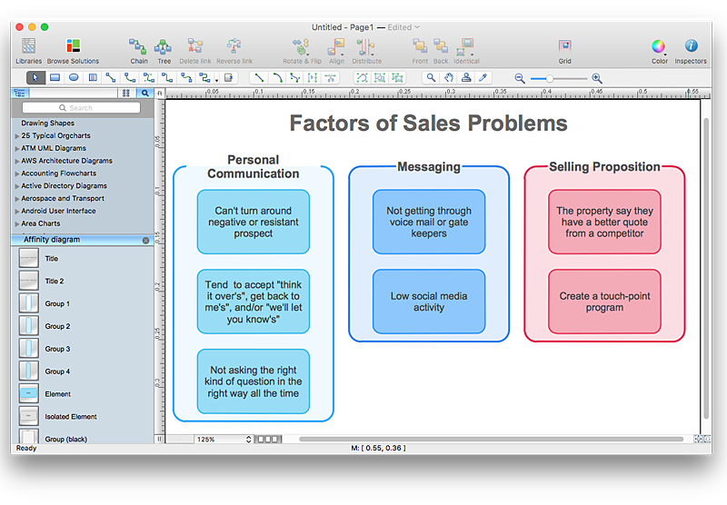
親和圖 Affinity Diagram

Slide 50
Group Creativity Techniques 群體創意
Multi-Criteria Decision Analysis 多重準則決策分析
Matrix used to help establish decision criteria and evaluate/rank many ideas
Very analytical approach to decision making, focused on a variety of formal criteria
Decision Making 決策
Majority method requires at least 50% of voting members to agree 投票過半
Plurality method selects most popular choice, even if not a majority 多數決，不必過半
Dictated outcome occurs when project manager or other individual makes a unilateral decision 專案經理獨斷
Notes:
https://www.youtube.com/watch?v=7OoKJHvsUbo

Slide 51
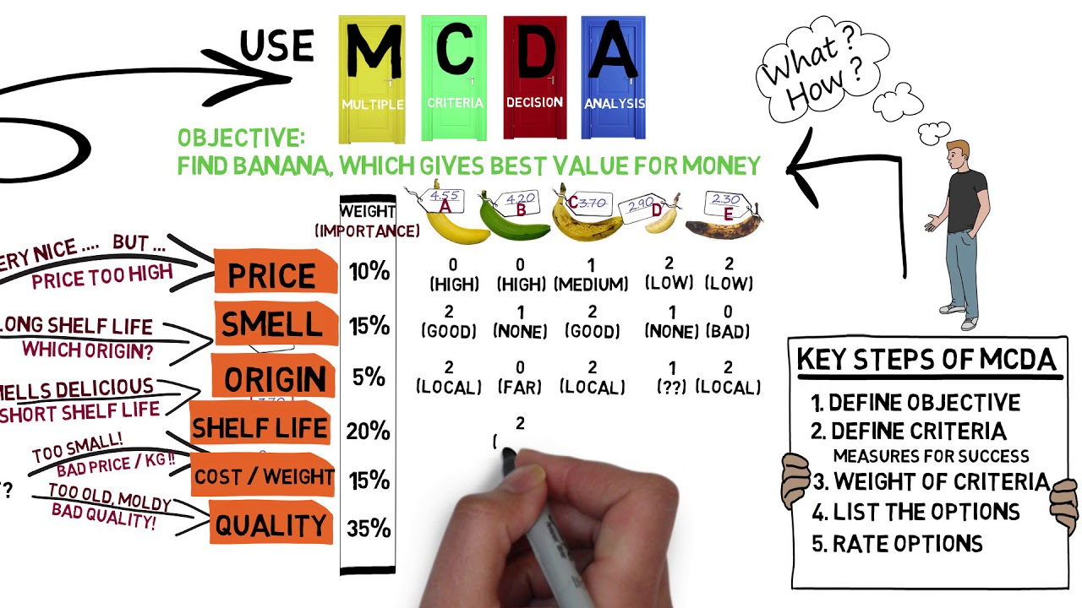
Multi-Criteria Decision Analysis 多重準則決策分析
Notes:
https://www.youtube.com/watch?v=7OoKJHvsUbo

Slide 52
Leveraging Data and Analytics 資料分析與應用
Questionnaires and Surveys 問卷調查
Good for quickly obtaining information and opinions from many participants
Best used with large, varied groups 量體要大
Useful when quick feedback is needed
Valuable when statistical analysis is planned 統計分析
Observations 觀察
Direct way to observe workers, processes and environments
Helpful when respondents cannot or will not effectively explain a process or circumstance narratively
Can involve job shadowing or experiential learning

Slide 53
Leveraging Data and Analytics 資料分析與應用
Prototypes 雛型
Working model of expected product used for early feedback
Tangibility allows for experimentation instead of only discussion
Highly useful in iterative development
Storyboarding is a kind of prototyping
Benchmarking 標竿學習
Compare results or practices to expected results or practices 最佳實務
Plans or competitive comparisons often used as a baseline for comparison
External or internal points of comparison may be used

Slide 54
Leveraging Data and Analytics 資料分析與應用
Context Diagrams 環境關聯圖
Visually depict product scope by relating a business system to people and other systems 系統之間的關係
Shows inputs to system, who provides the input, system output and output recipients
Document Analysis 文件分析
Existing documents can assist in creating requirements:
•Business plans
•Marketing literature
•Agreements
•RFPs
•Current process flows
•Logical data models
•Business rules
•Application documentation
•Process/interface documentation
•Use cases
•Problem/issue logs
•Policies/procedures
•Regulatory documentation

Slide 55
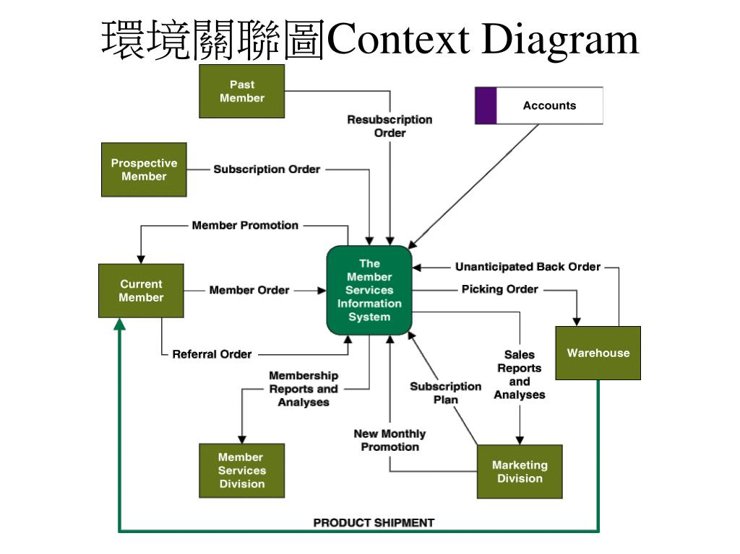

Slide 56
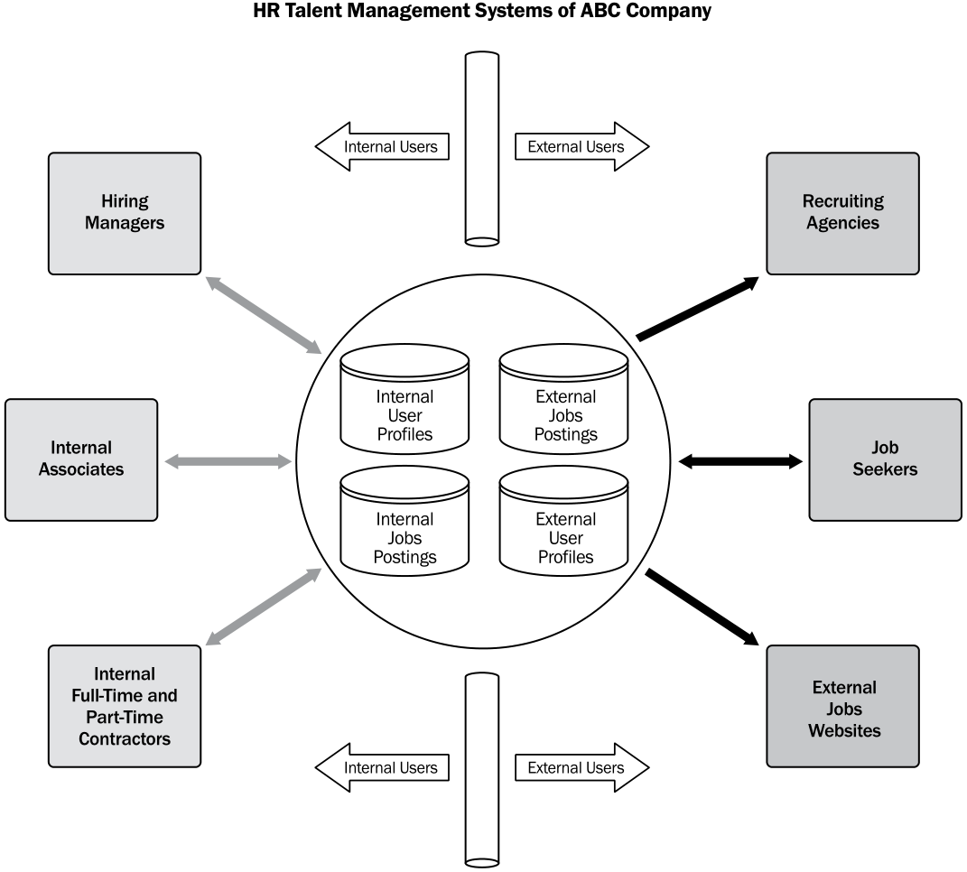
脈絡圖 Context Diagram

Slide 57
The Requirements Traceability Matrix 需求追溯矩陣
用途
內容
Linking business objectives to project objectives
Tracking requirements for the whole project lifecycle
Identifying responsible stakeholders
Managing changes to scope
Business needs/opportunities
Project objectives
Portions of project scope and WBS deliverables
Product design
Product development
Strategy and scenario testing
Requirements at various levels of detail

Slide 58
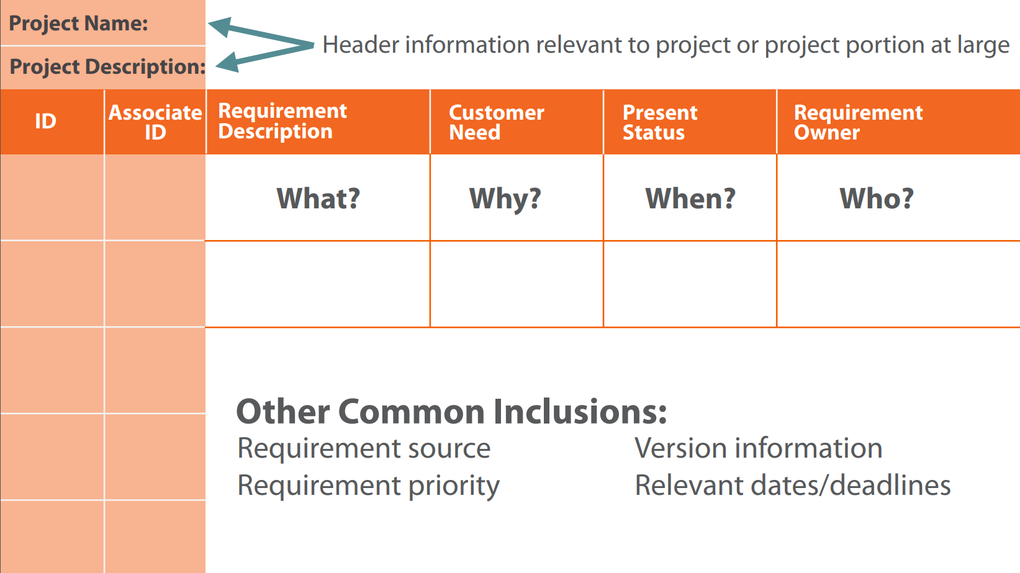
The Requirements Traceability Matrix 需求追溯矩陣

Slide 59
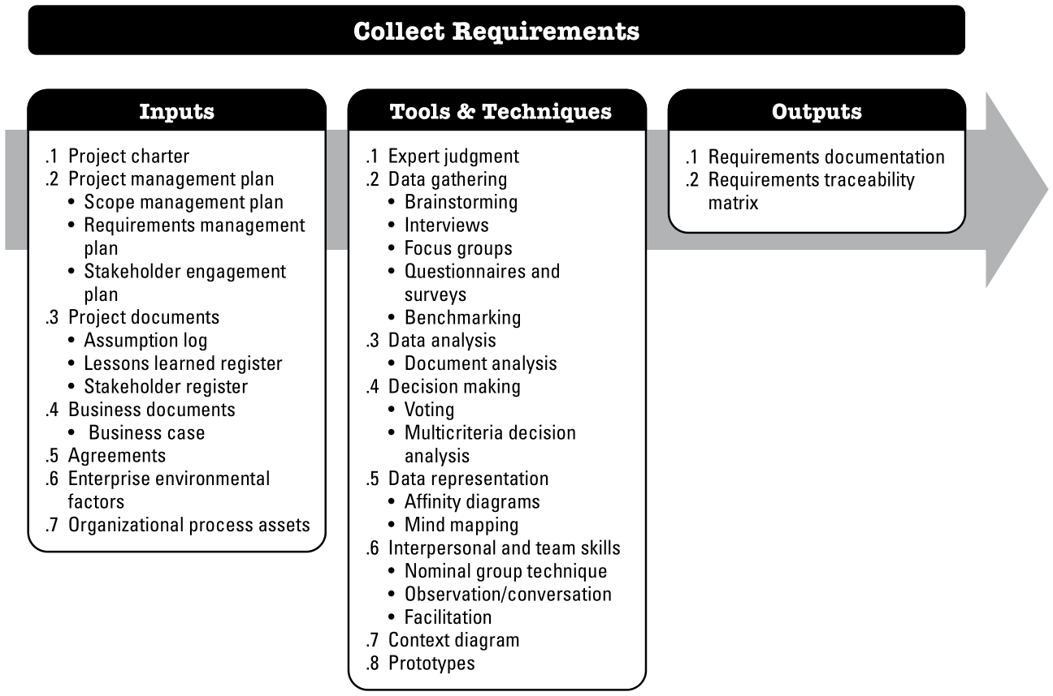

Slide 60
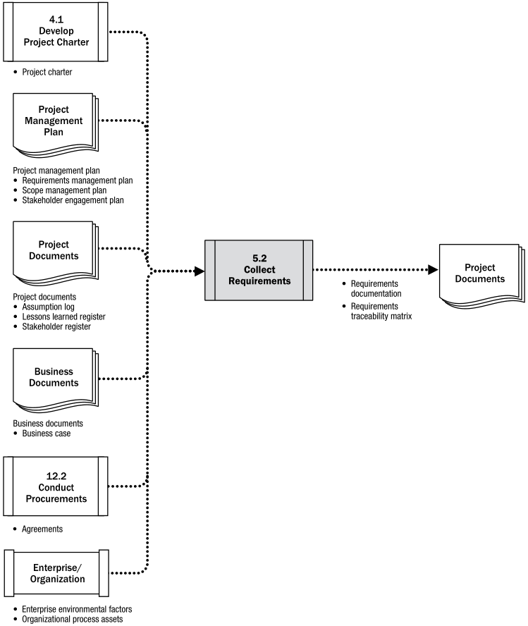
Collect Requirements: Data Flow Diagram

Slide 61
輸出：需求文件 Requirements Documentation
描述專案的各項需求如何滿足商業需要（business needs）
專案剛開始執行時，需求只是概略的、高層次的，隨著資訊增加而逐漸明確且詳細。
需求必須
明確：可量測（measurable）、可測試（testable）
可追溯（traceable）
完整（complete）
一致（consistence）
可以被利害關係人接受

Slide 62
《PMBOK指引》的需求文件細分
商業需求 Business requirements
描述組織高層需求，包括商業考量、競爭機會、計畫緣由
利害關係人需求 Stakeholder requirements
解決方案需求 Solution requirements
描述產品的特色（features）、功能（functions）、特性（characteristics）
功能性需求 functional requirements
the behaviors of the product
非功能性需求 non-functional requirements
supplement functional requirements
the environmental conditions or qualities required for the product to be effective

Slide 63
《PMBOK指引》的需求文件細分（續）
轉移和備便需求 Transition and readiness requirements
temporary capabilities
such as data conversion and training requirements, needed to transition from the current as-is state to the desired future state
專案需求 Project requirements
the actions, processes, or other conditions the project needs to meet
Such as milestone dates, contractual obligations, constraints, etc.
品質需求 Quality requirements
any condition or criteria needed to validate the successful completion of a project deliverable or fulfillment of other project requirements
Such as tests, certifications, validations, etc.

Slide 64
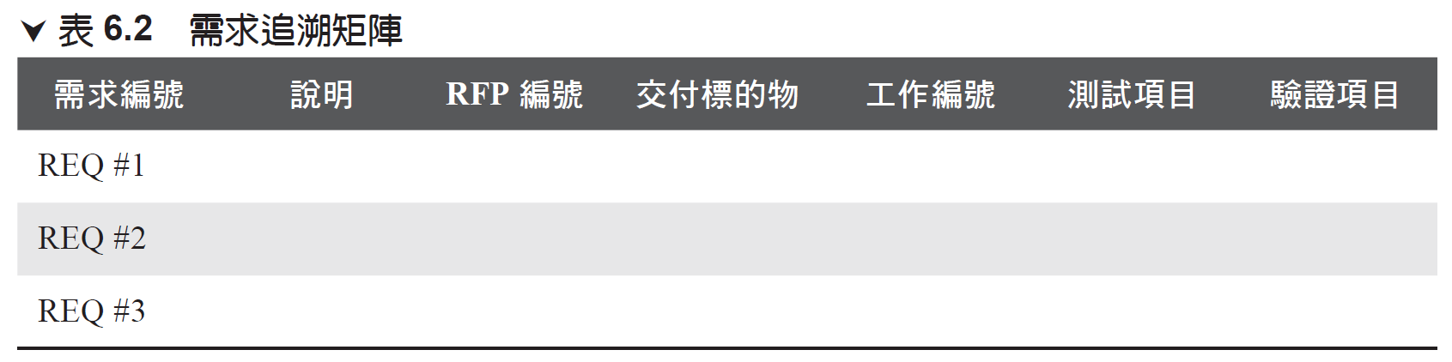
輸出：需求追溯矩陣 Requirements Traceability Matrix
需求追溯矩陣是一份記錄和檢查專案需求是否被滿足的文件，
以表格方式呈現
以線條連結方式追蹤從專案起動到結束的每一個需求是否被滿足
將需求變更對映到產品範疇

Slide 65
輸出：需求管理計畫書 Requirements Management Plan
也稱為《商業分析計畫書》（Business Analysis Plan）
作為估算、執行、追蹤專案活動的基礎
需求管理包括建立和維護顧客及開發者在技術上和非技術上的協議。
How requirements activities will be planned, tracked, and reported;
Configuration management activities such as: how changes will be initiated; how impacts will be analyzed; how they will be traced, tracked, and reported; as well as the authorization levels required to approve these changes;
Requirements prioritization process;
Metrics that will be used and the rationale for using them; and
Traceability structure that reflects the requirement attributes captured on the traceability matrix.

Slide 66
定義範疇 Define Scope

Slide 67
定義範疇 Define Scope
定義範疇是發展專案和產品之詳細描述的過程
目的：將主要利害關係人的需求轉換成專案範疇陳述。
描述產品、服務或結果的界線和接受條件
TPM專案只執行一次
APM專案依預定的週期／循環數執行多次
首先建立整個專案的高層次範疇版本
每一次反覆／週期時建立當次反覆／週期之詳細範疇
根據工作進度和最新資訊詳細規劃下一個反覆／週期的範疇
範疇定義要儘可能簡要且完整。

Slide 68
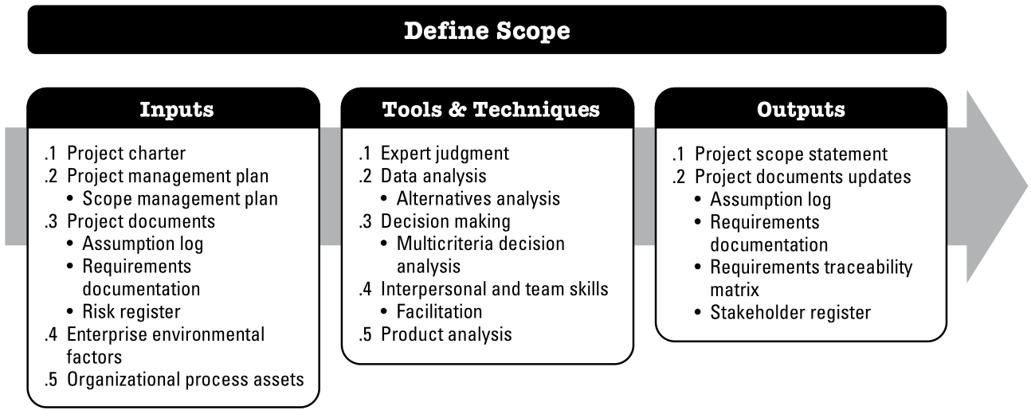
定義範疇 Define Scope

Slide 69
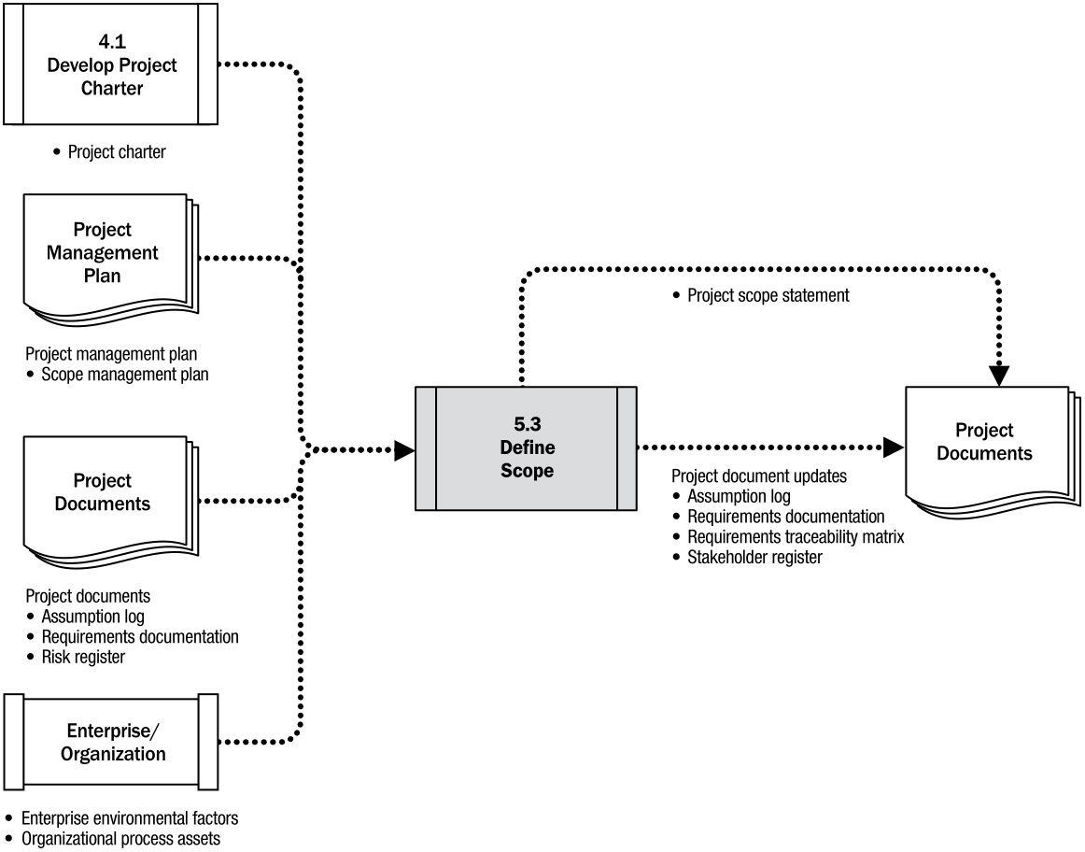
Define Scope: Data Flow Diagram

Slide 70
定義範疇：輸入
專案章程：
了解高層次專案說明、專案特徵、和已核准的需求之資訊。
專案管理計畫書：
了解專案範疇如何定義、驗證、和管制。
專案文件：
假設日誌：
了解有哪些假設和限制會影響到專案範疇。
需求文件：
了解被納入範疇的需求。
風險登記簿：
了解可能影響範疇的風險回應策略。
企業環境因素：
包含組織文化和市場條件等。
組織流程資產：
如公司的政策或流程、過去所建立的專案範疇相關檔案資料，以制定新專案的範疇說明。

Slide 71
定義範疇：工具和技術
專家判斷：
具有類似專案之經驗或知識的個人或群體。
替代方案分析：
可用於評估滿足章程中所識別出的需求和目標之方案。
多準則決策分析：
一種決策分析技術，使用決策矩陣來提供系統的分析方法，以建立準則，以使專案和專案的產品範圍更加完善。
引導力：
屬人際和團隊技能之一。
產品分析 Product analysis 定義產品和服務，工具包括
產品分解結構 Product breakdown
系統分析 Systems analysis
需求分析 Requirements analysis
系統工程 Systems engineering
價值工程 Value engineering： value=performance/cost
價值分析 Value analysis：就已開發完成產品之價值分析，以了解是否可進一步改善和提昇CP值。

Slide 72
定義範疇：輸出 專案範疇陳述 Project Scope Statement
產品範疇描述 Product scope description
詳細說明 Project Charter 和 Requirement Document 裡列舉的各項產品特性
交付項目 Deliverables
每一項可供驗證的產出
可以包括附帶產出：例如專案管理報告
接受條件 Acceptance criteria
交付項目必須滿足那些條件才可以被接受？
專案排外項目 Project exclusions
明確列出不包含在專案範疇內的工作項目

Slide 73
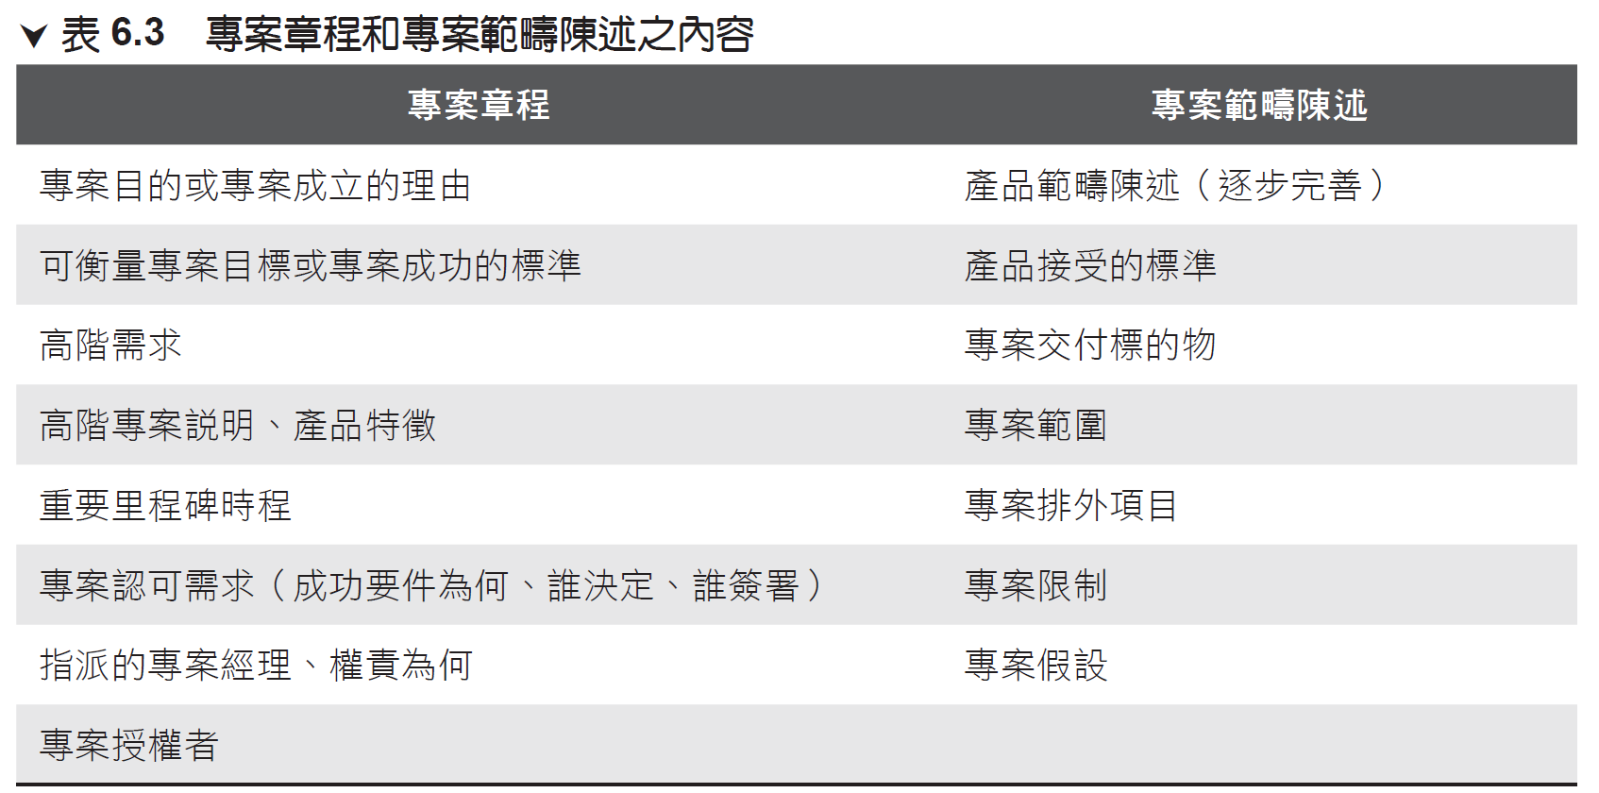

Slide 74
定義範疇：輸出 專案文件更新
假設日誌 Assumption log
在此過程中識別的附加假設或限制條件。
需求文件 Requirements documentation
因額外或變更的需求而更新。
需求追溯矩陣 Requirements traceability matrix
反映需求文件中的更新。
利害關係人登記簿 Stakeholder register
關於現有或新的利害關係人額外資訊

Slide 75
建立工作分解結構 Create WBS

Slide 76
建立工作分解結構 Create WBS
將專案交付標的物和專案工作分解成較小的、更易於管理的組成部分。
WBS 是一個階層式的樹狀結構
Roll-down（展開）：由上向下展開為系統、次系統、組件、到專案所有工作
Roll-up（捲起）：由下向上捲起可以依序整合為組件、次系統、系統到整個專案
WBS 是專案所有工作的地圖
位於 WBS 最底層的組成部分稱為工作包（Work Package，WP）

Slide 77
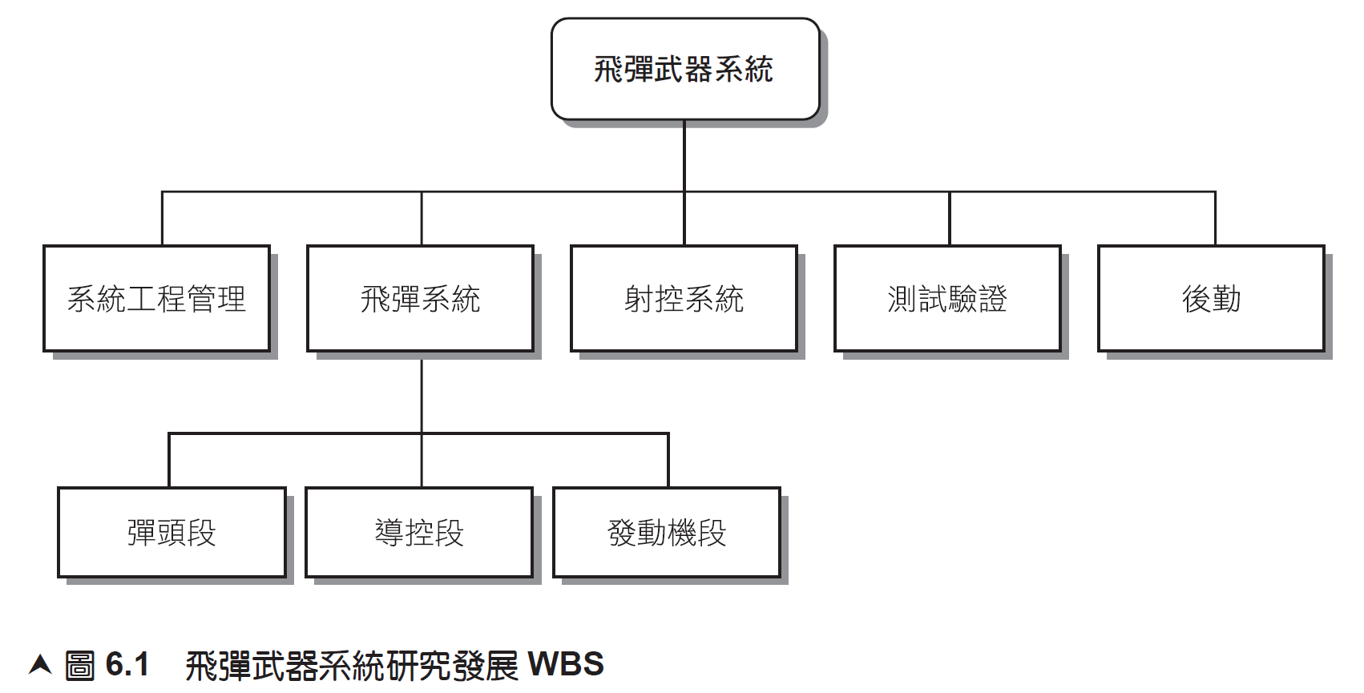

Slide 78
工作包 Work Package 內容包括：
定義工作內容（What）
估算所需時間（How Long）
估算成本（How Much）
估算資源（Resource）
指派負責人（Who）
制定監控點以衡量工作進度（How Well）

Slide 79
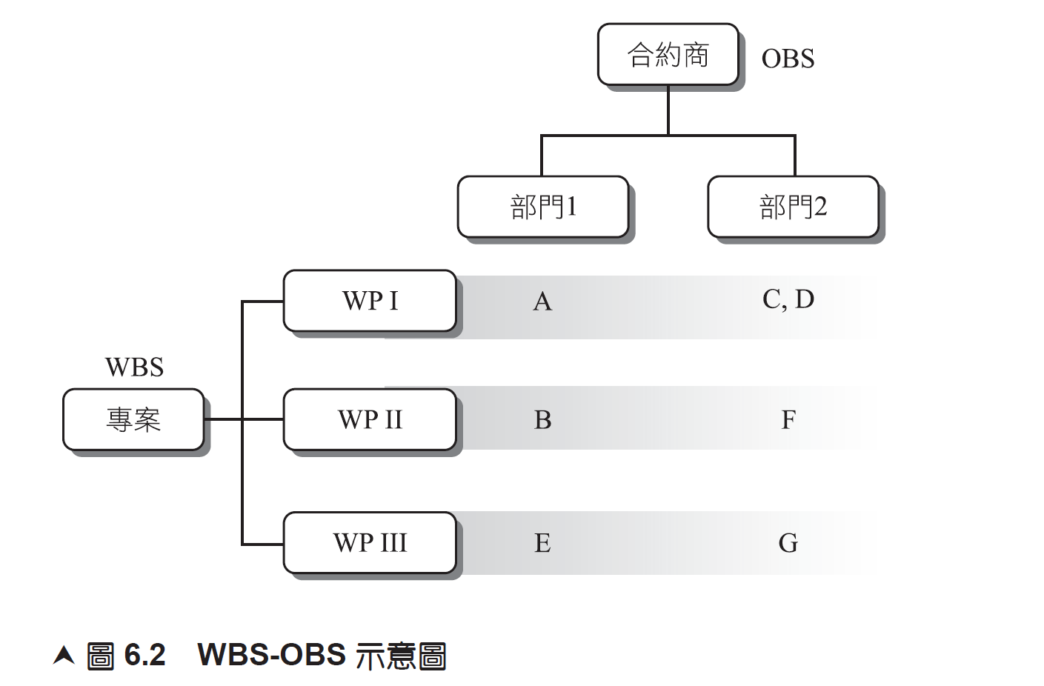
Organization Breakdown Structure (OBS)

Slide 80
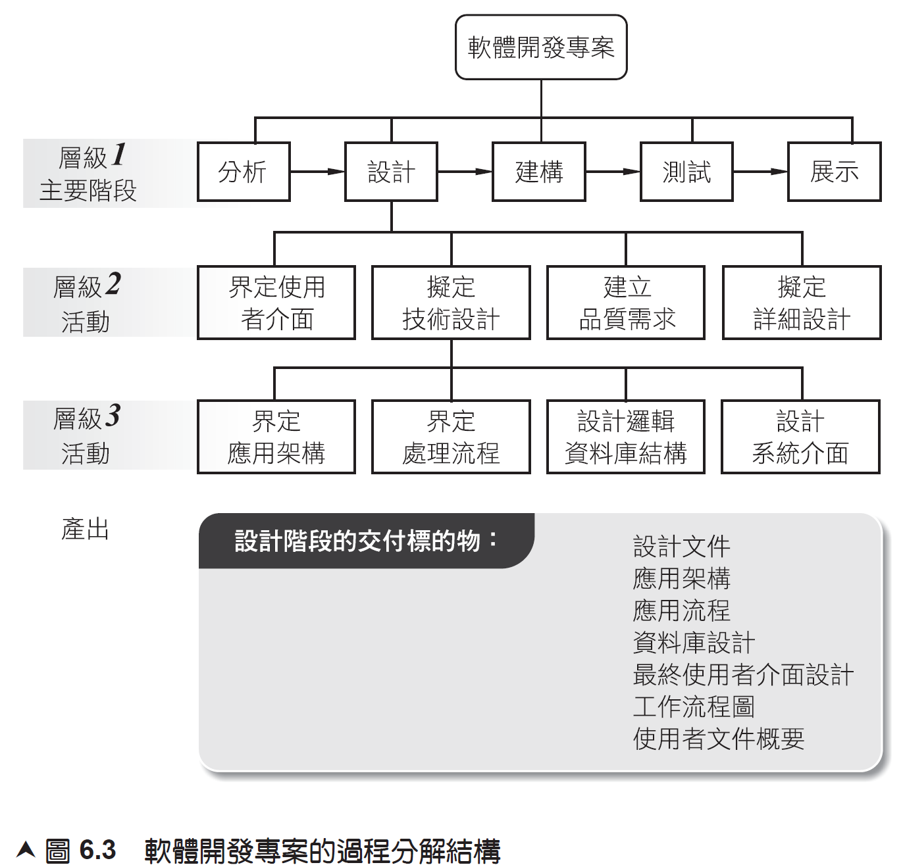
Process Breakdown Structure (PBS)

Slide 81
責任指派矩陣 Responsibility Assignment Matrix (RAM)
對於較大型專案，專案經常會建立工作分解結構（WBS）和組織分解結構（OBS）來指派各個工作的負責單位與個人。
但對於較小專案而言，較常用的工具為責任指派矩陣
透過RAM和所定義的權力、責任、和溝通的架構，執行專案工作的組織間之關係會更清楚。

Slide 82
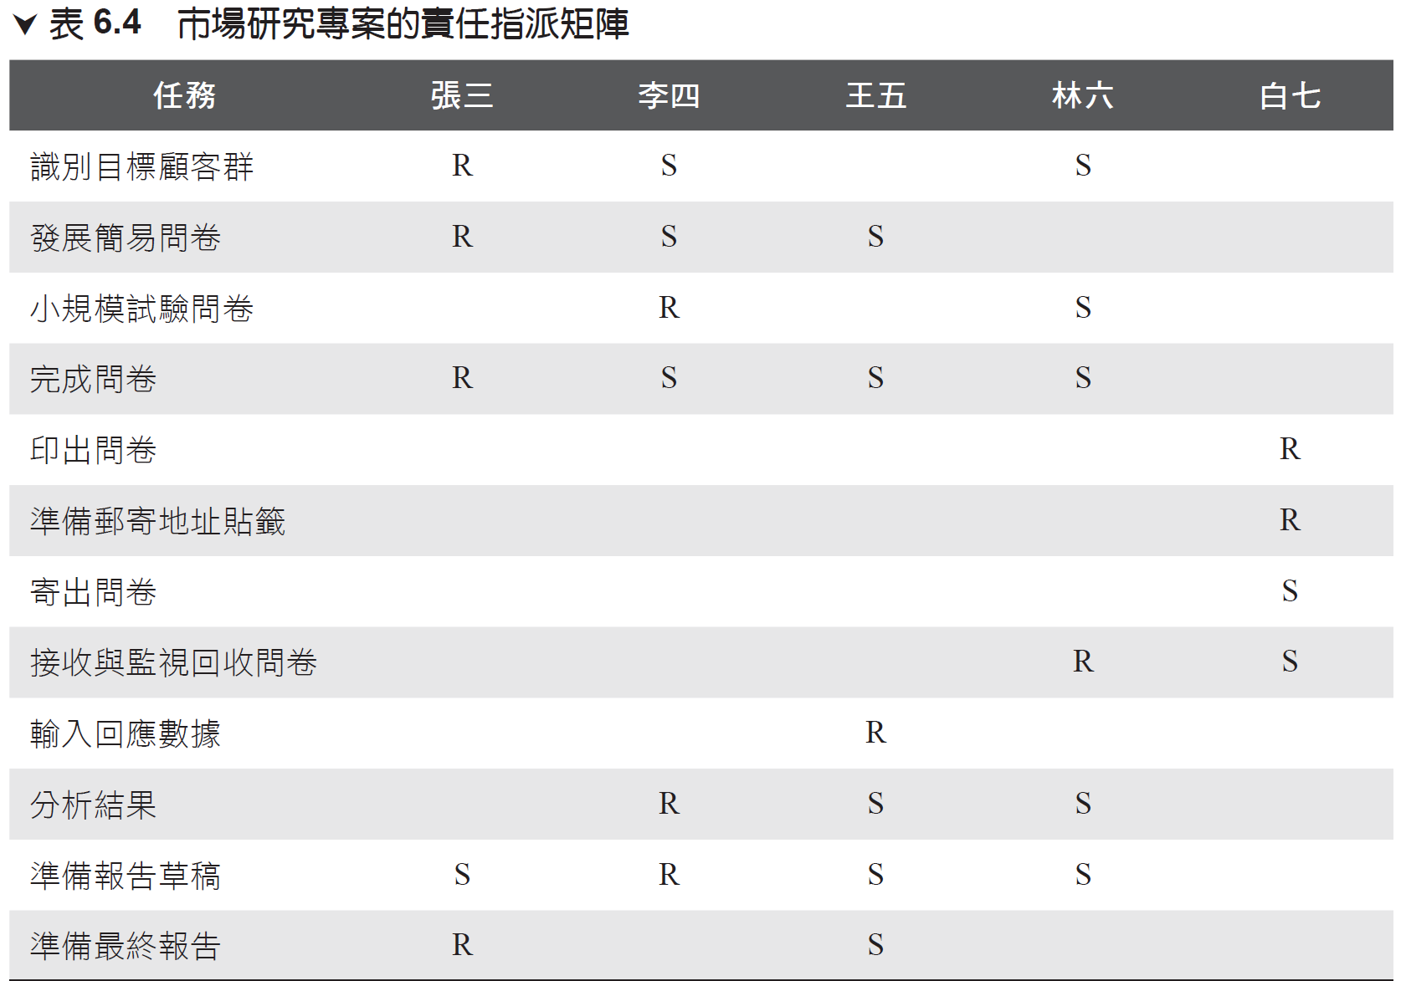
R: Responsible, S: Support

Slide 83
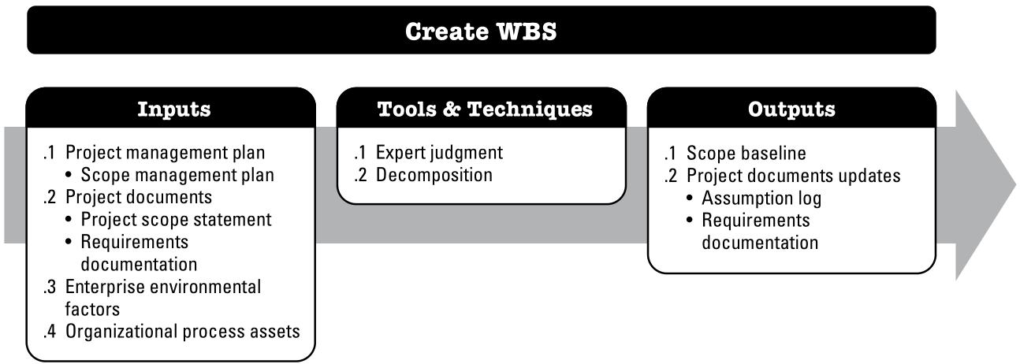
建立工作分解結構 Create WBS

Slide 84
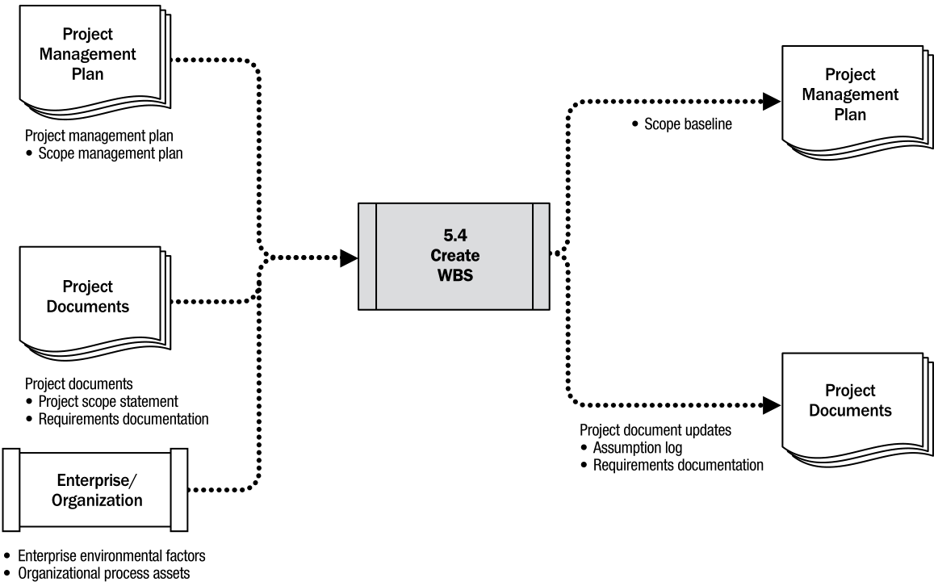
Create WBS: Data Flow Diagram

Slide 85
工作分解
將專案交付標的物分解成較小的、更易於管理的組成部分，直到它們可以被估計、納入排程和管制的程度為止。
WBS 最底層的工作包作為估計所需工期和成本之基礎。
工作包詳細程度通常依專案的大小和複雜度而定。

Slide 86
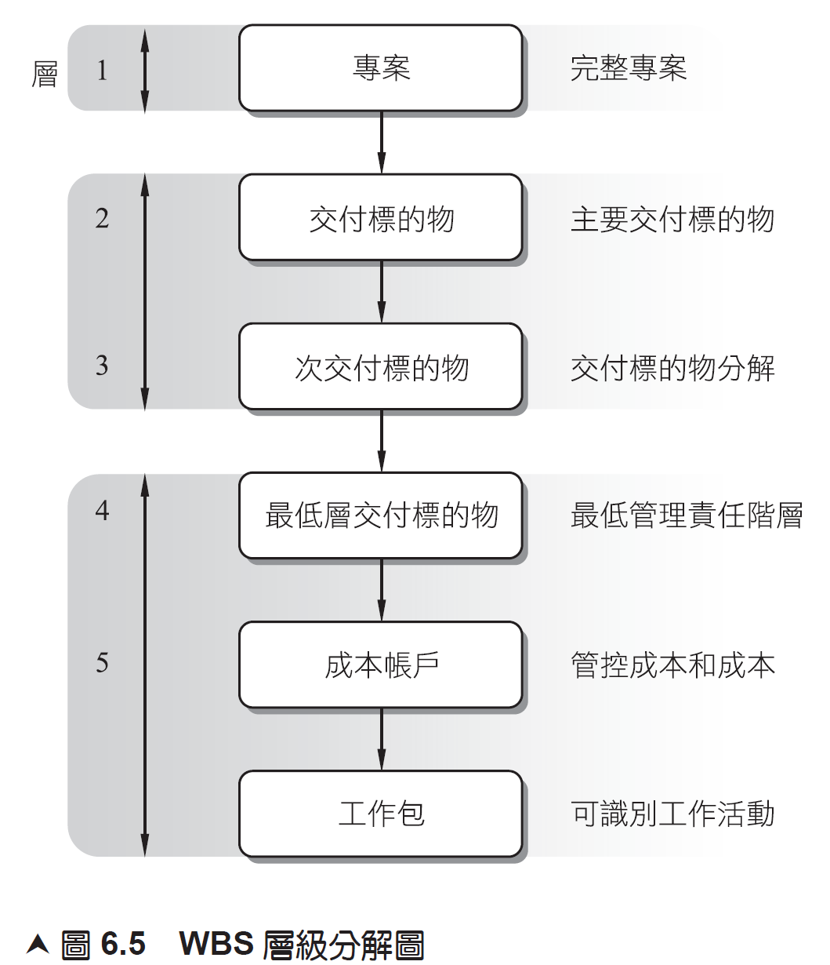
Cost Account

Slide 87
建立WBS：輸出 範疇基線 Scope Baseline
是專案管理計畫裡非常重要的部份，包含
核准後的專案範疇陳述（Project Scope Statement）
WBS
工作包（Work Package）
規劃包（Planning Package）
WBS 字典
作為專案工作績效的估算基準
此後如有變更，必須通過變更管理程序

Slide 88
建立WBS：輸出 範疇基線 Scope Baseline內容包括
專案範疇陳述 Project scope statement
Includes the description of the project scope, major deliverables, assumptions, and constraints
工作分解結構 WBS
A hierarchical decomposition of the total scope of work to be carried out by the project team to accomplish the project objectives and create the required deliverables.
Each descending level of the WBS represents an increasingly detailed definition of the project work.

Slide 89
建立WBS：輸出 範疇基線/工作包 Work package
Each has a unique identifier.
Provide a structure for hierarchical summation of costs, schedule, and resource information and form a code of accounts.
Each work package is part of a control account.
A control account is a management control point where scope, budget, and schedule are integrated and compared to the earned value for performance measurement.
A control account has two or more work packages, though each work package is associated with a single control account.

Slide 90
建立WBS：輸出 範疇基線/規劃包 Planning Package
A control account may include one or more planning packages.
A planning package is a work breakdown structure component below the control account and above the work package with known work content but without detailed schedule activities.

Slide 91
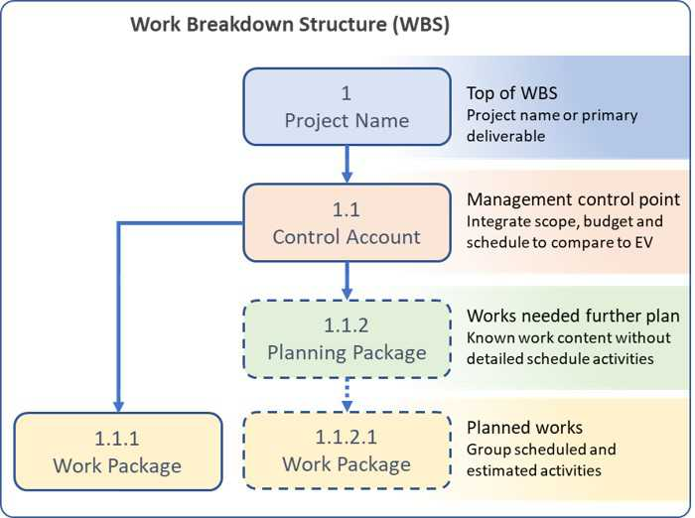
比較 Control Account, Work Package, Planning Package
A control account has two or more work packages, though each work package is associated with a single control account
A control account may include one or more planning packages
A planning package will be decomposed into a work package when the needed details regarding scope, budget and schedule are defined
Notes:
https://mudassiriqbal.net/controlaccount-workpackage-planning-package/
http://www.trulypm.com/2019/02/what-are-wp-ca-pp-en.html

Slide 92
建立WBS：輸出 範疇基線/WBS 字典 WBS Dictionary
Provides detailed deliverable, activity, and scheduling information about each component in the WBS.
The WBS dictionary is a document that supports the WBS
Most of the information included in the WBS dictionary is created by other processes and added to this document at a later stage.
WBS 字典可包含：
帳號編號 Code of account identifier,
工作描述 Description of work,
前提假設與限制 Assumptions and constraints,
負責單位 Responsible organization,
時程里程碑 Schedule milestones,
相關時程活動 Associated schedule activities,
資源需求 Resources required,
預估成本 Cost estimates,
品質要求 Quality requirements,
接受條件 Acceptance criteria,
技術參考 Technical references, and
協議資訊 Agreement information.

Slide 93
建立WBS：輸出 專案文件更新 Project Document Updates
假設日誌：
在此過程中所識別出的附加假設或限制要更新到假設日誌。
需求文件：
來自於此過程的核准變更要更新到需求文件。

Slide 94
驗證範疇 Validate Scope

Slide 95
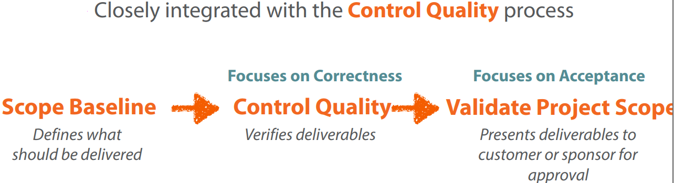
驗證範疇 Validate Scope
是正式接受專案交付標的物的過程
客觀地檢驗每一項專案產出，提高交付標的物被客戶接受的機率
在專案生命週期中持續地執行

Slide 96
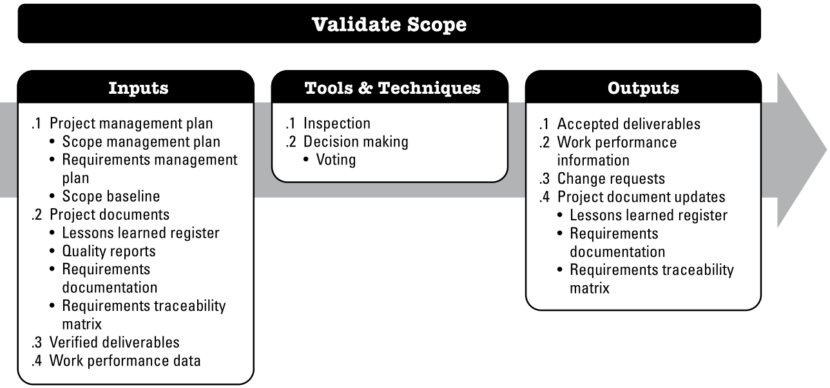
驗證範疇 Validate Scope

Slide 97
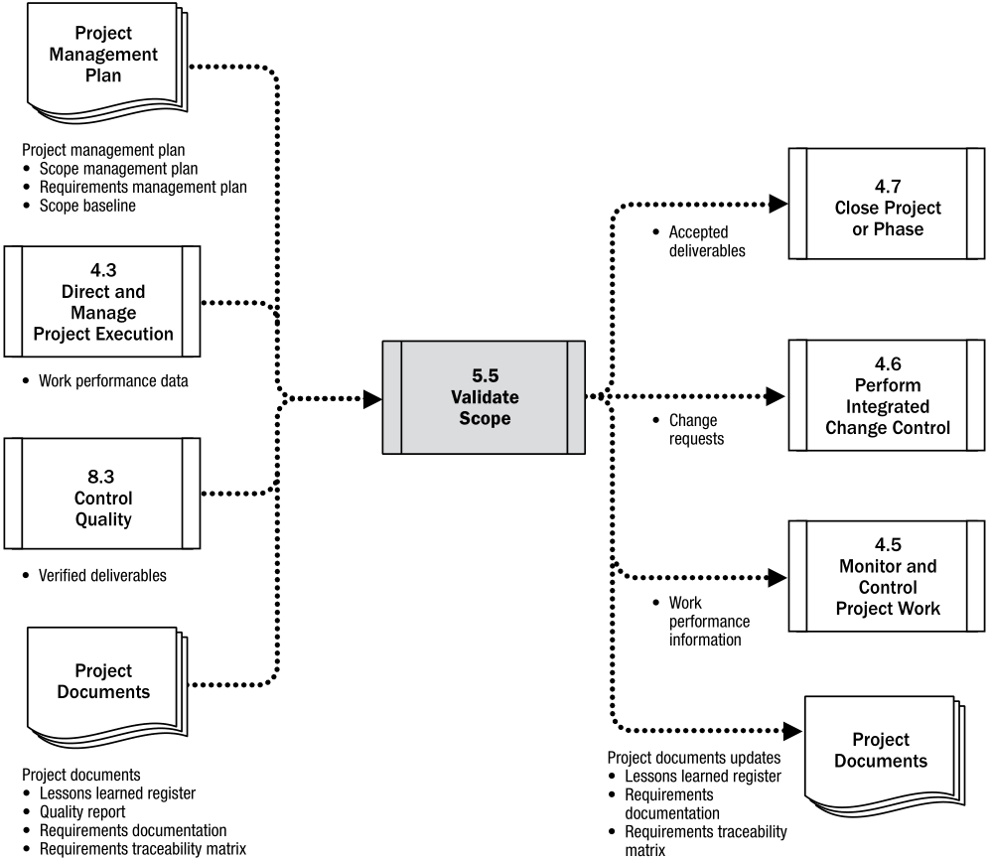
Validate Scope: Data Flow Diagram

Slide 98
驗證範疇 Validate Scope 輸出
Accepted Deliverables:
Once criteria for acceptance determined to be met, customer or sponsor formally approves
Acceptance documentation passed along to the Close Project or Phase process
Change Requests:
When deliverables not formally accepted, necessary changes and justifications documented
Change requests are passed along to Perform Integrated Change Control process
Validate Scope process often revisited after changes have been made

Slide 99
驗證範疇 Validate Scope 輸出
Work Performance Information
Project progress
Deliverables underway
Deliverables completed
Deliverables accepted
Project Document Updates:
Lessons learned register
Requirements documentation
Requirements traceability matrix

Slide 100
管制範疇 Control Scope

Slide 101
管制範疇 Control Scope
確保所有的變更請求、矯正措施、預防行動都經過整合變更控制的流程
監控專案和產品的範疇狀況，管制範疇基線變更，維護範疇基線
管制範疇過程中包括
識別哪些因素會導致專案範疇變更。
評估當這些因素發生時對專案範疇變更所造成的衝擊。

Slide 102
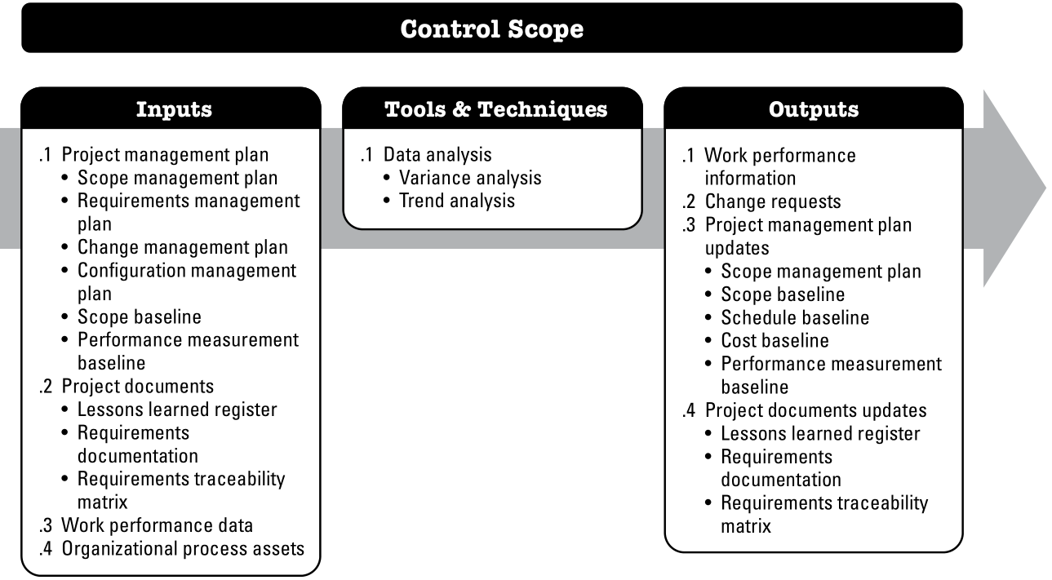
管制範疇 Control Scope

Slide 103
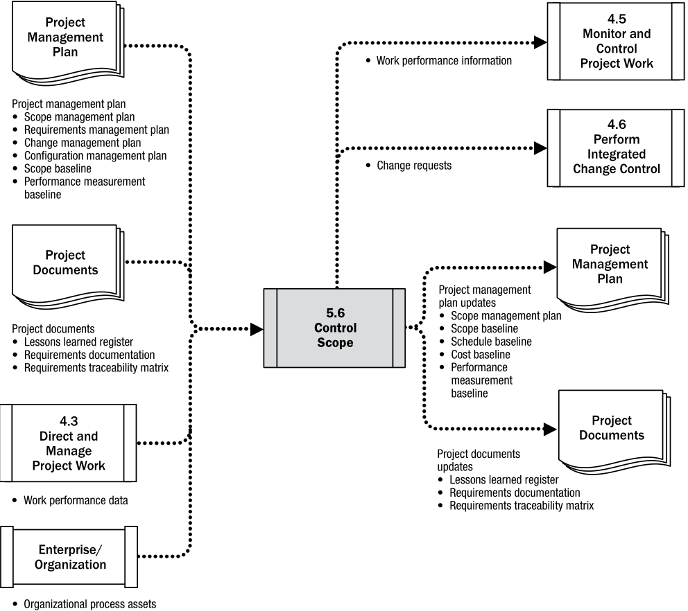
Control Scope: Data Flow Diagram

Slide 104
管制範疇 Control Scope 工具與技術 資料分析 Data Analysis
差異分析 Variance Analysis
比較實際結果與範疇基線之差異
差異是否已經超出門檻值（threshold）？
判斷是否應採取矯正措施或預防行動
趨勢分析 Trend Analysis
以時間為軸線檢查專案績效
判斷專案績效是逐漸獲得提昇，或是逐漸降低？
重要的是發生差異的根本原因為何？
如何評估差異程度有多大（Relative to the scope baseline）？
應該採取何種矯正措施或預防行動？

Slide 105
管制範疇 Control Scope 輸出
Change Requests:
Changes to scope baseline or other portions of project plans may be requested based on analysis
May include preventative/corrective actions, defect repairs and enhancement requests
Project Management Plan Updates:
Scope baseline updated when changes are approved
Other baselines may also be updated (cost, schedule, etc)
Project Document Updates:
Requirements documentation
Lessons learned register
Requirements traceability matrix

Slide 106
Wrap Up
專案範疇定義專案該做和不該做的工作
專案範疇管理 Project Scope Management
規劃範疇管理 Plan Scope Management
蒐集需求 Collect Requirements
定義範疇 Define Scope
建立工作分解結構 Create WBS
驗證範疇 Validate Scope
控制範疇 Control Scope
變更無可避免，所有的變更都要經過專案變更管制委員會審查

Slide 107
試說明確保能完整界定專案範疇的步驟
專案目標（project objective）：首先界定能滿足顧客需求的整體目標。專案目標內容必須包括做什麼（what）、在什麼時間內完成（when）、和花費多少預算（how much）。
界定主要的交付標的物（即在專案生命週期中預期產出項目）。
設定里程碑。
定義技術需求，通常產品或服務會有技術需求以確保提供適當的性能。
分析限制和除外項目。
會同顧客一起審查，最後將所定義專案範疇會同顧客審查以取得顧客認同，此處主要關心的是對於期待項目的瞭解並取得協議。

Slide 108
何謂驗證範疇？並說明驗證範疇和品質管制兩者之間的不同之處
驗證範疇是正式驗收專案已完成交付標的物的過程。驗證範疇包括與顧客或贊助人一起審查所完成的交付標的物和工作成果，參照WBS字典、專案範疇說明書、專案範疇管理計畫所述以確保達成顧客或贊助人的要求並獲得其正式簽字接收。通常專案團隊會在交付標的物完成但在顧客驗收前先行驗證範疇，以確保所完成的交付標的物能符合顧客之需求。
驗證範疇和品質管制兩者之間的不同之處在於驗證範疇主要關注於交付標的物的驗收，而品質管制則關注於交付標的物是否正確和是否滿足品質要求。前者是檢查和測試所完成交付標的物能符合顧客的規格要求（偏重結果），而後者是著重於製程的監控以確保製程品質（偏重過程）。品質品質管制通常在驗證範疇之前進行，但二者亦可同時進行。

Slide 109
試說明工作績效資料和工作績效資訊之差別
工作績效資料：可提供變更需求件數、已核准的變更需求件數、以及已完成交付標的物的數量等工作績效資料。
工作績效資訊：工作績效資訊是差異分析結果的資訊，包括範疇實際績效與原先範疇基線差異對於專案時程和成本的衝擊等分析資訊。

