Slide 1
Node.js 簡介
Introduction to Node.js

Slide 2
What is Node.js?
An open source server environment
Runs on various platforms (Windows, Linux, Unix, Mac OS X, etc.)
Node.js uses JavaScript on the server
Asynchronous and Event Driven
Super Fast
Can do everything…
Notes:
https://www.reddit.com/r/node/comments/697tlv/what_nodejs_cannot_do/

Slide 3
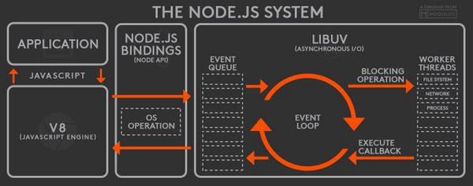
Node.js Architecture
Notes:
https://codeburst.io/all-about-node-js-you-wanted-to-know-25f3374e0be7

Slide 4

Node.js Block Diagram
JavaScript
Node.js Standard Library
C/C++
Node.js Bindings
(socket, http, etc.)
C/C++ Addons
V8
JavaScript Engine
Libuv
Event loop & Async I/O
http parser
Open SSL
zlib
The V8 JavaScript Engine.
Developed by the Chromium Project for Google Chrome and Chromium web browsers.
Notes:
http://sj82516-blog.logdown.com/posts/3903966/from-libuv-v8-to-nodejs-series-libuv-environment-setting-and-description

Slide 5
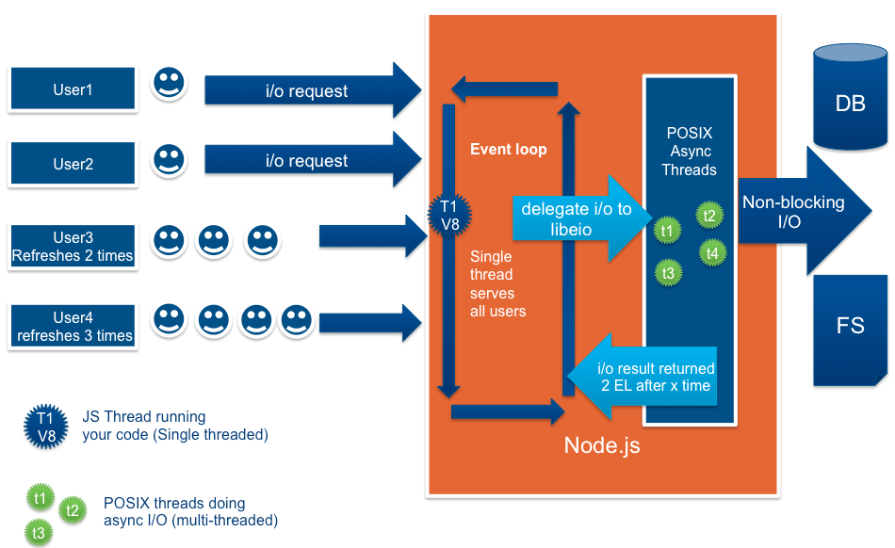
The Single Threaded Event Loop
Notes:
https://codeburst.io/how-node-js-single-thread-mechanism-work-understanding-event-loop-in-nodejs-230f7440b0ea

Slide 6
A simplified overview of the event loop's order of operations
timers: executes callbacks scheduled by setTimeout() and setInterval().
pending callbacks: executes I/O callbacks deferred to the next loop iteration.
idle, prepare: only used internally.
poll: retrieve new I/O events; execute I/O related callbacks check: setImmediate() callbacks are invoked here.
close callbacks: some close callbacks, e.g. socket.on('close', ...)
Notes:
https://nodejs.org/en/docs/guides/event-loop-timers-and-nexttick/

Slide 7
Build Up A Development Environment
Install Node.js
Install Visual Studio Code
Install related VS Code extensions
Install express
Notes:
https://code.visualstudio.com/docs/nodejs/nodejs-tutorial
https://code.visualstudio.com/docs/languages/javascript

Slide 8
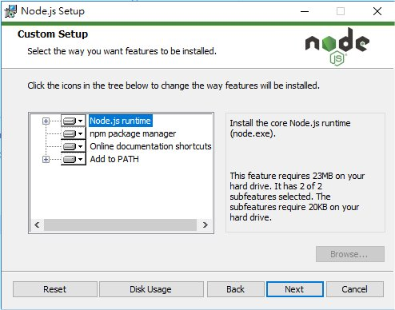
Install Node.js
Download Node.js and run the installer

Slide 9
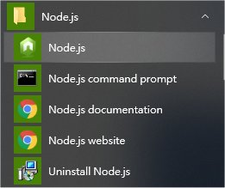
Test Node.js Installation

Slide 10
Install Visual Studio Code
Download Visual Studio Code

Slide 11
Install related VS Code extensions
HTML CSS Support
npm Intellisense
EJS Language Support
formatter-pug

Slide 12
Verify Node.js and VS Code Installation
依照 Node.js tutorial in Visual Studio Code 寫一個 Node.js 版的 Hello World
Notes:
https://code.visualstudio.com/docs/nodejs/nodejs-tutorial

Slide 13
按 Ctrl+` 開啟 Terminal

Slide 14
Install express
npm install -g express-generator
Node Package Manager
Global

Slide 15
Verify the Installation of Express.js
依照 Node.js tutorial in Visual Studio Code 寫一個 Express App
express --view=ejs myExpressApp

Slide 16
按 Ctrl+C 結束

Slide 17
npm Versioning
檢視 package.json
~1.4.3 可接受 1.4.*
^2.6.9 可接受 2.*.*

Slide 18
結論
Node.js 是一個 JavaScript 的執行環境，效率極高
可以透過外掛模組擴充功能
外掛模組可以用 C/C++ 撰寫
Express 是 Node.js 的 Web Framework

Slide 19
練習：修改 myExpressApp
http://localhost:3000
http://localhost:3000/users
Notes:
do-some-math.html

Slide 20
Install nodemon
npm install -g nodemon
修改 package.json
改以 npm run devstart 啟動應用
檔案修改後存檔，立即重新載入

