Slide 1
資訊安全 Chapter 1 Overview 概述
Joseph Deng
josephdeng@g2.usc.edu.tw

Slide 2
Outline 大綱
Computer security concepts 資安觀念
Threats, attacks, and assets 威脅、攻擊、資產
Security functional requirements 資安的功能性需求
Fundamental security design principles 基本的資安設計原則
Attack surfaces and attack trees 攻擊面 與 攻擊樹
Computer security strategy 資安策略
Standards 標準

Slide 3
Learning Objectives 學習目標
Describe the key security requirements of confidentiality, integrity, and availability. 資安需求的關鍵：CIA
Discuss the types of security threats and attacks that must be dealt with and give examples of the types of threats and attacks that apply to different categories of computer and network assets. 威脅&攻擊
Summarize the functional requirements for computer security. 功能性需求
Explain the fundamental security design principles. 資安設計原則
Discuss the use of attack surfaces and attack trees. 攻擊面&攻擊樹
Understand the principle aspects of a comprehensive security strategy. 資安策略

Slide 4
Three Fundamental Questions
What assets do we need to protect? 保護那些資產？
How are those assets threatened? 面臨何種威脅？
What can we do to counter those threats? 如何應對這些威脅？

Slide 5
Definition of Computer Security 資安的定義
Measures and controls that ensure confidentiality, integrity, and availability of information system assets including hardware, software, firmware, and information being processed, stored, and communicated.
Confidentiality 機密
Integrity 完整
Availability 可得
The NIST Internal/Interagency Report NISTIR 7298
Glossary of Key Information Security Terms , May 2013
NIST: National Institute of Standards and Technology
The CIA Triad

Slide 6
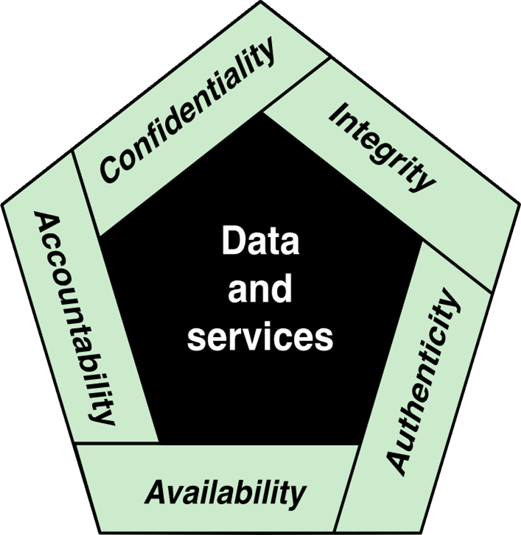
Essential Network and Computer Security Requirements

Slide 7
Key Security Concepts
Confidentiality
Preserving authorized restrictions on information access and disclosure, including means for protecting personal privacy and proprietary information
Integrity
Guarding against improper information modification or destruction, including ensuring information nonrepudiation and authenticity
Availability
Ensuring timely and reliable access to and use of information
Notes:
FIPS 199 provides a useful characterization of these three objectives in terms of requirements
and the definition of a loss of security in each category:
• Confidentiality: Preserving authorized restrictions on information access
and disclosure, including means for protecting personal privacy and proprietary
information. A loss of confidentiality is the unauthorized disclosure of
information.
• Integrity: Guarding against improper information modification or destruction,
including ensuring information non-repudiation and authenticity. A loss of
integrity is the unauthorized modification or destruction of information.
• Availability: Ensuring timely and reliable access to and use of information.
A loss of availability is the disruption of access to or use of information or an
information system.
Although the use of the CIA triad to define security objectives is well established,
some in the security field feel that additional concepts are needed to present
a complete picture. Two of the most commonly mentioned are as follows:
• Authenticity: The property of being genuine and being able to be verified and
trusted; confidence in the validity of a transmission, a message, or message
originator. This means verifying that users are who they say they are and that
each input arriving at the system came from a trusted source.
• Accountability: The security goal that generates the requirement for actions
of an entity to be traced uniquely to that entity. This supports nonrepudiation,
deterrence, fault isolation, intrusion detection and prevention, and after-action
recovery and legal action. Because truly secure systems aren’t yet an achievable
goal, we must be able to trace a security breach to a responsible party. Systems
must keep records of their activities to permit later forensic analysis to trace
security breaches or to aid in transaction disputes.
Note that FIPS 199 includes authenticity under integrity.

Slide 8
Confidentiality 機密
Data confidentiality 資料保密
Privacy 隱私
Preserving authorized restrictions on information access and disclosure, including means for protecting personal privacy and proprietary information.

Slide 9
Integrity 完整
Data integrity 資料完整，沒多、沒少、沒被竄改
System integrity 系統完整，功能正常、沒被入侵
Guarding against improper information modification or destruction, including ensuring information non-repudiation and authenticity.
A loss of integrity is the unauthorized modification or destruction of information.

Slide 10
Availability 可得
Ensuring timely and reliable access to and use of information. 隨時想要就能取得
A loss of availability is the disruption of access to or use of information or an information system.

Slide 11
Authenticity 真實
The property of being genuine and being able to be verified and trusted; confidence in the validity of a transmission, a message, or message originator. 真品、可驗證
This means verifying that users are who they say they are and that each input arriving at the system came from a trusted source. 可信任的來源

Slide 12
Accountability 當責
The security goal that generates the requirement for actions of an entity to be traced uniquely to that entity. 追溯
This supports nonrepudiation, deterrence, fault isolation, intrusion detection and prevention, and after-action recovery and legal action. 不能抵賴
Because truly secure systems aren’t yet an achievable goal, we must be able to trace a security breach to a responsible party.
Systems must keep records of their activities to permit later forensic analysis to trace security breaches or to aid in transaction disputes. 鑑識

Slide 13
Levels of Impact
Low
The loss could be expected to have a limited adverse effect on organizational operations, organizational assets, or individuals
Moderate
The loss could be expected to have a serious adverse effect on organizational operations, organizational assets, or individuals
High
The loss could be expected to have a severe or catastrophic adverse effect on organizational operations, organizational assets, or individuals
低
中
高
有限的
嚴重的
災難性的
Notes:
We use three levels of impact on organizations or
individuals should there be a breach of security (i.e., a loss of confidentiality, integrity,
or availability). These levels are defined in FIPS 199:
• Low: The loss could be expected to have a limited adverse effect on organizational
operations, organizational assets, or individuals. A limited adverse effect
means that, for example, the loss of confidentiality, integrity, or availability
might (i) cause a degradation in mission capability to an extent and duration
that the organization is able to perform its primary functions, but the effectiveness
of the functions is noticeably reduced; (ii) result in minor damage to
organizational assets; (iii) result in minor financial loss; or (iv) result in minor
harm to individuals.
• Moderate: The loss could be expected to have a serious adverse effect on
organizational operations, organizational assets, or individuals. A serious
adverse effect means that, for example, the loss might (i) cause a significant
degradation in mission capability to an extent and duration that the organization
is able to perform its primary functions, but the effectiveness of the functions
is significantly reduced; (ii) result in significant damage to organizational
assets; (iii) result in significant financial loss; or (iv) result in significant harm
to individuals that does not involve loss of life or serious, life-threatening
injuries.
• High: The loss could be expected to have a severe or catastrophic adverse
effect on organizational operations, organizational assets, or individuals. A
severe or catastrophic adverse effect means that, for example, the loss might
(i) cause a severe degradation in or loss of mission capability to an extent
and duration that the organization is not able to perform one or more of its
primary functions; (ii) result in major damage to organizational assets; (iii)
result in major financial loss; or (iv) result in severe or catastrophic harm to
individuals involving loss of life or serious life-threatening injuries.

Slide 14
Computer Security Challenges
Computer security is not as simple as it might first appear to the novice. 複雜
The mechanisms used to meet those requirements can be quite complex,
Understanding them may involve rather subtle reasoning.
In developing a particular security mechanism or algorithm, one must always consider potential attacks on those security features
Procedures used to provide particular services are often counterintuitive
Physical and logical placement needs to be determined
代誌絕對不是憨人你所想的那麼簡單

Slide 15
Computer Security Challenges(continued)
Security mechanisms typically involve more than a particular algorithm or protocol and also require that participants be in possession of some secret information which raises questions about the creation, distribution, and protection of that secret information
Attackers only need to find a single weakness, while the designer must find and eliminate all weaknesses to achieve perfect security
Security is still too often an afterthought to be incorporated into a system after the design is complete, rather than being an integral part of the design process

Slide 16
Computer Security Challenges(continued)
Security requires regular and constant monitoring
There is a natural tendency on the part of users and system managers to perceive little benefit from security investment until a security failure occurs
Many users and even security administrators view strong security as an impediment to efficient and user-friendly operation of an information system or use of information

Slide 17
A Model for Computer Security
The assets or system resources of a computer system can be categorized as follows:
Hardware: Including computer systems and other data processing, data storage, and data communications devices.
Software: Including the operating system, system utilities, and applications.
Data: Including files and databases, as well as security-related data, such as password files.
Communication facilities and networks: Local and wide area network communication links, bridges, routers, and so on.

Slide 18
Assets of a Computer System
Hardware
Software
Data
Communication facilities and networks
Notes:
The assets of a computer system can be categorized as follows:
• Hardware: Including computer systems and other data processing, data storage,
and data communications devices
• Software: Including the operating system, system utilities, and applications.
• Data: Including files and databases, as well as security-related data, such as
password files.
• Communication facilities and networks: Local and wide area network
communication links, bridges, routers, and so on.

Slide 19
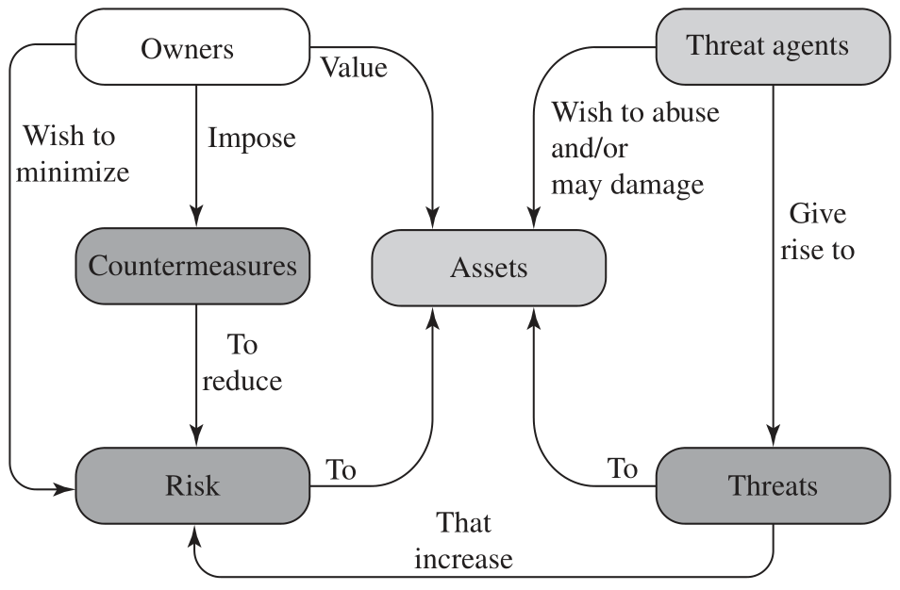
Security Concepts and Relationships
（資產的）擁有者
珍惜
威脅的主體
濫用
施加
希望降低
損害
對策
資產
引發
威脅
風險
提昇
Notes:
Figure 1.2, based on [CCPS12a], shows the relationship among some of these terms.
We start with the concept of a system resource , or asset , that users and owners wish to protect.

Slide 20
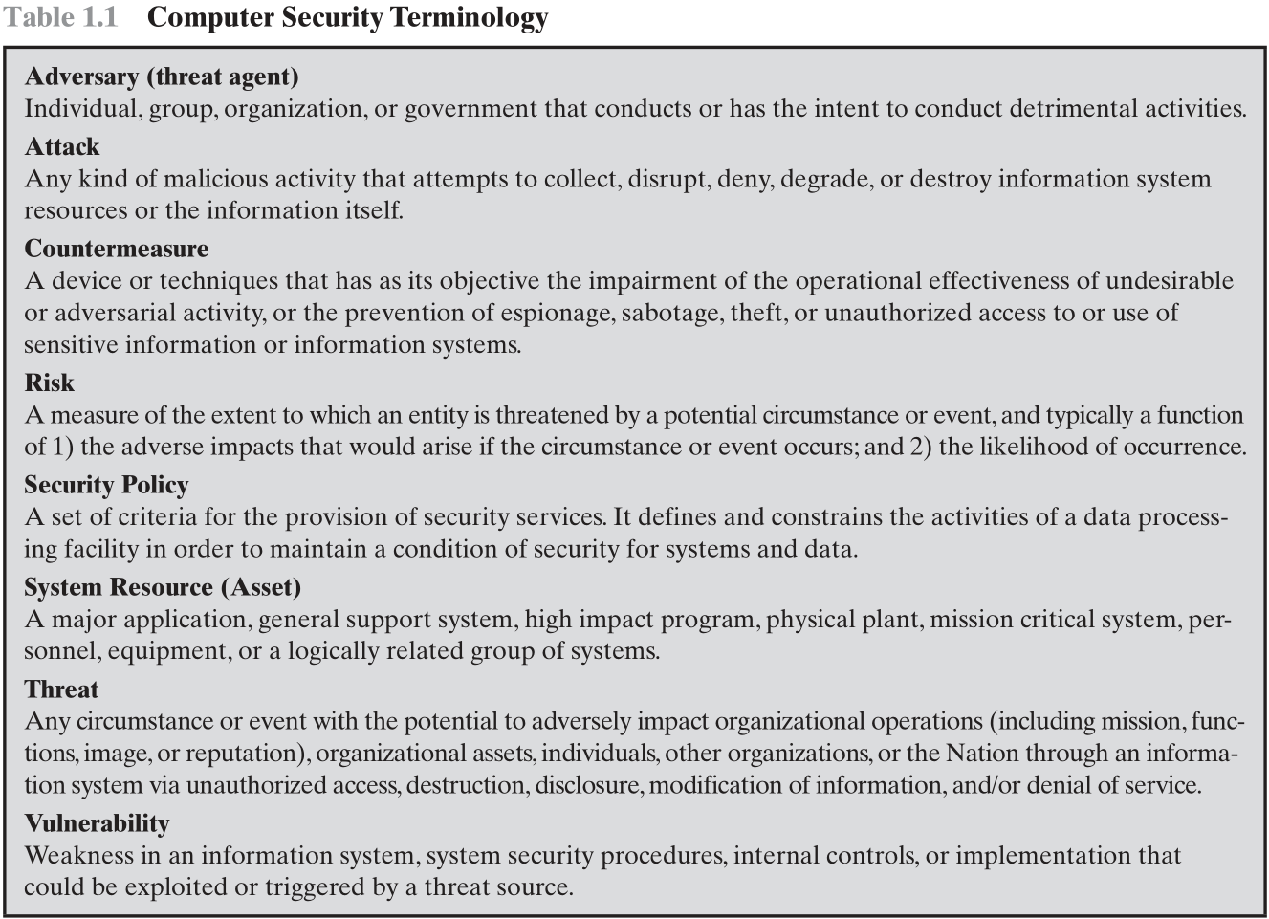
敵手
攻擊
對策
減低
間諜
破壞
竊盜
風險
安全政策
系統資源
（資產）
威脅
弱點
Notes:
We now introduce some terminology that will be useful throughout the book, relying
on RFC 2828, Internet Security Glossary . Table 1.1 defines terms.

Slide 21
Categories of Vulnerabilities 弱點
The system can be corrupted, so it does the wrong thing or gives wrong answers. 污染(loss of integrity)
Stored data values may differ from what they should be because they have been improperly modified. 遭到竄改
The system can become leaky. 洩漏(loss of confidentiality)
Someone who should not have access to some or all of the information available through the network obtains such access.
The system can become unavailable or very slow. 不能存取(loss of availability)
Using the system or network becomes impossible or impractical.

Slide 22
Threats 威脅
Capable of exploiting vulnerabilities
Represent potential security harm to an asset
Threat Agent 威脅的主體
The agent carrying out attacks
The attacker 攻擊者

Slide 23
Attacks 攻擊
An attack is a threat that is carried out (threat action) and, if successful, leads to an undesirable violation of security, or threat consequence.
Types of attacks
Active 主動 – attempt to alter system resources or affect their operation
Passive 被動 – attempt to learn or make use of information from the system that does not affect system resources
Insider 內部 – initiated by an entity inside the security parameter
Outsider 外部 – initiated from outside the perimeter
Notes:
In the context of security, our concern is with the vulnerabilities of system
resources. [NRC02] lists the following general categories of vulnerabilities of a
computer system or network asset:
• The system can be corrupted , so it does the wrong thing or gives wrong answers.
For example, stored data values may differ from what they should be because
they have been improperly modified.
• The system can become leaky . For example, someone who should not have access to
some or all of the information available through the network obtains such
access.
• The system can become unavailable or very slow. That is, using the system or network
becomes impossible or impractical.
These three general types of vulnerability correspond to the concepts of integrity,
confidentiality, and availability, enumerated earlier in this section.
Corresponding to the various types of vulnerabilities to a system resource are
threats that are capable of exploiting those vulnerabilities. A threat represents a
potential security harm to an asset. An attack is a threat that is carried out (threat
action) and, if successful, leads to an undesirable violation of security, or threat
consequence. The agent carrying out the attack is referred to as an attacker, or
threat agent . We can distinguish two types of attacks:
• Active attack: An attempt to alter system resources or affect their operation.
• Passive attack: An attempt to learn or make use of information from the
system that does not affect system resources.
We can also classify attacks based on the origin of the attack:
• Inside attack: Initiated by an entity inside the security perimeter (an “insider”).
The insider is authorized to access system resources but uses them in a way not
approved by those who granted the authorization.
• Outside attack: Initiated from outside the perimeter, by an unauthorized or
illegitimate user of the system (an “outsider”). On the Internet, potential
outside attackers range from amateur pranksters to organized criminals, international
terrorists, and hostile governments.

Slide 24
Countermeasures 對策
Any means taken to deal with a security attack.
Ideally, a countermeasure can be devised to prevent a particular type of attack from succeeding.
When prevention is not possible, or fails in some instance, the goal is to detect the attack then recover from the effects of the attack.
A countermeasure may itself introduce new vulnerabilities.
In any case, residual vulnerabilities may remain after the imposition of countermeasures.
Such vulnerabilities may be exploited by threat agents representing a residual level of risk to the assets.
Owners will seek to minimize that risk given other constraints.
Notes:
Finally, a countermeasure is any means taken to deal with a security attack.
Ideally, a countermeasure can be devised to prevent a particular type of attack from
succeeding. When prevention is not possible, or fails in some instance, the goal is to
detect the attack and then recover from the effects of the attack. A countermeasure
may itself introduce new vulnerabilities. In any case, residual vulnerabilities
may remain after the imposition of countermeasures. Such vulnerabilities may be
exploited by threat agents representing a residual level of risk to the assets. Owners
will seek to minimize that risk given other constraints.

Slide 25
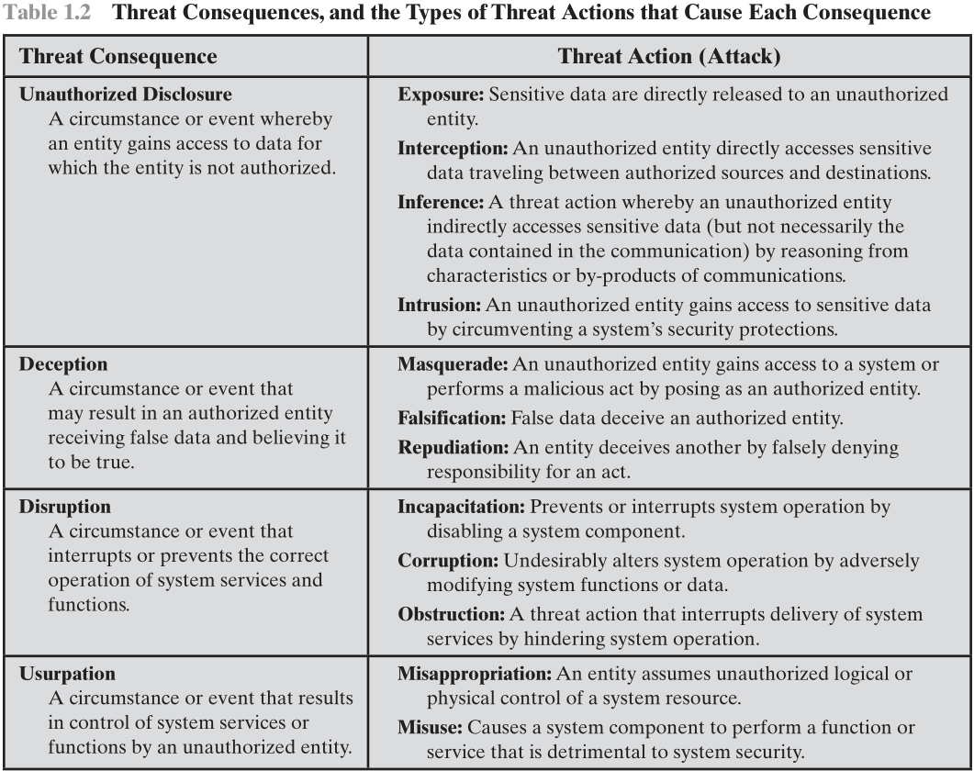
Threats and Attacks
未經授權的披露
confidentiality
暴光
攔截
推斷
入侵
欺騙
system integrity or data integrity
偽裝
偽造
拒絕
破壞
availability or system integrity
失能
污染
阻礙
篡奪
system integrity
盜用
濫用
Notes:
Table 1.2 , based on RFC 4949, describes four kinds of threat consequences and lists
the kinds of attacks that result in each consequence.
Unauthorized disclosure is a threat to confidentiality. The following types of
attacks can result in this threat consequence:
• Exposure: This can be deliberate, as when an insider intentionally releases
sensitive information, such as credit card numbers, to an outsider. It can also
be the result of a human, hardware, or software error, which results in an entity
gaining unauthorized knowledge of sensitive data. There have been numerous
instances of this, such as universities accidentally posting student confidential
information on the Web.
• Interception: Interception is a common attack in the context of communications.
On a shared local area network (LAN), such as a wireless LAN or a
broadcast Ethernet, any device attached to the LAN can receive a copy of
packets intended for another device. On the Internet, a determined hacker
can gain access to e-mail traffic and other data transfers. All of these situations
create the potential for unauthorized access to data.
• Inference: An example of inference is known as traffic analysis, in which an
adversary is able to gain information from observing the pattern of traffic on
a network, such as the amount of traffic between particular pairs of hosts on
the network. Another example is the inference of detailed information from
a database by a user who has only limited access; this is accomplished by
repeated queries whose combined results enable inference.
• Intrusion: An example of intrusion is an adversary gaining unauthorized
access to sensitive data by overcoming the system’s access control protections.
Deception is a threat to either system integrity or data integrity. The following
types of attacks can result in this threat consequence:
• Masquerade: One example of masquerade is an attempt by an unauthorized
user to gain access to a system by posing as an authorized user; this could
happen if the unauthorized user has learned another user’s logon ID and
password. Another example is malicious logic, such as a Trojan horse, that
appears to perform a useful or desirable function but actually gains unauthorized
access to system resources or tricks a user into executing other malicious
logic.
• Falsification: This refers to the altering or replacing of valid data or the introduction
of false data into a file or database. For example, a student may alter
his or her grades on a school database.
• Repudiation: In this case, a user either denies sending data or a user denies
receiving or possessing the data.
Disruption is a threat to availability or system integrity. The following types of
attacks can result in this threat consequence:
• Incapacitation: This is an attack on system availability. This could occur as a
result of physical destruction of or damage to system hardware. More typically,
malicious software, such as Trojan horses, viruses, or worms, could operate in
such a way as to disable a system or some of its services.
• Corruption: This is an attack on system integrity. Malicious software in this
context could operate in such a way that system resources or services function
in an unintended manner. Or a user could gain unauthorized access to a system
and modify some of its functions. An example of the latter is a user placing
backdoor logic in the system to provide subsequent access to a system and its
resources by other than the usual procedure.
Obstruction: One way to obstruct system operation is to interfere with communications
by disabling communication links or altering communication
control information. Another way is to overload the system by placing excess
burden on communication traffic or processing resources.
Usurpation is a threat to system integrity. The following types of attacks can
result in this threat consequence:
• Misappropriation: This can include theft of service. An example is a distributed
denial of service attack, when malicious software is installed on a number of hosts
to be used as platforms to launch traffic at a target host. In this case, the malicious
software makes unauthorized use of processor and operating system resources.
• Misuse: Misuse can occur by means of either malicious logic or a hacker that
has gained unauthorized access to a system. In either case, security functions
can be disabled or thwarted.

Slide 26
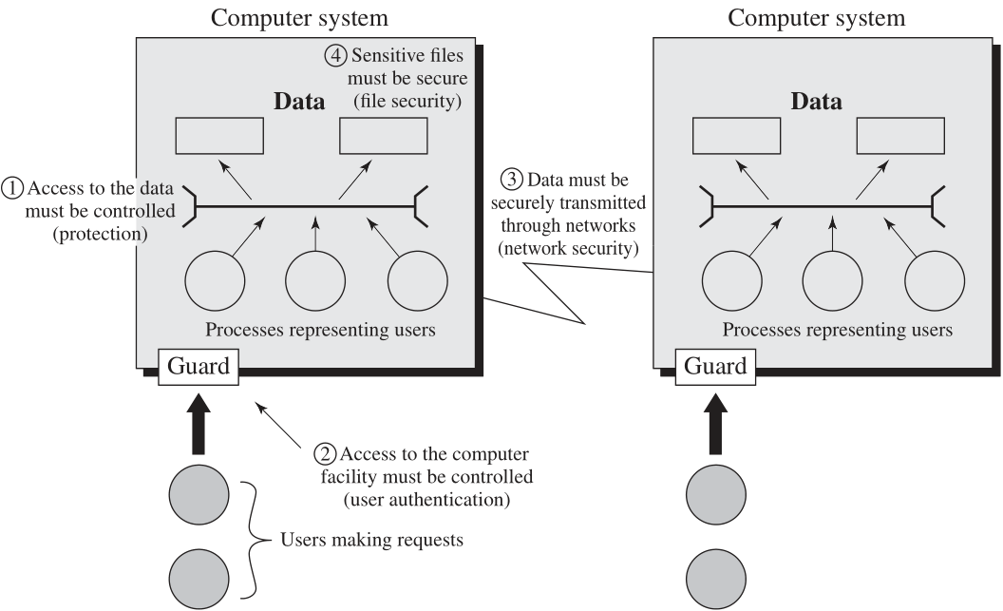
Scope of Computer Security
Threats and Assets
Notes:
The assets of a computer system can be categorized as hardware, software, data,
and communication lines and networks. In this subsection, we briefly describe these
four categories and relate these to the concepts of integrity, confidentiality, and
availability introduced in Section 1.1 (see Figure 1.3 and Table 1.3 ).

Slide 27
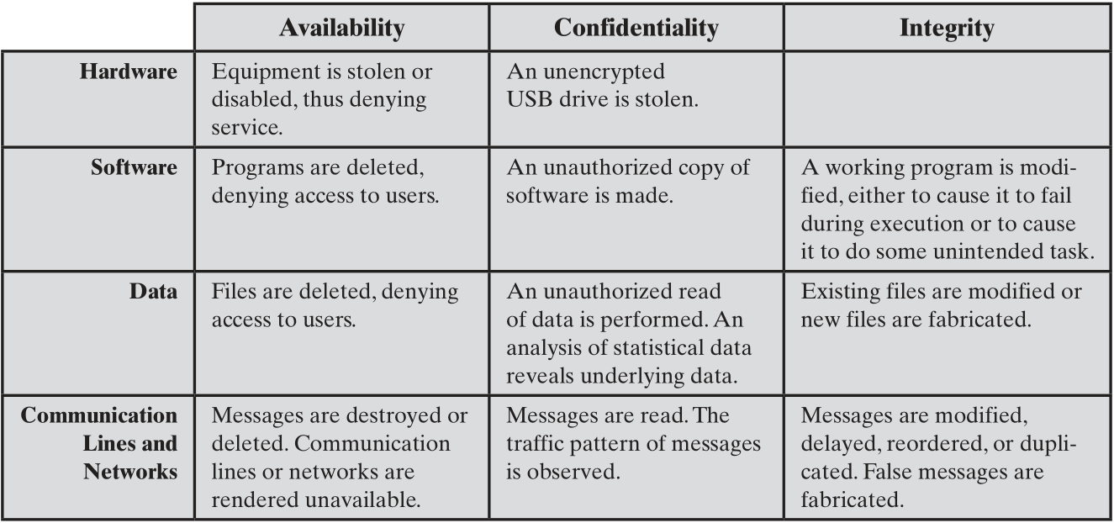
Computer and Network Assets, with Examples of Threats
Notes:
HARDWARE A major threat to computer system hardware is the threat to
availability. Hardware is the most vulnerable to attack and the least susceptible to
automated controls. Threats include accidental and deliberate damage to equipment
as well as theft. The proliferation of personal computers and workstations and the
widespread use of LANs increase the potential for losses in this area. Theft of
USB drives can lead to loss of confidentiality. Physical and administrative
security measures are needed to deal with these threats.
SOFTWARE Software includes the operating system, utilities, and application
programs. A key threat to software is an attack on availability. Software, especially
application software, is often easy to delete. Software can also be altered or
damaged to render it useless. Careful software configuration management, which
includes making backups of the most recent version of software, can maintain high
availability. A more difficult problem to deal with is software modification that
results in a program that still functions but that behaves differently than before,
which is a threat to integrity/authenticity. Computer viruses and related attacks fall
into this category. A final problem is protection against software piracy. Although
certain countermeasures are available, by and large the problem of unauthorized
copying of software has not been solved.
DATA Hardware and software security are typically concerns of computing center
professionals or individual concerns of personal computer users. A much more
widespread problem is data security, which involves files and other forms of data
controlled by individuals, groups, and business organizations.
Security concerns with respect to data are broad, encompassing availability,
secrecy, and integrity. In the case of availability, the concern is with the destruction
of data files, which can occur either accidentally or maliciously.
The obvious concern with secrecy is the unauthorized reading of data files or
databases, and this area has been the subject of perhaps more research and effort
than any other area of computer security. A less obvious threat to secrecy involves
the analysis of data and manifests itself in the use of so-called statistical databases,
which provide summary or aggregate information. Presumably, the existence of
aggregate information does not threaten the privacy of the individuals involved.
However, as the use of statistical databases grows, there is an increasing potential
for disclosure of personal information. In essence, characteristics of constituent
individuals may be identified through careful analysis. For example, if one table
records the aggregate of the incomes of respondents A, B, C, and D and another
records the aggregate of the incomes of A, B, C, D, and E, the difference between
the two aggregates would be the income of E. This problem is exacerbated by the
increasing desire to combine data sets. In many cases, matching several sets of data
for consistency at different levels of aggregation requires access to individual units.
Thus, the individual units, which are the subject of privacy concerns, are available at
various stages in the processing of data sets.
Finally, data integrity is a major concern in most installations. Modifications
to data files can have consequences ranging from minor to disastrous.

Slide 28
Passive and Active Attacks
Passive Attack
Active Attack
Attempts to learn or make use of information from the system but does not affect system resources
Eavesdropping on, or monitoring of, transmissions
Goal of attacker is to obtain information that is being transmitted
Two types:
Release of message contents
Traffic analysis
Attempts to alter system resources or affect their operation
Involve some modification of the data stream or the creation of a false stream
Four categories:
Replay
Masquerade
Modification of messages
Denial of service
Notes:
Network security attacks can be classified
as passive attacks and active attacks . A passive attack attempts to learn or make
use of information from the system but does not affect system resources. An active
attack attempts to alter system resources or affect their operation.
Passive attacks are in the nature of eavesdropping on, or monitoring of,
transmissions. The goal of the attacker is to obtain information that is being transmitted.
Two types of passive attacks are release of message contents and traffic
analysis.
The release of message contents is easily understood. A telephone conversation,
an electronic mail message, and a transferred file may contain sensitive or
confidential information. We would like to prevent an opponent from learning the
contents of these transmissions.
A second type of passive attack, traffic analysis , is subtler. Suppose that we
had a way of masking the contents of messages or other information traffic so that
opponents, even if they captured the message, could not extract the information
from the message. The common technique for masking contents is encryption. If we
had encryption protection in place, an opponent might still be able to observe the
pattern of these messages. The opponent could determine the location and identity
of communicating hosts and could observe the frequency and length of messages
being exchanged. This information might be useful in guessing the nature of the
communication that was taking place.
Passive attacks are very difficult to detect because they do not involve any
alteration of the data. Typically, the message traffic is sent and received in an
apparently normal fashion and neither the sender nor receiver is aware that a
third party has read the messages or observed the traffic pattern. However, it is
feasible to prevent the success of these attacks, usually by means of encryption.
Thus, the emphasis in dealing with passive attacks is on prevention rather than
detection.
Active attacks involve some modification of the data stream or the creation
of a false stream and can be subdivided into four categories: replay, masquerade,
modification of messages, and denial of service.
Replay involves the passive capture of a data unit and its subsequent retransmission
to produce an unauthorized effect.
A masquerade takes place when one entity pretends to be a different entity. A
masquerade attack usually includes one of the other forms of active attack. For example,
authentication sequences can be captured and replayed after a valid authentication
sequence has taken place, thus enabling an authorized entity with few privileges
to obtain extra privileges by impersonating an entity that has those privileges.
Modification of messages simply means that some portion of a legitimate
message is altered, or that messages are delayed or reordered, to produce an
unauthorized effect. For example, a message stating, “Allow John Smith to read
confidential file accounts” is modified to say, “Allow Fred Brown to read confidential
file accounts.”
The denial of service prevents or inhibits the normal use or management of
communications facilities. This attack may have a specific target; for example, an
entity may suppress all messages directed to a particular destination (e.g., the security
audit service). Another form of service denial is the disruption of an entire network,
either by disabling the network or by overloading it with messages so as to degrade
performance.
Active attacks present the opposite characteristics of passive attacks. Whereas
passive attacks are difficult to detect, measures are available to prevent their
success. On the other hand, it is quite difficult to prevent active attacks absolutely,
because to do so would require physical protection of all communications facilities
and paths at all times. Instead, the goal is to detect them and to recover from any
disruption or delays caused by them. Because the detection has a deterrent effect, it
may also contribute to prevention.

Slide 29
Security Requirements
Access Control
Awareness and Training
Audit and Accountability
Certification, Accreditation, and Security Assessments
Configuration Management
Contingency Planning
Identification and Authentication
Incident Response
Maintenance
Media Protection
Physical and Environmental Protection
Planning
Personnel Security
Risk Assessment
Systems and Services Acquisition
System and Communications Protection
System and Information Integrity
Notes:
There are a number of ways of classifying and characterizing the countermeasures
that may be used to reduce vulnerabilities and deal with threats to system assets. It
will be useful for the presentation in the remainder of the book to look at several
approaches, which we do in this and the next two sections. In this section, we view
countermeasures in terms of functional requirements, and we follow the classification
defined in FIPS 200 ( Minimum Security Requirements for Federal Information
and Information Systems ). This standard enumerates 17 security-related areas with
regard to protecting the confidentiality, integrity, and availability of information
systems and the information processed, stored, and transmitted by those systems.
The areas are defined in Table 1.4.
The requirements listed in FIP 200 encompass a wide range of countermeasures
to security vulnerabilities and threats. Roughly, we can divide these
countermeasures into two categories: those that require computer security technical
measures (covered in this book in Parts One and Two), either hardware or
software, or both; and those that are fundamentally management issues (covered in
Part Three).

Slide 30
Security Requirements Access Control 存取控制
Limit information system access
to authorized users, processes acting on behalf of authorized users, or devices (including other information systems) and
to the types of transactions and functions that authorized users are permitted to exercise.
Notes:
There are a number of ways of classifying and characterizing the countermeasures
that may be used to reduce vulnerabilities and deal with threats to system assets. It
will be useful for the presentation in the remainder of the book to look at several
approaches, which we do in this and the next two sections. In this section, we view
countermeasures in terms of functional requirements, and we follow the classification
defined in FIPS 200 ( Minimum Security Requirements for Federal Information
and Information Systems ). This standard enumerates 17 security-related areas with
regard to protecting the confidentiality, integrity, and availability of information
systems and the information processed, stored, and transmitted by those systems.
The areas are defined in Table 1.4.
The requirements listed in FIP 200 encompass a wide range of countermeasures
to security vulnerabilities and threats. Roughly, we can divide these
countermeasures into two categories: those that require computer security technical
measures (covered in this book in Parts One and Two), either hardware or
software, or both; and those that are fundamentally management issues (covered in
Part Three).

Slide 31
Security Requirements Awareness and Training 意識和培訓
Ensure that managers and users of organizational information systems are made aware of the security risks associated with their activities and of the applicable laws, regulations, and policies related to the security of organizational information systems;
Ensure that personnel are adequately trained to carry out their assigned information security-related duties and responsibilities.
Notes:
There are a number of ways of classifying and characterizing the countermeasures
that may be used to reduce vulnerabilities and deal with threats to system assets. It
will be useful for the presentation in the remainder of the book to look at several
approaches, which we do in this and the next two sections. In this section, we view
countermeasures in terms of functional requirements, and we follow the classification
defined in FIPS 200 ( Minimum Security Requirements for Federal Information
and Information Systems ). This standard enumerates 17 security-related areas with
regard to protecting the confidentiality, integrity, and availability of information
systems and the information processed, stored, and transmitted by those systems.
The areas are defined in Table 1.4.
The requirements listed in FIP 200 encompass a wide range of countermeasures
to security vulnerabilities and threats. Roughly, we can divide these
countermeasures into two categories: those that require computer security technical
measures (covered in this book in Parts One and Two), either hardware or
software, or both; and those that are fundamentally management issues (covered in
Part Three).

Slide 32
Security Requirements Audit and Accountability 稽核和可說明性
Create, protect, and retain information system audit records to the extent needed to enable the monitoring, analysis, investigation, and reporting of unlawful, unauthorized, or inappropriate information system activity;
Ensure that the actions of individual information system users can be uniquely traced to those users so they can be held accountable for their actions.
Notes:
There are a number of ways of classifying and characterizing the countermeasures
that may be used to reduce vulnerabilities and deal with threats to system assets. It
will be useful for the presentation in the remainder of the book to look at several
approaches, which we do in this and the next two sections. In this section, we view
countermeasures in terms of functional requirements, and we follow the classification
defined in FIPS 200 ( Minimum Security Requirements for Federal Information
and Information Systems ). This standard enumerates 17 security-related areas with
regard to protecting the confidentiality, integrity, and availability of information
systems and the information processed, stored, and transmitted by those systems.
The areas are defined in Table 1.4.
The requirements listed in FIP 200 encompass a wide range of countermeasures
to security vulnerabilities and threats. Roughly, we can divide these
countermeasures into two categories: those that require computer security technical
measures (covered in this book in Parts One and Two), either hardware or
software, or both; and those that are fundamentally management issues (covered in
Part Three).

Slide 33
Security Requirements Certification 認證, Accreditation 信賴, and Security Assessments 安全評估
Periodically assess the security controls in organizational information systems to determine if the controls are effective in their application;
Develop and implement plans of action designed to correct deficiencies and reduce or eliminate vulnerabilities in organizational information systems;
Authorize the operation of organizational information systems and any associated information system connections;
Monitor information system security controls on an ongoing basis to ensure the continued effectiveness of the controls.
Notes:
There are a number of ways of classifying and characterizing the countermeasures
that may be used to reduce vulnerabilities and deal with threats to system assets. It
will be useful for the presentation in the remainder of the book to look at several
approaches, which we do in this and the next two sections. In this section, we view
countermeasures in terms of functional requirements, and we follow the classification
defined in FIPS 200 ( Minimum Security Requirements for Federal Information
and Information Systems ). This standard enumerates 17 security-related areas with
regard to protecting the confidentiality, integrity, and availability of information
systems and the information processed, stored, and transmitted by those systems.
The areas are defined in Table 1.4.
The requirements listed in FIP 200 encompass a wide range of countermeasures
to security vulnerabilities and threats. Roughly, we can divide these
countermeasures into two categories: those that require computer security technical
measures (covered in this book in Parts One and Two), either hardware or
software, or both; and those that are fundamentally management issues (covered in
Part Three).

Slide 34
Security Requirements Configuration Management 組態管理
Establish and maintain baseline configurations and inventories of organizational information systems (including hardware, software, firmware, and documentation) throughout the respective system development life cycles;
Establish and enforce security configuration settings for information technology products employed in organizational information systems.
Notes:
There are a number of ways of classifying and characterizing the countermeasures
that may be used to reduce vulnerabilities and deal with threats to system assets. It
will be useful for the presentation in the remainder of the book to look at several
approaches, which we do in this and the next two sections. In this section, we view
countermeasures in terms of functional requirements, and we follow the classification
defined in FIPS 200 ( Minimum Security Requirements for Federal Information
and Information Systems ). This standard enumerates 17 security-related areas with
regard to protecting the confidentiality, integrity, and availability of information
systems and the information processed, stored, and transmitted by those systems.
The areas are defined in Table 1.4.
The requirements listed in FIP 200 encompass a wide range of countermeasures
to security vulnerabilities and threats. Roughly, we can divide these
countermeasures into two categories: those that require computer security technical
measures (covered in this book in Parts One and Two), either hardware or
software, or both; and those that are fundamentally management issues (covered in
Part Three).

Slide 35
Security Requirements Contingency Planning 急難救援計畫
Establish, maintain, and implement plans for emergency response, backup operations, and post-disaster recovery for organizational information systems to ensure the availability of critical information resources and continuity of operations in emergency situations.
Notes:
There are a number of ways of classifying and characterizing the countermeasures
that may be used to reduce vulnerabilities and deal with threats to system assets. It
will be useful for the presentation in the remainder of the book to look at several
approaches, which we do in this and the next two sections. In this section, we view
countermeasures in terms of functional requirements, and we follow the classification
defined in FIPS 200 ( Minimum Security Requirements for Federal Information
and Information Systems ). This standard enumerates 17 security-related areas with
regard to protecting the confidentiality, integrity, and availability of information
systems and the information processed, stored, and transmitted by those systems.
The areas are defined in Table 1.4.
The requirements listed in FIP 200 encompass a wide range of countermeasures
to security vulnerabilities and threats. Roughly, we can divide these
countermeasures into two categories: those that require computer security technical
measures (covered in this book in Parts One and Two), either hardware or
software, or both; and those that are fundamentally management issues (covered in
Part Three).

Slide 36
Security Requirements Identification and Authentication 識別和認證
Identify information system users, processes acting on behalf of users, or devices, and
authenticate or verify the identities of those users, processes, or devices, as a prerequisite to allowing access to organizational information systems.
Notes:
There are a number of ways of classifying and characterizing the countermeasures
that may be used to reduce vulnerabilities and deal with threats to system assets. It
will be useful for the presentation in the remainder of the book to look at several
approaches, which we do in this and the next two sections. In this section, we view
countermeasures in terms of functional requirements, and we follow the classification
defined in FIPS 200 ( Minimum Security Requirements for Federal Information
and Information Systems ). This standard enumerates 17 security-related areas with
regard to protecting the confidentiality, integrity, and availability of information
systems and the information processed, stored, and transmitted by those systems.
The areas are defined in Table 1.4.
The requirements listed in FIP 200 encompass a wide range of countermeasures
to security vulnerabilities and threats. Roughly, we can divide these
countermeasures into two categories: those that require computer security technical
measures (covered in this book in Parts One and Two), either hardware or
software, or both; and those that are fundamentally management issues (covered in
Part Three).

Slide 37
Security Requirements Incident Response 事故反應
Establish an operational incident-handling capability for organizational information systems that includes adequate preparation, detection, analysis, containment, recovery, and user-response activities;
Track, document, and report incidents to appropriate organizational officials and/or authorities.
Notes:
There are a number of ways of classifying and characterizing the countermeasures
that may be used to reduce vulnerabilities and deal with threats to system assets. It
will be useful for the presentation in the remainder of the book to look at several
approaches, which we do in this and the next two sections. In this section, we view
countermeasures in terms of functional requirements, and we follow the classification
defined in FIPS 200 ( Minimum Security Requirements for Federal Information
and Information Systems ). This standard enumerates 17 security-related areas with
regard to protecting the confidentiality, integrity, and availability of information
systems and the information processed, stored, and transmitted by those systems.
The areas are defined in Table 1.4.
The requirements listed in FIP 200 encompass a wide range of countermeasures
to security vulnerabilities and threats. Roughly, we can divide these
countermeasures into two categories: those that require computer security technical
measures (covered in this book in Parts One and Two), either hardware or
software, or both; and those that are fundamentally management issues (covered in
Part Three).

Slide 38
Security Requirements Maintenance 維護
Perform periodic and timely maintenance on organizational information systems;
Provide effective controls on the tools, techniques, mechanisms, and personnel used to conduct information system maintenance.
Notes:
There are a number of ways of classifying and characterizing the countermeasures
that may be used to reduce vulnerabilities and deal with threats to system assets. It
will be useful for the presentation in the remainder of the book to look at several
approaches, which we do in this and the next two sections. In this section, we view
countermeasures in terms of functional requirements, and we follow the classification
defined in FIPS 200 ( Minimum Security Requirements for Federal Information
and Information Systems ). This standard enumerates 17 security-related areas with
regard to protecting the confidentiality, integrity, and availability of information
systems and the information processed, stored, and transmitted by those systems.
The areas are defined in Table 1.4.
The requirements listed in FIP 200 encompass a wide range of countermeasures
to security vulnerabilities and threats. Roughly, we can divide these
countermeasures into two categories: those that require computer security technical
measures (covered in this book in Parts One and Two), either hardware or
software, or both; and those that are fundamentally management issues (covered in
Part Three).

Slide 39
Security Requirements Media Protection 媒體保護
Protect information system media, both paper and digital;
Limit access to information on information system media to authorized users;
Sanitize or destroy information system media before disposal or release for reuse.
Notes:
There are a number of ways of classifying and characterizing the countermeasures
that may be used to reduce vulnerabilities and deal with threats to system assets. It
will be useful for the presentation in the remainder of the book to look at several
approaches, which we do in this and the next two sections. In this section, we view
countermeasures in terms of functional requirements, and we follow the classification
defined in FIPS 200 ( Minimum Security Requirements for Federal Information
and Information Systems ). This standard enumerates 17 security-related areas with
regard to protecting the confidentiality, integrity, and availability of information
systems and the information processed, stored, and transmitted by those systems.
The areas are defined in Table 1.4.
The requirements listed in FIP 200 encompass a wide range of countermeasures
to security vulnerabilities and threats. Roughly, we can divide these
countermeasures into two categories: those that require computer security technical
measures (covered in this book in Parts One and Two), either hardware or
software, or both; and those that are fundamentally management issues (covered in
Part Three).

Slide 40
Security Requirements Physical and Environmental Protection 實體環境保護
Limit physical access to information systems, equipment, and the respective operating environments to authorized individuals;
Protect the physical plant and support infrastructure for information systems;
Provide supporting utilities for information systems;
Protect information systems against environmental hazards;
Provide appropriate environmental controls in facilities containing information systems.
Notes:
There are a number of ways of classifying and characterizing the countermeasures
that may be used to reduce vulnerabilities and deal with threats to system assets. It
will be useful for the presentation in the remainder of the book to look at several
approaches, which we do in this and the next two sections. In this section, we view
countermeasures in terms of functional requirements, and we follow the classification
defined in FIPS 200 ( Minimum Security Requirements for Federal Information
and Information Systems ). This standard enumerates 17 security-related areas with
regard to protecting the confidentiality, integrity, and availability of information
systems and the information processed, stored, and transmitted by those systems.
The areas are defined in Table 1.4.
The requirements listed in FIP 200 encompass a wide range of countermeasures
to security vulnerabilities and threats. Roughly, we can divide these
countermeasures into two categories: those that require computer security technical
measures (covered in this book in Parts One and Two), either hardware or
software, or both; and those that are fundamentally management issues (covered in
Part Three).

Slide 41
Security Requirements Planning 規劃
Develop, document, periodically update, and implement security plans for organizational information systems that describe
the security controls in place or planned for the information systems and
the rules of behavior for individuals accessing the information systems.
Notes:
There are a number of ways of classifying and characterizing the countermeasures
that may be used to reduce vulnerabilities and deal with threats to system assets. It
will be useful for the presentation in the remainder of the book to look at several
approaches, which we do in this and the next two sections. In this section, we view
countermeasures in terms of functional requirements, and we follow the classification
defined in FIPS 200 ( Minimum Security Requirements for Federal Information
and Information Systems ). This standard enumerates 17 security-related areas with
regard to protecting the confidentiality, integrity, and availability of information
systems and the information processed, stored, and transmitted by those systems.
The areas are defined in Table 1.4.
The requirements listed in FIP 200 encompass a wide range of countermeasures
to security vulnerabilities and threats. Roughly, we can divide these
countermeasures into two categories: those that require computer security technical
measures (covered in this book in Parts One and Two), either hardware or
software, or both; and those that are fundamentally management issues (covered in
Part Three).

Slide 42
Security Requirements Personnel Security 人員安全
Ensure that individuals occupying positions of responsibility within organizations (including third-party service providers) are trustworthy and meet established security criteria for those positions;
Ensure that organizational information and information systems are protected during and after personnel actions such as terminations and transfers; 離職與調動
Employ formal sanctions for personnel failing to comply with organizational security policies and procedures. 制裁
Notes:
There are a number of ways of classifying and characterizing the countermeasures
that may be used to reduce vulnerabilities and deal with threats to system assets. It
will be useful for the presentation in the remainder of the book to look at several
approaches, which we do in this and the next two sections. In this section, we view
countermeasures in terms of functional requirements, and we follow the classification
defined in FIPS 200 ( Minimum Security Requirements for Federal Information
and Information Systems ). This standard enumerates 17 security-related areas with
regard to protecting the confidentiality, integrity, and availability of information
systems and the information processed, stored, and transmitted by those systems.
The areas are defined in Table 1.4.
The requirements listed in FIP 200 encompass a wide range of countermeasures
to security vulnerabilities and threats. Roughly, we can divide these
countermeasures into two categories: those that require computer security technical
measures (covered in this book in Parts One and Two), either hardware or
software, or both; and those that are fundamentally management issues (covered in
Part Three).

Slide 43
Security Requirements Risk Assessment 風險評估
Periodically assess the risk to
organizational operations (including mission, functions, image, or reputation) 任務、職能、形象、聲譽
organizational assets, and
individuals,
Resulting from the operation of organizational information systems and the associated processing, storage, or transmission of organizational information.
Notes:
There are a number of ways of classifying and characterizing the countermeasures
that may be used to reduce vulnerabilities and deal with threats to system assets. It
will be useful for the presentation in the remainder of the book to look at several
approaches, which we do in this and the next two sections. In this section, we view
countermeasures in terms of functional requirements, and we follow the classification
defined in FIPS 200 ( Minimum Security Requirements for Federal Information
and Information Systems ). This standard enumerates 17 security-related areas with
regard to protecting the confidentiality, integrity, and availability of information
systems and the information processed, stored, and transmitted by those systems.
The areas are defined in Table 1.4.
The requirements listed in FIP 200 encompass a wide range of countermeasures
to security vulnerabilities and threats. Roughly, we can divide these
countermeasures into two categories: those that require computer security technical
measures (covered in this book in Parts One and Two), either hardware or
software, or both; and those that are fundamentally management issues (covered in
Part Three).

Slide 44
Security Requirements Systems and Services Acquisition 系統和服務獲取
Allocate sufficient resources to adequately protect organizational information systems;
Employ system development life cycle processes that incorporate information security considerations;
Employ software usage and installation restrictions;
Ensure that third-party providers employ adequate security measures to protect information, applications, and/or services outsourced from the organization.
Notes:
There are a number of ways of classifying and characterizing the countermeasures
that may be used to reduce vulnerabilities and deal with threats to system assets. It
will be useful for the presentation in the remainder of the book to look at several
approaches, which we do in this and the next two sections. In this section, we view
countermeasures in terms of functional requirements, and we follow the classification
defined in FIPS 200 ( Minimum Security Requirements for Federal Information
and Information Systems ). This standard enumerates 17 security-related areas with
regard to protecting the confidentiality, integrity, and availability of information
systems and the information processed, stored, and transmitted by those systems.
The areas are defined in Table 1.4.
The requirements listed in FIP 200 encompass a wide range of countermeasures
to security vulnerabilities and threats. Roughly, we can divide these
countermeasures into two categories: those that require computer security technical
measures (covered in this book in Parts One and Two), either hardware or
software, or both; and those that are fundamentally management issues (covered in
Part Three).

Slide 45
Security Requirements System and Communications Protection 系統和通訊保護
Monitor, control, and protect organizational communications (i.e., information transmitted or received by organizational information systems) at the external boundaries and key internal boundaries of the information systems;
Employ architectural designs, software development techniques, and systems engineering principles that promote effective information security within organizational information systems.
Notes:
There are a number of ways of classifying and characterizing the countermeasures
that may be used to reduce vulnerabilities and deal with threats to system assets. It
will be useful for the presentation in the remainder of the book to look at several
approaches, which we do in this and the next two sections. In this section, we view
countermeasures in terms of functional requirements, and we follow the classification
defined in FIPS 200 ( Minimum Security Requirements for Federal Information
and Information Systems ). This standard enumerates 17 security-related areas with
regard to protecting the confidentiality, integrity, and availability of information
systems and the information processed, stored, and transmitted by those systems.
The areas are defined in Table 1.4.
The requirements listed in FIP 200 encompass a wide range of countermeasures
to security vulnerabilities and threats. Roughly, we can divide these
countermeasures into two categories: those that require computer security technical
measures (covered in this book in Parts One and Two), either hardware or
software, or both; and those that are fundamentally management issues (covered in
Part Three).

Slide 46
Security Requirements System and Information Integrity 系統和資訊完整性
Identify, report, and correct information and information system flaws in a timely manner;
Provide protection from malicious code at appropriate locations within organizational information systems;
Monitor information system security alerts and advisories and take appropriate actions in response.
Notes:
There are a number of ways of classifying and characterizing the countermeasures
that may be used to reduce vulnerabilities and deal with threats to system assets. It
will be useful for the presentation in the remainder of the book to look at several
approaches, which we do in this and the next two sections. In this section, we view
countermeasures in terms of functional requirements, and we follow the classification
defined in FIPS 200 ( Minimum Security Requirements for Federal Information
and Information Systems ). This standard enumerates 17 security-related areas with
regard to protecting the confidentiality, integrity, and availability of information
systems and the information processed, stored, and transmitted by those systems.
The areas are defined in Table 1.4.
The requirements listed in FIP 200 encompass a wide range of countermeasures
to security vulnerabilities and threats. Roughly, we can divide these
countermeasures into two categories: those that require computer security technical
measures (covered in this book in Parts One and Two), either hardware or
software, or both; and those that are fundamentally management issues (covered in
Part Three).

Slide 47
Fundamental Security Design Principles
Economy of mechanism
Fail-safe defaults
Complete mediation
Open design
Separation of privilege
Least privilege
Least common mechanism
Psychological acceptability
Isolation
Encapsulation
Modularity
Layering
Least astonishment
Notes:
Despite years of research and development, it has not been possible to develop
security design and implementation techniques that systematically exclude security
flaws and prevent all unauthorized actions. In the absence of such foolproof techniques,
it is useful to have a set of widely agreed design principles that can guide
the development of protection mechanisms. The National Centers of Academic
Excellence in Information Assurance/Cyber Defense, which is jointly sponsored by
the U.S. National Security Agency and the U. S. Department of Homeland Security,
list the following as fundamental security design principles [NCAE13]:
• Economy of mechanism
• Fail-safe defaults
• Complete mediation
• Open design
• Separation of privilege
• Least privilege
• Least common mechanism
• Psychological acceptability
• Isolation
• Encapsulation
• Modularity
• Layering
• Least astonishment
The first eight listed principles were first proposed in [SALT75] and have withstood
the test of time.

Slide 48
Economy of Mechanism 經濟機制
The design of security measures embodied in both hardware and software should be as simple and small as possible
Simple, small design is easier to test and verify thoroughly
Simple mechanisms tend to have fewer exploitable flaws and require less maintenance
In practice, this is perhaps the most difficult principle to honor.
There is a constant demand for new features in both hardware and software, complicating the security design task

Slide 49
Fail-Safe Default 故障安全的預設值
Access decisions should be based on permission rather than exclusion
The default situation is lack of access, and the protection scheme identifies conditions under which access is permitted
正面表列：只允許清單裡面列的，不在清單裡的都不准。 系統故障拿不到清單時，全部不准。
For example, most file access systems work on this principle and virtually all protected services on client/server systems work this way.

Slide 50
Complete Mediation 完整中介
Every access must be checked against the access control mechanism
Systems should not rely on access decisions retrieved from a cache.
File access systems appear to provide an example of a system that complies with this principle.
However, typically, once a user has opened a file, no check is made to see of permissions change.
To fully implement complete mediation, every time a user reads a field or record in a file, or a data item in a database, the system must exercise access control.

Slide 51
Open Design 開放式設計
The design of a security mechanism should be open rather than secret.
For example, although encryption keys must be secret, encryption algorithms should be open to public scrutiny.
The algorithms can then be reviewed by many experts, and users can therefore have high confidence in them.
This is the philosophy behind the National Institute of Standards and Technology (NIST) program of standardizing encryption and hash algorithms, and has led to the widespread adoption of NIST-approved algorithms.

Slide 52
Separation of Privilege 權限分離
Multiple privilege attributes are required to achieve access to a restricted resource.
Multifactor user authentication 多重因素認證
Requires the use of multiple techniques, such as a password and a smart card, to authorize a user
A program is divided into parts that are limited to the specific privileges they require in order to perform a specific task
Mitigate the potential damage of a computer security attack
Removing high privilege operations to another process and running that process with the higher privileges required to perform its tasks.
Day-to-day interfaces are executed in a lower privileged process.

Slide 53
Least Privilege 只賦予恰好足夠的權限
Every process and every user of the system should operate using the least set of privileges necessary to perform the task.
Role-based access control
Each role is assigned only those permissions needed to perform its functions
Each permission specifies a permitted access to a particular resource
Unless permission is granted explicitly, the user or process should not be able to access the protected resource
Any access control system should allow each user only the privileges that are authorized for that user
System programs or administrators who have special privileges should have those privileges only when necessary;
When they are doing ordinary activities the privileges should be withdrawn.

Slide 54
Least Common Mechanism 最少共用機制
The design should minimize the functions shared by different users, providing mutual security.
Reduce the number of unintended communication paths
Reduces the amount of hardware and software on which all users depend,
Making it easier to verify if there are any undesirable security implications.

Slide 55
Psychological Acceptability 心理上的接受度
The security mechanisms should not interfere unduly with the work of users, and at the same time meet the needs of those who authorize access.
If security mechanisms hinder the usability or accessibility of resources, users may opt to turn off those mechanisms. 太不方便的就會被設法關掉
Security mechanisms should be transparent to the users of the system or at most introduce minimal obstruction. 讓使用者察覺不到才是最好的資安
In addition to not being intrusive or burdensome, 非侵入性、負擔不重
Security procedures must reflect the user’s mental model of protection.
If the protection procedures do not make sense to the user or if the user, must translate his or her image of protection into a substantially different protocol, the user is likely to make errors. 看不懂、想不通，就不會被遵守

Slide 56
Isolation 隔離
Public access systems should be isolated from critical resources to prevent disclosure or tampering.
Physical isolation may include ensuring that no physical connection exists
Logical isolation: Layers of security services and mechanisms should be established
The processes and files of individual users should be isolated from one another except where it is explicitly desired.
Modern OS: Individual users have separate, isolated process space, memory space, and file space, with protections for preventing unauthorized access
Security mechanisms should be isolated in the sense of preventing access to those mechanisms.
Logical access control may provide a means of isolating cryptographic software from other parts of the host system

Slide 57
Encapsulation 封裝
A specific form of isolation
Protection is provided by encapsulating a collection of procedures and data objects in a domain of its own
The internal structure of a data object is accessible only to the procedures of the protected subsystem and
The procedures may be called only at designated domain entry points.

Slide 58
Modularity 模組化
The development of security functions as separate, protected modules
Each security mechanism should be able to support migration to new technology or upgrade of new features without requiring an entire system redesign.
The security design should be modular so that individual parts of the security design can be upgraded without the requirement to modify the entire system.
The use of a modular architecture for mechanism design and implementation.
To provide common security functions and services, such as cryptographic functions, as common modules.
For example, numerous protocols and applications make use of cryptographic functions. Rather than implementing such functions in each protocol or application,
A more secure design is provided by developing a common cryptographic module that can be invoked by numerous protocols and applications.
The design and implementation effort can then focus on the secure design and implementation of a single cryptographic module, including mechanisms to protect the module from tampering.

Slide 59
Layering 分層
The use of multiple, overlapping protection approaches addressing the people, technology, and operational aspects of information systems.
The failure or circumvention of any individual protection approach will not leave the system unprotected.
Layering approach is often used to provide multiple barriers between an adversary and protected information or services.
This technique is often referred to as defense in depth.

Slide 60
Least Astonishment 避免驚喜
A program or user interface should always respond in the way that is least likely to astonish the user.
For example, the mechanism for authorization should be transparent enough to a user that the user has a good intuitive understanding of how the security goals map to the provided security mechanism.

Slide 61
Attack Surfaces 攻擊面
An attack surface consists of the reachable and exploitable vulnerabilities in a system
Examples
Open ports on outward facing Web and other servers, and code listening on those ports
Services available on the inside of a firewall
Code that processes incoming data, e-mail, XML, office documents, and industry-specific custom data exchange formats
Interfaces, SQL, and web forms
An employee with access to sensitive information vulnerable to a social engineering attack
Notes:
An attack surface consists of the reachable and exploitable vulnerabilities in a system
[BELL16, MANA11, HOWA03]. Examples of attack surfaces are the following:
• Open ports on outward facing Web and other servers, and code listening on
those ports
• Services available on the inside of a firewall
• Code that processes incoming data, email, XML, office documents, and industry-specific
custom data exchange formats
• Interfaces, SQL, and Web forms
• An employee with access to sensitive information vulnerable to a social engineering
attack

Slide 62
Attack Surfaces Categories 分類
Network attack surface: 網路
This category refers to vulnerabilities over an enterprise network, wide-area network, or the Internet.
Network protocol vulnerabilities, such as those used for a denial-of-service attack, disruption of communications links, and various forms of intruder attacks.
Software attack surface: 軟體
This refers to vulnerabilities in application, utility, or operating system code.
A particular focus in this category is Web server software.
Human attack surface: 人
This category refers to vulnerabilities created by personnel or outsiders, such as social engineering, human error, and trusted insiders.

Slide 63
Attack Surface Analysis 攻擊面分析
Assessing the scale and severity of threats to a system.
A systematic analysis of points of vulnerability makes developers and security analysts aware of where security mechanisms are required. 需要那些防禦機制？
Once an attack surface is defined, designers may be able to find ways to make the surface smaller, thus making the task of the adversary more difficult. 縮小攻擊面，提高對手攻擊的難度
The attack surface also provides guidance on setting priorities for testing, strengthening security measures, or modifying the service or application.

Slide 64
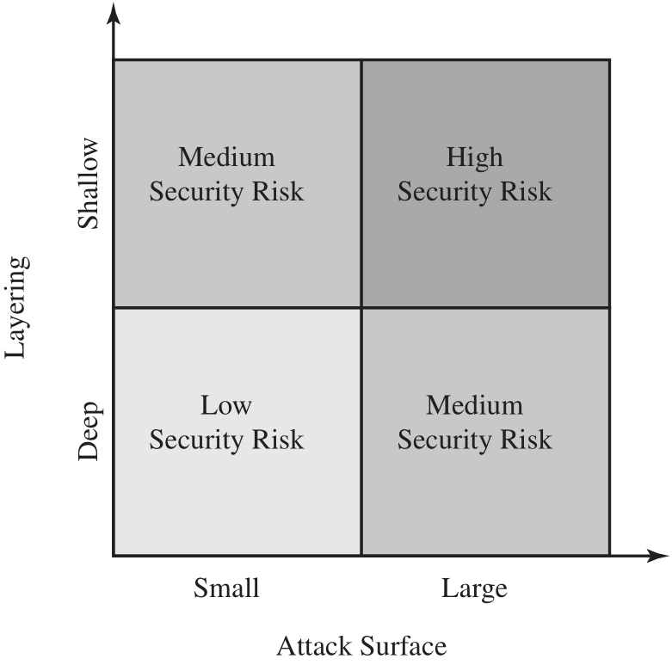
Defense in Depth and Attack Surface

Slide 65
Attack Trees 攻擊樹
An attack tree is a branching, hierarchical data structure that represents a set of potential techniques for exploiting security vulnerabilities 潛在的弱點與攻擊
The security incident that is the goal of the attack is represented as the root node of the tree, and the ways by which an attacker could reach that goal are iteratively and incrementally represented as branches and subnodes of the tree.
Each subnode defines a subgoal, and each subgoal may have its own set of further subgoals, and so on.
The final nodes on the paths outward from the root, that is, the leaf nodes, represent different ways to initiate an attack

Slide 66
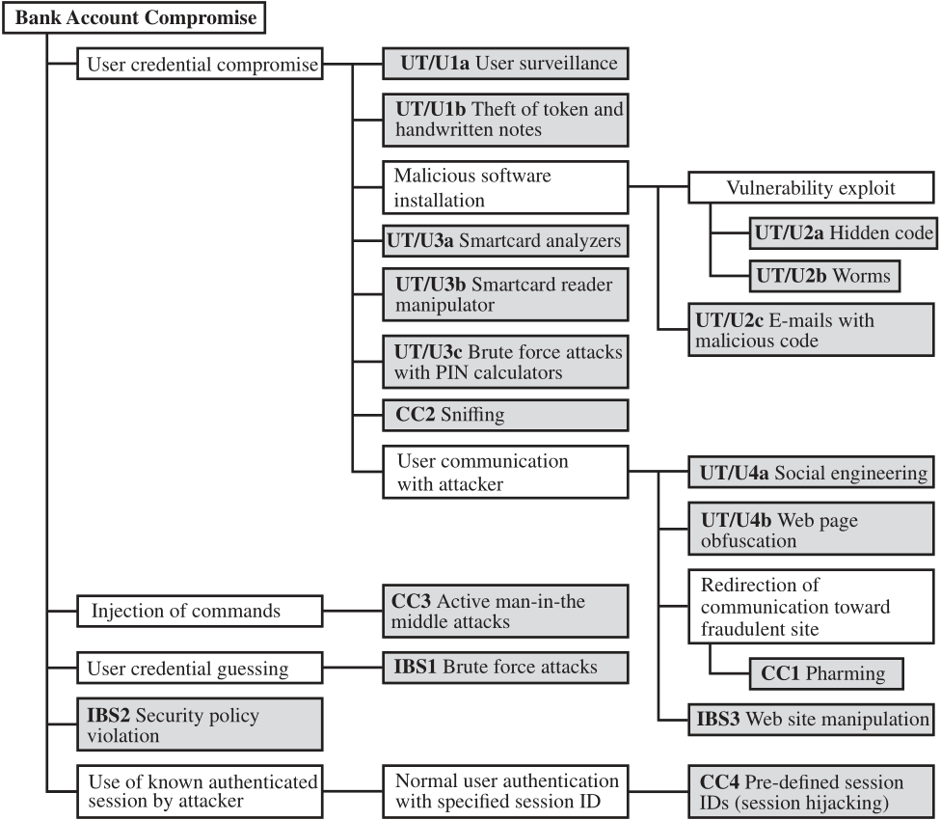
An Attack Tree for
Internet Banking Authentication
獲取用戶憑證
UT/U: User terminal and user
CC: Communications channel
IBS: Internet banking server
命令注入
猜測用戶憑證
違反安全政策
Notes:
An attack tree is a branching, hierarchical data structure that represents a set of
potential techniques for exploiting security vulnerabilities [MAUW05, MOOR01,
SCHN99]. The security incident that is the goal of the attack is represented as the
root node of the tree, and the ways that an attacker could reach that goal are iteratively
and incrementally represented as branches and subnodes of the tree. Each
subnode defines a subgoal, and each subgoal may have its own set of further subgoals,
etc. The final nodes on the paths outward from the root, i.e., the leaf nodes,
represent different ways to initiate an attack. Each node other than a leaf is either
an AND-node or an OR-node. To achieve the goal represented by an AND-node,
the subgoals represented by all of that node’s subnodes must be achieved; and for
an OR-node, at least one of the subgoals must be achieved. Branches can be labeled
with values representing difficulty, cost, or other attack attributes, so that alternative
attacks can be compared.
The motivation for the use of attack trees is to effectively exploit the information
available on attack patterns. Organizations such as CERT publish security
advisories that have enabled the development of a body of knowledge about both
general attack strategies and specific attack patterns. Security analysts can use the
attack tree to document security attacks in a structured form that reveals key vulnerabilities.
The attack tree can guide both the design of systems and applications,
and the choice and strength of countermeasures.
Figure 1.5, based on a figure in [DIMI07], is an example of an attack tree analysis
for an Internet banking authentication application. The root of the tree is the objective
of the attacker, which is to compromise a user’s account. The shaded boxes on the tree
are the leaf nodes, which represent events that comprise the attacks. The white boxes
are categories which consist of one or more specific attack events (leaf nodes). Note
that in this tree, all the nodes other than leaf nodes are OR-nodes. The analysis used
to generate this tree considered the three components involved in authentication:
• User terminal and user (UT/U): These attacks target the user equipment,
including the tokens that may be involved, such as smartcards or other password
generators, as well as the actions of the user.
• Communications channel (CC): This type of attack focuses on communication
links.
• Internet banking server (IBS): These types of attacks are offline attack against
the servers that host the Internet banking application.
Five overall attack strategies can be identified, each of which exploits one or
more of the three components. The five strategies are as follows:
• User credential compromise: This strategy can be used against many elements
of the attack surface. There are procedural attacks, such as monitoring a user’s
action to observe a PIN or other credential, or theft of the user’s token or
handwritten notes. An adversary may also compromise token information using
a variety of token attack tools, such as hacking the smartcard or using a brute
force approach to guess the PIN. Another possible strategy is to embed malicious
software to compromise the user’s login and password. An adversary may
also attempt to obtain credential information via the communication channel
(sniffing). Finally, an adversary may use various means to engage in communication
with the target user, as shown in Figure 1.5.
• Injection of commands: In this type of attack, the attacker is able to intercept
communication between the UT and the IBS. Various schemes can be used to
be able to impersonate the valid user and so gain access to the banking system.
• User credential guessing: It is reported in [HILT06] that brute force
attacks against some banking authentication schemes are feasible by sending
random usernames and passwords. The attack mechanism is based on
distributed zombie personal computers, hosting automated programs for
username- or password-based calculation.
• Security policy violation: For example, violating the bank’s security policy in
combination with weak access control and logging mechanisms, an employee
may cause an internal security incident and expose a customer’s account.
• Use of known authenticated session: This type of attack persuades or forces the
user to connect to the IBS with a preset session ID. Once the user authenticates
to the server, the attacker may utilize the known session ID to send packets to
the IBS, spoofing the user’s identity.
Figure 1.5 provides a thorough view of the different types of attacks on an
Internet banking authentication application. Using this tree as a starting point, security
analysts can assess the risk of each attack and, using the design principles outlined
in the preceding section, design a comprehensive security facility. [DIMO07]
provides a good account of the results of this design effort.

Slide 67
Computer Security Strategy
Specification/policy:
What is the security scheme supposed to do?
Implementation/mechanisms:
How does it do it?
Correctness/assurance:
Does it really work?

Slide 68
Security Policy 安全政策
An informal description of desired system behavior
Reference requirements for security, integrity, and availability.
A formal statement of rules and practices that specify or regulate how a system or organization provides security services to protect sensitive and critical system resources
Being enforced by the system’s technical controls as well as its management and operational controls.
A security manager needs to consider
The value of the assets being protected
The vulnerabilities of the system
Potential threats and the likelihood of attacks

Slide 69
Security Policy Trade-offs 權衡取捨
Ease of use versus security
Access control 安檢嚴格=>使用不便
Firewalls 防火牆條件嚴格=>傳輸變慢
Virus-checking 病毒檢查嚴格=>電腦變慢
Cost of security versus cost of failure and recovery
Balance against
The cost of security failure
The cost of system/assets recovery
The value of the assets being protected
The damages resulting from a security violation
The risk: the probability that a particular threat will exploit

Slide 70
Security Implementation 實施
Prevention 預防
Ideal: no attack is successful
Absolute protection is not feasible
Detection 檢測
Detect security attacks
Response 反應
Halt on-going attacks and prevent further damage
Recovery 恢復
Backup/Restore
If data integrity is compromised, a prior, correct copy can be reloaded

Slide 71
Assurance and Evaluation 確保和評估
Assurance is an attribute of an information system that provides grounds for having confidence that the system operates such that the system’s security policy is enforced.
System design and system implementation
“Does the security system design meet its requirements?” and “Does the security system implementation meet its specifications?”
Expressed as a degree of confidence
Evaluation is the process of examining a computer product or system with respect to certain criteria.
Involves testing and may also formal analytic or mathematical techniques.
Development of evaluation criteria

Slide 72
Standards
Standards have been developed to cover management practices and the overall architecture of security mechanisms and services
The most important of these organizations are:
National Institute of Standards and Technology (NIST)
Internet Society (ISOC)
International Telecommunication Union (ITU-T)
International Organization for Standardization (ISO)
Notes:
Many of the security techniques and applications described in this book have been
specified as standards. Additionally, standards have been developed to cover management
practices and the overall architecture of security mechanisms and services.
Throughout this book, we will describe the most important standards in use or that
are being developed for various aspects of computer security. Various organizations
have been involved in the development or promotion of these standards. The most
important (in the current context) of these organizations are as follows:
• National Institute of Standards and Technology: NIST is a U.S. federal agency
that deals with measurement science, standards, and technology related to U.S.
government use and to the promotion of U.S. private sector innovation. Despite
its national scope, NIST Federal Information Processing Standards (FIPS) and
Special Publications (SP) have a worldwide impact.
Internet Society: ISOC is a professional membership society with worldwide
organizational and individual membership. It provides leadership in addressing
issues that confront the future of the Internet, and is the organization home
for the groups responsible for Internet infrastructure standards, including the
Internet Engineering Task Force (IETF) and the Internet Architecture Board
(IAB). These organizations develop Internet standards and related specifications,
all of which are published as Requests for Comments (RFCs).
• ITU-T: The International Telecommunication Union (ITU) is a United Nations
agency in which governments and the private sector coordinate global telecom
networks and services. The ITU Telecommunication Standardization Sector
(ITU-T) is one of the three sectors of the ITU. ITU-T’s mission is the production
of standards covering all fields of telecommunications. ITU-T standards
are referred to as Recommendations.
• ISO: The International Organization for Standardization (ISO) is a worldwide
federation of national standards bodies from more than 140 countries. ISO is a
nongovernmental organization that promotes the development of standardization
and related activities with a view to facilitating the international exchange
of goods and services, and to developing cooperation in the spheres of intellectual,
scientific, technological, and economic activity. ISO’s work results in
international agreements that are published as International Standards.

Slide 73
National Institute of Standards and Technology (NIST)
NIST is a U.S. federal agency that deals with measurement science, standards, and technology related to U.S. government use and to the promotion of U.S. private sector innovation.
FIPS: Federal Information Processing Standards
SP: Special Publications
Notes:
Many of the security techniques and applications described in this book have been
specified as standards. Additionally, standards have been developed to cover management
practices and the overall architecture of security mechanisms and services.
Throughout this book, we will describe the most important standards in use or that
are being developed for various aspects of computer security. Various organizations
have been involved in the development or promotion of these standards. The most
important (in the current context) of these organizations are as follows:
• National Institute of Standards and Technology: NIST is a U.S. federal agency
that deals with measurement science, standards, and technology related to U.S.
government use and to the promotion of U.S. private sector innovation. Despite
its national scope, NIST Federal Information Processing Standards (FIPS) and
Special Publications (SP) have a worldwide impact.
Internet Society: ISOC is a professional membership society with worldwide
organizational and individual membership. It provides leadership in addressing
issues that confront the future of the Internet, and is the organization home
for the groups responsible for Internet infrastructure standards, including the
Internet Engineering Task Force (IETF) and the Internet Architecture Board
(IAB). These organizations develop Internet standards and related specifications,
all of which are published as Requests for Comments (RFCs).
• ITU-T: The International Telecommunication Union (ITU) is a United Nations
agency in which governments and the private sector coordinate global telecom
networks and services. The ITU Telecommunication Standardization Sector
(ITU-T) is one of the three sectors of the ITU. ITU-T’s mission is the production
of standards covering all fields of telecommunications. ITU-T standards
are referred to as Recommendations.
• ISO: The International Organization for Standardization (ISO) is a worldwide
federation of national standards bodies from more than 140 countries. ISO is a
nongovernmental organization that promotes the development of standardization
and related activities with a view to facilitating the international exchange
of goods and services, and to developing cooperation in the spheres of intellectual,
scientific, technological, and economic activity. ISO’s work results in
international agreements that are published as International Standards.

Slide 74
Internet Society (ISOC)
ISOC is a professional membership society with worldwide organizational and individual membership.
It provides leadership in addressing issues that confront the future of the Internet
Groups responsible for Internet infrastructure standards
IETF: Internet Engineering Task Force
IAB: Internet Architecture Board
These organizations develop Internet standards and related specifications, all of which are published as RFCs
RFC: Requests for Comments
Notes:
Many of the security techniques and applications described in this book have been
specified as standards. Additionally, standards have been developed to cover management
practices and the overall architecture of security mechanisms and services.
Throughout this book, we will describe the most important standards in use or that
are being developed for various aspects of computer security. Various organizations
have been involved in the development or promotion of these standards. The most
important (in the current context) of these organizations are as follows:
• National Institute of Standards and Technology: NIST is a U.S. federal agency
that deals with measurement science, standards, and technology related to U.S.
government use and to the promotion of U.S. private sector innovation. Despite
its national scope, NIST Federal Information Processing Standards (FIPS) and
Special Publications (SP) have a worldwide impact.
Internet Society: ISOC is a professional membership society with worldwide
organizational and individual membership. It provides leadership in addressing
issues that confront the future of the Internet, and is the organization home
for the groups responsible for Internet infrastructure standards, including the
Internet Engineering Task Force (IETF) and the Internet Architecture Board
(IAB). These organizations develop Internet standards and related specifications,
all of which are published as Requests for Comments (RFCs).
• ITU-T: The International Telecommunication Union (ITU) is a United Nations
agency in which governments and the private sector coordinate global telecom
networks and services. The ITU Telecommunication Standardization Sector
(ITU-T) is one of the three sectors of the ITU. ITU-T’s mission is the production
of standards covering all fields of telecommunications. ITU-T standards
are referred to as Recommendations.
• ISO: The International Organization for Standardization (ISO) is a worldwide
federation of national standards bodies from more than 140 countries. ISO is a
nongovernmental organization that promotes the development of standardization
and related activities with a view to facilitating the international exchange
of goods and services, and to developing cooperation in the spheres of intellectual,
scientific, technological, and economic activity. ISO’s work results in
international agreements that are published as International Standards.

Slide 75
International Telecommunication Union (ITU-T)
The International Telecommunication Union (ITU) is a United Nations agency in which governments and the private sector coordinate global telecom networks and services.
The ITU Telecommunication Standardization Sector (ITU-T) is one of the three sectors of the ITU.
ITU-T’s mission is the production of standards covering all fields of telecommunications.
ITU-T standards are referred to as Recommendations.
Notes:
Many of the security techniques and applications described in this book have been
specified as standards. Additionally, standards have been developed to cover management
practices and the overall architecture of security mechanisms and services.
Throughout this book, we will describe the most important standards in use or that
are being developed for various aspects of computer security. Various organizations
have been involved in the development or promotion of these standards. The most
important (in the current context) of these organizations are as follows:
• National Institute of Standards and Technology: NIST is a U.S. federal agency
that deals with measurement science, standards, and technology related to U.S.
government use and to the promotion of U.S. private sector innovation. Despite
its national scope, NIST Federal Information Processing Standards (FIPS) and
Special Publications (SP) have a worldwide impact.
Internet Society: ISOC is a professional membership society with worldwide
organizational and individual membership. It provides leadership in addressing
issues that confront the future of the Internet, and is the organization home
for the groups responsible for Internet infrastructure standards, including the
Internet Engineering Task Force (IETF) and the Internet Architecture Board
(IAB). These organizations develop Internet standards and related specifications,
all of which are published as Requests for Comments (RFCs).
• ITU-T: The International Telecommunication Union (ITU) is a United Nations
agency in which governments and the private sector coordinate global telecom
networks and services. The ITU Telecommunication Standardization Sector
(ITU-T) is one of the three sectors of the ITU. ITU-T’s mission is the production
of standards covering all fields of telecommunications. ITU-T standards
are referred to as Recommendations.
• ISO: The International Organization for Standardization (ISO) is a worldwide
federation of national standards bodies from more than 140 countries. ISO is a
nongovernmental organization that promotes the development of standardization
and related activities with a view to facilitating the international exchange
of goods and services, and to developing cooperation in the spheres of intellectual,
scientific, technological, and economic activity. ISO’s work results in
international agreements that are published as International Standards.

Slide 76
International Organization for Standardization (ISO)
The International Organization for Standardization (ISO) is a worldwide federation of national standards bodies from more than 140 countries.
ISO is a nongovernmental organization that promotes the development of standardization and related activities
with a view to facilitating the international exchange of goods and services, and
to developing cooperation in the spheres of intellectual, scientific, technological, and economic activity.
ISO’s work results in international agreements that are published as International Standards.
Notes:
Many of the security techniques and applications described in this book have been
specified as standards. Additionally, standards have been developed to cover management
practices and the overall architecture of security mechanisms and services.
Throughout this book, we will describe the most important standards in use or that
are being developed for various aspects of computer security. Various organizations
have been involved in the development or promotion of these standards. The most
important (in the current context) of these organizations are as follows:
• National Institute of Standards and Technology: NIST is a U.S. federal agency
that deals with measurement science, standards, and technology related to U.S.
government use and to the promotion of U.S. private sector innovation. Despite
its national scope, NIST Federal Information Processing Standards (FIPS) and
Special Publications (SP) have a worldwide impact.
Internet Society: ISOC is a professional membership society with worldwide
organizational and individual membership. It provides leadership in addressing
issues that confront the future of the Internet, and is the organization home
for the groups responsible for Internet infrastructure standards, including the
Internet Engineering Task Force (IETF) and the Internet Architecture Board
(IAB). These organizations develop Internet standards and related specifications,
all of which are published as Requests for Comments (RFCs).
• ITU-T: The International Telecommunication Union (ITU) is a United Nations
agency in which governments and the private sector coordinate global telecom
networks and services. The ITU Telecommunication Standardization Sector
(ITU-T) is one of the three sectors of the ITU. ITU-T’s mission is the production
of standards covering all fields of telecommunications. ITU-T standards
are referred to as Recommendations.
• ISO: The International Organization for Standardization (ISO) is a worldwide
federation of national standards bodies from more than 140 countries. ISO is a
nongovernmental organization that promotes the development of standardization
and related activities with a view to facilitating the international exchange
of goods and services, and to developing cooperation in the spheres of intellectual,
scientific, technological, and economic activity. ISO’s work results in
international agreements that are published as International Standards.

Slide 77
Summary
Computer security concepts
Definition
Challenges
Model
Threats, attacks, and assets
Threats and attacks
Threats and assets
Security functional requirements
Fundamental security design principles
Attack surfaces and attack trees
Attack surfaces
Attack trees
Computer security strategy
Security policy
Security implementation
Assurance and evaluation
Standards
Notes:
Chapter 1 summary.

Slide 78
Review Questions
What is meant by the CIA triad?
What is the difference between data integrity and system integrity?
List and briefly define the kinds of threat consequences and the types of threat actions which cause these consequences.
List and briefly define the fundamental security design principles.
What is a security policy? What are the actions involved when implementing a security policy?
Differentiate between a network attack surface and a software attack surface.

