Slide 1
資訊安全 Chapter 2 Cryptographic Tools 密碼學工具
Joseph Deng
josephdeng@g2.usc.edu.tw

Slide 2
Outline 大綱
Confidentiality with Symmetric Encryption
Message Authentication and Hash Functions
Public-Key Encryption
Digital Signatures and Key Management
Random and Pseudorandom Numbers
Practical Application: Encryption of Stored Data

Slide 3
Symmetric Encryption
The universal technique for providing confidentiality for transmitted or stored data
Also referred to as conventional encryption or single-key encryption
Two requirements for secure use:
Need a strong encryption algorithm
Sender and receiver must have obtained copies of the secret key in a secure fashion and must keep the key secure
Notes:
The universal technique for providing confidentiality for transmitted or stored
data is symmetric encryption.
This section introduces the basic concept of symmetric encryption. This is followed by an overview of the two most important symmetric encryption algorithms: the Data Encryption Standard (DES) and the Advanced Encryption Standard (AES), which are block encryption algorithms. Finally, this section introduces the concept of symmetric stream encryption algorithms.
Symmetric encryption, also referred to as conventional encryption or single-key
encryption, was the only type of encryption in use prior to the introduction of public-key
encryption in the late 1970s. Countless individuals and groups, from Julius Caesar to the
German U-boat force to present-day diplomatic, military, and commercial users, have
used symmetric encryption for secret communication. It remains the more widely used
of the two types of encryption.
There are two requirements for secure use of symmetric encryption:
1. We need a strong encryption algorithm. At a minimum, we would like the
algorithm to be such that an opponent who knows the algorithm and has
access to one or more ciphertexts would be unable to decipher the ciphertext
or figure out the key. This requirement is usually stated in a stronger form:
The opponent should be unable to decrypt ciphertext or discover the key even
if he or she is in possession of a number of ciphertexts together with the plaintext
that produced each ciphertext.
2. Sender and receiver must have obtained copies of the secret key in a secure
fashion and must keep the key secure. If someone can discover the key and
knows the algorithm, all communication using this key is readable.

Slide 4
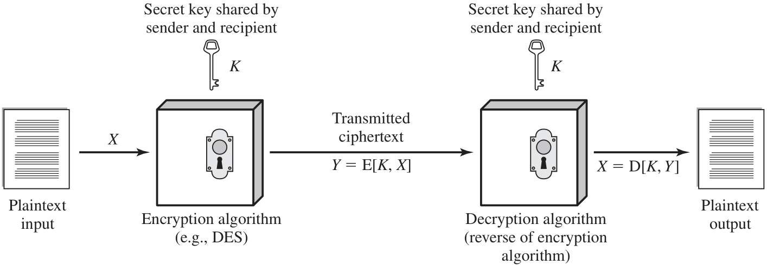
Simplified Model of Symmetric Encryption
Notes:
A symmetric encryption scheme has five ingredients (Figure 2.1):
• Plaintext: This is the original message or data that is fed into the algorithm as
input.
• Encryption algorithm: The encryption algorithm performs various substitutions
and transformations on the plaintext.
• Secret key: The secret key is also input to the encryption algorithm. The exact
substitutions and transformations performed by the algorithm depend on the
key.
• Ciphertext: This is the scrambled message produced as output. It depends on
the plaintext and the secret key. For a given message, two different keys will
produce two different ciphertexts.
• Decryption algorithm: This is essentially the encryption algorithm run in
reverse. It takes the ciphertext and the secret key and produces the original
plaintext.

Slide 5
Attacking Symmetric Encryption
Cryptanalytic Attacks
Brute-Force Attacks
Rely on:
Nature of the algorithm
Some knowledge of the general characteristics of the plaintext
Some sample plaintext-ciphertext pairs
Exploits the characteristics of the algorithm to attempt to deduce a specific plaintext or the key being used
If successful all future and past messages encrypted with that key are compromised
Try all possible keys on some ciphertext until an intelligible translation into plaintext is obtained
On average half of all possible keys must be tried to achieve success
Notes:
There are two general approaches to attacking a symmetric encryption
scheme. The first attack is known as cryptanalysis. Cryptanalytic attacks rely on
the nature of the algorithm plus perhaps some knowledge of the general characteristics
of the plaintext or even some sample plaintext-ciphertext pairs. This type of
attack exploits the characteristics of the algorithm to attempt to deduce a specific
plaintext or to deduce the key being used. If the attack succeeds in deducing the
key, the effect is catastrophic: All future and past messages encrypted with that key
are compromised.
The second method, known as the brute-force attack, is to try every possible
key on a piece of ciphertext until an intelligible translation into plaintext is obtained.
On average, half of all possible keys must be tried to achieve success.

Slide 6
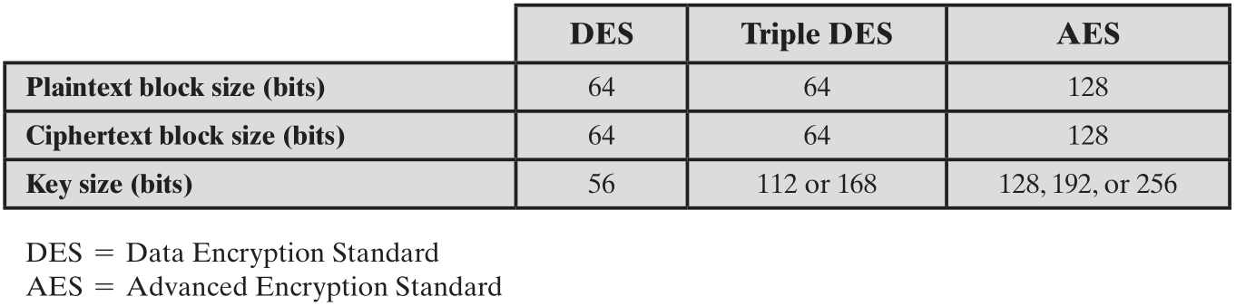
Comparison of Three Popular Symmetric Encryption Algorithms
Notes:
The most commonly used symmetric encryption algorithms are block ciphers. A block cipher processes the plaintext input in fixed-size blocks and produces a block of ciphertext of equal size for each plaintext block. The algorithm processes longer plaintext amounts as a series of fixed-size blocks. The most important symmetric algorithms, all of which are block ciphers, are the Data Encryption Standard (DES), triple DES, and the Advanced Encryption Standard (AES); see Table 2.1. This subsection provides an overview of these algorithms. Chapter 20 presents the technical details.

Slide 7
Data Encryption Standard (DES)
Until recently was the most widely used encryption scheme
FIPS PUB 46
Referred to as the Data Encryption Algorithm (DEA)
Uses 64 bit plaintext block and 56 bit key to produce a 64 bit ciphertext block
Strength concerns:
Concerns about the algorithm itself
DES is the most studied encryption algorithm in existence
Concerns about the use of a 56-bit key
The speed of commercial off-the-shelf processors makes this key length woefully inadequate
Notes:
Until recently, the most widely used encryption
scheme was based on the Data Encryption Standard (DES) adopted in 1977 by the
National Bureau of Standards, now the National Institute of Standards and Technology
(NIST), as FIPS PUB 46 (Data Encryption Standard , January 1977). The
algorithm itself is referred to as the Data Encryption Algorithm (DEA). DES takes a
plaintext block of 64 bits and a key of 56 bits, to produce a ciphertext block of 64 bits.
Concerns about the strength of DES fall into two categories: concerns about the
algorithm itself, and concerns about the use of a 56-bit key. The first concern refers to
the possibility that cryptanalysis is possible by exploiting the characteristics of the DES
algorithm. Over the years, there have been numerous attempts to find and exploit weaknesses
in the algorithm, making DES the most-studied encryption algorithm in existence.
Despite numerous approaches, no one has so far reported a fatal weakness in DES.
A more serious concern is key length. With a key length of 56 bits, there are 2⁵⁶
possible keys, which is approximately 7.2 x 10¹⁶ keys. Given the speed of commercial
off-the-shelf processors, this key length is woefully inadequate. A paper from Seagate
Technology [SEAG08] suggests that a rate of one billion (10⁹ ) key combinations per
second is reasonable for today’s multicore computers. Recent offerings confirm this.
Both Intel and AMD now offer hardware-based instructions to accelerate the use
of AES. Tests run on a contemporary multicore Intel machine resulted in an encryption
rate of about half a billion encryptions per second [BASU12]. Another recent
analysis suggests that with contemporary supercomputer technology, a rate of 10¹³
encryptions/s is reasonable [AROR12].

Slide 8
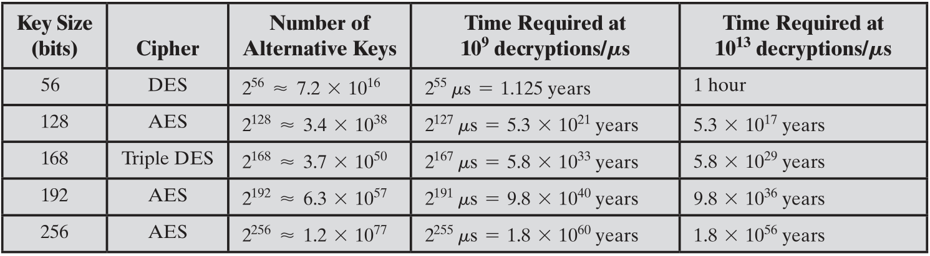
Average Time Required for Exhaustive Key Search
Notes:
Table 2.2 shows how much time is required for
a brute-force attack for various key sizes. As can be seen, a single PC can break
DES in about a year; if multiple PCs work in parallel, the time is drastically shortened.
And today’s supercomputers should be able to find a key in about an hour.
Key sizes of 128 bits or greater are effectively unbreakable using simply a brute-force
approach. Even if we managed to speed up the attacking system by a factor
of 1 trillion (10¹² ), it would still take over 100,000 years to break a code using a
128-bit key.

Slide 9
Triple DES (3DES)
Repeats basic DES algorithm three times using either two or three unique keys
First standardized for use in financial applications in ANSI standard X9.17 in 1985
Attractions:
168-bit key length overcomes the vulnerability to brute-force attack of DES
Underlying encryption algorithm is the same as in DES
Drawbacks:
Algorithm is sluggish in software
Uses a 64-bit block size
Notes:
The life of DES was extended by the use of triple DES (3DES),
which involves repeating the basic DES algorithm three times, using either two
or three unique keys, for a key size of 112 or 168 bits. Triple DES (3DES) was
first standardized for use in financial applications in ANSI standard X9.17 in 1985.
3DES was incorporated as part of the Data Encryption Standard in 1999, with the
publication of FIPS PUB 46-3.
3DES has two attractions that assure its widespread use over the next few
years. First, with its 168-bit key length, it overcomes the vulnerability to brute-force
attack of DES. Second, the underlying encryption algorithm in 3DES is the same as
in DES. This algorithm has been subjected to more scrutiny than any other encryption
algorithm over a longer period of time, and no effective cryptanalytic attack
based on the algorithm rather than brute force has been found. Accordingly, there
is a high level of confidence that 3DES is very resistant to cryptanalysis. If security
were the only consideration, then 3DES would be an appropriate choice for a standardized
encryption algorithm for decades to come.
The principal drawback of 3DES is that the algorithm is relatively sluggish in
software. The original DES was designed for mid-1970s hardware implementation
and does not produce efficient software code. 3DES, which requires three times as
many calculations as DES, is correspondingly slower. A secondary drawback is that
both DES and 3DES use a 64-bit block size. For reasons of both efficiency and security,
a larger block size is desirable.

Slide 10
Advanced Encryption Standard (AES)
Needed a replacement for 3DES
3DES was not reasonable for long term use
NIST called for proposals for a new AES in 1997
Should have a security strength equal to or better than 3DES
Significantly improved efficiency
Symmetric block cipher
128 bit data and 128/192/256 bit keys
Selected Rijndael in November 2001
Published as FIPS 197
Notes:
Because of its drawbacks, 3DES is not a
reasonable candidate for long-term use. As a replacement, NIST in 1997 issued a
call for proposals for a new Advanced Encryption Standard (AES), which should
have a security strength equal to or better than 3DES and significantly improved
efficiency. In addition to these general requirements, NIST specified that AES must
be a symmetric block cipher with a block length of 128 bits and support for key
lengths of 128, 192, and 256 bits. Evaluation criteria included security, computational
efficiency, memory requirements, hardware and software suitability, and flexibility.
In a first round of evaluation, 15 proposed algorithms were accepted. A
second round narrowed the field to 5 algorithms. NIST completed its evaluation
process and published a final standard (FIPS PUB 197) in November of 2001. NIST
selected Rijndael as the proposed AES algorithm. AES is now widely available in
commercial products. AES is described in detail in Chapter 20.

Slide 11
Practical Security Issues
Typically symmetric encryption is applied to a unit of data larger than a single 64-bit or 128-bit block
Electronic codebook (ECB) mode is the simplest approach to multiple-block encryption
Each block of plaintext is encrypted using the same key
Cryptanalysts may be able to exploit regularities in the plaintext
Modes of operation
Alternative techniques developed to increase the security of symmetric block encryption for large sequences
Overcomes the weaknesses of ECB
Notes:
Typically, symmetric encryption is applied to a
unit of data larger than a single 64-bit or 128-bit block. E-mail messages, network
packets, database records, and other plaintext sources must be broken up into a
series of fixed-length block for encryption by a symmetric block cipher. The simplest
approach to multiple-block encryption is known as electronic codebook (ECB)
mode, in which plaintext is handled b bits at a time and each block of plaintext is
encrypted using the same key. Typically b =64 or b =128
For lengthy messages, the ECB mode may not be secure. A cryptanalyst may
be able to exploit regularities in the plaintext to ease the task of decryption. For
example, if it is known that the message always starts out with certain predefined
fields, then the cryptanalyst may have a number of known plaintext-ciphertext pairs
to work with.
To increase the security of symmetric block encryption for large sequences
of data, a number of alternative techniques have been developed, called modes of
operation. These modes overcome the weaknesses of ECB; each mode has its own
particular advantages. This topic is explored in Chapter 20.

Slide 12
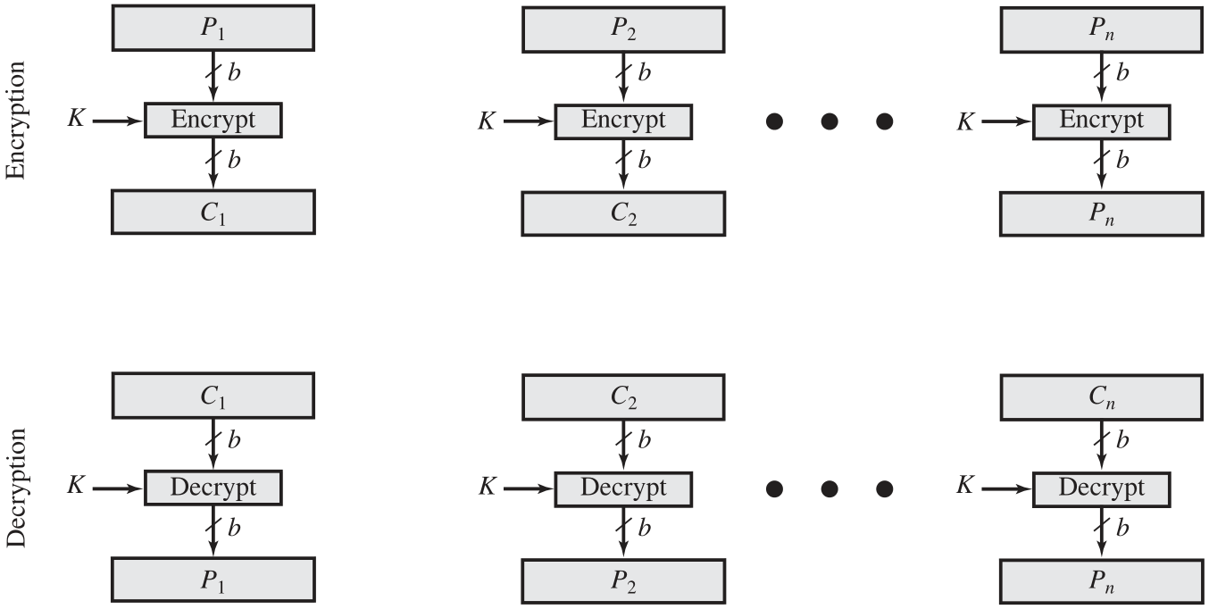
Types of Symmetric Encryption Block Cipher Encryption (Electronic CodeBook Mode)

Slide 13
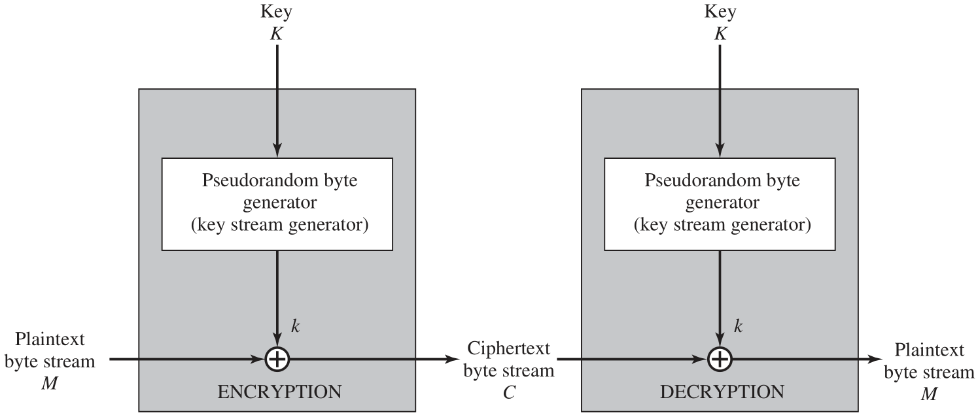
Types of Symmetric Encryption Stream Encryption

Slide 14
Block & Stream Ciphers
Block Cipher
Stream Cipher
Processes the input one block of elements at a time
Produces an output block for each input block
Can reuse keys
More common
Processes the input elements continuously
Produces output one element at a time
Primary advantage is that they are almost always faster and use far less code
Encrypts plaintext one byte at a time
Pseudorandom stream is one that is unpredictable without knowledge of the input key
Notes:
A block cipher processes the input one block of elements at a time, producing an
output block for each input block. A stream cipher processes the input elements
continuously, producing output one element at a time, as it goes along. Although
block ciphers are far more common, there are certain applications in which a stream
cipher is more appropriate. Examples are given subsequently in this book.
A typical stream cipher encrypts plaintext one byte at a time, although a stream
cipher may be designed to operate on one bit at a time or on units larger than a byte
at a time.
With a properly designed pseudorandom number generator, a stream cipher
can be as secure as block cipher of comparable key length. The primary advantage
of a stream cipher is that stream ciphers are almost always faster and use far less
code than do block ciphers. The advantage of a block cipher is that you can reuse
keys. For applications that require encryption/decryption of a stream of data, such as
over a data communications channel or a browser/Web link, a stream cipher might
be the better alternative. For applications that deal with blocks of data, such as file
transfer, e-mail, and database, block ciphers may be more appropriate. However,
either type of cipher can be used in virtually any application.

Slide 15
Message Authentication
Protects against active attacks
Verifies received message is authentic
Contents have not been altered
From authentic source
Timely and in correct sequence
Can use conventional encryption
Only sender and receiver share a key
Notes:
Encryption protects against passive attack (eavesdropping). A different requirement
is to protect against active attack (falsification of data and transactions). Protection
against such attacks is known as message or data authentication.
A message, file, document, or other collection of data is said to be authentic
when it is genuine and came from its alleged source. Message or data authentication
is a procedure that allows communicating parties to verify that received or stored
messages are authentic. The two important aspects are to verify that the contents of
the message have not been altered and that the source is authentic. We may also wish
to verify a message’s timeliness (it has not been artificially delayed and replayed)
and sequence relative to other messages flowing between two parties. All of these
concerns come under the category of data integrity as described in Chapter 1.
It would seem possible to perform authentication simply by the use of symmetric
encryption. If we assume that only the sender and receiver share a key (which is
as it should be), then only the genuine sender would be able to encrypt a message
successfully for the other participant, provided the receiver can recognize a valid message.
Furthermore, if the message includes an error-detection code and a sequence
number, the receiver is assured that no alterations have been made and that sequencing
is proper. If the message also includes a timestamp, the receiver is assured that the
message has not been delayed beyond that normally expected for network transit.
In fact, symmetric encryption alone is not a suitable tool for data authentication.
To give one simple example, in the ECB mode of encryption, if an attacker
reorders the blocks of ciphertext, then each block will still decrypt successfully.
However, the reordering may alter the meaning of the overall data sequence.
Although sequence numbers may be used at some level (e.g., each IP packet), it is
typically not the case that a separate sequence number will be associated with each
b-bit block of plaintext. Thus, block reordering is a threat.

Slide 16
Message Authentication Without Confidentiality
Message encryption by itself does not provide a secure form of authentication
It is possible to combine authentication and confidentiality in a single algorithm by encrypting a message plus its authentication tag
Typically message authentication is provided as a separate function from message encryption
May be preferable when:
The same message is broadcast to a number of destinations
One side has a heavy load, cannot afford the time to decrypt all incoming messages
Authentication of a computer program in plaintext is an attractive service
Thus, there is a place for both authentication and encryption in meeting security requirements
Notes:
Because the approaches discussed in this section do not encrypt the message,
message confidentiality is not provided. As was mentioned, message encryption by
itself does not provide a secure form of authentication. However, it is possible to combine
authentication and confidentiality in a single algorithm by encrypting a message
plus its authentication tag. Typically, however, message authentication is provided as
a separate function from message encryption. [DAVI89] suggests three situations in
which message authentication without confidentiality is preferable:
1. There are a number of applications in which the same message is broadcast to
a number of destinations. Two examples are notification to users that the network
is now unavailable, and an alarm signal in a control center. It is cheaper
and more reliable to have only one destination responsible for monitoring
authenticity. Thus, the message must be broadcast in plaintext with an associated
message authentication tag. The responsible system performs authentication.
If a violation occurs, the other destination systems are alerted by a
general alarm.
2. Another possible scenario is an exchange in which one side has a heavy load and
cannot afford the time to decrypt all incoming messages. Authentication is carried
out on a selective basis, with messages being chosen at random for checking.
3. Authentication of a computer program in plaintext is an attractive service. The
computer program can be executed without having to decrypt it every time,
which would be wasteful of processor resources. However, if a message authentication
tag were attached to the program, it could be checked whenever assurance
is required of the integrity of the program.
Thus, there is a place for both authentication and encryption in meeting security
requirements.

Slide 17
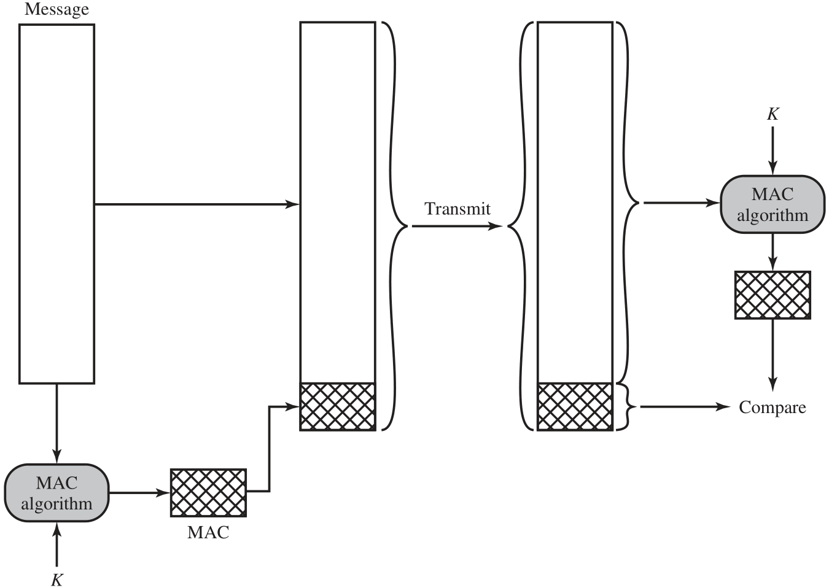
Message Authentication Using a Message Authentication Code (MAC)
Notes:
One authentication technique involves
the use of a secret key to generate a small block of data, known as a message
authentication code, that is appended to the message. This technique assumes that
two communicating parties, say A and B, share a common secret key K_{AB}. When
A has a message to send to B, it calculates the message authentication code as a
complex function of the message and the key: MAC_{M} F(K_{AB}, M). The message
plus code are transmitted to the intended recipient. The recipient performs the same
calculation on the received message, using the same secret key, to generate a new
message authentication code. The received code is compared to the calculated code
(Figure 2.3). If we assume that only the receiver and the sender know the identity of
the secret key, and if the received code matches the calculated code, then
1. The receiver is assured that the message has not been altered. If an attacker
alters the message but does not alter the code, then the receiver’s calculation
of the code will differ from the received code. Because the attacker is assumed
not to know the secret key, the attacker cannot alter the code to correspond to
the alterations in the message.
2. The receiver is assured that the message is from the alleged sender. Because
no one else knows the secret key, no one else could prepare a message with a
proper code.
3. If the message includes a sequence number (such as is used with X.25, HDLC,
and TCP), then the receiver can be assured of the proper sequence, because
an attacker cannot successfully alter the sequence number.
A number of algorithms could be used to generate the code. The now withdrawn
NIST publication FIPS PUB 113 (Computer Data Authentication , May 1985),
recommended the use of DES. However AES would now be a more suitable choice.
DES or AES is used to generate an encrypted version of the message, and some of
the bits of ciphertext are used as the code. A 16- or 32-bit code used to be typical, but
would now be much too small to provide sufficient collision resistance, as we will
discuss shortly.
The process just described is similar to encryption. One difference is that the
authentication algorithm need not be reversible, as it must for decryption. It turns
out that because of the mathematical properties of the authentication function, it is
less vulnerable to being broken than encryption.

Slide 18
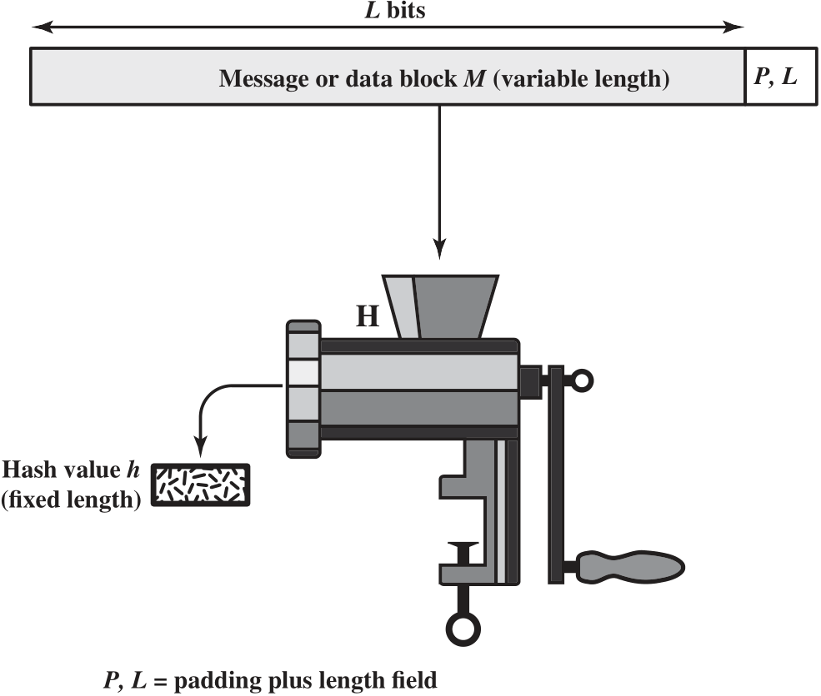
Cryptographic Hash Function; h = H(M)
Notes:
An alternative to the message authentication code is the
one-way hash function. As with the message authentication code, a hash function
accepts a variable-size message M as input and produces a fixed-size message digest
H(M) as output (Figure 2.4). Typically, the message is padded out to an integer multiple
of some fixed length (e.g., 1024 bits) and the padding includes the value of the length
of the original message in bits. The length field is a security measure to increase the
difficulty for an attacker to produce an alternative message with the same hash value.

Slide 19
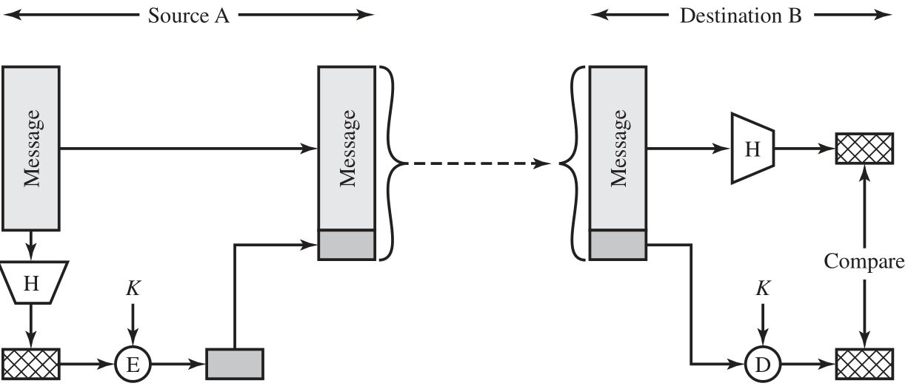
Message Authentication Using a One-Way Hash Function (a) Using symmetric encryption
Notes:
Unlike the MAC, a hash function does not also take a secret key as input.
To authenticate a message, the message digest is sent with the message in such
a way that the message digest is authentic. Figure 2.5 illustrates three ways in
which the message can be authenticated using a hash code. The message digest
can be encrypted using symmetric encryption (part a); if it is assumed that only
the sender and receiver share the encryption key, then authenticity is assured. The
message digest can also be encrypted using public-key encryption (part b); this is
explained in Section 2.3. The public-key approach has two advantages: It provides
a digital signature as well as message authentication; and it does not require the
distribution of keys to communicating parties.
These two approaches have an advantage over approaches that encrypt the
entire message in that less computation is required. But an even more common approach is
the use of a technique that avoids encryption altogether. Several reasons
for this interest are pointed out in [TSUD92]:
• Encryption software is quite slow. Even though the amount of data to be
encrypted per message is small, there may be a steady stream of messages into
and out of a system.
• Encryption hardware costs are non-negligible. Low-cost chip implementations
of DES are available, but the cost adds up if all nodes in a network must have
this capability.
• Encryption hardware is optimized toward large data sizes. For small blocks of
data, a high proportion of the time is spent in initialization/invocation overhead.
• An encryption algorithm may be protected by a patent.
Figure 2.5c shows a technique that uses a hash function but no encryption
for message authentication. This technique, known as a keyed hash MAC, assumes
that two communicating parties, say A and B, share a common secret key K.
This secret key is incorporated into the process of generating a hash code. In the
approach illustrated in Figure 2.5c, when A has a message to send to B, it calculates
the hash function over the concatenation of the secret key and the message:
MD_{M} = H(K ll M ll K). It then sends [ M ii MD_{M}] to B. Because B possesses K, it can
recompute H(K ll M ll K) and verify MD_{M}. Because the secret key itself is not sent, it
should not be possible for an attacker to modify an intercepted message. As long as
the secret key remains secret, it should not be possible for an attacker to generate a
false message.
Note that the secret key is used as both a prefix and a suffix to the message. If
the secret key is used as either only a prefix or only a suffix, the scheme is less secure.
This topic is discussed in Chapter 21. Chapter 21 also describes a scheme known
as HMAC, which is somewhat more complex than the approach of Figure 2.5c and
which has become the standard approach for a keyed hash MAC.

Slide 20
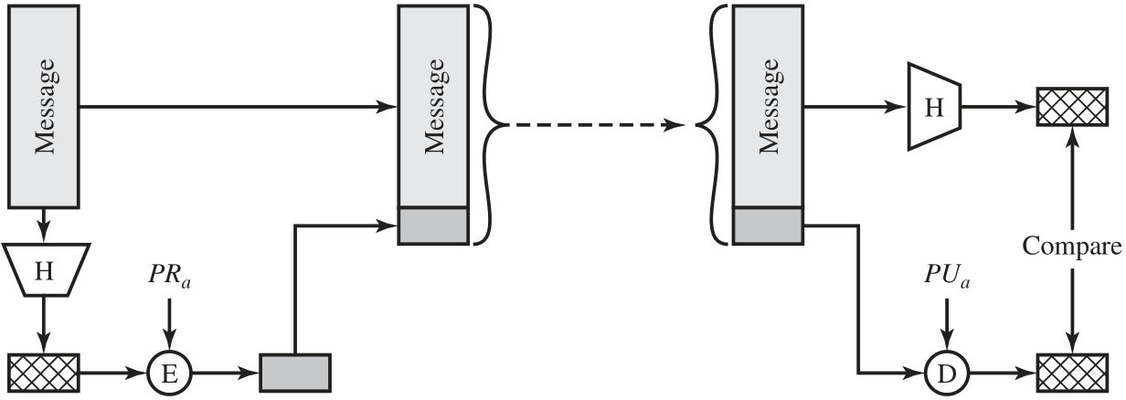
Message Authentication Using a One-Way Hash Function (b) Using public-key encryption
Notes:
Unlike the MAC, a hash function does not also take a secret key as input.
To authenticate a message, the message digest is sent with the message in such
a way that the message digest is authentic. Figure 2.5 illustrates three ways in
which the message can be authenticated using a hash code. The message digest
can be encrypted using symmetric encryption (part a); if it is assumed that only
the sender and receiver share the encryption key, then authenticity is assured. The
message digest can also be encrypted using public-key encryption (part b); this is
explained in Section 2.3. The public-key approach has two advantages: It provides
a digital signature as well as message authentication; and it does not require the
distribution of keys to communicating parties.
These two approaches have an advantage over approaches that encrypt the
entire message in that less computation is required. But an even more common approach is
the use of a technique that avoids encryption altogether. Several reasons
for this interest are pointed out in [TSUD92]:
• Encryption software is quite slow. Even though the amount of data to be
encrypted per message is small, there may be a steady stream of messages into
and out of a system.
• Encryption hardware costs are non-negligible. Low-cost chip implementations
of DES are available, but the cost adds up if all nodes in a network must have
this capability.
• Encryption hardware is optimized toward large data sizes. For small blocks of
data, a high proportion of the time is spent in initialization/invocation overhead.
• An encryption algorithm may be protected by a patent.
Figure 2.5c shows a technique that uses a hash function but no encryption
for message authentication. This technique, known as a keyed hash MAC, assumes
that two communicating parties, say A and B, share a common secret key K.
This secret key is incorporated into the process of generating a hash code. In the
approach illustrated in Figure 2.5c, when A has a message to send to B, it calculates
the hash function over the concatenation of the secret key and the message:
MD_{M} = H(K ll M ll K). It then sends [ M ii MD_{M}] to B. Because B possesses K, it can
recompute H(K ll M ll K) and verify MD_{M}. Because the secret key itself is not sent, it
should not be possible for an attacker to modify an intercepted message. As long as
the secret key remains secret, it should not be possible for an attacker to generate a
false message.
Note that the secret key is used as both a prefix and a suffix to the message. If
the secret key is used as either only a prefix or only a suffix, the scheme is less secure.
This topic is discussed in Chapter 21. Chapter 21 also describes a scheme known
as HMAC, which is somewhat more complex than the approach of Figure 2.5c and
which has become the standard approach for a keyed hash MAC.

Slide 21
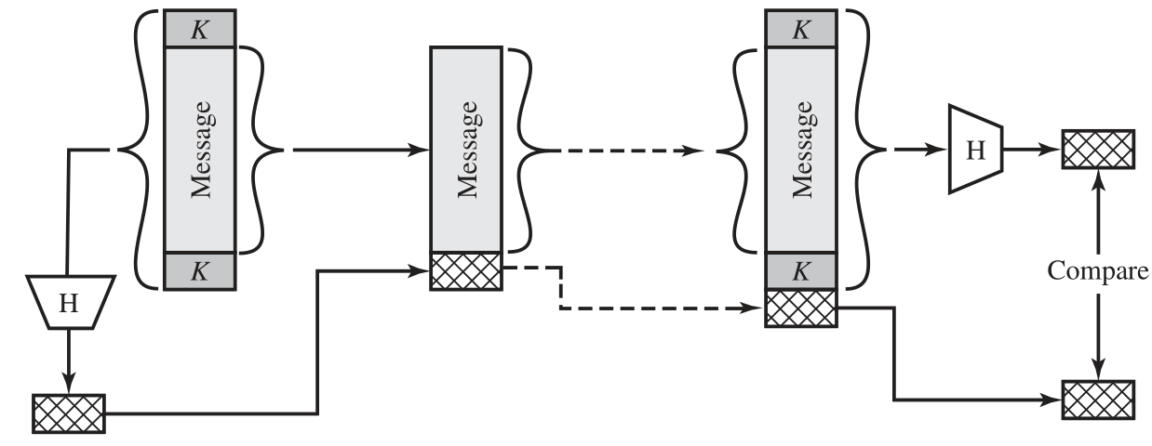
Message Authentication Using a One-Way Hash Function (c) Using secret value
Notes:
Unlike the MAC, a hash function does not also take a secret key as input.
To authenticate a message, the message digest is sent with the message in such
a way that the message digest is authentic. Figure 2.5 illustrates three ways in
which the message can be authenticated using a hash code. The message digest
can be encrypted using symmetric encryption (part a); if it is assumed that only
the sender and receiver share the encryption key, then authenticity is assured. The
message digest can also be encrypted using public-key encryption (part b); this is
explained in Section 2.3. The public-key approach has two advantages: It provides
a digital signature as well as message authentication; and it does not require the
distribution of keys to communicating parties.
These two approaches have an advantage over approaches that encrypt the
entire message in that less computation is required. But an even more common approach is
the use of a technique that avoids encryption altogether. Several reasons
for this interest are pointed out in [TSUD92]:
• Encryption software is quite slow. Even though the amount of data to be
encrypted per message is small, there may be a steady stream of messages into
and out of a system.
• Encryption hardware costs are non-negligible. Low-cost chip implementations
of DES are available, but the cost adds up if all nodes in a network must have
this capability.
• Encryption hardware is optimized toward large data sizes. For small blocks of
data, a high proportion of the time is spent in initialization/invocation overhead.
• An encryption algorithm may be protected by a patent.
Figure 2.5c shows a technique that uses a hash function but no encryption
for message authentication. This technique, known as a keyed hash MAC, assumes
that two communicating parties, say A and B, share a common secret key K.
This secret key is incorporated into the process of generating a hash code. In the
approach illustrated in Figure 2.5c, when A has a message to send to B, it calculates
the hash function over the concatenation of the secret key and the message:
MD_{M} = H(K ll M ll K). It then sends [ M ii MD_{M}] to B. Because B possesses K, it can
recompute H(K ll M ll K) and verify MD_{M}. Because the secret key itself is not sent, it
should not be possible for an attacker to modify an intercepted message. As long as
the secret key remains secret, it should not be possible for an attacker to generate a
false message.
Note that the secret key is used as both a prefix and a suffix to the message. If
the secret key is used as either only a prefix or only a suffix, the scheme is less secure.
This topic is discussed in Chapter 21. Chapter 21 also describes a scheme known
as HMAC, which is somewhat more complex than the approach of Figure 2.5c and
which has become the standard approach for a keyed hash MAC.

Slide 22
To be useful for message authentication, a hash function H must have the following properties:
Can be applied to a block of data of any size
Produces a fixed-length output
H(x) is relatively easy to compute for any given x
One-way or pre-image resistant
Computationally infeasible to find x such that H(x) = h
Computationally infeasible to find y ≠ x such that H(y) = H(x)
Collision resistant or strong collision resistance
Computationally infeasible to find any pair (x,y) such that H(x) = H(y)
Notes:
The purpose of a hash function is to produce a
“fingerprint” of a file, message, or other block of data. To be useful for message
authentication, a hash function H must have the following properties:
1. H can be applied to a block of data of any size.
2. H produces a fixed-length output.
3. H(x) is relatively easy to compute for any given x, making both hardware and
software implementations practical.
4. For any given code h, it is computationally infeasible to find x such that
H(x) h. A hash function with this property is referred to as one-way or preimage
resistant.
5. For any given block x, it is computationally infeasible to find y ≠ x with
H(y) H(x). A hash function with this property is referred to as second preimage
resistant. This is sometimes referred to as weak collision resistant.
6. It is computationally infeasible to find any pair (x, y) such that H(x) H(y).
A hash function with this property is referred to as collision resistant. This is
sometimes referred to as strong collision resistant.
The first three properties are requirements for the practical application of a hash
function to message authentication.
The fourth property is the one-way property: It is easy to generate a code given a
message, but virtually impossible to generate a message given a code. This property is
important if the authentication technique involves the use of a secret value (Figure 2.5c).
The secret value itself is not sent; however, if the hash function is not one way, an attacker
can easily discover the secret value: If the attacker can observe or intercept a transmission,
the attacker obtains the message M and the hash code MD_{M} = H(K || M || K). The attacker
then inverts the hash function to obtain K || M || K = H⁻¹(MD_{M}). Because the attacker now
has both M and K || M || K, it is a trivial matter to recover K.
The fifth property guarantees that it is impossible to find an alternative
message with the same hash value as a given message. This prevents forgery when
an encrypted hash code is used (Figures 2.5a and b). If this property were not true,
an attacker would be capable of the following sequence: First, observe or intercept
a message plus its encrypted hash code; second, generate an unencrypted hash code
from the message; third, generate an alternate message with the same hash code.
A hash function that satisfies the first five properties in the preceding list is
referred to as a weak hash function. If the sixth property is also satisfied, then it
is referred to as a strong hash function. A strong hash function protects against an
attack in which one party generates a message for another party to sign. For example,
suppose Bob gets to write an IOU message, send it to Alice, and she signs it.
Bob finds two messages with the same hash, one of which requires Alice to pay a
small amount and one that requires a large payment. Alice signs the first message
and Bob is then able to claim that the second message is authentic.

Slide 23
Security of Hash Functions
There are two approaches to attacking a secure hash function:
Cryptanalysis
Exploit logical weaknesses in the algorithm
Brute-force attack
Strength of hash function depends solely on the length of the hash code produced by the algorithm
SHA most widely used hash algorithm
Additional secure hash function applications:
Passwords
Hash of a password is stored by an operating system
Intrusion detection
Store H(F) for each file on a system and secure the hash values
Notes:
As with symmetric encryption, there are two
approaches to attacking a secure hash function: cryptanalysis and brute-force attack.
As with symmetric encryption algorithms, cryptanalysis of a hash function involves
exploiting logical weaknesses in the algorithm.
The strength of a hash function against brute-force attacks depends solely on
the length of the hash code produced by the algorithm.
For a hash code of length n,
the level of effort required is proportional to the following:
Preimage resistant 2n
Second preimage resistant 2n
Collision resistant 2n/2
If collision resistance is required (and this is desirable for a general-purpose
secure hash code), then the value 2n/2 determines the strength of the hash code against
brute-force attacks. Van Oorschot and Wiener [VANO94] presented a design for a
$10 million collision search machine for MD5, which has a 128-bit hash length, that
could find a collision in 24 days. Thus a 128-bit code may be viewed as inadequate.
The next step up, if a hash code is treated as a sequence of 32 bits, is a 160-bit hash
length. With a hash length of 160 bits, the same search machine would require over
four thousand years to find a collision. With today’s technology, the time would be
much shorter, so that 160 bits now appears suspect.
In recent years, the most widely used
hash function has been the Secure Hash Algorithm (SHA). SHA was developed
by the National Institute of Standards and Technology (NIST) and published as
a federal information processing standard (FIPS 180) in 1993. When weaknesses
were discovered in SHA, a revised version was issued as FIPS 180-1 in 1995 and is
generally referred to as SHA-1. SHA-1 produces a hash value of 160 bits. In 2002,
NIST produced a revised version of the standard, FIPS 180–2, that defined three
new versions of SHA, with hash value lengths of 256, 384, and 512 bits, known as
SHA-256, SHA-384, and SHA-512. These new versions have the same underlying
structure and use the same types of modular arithmetic and logical binary operations
as SHA-1. In 2005, NIST announced the intention to phase out approval of SHA-1
and move to a reliance on the other SHA versions by 2010. As discussed in Chapter
21, researchers have demonstrated that SHA-1 is far weaker than its 160-bit hash
length suggests, necessitating the move to the newer versions of SHA.
We have discussed the use of hash functions for message authentication and for the
creation of digital signatures (the latter is discussed in more detail later in this chapter).
Here are two other examples of secure hash function applications:
• Passwords: Chapter 3 explains a scheme in which a hash of a password is
stored by an operating system rather than the password itself. Thus, the actual
password is not retrievable by a hacker who gains access to the password file.
In simple terms, when a user enters a password, the hash of that password is
compared to the stored hash value for verification. This application requires
preimage resistance and perhaps second preimage resistance.
• Intrusion detection: Store H(F) for each file on a system and secure the hash
values (e.g., on a CD-R that is kept secure). One can later determine if a file has
been modified by recomputing H(F). An intruder would need to change F without
changing H(F). This application requires weak second preimage resistance

Slide 24
Public-Key Encryption Structure
Publicly proposed by Diffie and Hellman in 1976
Based on mathematical functions
Asymmetric
Uses two separate keys
Public key and private key
Public key is made public for others to use
Some form of protocol is needed for distribution
Notes:
Public-key encryption, first publicly proposed by Diffie and Hellman in 1976
[DIFF76], is the first truly revolutionary advance in encryption in literally thousands
of years. Public-key algorithms are based on mathematical functions rather than on
simple operations on bit patterns, such as are used in symmetric encryption algorithms.
More important, public-key cryptography is asymmetric, involving the use
of two separate keys, in contrast to symmetric encryption, which uses only one key.
The use of two keys has profound consequences in the areas of confidentiality, key
distribution, and authentication.
Before proceeding, we should first mention several common misconceptions
concerning public-key encryption. One is that public-key encryption is more secure
from cryptanalysis than symmetric encryption. In fact, the security of any encryption
scheme depends on (1) the length of the key and (2) the computational work involved
in breaking a cipher. There is nothing in principle about either symmetric or public-key
encryption that makes one superior to another from the point of view of resisting cryptanalysis.
A second misconception is that public-key encryption is a general- purpose
technique that has made symmetric encryption obsolete. On the contrary, because of
the computational overhead of current public-key encryption schemes, there seems no
foreseeable likelihood that symmetric encryption will be abandoned. Finally, there is
a feeling that key distribution is trivial when using public-key encryption, compared to
the rather cumbersome handshaking involved with key distribution centers for symmetric
encryption. For public-key key distribution, some form of protocol is needed,
often involving a central agent, and the procedures involved are no simpler or any
more efficient than those required for symmetric encryption.
As the names suggest, the public key of the pair is made public for others to
use, while the private key is known only to its owner. A general-purpose public-key
cryptographic algorithm relies on one key for encryption and a different but related
key for decryption.

Slide 25
A Public-Key Encryption Scheme has Six Ingredients
Plaintext
Readable message or data that is fed into the algorithm as input
Encryption algorithm
Performs transformations on the plaintext
Public and private key
Pair of keys, one for encryption, one for decryption
Ciphertext
Scrambled message produced as output
Decryption key
Produces the original plaintext
Notes:
A public-key encryption scheme has six ingredients (Figure 2.6a):
• Plaintext: This is the readable message or data that is fed into the algorithm as
input.
• Encryption algorithm: The encryption algorithm performs various transformations
on the plaintext.
• Public and private key: This is a pair of keys that have been selected so that
if one is used for encryption, the other is used for decryption. The exact
transformations performed by the encryption algorithm depend on the public
or private key that is provided as input.
Ciphertext: This is the scrambled message produced as output. It depends on
the plaintext and the key. For a given message, two different keys will produce
two different ciphertexts.
• Decryption algorithm: This algorithm accepts the ciphertext and the matching
key and produces the original plaintext.
As the names suggest, the public key of the pair is made public for others to
use, while the private key is known only to its owner. A general-purpose public-key
cryptographic algorithm relies on one key for encryption and a different but related
key for decryption.
The essential steps are the following:
1. Each user generates a pair of keys to be used for the encryption and decryption
of messages.
2. Each user places one of the two keys in a public register or other accessible
file. This is the public key. The companion key is kept private. As Figure 2.6a
suggests, each user maintains a collection of public keys obtained from others.
3. If Bob wishes to send a private message to Alice, Bob encrypts the message
using Alice’s public key.
4. When Alice receives the message, she decrypts it using her private key. No
other recipient can decrypt the message because only Alice knows Alice’s private
key.
With this approach, all participants have access to public keys, and private keys
are generated locally by each participant and therefore need never be distributed.
As long as a user protects his or her private key, incoming communication is secure.
At any time, a user can change the private key and publish the companion public
key to replace the old public key.
Note that the scheme of Figure 2.6a is directed toward providing confidentiality:
Only the intended recipient should be able to decrypt the ciphertext because only
the intended recipient is in possession of the required private key. Whether in fact
confidentiality is provided depends on a number of factors, including the security of
the algorithm, whether the private key is kept secure, and the security of any protocol
of which the encryption function is a part.

Slide 26
Public-Key Encryption Essential Steps
Each user generates a pair of keys to be used for the encryption and decryption of messages.
Each user places one of the two keys in a public register or other accessible file.
This is the public key.
The companion key is kept private.
Each user maintains a collection of public keys obtained from others.
If Bob wishes to send a private message to Alice, Bob encrypts the message using Alice’s public key.
When Alice receives the message, she decrypts it using her private key.
No other recipient can decrypt the message because only Alice knows Alice’s private key.

Slide 27
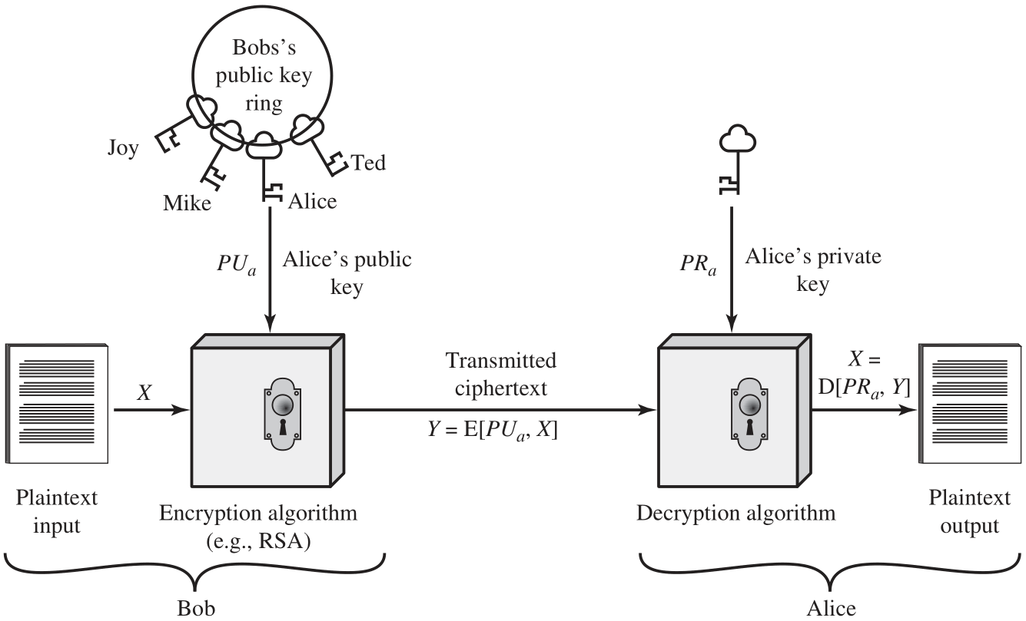
Encryption with Public Key Provide Confidentiality

Slide 28
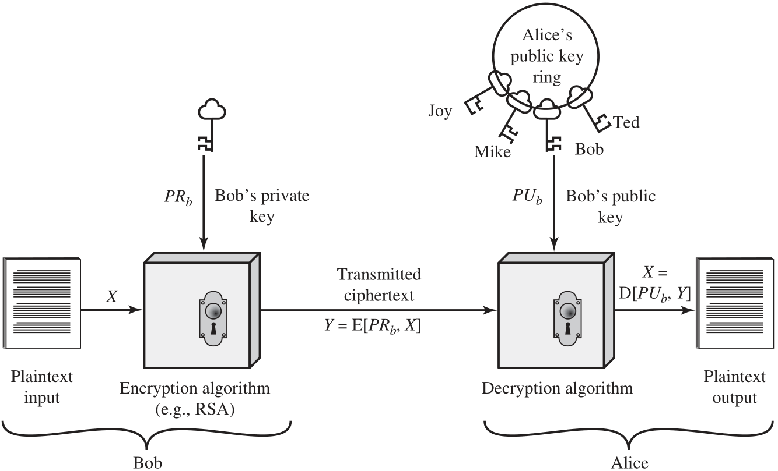
Encryption with Private Key Provide Authentication, Data Integrity

Slide 29
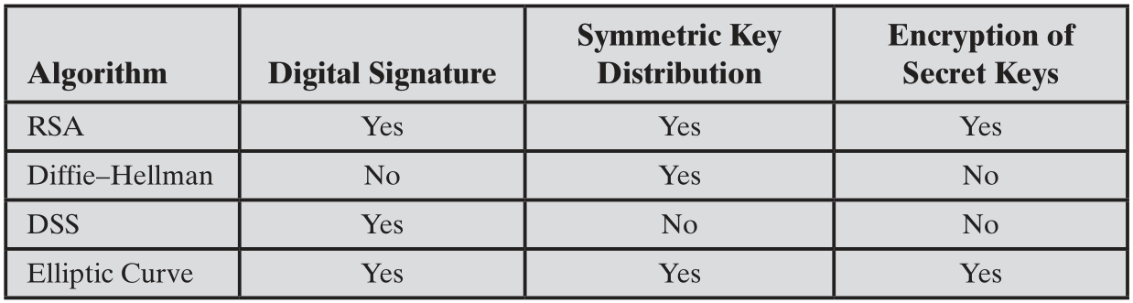
Applications for Public-Key Cryptosystems
Notes:
Public-key systems are characterized by the use of a cryptographic type of algorithm
with two keys, one held private and one available publicly. Depending on the application,
the sender uses either the sender’s private key or the receiver’s public key, or
both, to perform some type of cryptographic function. In broad terms, we can classify
the use of public-key cryptosystems into three categories: digital signature, symmetric
key distribution, and encryption of secret keys.
These applications will be discussed in Section 2.4. Some algorithms are suitable
for all three applications, whereas others can be used only for one or two of
these applications. Table 2.3 indicates the applications supported by the algorithms
discussed in this section.

Slide 30
Requirements for Public-Key Cryptosystems
Computationally easy to create key pairs
Computationally easy for sender knowing public key to encrypt messages
Computationally easy for receiver knowing private key to decrypt ciphertext
Computationally infeasible for opponent to determine private key from public key
Computationally infeasible for opponent to otherwise recover original message
Useful if either key can be used for each role
Notes:
The cryptosystem illustrated in Figure 2.6 depends on a cryptographic algorithm
based on two related keys. Diffie and Hellman postulated this system without demonstrating
that such algorithms exist. However, they did lay out the conditions that
such algorithms must fulfill [DIFF76]:

Slide 31
Asymmetric Encryption Algorithms
RSA (Rivest, Shamir, Adleman)
Developed in 1977
Most widely accepted and implemented approach to public-key encryption
Block cipher in which the plaintext and ciphertext are integers between 0 and n-1 for some n.
Diffie-Hellman key exchange algorithm
Enables two users to securely reach agreement about a shared secret that can be used as a secret key for subsequent symmetric encryption of messages
Limited to the exchange of the keys
Digital Signature Standard (DSS)
Provides only a digital signature function with SHA-1
Cannot be used for encryption or key exchange
Elliptic curve cryptography (ECC)
Security like RSA, but with much smaller keys
Notes:
RSA One of the first public-key schemes was developed in 1977 by Ron Rivest, Adi
Shamir, and Len Adleman at MIT and first published in 1978 [RIVE78]. The RSA
scheme has since reigned supreme as the most widely accepted and implemented
approach to public-key encryption. RSA is a block cipher in which the plaintext and
ciphertext are integers between 0 and n – 1 for some n.
In 1977, the three inventors of RSA dared Scientific American readers to decode
a cipher they printed in Martin Gardner’s “Mathematical Games” column. They
offered a $100 reward for the return of a plaintext sentence, an event they predicted
might not occur for some 40 quadrillion years. In April of 1994, a group working over
the Internet and using over 1600 computers claimed the prize after only eight months
of work [LEUT94]. This challenge used a public-key size (length of n) of 129 decimal
digits, or around 428 bits. This result does not invalidate the use of RSA; it simply
means that larger key sizes must be used. Currently, a 1024-bit key size (about 300
decimal digits) is considered strong enough for virtually all applications.
DIFFIE-HELLMAN KEY AGREEMENT The first published public-key algorithm
appeared in the seminal paper by Diffie and Hellman that defined public-key
cryptography [DIFF76] and is generally referred to as Diffie-Hellman key exchange,
or key agreement. A number of commercial products employ this key exchange
technique.
The purpose of the algorithm is to enable two users to securely reach agreement
about a shared secret that can be used as a secret key for subsequent symmetric
encryption of messages. The algorithm itself is limited to the exchange of the keys.
DIGITAL SIGNATURE STANDARD The National Institute of Standards and Technology
(NIST) has published Federal Information Processing Standard FIPS PUB 186,
known as the Digital Signature Standard (DSS). The DSS makes use of SHA-1
and presents a new digital signature technique, the Digital Signature Algorithm
(DSA). The DSS was originally proposed in
1991 and revised in 1993 in response to public feedback concerning the security of the
scheme. There were further revisions in 1998, 2000, 2009, and most recently in 2013 as
FIPS PUB 186–4. The DSS uses an algorithm that is designed to provide only the digital
signature function. Unlike RSA, it cannot be used for encryption or key exchange.
ELLIPTIC CURVE CRYPTOGRAPHY The vast majority of the products and standards
that use public-key cryptography for encryption and digital signatures use RSA.
The bit length for secure RSA use has increased over recent years, and this has put
a heavier processing load on applications using RSA. This burden has ramifications,
especially for electronic commerce sites that conduct large numbers of secure
transactions. Recently, a competing system has begun to challenge RSA: elliptic
curve cryptography (ECC). Already, ECC is showing up in standardization efforts,
including the IEEE (Institute of Electrical and Electronics Engineers) P1363
Standard for Public-Key Cryptography.
The principal attraction of ECC compared to RSA is that it appears to offer
equal security for a far smaller bit size, thereby reducing processing overhead. On
the other hand, although the theory of ECC has been around for some time, it is
only recently that products have begun to appear and that there has been sustained
cryptanalytic interest in probing for weaknesses. Thus, the confidence level in ECC
is not yet as high as that in RSA.

Slide 32
Digital Signatures
NIST FIPS PUB 186-4 defines a digital signature as:
The result of a cryptographic transformation of data that, when properly implemented, provides a mechanism for verifying origin authentication, data integrity and signatory non-repudiation.
Thus, a digital signature is a data-dependent bit pattern, generated by an agent as a function of a file, message, or other form of data block
FIPS 186-4 specifies the use of one of three digital signature algorithms:
Digital Signature Algorithm (DSA)
RSA Digital Signature Algorithm
Elliptic Curve Digital Signature Algorithm (ECDSA)
Notes:
Public-key encryption can be used for authentication with a technique known as the
digital signature. NIST FIPS PUB 186-4 [Digital Signature Standard (DSS) , July 2013]
defines a digital signature as follows: The result of a cryptographic transformation
of data that, when properly implemented, provides a mechanism for verifying origin
authentication, data integrity and signatory non-repudiation.
Thus, a digital signature is a data-dependent bit pattern, generated by an agent
as a function of a file, message, or other form of data block. Another agent can access
the data block and its associated signature and verify (1) the data block has been
signed by the alleged signer, and (2) the data block has not been altered since the
signing. Further, the signer cannot repudiate the signature.
FIPS 186-4 specifies the use of one of three digital signature algorithms:
• Digital Signature Algorithm (DSA): The original NIST-approved algorithm,
which is based on the difficulty of computing discrete logarithms.
• RSA Digital Signature Algorithm: Based on the RSA public-key algorithm.
• Elliptic Curve Digital Signature Algorithm (ECDSA): Based on elliptic-curve
cryptography.

Slide 33
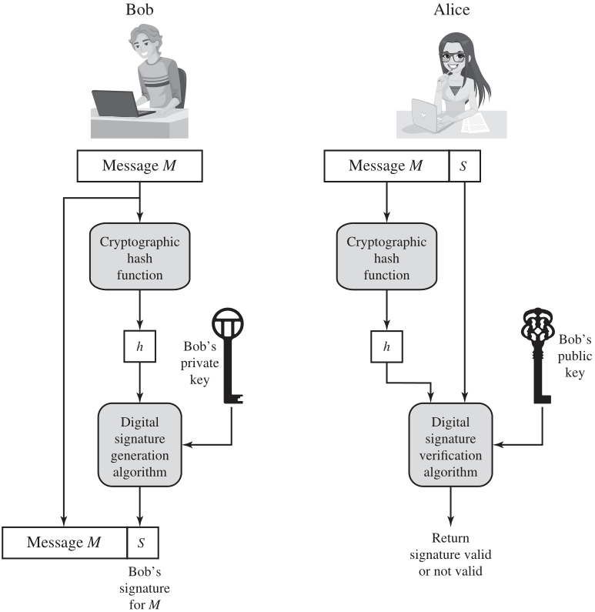
Simplified Depiction of Essential Elements of Digital Signature Process
Notes:
Figure 2.7 is a generic model of the process of making and using digital signatures.
All of the digital signature schemes in FIPS 186-4 have this structure. Suppose
Bob wants to send a message to Alice. Although it is not important that the message
be kept secret, he wants Alice to be certain that the message is indeed from him.
For this purpose, Bob uses a secure hash function, such as SHA-512, to generate a
hash value for the message. That hash value, together with Bob’s private key, serve
as input to a digital signature generation algorithm that produces a short block that
functions as a digital signature. Bob sends the message with the signature attached.
When Alice receives the message plus signature, she (1) calculates a hash value for
the message; (2) provides the hash value and Bob’s public key as inputs to a digital
signature verification algorithm. If the algorithm returns the result that the signature
is valid, Alice is assured that the message must have been signed by Bob. No one else
has Bob’s private key, and therefore no one else could have created a signature that
could be verified for this message with Bob’s public key. In addition, it is impossible to
alter the message without access to Bob’s private key, so the message is authenticated
both in terms of source and in terms of data integrity.
The digital signature does not provide confidentiality. That is, the message being
sent is safe from alteration, but not safe from eavesdropping. This is obvious in the
case of a signature based on a portion of the message, because the rest of the message
is transmitted in the clear. Even in the case of complete encryption, there is no
protection of confidentiality because any observer can decrypt the message by using
the sender’s public key.

Slide 34
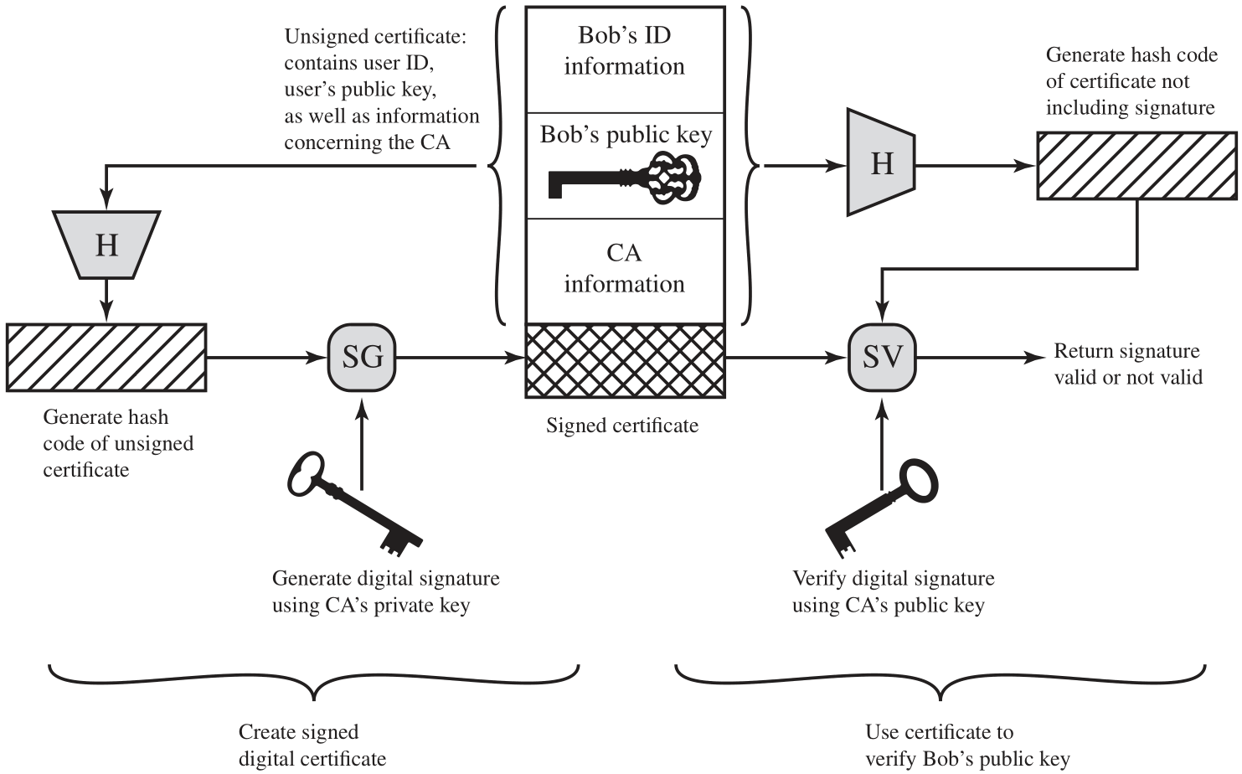
Public-Key Certificate Use
Notes:
On the face of it, the point of public-key encryption is that the public key is public. Thus,
if there is some broadly accepted public-key algorithm, such as RSA, any participant
can send his or her public key to any other participant or broadcast the key to the community
at large. Although this approach is convenient, it has a major weakness. Anyone
can forge such a public announcement. That is, some user could pretend to be Bob and
send a public key to another participant or broadcast such a public key. Until such time
as Bob discovers the forgery and alerts other participants, the forger is able to read all
encrypted messages intended for Bob and can use the forged keys for authentication.
The solution to this problem is the public-key certificate. In essence, a certificate
consists of a public key plus a user ID of the key owner, with the whole block
signed by a trusted third party. The certificate also includes some information about
the third party plus an indication of the period of validity of the certificate. Typically,
the third party is a certificate authority (CA) that is trusted by the user community,
such as a government agency or a financial institution. A user can present his or her
public key to the authority in a secure manner and obtain a signed certificate. The
user can then publish the certificate. Anyone needing this user’s public key can obtain
the certificate and verify that it is valid by means of the attached trusted signature.
Figure 2.8 illustrates the process.
The key steps can be summarized as follows:
1. User software (client) creates a pair of keys: one public and one private.
2. Client prepares an unsigned certificate that includes the user ID and user’s
public key.
3. User provides the unsigned certificate to a CA in some secure manner. This might
require a face-to-face meeting, the use of registered e-mail, or happen via a Web
form with e-mail verification.
4. CA creates a signature as follows:
a. CA uses a hash function to calculate the hash code of the unsigned certificate.
A hash function is one that maps a variable-length data block or message
into a fixed-length value called a hash code, such as SHA family that
we will discuss in Sections 2.2 and 21.1.
b. CA generates digital signature using the CA’s private key and a signature
generation algorithm.
5. CA attaches the signature to the unsigned certificate to create a signed certificate.
6. CA returns the signed certificate to client.
7. Client may provide the signed certificate to any other user.
8. Any user may verify that the certificate is valid as follows:
a. User calculates the hash code of certificate (not including signature).
b. User verifies digital signature using CA’s public key and the signature verification
algorithm. The algorithm returns a result of either signature valid
or invalid.
One scheme has become universally accepted for formatting public-key
certificates: the X.509 standard. X.509 certificates are used in most network security
applications, including IP Security (IPsec), Transport Layer Security (TLS), Secure
Shell (SSH), and Secure/Multipurpose Internet Mail Extension (S/MIME). We will
examine most of these applications in Part Five.

Slide 35
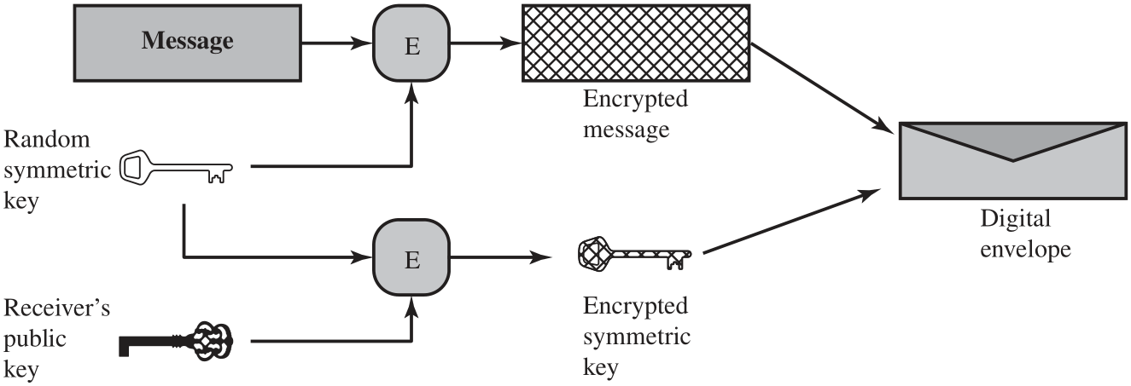
Digital Envelopes (a) Creation of a digital envelope
Notes:
Another application in which public-key encryption is used to protect a symmetric
key is the digital envelope, which can be used to protect a message without needing
to first arrange for sender and receiver to have the same secret key. The technique
is referred to as a digital envelope, which is the equivalent of a sealed envelope
containing an unsigned letter. The general approach is shown in Figure 2.9. Suppose
Bob wishes to send a confidential message to Alice, but they do not share a symmetric
secret key. Bob does the following:
1. Prepare a message.
2. Generate a random symmetric key that will be used this one time only.
3. Encrypt that message using symmetric encryption the one-time key.
4. Encrypt the one-time key using public-key encryption with Alice’s public key.
5. Attach the encrypted one-time key to the encrypted message and send it to
Alice.
Only Alice is capable of decrypting the one-time key and therefore of recovering
the original message. If Bob obtained Alice’s public key by means of Alice’s
public-key certificate, then Bob is assured that it is a valid key.

Slide 36
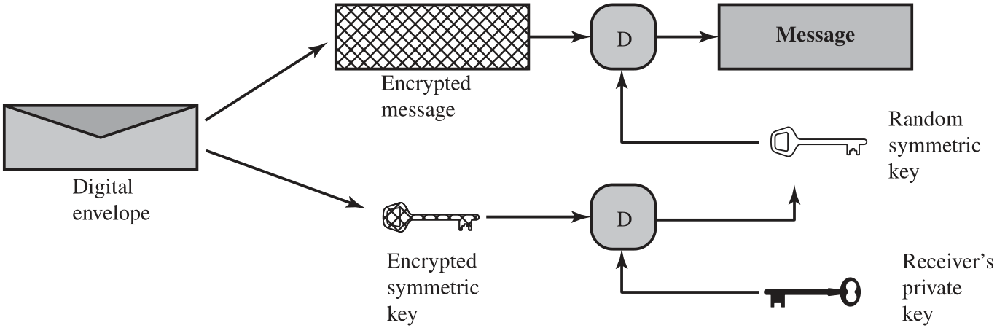
Digital Envelopes (b) Opening a digital envelope
Notes:
Another application in which public-key encryption is used to protect a symmetric
key is the digital envelope, which can be used to protect a message without needing
to first arrange for sender and receiver to have the same secret key. The technique
is referred to as a digital envelope, which is the equivalent of a sealed envelope
containing an unsigned letter. The general approach is shown in Figure 2.9. Suppose
Bob wishes to send a confidential message to Alice, but they do not share a symmetric
secret key. Bob does the following:
1. Prepare a message.
2. Generate a random symmetric key that will be used this one time only.
3. Encrypt that message using symmetric encryption the one-time key.
4. Encrypt the one-time key using public-key encryption with Alice’s public key.
5. Attach the encrypted one-time key to the encrypted message and send it to
Alice.
Only Alice is capable of decrypting the one-time key and therefore of recovering
the original message. If Bob obtained Alice’s public key by means of Alice’s
public-key certificate, then Bob is assured that it is a valid key.

Slide 37
Random Numbers
Uses include generation of:
Keys for public-key algorithms
Stream key for symmetric stream cipher
Symmetric key for use as a temporary session key or in creating a digital envelope
Handshaking to prevent replay attacks
Session key
Notes:
A number of network security algorithms based on cryptography make use of
random numbers. For example,
• Generation of keys for the RSA public-key encryption algorithm (described
in Chapter 21) and other public-key algorithms.
• Generation of a stream key for symmetric stream cipher.
• Generation of a symmetric key for use as a temporary session key or in creating
a digital envelope.
• In a number of key distribution scenarios, such as Kerberos (described in
Chapter 23), random numbers are used for handshaking to prevent replay
attacks.
• Session key generation, whether done by a key distribution center or by one of
the principals.
These applications give rise to two distinct and not necessarily compatible
requirements for a sequence of random numbers: randomness and unpredictability.

Slide 38
Random Number Requirements
Randomness
Unpredictability
Criteria:
Uniform distribution
Frequency of occurrence of each of the numbers should be approximately the same
Independence
No one value in the sequence can be inferred from the others
Each number is statistically independent of other numbers in the sequence
Opponent should not be able to predict future elements of the sequence on the basis of earlier elements
Notes:
Traditionally, the concern in the generation of a sequence of
allegedly random numbers has been that the sequence of numbers be random in
some well-defined statistical sense. The following two criteria are used to validate
that a sequence of numbers is random:
• Uniform distribution: The distribution of numbers in the sequence should be
uniform; that is, the frequency of occurrence of each of the numbers should be
approximately the same.
• Independence: No one value in the sequence can be inferred from the others.
Although there are well-defined tests for determining that a sequence of numbers
matches a particular distribution, such as the uniform distribution, there is no such
test to “prove” independence. Rather, a number of tests can be applied to demonstrate
if a sequence does not exhibit independence. The general strategy is to apply a number
of such tests until the confidence that independence exists is sufficiently strong.
In the context of our discussion, the use of a sequence of numbers that appear
statistically random often occurs in the design of algorithms related to cryptography.
In essence, if a problem is too hard or time-consuming to solve exactly, a simpler, shorter approach
based on randomization is used to provide an answer with any desired level of
confidence.
UNPREDICTABILITY
In applications such as reciprocal authentication and session key
generation, the requirement is not so much that the sequence of numbers be statistically
random but that the successive members of the sequence are unpredictable. With
“true” random sequences, each number is statistically independent of other numbers
in the sequence and therefore unpredictable. However, as is discussed shortly, true
random numbers are not always used; rather, sequences of numbers that appear to
be random are generated by some algorithm. In this latter case, care must be taken
that an opponent not be able to predict future elements of the sequence on the basis
of earlier elements.

Slide 39
Random versus Pseudorandom
Cryptographic applications typically make use of algorithmic techniques for random number generation
Algorithms are deterministic and therefore produce sequences of numbers that are not statistically random
Pseudorandom numbers are:
Sequences produced that satisfy statistical randomness tests
Likely to be predictable
True random number generator (TRNG):
Uses a nondeterministic source to produce randomness
Most operate by measuring unpredictable natural processes
e.g. radiation, gas discharge, leaky capacitors
Increasingly provided on modern processors
Notes:
Cryptographic applications typically make use of algorithmic techniques for random
number generation. These algorithms are deterministic and therefore produce
sequences of numbers that are not statistically random. However, if the algorithm is
good, the resulting sequences will pass many reasonable tests of randomness. Such
numbers are referred to as pseudorandom numbers.
You may be somewhat uneasy about the concept of using numbers generated
by a deterministic algorithm as if they were random numbers. Despite what might
be called philosophical objections to such a practice, it generally works. That is,
under most circumstances, pseudorandom numbers will perform as well as if they
were random for a given use. The phrase “as well as” is unfortunately subjective, but
the use of pseudorandom numbers is widely accepted. The same principle applies
in statistical applications, in which a statistician takes a sample of a population and
assumes the results will be approximately the same as if the whole population were
measured.
A true random number generator (TRNG) uses a nondeterministic source to
produce randomness. Most operate by measuring unpredictable natural processes,
such as pulse detectors of ionizing radiation events, gas discharge tubes, and leaky
capacitors. Intel has developed a commercially available chip that samples thermal
noise by amplifying the voltage measured across undriven resistors [JUN99].
A group at Bell Labs has developed a technique that uses the variations in the
response time of raw read requests for one disk sector of a hard disk [JAKO98].
LavaRnd is an open source project for creating truly random numbers using inexpensive
cameras, open source code, and inexpensive hardware. The system uses a
saturated charge- coupled device (CCD) in a light-tight can as a chaotic source to
produce the seed. Software processes the result into truly random numbers in a
variety of formats. The first commercially available TRNG that achieves bit production
rates comparable with that of PRNGs is the Intel digital random number generator
(DRNG) [TAYL11], offered on new multicore chips since May 2012.

Slide 40
Practical Application: Encryption of Stored Data
Common to encrypt transmitted data
Much less common for stored data
There is often little protection beyond domain authentication and operating system access controls
Data are archived for indefinite periods
Even though erased, until disk sectors are reused data are recoverable
Approaches to encrypt stored data:
Use a commercially available encryption package
Back-end appliance
Library based tape encryption
Background laptop/PC data encryption
Notes:
One of the principal security requirements of a computer system is the protection
of stored data. Security mechanisms to provide such protection include access control,
intrusion detection, and intrusion prevention schemes, all of which are discussed
in this book. The book also describes a number of technical means by which
these various security mechanisms can be made vulnerable. But beyond technical
approaches, these approaches can become vulnerable because of human factors.
We list a few examples here, based on [ROTH05].
• In December of 2004, Bank of America employees backed up and sent to its
backup data center tapes containing the names, addresses, bank account numbers,
and Social Security numbers of 1.2 million government workers enrolled
in a charge-card account. None of the data were encrypted. The tapes never
arrived and indeed have never been found. Sadly, this method of backing up
and shipping data is all too common. As an another example, in April of 2005,
Ameritrade blamed its shipping vendor for losing a backup tape containing
unencrypted information on 200,000 clients.
• In April of 2005, San Jose Medical group announced that someone had physically
stolen one of its computers and potentially gained access to 185,000
unencrypted patient records.
• There have been countless examples of laptops lost at airports, stolen from a
parked car, or taken while the user is away from his or her desk. If the data on the
laptop’s hard drive are unencrypted, all of the data are available to the thief.
Although it is now routine for businesses to provide a variety of protections,
including encryption, for information that is transmitted across networks, via the
Internet, or via wireless devices, once data are stored locally (referred to as data at
rest), there is often little protection beyond domain authentication and operating
system access controls. Data at rest are often routinely backed up to secondary storage
such as CDROM or tape, archived for indefinite periods. Further, even when
data are erased from a hard disk, until the relevant disk sectors are reused, the data
are recoverable. Thus it becomes attractive, and indeed should be mandatory, to
encrypt data at rest and combine this with an effective encryption key management
scheme.
There are a variety of ways to provide encryption services. A simple approach
available for use on a laptop is to use a commercially available encryption package
such as Pretty Good Privacy (PGP). PGP enables a user to generate a key from a
password and then use that key to encrypt selected files on the hard disk. The PGP
package does not store the password. To recover a file, the user enters the password,
PGP generates the password, and PGP decrypts the file. So long as the user protects
his or her password and does not use an easily guessable password, the files are fully
protected while at rest. Some more recent approaches are listed in [COLL06]:
• Back-end appliance: This is a hardware device that sits between servers and
storage systems and encrypts all data going from the server to the storage system
and decrypts data going in the opposite direction. These devices encrypt
data at close to wire speed, with very little latency. In contrast, encryption
software on servers and storage systems slows backups. A system man ager
configures the appliance to accept requests from specified clients, for which
unencrypted data are supplied.
• Library-based tape encryption: This is provided by means of a co-processor board
embedded in the tape drive and tape library hardware. The co-processor encrypts
data using a nonreadable key configured into the board. The tapes can then be sent
off-site to a facility that has the same tape drive hardware. The key can be exported
via secure e-mail or a small flash drive that is transported securely. If the matching
tape drive hardware co-processor is not available at the other site, the target facility
can use the key in a software decryption package to recover the data.
• Background laptop and PC data encryption: A number of vendors offer software
products that provide encryption that is transparent to the application and
the user. Some products encrypt all or designated files and folders. Other
products, such as Windows BitLocker and MacOS FileVault, encrypt an entire
disk or disk image located on either the user’s hard drive or maintained on a
network storage device, with all data on the virtual disk encrypted. Various key
management solutions are offered to restrict access to the owner of the data.

Slide 41
Summary
Confidentiality with symmetric encryption
Symmetric encryption
Symmetric block encryption algorithms
Stream ciphers
Message authentication and hash functions
Authentication using symmetric encryption
Message authentication without message encryption
Secure hash functions
Other applications of hash functions
Random and pseudorandom numbers
The use of random numbers
Random versus pseudorandom
Public-key encryption
Structure
Applications for public-key cryptosystems
Requirements for public-key cryptography
Asymmetric encryption algorithms
Digital signatures and key management
Digital signature
Public-key certificates
Symmetric key exchange using public-key encryption
Digital envelopes
Practical Application: Encryption of Stored Data
Notes:
Chapter 2 summary.

