Slide 2
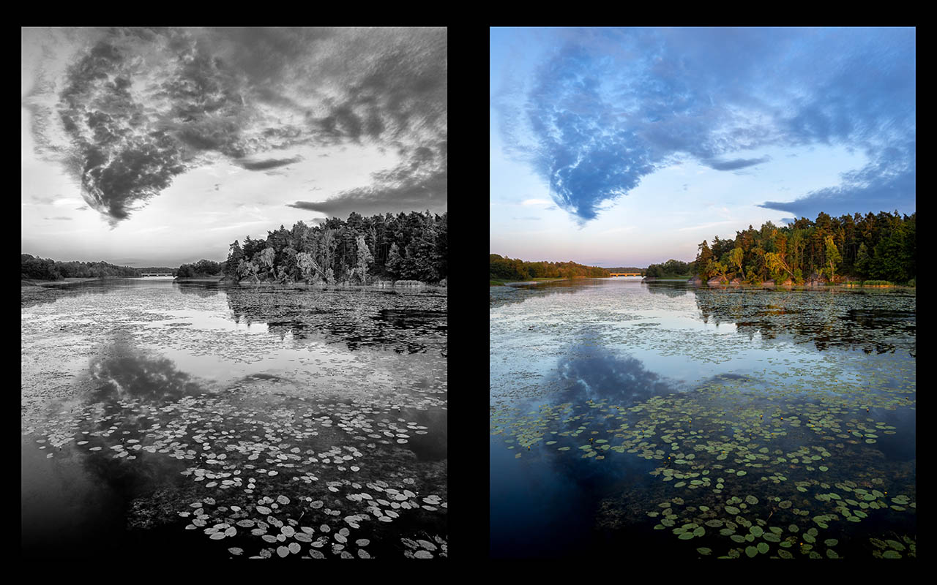
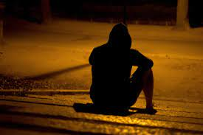

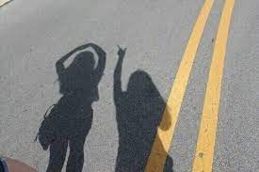
Do lonely people perceive the world differently?
Lonely
Cold
Not lonely
Warm

Slide 3

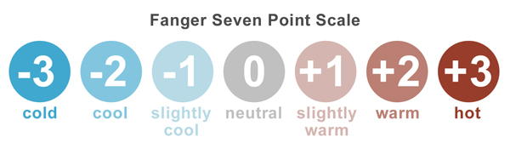
Loneliness
Bias in perceived images
Measure perceived images
Rate bias
(by independent raters)

