Slide 1

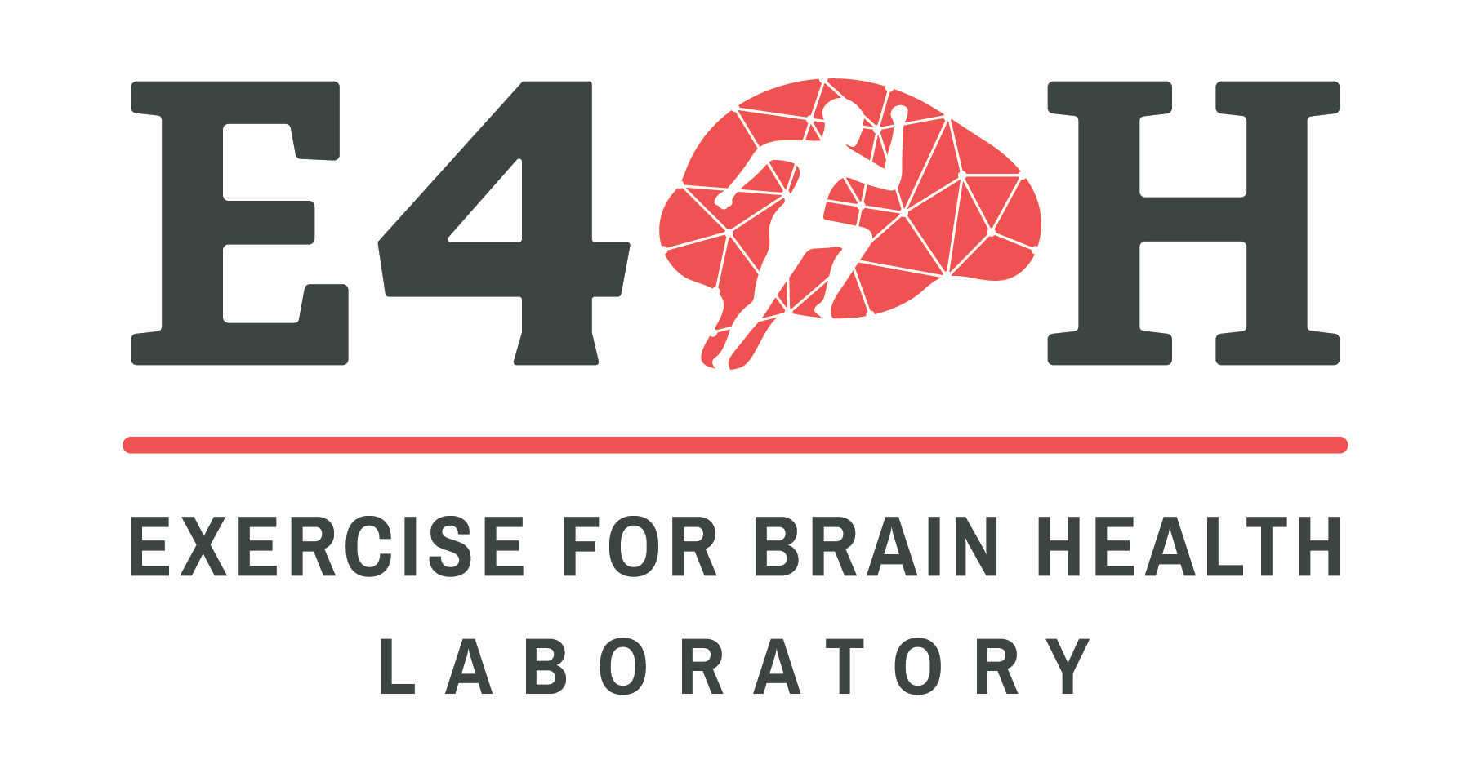
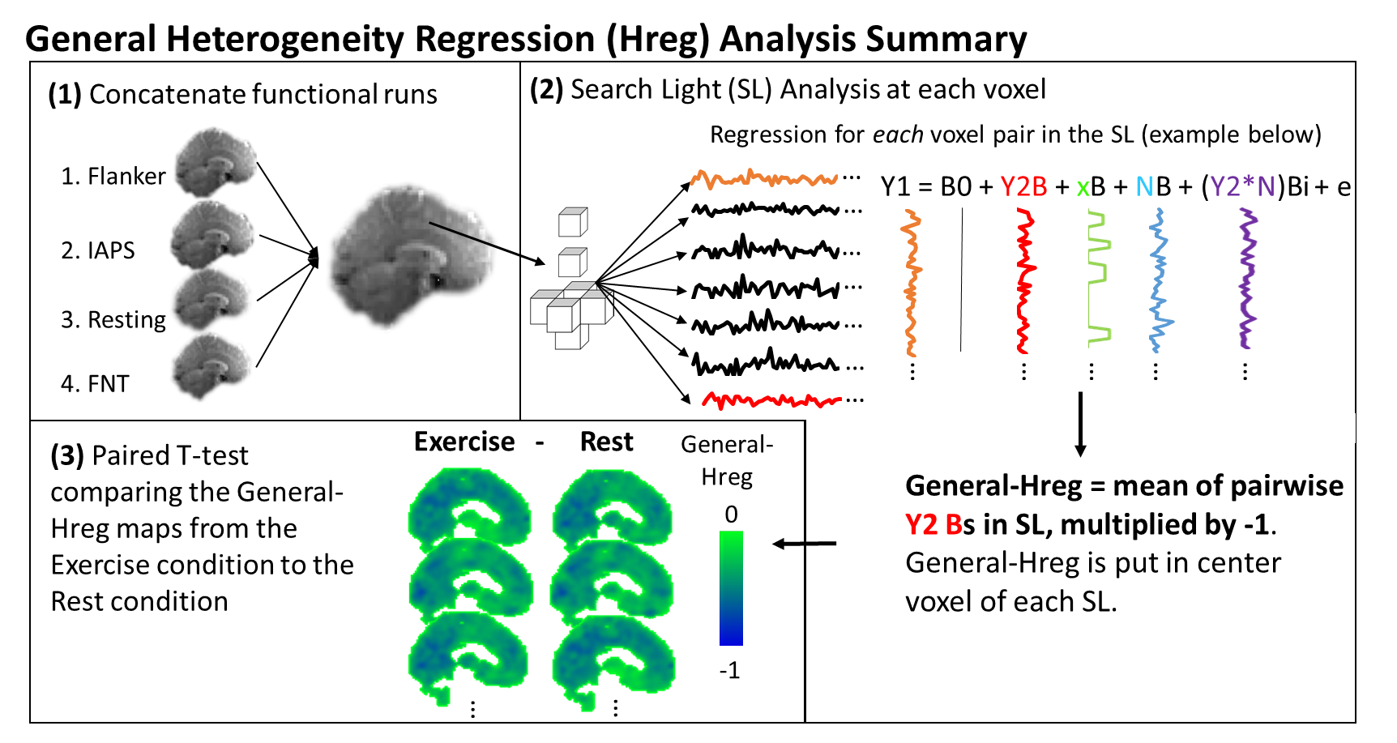
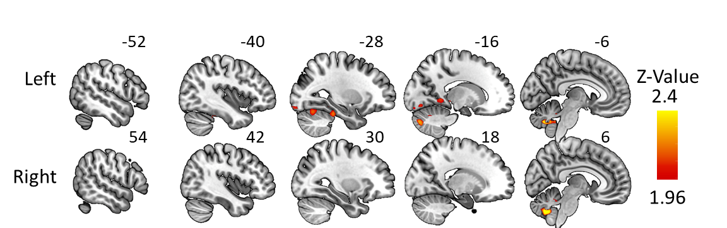
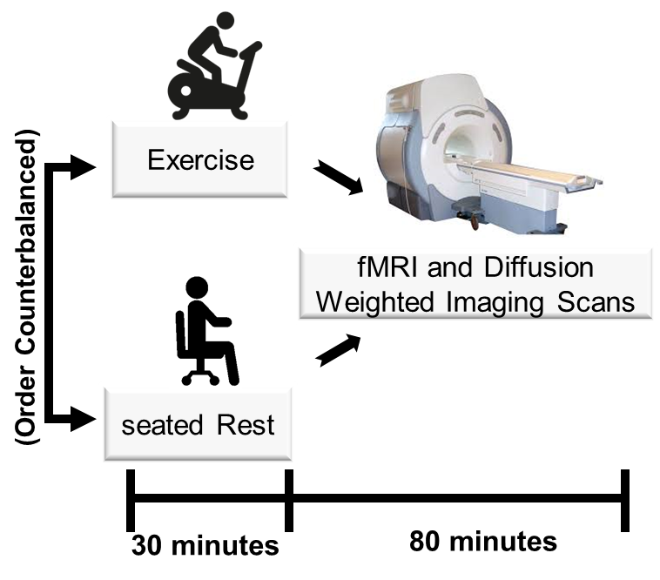
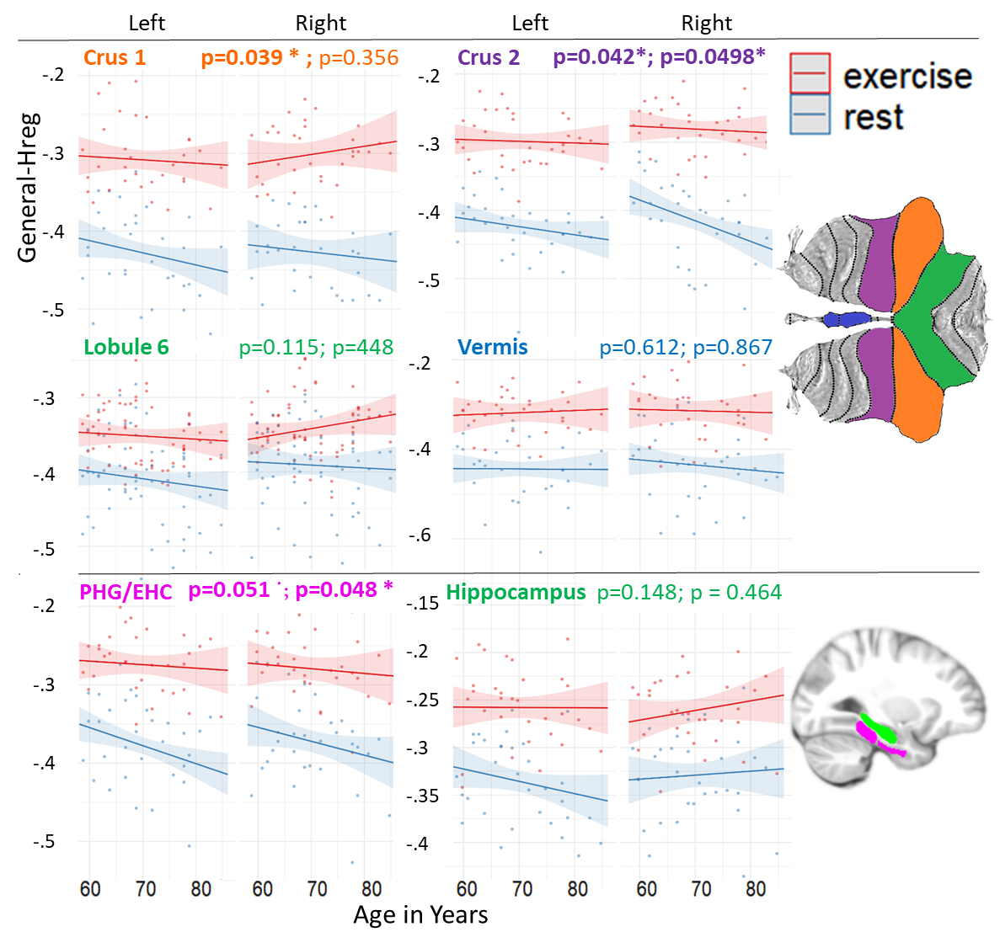
Increased Neural Differentiation after a Single Session of Aerobic Exercise in Older Adults
Jeremy Purcell¹, J. Won², D. Callow¹, R. Wiley⁴, L. Weiss³, A. Alfini¹, & J. C. Smith¹
1. Department of Kinesiology, University of Maryland, College Park, MD: 2. Institute for Exercise and Environmental Medicine, Texas Health Presbyterian Dallas, Dallas, TX: 3. Program in Neuroscience and Cognitive Science, University of Maryland, College Park, MD: 4. Department of Psychology, University of North Carolina at Greensboro, Greensboro, NC
https://e4bh.com/
Background and Methods
Local Neural Differentiation
Healthy neural systems for motor, sensory, and cognitive function have well differentiated neural signals.
Aging is associated with neural de-differentiation (e.g., Carp et al., 2011), including the hippocampal formation (Koen and Rugg, 2019).
Research suggests that there are neural functional improvements immediately after exercise (Won et al., 2021).
It has not yet been shown that there is increased neural differentiation in older adults immediately after exercise.
Hypotheses immediately after 30 minutes of exercise:
There will be higher neural differentiation within the hippocampal formation.
These increases in neural differentiation will be age dependent.
Result 1: Increased neural differentiation immediately after exercise in the hippocampal formation and cerebellum.
Methods
Result 2: Age dependent higher neural differentiation after exercise
Mixed Model: Dreg ~Rest_Exercise *Age * Hemisphere (1 + Rest_Exercise + hemisphere | Subject).
Participants: 32 physically active older adults (23 females).
Age: 66.4±7.5 years.
Interventions: Within-subject design,1) 30-min aerobic exercise on Monark cycle ergometer (RPE: 15) 2) 30-min seated rest
Functional MRI: 4 Scans: (1) Flanker Task, (2) International Affective Picture System (IAPS) task; (3) Resting State, and (4) Famous Names Task (FNT). Approximately 31 min. of combined fMRI data.
Manipulation Check
HR and RPE were significantly higher during the exercise (133.6±19.0 bpm and 14.0±1.1) session compared to the rest (66.5±8.7 bpm and 6.1±0.4), suggesting that our exercise intervention was sound.
Summary:
Acute Exercise led to increased neural differentiation in the hippocampal formation and cerebellum.
Some of the greater effects of exercise were found with increased age, suggesting that acute exercise may help, at least transiently, to counteract age induced neural de-differentiation.
References
Carp, Joshua, Joonkoo Park, Thad A. Polk, and Denise C. Park. 2011. “Age Differences in Neural Distinctiveness Revealed by Multi-Voxel Pattern Analysis.” NeuroImage 56 (2): 736–43.
Koen, Joshua D., and Michael D. Rugg. 2019. “Neural Dedifferentiation in the Aging Brain.” Trends in Cognitive Sciences 23 (7): 547–59.
Won, Junyeon, Daniel D. Callow, Gabriel S. Pena, Leslie S. Jordan, Naomi A. Arnold-Nedimala, Kristy A. Nielson, & J. Carson Smith. 2021. “Hippocampal Functional Connectivity and Memory Performance After Exercise Intervention in Older Adults with Mild Cognitive Impairment.” Journal of Alzheimer’s Disease
Notes:
Image Processing
Anatomical images processed with Freesurfer longitudinal stream.
Diffusion images motion, eddy current-induced distortions, b0 inhomogeneities were corrected with FSL.
Dtifit program used to fit diffusion tensor model at each brain voxel to create diffusivity measures like FA and MD.
Automated hippocampal and amygdala segmentation performed using Freesurfer longitudinal subregion segmentation program.
Freesurfer bbregister program was used to co-register T1 to b0 diffusion image.

