Slide 1
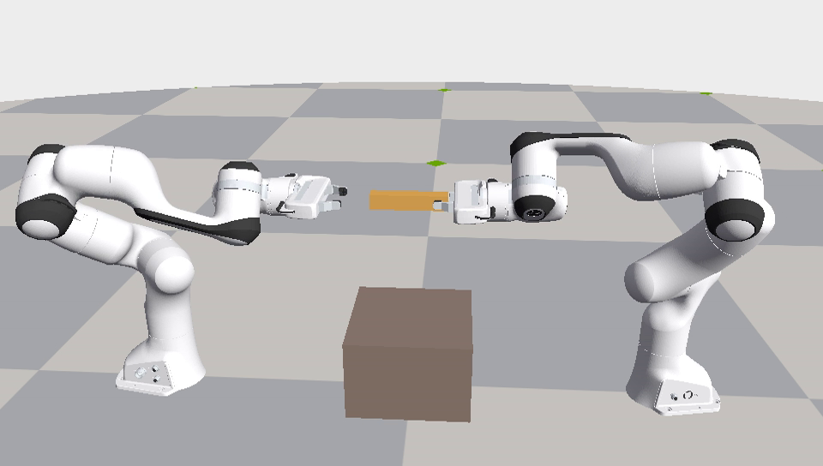
Robust Bimanual Handover — Final Delivery v2.1.0
Geometry vs residual RL · Isaac Lab 3.0 / Isaac Sim 6.2 (PhysX) · CSCI 645, Fall 2026 · Yan Wen
• Two Franka Panda arms, parallel-jaw grippers, one rigid bar; success = 2 s receiver-only hold
• v1: geometry module decisive, but the selector picked untrained policies (8/9 runs)
• v2: audit v1 → diagnose residuals → ablate geometry → preregistered harder experiment
• Answer (this task and training setup): strong geometry sufficed; learned residuals on top
  – added no robust value and lost to a tuned constant
• Closeout: corrected reproduction, scoped wording, supplementary repeatability check

Slide 2
Task and methods
method | receiver target | release
nominal | fixed approach–grasp schedule | scheduled
geometry | + alignment (A) + shared-holding anchor (H) | contact-gated (G)
residual | + learned 3-D residual, 2 cm bound (PPO) | scheduled
combined | geometry on top of nominal + residual | contact-gated
combined_no_phase | combined without 4 contact-phase inputs | contact-gated
constant controls | residual replaced by a fixed offset | as base
• Perturbations: bar start position (per axis) and release time
• 20 Hz control through differential IK, fixed orientations
• PPO (RSL-RL 5.5.1), 1,024 envs, 10M transitions per run
• Same evaluator and case realizations for every controller

Slide 3
Stage 1 — Audit of v1
reproducible; two labelling/logging errors, one interpretation gap
• Fresh download: 21/21 checksums, 556 archive members re-hashed; tables regenerate byte for byte
• 19,800 + 16,200 records, identical case IDs, 0 duplicates / invalid resets / errors
• E1: aggregate labels '1,400 in-range / 400 stress' → 1,200 non-stress / 600 stress (numbers unchanged)
• E2: recorded episode_return omits the terminal-step reward (records written before rewards) — logging only
• E3: 'untrained' step-0 policies output a seed-specific constant (+1.4 / +1.0 / −2.5 mm), not zero
• Replay of a predeclared, boundary-enriched sample (23 cases × 20 policies, new processes):
  – terminal reasons 456/460 (batch 23) and 457/460 (batch 1); disagreements only at boundaries
  – (rates of that selected sample; GPU physics is not bitwise reproducible across batch layouts)
• Negative controls physical: table support → receiver grips 17 N, giver open, table 1.3–1.6 N → 0/20 success

Slide 4
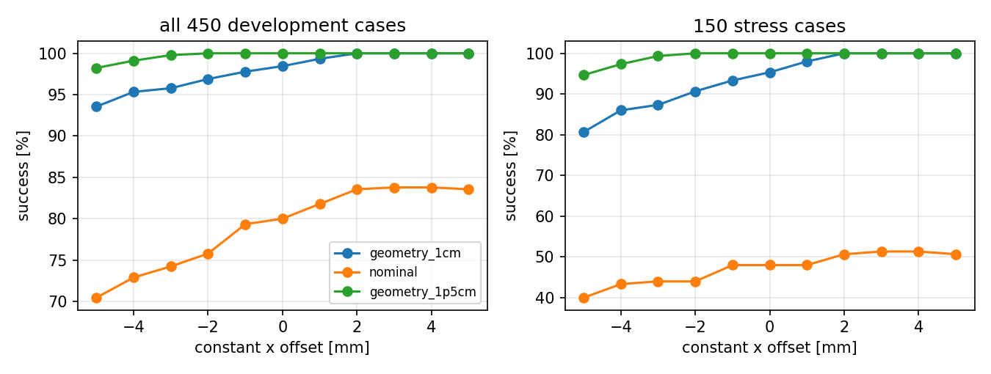
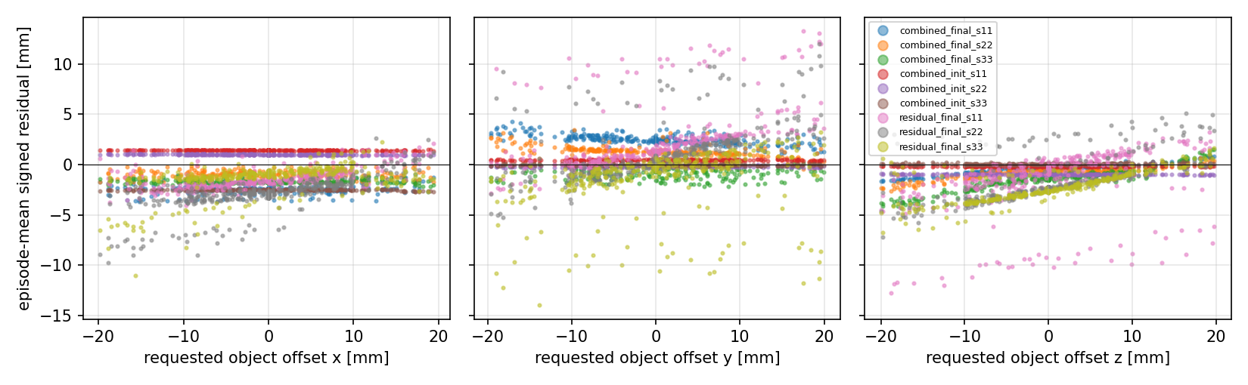
Stage 2 — What do the learned residuals do?
450 development cases, archived v1 checkpoints
• Geometry + constant +3 mm: 450/450 (geometry + 0: 443)
• Trained combined: near-constant −1…−2.5 mm x bias (spread ≤ 0.4 mm), the harmful direction
  – −7.8 pp vs the constant on stress cases [−13.1, −3.3]
• Failures = palm hits bar end when the object is shifted +15…+19 mm toward the receiver
• Residual-only policies are state dependent (slope 0.07–0.16) but ≈ best constant (+4.4 [−2.0, +11.3])

Slide 5
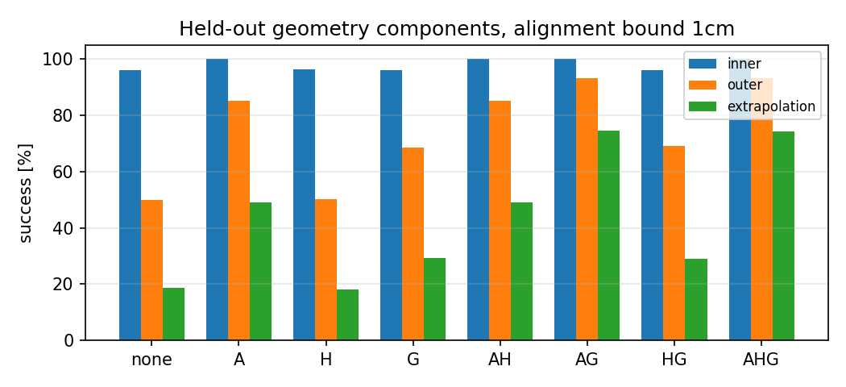
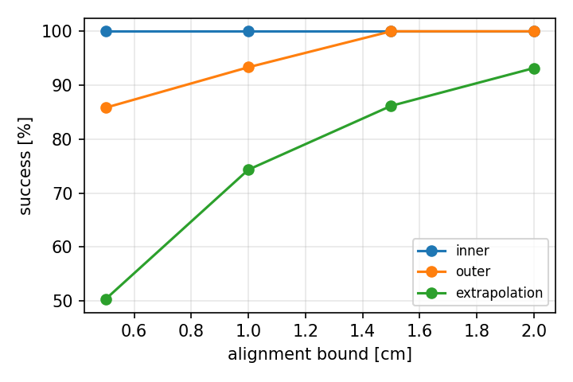
Stage 3 — Which geometry component matters?
held-out v2 suite, residual = 0
• Alignment A: +18.9 pp (1 cm), +24.0 pp (1.5 cm)
• Release gate G: +7.8 / +7.3 pp; up to +25.5 pp beyond the alignment bound
• Shared-holding anchor H: no measurable effect (±0.1 pp)
• Bound 0.5 / 1 / 1.5 / 2 cm → 84.0 / 91.9 / 96.5 / 98.3 % (all cases)

Slide 6
Stage 4 — Preregistered v2 protocol
frozen at tag experiment-v2 (protocol sha256 bd79ae51…)
• Training range widened to ±2 cm / ±0.30 s (curriculum); 1.5 cm geometry in combined methods
• Zero-mean actor initialization (pilot P2 chosen by a predeclared rule; 14.75M of 15M pilot budget)
• Selection excludes step 0; ties → fewer collisions → smaller residual → latest
• Constants tuned on 750 development cases: nominal +9 mm, geometry 1 cm +7 mm, geometry 1.5 cm +10 mm
• Final suite: 12 conditions × 200 fresh cases incl. ±3 cm extrapolation (feasibility-checked)
• Disclosed: the training range is already solved by 1.5 cm geometry; validation near-saturated
• 9 runs × 10,027,008 transitions; 117,600 evaluation episodes, all reconciled (0 invalid, 0 errors)

Slide 7
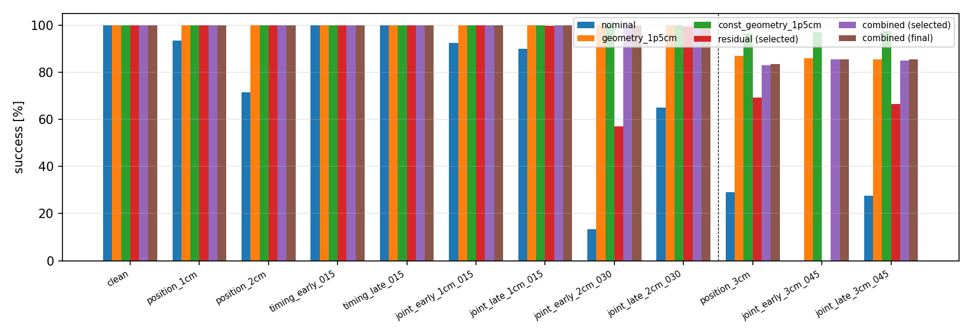
Stage 5 — Held-out results
success %, 2,400 fresh cases; learned = mean of 3 seeds (selected checkpoints)
controller | inner | outer ±2 cm | extrap. ±3 cm | all
nominal | 96.0 | 50.0 | 18.8 | 65.2
nominal + 9 mm | 99.9 | 57.0 | 20.3 | 69.3
geometry 1.5 cm | 100.0 | 100.0 | 86.2 | 96.5
geometry 1.5 cm + 10 mm | 100.0 | 100.0 | 97.0 | 99.2
residual (PPO) | 99.9 | 85.5 | 45.2 | 82.6
combined (PPO) | 100.0 | 100.0 | 84.4 | 96.1
combined_no_phase | 100.0 | 100.0 | 85.2 | 96.3
• Everything with 1.5 cm geometry is 100 % inside the training range
• Differences appear only in extrapolation

Slide 8
Primary comparisons (original v2 results)
paired seed × case bootstrap, pp [95% CI], all 2,400 cases
comparison | selected | final checkpoints
combined − geometry 1.5 cm | -0.4 [-0.8, -0.2] | -0.4 [-0.6, -0.1]
combined − (geometry + 10 mm) | -3.2 [-4.0, -2.3] | -3.1 [-3.9, -2.2]
residual − nominal | +17.4 [+15.9, +19.0] | +17.7 [+16.1, +19.2]
residual − (nominal + 9 mm) | +13.3 [+12.0, +14.7] | +13.6 [+12.2, +15.0]
combined − combined_no_phase | -0.2 [-0.6, +0.2] | -0.1 [-0.3, +0.1]
• Extrapolation: combined − geometry -1.8 [-3.1, -0.7]; − (geometry + const) -12.6 [-16.0, -9.3]
• Trained combined is 0.4 pp below its own untrained (= geometry) version
• Residual RL without geometry learns a state-dependent correction a constant cannot match (+13 pp)
• Explicit contact-phase label: no clear effect detected (this task, observation set, budget)
• CIs resample seeds and cases only, not evaluation processes / batch layouts (see closeout check)

Slide 9
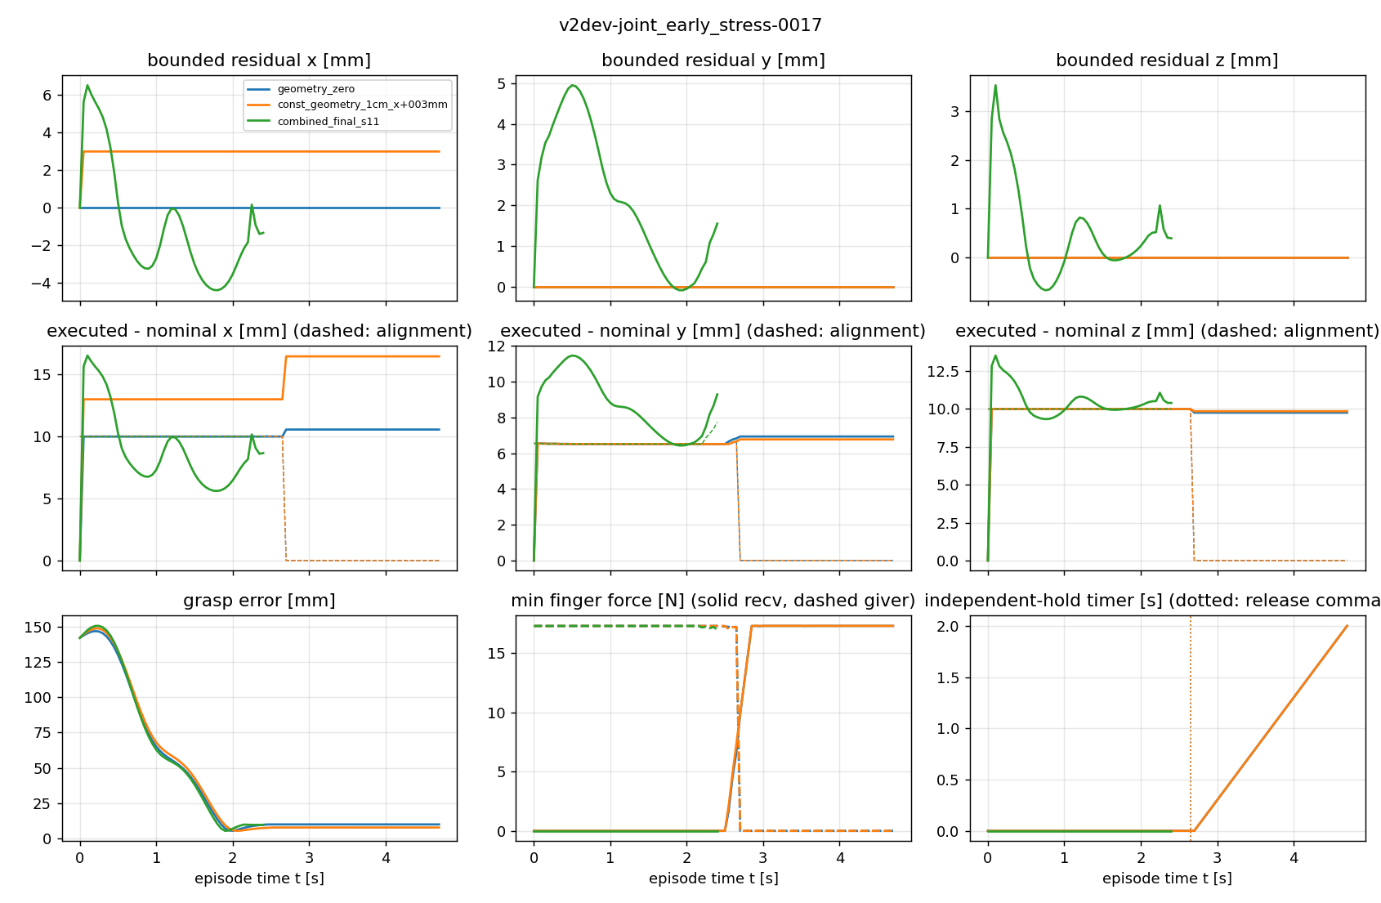
Why combined does not help
same mechanism in v1 and v2
• Learned combined residual ≈ constant −1…−2.4 mm in x (spread ≤ 0.6 mm, slope ≈ 0)
• 92–100 % of combined failures: object shifted > 2 cm toward the receiver (beyond the 1.5 cm bound)
• Those cases need a positive offset; the +10 mm constant solves 97 % of extrapolation cases
• Inside the training range geometry already succeeds → no learning signal for the useful direction
• Residual-only policies see failures in training and learn ~10–13 % offset tracking

Slide 10
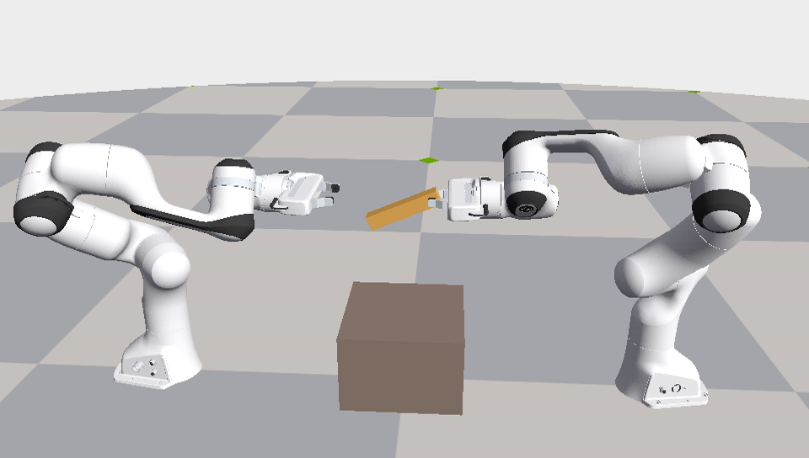
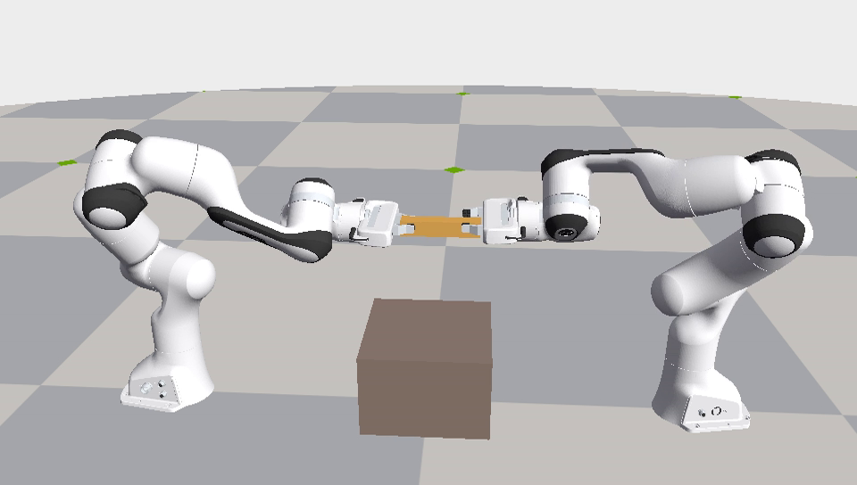
Demo (10 provenance-linked videos in the release)
every single-env replay matched its evaluation record
nominal: timeout (joint −0.30 s, ±2 cm)
geometry 1.5 cm: success (same case)
combined: palm collision at ±3 cm
• Matched comparison, release-gate rescue, alignment-bound example, trained success/failure, residual policy
• Selected by a rule frozen before final outcomes (videos.json lists rule, hashes, replay outcome)

Slide 11
Closeout — repeatability check (supplementary)
retrospective robustness check on the already-used v2 final suite; nothing selected from it
layout / process | comb − geometry (sel.) | (final) | comb − geom+10 mm (sel.)
v2.0.0 archived (900, seed 0) | -0.44 [-0.76, -0.17] | -0.36 [-0.62, -0.11] | -3.15 [-4.03, -2.29]
batch 900, repeat 1 | -0.44 [-0.78, -0.14] | -0.39 [-0.69, -0.11] | -3.15 [-4.01, -2.29]
batch 900, repeat 2 | -0.44 [-0.78, -0.14] | -0.39 [-0.69, -0.11] | -3.15 [-4.01, -2.29]
batch 900, repeat 3 | -0.44 [-0.78, -0.14] | -0.39 [-0.69, -0.11] | -3.15 [-4.01, -2.29]
batch 900, mean of 3 repeats | -0.44 [-0.78, -0.14] | -0.39 [-0.69, -0.11] | -3.15 [-4.01, -2.29]
batch 23, repeat 1 | -0.40 [-0.72, -0.11] | -0.35 [-0.64, -0.08] | -3.11 [-3.97, -2.25]
batch 23, repeat 2 | -0.40 [-0.72, -0.11] | -0.35 [-0.64, -0.08] | -3.11 [-3.97, -2.25]
batch 23, repeat 3 | -0.40 [-0.72, -0.11] | -0.35 [-0.64, -0.08] | -3.11 [-3.97, -2.25]
batch 23, mean of 3 repeats | -0.40 [-0.72, -0.11] | -0.35 [-0.64, -0.08] | -3.11 [-3.97, -2.25]
• 115,200 / 115,200 episodes recorded; 0 missing, 0 invalid resets
• 8 controllers × 2,400 cases × 3 processes × batch 900 / 23
• combined − geometry: stable disadvantage under the tested settings (selected), stable disadvantage under the tested settings (final)
• combined − geometry + const: stable disadvantage under the tested settings
• Repeats are not new seeds or cases: cases are averaged over repeats before resampling

Slide 12
Closeout — corrections (docs/closeout/ERRATA.md)
v2 numbers unchanged; wording and reproduction fixed
• Phase ablation: 'no effect' → no clear effect detected under this task, observations and budget
• Residual RL value: scoped to this task, controller, reward, PPO setup and training distribution
• Boundary replay 487/506 (terminal) and 492/506 (success): observed on a selected sample, not an upper bound
• Whole-suite 2/2,400 and 10/2,400 terminal-reason differences: not a universal noise floor
• Seed × case CIs omit process / batch-layout variability → supplementary check (previous slide)
• Reproduction: experiment checkout (experiment-v2) + delivery-tools checkout; one driver, scripts/closeout.py
• Asset name raw-development.tar.gz; video replay commands concrete; superseded smoke checkpoint disclosed

Slide 13
Conclusions and limitations
• Strong geometry was sufficient for this handover; alignment does most of the work, gating the rest
• Residual RL on top of geometry added no robust value here and lost to a development-tuned constant
  – (scope: this task, reward, PPO configuration and training distribution — not a general impossibility)
• Residual RL alone helps a lot over nominal (+17 pp) but stays far below geometry
• Limitations: simulation only, privileged state, translation-only perturbations, 3 seeds,
  – v2 designed after v1 diagnostics, saturated training range / validation, one reward design
• Everything public: tags experiment-v2, closeout-eval-v1, v2.1.0 + self-contained release v2.1.0

