Slide 1
Observation Robustness in Bimanual Handover — v3
Sensor bias, noise and delay vs geometry and residual PPO · Isaac Lab 3.0 / Isaac Sim 6.2 (PhysX) · CSCI 645, Fall 2026 · Yan Wen
• Two Franka arms, parallel-jaw grippers, one rigid bar; success = 2 s receiver-only hold
• v3 corrupts only the bar's translation measurement (synthetic sensor, not vision)
• Held-out: 135,200 logical episodes (6 baselines + 23 PPO runs × selected/final × 2,600 cases)
• Strong estimator saturates the suite: geometry_common 100.0% on mixed_id
• Both primary contrasts are exactly 0 pp: a ceiling, not a win for learning
• Release v3.0.0: every checkpoint, raw record, log, video and checksum
Notes:
This is the third study on the same two-arm handover. v1 and v2 used accurate object state. v3 asks what happens when the object position measurement is wrong. Headline: the strong deterministic controller with a giver-grasp reference already succeeds on every held-out case, so learning has no room to help.

Slide 2
Where v2 left off
previous studies, quoted from the v2 report (release v2.1.1)
v2 controller (accurate state) | all-case success
nominal script | 65.2%
residual PPO | 82.6%
geometry | 96.5%
combined (geometry + residual PPO) | 96.1%
geometry + tuned constant | 99.2%
• v2: learned residuals on top of geometry ≈ a small constant offset
• Open question: does geometry break when the object estimate is corrupted?
• Hypotheses (frozen before held-out data):
  – H1 bias / noise / delay hurt controllers differently
  – H2 noise-trained residuals beat clean-trained ones
  – H3 a 5-frame history helps beyond input size
  – H4 filtering + giver-grasp reference remove that benefit
Notes:
These v2 numbers are prior work and were not re-measured. The v3 design keeps everything from v2 except the object translation measurement, and adds a repeated-current-frame control so that any history effect can be separated from simply having more inputs.

Slide 3
Synthetic translation sensor
• y_k = x_{k−d} + b + σ·n(seed, k); estimate ŷ_k = α·y_k + (1−α)·ŷ_{k−1}
• Same noise sequence for every controller on a case (counter-based generator)
• Giver reference: while the giver holds, estimate = giver TCP − nominal grasp offset (proprioception)
• Orientation, joints, TCPs, gripper widths and contact forces stay accurate
• Final suite: 200 base cases × 13 conditions = 2,600 paired cases
  – clean, physical_only, bias 2/5/10 mm, noise 1/2/4 mm, delay 1/2/4 steps (50 ms each)
  – mixed_id: bias ≤ 5 mm, σ 2 mm, delay 2 · mixed_ood: bias ≤ 10 mm, σ 4 mm, delay 4
• Validation 240 cases and development 312 cases on separate seeds
A controlled model of translation-estimation error — not a vision system and not a sim-to-real claim.
Notes:
Bias is fixed per episode, noise is drawn per control step from a seed indexed by case and step, delay shifts the measurement back by whole control steps. mixed_id matches the training corruption; mixed_ood doubles it.

Slide 4
Controllers and learned policies
controller | estimator | learned
nominal | none (fixed schedule) | –
geometry_raw | α = 1, no giver reference | –
geometry_filtered | EMA α = 0.2 | –
geometry_common (= best_constant = giver) | α = 1 + giver reference | –
combined_clean_ff / robust_ff | geometry_common | PPO residual, 1 frame (46 inputs)
combined_robust_history | geometry_common | PPO residual, 5 frames (230 inputs)
combined_robust_repeat | geometry_common | 5 × current frame (memory control)
residual_robust_history | on nominal script | PPO residual, 5 frames
• Residual = 0.02·tanh(a) m per axis; PPO (RSL-RL 5.5.1), MLP [128,128]; 10,027,008 transitions per run
• Seeds 11/22/33/44/55 (repeat control: 11/22/33) → 23 formal runs
Notes:
Three baseline roles turned out identical after the development search: the best constant offset was zero and the best giver-reference configuration was the shared estimator. They were evaluated once and reused under recorded aliases; aliases are not counted as independent evidence.

Slide 5
Protocol: develop → freeze → train → validate → test
• Remote acceptance: 10 of 10 checks passed (sensor, resets, no hidden truth path, PPO resume, caches)
• Development search over estimators and constants on development cases only
• Pilots ≤ 24M transitions → PPO settings unchanged; protocol frozen as tag experiment-v3
• 23 runs × 10M transitions: 7.6 A100 GPU-hours
• Selection on 240 validation cases at 2/4/6/8/10M (step 0 = control, never eligible)
• Final: one fresh process per entry, batch 256, all 2,600 cases; 0 invalid resets
• Primary (mixed_id, selected): history − robust FF; history − geometry_best_constant
• Paired bootstrap, 10,000 replicates over seeds and base-case clusters; 97.5% Bonferroni
Notes:
Everything that touches held-out data ran from the clean experiment-v3 commit. Decisions are logged with UTC times in docs/v3/DECISIONS.md.

Slide 6
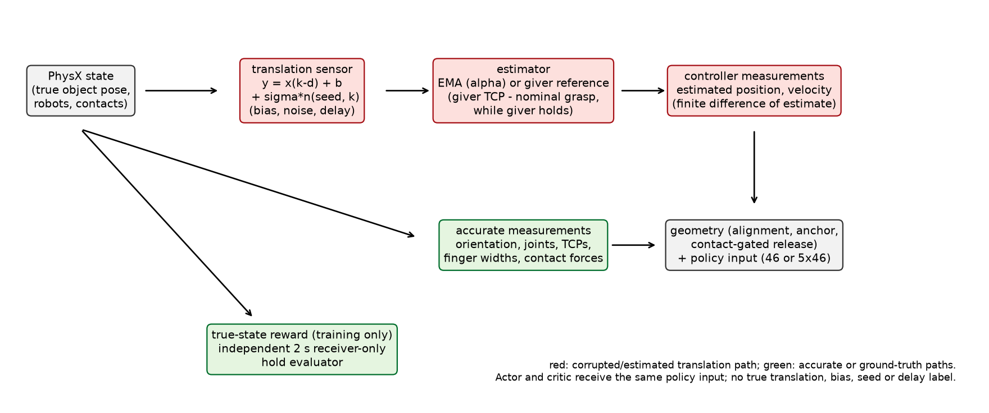
Development: the estimator decides
development cases, used only to choose baselines
• Raw estimate + noise ≥ 2 mm: release gate never opens (timeouts)
• EMA filtering helps noise; giver reference fixes it for every smoothing level
• Delay up to 4 steps: no effect (the bar is nearly stationary before release)
• Best constant offset = 0 → geometry_best_constant = geometry_common
• This was decided before any validation or final data
Notes:
The acceptance check that found the release-gate blocking is check 7. Choosing the giver-reference estimator for all combined policies was therefore a development decision, not a reaction to final results.

Slide 7
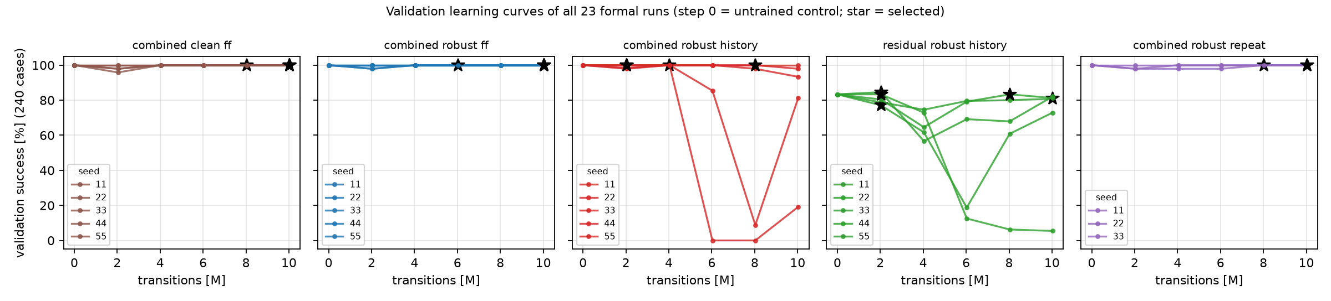
Validation learning curves (all 23 runs)
• Combined runs at 100% from step 0; selection fell to the residual-size / latest-step tie-breaks
• History training is unstable: seed 55 0.0% at 6M, seed 11 8.8% at 8M
• Residual-only history declines after 2–4M (seed 55: 5.4% at 10M)
Notes:
Stars mark the selected checkpoints. Step 0 is the untrained control. Selection protected the study from the late collapses, which is why final checkpoints are reported separately.

Slide 8
Held-out success (%) by condition
selected checkpoints; learned rows = mean over seeds; 200 cases per cell
controller | clean | physical only | bias 10mm | noise 4mm | delay 4step | mixed id | mixed ood
nominal | 100.0 | 71.0 | 71.0 | 70.0 | 71.0 | 70.5 | 71.0
geometry_raw | 100.0 | 100.0 | 67.0 | 0.0 | 100.0 | 0.0 | 0.0
geometry_filtered | 100.0 | 100.0 | 67.5 | 99.5 | 100.0 | 100.0 | 96.0
geometry_common | 100.0 | 100.0 | 100.0 | 100.0 | 100.0 | 100.0 | 100.0
combined clean FF | 100.0 | 100.0 | 100.0 | 100.0 | 100.0 | 100.0 | 100.0
combined robust FF | 100.0 | 100.0 | 100.0 | 100.0 | 100.0 | 100.0 | 100.0
combined robust history | 100.0 | 100.0 | 100.0 | 100.0 | 100.0 | 100.0 | 100.0
combined repeated-current | 100.0 | 100.0 | 100.0 | 100.0 | 100.0 | 100.0 | 100.0
residual-only history | 100.0 | 68.9 | 68.7 | 68.4 | 68.3 | 68.7 | 68.8
Full 13-condition table with final checkpoints: report Section 6.2.
Notes:
Read across a row for sensitivity to each corruption. The nominal script and residual-only policies fail on physical offsets, not on the sensor: their clean success is 100% and every sensor condition matches physical_only. Raw geometry fails under noise; filtered geometry under 10 mm bias.

Slide 9
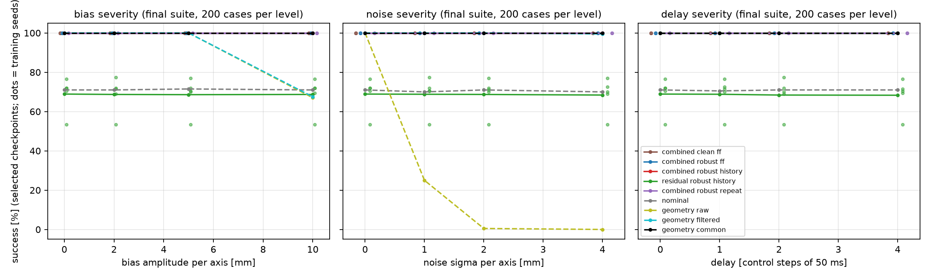
Severity curves (selected checkpoints, per-seed dots)
• Noise: raw geometry 25.0% at 1 mm → 0.5% at 2 mm (release timeouts)
• Bias 10 mm: raw 67.0%, filtered 67.5% (collisions); giver reference 100%
Notes:
Delay has no effect for any controller. All combined policies and geometry_common lie on the 100% line.

Slide 10
Primary contrasts: exactly zero
mixed_id, selected checkpoints, 5 seeds × 200 paired cases
contrast | difference [pp] (95% CI) | 97.5% Bonferroni | per seed
history − robust FF | +0.0 [+0.0, +0.0] | [+0.0, +0.0] | +0.0 / +0.0 / +0.0 / +0.0 / +0.0
history − geometry_best_constant | +0.0 [+0.0, +0.0] | [+0.0, +0.0] | +0.0 / +0.0 / +0.0 / +0.0 / +0.0
robust FF − clean FF (secondary) | +0.0 [+0.0, +0.0] | – | +0.0 / +0.0 / +0.0 / +0.0 / +0.0
history − repeated-current (secondary) | +0.0 [+0.0, +0.0] | – | +0.0 / +0.0 / +0.0
residual-only history − nominal (secondary) | −1.8 [−10.2, +4.4] | – | +0.0 / −17.0 / +6.5 / +1.5 / +0.0
• Zero-width intervals: both sides succeed on every case — a ceiling, not proof of equivalence
• No evidence that history or noise-trained residuals help on this suite (H2, H3 untestable here)
• Residual-only history does not beat the nominal script (unlike v2 with accurate state)
Notes:
The bootstrap resamples seeds and base-case clusters; when every paired difference is zero there is nothing to resample, so the interval collapses. The honest reading is that this suite cannot rank these policies.

Slide 11
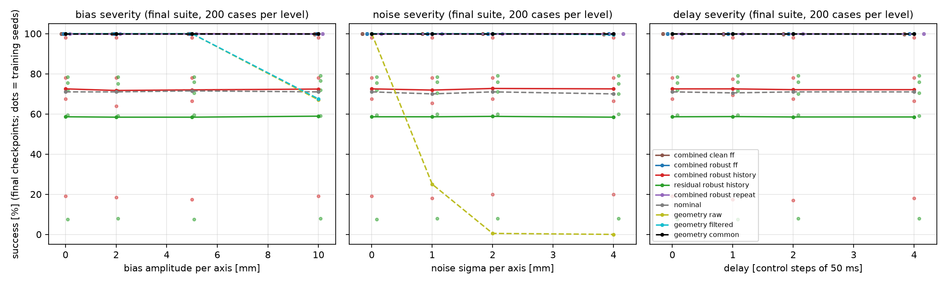
Final (10M) checkpoints: selection mattered
declared secondary analysis
• History final − geometry_common, mixed_id: −28.2 [−56.4, −5.4] pp
  – per seed −35.5 / +0.0 / −22.0 / −2.0 / −81.5
• Validation at 10M predicted it: seed 55 19.2% (collisions)
• Feed-forward and repeated-current final checkpoints stay at ceiling
• Residual-only history final − nominal: −12.1 [−38.4, +5.7] pp
Notes:
The late instability is specific to real history inputs in this setup. Validation-based selection removed it; training to a fixed budget and keeping the last checkpoint would have produced a large negative result.

Slide 12
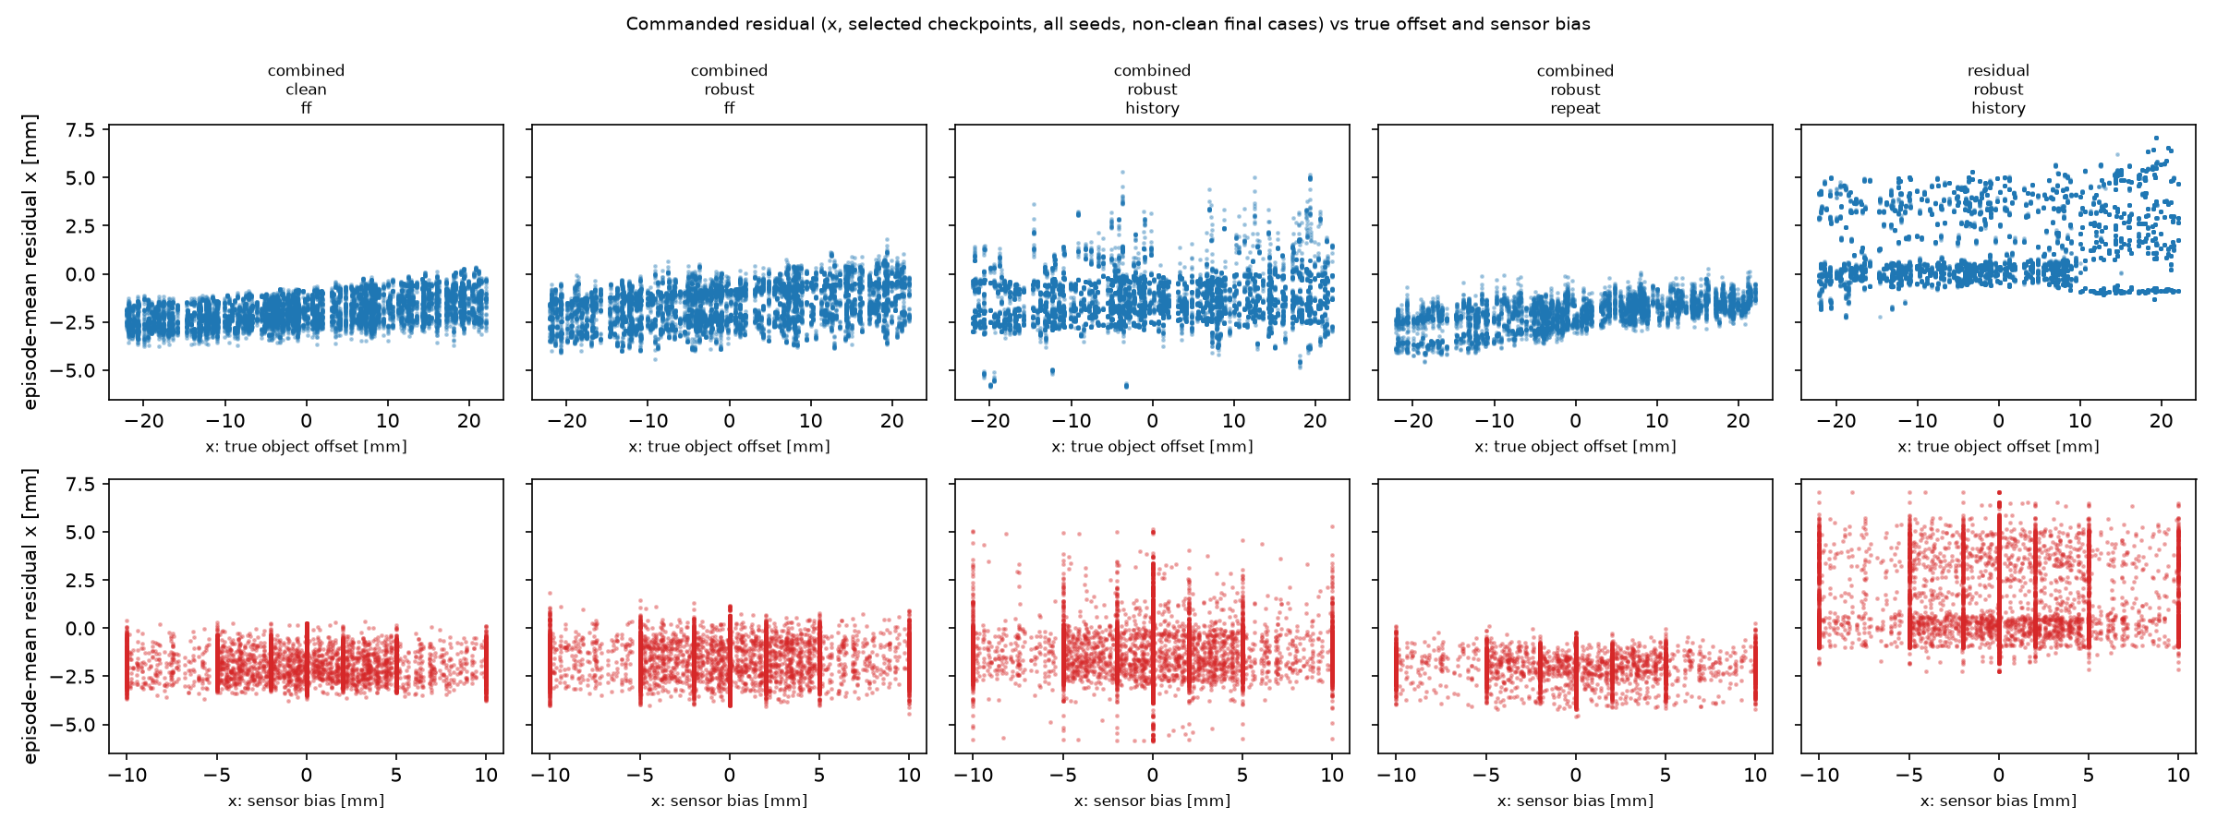
What the residuals do
• Combined: episode-mean x offset ≈ constant, -2.6 to -0.4 mm
• Slope on injected bias ≤ 0.008: ignores the sensor error
• Mean |residual| 2.0–7.8 mm, max 17.2 of 20 mm; no clipping
• Frames permuted / current-only: 325 and 325 of 325 successes (unmodified 325)
• Step-0 policies reproduce their controller: 65/65
Notes:
Each dot is one episode: mean commanded x residual against the true offset (top) and the injected sensor bias (bottom). Flat clouds mean the policy does not use either. The robustness comes from the estimator.

Slide 13
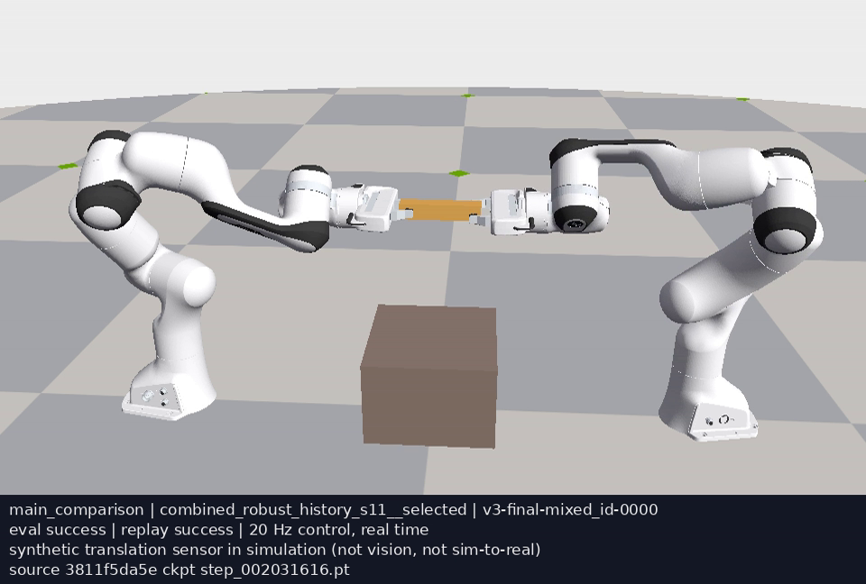
Repeatability and videos
• 65-case subset × 7 entries × 3 process seeds × batch 1/23: 2,730 of 2,730 terminal outcomes reproduced
• History − geometry_common: +0.0 [+0.0, +0.0] pp (batch 1), +0.0 [+0.0, +0.0] pp (batch 23)
• Sensor parameters identical in every rerun; a check at the ceiling, not of a nonzero effect
• Videos: 8 clips by a frozen rule + 43 s montage; 20 Hz, real time
  – No main-comparison failure exists in mixed_id / mixed_ood → none shown, none substituted
  – Evaluation vs single-env replay disagreements: 0
Notes:
Every clip has a sidecar with case, method, seed, checkpoint hash, camera and both outcomes. The index is results/v3/videos/video_index.json.

Slide 14
Conclusions
• H1 supported: noise breaks the raw estimate at the release gate; 10 mm bias causes collisions; delay is harmless
• H4 supported: a giver-grasp reference makes geometry perfect on all 2,600 held-out cases
• H2, H3 not testable: every selected combined policy is also at 100%
• History training was the least stable; validation selection prevented a large loss
• Learned residuals act as small constant offsets and ignore the sensor error
• Next step (would be a new study): harder suites, e.g. error after release, object motion, grasp slip
Notes:
The result reproduces the v2 pattern under corrupted sensing: when a strong, well-informed geometric controller exists, residual PPO adds nothing measurable here.

Slide 15
Limitations and artifacts
• Ceiling makes the primary contrasts uninformative; one object, fixed physics
• Giver reference assumes a rigid grasp with known offset and accurate giver proprioception
• Synthetic translation sensor only; simulation only; 5 seeds (3 for the memory control)
• Physical-transfer extension not performed (spawn overrides not validated before freeze)
• Release v3.0.0: source (experiment-v3 + v3.0.0), all checkpoints, raw records, logs, videos,
  – release_manifest.json, SHA256SUMS, archive inventories; fresh-download verification report
• AI-assisted: implemented, run and written by an AI coding agent (Claude Code) for the owner
Notes:
Everything needed to reproduce or audit the numbers is public. docs/v3/REPRODUCE.md has the commands; docs/v3/VERIFICATION.md records the fresh-download check.

