Slide 1
Uncertain Giver Grasp in Bimanual Handover — V4
Where a fixed grasp transform fails, and what fixes it · Isaac Lab 3.0 / Isaac Sim 6.2 (PhysX) · CSCI 645, Fall 2026 · Yan Wen
• Two Franka arms with parallel-jaw grippers hand over a rigid bar; success = receiver holds it alone for 2 s
• V4: the bar's position inside the giver's grasp is unknown (−7…+15 mm along the bar, ±15 mm vertical)
• Fixed-transform reference (V3) collapses: 5.5% at +15 mm
• 0.5 s calibration from the same noisy sensor restores it: 94.5%
• History / residual PPO: at most a few cases in distribution, worse outside the training support
• Release v4.0.0: 132,000 logical held-out episodes, every checkpoint and raw record
Notes:
Fourth study on the same handover. V3 showed that a controller using the giver's grasp to locate the bar saturates the benchmark — but it assumed the grasp transform is known. V4 removes that assumption physically and measures what breaks.

Slide 2
Why V4
earlier studies, quoted from their reports
• V1/V2: geometric coordination did most of the work; learned residuals ≈ small constant offsets
• V3: corrupted bar position (bias, noise, delay). Geometry + giver reference: 100% of 2,600 held-out cases
  – every learned policy also 100% → a ceiling; nothing could be ranked
• V3's key assumption: bar position = giver TCP + a known, rigid grasp transform
• V4 question: what if the bar sits somewhere else in the giver's fingers?
  – where does the fixed transform fail? do calibration, filtering, history or residual PPO help there?
Notes:
These are earlier-study results, not re-measured here. V4 keeps everything from V3 except the grasp.

Slide 3
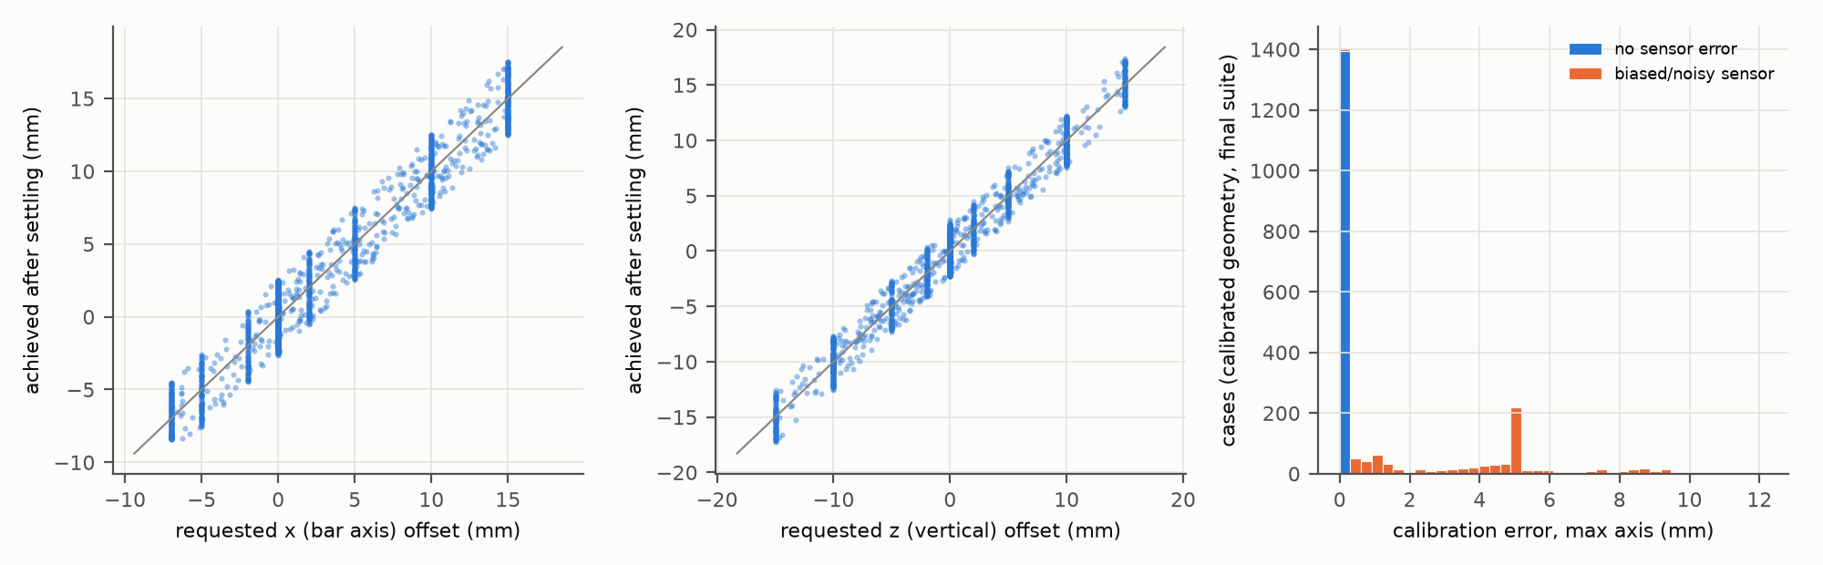
The unknown in-grasp offset is physical, not a sensor trick
• Reset: bar pinned at nominal + joint displacement + in-grasp offset; giver closes at its unshifted pose
• Pin removed → only finger contact holds the bar; validity checked after settling; achieved offset recorded
• No weld, no teleport during the scored episode; the true offset is never visible to a controller
• Feasibility probe (development): y re-centred by the fingers → not a supported axis
  – toward the palm: −10 mm touches the giver hand (invalid), −7 mm valid; toward receiver: +15 mm stable
• Training support: x ∈ [−5, +15] mm, z ∈ [−10, +10] mm, 25% zero; evaluation adds −7 mm and ±15 mm (z)
Notes:
The achieved offsets track the requests within about a millimetre. The right panel shows the calibration error: about zero without sensor error, about the bias with it.

Slide 4
Same information for every method
controller | how it locates the bar | fails when
fixed transform (V3) | giver TCP + nominal grasp vector | in-grasp offset (undetectable)
calibrated (0.5 s) | fixed transform + mean(measurement − fixed) over 10 frames | sensor bias (inherited)
EMA geometry (α 0.2) | filtered measurement only | bias, noise lag
learned residual (PPO, ±2 cm) | added to the calibrated parent or to nominal | outside training support
• Inputs for all: corrupted translation, proprioception, measured orientation, finger contacts, phase
• No controller reads the true offset, clean pose, case label or a future measurement (checked: A6/A8)
• Calibration window lies inside the common schedule (receiver pre-grasp at 1.0 s); timings include it
Notes:
Calibration cannot tell a sensor bias from a grasp offset — it removes their sum's grasp part but keeps the bias.

Slide 5
Develop → accept → pilot → freeze → train → validate → test
• Development: two registered baseline grids (≤ 36 configs) on 288 cases → calibrated parent (α 0.2, 0.5 s, 2.5 cm)
• Acceptance: V3 reproduced exactly (65/65 + 65/65), no hidden truth path, resets independent, resume works
• Pilots: 23,658,496 transitions (cap 24M) → V3 PPO settings kept; tag experiment-v4 frozen
• 25 formal runs: 5 profiles × seeds 111/222/333/444/555 × 10,027,008 transitions
• Checkpoint selection on 240 validation cases (2/4/6/8/10M; step 0 never eligible)
• Final: 12 conditions × 200 paired cases; 54 executed entries, 129,600 episodes
• Primary (mixed_id, selected): history − robust FF; history − best constant geometry; 10,000-draw paired bootstrap
Notes:
The development support was widened once before any training, because in round 1 the strongest baselines were already at the ceiling in the primary condition. Everything is logged with times in docs/v4/DECISIONS.md.

Slide 6
Result 1: the fixed transform breaks beyond ~+5 mm
held-out, 200 cases per condition
condition | nominal | fixed transform | EMA | calibrated
clean | 100.0 | 100.0 | 100.0 | 100.0
grasp_5mm | 64.0 | 95.5 | 100.0 | 100.0
grasp_10mm | 47.0 | 39.5 | 100.0 | 100.0
grasp_15mm | 38.5 | 5.5 | 94.0 | 94.5
bias_5mm | 72.5 | 100.0 | 100.0 | 100.0
mixed_id | 59.5 | 69.5 | 99.0 | 98.5
mixed_ood | 59.0 | 73.5 | 90.5 | 94.5
boundary_x_minus_7 | 48.0 | 96.0 | 96.0 | 96.5
• Calibrated − fixed on grasp_15mm: +89.0 [+84.5, +93.0] pp
• Failures are collisions with the bar end: the target lies inside the bar
• Vertical and palm-side offsets are tolerated by the fixed transform
• Sensor-only corruption does not hurt it (it ignores the sensor while the giver holds)
Notes:
Success in percent. The calibrated controller removes most of the failure at the cost of inheriting sensor bias.

Slide 7
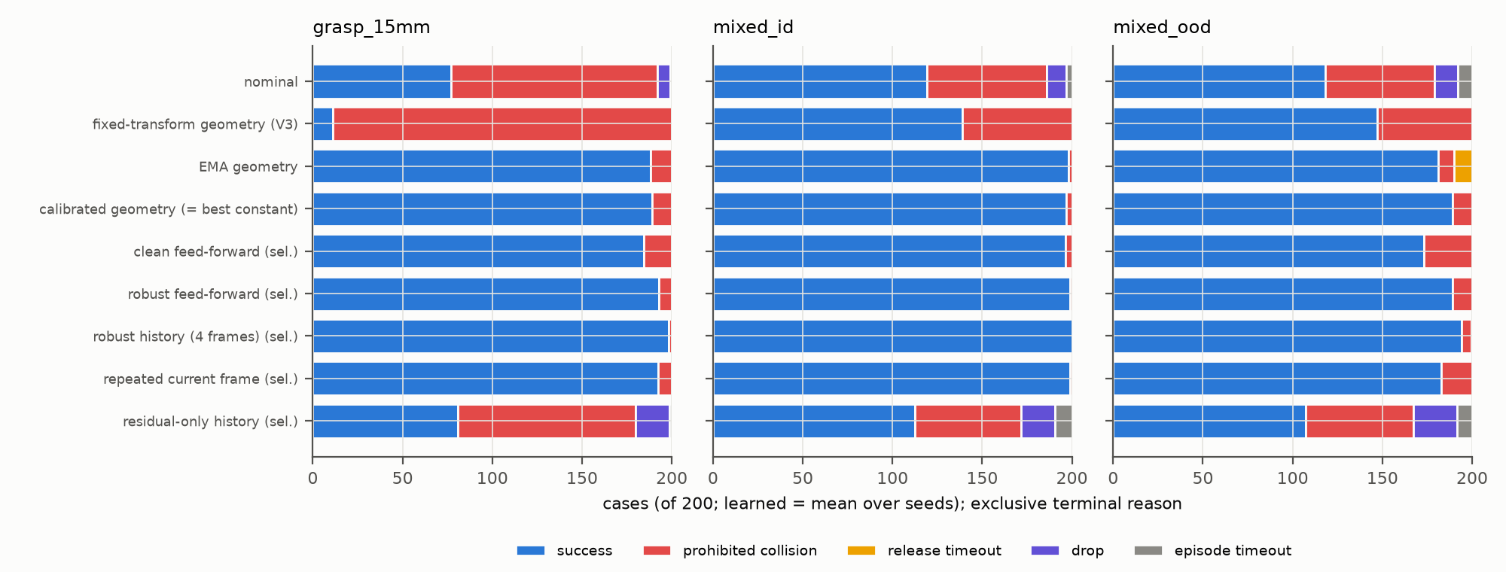
Failure modes by method
Notes:
Exclusive terminal reasons. Fixed transform: collisions. EMA: some release timeouts under heavy noise. Residual-only: collisions and drops.

Slide 8
Result 2: learned history adds at most a few cases
mixed_id, selected checkpoints, paired bootstrap
contrast | difference [pp] (95% CI) | 97.5% Bonferroni
history − robust feed-forward | +0.6 [+0.0, +2.0] | [+0.0, +2.1]
history − best constant geometry | +1.5 [+0.0, +3.5] | [+0.0, +3.5]
• Robust history: 100.0% on mixed_id; calibrated baseline 98.5%
• Both intervals touch zero → no improvement established; no equivalence claimed
• Deterministic baseline is one row, never counted as five seeds
• Final (10M) checkpoints instead: history − best constant = −1.5 [−5.5, +1.7] pp
Notes:
The two primary contrasts were frozen before any training. Selected checkpoints come from validation only.

Slide 9
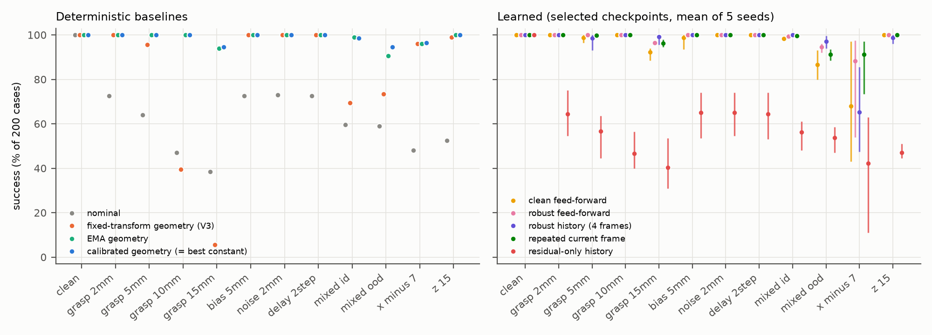
Result 3: fragile outside the training support
• Palm-side −7 mm (outside [−5, +15]): history 65.2% vs calibrated parent 96.5%
  – per seed 59.0 / 61.5 / 85.5 / 72.5 / 47.5%
• Over all non-clean conditions: history − parent = −2.3 [−3.9, −0.7] pp
• Residual-only on nominal: 56.3% vs nominal 59.5% (mixed_id)
Notes:
Validation did not include the palm-side boundary, so checkpoint selection could not detect this weakness.

Slide 10
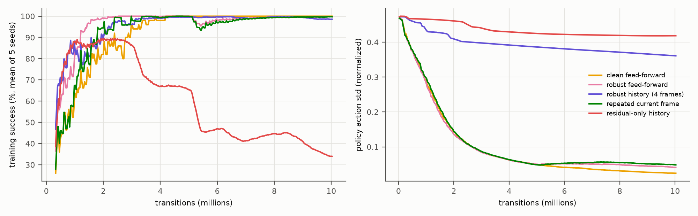
Result 4: late training instability (again)
• History final checkpoints: bias_5mm per seed 100.0 / 100.0 / 60.5 / 84.5 / 100.0%
• Residual-only collapses after ~3M transitions: final 33.3% on mixed_id
• Selected steps ({step: runs}): 2031616: 4, 4030464: 2, 6029312: 6, 8028160: 3, 10027008: 10
• Validation-based selection avoided most of the late damage
Notes:
Same pattern as V3: some history seeds degrade late. Selected and final checkpoints are reported separately.

Slide 11
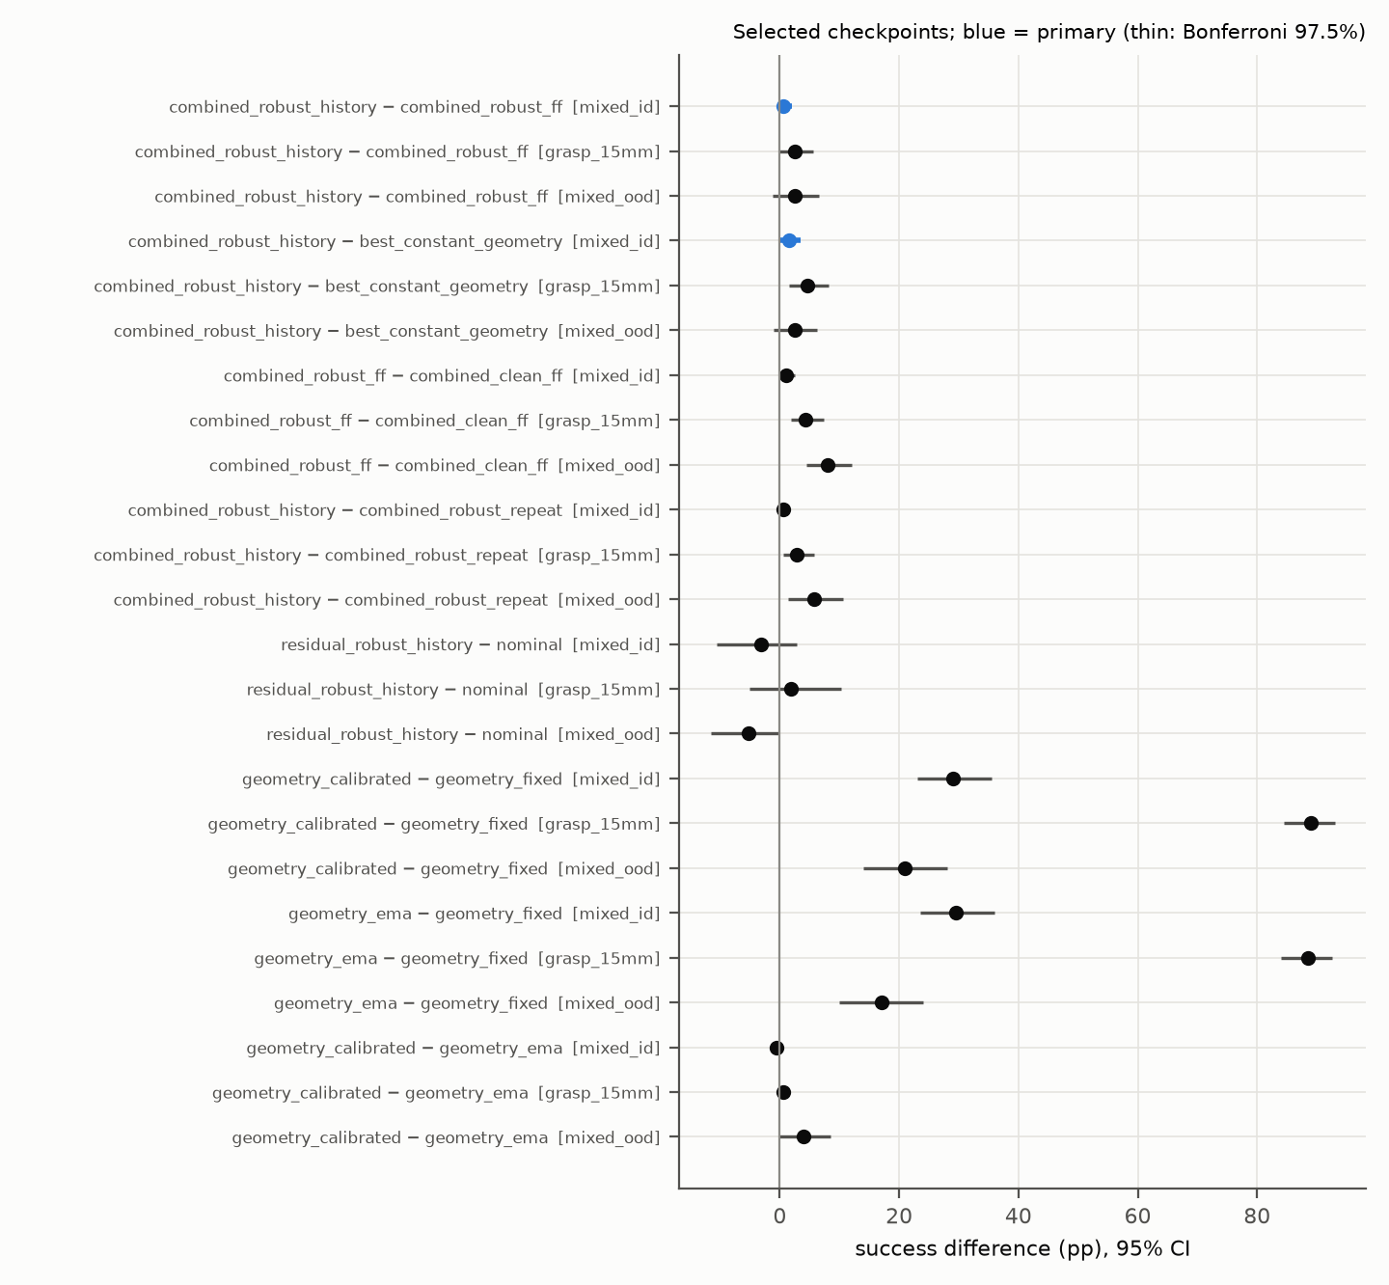
Paired effects (selected checkpoints)
Notes:
Calibrated vs fixed is the large effect. Learned-vs-learned and learned-vs-parent effects are small or negative.

Slide 12
What do the learned residuals do?
60-case subset (5 per condition), selected history runs
run | policy | reversed | current only | dev constant | parent
history s111 | 57 | 57 | 55 | 60 | 60
history s222 | 58 | 57 | 57 | 60 | 60
history s333 | 59 | 60 | 59 | 60 | 60
history s444 | 59 | 60 | 58 | 60 | 60
history s555 | 55 | 51 | 51 | 59 | 60
• A constant fitted on development records does as well as each policy (or better)
• Reversing or removing frame order changes only a few outcomes → little temporal use
• Residual-only seeds 222/333 learned ~1 cm offsets (+9.1, −11.0, −11.8 mm) and fail
• Untrained step-0 checkpoints reproduce their parents (60/60)
Notes:
Successes out of 60. This is the same picture as V2 and V3: learned residuals mostly encode a fixed offset.

Slide 13
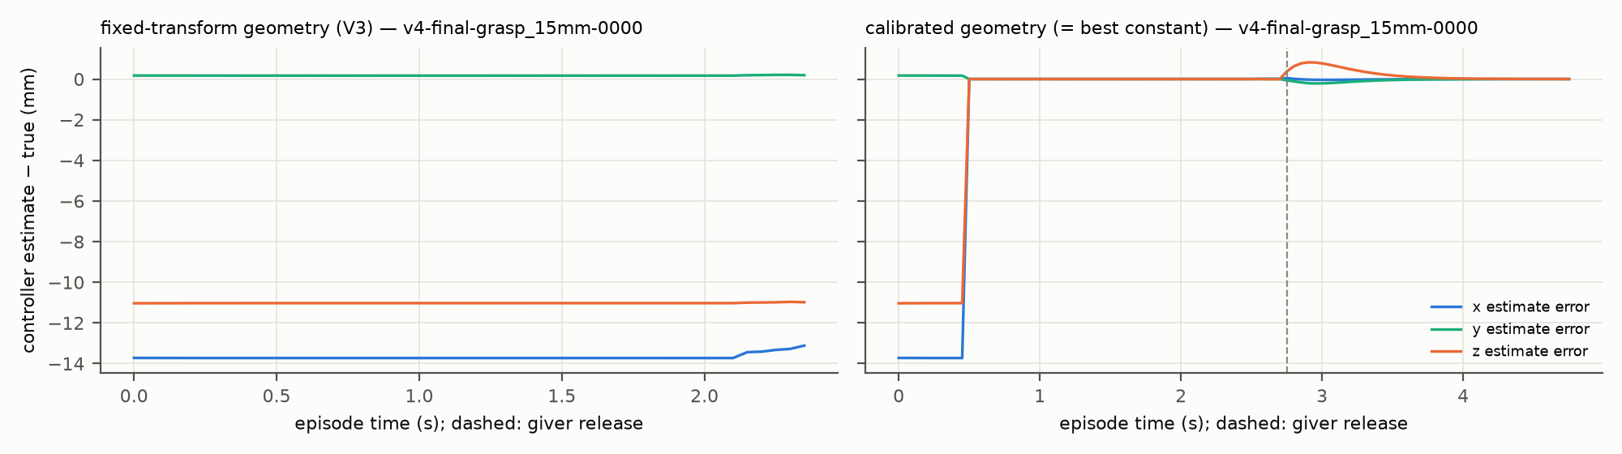
Repeatability, traces and videos
• Repeatability: 2,160 of 2,160 reruns (batch 6/20 × 3 process seeds) reproduce the outcome
• Six-case trace runs agree with formal records in 323/324 pairs
• 10 clips + 53 s montage by a frozen rule; replays = evaluations
• No selected history policy failed a mixed_id case → no failure clip, no substitute
• Trace: fixed transform keeps the offset as a constant error until collision; calibration removes it at 0.5 s
Notes:
The trace shows the mechanism of the boundary directly. Videos are in the release with a montage.

Slide 14
Answer to the V4 question
• The fixed-transform grasp reference breaks beyond ~+5 mm toward the receiver (39.5% at +10 mm)
• A 0.5 s calibration from the same noisy measurements is the effective fix (+29.0 [+23.0, +35.5] pp on mixed_id)
• Calibration inherits sensor bias; EMA filtering is a close second in distribution
• Residual PPO and short history add at most a few in-distribution cases (primary CIs touch zero)
• …and they are fragile outside the training support and late in training
• Practical lesson: estimate what you can measure (calibrate) before learning a residual
Notes:
A measured failure boundary plus a strong geometric remedy; no positive RL result, consistent with V1–V3.

Slide 15
Limitations
• Static in-grasp offsets only; dynamic slip not performed (no slip-robustness claim)
• Synthetic translation sensor, one bar, simulation only (no vision, no sim-to-real)
• Calibration assumes accurate proprioception/orientation and a still giver during 0.5 s
• Near-ceiling primary condition (calibrated 98.5%): small effects, no equivalence claim
• Training support widened once during development (logged); −7 mm boundary was outside it and outside validation
• 380 invalid resets at the −7 mm palm limit count as failures for every method
• Five seeds per profile
Notes:
All limitations are also in the report, Section 10.

Slide 16
Everything is released
github.com/ywen0511/CSCI645-Project · release v4.0.0
• Tags: experiment-v4 (simulator source of every run) and v4.0.0 (analysis, report, packaging)
• Every checkpoint (formal, pilot, smoke, resume, killed attempt), raw record, log, ledger, video
• Manifest + per-archive member inventories + SHA256SUMS; checkpoint index with asset/member/SHA-256
• docs/v4/REPRODUCE.md: anonymous download → verify → regenerate tables/figures → replay/reload/resume
• Compute: 16.0 A100 GPU-hours for the whole continuation (cap 100)
• AI assistance: implemented, run and written by an AI coding agent (Claude via Claude Code) for the owner
Notes:
The public-download verification record is docs/v4/VERIFICATION.md on the branch.

