Slide 1
Local RAG Assistant
Using Microsoft Foundry Local
Shahd Srour · University of Reading · Accounting & Finance

Slide 2
The problem
• LLMs do not automatically know private documents.
• They can answer incorrectly when the answer is not in their context.
• A local project needs answers grounded in local files.
Private files
→ Unknown to model
RAG
→ Retrieves context first

Slide 3
What is RAG?
RAG means Retrieval-Augmented Generation.
Retrieval: search the local knowledge base.
Augmented generation: give the retrieved text to the model before it answers.
Question
↓
Relevant document chunks
↓
Local model answer

Slide 4
How the system works
Documents
↓
Chunking
↓
Embeddings
↓
Cosine similarity search
↓
Retrieved context
↓
Local LLM answer + sources
The important idea: the model answers using retrieved text, not only its training knowledge.

Slide 5
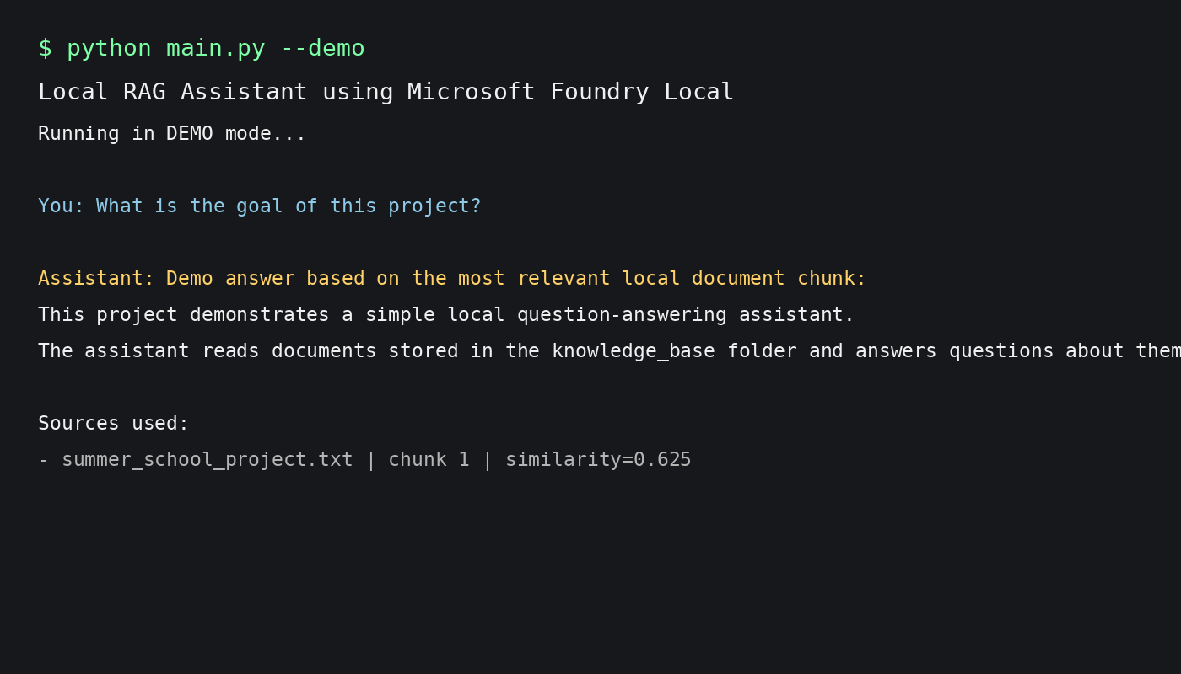
Demo
Demo steps:
• Run the Python app
• Ask a document question
• Retrieve relevant chunks
• Generate an answer
• Show the source file

Slide 6
Conclusion
This project shows how local AI can answer questions using private documents.
Future improvements:
• Graphical user interface
• More file types
• Vector database
• Conversation history
Local data
+ Retrieval
+ Local model
= Grounded answers

