Slide 1
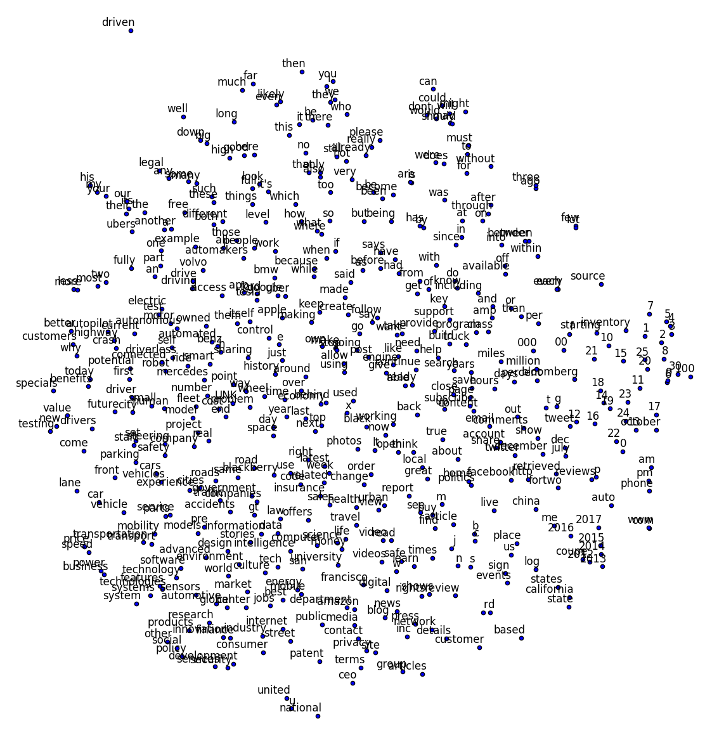
전치사들, be동사들, e.g., without, for, must, after, can, could, was…
numbers
vehicle, vehicles, car, cars
states, california, state
research, technology,
system

