Slide 1

High Performance Quantum Well InGaAs-On-Si MOSFETs With sub-20 nm Gate Length For RF Application
C. B. Zota, C. Convertino, Y. Baumgartner, M. Sousa, D. Caimi and L. Czornomaz
*IBM Research GmbH Zürich Laboratory, Säumerstrasse 4, CH-8803 Rüschlikon, Switzerland
E-mail: zot@zurich.ibm.com
reporter: shanyu
IEDM18-907

Slide 2
Contents
1. Introduction
2. Fabrication
3. Result
4. Conclusion

Slide 3
Introduction
High-electron mobility Ⅲ-Ⅴsemiconductor
advantage
1.offer increased drive current at reduced V_{dd} .
2.be used as channel in state-of the-art HEMTs
challenge
1.have to transfer a complex heterostructure onto a Si substrates
2.HEMT fabrication utilizes a flow which is typically not compatible with Si CMOS

Slide 4

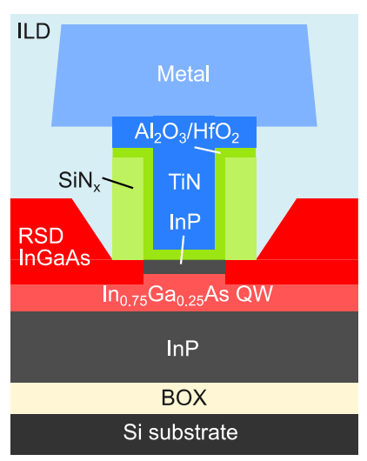
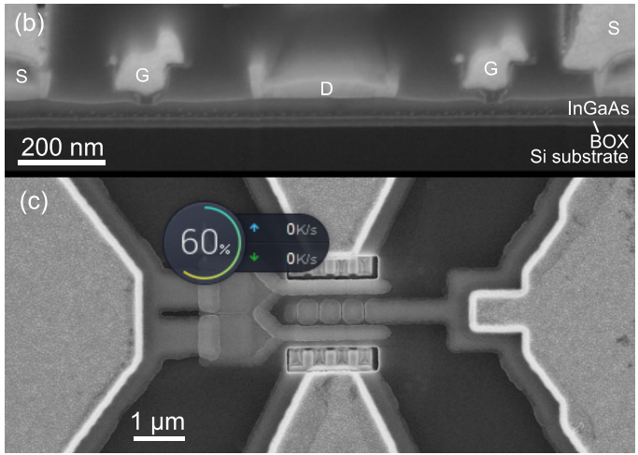
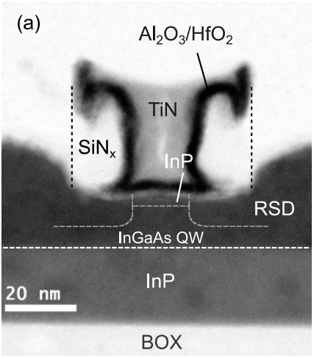
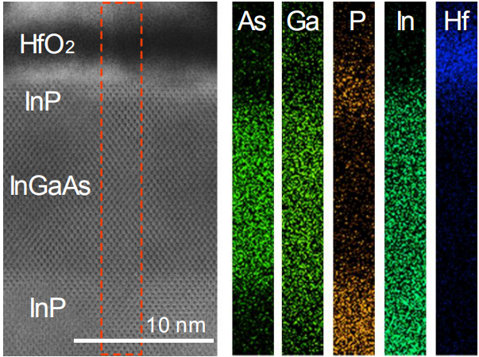
cross-section schematic of the fabricated
InGaAs-On-Si quantum Well RF-MOSFET
(b) is SEM image of two fingers,and (c) is top view
SEM image
STEM image
HRTEM image of the channel region

Slide 5

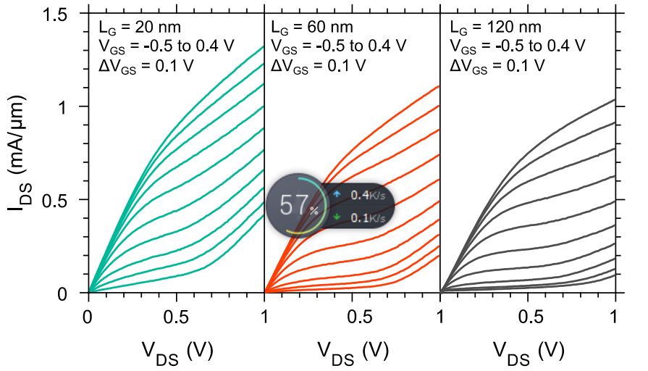
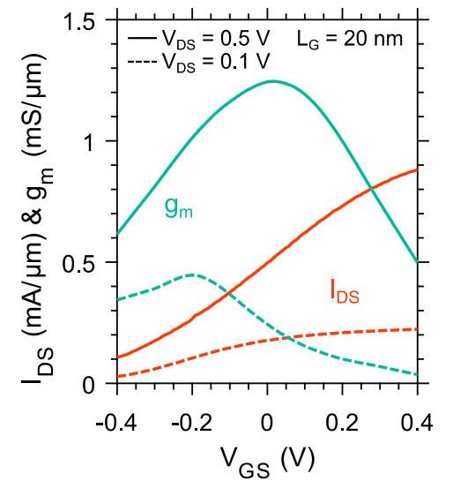
Device are first characterized under DC
(a)output characteristic
(b)Transfer characteristic
The on-resistance, R_{ON}, for the three Devices is 400, 470, and 525 Ωμm in(a).
Without the top barrier,peak transcondance can obtain at V_{GS}=0.3V

Slide 6
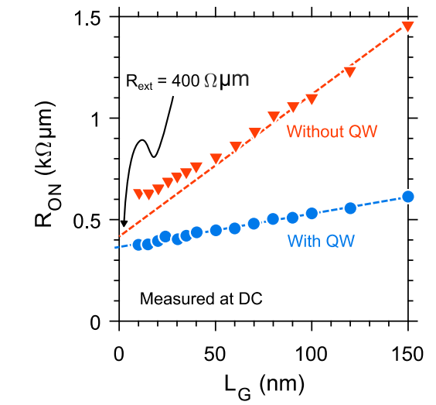
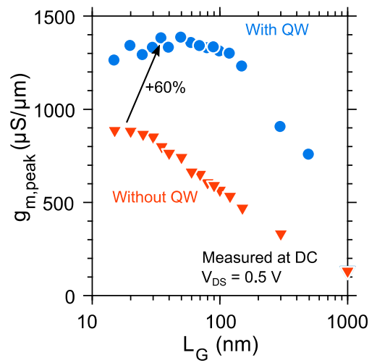
Result
with and without QW
(a) R_{ON} versus L_{G}
(b) g_{m.peak} versus L_{G}
1. In (a),the mobility of Device with and without QW is 1500 and 500cm²/Vs.
2. In (b) , in scaled devices, those operate in quasi-ballistic regime .
In long channel devices, those operate in the drift-diffusion regime .

Slide 7
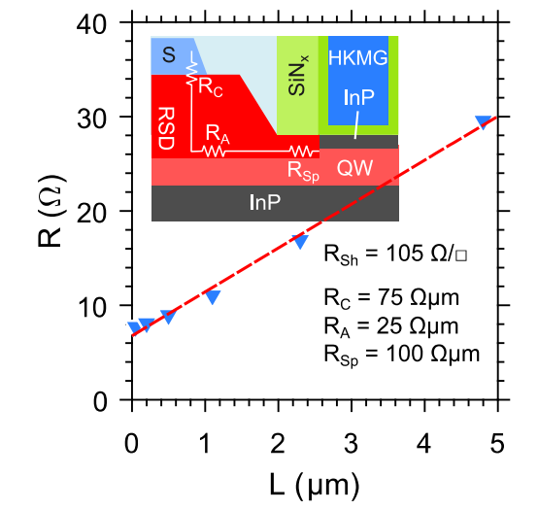
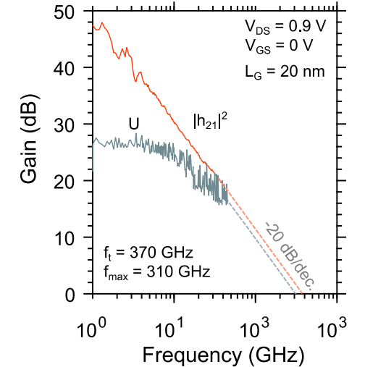
Result
we have obtained the R_{ext}.and we can deduce the R_{Sp} from R_{ext}/2=R_{C}+R_{A}+R_{Sp}

Slide 8
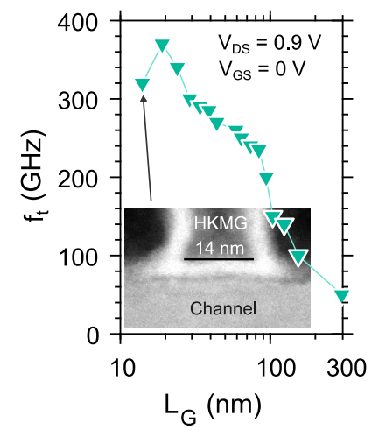
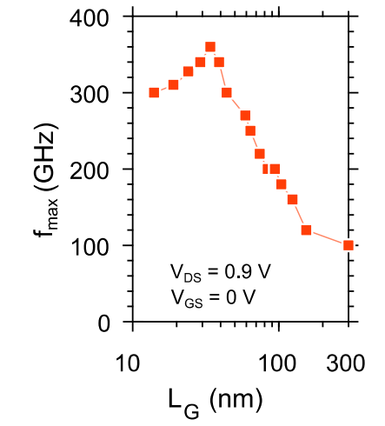
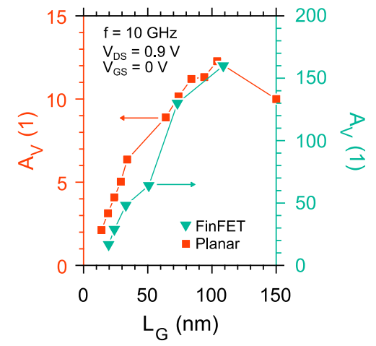
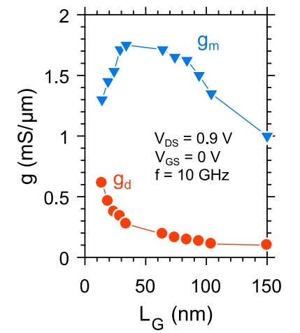
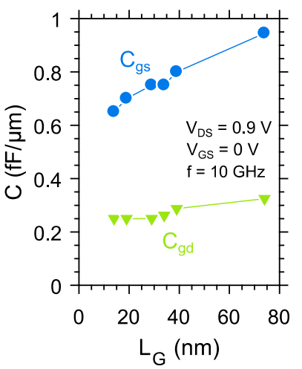
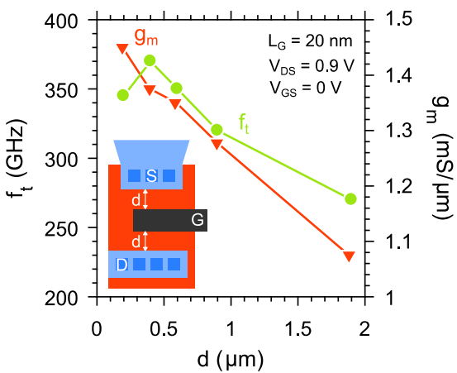
Result
A_{V}=g_{m}/g_{d}
f_{t} peak at 370Hz for L_{G}=20nm
f_{max} peak at 360Hz for L_{G}=35nm

Slide 9
Conclusion
Demonstrated quantum well InGaAs RF-MOSFETs integrated on Si substrates with LG down to 14 nm.
L_{G}= 20 nm devices exhibit extrapolated f_{t}= 370 GHz and f _{max}= 310 GHz, the highest reported for III-V MOSFETs on Si.
This is the first demonstration of III-V-on-Si clearly outperforming Si RF-CMOS, showing that III-V’s could make a significant impact in this field.

Slide 10


