Slide 1
ssb_bound_chx
ssb_total_chx
our
public
our
public
2840
177
307
1395
65
87

Slide 2
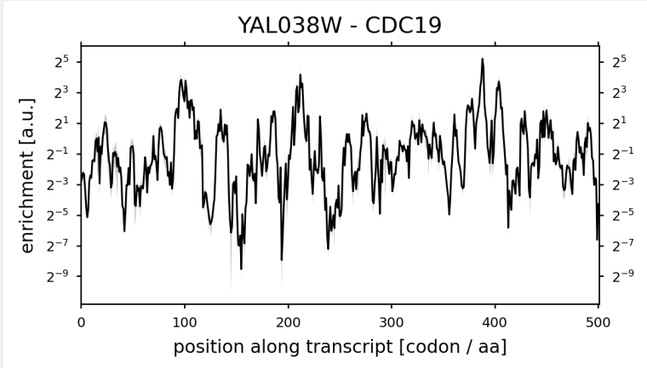
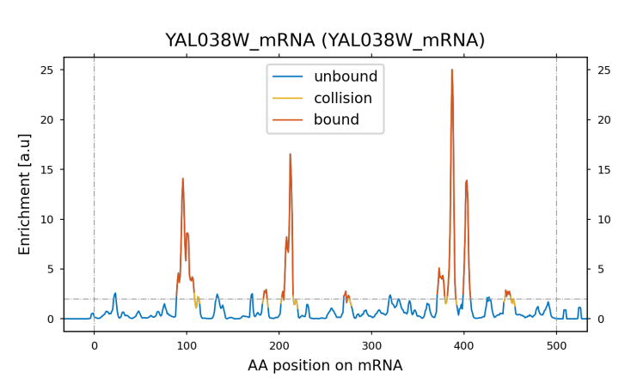
YAL038W

Slide 3
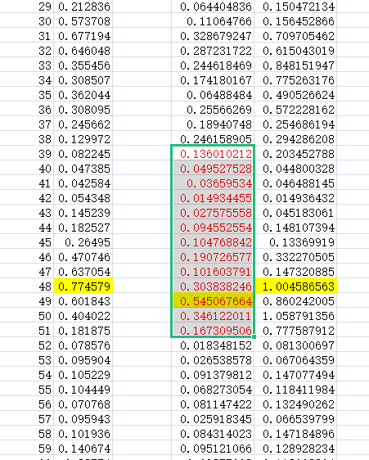
YAL038W

Slide 4
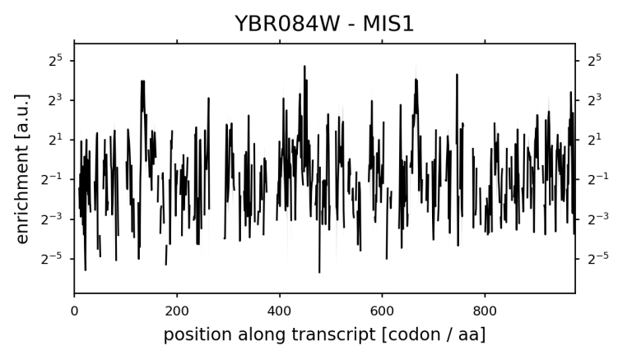
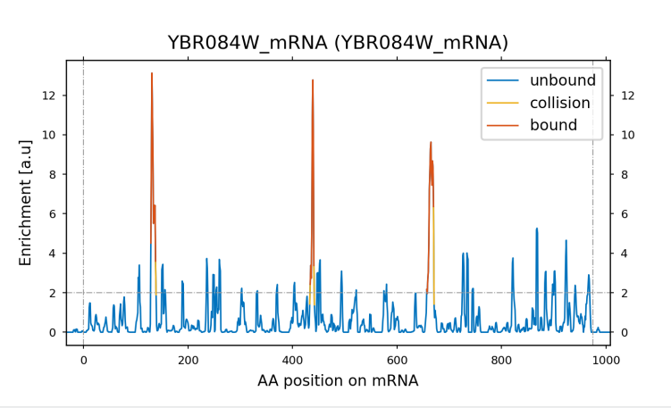
YBR084W

Slide 5
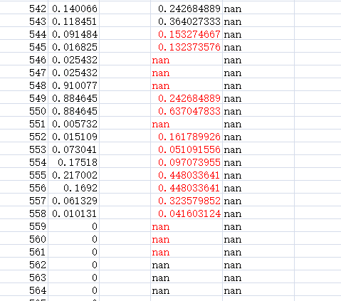
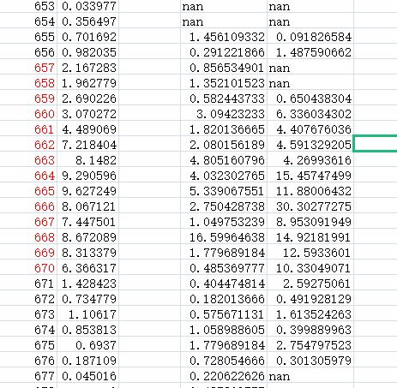
YBR084W

Slide 6
ssb_bound_puro
ssb_total_puro
our
public
our
public
3194
189
239
2935
93
103

Slide 7
tric_bound_chx
tric_total_chx
our
public
our
public
992
92
99
488
3
5

Slide 8
tric_bound_puro
tric_total_puro
our
public
our
public
160
12
13
184
0
1

Slide 9
tric_bound_apt
tric_total_apt
our
public
our
public
4626
694
1034
830
10
15

Slide 10
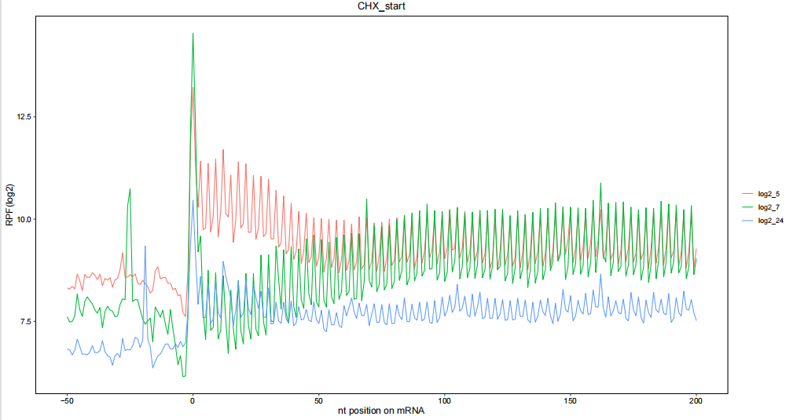
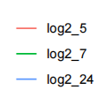
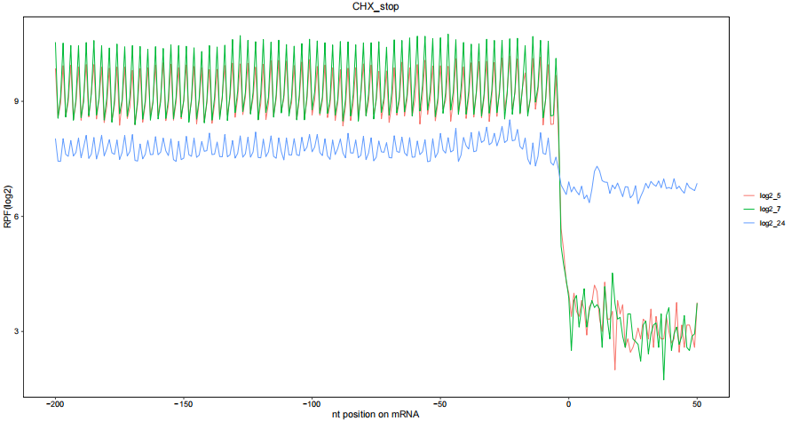
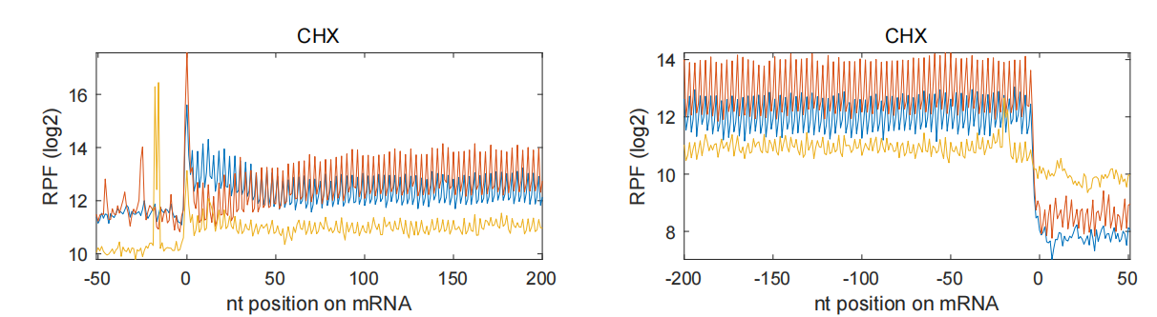


Slide 11
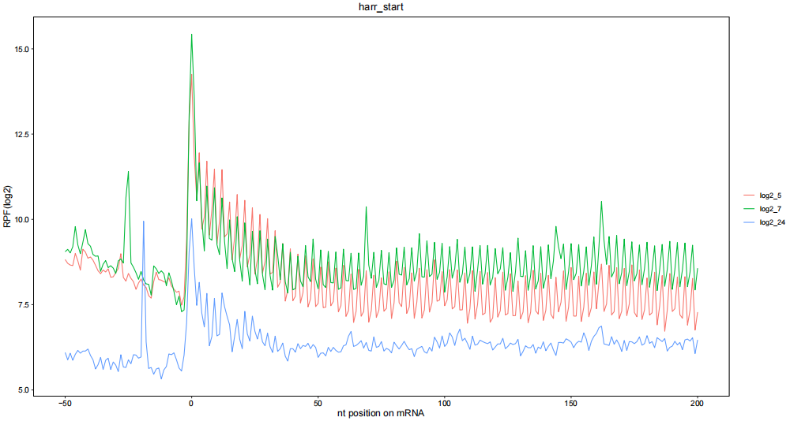
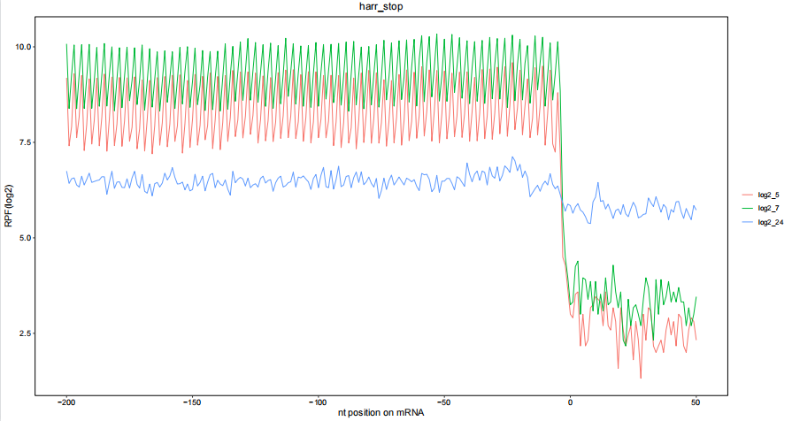

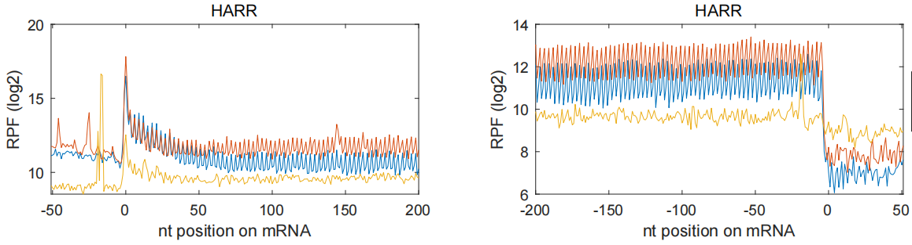


Slide 12
