Slide 1
ssb_bound_chx
ssb_total_chx
our
public
our
public
2778
178
311
1413
66
91

Slide 2
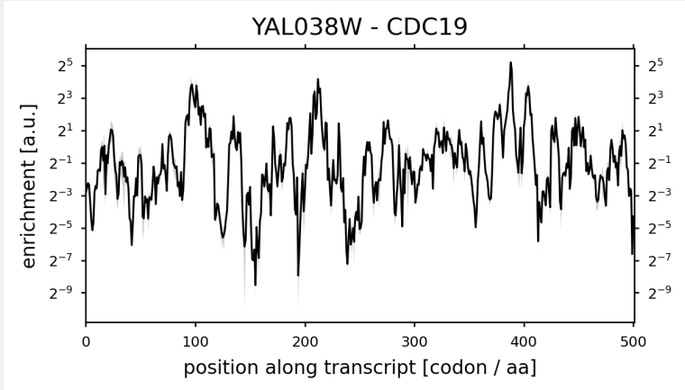
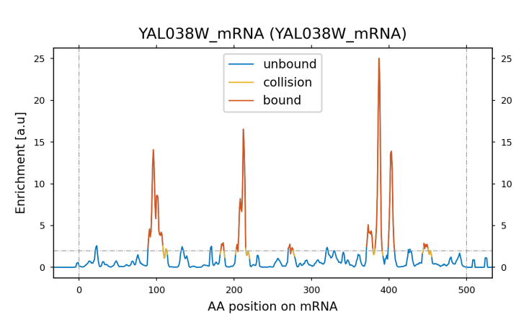
YAL038W

Slide 3
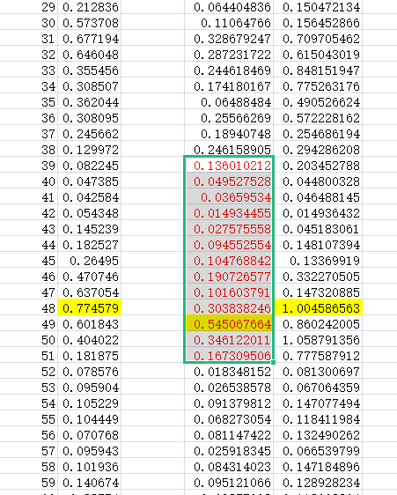
YAL038W

Slide 4
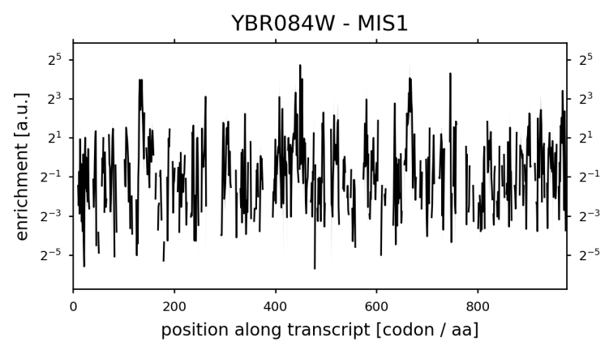
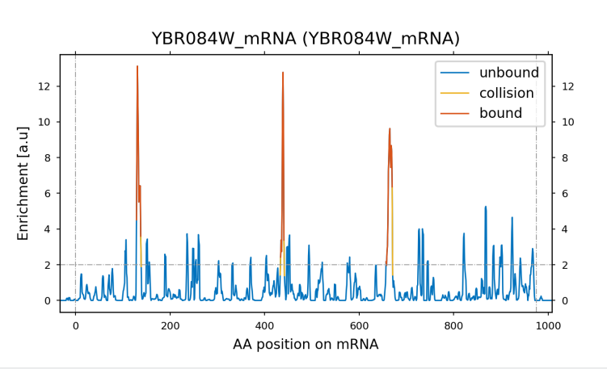
YBR084W

Slide 5
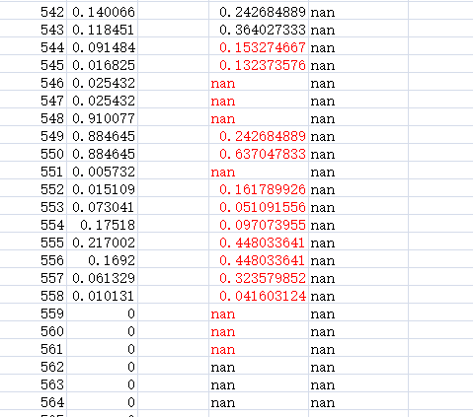
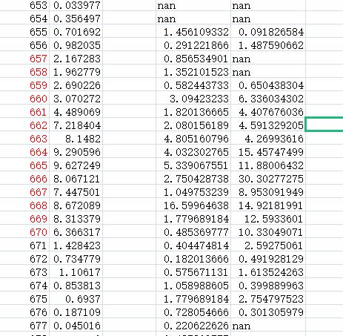
YBR084W

Slide 6
ssb_bound_puro
ssb_total_puro
our
public
our
public
3219
194
245
3017
97
111

Slide 7
tric_bound_chx
tric_total_chx
our
public
our
public
1012
91
102
506
3
9

Slide 8
tric_bound_puro
tric_total_puro
our
public
our
public
166
14
15
191
0
1

Slide 9
tric_bound_apt
tric_total_apt
our
public
our
public
4608
696
1040
859
12
19

Slide 11
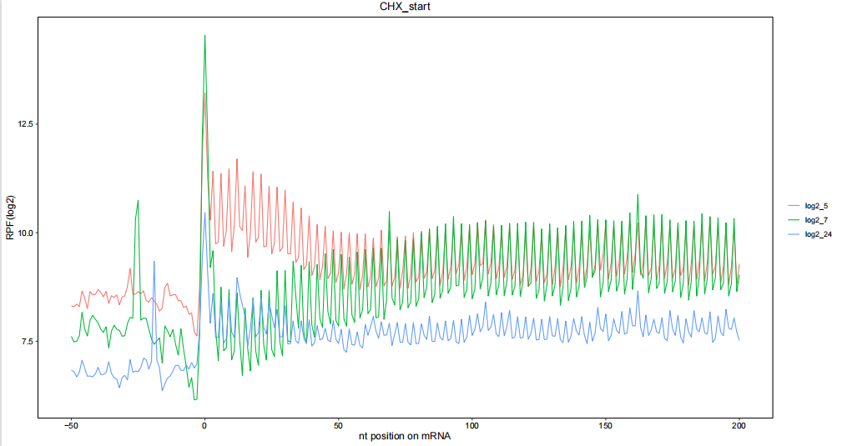
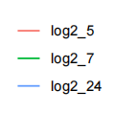
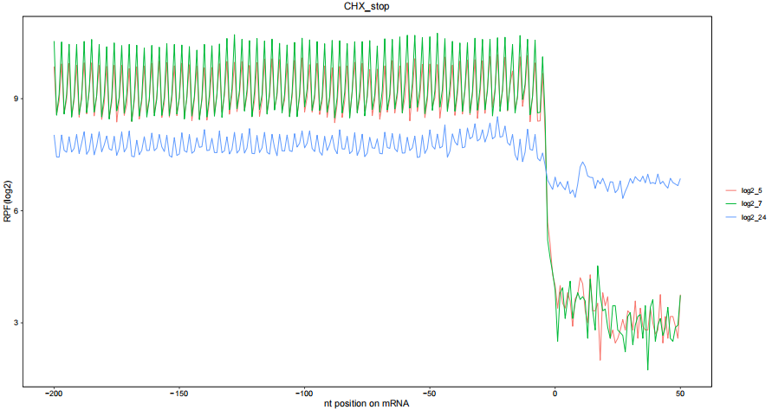
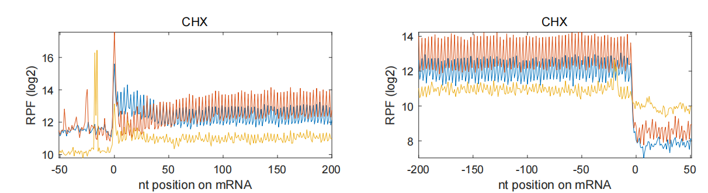


Slide 12
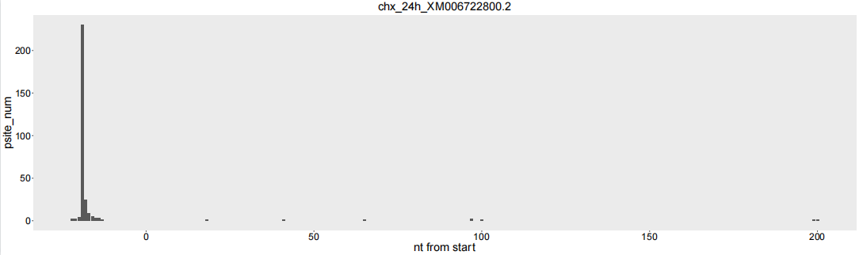
XM006722800.2
MAP2K7 mitogen-activated protein kinase kinase 7
This kinase is involved in the signal transduction mediating the cell responses to proinflammatory cytokines, and environmental stresses.

Slide 13
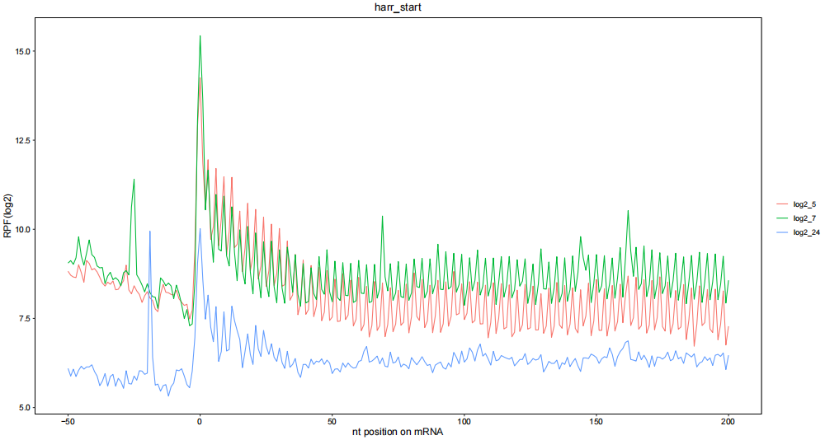
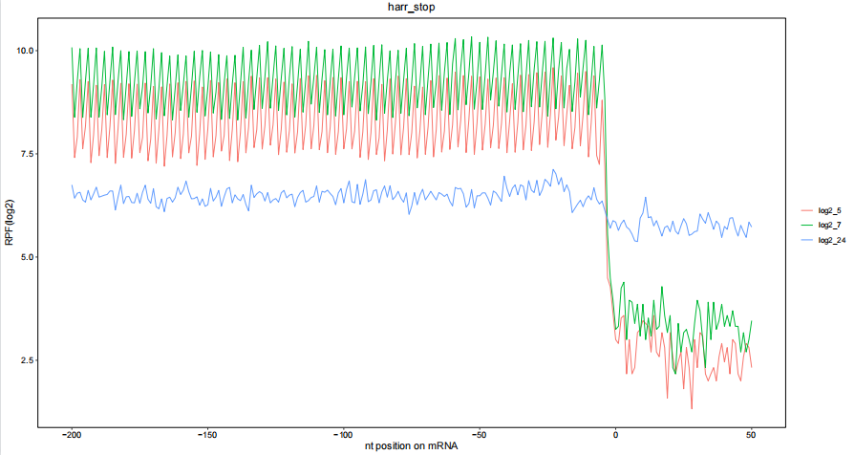

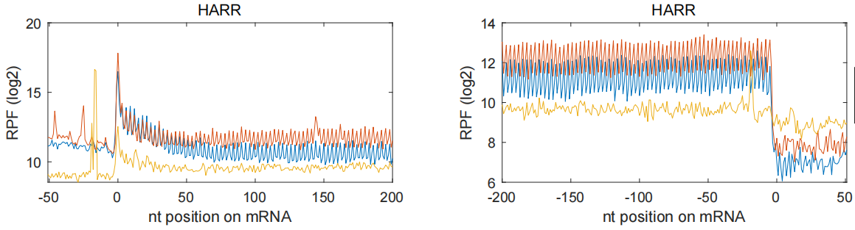


Slide 14
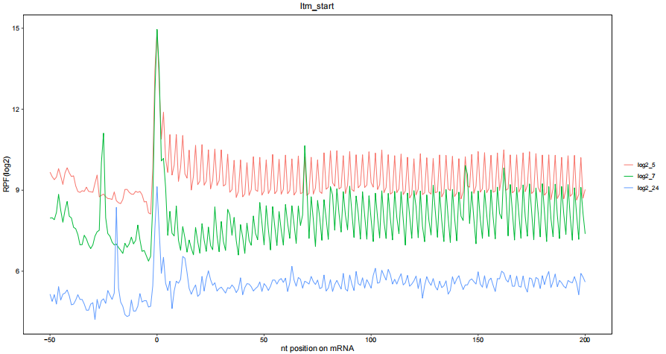
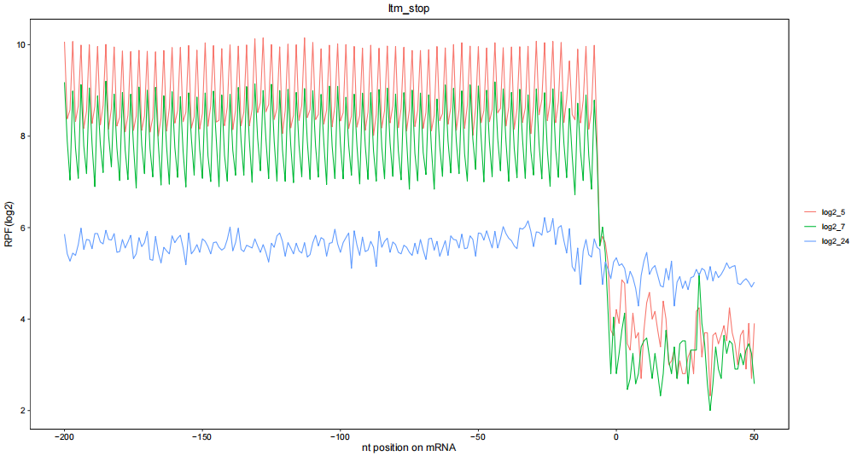

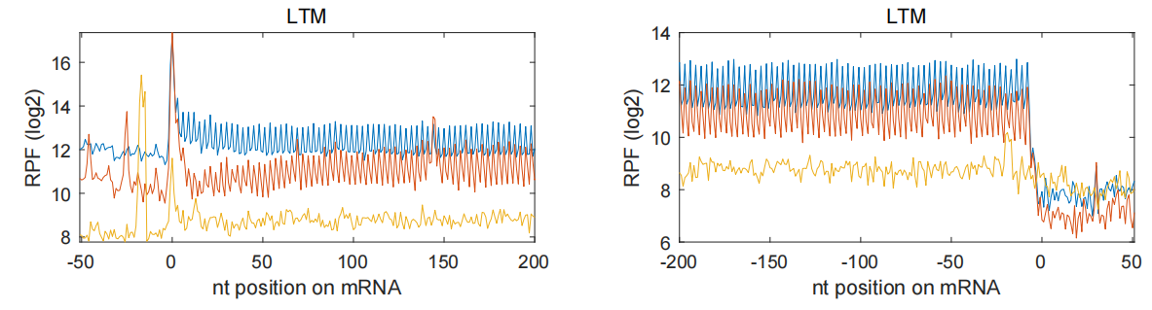


Slide 15
Peaks at -19nt from start coden

Slide 16
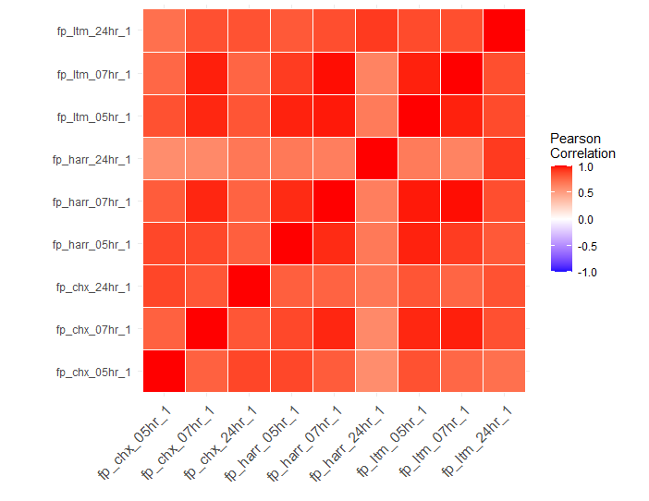
Correlation

Slide 17
