Slide 1
NYC Expense Budget From NYC Open Data https://data.cityofnewyork.us/City-Government/Expense-Budget/mwzb-yiwb

Slide 2
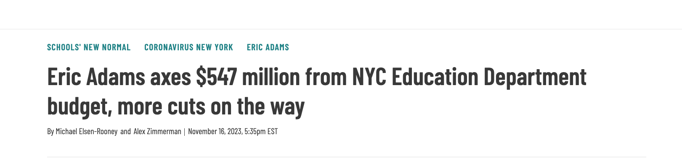
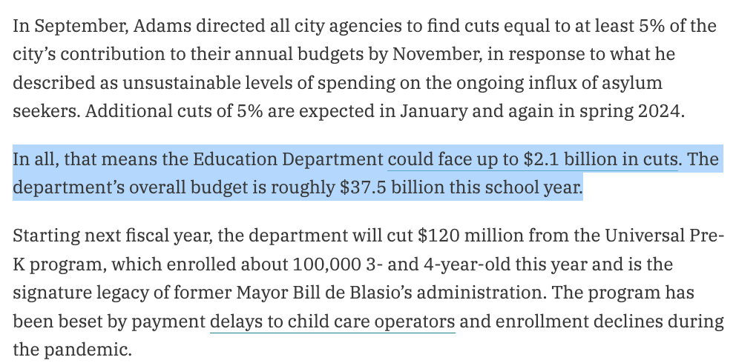

Slide 3

How does NYC allocate expense budget across different agencies?
This Photo by Unknown Author is licensed under CC BY-NC

Slide 4
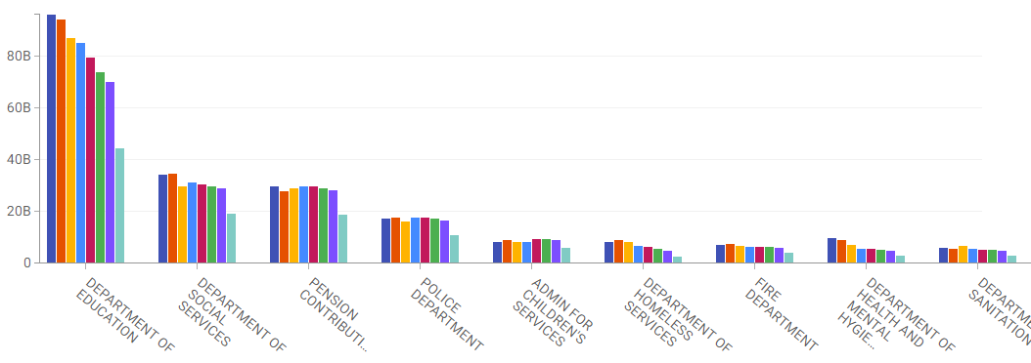

Data Overview
Time frame: 2017-2024
Showing top 10 (out of 146)
Group by fiscal year

Slide 5
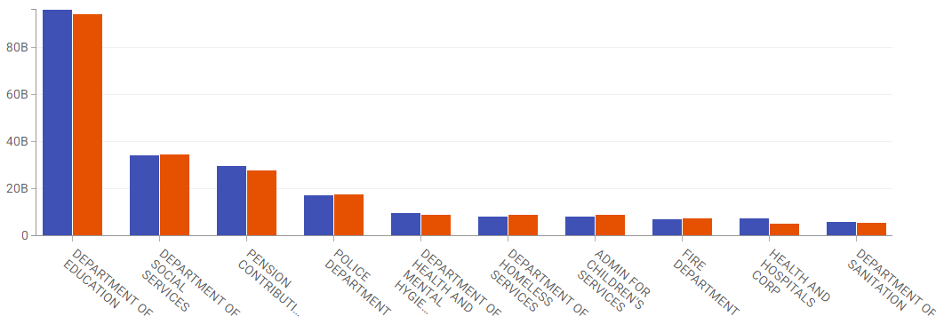

Compare FY 2023 Budget with 2024

Slide 6
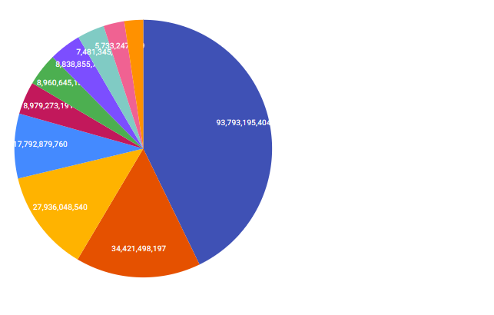
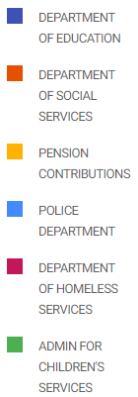
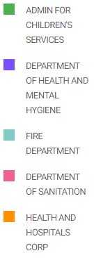
FY 2024 Budget Summary What is the proportion of the NYC expense budget allocated to agencies?

