Slide 1

Correlation of Life Expectancy with Education Team Compsognathus
John Clos, Ling Lu and Yuman Wu

Slide 2
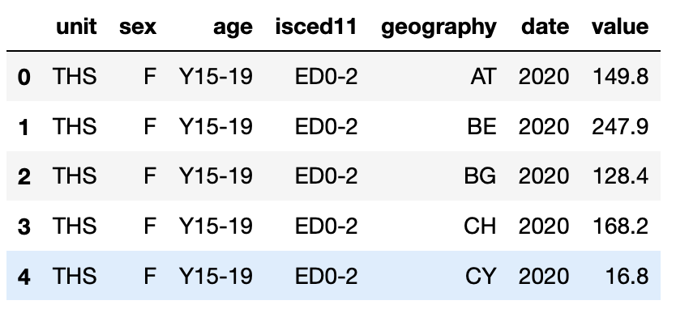
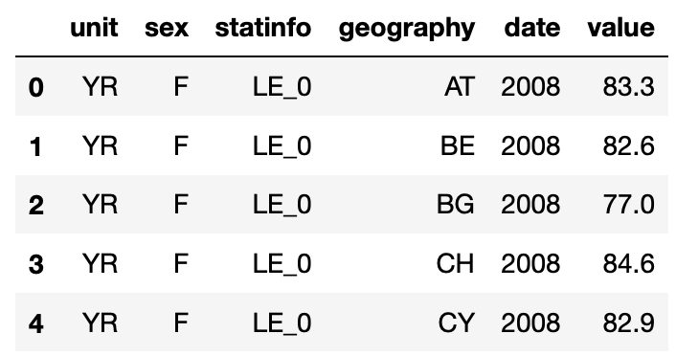
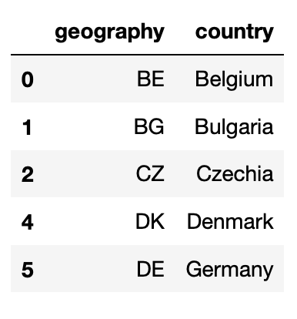
Project Objective
The objective of the project is to explore whether life expectancy correlated with the level of education in 31 Europe countries from year 2008 to 2019.
Data Sets:
Population By Education Levels in Europe (table 1)
Life Expectancy of Birth in Europe (Table 2)
Europe Country Abbreviations (Table 3)
Table 1
Table 2
Table 3
Notes:
This is the data sets we used, there are 29 age groups, and 4 education levels. We inner join table 1 and table 2 on sex, geography, and date. Then left join the new dataframe with table 3 on geography. Clean up new created dataframe and ready for analysis.

Slide 3

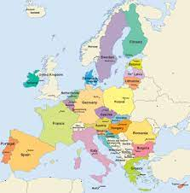
Hypothesis:
Higher education rates correlates with increased life expectancy
Is there a difference between males and females?
Does the education rate between countries influence their life expectancy?

Slide 4
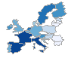
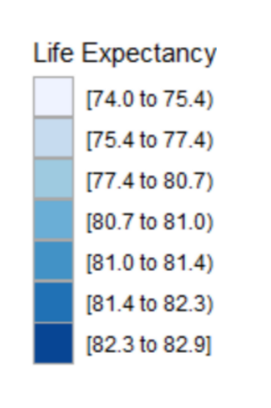
Choropleth Map of Life Expectancy for European Union Countries
Exploratory Data Analysis (EDA)
Notes:
This map shows the spatial life expectancy distribution across Europe countries. Eastern Europe definitely shows lower life expectancy than Western Europe.

Slide 5
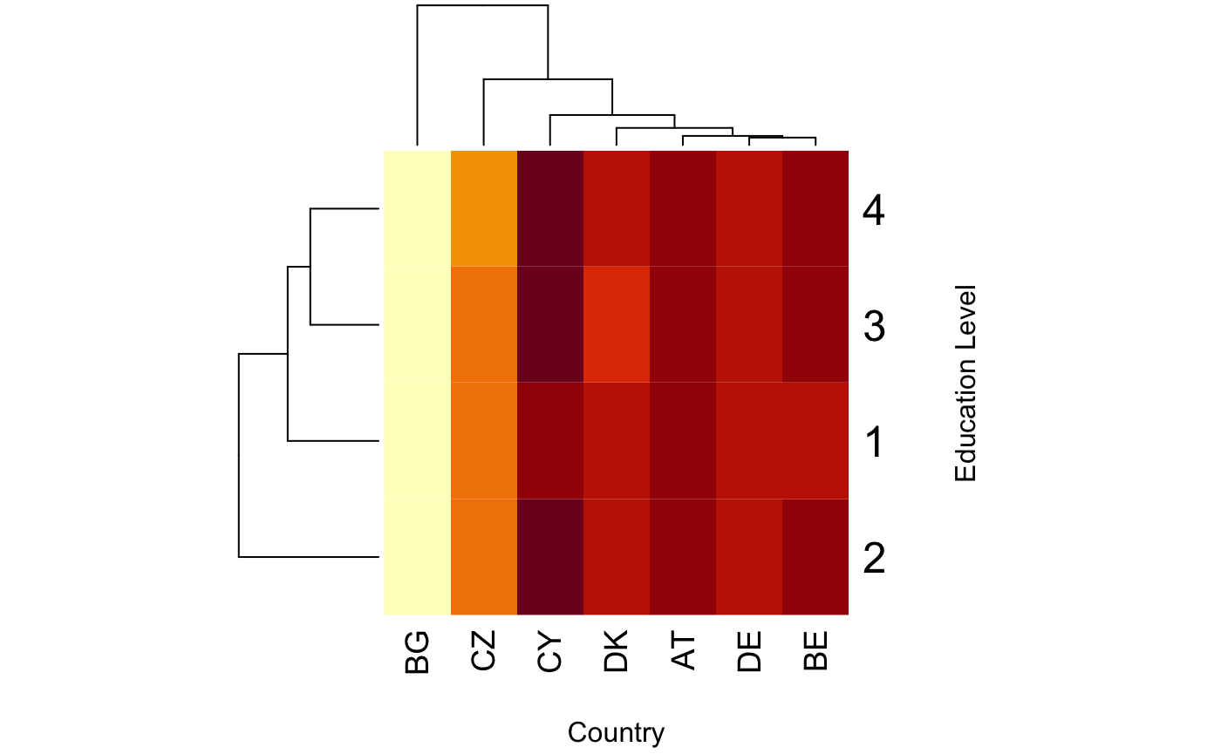
Heatmap with Education VS Life Expectancy
As number of rows increase, the life expectancy
Has increased

Slide 6
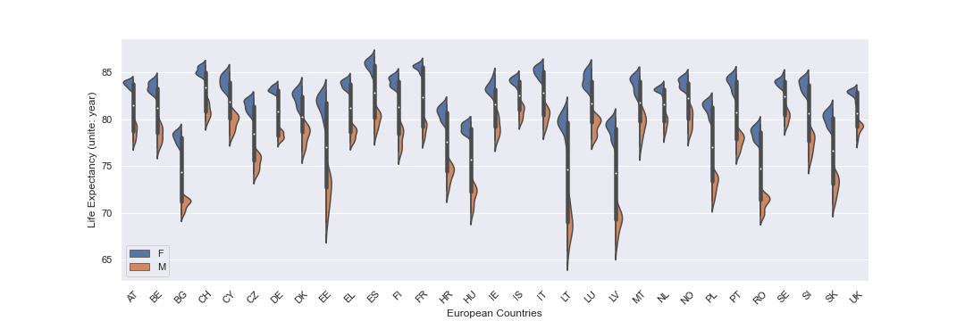
Life Expectancy by Country
Exploratory Data Analysis (EDA)
Notes:
This graph shows the life expectancy across each Europe country for male and female. We can see that men always have a lower life expectancy than women for each country

Slide 7
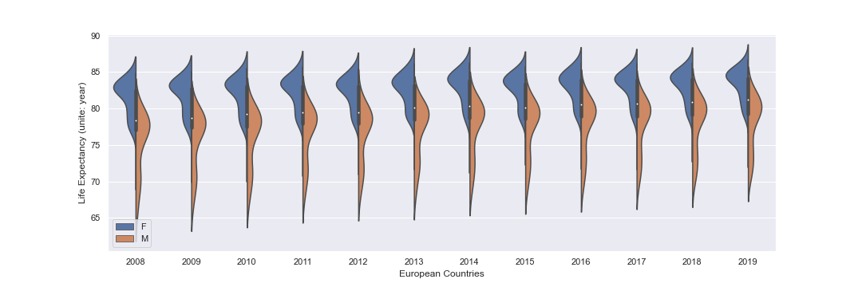
Life Expectancy by Year
Exploratory Data Analysis (EDA)
Notes:
Plots show that the distribution for women is shifted higher for life expectancy than men and also the range for men extends much lower

Slide 8
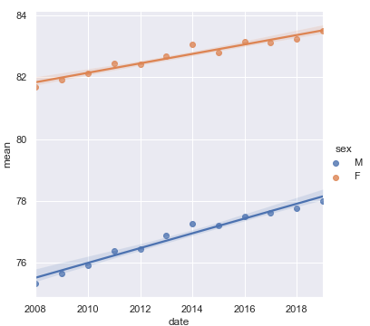
Average Life Expectancy regression over time
Exploratory Data Analysis (EDA)
Notes:
Life expectancy is improving each year, the improving rate of male are slightly higher than female

Slide 9
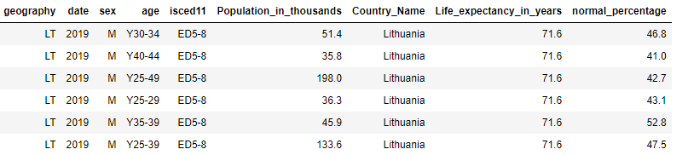
Data with High Education Rates (>40% ED5-8) and Lower Life Expectancy (<77 years)
Notes:
So if we filter the data for this range, we see that it is for Lithuania for the younger age ranges.

Slide 10
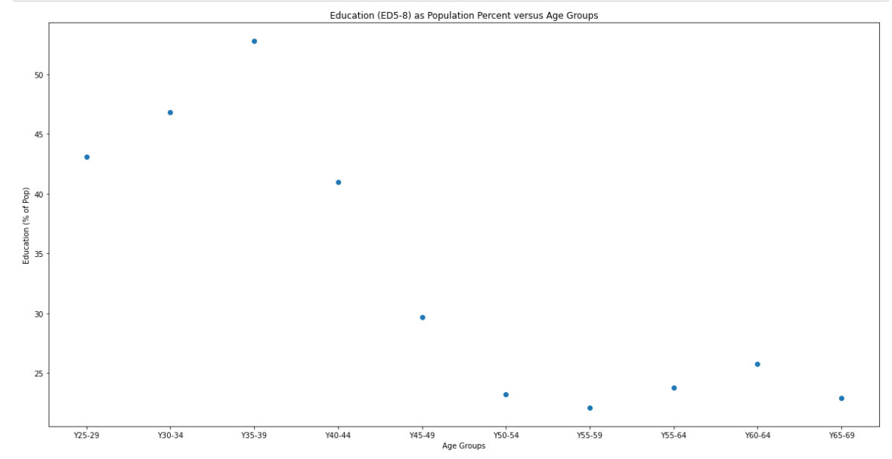
Correlation between Life Expectancy and Education (ED5-8) for Lithuania 2019
Notes:
So if we plot the data for Lithuania by age ranges, we see that the higher education rates are much better at the lower age ranges than the upper ones.
Maybe the improvement in education rates have not had a chance to improve the life expectancy for Lithuania.

Slide 11
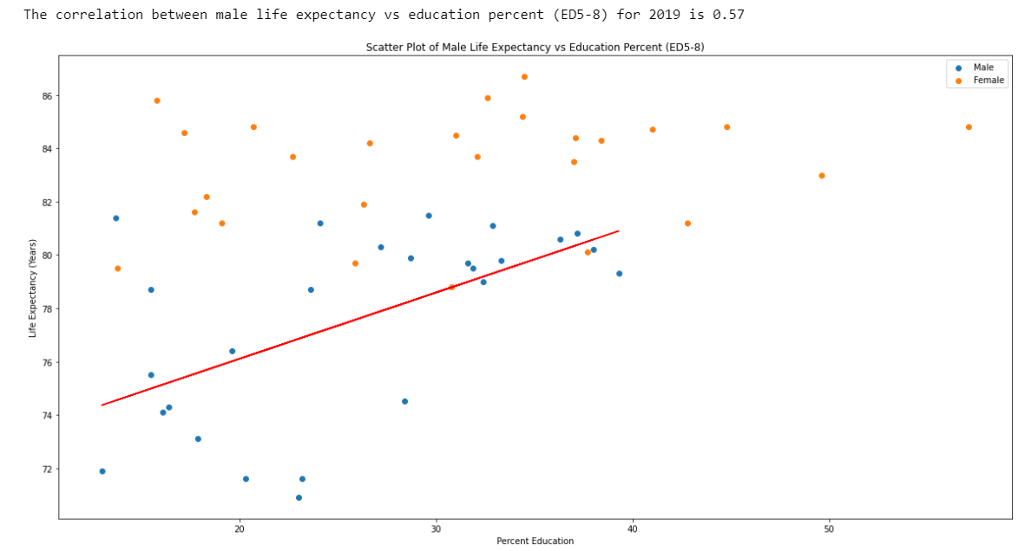
Correlation between Life Expectancy and Education (ED5-8) for 2019
Notes:
This shows that there isn’t a correlation for women with education, but for men there is a slight correlation. The reason might be that the jobs that women with lower education do not affect their health, but jobs that men have with lower education have a bad influence on their health.

Slide 12
Conclusions:
Higher education rates do correlate with increased life expectancy, but…
There is a difference when it comes to males and females.
The education rate between countries does have a slight influence on male life expectancy, especially at the higher rates.

Slide 13
Exploratory Data Analysis (EDA)
Chi-square test the education level difference among age groups
between female and male
All Education levels shows difference between genders | All Education levels shows no difference between genders
Germany | Ireland
Denmark | Luxembourg
Croatia
United Kingdom
Notes:
We run the chi-square test to see if the female and male education shows significant different among age groups for each Europe country, and we found that in Germany Denmark, Croatia, and United Kingdom, the population of female and male has significant difference in all the education levels. Meanwhile, Ireland and Luxembourg has no significant difference in all the education levels.

Slide 14
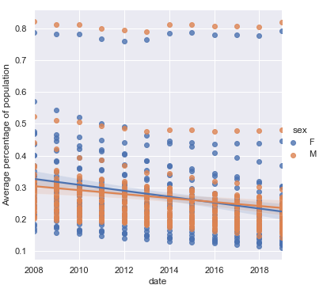
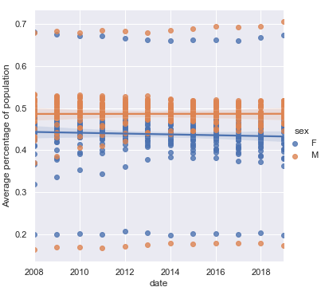
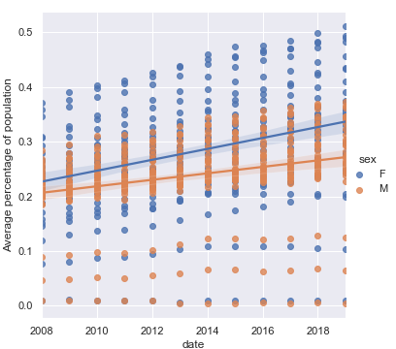
The trends of average percentage of population change over time among different education level. (average across all the Europe countries)
Exploratory Data Analysis (EDA)
Education level = ED0-2
Education level = ED3-4
Education level = ED5-8
Notes:
The population of primary education level decrease, and the population of bachelor or higher education level increase over time.

Slide 15
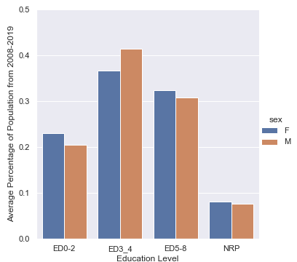
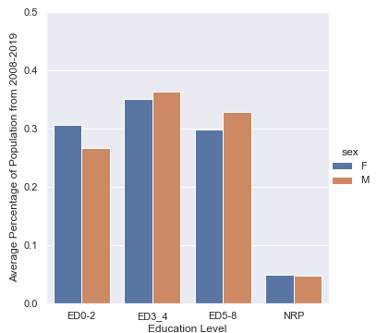
Average percentage of population for each education level
Exploratory Data Analysis (EDA)
UK
LU
Notes:
The bar charts show examples of the average percentage of population in United Kingdom and Luxembourg. There’s more population have secondary education level (ED3-4) in UK than LU.

Slide 16
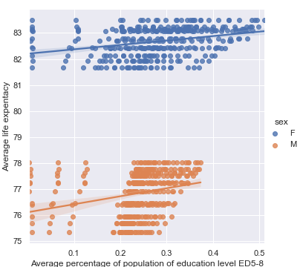
Average Life Expectancy regression over average percentage of population of education level ED5-8 across Europe countries
Exploratory Data Analysis (EDA)
Notes:
The average life expectancy increase with the increase percentage of population who has education level of Bachelor or higher.

Slide 17
Correlation between Life Expectancy and Education for European Union Countries
Notes:
The plot of all data doesn’t show us much.

Slide 18
Correlation between Life Expectancy and Education (All Data) for 2019
Notes:
When we just show the data for 2019 though, we can see that the life expectancy is much better for higher education rates except for a small group of data.

