Slide 1
Summer Internship Project
BMS and NCES
Department of Biostatistics
Evidence Generation and Decision Sciences
Yifan Wu
June 6, 2024

Slide 2


OX40L-OX40 Signaling as a Therapeutic Target in Atopic Dermatitis(AD)
Despite current AD treatment options, unmet needs still exist, such as^{1,2}:
Targeting heterogenous immune activation
Innovative treatment options with long-term durable response on- and off-drug
Extended dosing regimens
Drugs with minimal side effects
OX40 ligand (OX40L)-OX40 axis is a secondary co-stimulatory pathway that regulates the proliferation and survival of antigen-specific Th2 and Th1/Th17/Th22 cells, and the secretion of pro-inflammatory cytokines^{1,3-7}
Amlitelimab is a fully human, non-depleting, anti-OX40L monoclonal antibody that binds to OX40L on antigen-presenting cells (APCs), preventing interaction with OX40 on activated T cells^{1,7}
Antigen-presentation by APCs, an early aspect of the inflammatory cascade, represents a novel opportunity for effective intervention at an early stage of the immune response, preventing escalation of inflammation^{1,3}
A Phase 2a trial of amlitelimab IV high (500 mg/250 mg Q4W) and low (200 mg/100 mg Q4W) doses vs placebo in adults with moderate-to-severe AD met its primary endpoint of change in EASI from baseline to Week 16 while also showing acceptable safety¹
B7 (CD80/CD86)
CD28
Th2
Th17
Th22
Th1
OX40
APC
Activated T cell
X
IL-4
IL-13
IL-17
IL-22
IFNγ
OX40L
Amlitelimab
IL-5
IL-31
CD40
CD40L
Mast cells
Neutrophils
Eosinophils
T cells
B cells secreting IgE
Figure adapted from Fu Y, et al. Acta Pharm Sin B. 2020;10(3):414–433 and Haddad EB, et al. Dermatol Ther. 2022;12:1501–1533
AD, atopic dermatitis; APC, antigen presenting cell; CD, cluster of differentiation; EASI, Eczema Area and Severity Index; IgE, immunoglobulin E; IFNγ, interferon γ; IL, interleukin; IV, intravenous; OX40L, OX40 ligand; Q4W, every 4 weeks; Th, helper T cell.
1. Weidinger S, et al. Br J Dermatol. 2023;00:1–9; 2. Lobefaro F, et al. Biomedicines. 2022;10:2927; 3. Bieber T. Nat Rev Drug Discov. 2022;21:21–40; 4. Croft M, et al. Immunol Rev. 2009;229:173−191; 5. Leung DY, et al. J Allergy Clin Immunol. 2014;134:769–779; 6. Furue M, et al. J Clin Med. 2021;10:2578; 7. Fu N, et al. Front Immunol. 2021;12:670637.

Slide 3
STREAM-AD Phase 2b Trial Design (NCT05131477)
Week 0
Week 4
Week 16
Week 24
Week 52
Week 68
Primary endpoint
Randomized 1:1:1:1:1 (n=390)
Treated* (n=388)
Primary Endpoint
Key Secondary Endpoints
End of efficacy evaluations
End of follow-up
Percentage change in EASI from baseline to Week 16
R
Secondary endpoints
500 mg LD
500 mg LD
250 mg SC Q4W (n=77)
250 mg SC Q4W (n=77)
Percentage change in EASI from baseline to Week 24
Percentage of patients with EASI-75 at Week 16/24
Percentage of patients with IGA 0/1 at Week 16/24
Percentage of patients with reduction of weekly average of peak pruritus NRS ≥4 with a baseline peak pruritus NRS of ≥4 from baseline to Week 16/24
Incidence of treatment-emergent adverse events
Change in soluble protein blood biomarkers
ADA titers and incidence
YES
Withdrawal (placebo)‡
Safety follow-up‡
250 mg + placebo LD
250 mg SC Q4W (n=78)
R 3:1
Week
-4 to 0 Screened: N=589
Pre-Week 24 dose‡
Week 24 Response†
125 mg + placebo LD
125 mg SC Q4W (n=77)
NO
Enter LTE or Safety follow-up
62.5 mg + placebo LD
62.5 mg SC Q4W (n=79)
NA + placebo LD
Placebo SC Q4W
(n=79)
Completed to Week 24§: n=333
Discontinued study: n=51
Other ‖: n=6
Part 1 - Focus of today’s presentation
Part 2
*Two patients found to be not eligible after randomization. †Met EASI-75 and/or IGA 0/1 randomized to Withdrawal (placebo) or Pre-Week 24 dose groups; not EASI-75 and IGA 2/3/4 entered to LTE or Safety follow-up. ‡Patients demonstrating loss of clinical response during part 2 are entered preferably into the LTE (or Safety follow-up). §Completed to Week 24 are patients who have reached Week 24 regardless of whether they completed treatment period. ‖6 patients did not show as completed or discontinued study prior to Week 24: 5 patients discontinued the study without an ‘end of study visit’ (effort to reach patients will continue until the closure of the study), and 1 was in the safety follow-up period.
AD, atopic dermatitis; ADA, anti-drug antibodies; EASI, Eczema Area and Severity Index; IGA, investigator global assessment; LD, loading dose; LTE, long-term extension; NA, not applicable; NRS, numerical rating scale; Q4W, every 4 weeks; R, randomization; SC, subcutaneous; STREAM-AD, Study Testing Response Effect of KY1005 Against Moderate-to-Severe Atopic Dermatitis.

Slide 4
Project background
Change of expression of a gene from baseline
In a phase II clinical trial, the treated group was dichotomized to 2 subgroups based on the response variable
Responders who were responsive to the drug treatment
Non-responders who were not responsive to the drug treatment
Project goal
It is of interest to find drug-related biomarkers whose changes from baseline are associated with the drug response status
These drug-related biomarkers would help to find root cause of non-responsiveness, such as mutation
Non-responder
responder

Slide 5
Info about data
Biomarker data
Bulk RNAseq data (measuring mRNA abundance in whole genome scale)
“bulk” indicates mRNA abundance was not measured at single cell level, instead at tissue level
Olink data (measuring protein abundance in whole genome scale)
clinical biomarkers (~10 continuous clinical variables)

Slide 6
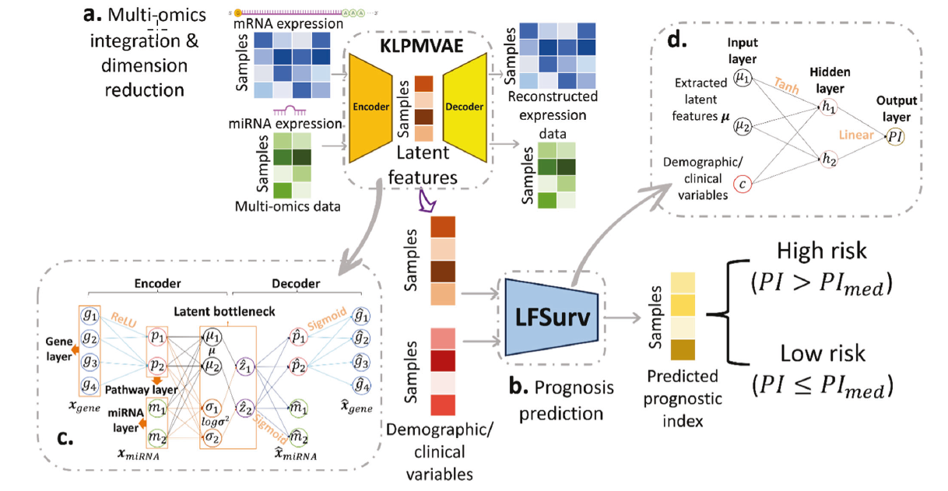
Deep learning approach
AUTOSurv: interpretable deep learning framework for cancer survival analysis incorporating clinical and multi-omics data
npj Precision Oncology (2024) 4
We released AUTOSurv with source code, executable file, testing data, and tutorials at
https://github.com/jianglindong93/AUTOSurv.

Slide 7
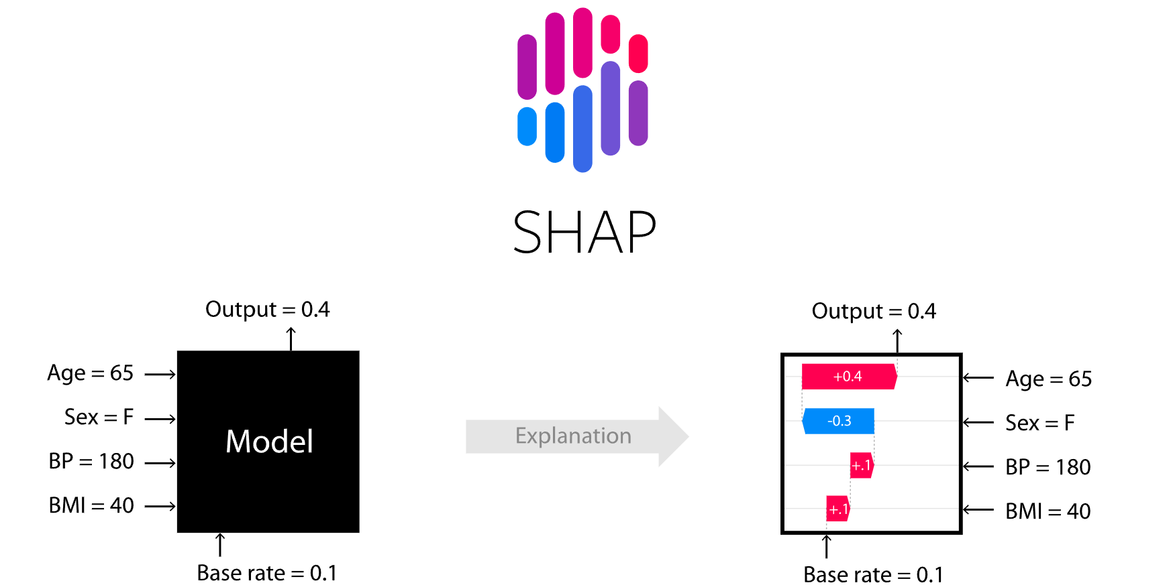
Deep learning approach
SHAP(SHapley Additive exPlanations) is a game theoretic approach to explain the output of any machine learning model.
Lundberg, S. M., & Lee, S.-I. (2017). A Unified Approach to Interpreting Model Predictions. In I. Guyon, U. V. Luxburg, S. Bengio, H. Wallach, R. Fergus, S. Vishwanathan, & R. Garnett (Eds.), Advances in Neural Information Processing Systems 30 (pp. 4765–4774). Retrieved from http://papers.nips.cc/paper/7062-a-unified-approach-to-interpreting-model-predictions.pdf

Slide 8
Thank you!

