Slide 1
Artistic Rendering Line drawing
Yuefeng Wu
Jason Narine

Slide 2
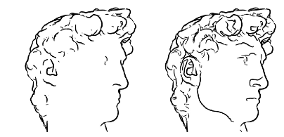
Goal
A non-photorealistic rendering system that conveys shape using lines
Contours
Suggestive Contours
http://www.cs.northwestern.edu/~ago820/cs395/Papers/W03_NPR/Decarlo_2003.pdf

Slide 3
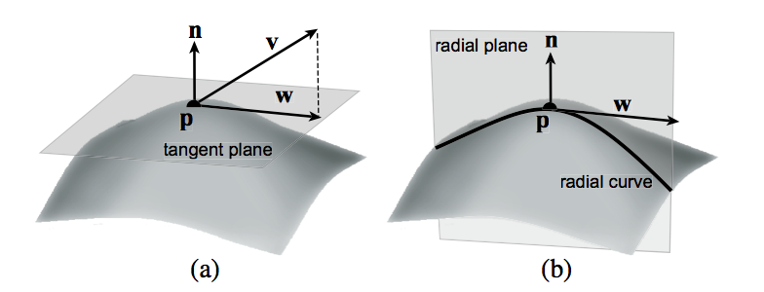
Approach
Contours
The contour generator is the set of points on the surface whose normal vector is perpendicular to the viewing direction.
When projected into the image, its visible portions are called the contour.
^{n(p) · v(p) = 0}
p ∈ S is a point on the surface
n(p) is the unit surface normal at p
v is the view vector: v(p) = c − p
http://www.cs.northwestern.edu/~ago820/cs395/Papers/W03_NPR/Decarlo_2003.pdf

Slide 4
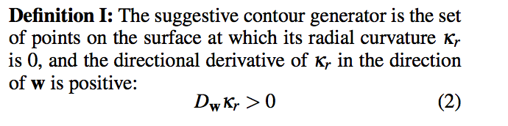

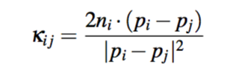
Approach
Suggestive Contours
Finding the solution to Kr = 0 by searching over the entire mesh.
http://gfx.cs.princeton.edu/pubs/_2004_ECA/curvpaper.pdf
http://www.cs.northwestern.edu/~ago820/cs395/Papers/W03_NPR/Decarlo_2003.pdf

Slide 5
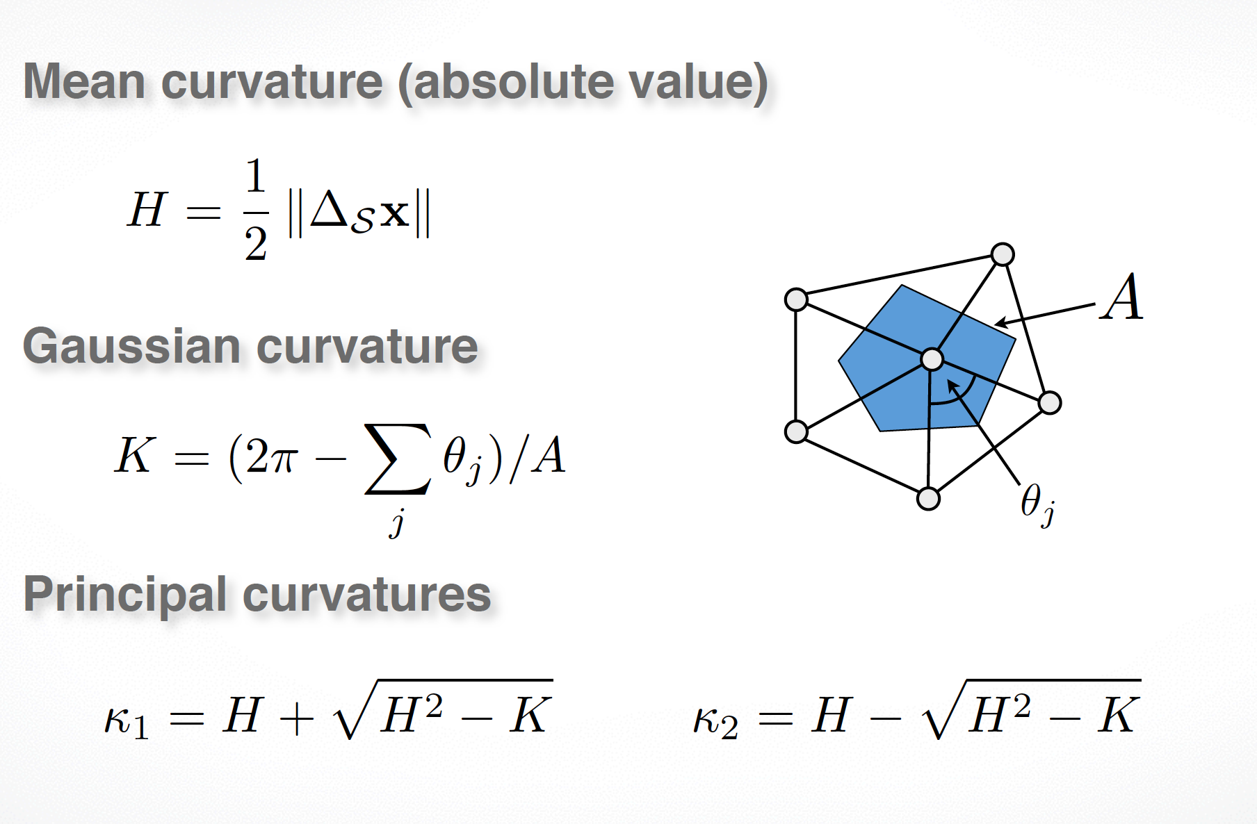
Another Approach
http://www.hao-li.com/cs599/slides/Lecture03.2.pdf

Slide 6
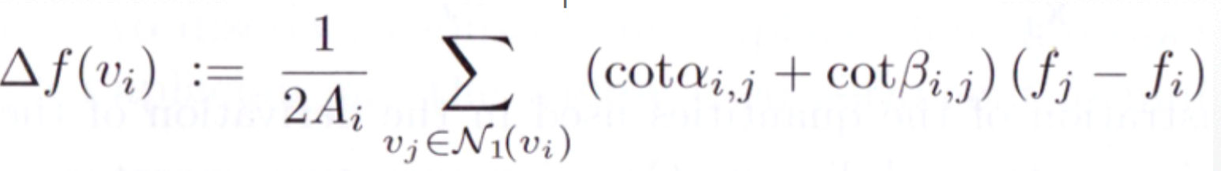
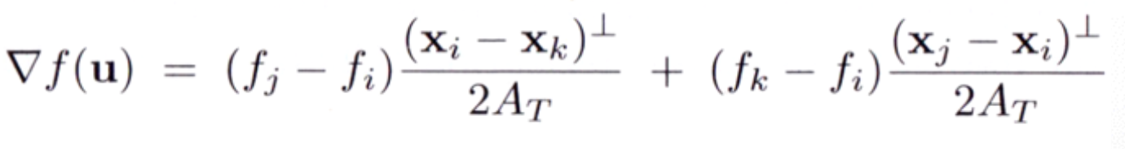
Another Approach
http://www.hao-li.com/cs599/slides/Lecture03.2.pdf

Slide 7
Methodology
Three Key Words about our approach
Estimate
Detect
Threshold

Slide 8
Methodology
Estimate
^{n(p) · v(p) = 0}
v is the view vector: v(p) = c − p
Contours
Suggestive Contours
http://www.cs.northwestern.edu/~ago820/cs395/Papers/W03_NPR/Decarlo_2003.pdf

Slide 9
Methodology
Estimate
How to calculate K1,K2 ?
The maximum and minimum of the normal curvature at a given point on a surface
are called the principal curvatures.
http://www.cs.northwestern.edu/~ago820/cs395/Papers/W03_NPR/Decarlo_2003.pdf

Slide 10
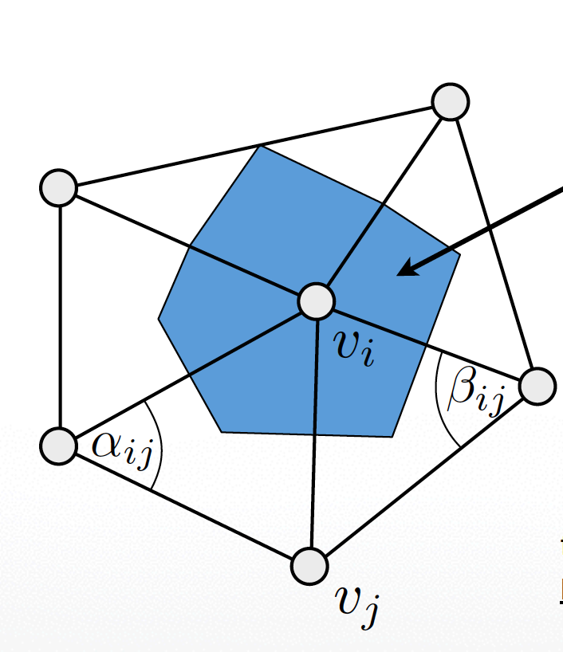
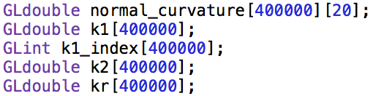
Methodology
Detect
Step 1
http://gfx.cs.princeton.edu/pubs/_2004_ECA/curvpaper.pdf
http://www.cs.northwestern.edu/~ago820/cs395/Papers/W03_NPR/Decarlo_2003.pdf

Slide 11
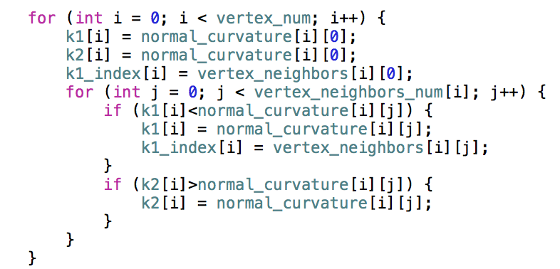
Methodology
Detect
Step 2
http://gfx.cs.princeton.edu/pubs/_2004_ECA/curvpaper.pdf
http://www.cs.northwestern.edu/~ago820/cs395/Papers/W03_NPR/Decarlo_2003.pdf

Slide 12
Methodology
Estimate
How to calculate φ ?
φ as the angle between w(p) and the principal curvature direction
corresponding to κ1.
http://www.cs.northwestern.edu/~ago820/cs395/Papers/W03_NPR/Decarlo_2003.pdf

Slide 13
Methodology
Threshold
^{n(p) · v(p) = 0}
http://www.cs.northwestern.edu/~ago820/cs395/Papers/W03_NPR/Decarlo_2003.pdf

Slide 14
Methodology
Threshold
Threshold | Elephant | Cow | Dragon | Sphere
Contours | 0.05 | 0.00025 | 0.00001 | 0.01
S_contours | 0.00005 | 0.0008 | 0.00001 | 0.025

Slide 15
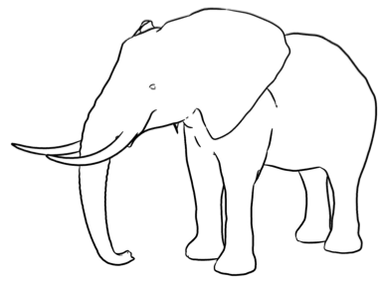
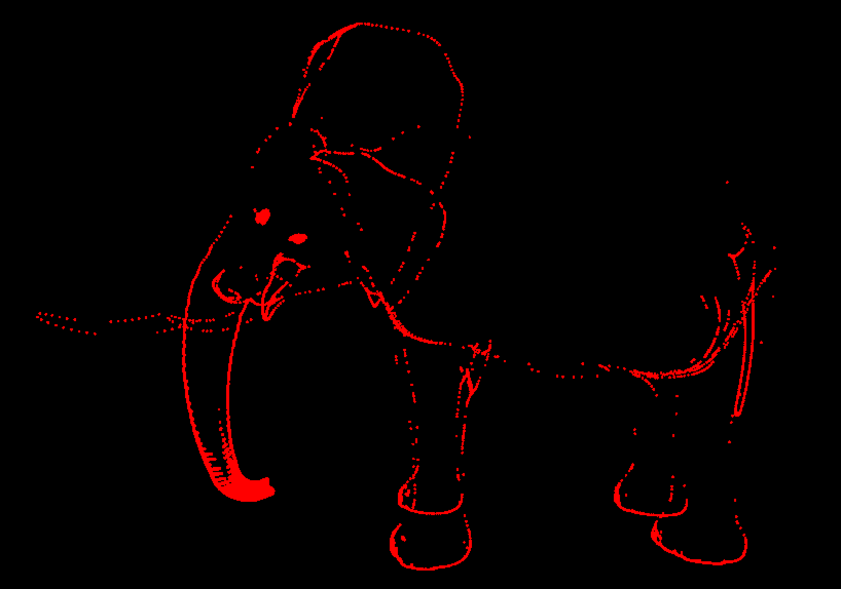
What didnʹt we implement? Why not?
Derivative of Kr
Draw Line_Strip
glEnable( GL_POINT_SMOOTH );
http://www.cs.northwestern.edu/~ago820/cs395/Papers/W03_NPR/Decarlo_2003.pdf

Slide 16
Demo

Slide 17
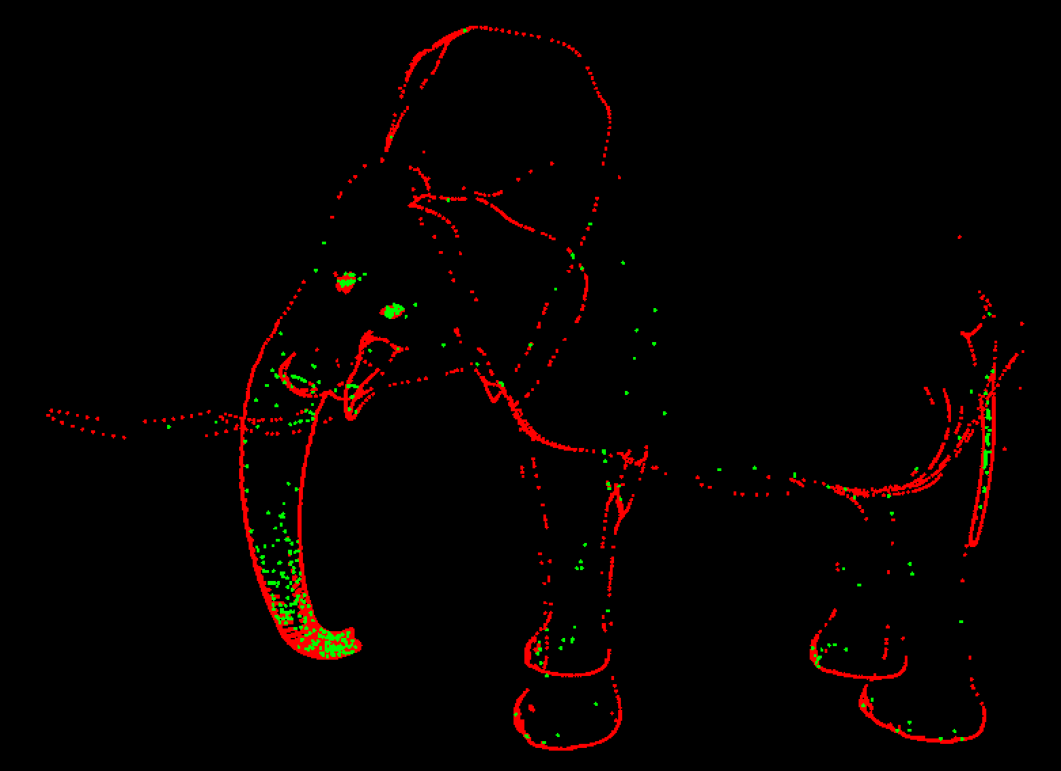
Results
Only Contours
Both Contours and Suggestive Contours

Slide 18
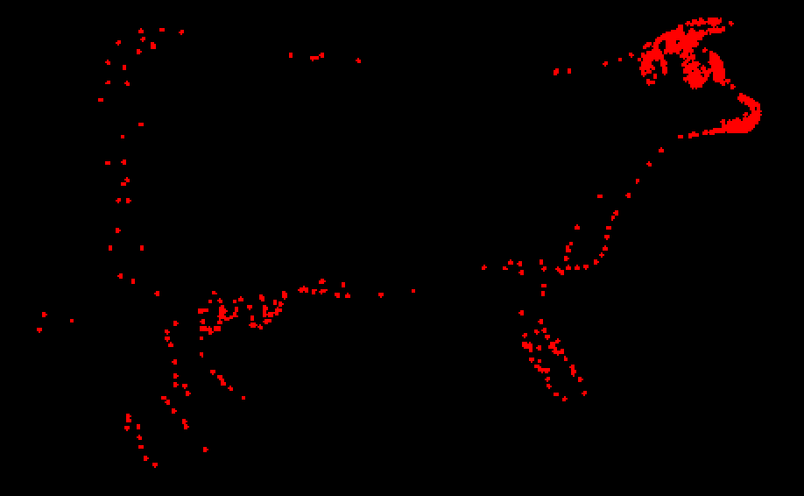
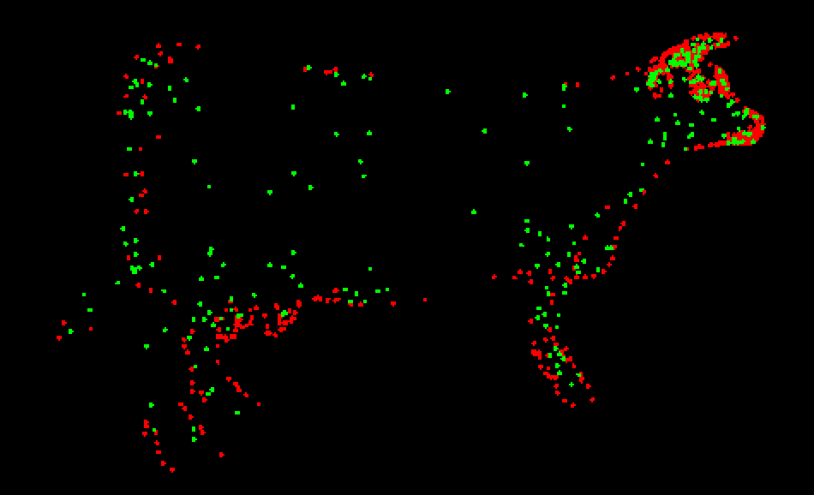
Results
Only Contours
Both Contours and Suggestive Contours

Slide 19
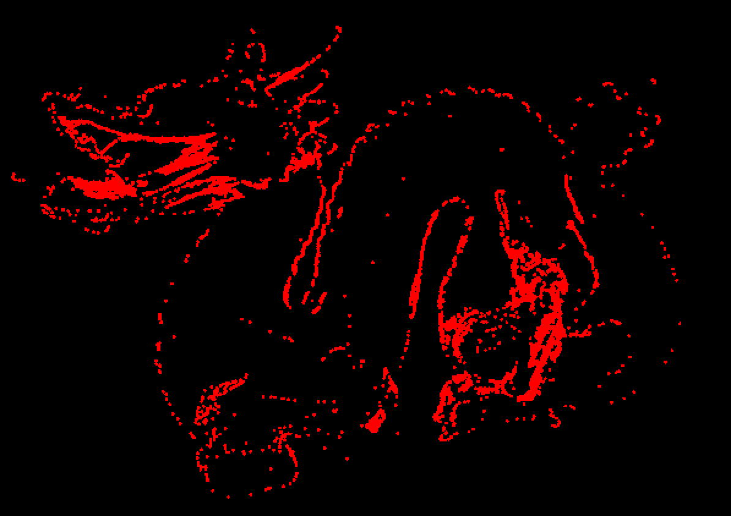
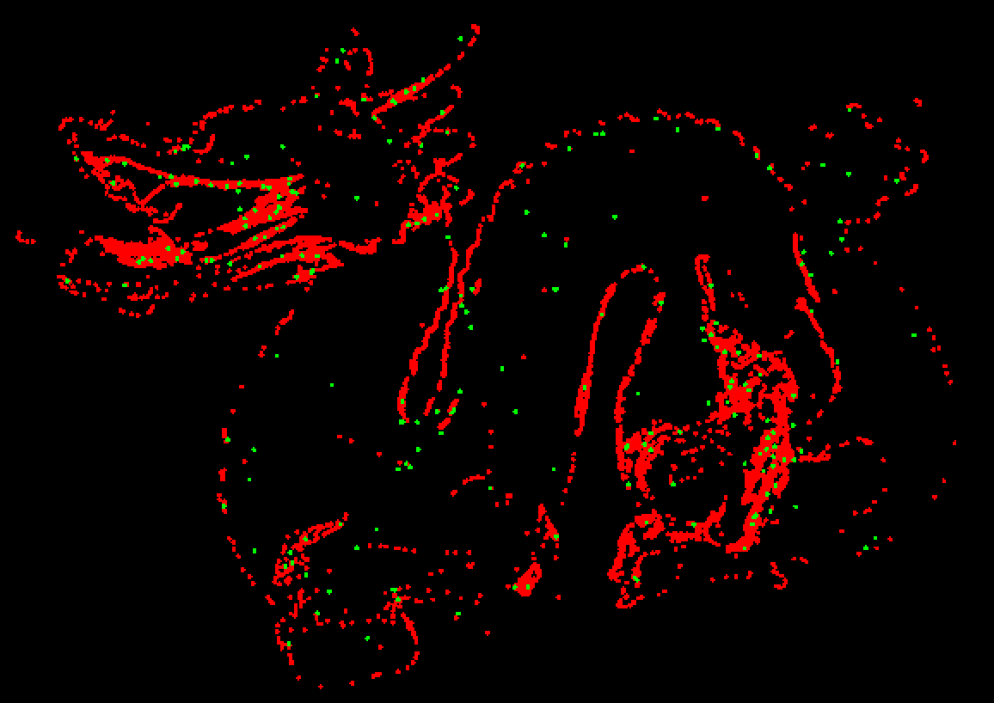
Results
Only Contours
Both Contours and Suggestive Contours

Slide 20
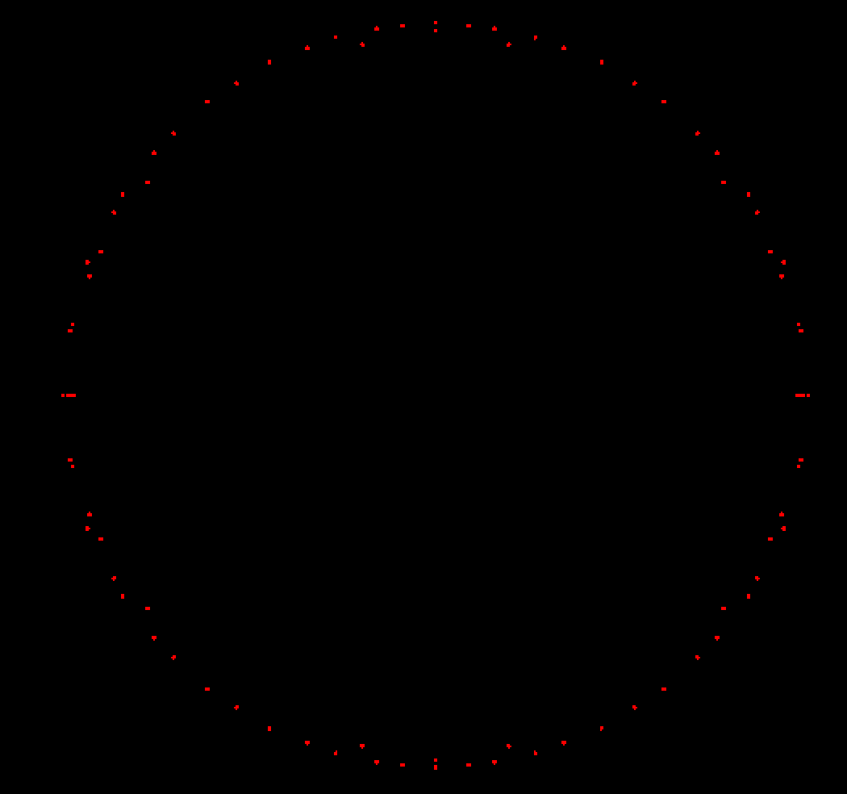
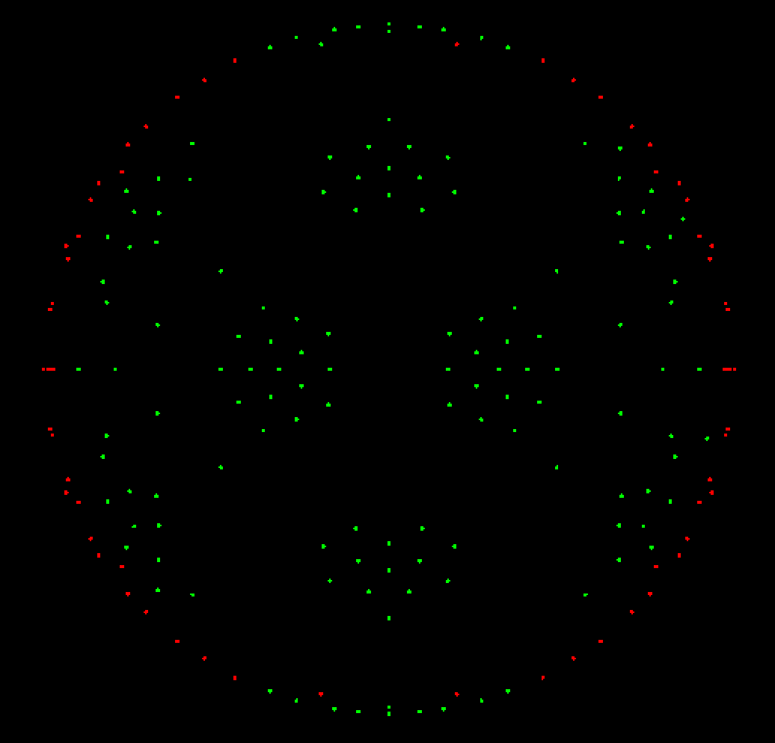
Results
Only Contours
Both Contours and Suggestive Contours

Slide 21
Indications
Line drawing is easier said than done
DeCarlo and co. have too much free time
Leave it to the experts

Slide 22
Promising?
Approach is promising
Done without TriMesh library
Done without several months-to-year timeframe
Better understanding of mathematical concepts will improve project

Slide 23
What Would Jesus Do? (Better Approach)
Correctly utilize TriMesh library
Have better understanding of mathematical concepts in Suggestive Contours for Conveying Shape paper and implement those formulas

Slide 24
What did we learn? Re: Indications
Line drawing is easier said than done
DeCarlo and co. have too much free time
Leave it to the experts

Slide 25
What Would We Do Differently?
Choose different project
Start earlier
Spend more time learning derivatives, radial curves, normal curves, etc.

Slide 26
Conclusion
Line drawing is easier said than done

Slide 27
Questions?

