Slide 1
Kaggle Competition: GoDaddy - Microbusiness Density Forecasting
Yu Wu

Slide 2
Outline
Problem Statement
Methodology
Data Pre-processing
Outlier detection
Feature engineering
Models
Post-processing
Round to real-world numbers
Blending
Results

Slide 3
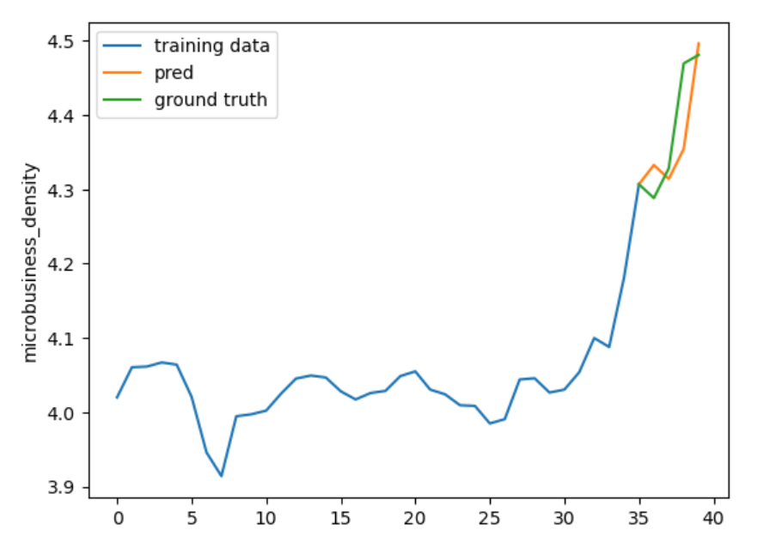
Problem Statement
Predict future microbusiness density (Microbusinesses are generally defined as businesses with an online presence and ten or fewer employees) :
39 months in training set, 8 months in testing set

Slide 4
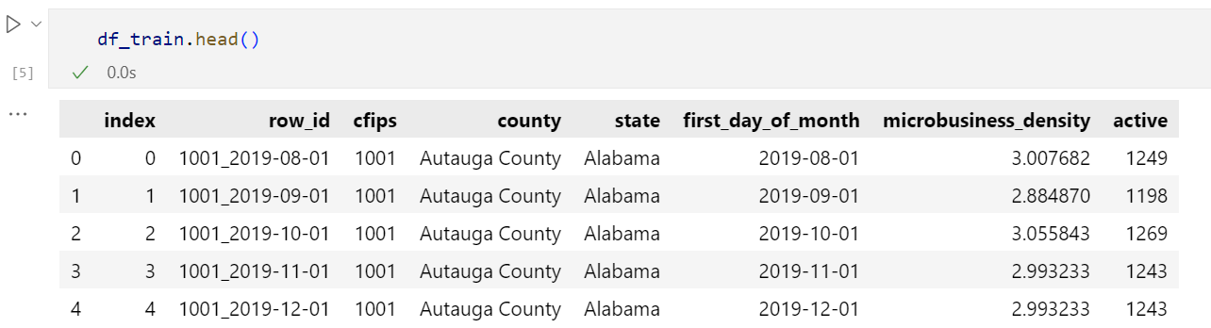
Dataset

Slide 5
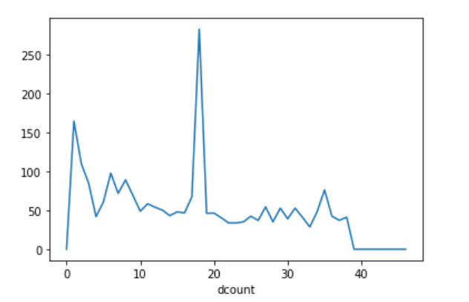
Methodology: Data Pre-processing
There are some outliers:

Slide 6
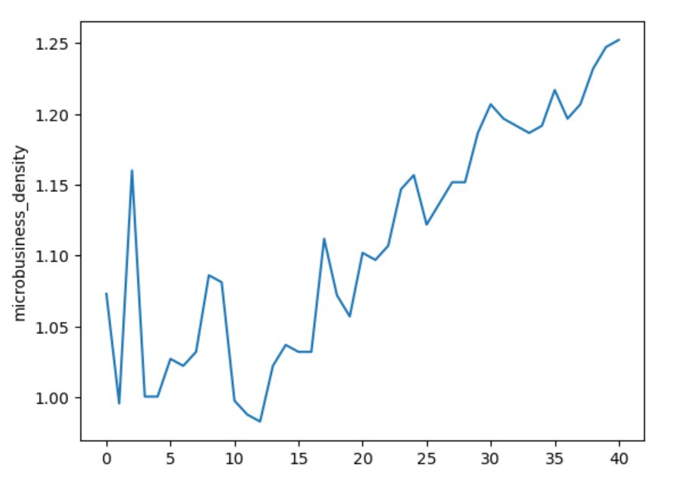
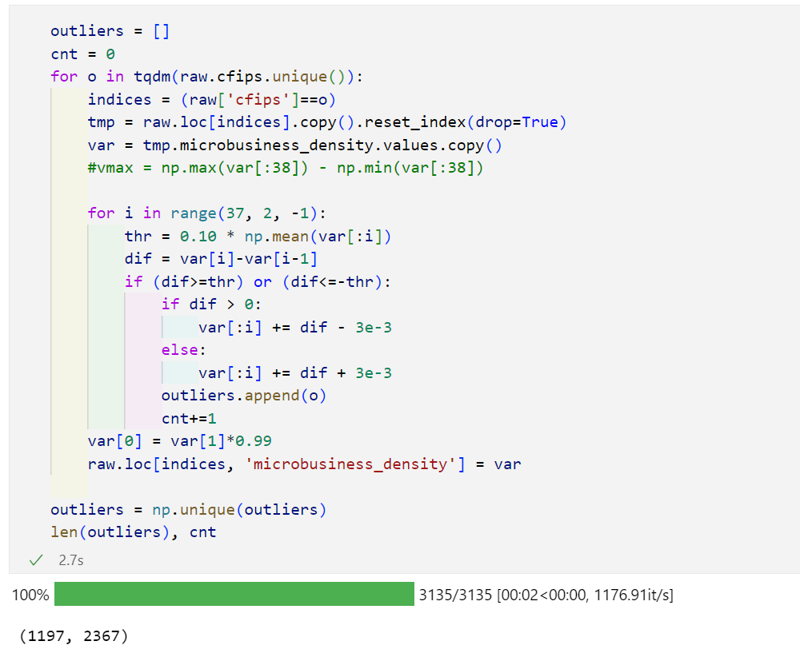
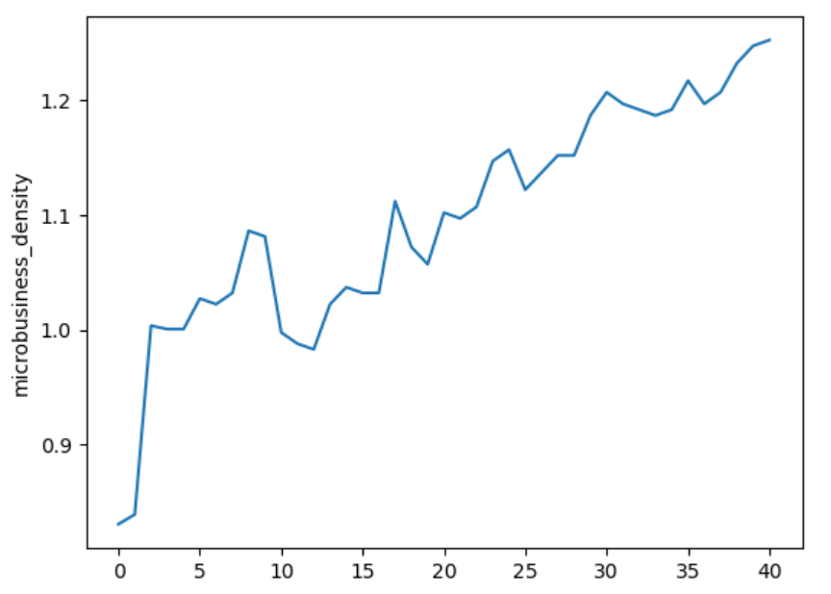
Methodology: Data Pre-processing
Smooth outliers:
before
after

Slide 7
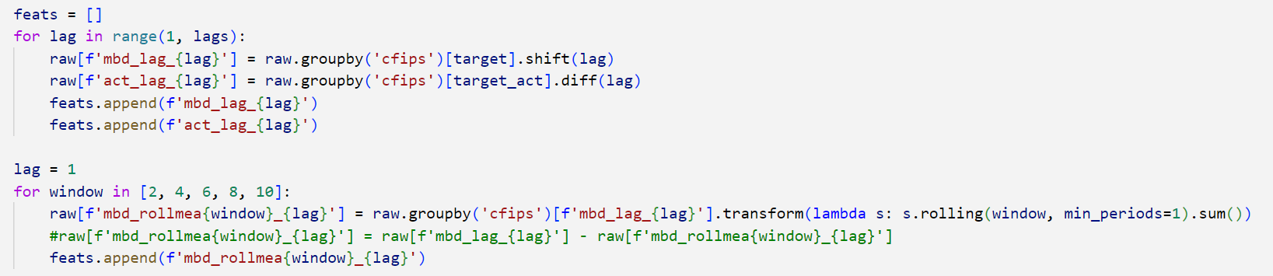
Methodology: Data Pre-processing
Add time-series feature:
X[t, lag_feature]
= MB(Microbusiness Density)_{t}, MB_{t-1}, MB_{t-2},…MB_{t-max_lag}
X[t, window_feature] = mean(X[t-2: t, lag_1]), mean(X[t-4:t, lag_1]), … mean(X[t-window_size:t, lag_1])

Slide 8
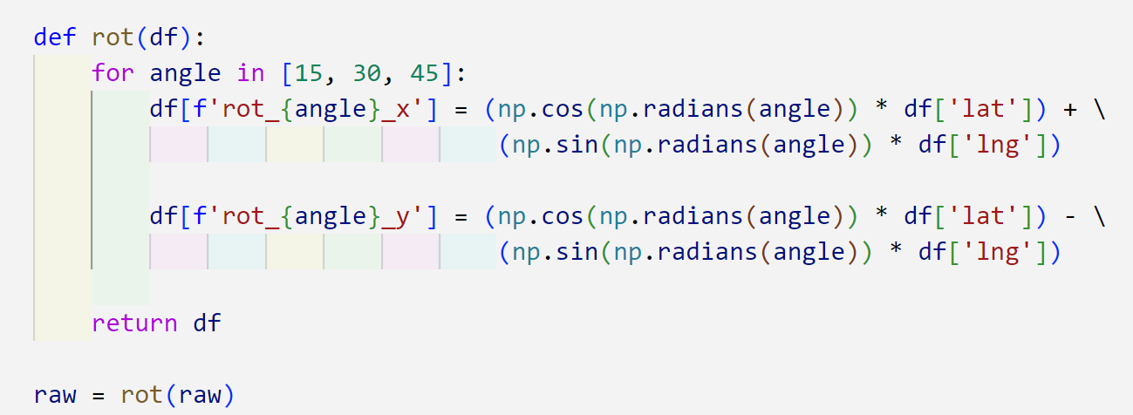
Methodology: Data Pre-processing
Add extra data (location, statistical data (population, death, birth, etc. )):
We use rotated location features：

Slide 9
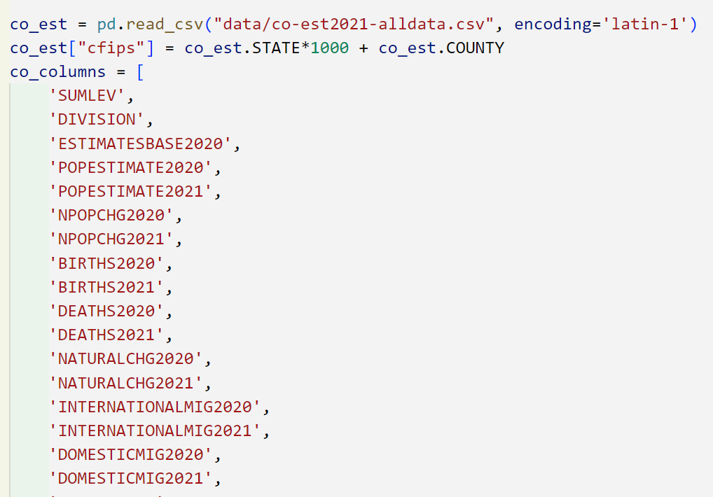
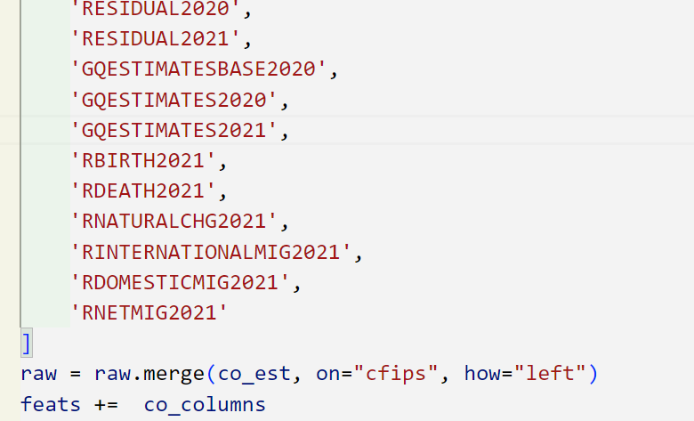
Methodology: Data Pre-processing
Add extra data (location, statistical data (population, death, birth, etc. )):
We merge statistical data into our data:

Slide 10
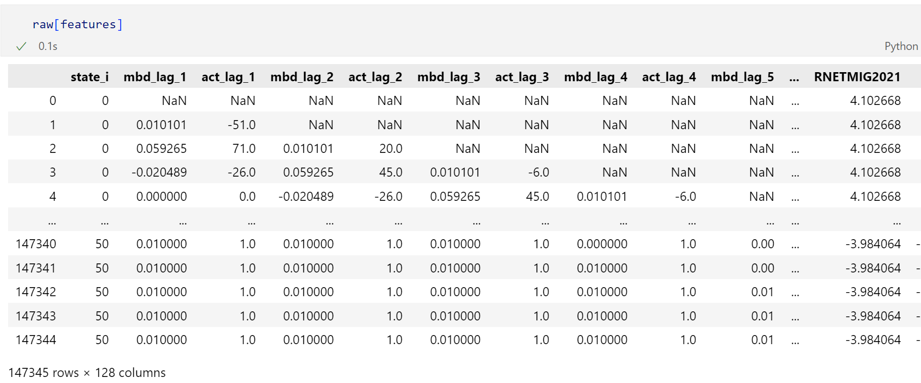
Methodology: Data Pre-processing
Processed data: 147345 data points with 128 features
The “128” features depends on the range lag and window size we choose

Slide 11
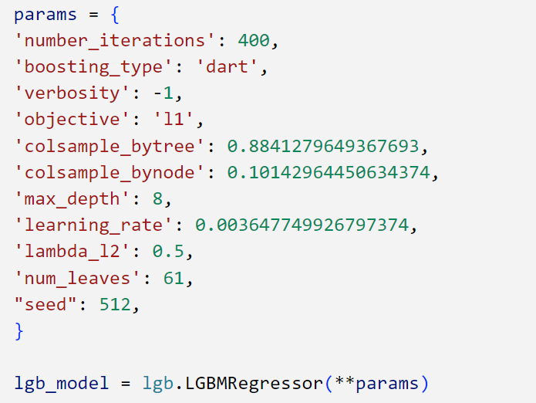
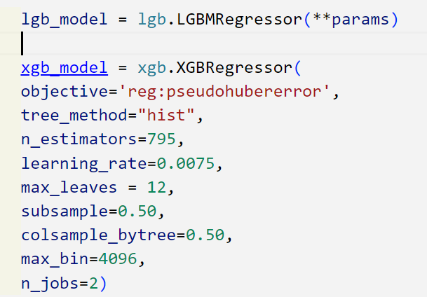
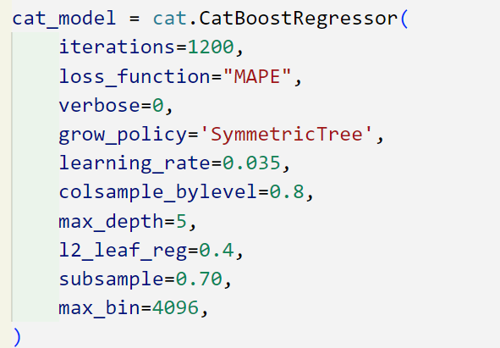
Methodology: Models
XGBoost
LightGBM
CatBoost

Slide 12
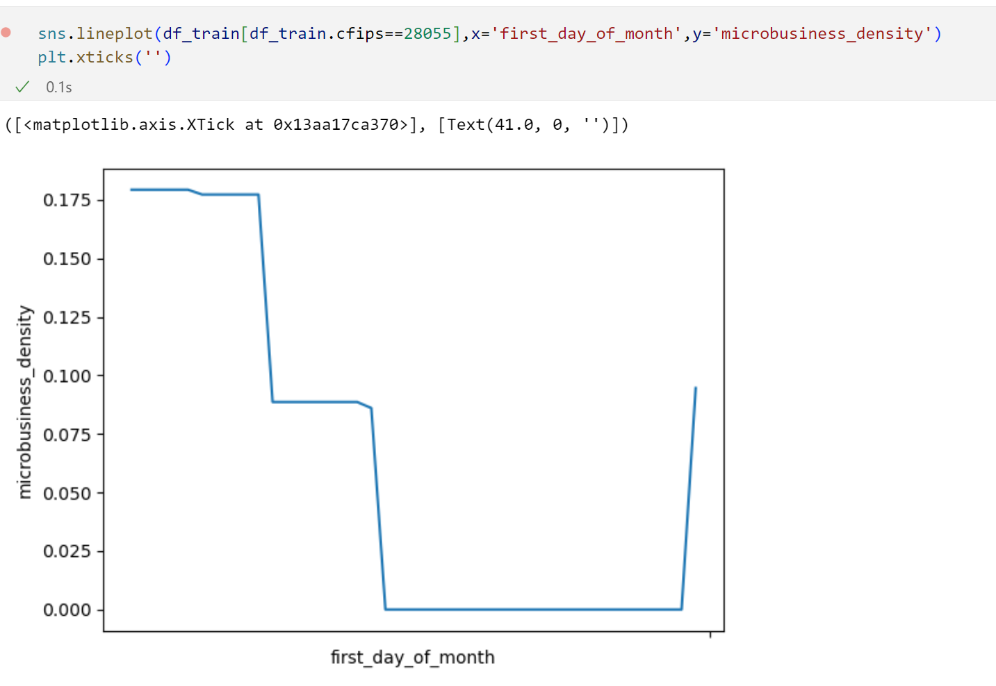
Methodology: freezing strategy
Freeze on region with low active (low raw count of microbusinesses)

Slide 13
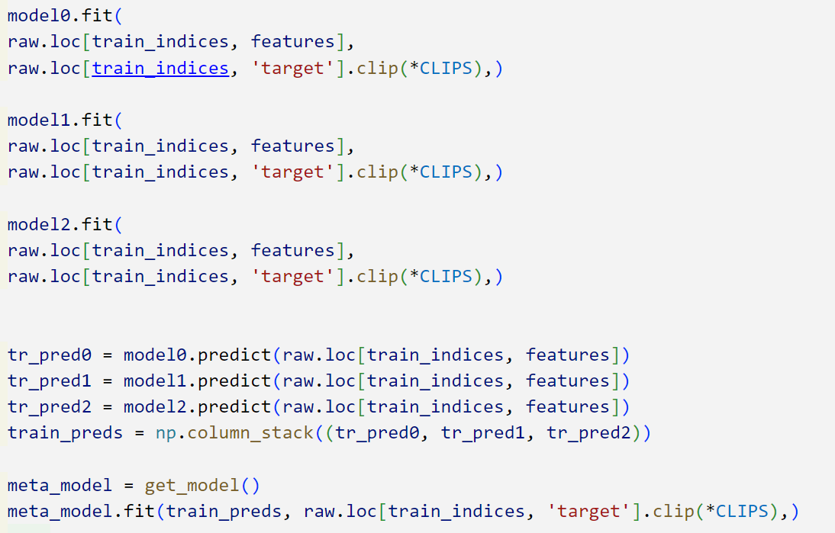
Methodology: Ensemble
Ensemble:
Train 3 models:
XGBoost
LightGBM
CatBoost
Use an extra model to map the overall output from 3 models to final output

Slide 14
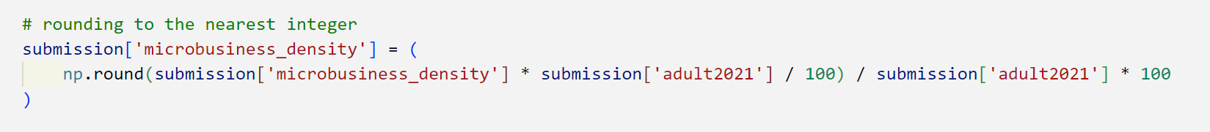
Post-processing: Adjust by population size
microbusiness_density = 100 * active / adult_population
Active must be some integer

Slide 15
Post-processing: Blending
I have many predictions for test set (submission.csv) whose first month score is revealed via online test
Choose the best 4 submissions
Weighted average according to their scores

Slide 16
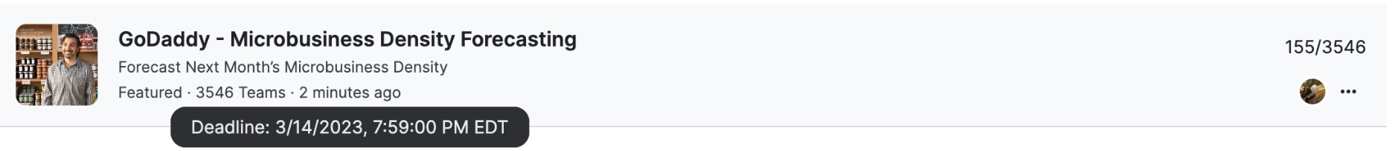
Result: current standing:155/3546

