Slide 1


Takito
Lancelei
Teresa
Colleen
Fran
Nigel

Slide 2
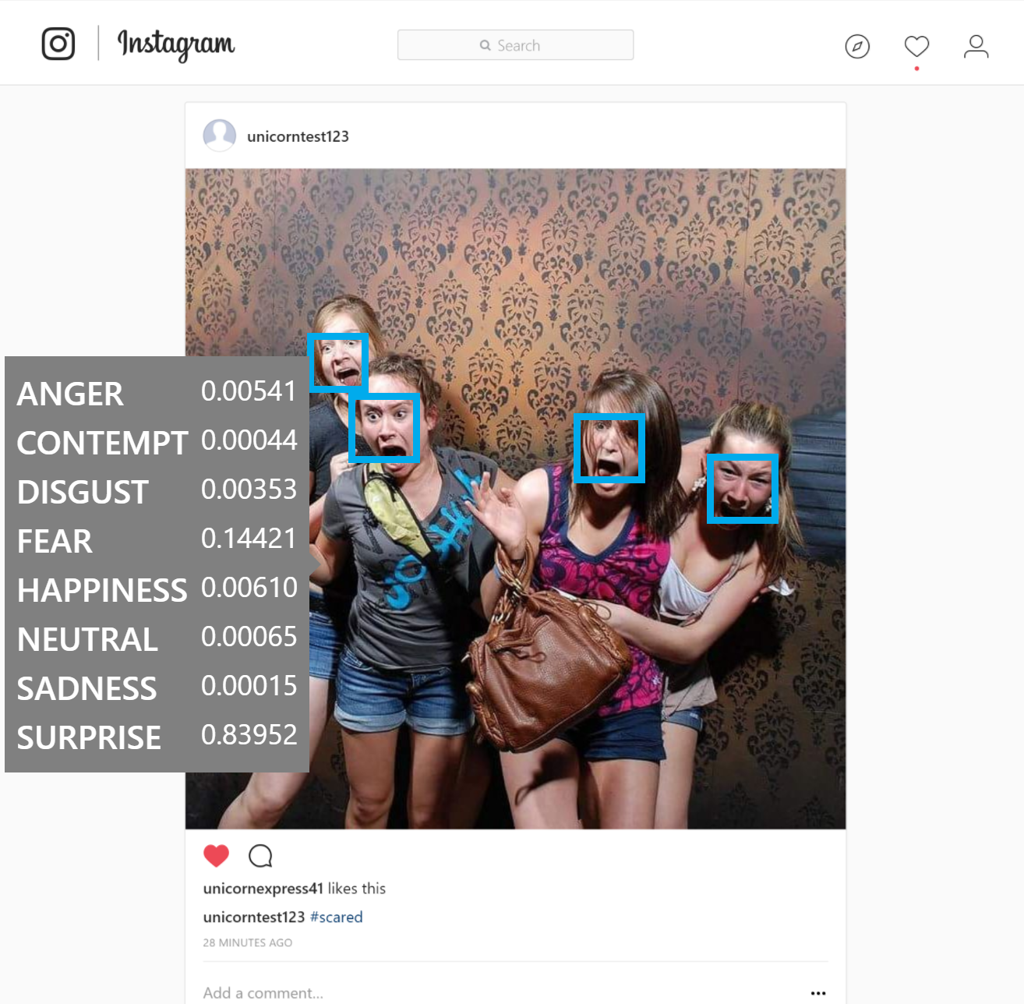
Using Microsoft’s Cognitive Services API to analyze the emotion of posts on Instagram.

Slide 3
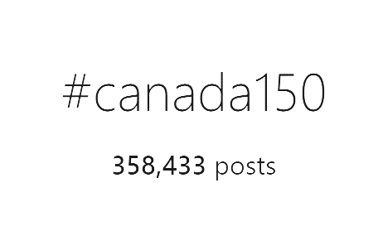
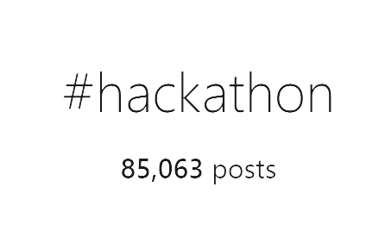
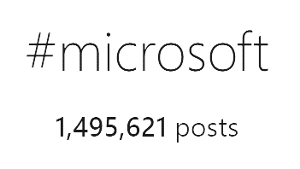
APPLICATION

Slide 4
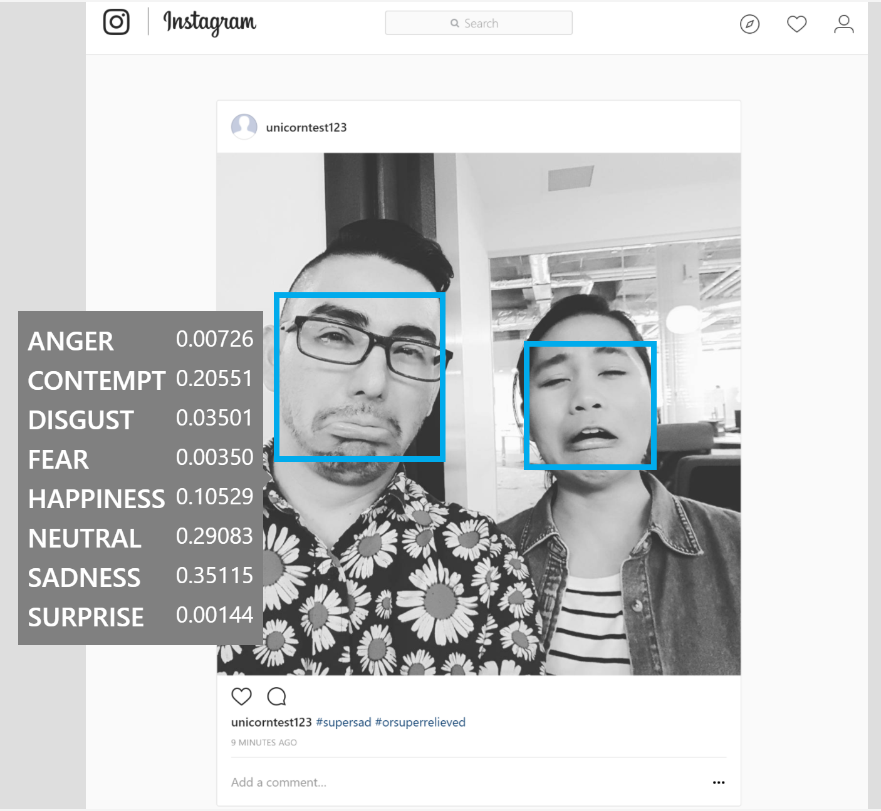
FUTURE CONSIDERATIONS

Slide 5


Slide 6


