Slide 1
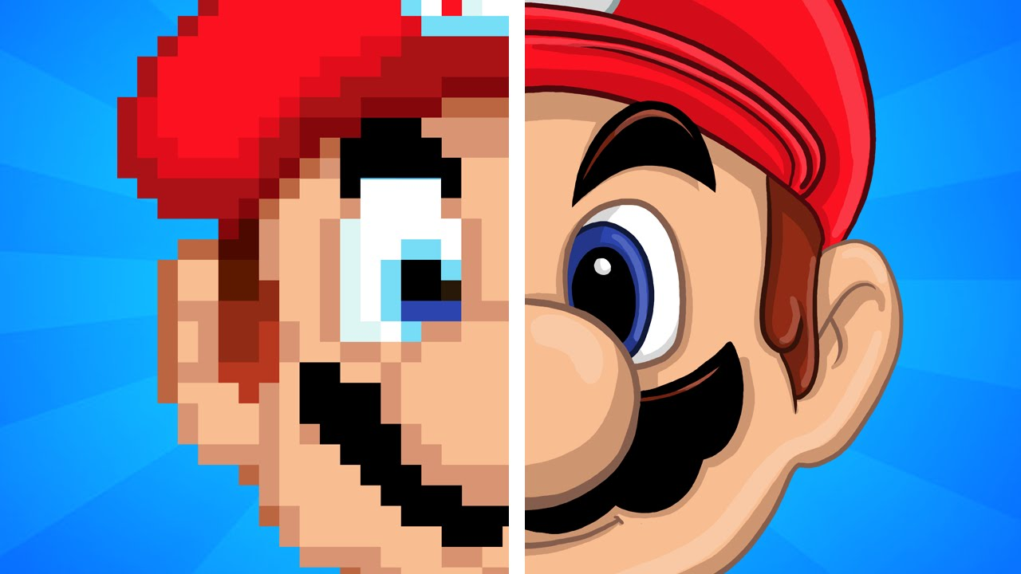
/Performance / Effect / /Almost Everything/ about Anti-aliasing
By Xiachao Yan
CS534 – Computational Photography

Slide 2
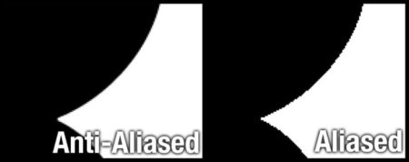
What is Anti-aliasing

Slide 3
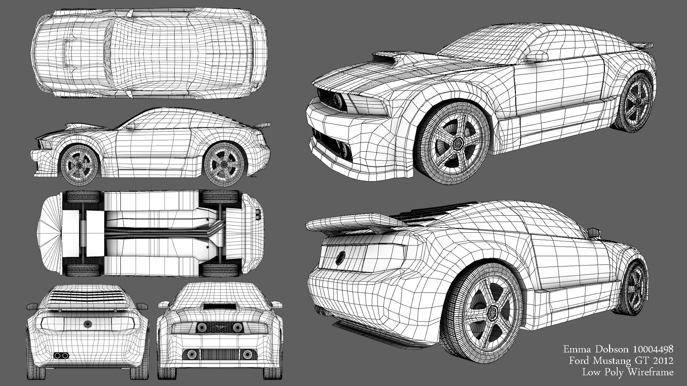
Cause of aliased image

Slide 5
Curved Surface in Real Life
Approximation in Digital World

Slide 6
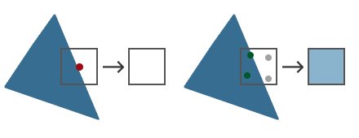
How ? Multi-Samping

Slide 7
How ? MFAA
Good :
Theoretically Best Image Quality
Easy to implement
Used in every situation
No compromise on Quality
Bad:
1.Extremely Expensive to compute

Slide 8
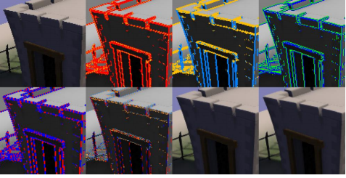
How ? Fast-Approximate AA

Slide 9
How ? FXAA
Good :
Better image than non-anti-aliased
Cheap -only takes little computational resources
Used in every situation
Bad:
1.Blur could be caused where edge blend into background
2.Quality does not match MSAA

Slide 10
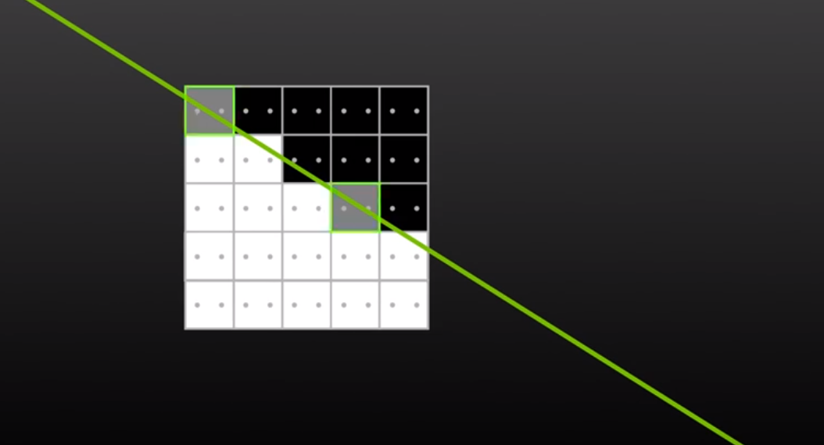
How ? Multi-Frame AA

Slide 11
How ? MFAA
Good :
Better image than non-anti-aliased
Cheap -only takes little computational resources
Bad:
1.Quality is observably lower than MSAA
2.Limited to situation that camera do not move very quickly

Slide 12
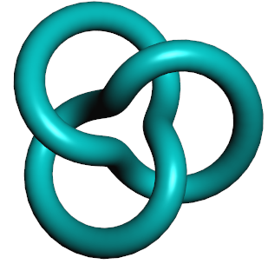
Personal Test on rendering Knot
Result of No anti-aliasing of Running 60 Seconds
Frames | Times | Min FPS | Max FPS | Avg FPS
4513 | 60000 | 35 | 120 | 75.217
Result of Cel-Shading AA of Running 60 Seconds
Frames | Times | Min FPS | Max FPS | Avg FPS
4486 | 60000 | 36 | 120 | 74.767

Slide 13
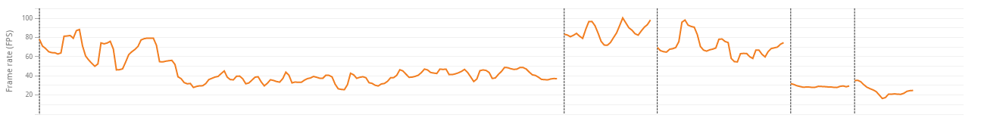
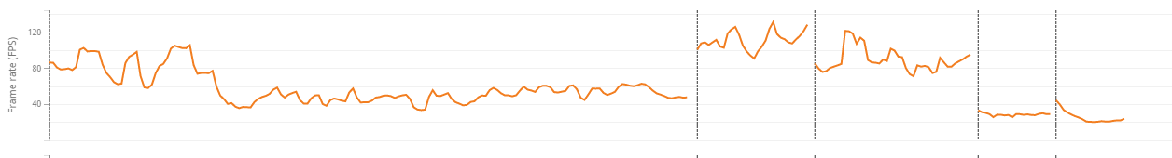
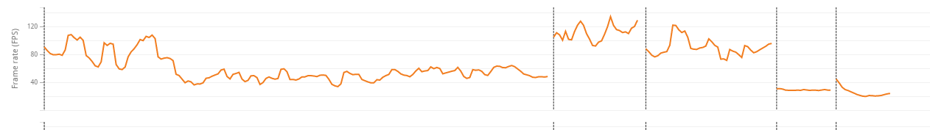
MSAA 4x
Avg 85
FXAA
Avg 111
No AA
Avg 111
Result from 3DMarks-Fire

Slide 14
Future Trend
Temporal Super-samlping AA - >Mainstream
TSAA
Algorithm not published yet. A algorithm based on Super-Sampling.
Hardware evolving fast.

Slide 15
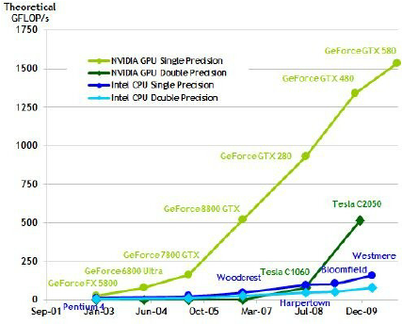
Moore’s Law still obeyed

Slide 16
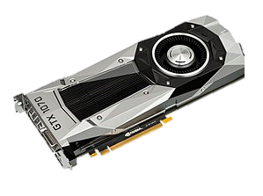

Moore’s Law still obeyed
Imaging this is a Nvi-1080
8228 Giga Flops per second
World Record 122.3 petaflops=122 x 10^6 GigaFlops
This is also what you can use to mine BitCoin

Slide 17
Cap?
What Can We Do?

Slide 18
End

