Slide 1
Air CC
Customer Satisfaction Analysis
Presentation for Stakeholders
Yixuan Chen
2022-08-15

Slide 2
01
Executive Summary
Assumptions
Background and Problems
02
Data Introduction and Assumptions
Data Introduction
Data Assumptions
03
Agenda
Data Exploration
04
Model Recommendation and Insights
Model Comparison
Conclusions of Final Model
05
Actions
Risk Management
Business Actions

Slide 3

Assumptions
Company
Air CC is a young Canadian airline company seeking long-term growth.
Target Audience
Directors of Air CC
Source from: https://www.csair.com/ca/en/about/gongsijianjie/

Slide 4

Background
Source from: statista, https://www-statista-com.centennial.idm.oclc.org/statistics/545642/air-carrier-canada-domestic-market-share/
Source from: https://publichealth.jhu.edu/2021/how-well-live-with-covid-after-the-pandemic
Intense Industry Competition
Opportunities after COVID-19

Slide 5

Problem Statement
Customer Churn
Intense Competition after Pandemic
Underutilization of Resources
Inefficient Marketing strategies
Air CC needs to acquire insights from analysis for improving customer experience and satisfaction to seek long-term growth.

Slide 6
Executive Summary
Assumptions
Background and Problems
Data Introduction and Assumptions
Data Introduction
Data Assumptions
Data Exploration
Model Recommendation and Insights
Model Comparison
Conclusions of Final Model
Actions
Risk Management
Business Actions

Slide 7
Data Introduction and Assumptions
A survey data contains 23 features and 129,880 observations
Customer profile variables
Airline service-related variables
Assumptions:
This dataset was built 2 years ago, which is representative.
These customers are randomly selected.

Slide 8
Executive Summary
Assumptions
Background and Problems
Data Introduction and Assumptions
Data Introduction
Data Assumptions
Data Exploration
Model Recommendation and Insights
Model Comparison
Conclusions of Final Model
Actions
Risk Management
Business Actions

Slide 9
Data Exploration

Slide 10
Data Exploration

Slide 11
Executive Summary
Assumptions
Background and Problems
Data Introduction and Assumptions
Data Introduction
Data Assumptions
Data Exploration
Model Recommendation and Insights
Model Comparison
Conclusions of Final Model
Actions
Risk Management
Business Actions

Slide 12
Model Comparison
Model | Accuracy | F1-Score | ROC AUC
Decision Tree | 0.9476 | 0.9515 | 0.9447
Random Forest | 0.9600 | 0.9630 | 0.9605
Logistic Regression | 0.8382 | 0.8520 | 0.8366
Neural Network | 0.9449 | 0.9494 | 0.9446
KNN | 0.9290 | 0.9337 | 0.9303
Voting Ensemble | 0.9554 | 0.9589 | 0.9556
Random Forest has the highest Accuracy, F1-Score and AUC of a ROC curve (area under the receiver operating characteristics curve) among these six model.

Slide 13
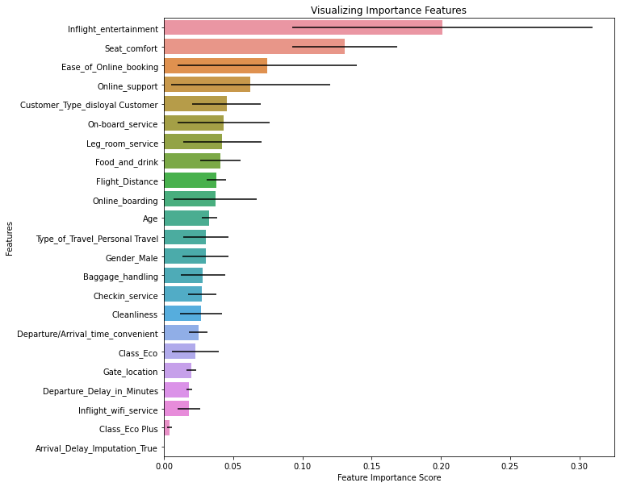
Key Drivers
Key features:
Inflight entertainment
Seat comfort
Ease of Online booking
Online Support
Gini importance

Slide 14

Conclusions of Final Model
Random Forest is the most effective model in terms of prediction Accuracy and F1 score.
Predict whether a customer satisfied or not
Identify key elements of influence customers’ satisfaction: Inflight entertainment, Seat comfort, Ease of Online booking, Online Support

Slide 15
Executive Summary
Assumptions
Background and Problems
Data Introduction and Assumptions
Data Introduction
Data Assumptions
Data Exploration
Model Recommendation and Insights
Model Comparison
Conclusions of Final Model
Actions
Risk Management
Business Actions

Slide 16
Risk Management
Model performance could get worse overtime
Keep monitor
Collect more recent data
Refit the model

Slide 17
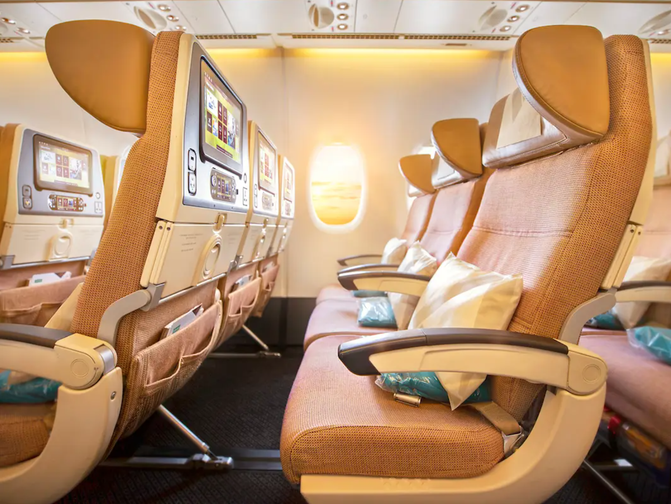
Business Actions
Actions based on key drivers
Provide more varied in-flight entertainment programs and upgrading the entertainment system facilities
Offer items or services that help passengers sitting more comfortable
Upgrading and improving existing online booking systems and services
More analysis for different customer groups
Analysis of satisfaction of disloyal customers
Analysis of satisfaction of customers in a personal travel
Source from: https://www.businessinsider.com/best-economy-airlines-in-the-world-according-to-youngest-man-to-visit-every-country-2019-1

Slide 18
Thank you！

