Slide 1
Generating Pokemon using GANs, machine learning,deep learning, Z-ENG, English or Hungarian
Élő Zsombor

Slide 2
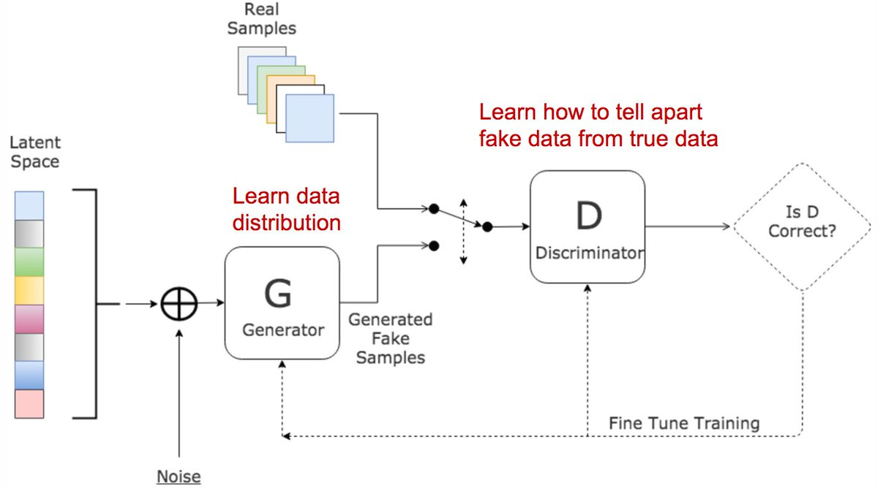
Introduction
GAN
Generative Adversial Networks (from now on: GAN) are an unsupervised learning technique for generating new data and discriminating between generated and original data.
Two parts:
Generator - tries to fool the Discriminator
Discriminator – tries to distinguish between real and fake
Goal:
Generating real-like data or distinguishing between real and fake data

Slide 3
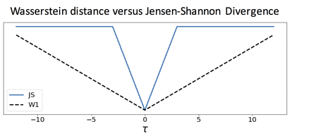
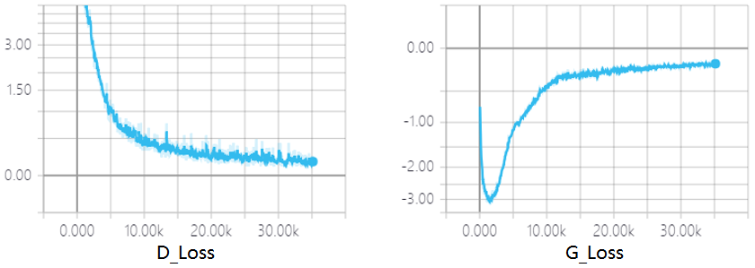
Introduction
WGAN
It is a GAN, which uses a loss method called Wasserstein Distance
Smoother, stabler training, because it doesn’t have sudden jumps, differentiable everywhere

Slide 4
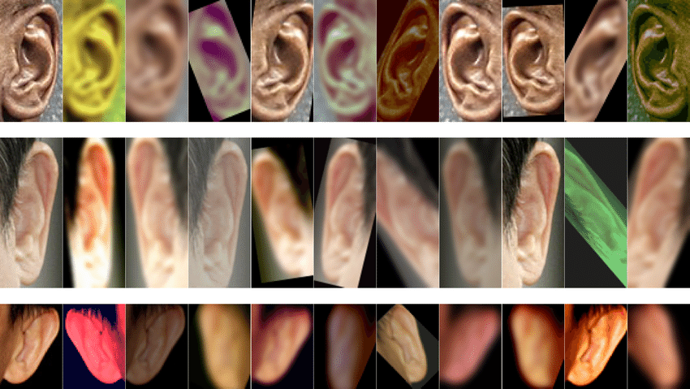
Introduction
Image Augmentation
Techniques used in this training project laboratory:
Flipping
Skewing
Recoloring
Rotating
Cropping

Slide 5

Tasks
Converting notebook to use on Google Colaboratory

Slide 6
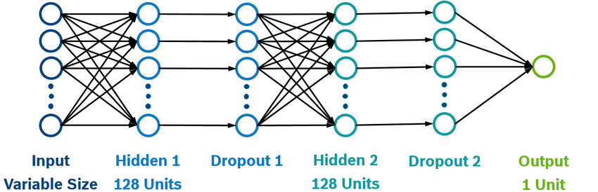
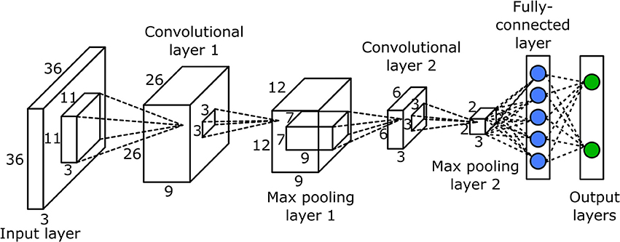
Tasks
Finding (a) good WGAN(s)

Slide 7
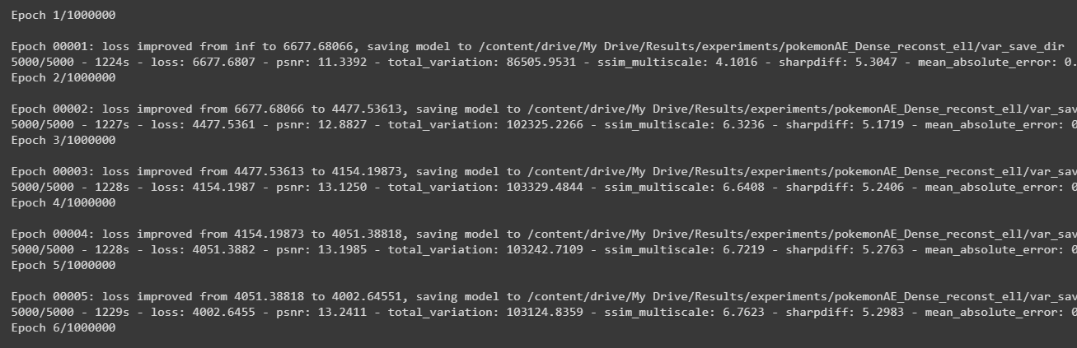
Tasks
Training the model

Slide 8
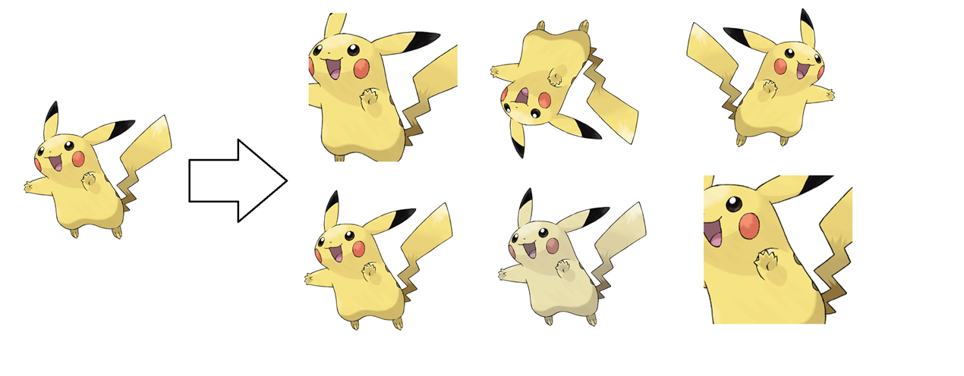
Tasks
Augment Data Set

Slide 9
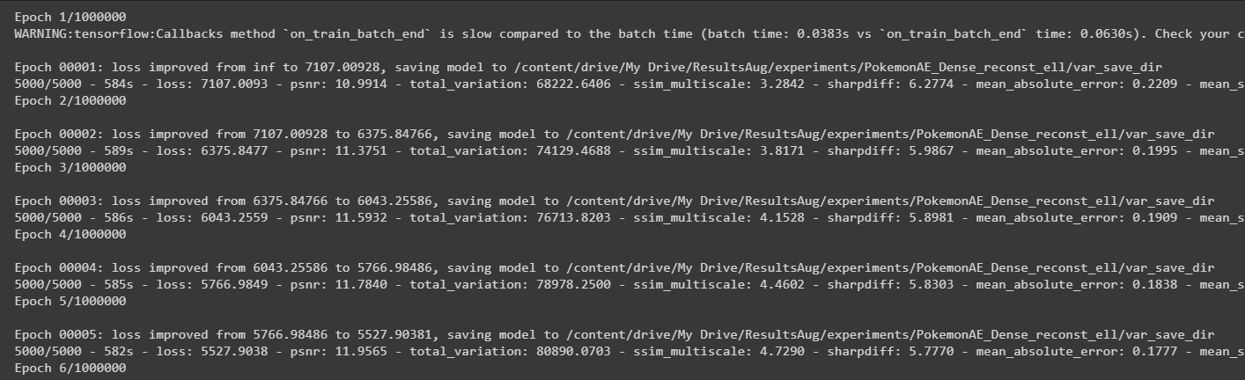
Tasks
Train again

Slide 10
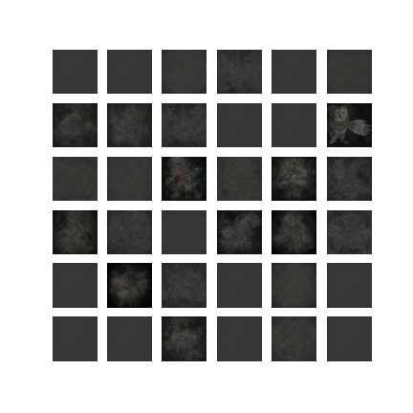
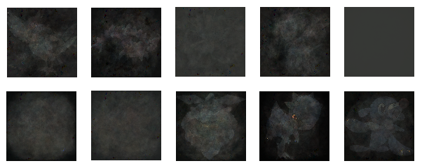
Results
WGAN, Dense Networks, Normal Data Set

Slide 11
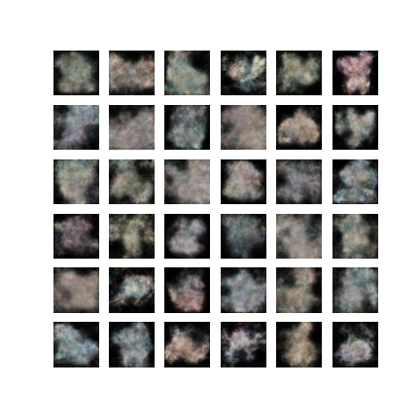
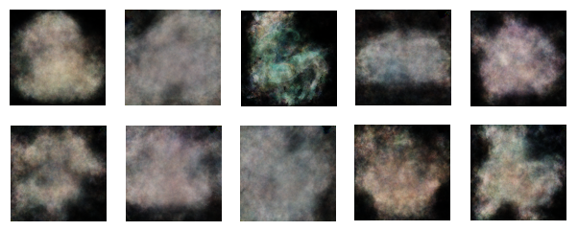
Results
WGAN, Dense Networks, Augmented Data Set

Slide 12
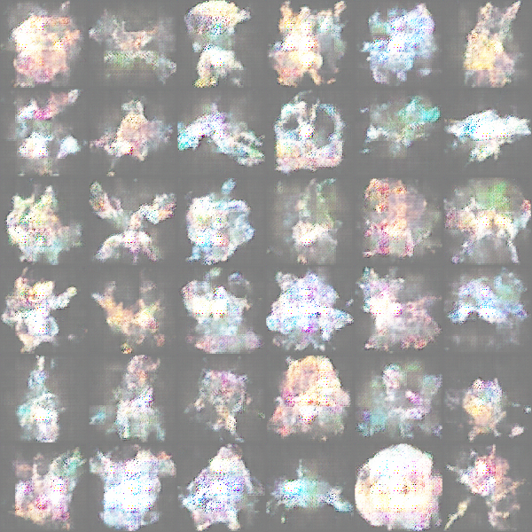
Results
WGAN, Convolutional Networks, Normal Data Set

Slide 13
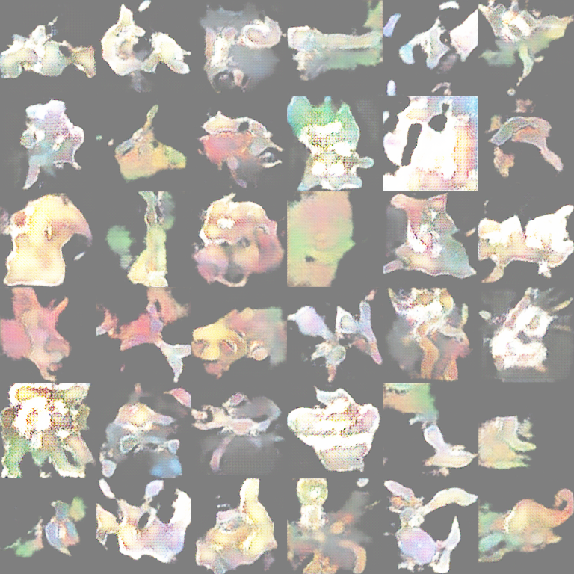
Results
WGAN, Convolutional Networks, Augmented Data Set

Slide 14
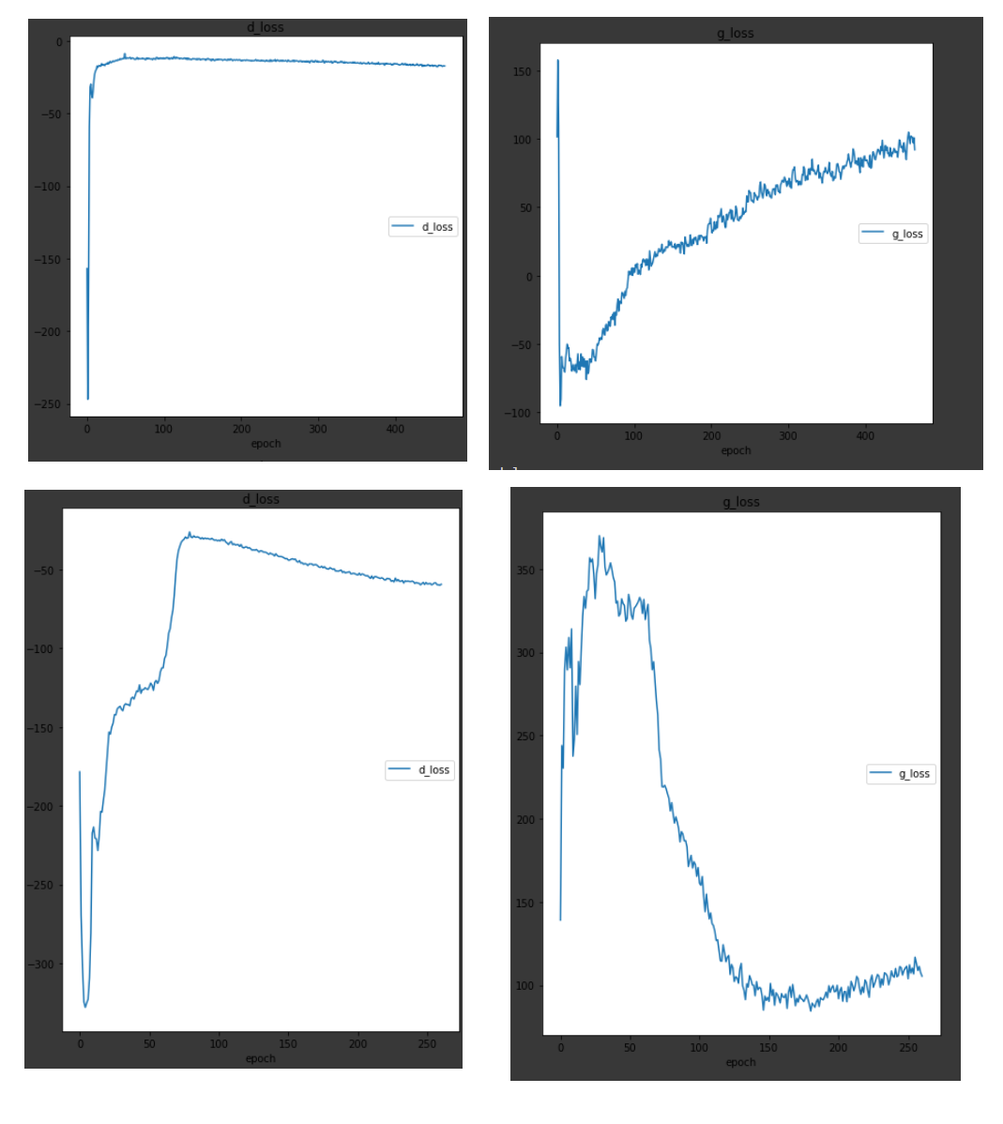
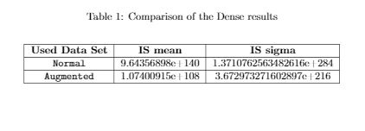
Metrics Comparison

Slide 15
Thank you!

