Slide 1
Two Attempts Towards Decentralized OSNs
-- PeerSoN & Vis-a-Vis
Hongxian Sun
hxsun@cs.hku.hk

Slide 2
Why decentralized?
OSNs(Online Social Networks)
have enjoyed unprecedented growth these years. Features of current systems raising concerns are:
Centralized
Rights to use users’ data
Call for decentralized solutions
Privacy

Slide 3
Two Attempts
PeerSoN SNS’09, S. Buchegger et al.
a Peer-to-peer approach supporting
Social links
Personal Spaces
Communication
Vis-à-vis WOSN’09, A. Shakimov et al.
virtual individual severs utilizing cloud
groups

Slide 4
PeerSoN
Architecture: two-tiered DHTs
lookup & data
Encryption
Encrypt content with public keys of whom the user grants access to
Key management is complicated.(Decentralized PKI)
Direct Exchange
Making use of local storage

Slide 5
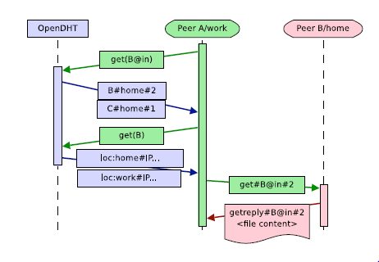
PeerSoN Basic Transcations
Globally Unique IDs
how to defeat impersonation
Log in
different values for each of A’s locations
Getting a file
Asynchronous Messages
Sending files Unasked

Slide 6
Challenges Facing PeerSon
Securing DHT
Storage
small files are accessed frequently
coding replication
contributing disk space
availability (100% is not possible)

Slide 7
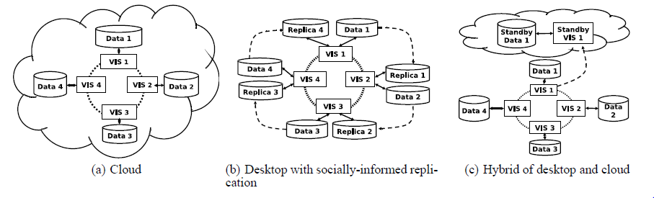
Vis-à-vis
Cloud-based
Cloud offers very high availability
Three paradigms

Slide 8
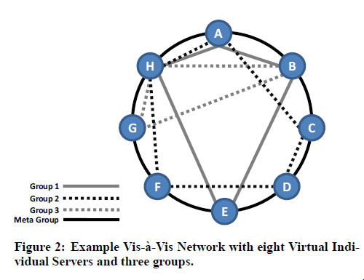
How does it work?
Purely cloud-based
Everyone stores his own data on a personal virtual machine instance called a VIS.
Different VISs can be in different clouds
VISs self-organize into structured overlay networks representing social groups.
Architecture - 2-tired DHT
meta group & individual groups
support varied group operations
Cost
a waste of computing resources
fee full control

Slide 9
Desktop & Hybrid
Desktop-based
Availability
Encryption
Social-informed replication
there are contents a peer don’t want anyone else to see.
replicas are read-only.
Hybrid
yet another compromise: availability cost
Cheap desktops for normal operation and failover to a standby VIS.
challenges: synchronization and failure checking

Slide 10
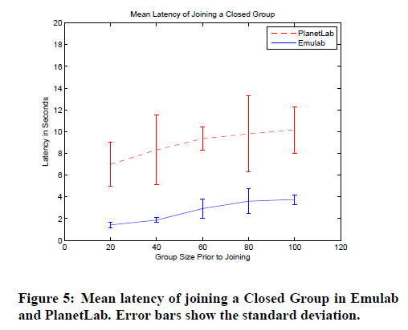
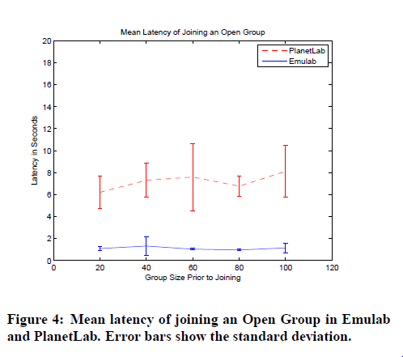
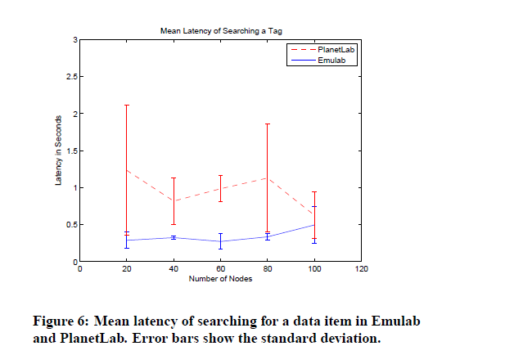
Performance of VISs

