Slide 1
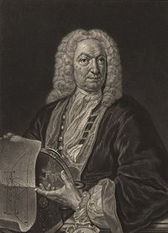
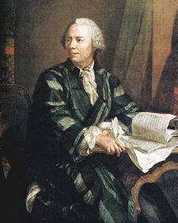
Differential Equations
Johann Bernoulli (1667–1748)
Leonhard Paul Euler (1707–1783)

Slide 2
1. Differential Equations: Definitions
We start with a continuous time series {x(t)}.
Ordinary Differential Equation (ODE)– it relates x(t)and its derivatives.
Example: G(t, x(t), x’(t), x’’(t),...) = 0 for all t t: scalar, usually time
An ODE depends on a single independent variable. A partial differential equation (PDE) depends on many independent variables.
ODE are classified according to the highest degree of derivative involved.
- First-Order ODE: x'(t) = F(t, x(t)) for all t.
- Nth-Order ODE: G(t, x(t), x'(t), ..., x^{n(}t)) = 0 for all t.
Examples: First-order ODE x'(t) = a x(t) + φ(t)
Second-order ODE x'' (t) = a₁ x’(t) + b x(t) + φ(t)

Slide 3
1. Differential Equations: Definitions
If G(.) is linear, we have a linear ODE. If G(.) is anything but linear, then we have a non-linear ODE.
A differential equation not depending directly on t is called autonomous.
Example: x'(t) = a x(t) + b is autonomous.
A differential equation is homogeneous if φ(t) = 0
Example: x'(t) = a x(t) is homogeneous.
If starting values, say x(0), are given. We have an initial value problem.
Example: x'(t) + 2 x(t) = 3 x(0) = 2.
If values of the function and/or derivatives at different points are given, we have a boundary value problem.
Example: x'(t) + 4 x(t) = 0 x(0) = -2, x(π/4) = 10.

Slide 4
1. Differential Equations: Definitions
A solution of an ODE is a function x(t) that satisfies the equation for all values of t. Many ODE have no solutions.
Analytic solutions -i.e., a closed expression of x in terms of t- can be found by different methods. Example: conjectures, integration.
Many ODE’s do not have analytic solutions. This is common problem. Numerical solutions will be needed. Example: Taylor Series Method, Euler Method.
If for some initial conditions a differential equation has a solution that is a constant function (independent of t), then the value of the constant, x∞, is called an equilibrium state or stationary state or critical point.
If, for all initial conditions, the solution of the differential equation converges to x∞ as t →∞, then the equilibrium is globally stable.

Slide 5
1. ODE: Classic Problem
Problem: “The rate of growth of the population is proportional to the size of the population.”
Quantities: t = time, P(t) = population, k = proportionality constant (growth-rate coefficient)
The differential equation representing this problem:
dP(t)/dt = kP(t)
Note that P₀=0 is a solution because dP(t)/dt = 0 forever (trivial!).
If P₀≠0, how does the behavior of the model depend on P₀ and k? In particular, how does it depend on the signs of P₀ and k?
Guessing a solution: The first derivative should be “similar” to the function. Let’s try an exponential: P(t) = c e^{kt}
dP(t)/dt = c ke^{kt} = kP(t) --it works! (and, in fact, c = P₀.)

Slide 6
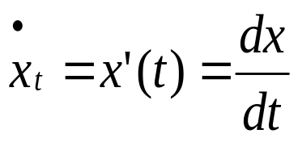
2. First-order differential equations: Notation and Steady state
A first-order ODE:
x'(t) = F(t, x(t)) for all t.
Notation
The steady state represents an equilibrium where the system does not change anymore. When x(t) does not change anymore, we call its value x∞, That is,
x'(t) = F(t, x(t))=0
Example: x'(t) = a x(t) + b, with a≠0.
When x'(t) = 0, x∞=-b/a

Slide 7
2. Separable first-order differential equations
A first-order ordinary differential equation that may be written in the form x'(t)=dx/dt = f (t)g(x) for all t is called separable.
x'(t)=dx/dt = [e^{x(t)+t}/x(t)]√(1 + t2) is separable. We can write it as:
x'(t) = [e^{x(t)}/x(t)]·[e^{t}√(1 + t2)].
x'(t) = F (t) + G(x(t)) is not separable unless either F or G is identically 0: it cannot be written in the form x'(t) = f (t)g(x).
If g is a constant, then the general solution of the equation is simply the indefinite integral of f .
If g is not constant, the equation may be easily solved. Assume g(x) ≠ 0 for all values that x assumes in a solution, we may write:
dx/g(x) = f (t)dt.
Then we may integrate both sides, to get
∫^{x}(1/g(x))dx = ∫^{t} f (t)dt.

Slide 8

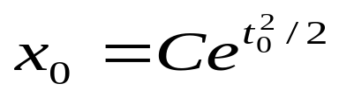
2. Separable first-order differential equations
Example: x'(t) = x(t) t.
  First write the equation as: dx/x = t dt.
  Integrate both sides: ln x = t²/2 + C. (C always consolidates the constants of integration).
  Finally, isolate x: for all t. (C= e^{C} ).
  (Note: if x(t) ≠ 0 for all t; in all the solutions we need C ≠ 0).
  With an initial condition x(t₀) = x₀, the value of C is determined:

Slide 9
2. Linear first-order differential equations
A linear first-order differential equation takes the form
x'(t) + a(t)x(t) = b(t) for all t for some functions a and b.
Case I. a(t) = a ≠ 0 for all t.
- Then, x'(t) + ax(t) = b(t) for all t.
- The LHS looks like the derivative of a product. But, not exactly the derivative of f (t)x(t). We would need f (t) = 1 and f '(t) = a for all t, which is not possible.
- Trick: Let’s we multiply both sides by g(t) for each t:
g(t) x'(t) + a g(t) x(t) = g(t) b(t) for all t.
- Now, we need f (t) = g(t) and f '(t) = ag(t).
If f (t) = e^{at} => f '(t) = a e^{at} = a f (t).

Slide 10
2. Linear first-order differential equations
- Set g(t) = e^{at} => e^{at} x'(t) + a e^{at} x(t) = e^{at} b(t)
- The integral of the LHS is e^{at}x(t)
- Solution:
e^{at}x(t) = C + ∫^{t}e^{as}b(s)ds, or
x(t) = e^{−at}[C + ∫^{t}e^{as}b(s)ds]. ( ∫^{t} f (s)ds is the indefinite integral of f (s) evaluated at t).
Proposition
The general solution of the differential equation
x'(t) + a x(t) = b(t) for all t,
where a is a constant and b is a continuous function, is given by
x(t) = e^{-at−at}[C + ∫^{tt}e^{asas}b(s)ds] for all t.

Slide 11
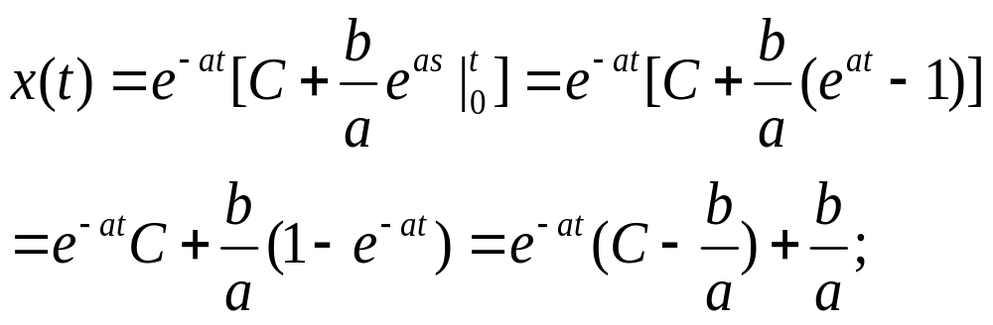
2. Linear first-order differential equations
Special Case: b(t)=b
The differential equation is x'(t) + ax(t) = b
Solution:
x(t) = e^{-at−at}[C + ∫^{tt}e^{asas}b ds] = e^{-at−at}[C +b ∫^{tt}e^{asas} ds]
Note: If x(0)=x₀, then x₀ = C
Stability: If a >0 => x(t) is stable (and x∞=b/a)
If a <0 => x(t) is unstable

Slide 12
2. Linear first-order differential equations: Phase Diagram
A phase diagram graphs the first-order ODE. That is, plots x’(t) and x(t):
Example: x'(t) + ax(t) = b
x’(t)
x’(t)
x∞=b/a
x(t)
x∞=b/a
x(t)
a > 0
a < 0

Slide 13
2. Linear first-order differential equations
Example: u'(t) + 0.5 u(t) = 2.
Solution:
u(t) = Ce^{-0.5t -}+ 4. (Solution is stable => 0.5>0)
Steady state: x∞ = b/a = 2/0.5 = 4
If u(0) = 20 => C = 16, => Definite solution: x(t) = 16 e^{-.5t -}+ 4.
Example: v'(t) - 2 v(t) = -4.
Solution:
v(t) = Ce^{2t -}- 2. (Solution is unstable => -2<0)
Steady state: v∞ = b/a = -4/-2 = 2
If v(0) = 3 => C = 7, => Definite solution: v(t) = 7 e^{2t -}+ 2.

Slide 14
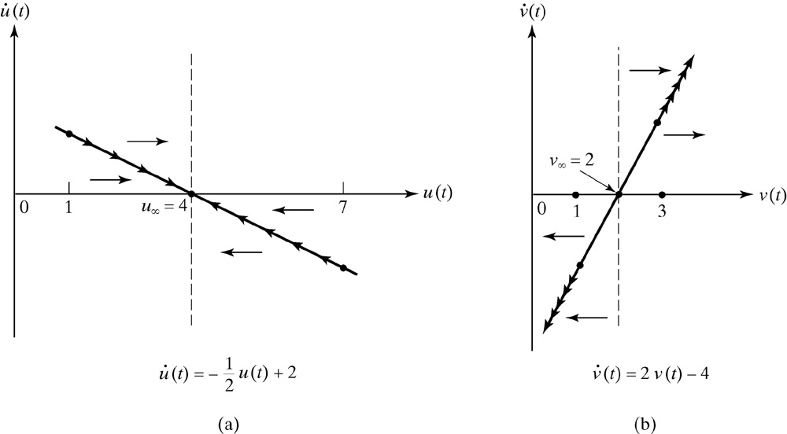
Figure 14.1 Phase Diagrams for Equations

Slide 15
2. Linear first-order differential equations: Price Dynamics
Let p be the price of a good.
Total demand: D(p) = a − bp
Total supply: S(p) = α + βp,
a, b, α, and β are positive constants.
Price dynamics: p'(t) = θ [D(p) − S(p)] with θ > 0.
Replacing supply and demand:
p'(t) + θ (b + β)p(t) = θ(a − α). (a first-order linear ODE)
Solution:
p(t) = Ce^{-θ(b+β)t} + (a − α)/(b + β).
p∞ = (a − α)/(b + β),
Given θ(b + β) > 0, this equilibrium is globally stable.

Slide 16
2. Linear first-order differential equations
Case II. a(t) ≠ a (a is a function!)
- Then, x'(t) + a(t) x(t) = b(t) for all t.
- Recall we need to recreate f (t)x(t) to apply product rule:
- We need f (t) = g(t) and f '(t) = a(t) g(t) for all t:
- Try: g(t) = e^{∫ ta(s)ds} (the derivative of ∫ ^{t}a(s)ds = a(t) ).
- Multiplying the ODE equation by g(t):
e^{∫ ∫ ta(s)ds} x'(t) + a(t)e ^{∫ ta(s)dss)}x(t) = e^{∫ ∫ a(s)ds} ^{s}b(t), or
(d/dt)[x(t) e^{∫ ∫ a(s)dss}] = e^{∫ ∫ ta(s)dss}b(t).
- Thus x(t) e ^{∫ta(s)ds =} C + ∫^{tt} e^{∫ ∫ a(s)ds} b(u)du, or
x(t) = e^{-∫∫ ta(s)ds s}[C + ∫^{tt} e^{∫ ∫ a(s)ds ds}b(u)du].

Slide 17
2. Linear first-order differential equations
  Example: x'(t) + (1/t)x(t) = e^{t}.
  We have ∫ ^{t}(1/s)ds = ln t => e^{∫ t(1/t)dt} = t.
  Solution:
  x(t) = (1/t)(C + ∫ ^{t}ue^{u}du)
  = (1/t)(C + te^{t} − ∫ ^{t}e^{u}du) (use integration by parts.)
  = (1/t)(C + te^{t} − e^{t})= C/t + e^{t} − e^{t}/t.
  We can check that this solution is correct by differentiating:
  x'(t) + x(t)/t = −C/t² + e^{t} − e^{t}/t + e^{t}/t² + C/t² + e^{t}/t − e^{t}/t² = e^{t}.
  As usual, an initial condition determines the value of C.

Slide 18
2. Linear differential equations: Analytic Solution Revisited - Proof
Suppose, we have the following form:
x"(t) + ax'(t) + bx(t) = f (t) (a and b are constants)
Let x₁ be a solution of the equation. For any other solution of this equation x, define z = x − x₁.
Then z is a solution of the homogeneous equation:
x"(t) + ax'(t) + bx(t) = 0.
=> z"(t) + az'(t) + bz(t) = [x"(t) + ax'(t) + bx(t)] − [x₁"(t) + ax₁'(t) + bx₁(t)] = f (t) − f (t) = 0.
Further, for every solution z of the homogeneous equation, x₁ + z is clearly a solution of original equation.
That is, the set of all solutions of the original equation may be found by finding one solution of this equation and adding to it the general solution of the homogeneous equation.

Slide 19
2. Linear differential equations: Analytic Solution Revisited
Thus, we can follow the same strategy used for difference equations to generate an analytic general solution:
Steps:
1) Solve homogeneous equation (constant term is equal to zero.)
2) Find a particular solution, for example x∞.
3) Add homogenous solution to particular solution
Example: x'(t) + 2x(t) = 8.
Step 1: Guess a solution to homogeneous equation: x'(t) + 2x(t) = 0
x(t) = Ce^{-2t}.
Step 2: Find a particular solution, say x∞ = 8/2=4
Step 3: Add both solutions: x(t) = Ce^{-2t} + 4

Slide 20
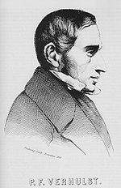
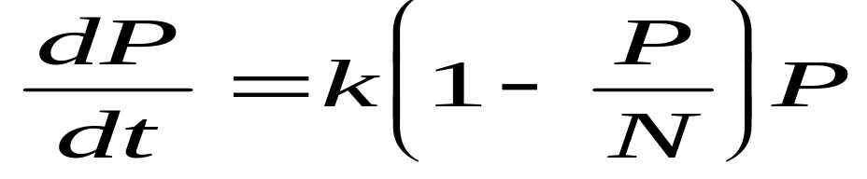
3. Non-linear ODE: Back to Population Model
The population model presented before is very simple. Let’s complicate the model:
1. If the population is small, growth is proportional to size.
2. If the population is too large for its environment to support, it will decrease.
We now have quantities: t = time, P = population, k = growth-rate coefficient for small populations, N = “carrying capacity”
Let’s restate 1. and 2. in terms of derivatives:
1. dP/dt is approximately kP when P is “small.”
2. dP/dt is negative when P > N.
Logistic Model (Pierre-François Verhulst ):

Slide 21
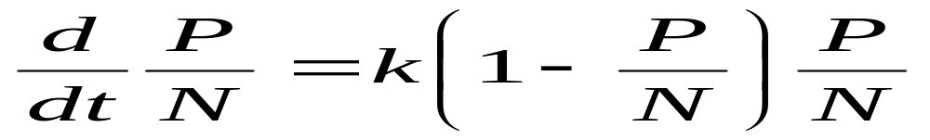
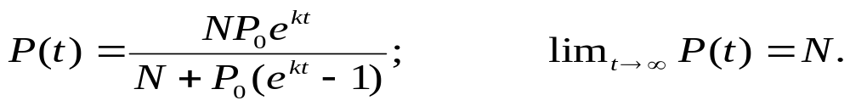
3. Non-linear ODE: Back to Population Model
Let’s divide both sides of the equation by N:
Let x(t)=P/N => x'(t) =k[1-x(t)] x(t)
Solution:

Slide 22
4. Second Order Differential Equations
A second-order ordinary differential equation is a differential equation of the form:
G(t, x(t), x'(t), x"(t)) = 0 for all t,
involving only t, x(t), and the first and second derivatives of x.
We can write such an equation in the form:
x"(t) = F (t, x(t), x'(t)).
Note that equations of the form x"(t) = F (t, x'(t)) can be reduced to a first-order equation by making the substitution
z(t) = x'(t).

Slide 23
4. Second Order Differential Equations: Risk Aversion Application
The function ρ(w) = −wu"(w)/u'(w) is the Arrow-Pratt measure of relative risk aversion, where u(w) is the utility function for wealth w
Question: What u(w) has a degree of risk-aversion that is independent of the level of wealth? Or, for what u do we have
a = −wu"(w)/u'(w) for all w?
This is a second-order differential equation in which the term u(w) does not appear. (The variable is w, rather than t.)
Let z(w) = u'(w) => a = −wz'(w)/z(w)
=> az(w) = −wz'(w), a separable equation
=> a·dw/w = −dz/z.
Solution: a·ln w = −ln z(w) + C, or
z(w) = C* w^{-a} (C*=exp(C))

Slide 24
4. Second Order Differential Equations: Risk Aversion Application
Solution: z(w) = C* w^{-a} (C*=exp(C))
Now, z(w) = u'(w), so to get u we need to integrate:
=> u(w) = C* ln w + B if a = 1
= C* w^{1−a}/(1 − a) + B if a ≠ 1
That is, a utility function with a constant degree of relative risk-aversion equal to a takes this form.

Slide 25
4. Linear second-order equations with constant coefficients: Finding a Solution
Based on the solutions for first-order equations, we guess that the homogeneous equation has a solution of the form x(t) = Ae^{rt}.
Check: x(t) = Ae^{rt}
x'(t) = rAe^{rt}
x"(t) = r²Ae^{rt},
=> x"(t) + ax'(t) + bx(t) = r²Ae^{rt} + arAe^{rt} + bAe^{rt} = 0
=> Ae^{rt}(r² + ar + b) = 0.
For x(t) to be a solution of the equation we need r² + ar + b = 0.
This equation is called the characteristic equation of the ODE.
Similar to second-order difference equations, we have 3 cases:
  If a² > 4b => 2 distinct real roots
  If a² = 4b => 1 real root
  If a² < 4b => 2 distinct complex roots.

Slide 26
4. Linear second-order equations with constant coefficients: Finding a Solution
If a² > 4b => Two distinct real roots: r and s.
=> x₁(t) = Ae^{rt} and x₂(t) = Be^{st}, for any values of A and B, are solutions.
=> also x(t) = Ae^{rt} + Be^{st} is a solution. (It can be shown that every solution of the equation takes this form.)
If a² = 4b => One single real root: r
=> (A + Bt)e^{rt} is a solution (r = −(1/2)a is the root).
If a² < 4b => Two complex roots: r_{j}= α±i β j=1,2.
(α=−a/2, β=√(b−a²)/4)
=> x₁(t) = e^{(α+iβ)t} and x₂(t) = e^{(α-iβ)t}
Use Euler’s formula to eliminate complex numbers: e^{iθ}=cos(θ)+i sin(θ). Adding both solutions and after some algebra:
=> x(t) = A e^{(α+iβ)t} + B e^{(α-iβ)t} = A e^{αt} cos(βt) + B e^{αt} sin(βt).

Slide 27
4. Linear second-order equations with constant coefficients: Finding a Solution
Example: x"(t) + x'(t) − 2x(t) = 0. (a² > 4b = 1>4*(-2)=8) Characteristic equation: r² + r − 2 = 0 => eigenvalues are 1 and −2.
Solution: x(t) = Ae^{t} + Be^{−2t}.
Example: x"(t) + 6x'(t) + 9x(t) = 0. (a² = 4b = 6² = 4*9 Characteristic equation: r² + 6r + 9 = 0 => eigenvalue is −3.
Solution: x(t) = (A + Bt)e^{−3t}.
Example: x"(t) + 2x'(t) + 17x(t) = 0. (a² < 4b = 4<4*(17)=68) Characteristic equation: r² + 2r + 17 = 0 =>roots are complex with α = −a/2 = -1 and β = √(b − a²/4) = 4.
Solution: [A cos(4t) + B sin(4t)]e^{−t}.

Slide 28
4. Linear second-order equations with constant coefficients: Stability
Consider the homogeneous equation x"(t) + ax'(t) + bx(t) = 0.
If b ≠ 0, there is a single equilibrium, namely 0 –i.e., the only constant function that is a solution is equal to 0 for all t.
Three cases:
Characteristic equation with two real roots: r and s.
Solution: x(t) = Ae^{rt} + Be^{st} => equilibrium is stable iff r < 0 and s < 0.
Characteristic equation with one single real root: r
  Solution: (A + Bt)e^{rt} => equilibrium is stable iff r < 0.
Characteristic equation with complex roots
  Solution: (A cos(βt) + B sin(βt))e^{αt}, where α = −a/2, the real part of each root. => equilibrium is stable iff α<0 (or a>0).

Slide 29
4. Linear second-order equations with constant coefficients: Stability
The real part of a real root is simply the root. We can combine the three cases:
The equilibrium is stable if and only if the real parts of both roots of the characteristic equation are negative. A bit of algebra shows that this condition is equivalent to a > 0 and b > 0.
Proposition
  An equilibrium of the homogeneous linear second-order differential equation x"(t) + ax'(t) + bx(t) = 0 is stable if and only if the real parts of both roots of the characteristic equation r² + ar + b = 0 are negative, or, equivalently, if and only if a > 0 and b > 0.
If b = 0, then every number is an equilibrium (and none is stable).

Slide 30
4. Linear second-order equations with constant coefficients: Example
Stability of a macroeconomic model.
Let Q be aggregate supply, p be the price level, and π be the expected rate of inflation.
Q(t) = a − bp + cπ, where a > 0, b > 0, and c > 0.
  Let Q* be the long-run sustainable level of output.
  Assume that prices adjust according to the equation:
  p'(t) = h(Q(t) − Q*) + π(t), where h > 0.
  Finally, suppose that expectations are adaptive:
  π'(t) = k(p'(t) − π(t)) for some k > 0.
  Question: Is this system stable?

Slide 31
4. Linear second-order equations with constant coefficients: Example
  Question: Is this system stable?
  Reduce the system to a second-order differential equation:
  1) Differentiate equation for p'(t) => get p"(t)
  2) Substitute in for π'(t) and π(t).
  We obtain: p"(t) − h(kc − b) p'(t) + khb p(t) = kh(a − Q*)
  => System is stable iff kc < b. (khb > 0 as required.)
  Note:
  If c = 0 -i.e., expectations are ignored- => system is stable.
  If c ≠ 0 and k is large -inflation expectations respond rapidly to changes in the rate of inflation- => system may be unstable.

Slide 32
5. System of Equations: First-Order Linear Differential Equations - Substitution
      Consider the 2x2 system of linear homogeneous differential equations (with constant coefficients)
      x'(t) = ax(t) + by(t)
      y'(t) = cx(t) + dy(t)
      We can solve this system using what we know:
      1. Isolate y(t) in the first equation => y(t) = x'(t)/b − ax(t)/b.
      2. Differentiate this y(t) equation => y'(t) = x"(t)/b − ax'(t)/b.
      3. Substitute for y(t) and y'(t) in the second equations in our system:
      x"(t)/b − ax'(t)/b = cx(t) + d[x'(t)/b − ax(t)/b],
      => x"(t) − (a + d)x'(t) + (ad − bc)x(t) = 0.
      This is a linear second-order differential equation in x(t). We know how to solve it.
      4. Go back to step 1. Solve for y(t) in terms of x'(t) and x(t).

Slide 33
5. System of Equations: First-Order Linear Differential Equations - Substitution
      Example:
        x'(t) = 2x(t) + y(t)
        y'(t) = −4x(t) − 3y(t).
        1. Isolate y(t) in the first equation: => y(t) = x'(t) − 2x(t),
        2. Differentiate in 1. => y'(t) = x"(t) − 2x'(t).
        3. Substitute these expressions into the second equation:
        x"(t) − 2x'(t) = −4x(t) − 3x'(t) + 6x(t), or
        x"(t) + x'(t) − 2x(t) = 0.
        Solution:
        x(t) = Ae^{t} + Be^{−2t}.
        4. Using the expression y(t) = x'(t) − 2x(t) we get
        y(t) = Ae^{t} − 2Be^{−2t} − 2Ae^{t} − 2Be^{−2t} = −Ae^{t} − 4Be^{−2t}.

Slide 34
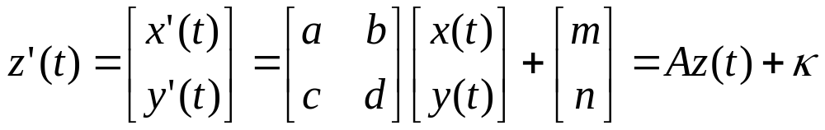
5. System of Equations: First-Order Linear Differential Equations - Diagonalization
      Consider the 2x2 system of linear differential equations (with constant coefficients)
      x'(t) = ax(t) + by(t) + m
      y'(t) = cx(t) + dy(t) + n
      Let’s rewrite the system using linear algebra:
Diagonalize the system (A must have independent eigenvectors):
H⁻¹ z’(t) = H⁻¹ A (H H⁻¹⁾ z(t) + H⁻¹ κ
H⁻¹ A H = Λ
H⁻¹ z(t) = u(t) and H⁻¹ κ = s
u’(t) = Λ u(t) + s => u’₁(t) = λ₁ u₁(t) + s₁
u’₂(t) = λ₂ u₂(t) + s₂

Slide 35
5. System of Equations: First-Order Linear Differential Equations - Diagonalization
Now, we have u’(t) = Λ u(t) + s
=> u’₁(t) = λ₁ u₁(t) + s₁
u’₂(t) = λ₂ u₂(t) + s₂
Solution:
u₁(t) = e^{-λ1t} [u₁(0) - s₁/λ₁] + s₁/λ₁
u₂(t) = e^{-λ2t} [u₂(0) - s₂ /λ₂] + s₂/λ₂

Slide 36
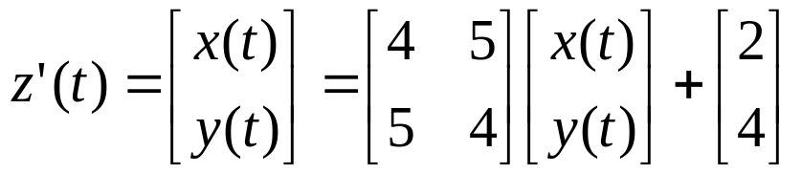
5. System of Equations: First-Order Difference Equations - Example
        Now, we have a system
      x'(t) = 4 x(t) + 5 y(t) + 2
      y'(t) = 5 x(t) + 4 y(t) + 4
        Let’s rewrite the system using linear algebra.
Eigenvalue equation: λ² - 8 λ - 9 = 0 => λ₁, λ₂=(9,−1)
u’₁(t) = 9 u₁(t) + s₁ (unstable equation)
u’₂(t) = -1 u₂(t) + s₂ (stable equation)
Solution:
u₁(t) = e^{9t} [u₁(0) - s₁/9] + s₁/9
u₂(t) = e^{-t} [u₂(0) - s₂ /(-1)] + s₂ /(-1)

Slide 37
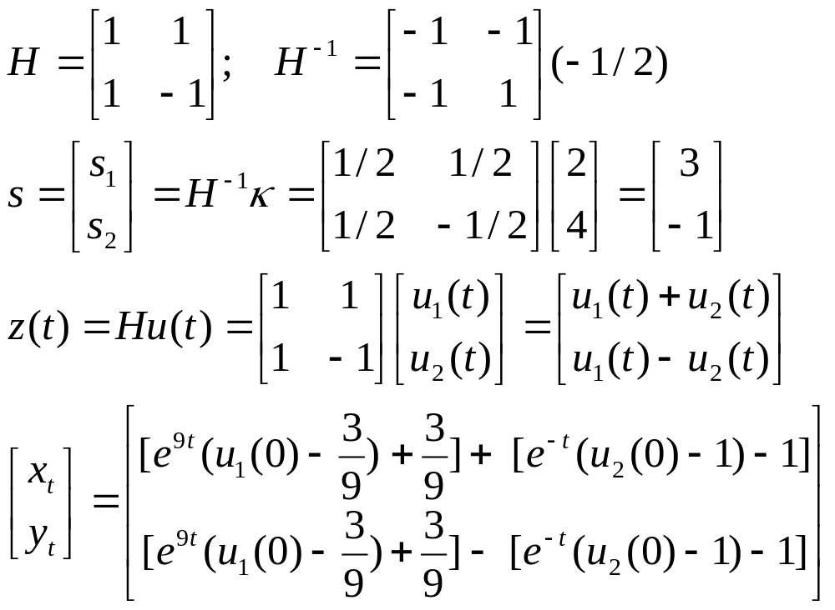
5. System of Equations: First-Order Difference Equations - Example
      Use the eigenvector matrix, H, to transform the system:
      We need [x(0),y(0)]=(x₀,y₀) to obtain u₁(0) and u₂(0).

Slide 38
5. System of Equations: First-Order Linear Differential Equations – General Approach
We start with an nxn system z’ (t) = Az(t) + b(t).
First, we solve the homogenous system:
Theorem: Let z’ = Az be a homogeneous linear first-order system. If z = ve^{λt} is a solution to this system (where v = [v₁, v₂, ..., v_{n}]¢ ], then λ is an eigenvalue of A and v is the corresponding eigenvector.
Proof: Start with z = ve^{λt} => z’ = λ ve^{λt}
Substitute for z and z’ in z’ = Az , => λ ve^{λt} = Ave^{λt}
Divide e^{λt} both sides => λ v = Av or (A - λ I)v = 0.
Thus, for a non-trivial solution, it must be that |A-λI| = 0, which is the characteristic equation of matrix A. Thus, λ is an eigenvalue of A and v is its associated eigenvector. ■

Slide 39

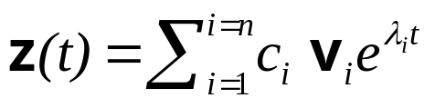
5. System of Equations: First-Order Linear Differential Equations – General Approach
A has n eigenvalues, λ ₁, .., λ _{n} and n eigenvectors, v₁, v₂, .., v_{n}
=> each term is a solution to z’ = Az.
Any linear combination of these terms are also solutions to z’ = Az.
Thus, the general solution to the homogeneous system z’ = Az is:
where c₁, .., c_{n} are arbitrary, possibly complex, constants.

Slide 40
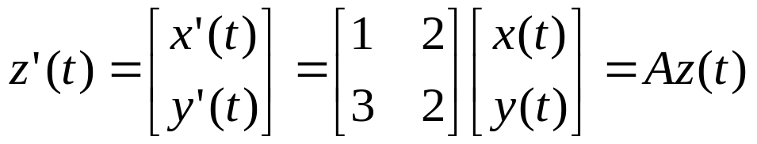
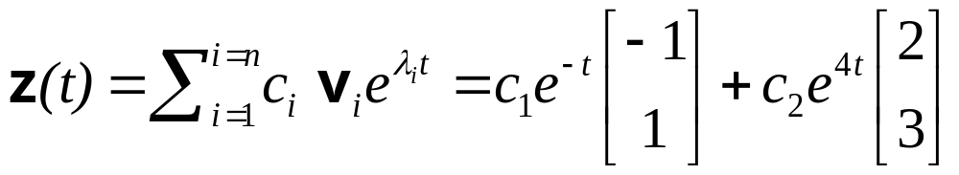
5. System of Equations: First-Order Linear Differential Equations – General Approach
Example: x'(t) = x(t) + 2 y(t)
      y'(t) = 3 x(t) + 2 y(t) x(0)=0, y(0)=-4
Rewrite system:
Eigenvalue equation: λ² - 3 λ - 4 = 0 => λ₁, λ₂=(−1,4)
Find Eigenvectors: λ₁=-1 => v₁=(v_{1,1} v_{1,2}) v_{1,1}=-v_{1,2}
Let v_{1,2}=1 => v₁=(-1,1)
λ₂=4 => v₂=(v_{2,1} v_{2,2}) v_{2,1}=(2/3)v_{2,2}
Let v_{2,2}=3 => v₂=(2,3)
Solution:

Slide 41
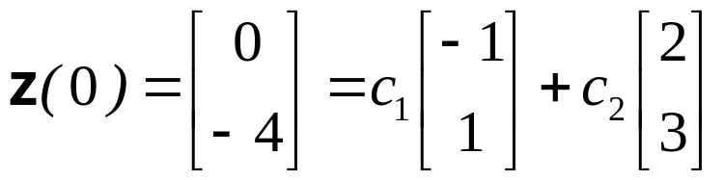
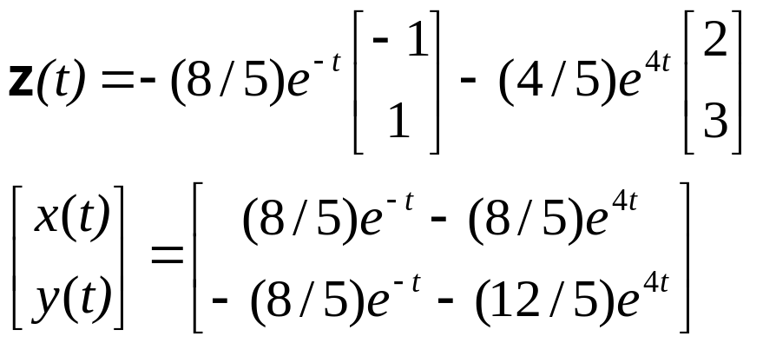
5. System of Equations: First-Order Linear Differential Equations – General Approach
Find constants:
=> 2x2 system: c₁=-(8/5);c₂=-(4/5)
Definite solution:

Slide 42
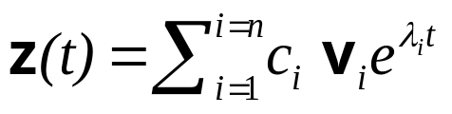
5. System of Equations: First-Order Linear Differential Equations – Stability
The general solution of the homogeneous equation:
The stability depends on the eigenvalues. Recall eigenvalue equation: λ² - tr(A) λ + |A| = 0
Three cases:
1. [tr(A)]² > 4|A| => 2 real distinct roots
- signs of λ₁, λ₂ 1) λ₁<0, λ₂ <0 if tr(A)<0,|A|>0
2) λ₁>0, λ₂ >0 if tr(A)>0,|A|>0
3) λ_{i}>0, λ_{j} <0 if |A|<0
  Under Situation 1, the system is globally stable. There is convergence towards (x∞, y∞), which is called a tangent node.

Slide 43
5. System of Equations: First-Order Linear Differential Equations – Stability
Example: x'(t) = -5x(t) + 1 y(t)
      y'(t) = 4 x(t) - 2 y(t) x(0)=1, y(0)=2
      Eigenvalue equation: λ² - 7 λ + 6 = 0 => λ₁, λ₂=(−1,−6)
Eigenvectors:
λ₁=-6 => v₁=(v_{1,1} v_{1,2}) v_{1,1}=-v_{1,2}
Let v_{1,2}=1 => v₁=(1,-1)
λ₂=-1 => v₂=(v_{2,1} v_{2,2}) v_{2,1}=(1/4)v_{2,2}
Let v_{2,2}=4 => v₂=(1,4)

Slide 44
5. System of Equations: First-Order Linear Differential Equations – Stability
  Under Situation 2, the system is globally unstable. There is no convergence towards (x∞, y∞). A shock will move the system away from the tangent node, unless we are lucky and the system jumps to the new tangent node.
  Under Situation 3, the system is saddle path unstable. We need C_{i}=0 when λ_{i}>0.

Slide 45
5. System of Equations: First-Order Linear Differential Equations – Stability
  2. [tr(A)]² = 4|A| => 1 real root equal to λ=tr(A)/2=(a+d)/2
  System cannot be diagonalized (eigenvectors are the same!).
      x(t) = C₁ e^{λt} + C₂ t e^{λt} +x∞
      y(t) = [(λ-a)/b (C₁ + C₂ t )+ C₂/b]e^{λt} + y∞
      The stability of the system depends on λ. If λ<0, the system is globally stable.

Slide 46
5. System of Equations: First-Order Linear Differential Equations – Stability
  3. [tr(A)]² > 4|A| => 2 complex roots r_{i}=λ±iμ
    Two solutions:
  Similar to what we did for second-order DE, we can use Euler’s formula to transform the e^{iλt} part and eliminate the complex part:
  e^{iθ} = cos(θ) + i sin(θ).
  Example: x'(t) = 3x(t) - 9 y(t)
      y'(t) = 4 x(t) - 3 y(t) x(0)=2, y(0)=-4
      Eigenvalue equation: λ² + 27= 0 => λ₁, λ₂= (3√3i, -3√3i)
Eigenvectors: λ₁ =3√3i => v_{1,2}=1/3(1- √3i)v_{1,1}
Let v_{1,1}=3 => v₁=(1, (1- √3i))
λ₂=-1 => v₂=(v_{2,1} v_{2,2}) v_{2,1}=(1/4)v_{2,2}
Let v_{2,2}=4 => v₂=(1,4)
The solution from the first eigenvalue λ₁ =3√3i: z₁(t)=v₁ e^{3√3it}

Slide 47
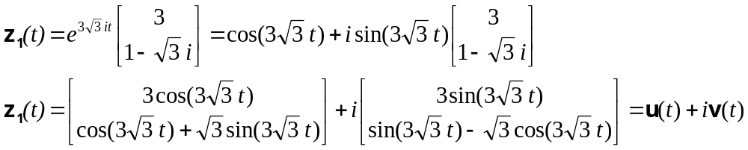
5. System of Equations: First-Order Linear Differential Equations – Stability
  Using Euler’s formula:
  It can be shown that both u(t) and v(t) are independent solutions. We can use them to get a general solution to the homogeneous system:
    z(t) = c₁u(t)+ c₂v(t)

Slide 48
5. System of Equations: First-Order Linear Differential Equations – Phase Plane
In the single ODE we sketch the solution, x(t), in the x-t plane. This will be difficult in this case since our solutions are actually vectors.
Think of the solutions as points in the x-y plane. Plot the points. The steady state corresponds to (x∞,y∞). The x-y plane is called the phase plane.
Phase diagrams are particularly useful for non-linear systems, where analytic solution may not possible. Phase diagrams provides qualitative information about the solution paths of nonlinear systems.
For the linear case, plot points in the x-y plane when z’(t)=0. Trajectories of z(t) are easy to deduce from the parameters a, b, c, and d.
For the non-linear case, we need to be more creative.

Slide 49
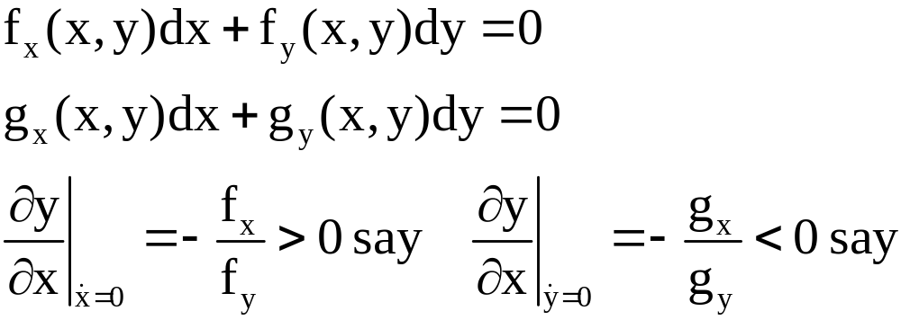
5. System of Equations: First-Order Linear Differential Equations – Phase Plane
      First, we start with the non-linear system:
      x'(t) = f(x(t),y(t))
      y'(t) = g(x(t),y(t))
      Second, we establish the slopes of the singular curves by totally differentiating the singular curves:

Slide 50


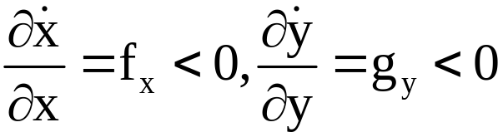
5. System of Equations: First-Order Linear Differential Equations – Phase Plane
y(t)
y∞
x∞
x(t)
Now, establish the directions of motion. Suppose that

Slide 51
y
y
x
x
y
y*
x*
x

Slide 52
Saddlepath
y
x
Focus
y
x

Slide 53
Limit Cycle
y
x

Slide 54
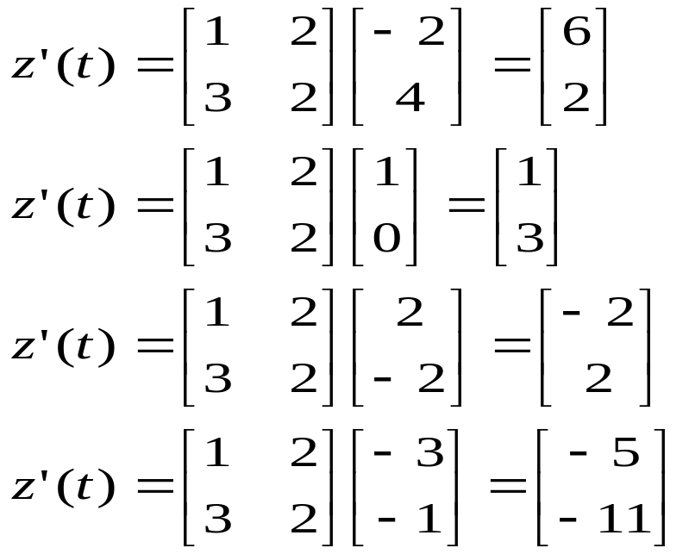
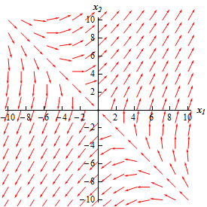
5. System of Equations: First-Order Linear Differential Equations – Phase Plane
Example:
  x'(t) = x(t) + 2 y(t)
  y'(t) = 3 x(t) + 2 y(t) x(0)=0, y(0)=-4
  Plot some points in the x-y plane: (-2,4); (1,0);(2,-2);(-3,-1)

Slide 55
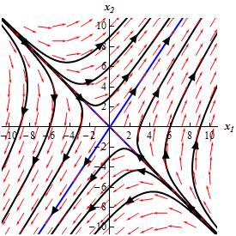
5. System of Equations: First-Order Linear Differential Equations – Phase Plane
Plot the trajectories of the solutions in black and blue. In blue, the lines that follow the direction of the eigenvectors:
With the exception of two trajectories, the trajectories in red move away from the equilibrium solution (0,0).
These equilibrium points are called saddle point, which is unstable.

Slide 56
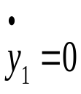
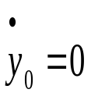
5. System of Equations: First-Order Linear Differential Equations – Stability - Application
  In economics, it is common to assume that the economy is a stable situation. If a model determines an equilibrium with a saddle path, the saddle path trajectory is assumed. If the equilibrium is perturbed, the economy jumps to the new saddle path.
y(t)
• This model displays “overshooting” in y(t). The economy jumps from y_{0,∞} to y_{J} immediately, then it converges to y_{1,∞}.
y_{J}
y_{1,∞}
y_{0,∞}
x(t)

Slide 57
6. Numerical Solutions
      Many differential equations cannot be solved analytically, in which case we have to satisfy ourselves with an approximation to the solution.
      Numerical ordinary differential equations is the part of numerical analysis which studies the numerical solution of ODE. This field is also known under the name numerical integration, but some people reserve this term for the computation of integrals.
      There are several algorithms to compute an approximate solution to an ODE.
      A simple method is to use techniques from calculus to obtain a series expansion of the solution. An example is the Taylor Series Method.

Slide 58
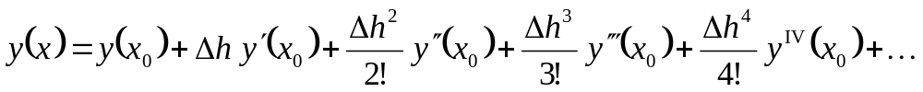

6. Numerical Solutions: Taylor Series Method
The Taylor series method is a straight forward adaptation of classic calculus to develop the solution as an infinite series.
The method is not strictly a numerical method but it is used in conjunction with numerical schemes.
Problem: Computers usually can not be programmed to construct the terms and the order of the expansion is a priori unknown
From the Taylor series expansion:
The step size is defined as:
Using the ODE to get all the derivatives and the initial conditions, a solution to the ODE can be approximated.

Slide 59
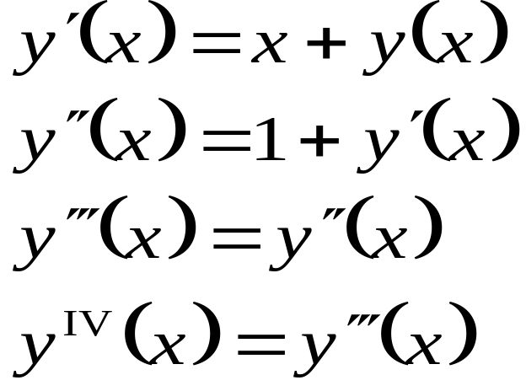
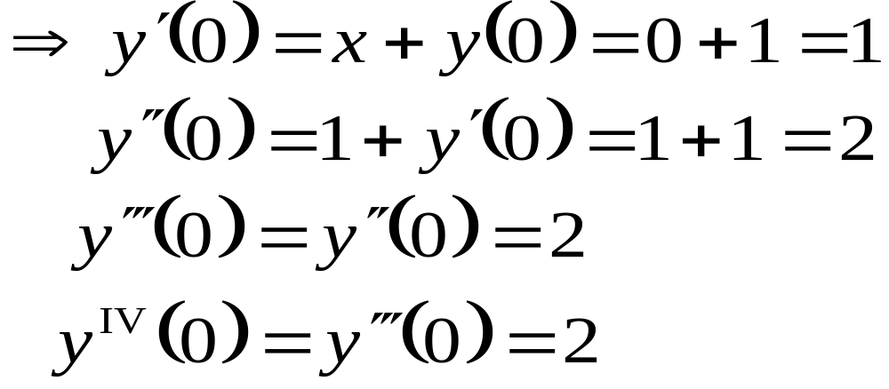
6. Numerical Solutions: Taylor Series Method
Example: ODE y’(x) = x + y y₀=1,
Analytical solution: y(x) = 2 e^{x} - x – 1
Let’s try to approximate y(x) using a Taylor series expansion.
- First, we need the jth order derivatives for j=1, 2, 3, ...

Slide 60
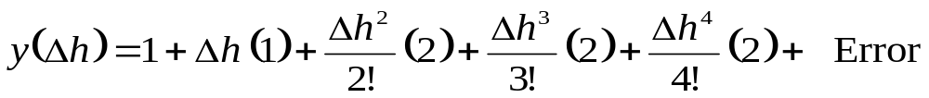
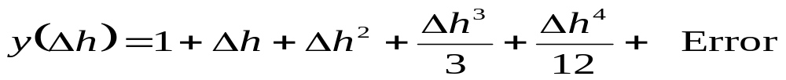
6. Numerical Solutions: Taylor Series Method
- Second, replace in the Taylor series expansion
Note that the Taylor series is a function of x₀ and Δh. Plug in the initial conditions (n=4):
Resulting in the equation:

Slide 61
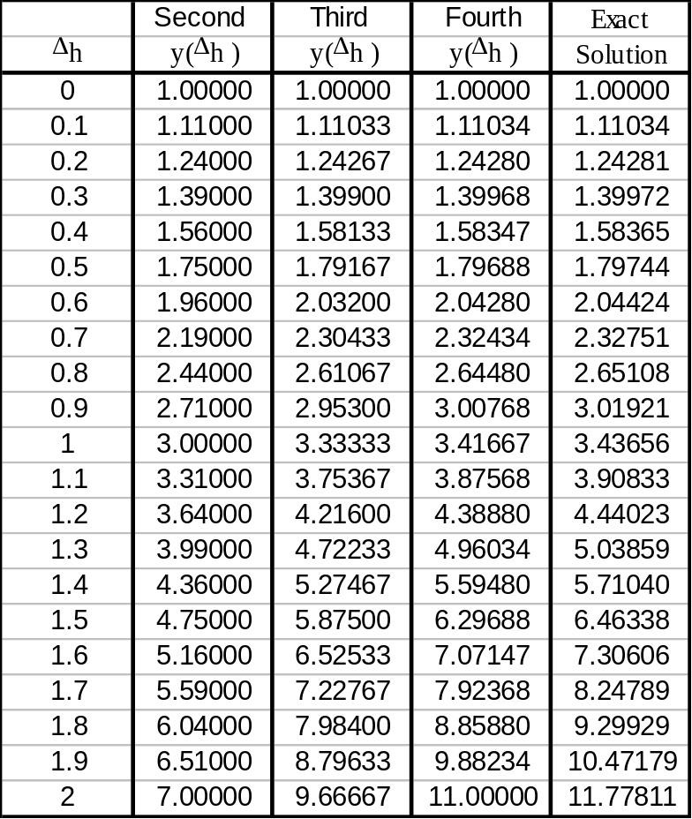
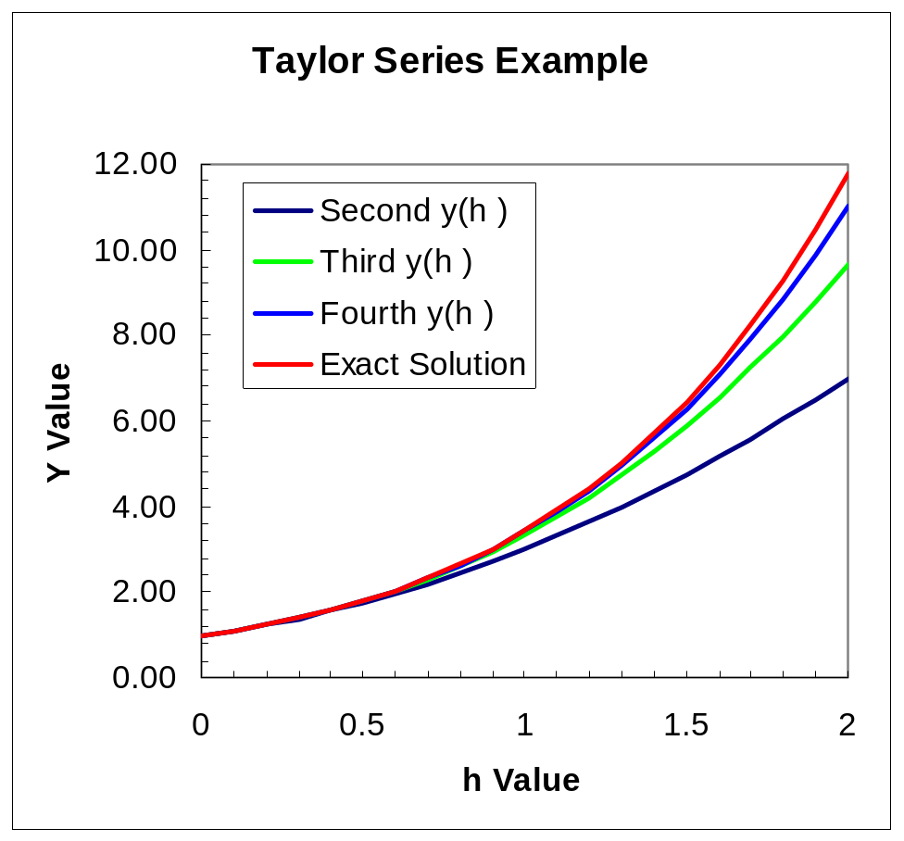
6. Numerical Solutions: Taylor Series Method
The results (x=0)

Slide 62

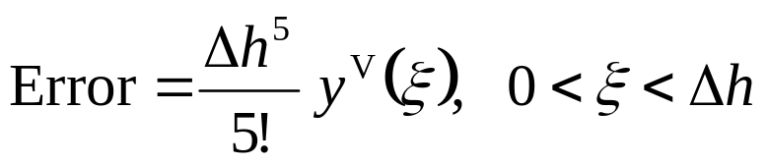
6. Numerical Solutions: Taylor Series Method
Note that the last set of terms, you start to lose accuracy for the 4th order
All we know is that it is in the range of 0< ξ <Δh

Slide 63
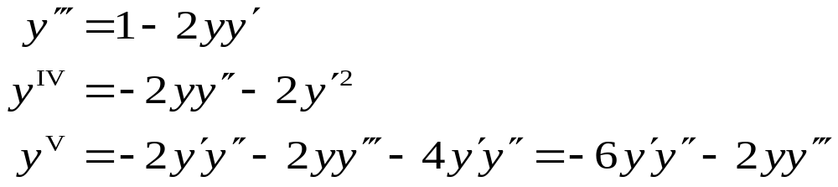
6. Numerical Solutions: Taylor Series Method
Numerical analysis is an art. The number of terms, we chose is a matter of judgment and experience.
We usually truncate the Taylor series, when the contribution of the last term is negligible to the number of decimal places to which we are working.
Things can get complicated for higher-order ODE.
Example: y’’(x) = 3 + x –y², y(0)=1, y’(0)=-2
The higher order terms can be calculated from previous values and they are difficult to calculate.

Slide 64
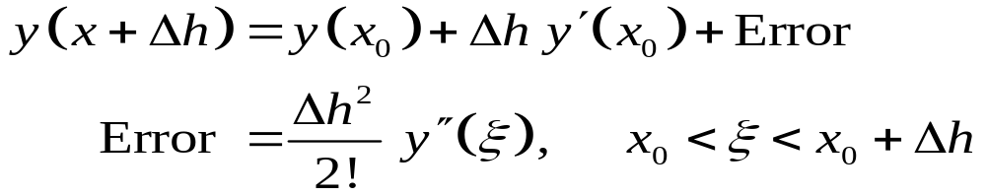
6. Numerical Solutions: Euler Method
One thing about the Taylor series, is that the error is small when the Δh is small and only a few terms are need for good accuracy.
The Euler method may be thought of an extreme of the idea for a Taylor series having a small error when Δh is extremely small. The Euler method is a first-order Taylor series with each step having an upgrade of the derivative and y term changed:
The Euler method can have the algorithm, where the coefficients are upgraded each time step:
The first derivative and the initial y values are update each iteration.

Slide 65
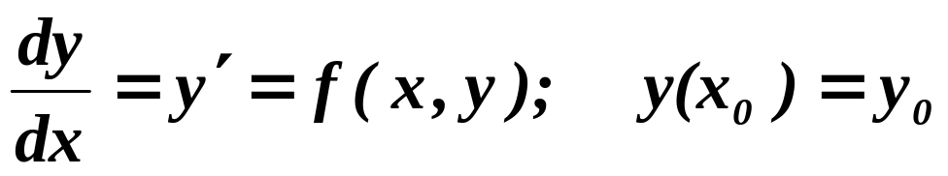
6. Numerical Solutions: Euler Method
Straight line approximation
y₀
x₀
h
x₁
h
x₂
h
x₃

Slide 66
6. Numerical Solutions: Euler Method
Consider: y’(x) = x + y
The initial condition is: y(0)=1
The step size is: Δh =.02
The analytical solution is: y(x) = 2 e^{x} - x – 1
The algorithm has a loop using the initial conditions and definition of the derivative
The derivative is calculated as: y_{i}’(x) = y_{i} + x_{i}
The next y value is calculated: y_{i+1}(x) = y_{i} + Δh y_{i}’(x)
Take the next step: x_{i+1} = x_{i} + Δh

Slide 67
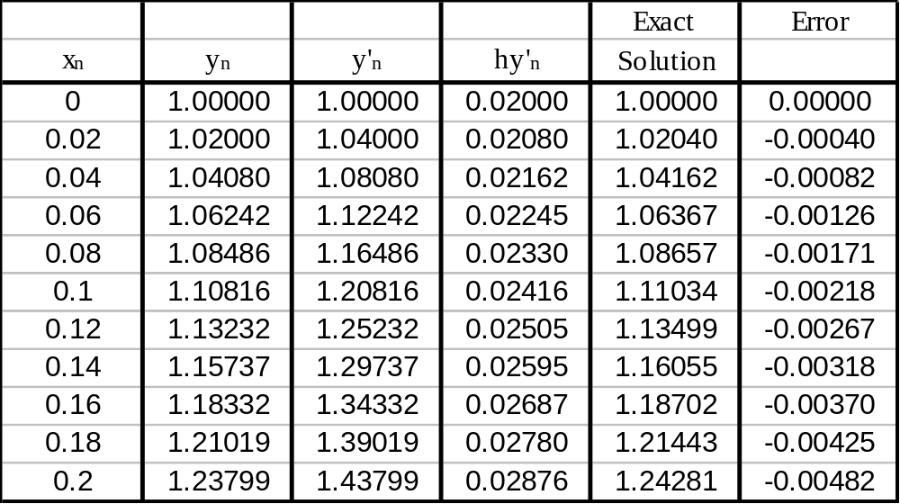
6. Numerical Solutions: Euler Method
The results

Slide 68
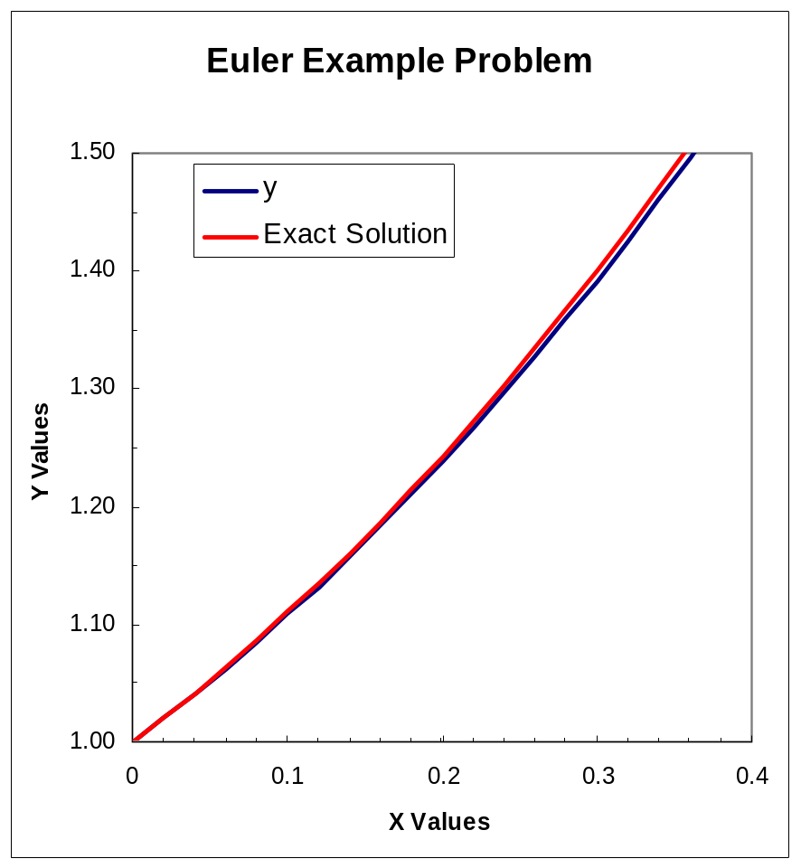
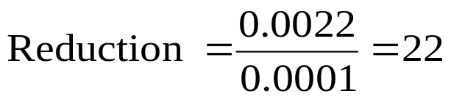
6. Numerical Solutions: Euler Method
Compare the error at y(0.1) with a Δh=0.02
Error = 1.1103-1.1081 = 0.0022
If we want the error to be smaller than 0.0001
We need to reduce the step size by 22 to get the desired error.

Slide 69
6. Numerical Solutions: Euler Method
The trouble with this method is
  Lack of accuracy
  Small step size
Note for the simple Euler method, we use the slope at the beginning of the interval y_{n}’, to determine the increment to the function, but this is always wrong. If the the slope is constant, the solution is linear.

Slide 70
Extra
Introduction to Stochastic Processes and Calculus

Slide 71
Preliminaries (1)
What is a sigma-algebra of a set Ω?
  Ω is the set of total events, ω is the element of Ω.
  A sigma algebra F is a subset of Ω s.t.:
    Φ є F.
    If ω є F, then ω’ є F.
    If ω₁, ω₂,…, ω_{n},… є F, then U_{(I >= 1)} ω_{i} є F.
  The set (Ω,F ) is called a measurable space.
    There may be certain elements in Ω that are not in F
  The smallest sigma algebra generated by the real space (Ω = R^{n}) is called the Borel Sigma Algebra β.

Slide 72
Preliminaries (2)
What is a probability Measure ?
  A probability measure is the triplet (Ω,F,P) where P: F → [0,1] is a function from F to [0,1].
    P(Φ) = 0 and P(Ω) = 1 always.
    The elements in Ω that are not in F have no probability.
      We can extend the probability definition by assigning a probability of zero to such elements.

Slide 73
Preliminaries (3)
What is a random variable x wrt (Ω,F,P) ?
  x : F → R^{n} is a measurable function.
    i.e. x ⁻¹(z) є F for all z in R^{n}
  Hence, P: F → [0,1] is translated to an equivalent function
  μ_{x} : R^{n} → [0,1], which is the distribution of x.
What is a stochastic Process X(t, ω)?
  It is a parameterized collection of random variables x(t), or X(t, ω) = {x(t)}_{t.}
  Normally, t is taken as time.
  Think of ω as one outcome from a set of possible outcomes of an experiment. Then, X(t, ω) is the state of an outcome ω of the experiment at time t.

Slide 74
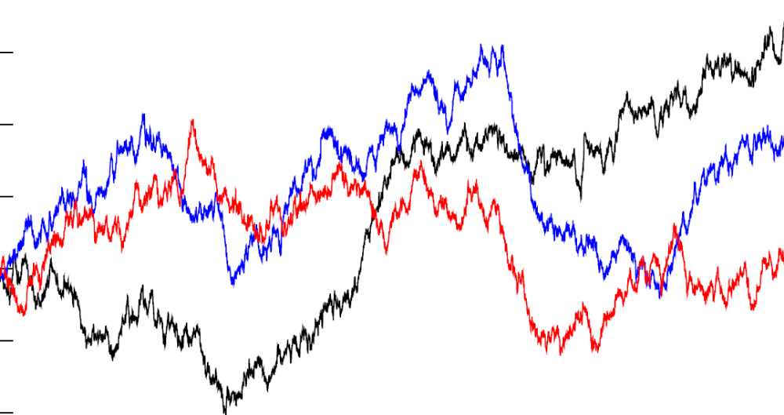
Stochastic Process - Illustration
Y₂ = X(t₂, ω)
Y₁ & Y₂ are 2 different random variables.
Y₁ = X(t₁, ω)
X(t,ω₁)
X(t,ω₂)
X(t,ω₃)
Stochastic Process X(t, ω) is a collection of these Y_{i}’s
Time

Slide 75
Stochastic Process: A few considerations
A Stochastic Process is a function of a continuous variable (most often: time).
The question now becomes how to determine the continuity and differentiability of a stochastic process?
  It is not simple as a stochastic process is not deterministic.
We use the same definitions of continuity, but now look at the expectations and probabilities.
  A deterministic function f(t) is continuous if:
  || f(t₁) – f(t₂)|| ≤ δ||t₁ – t₂||.
  To determine if a stochastic process X(t,ω) is continuous, we need to determine:
  P(|| X(t₁, ω) – X(t₂, ω)||) ≤ δ ||t₁ – t₂|| or
  E(|| X(t₁, ω) – X(t₂, ω)||) ≤ δ ||t₁ – t₂||

Slide 76
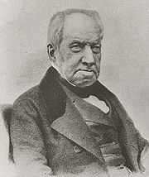
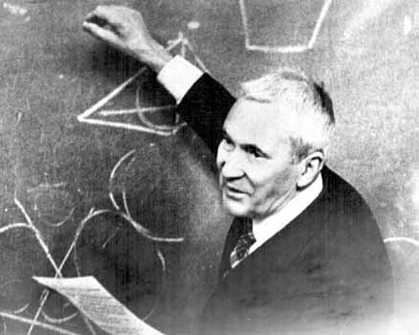
Stochastic Process: Kolomogorov Continuity Theorem
If for all T > 0, there exist a, b, δ > 0 such that:
E(|X(t₁, ω) – X(t₂, ω)|ª) ≤ δ |t₁ – t₂|^{(1 + b)}
Then X(t, ω) can be considered as a continuous stochastic process.
  Brownian motion is a continuous stochastic process.
  Brownian motion (Wiener process): X(t, ω) is almost surely continuous, has independent normal distribution (N(0,t-s)) increments and X(t=0, ω) =0. (“a continuous random walk”)
Andrey Kolmogorov (1903-1987)
Robert Brown (1773–1858)

Slide 77
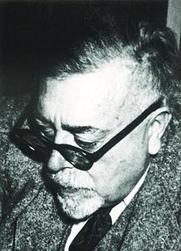

Stochastic Process: Wiener process
Let the variable z(t) be almost surely continuous, with z(t=0)=0.
Define Ν(μ,v) as a normal distribution with mean μ and variance v.
The change in a small interval of time Δt is Δz
Definition: The variable z(t) follows a Wiener process if
  Δz = ε√Δt , where ε〜N(0,1)
  The values of Δz for any 2 different (non-overlapping) periods of time are independent
Properties of Wiener processes:
  Mean of Δz is 0
  Variance of Δz is Δt
  Standard deviation of Δz is √Δt
  Let N=T/Δt, then

Slide 78
Stochastic Process: Generalized Wiener process
A Wiener process has a drift rate (i.e. average change per unit time) of 0 and a variance rate of 1.
In a generalized Wiener process the drift rate and the variance rate can be set equal to any chosen constants.
The variable x follows a Generalized Wiener process with a drift rate of μ and a variance rate of σ² if
dx= μ dt + σ dz
- The change in the value of x in any time interval T is normally distributed with:
- Mean change in x in time T is aT
- Variance of change in x in time T is σ²T

Slide 79
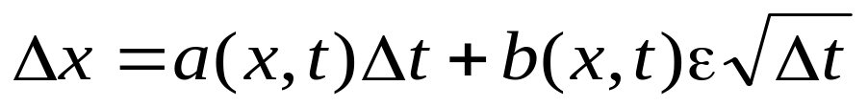

Stochastic Process: Generalized Wiener process
In an Itô process the drift rate and the variance rate are functions of time
dx=a(x,t) dt + b(x,t) dz
(the discrete time equivalent is only true in the limit as Δt tends to 0.)
Example: Ito process for stock prices (S)
dS= μ S dt + σ S dz
where μ is the expected return and σ is the volatility.
The discrete time equivalent is
where ΔS/S ~Ν(μΔt, σ²Δt).

Slide 80

Stochastic Process: Motivation
Consider the process which is the square of Brownian motion:
Y(t)=W(t)²
This process is always non-negative, Y(0) = 0, Y(t) has infinitely many zeroes on t > 0 and E[Y(t)]=E[W(t)²]=t.
Question: What is the stochastic differential of Y(t))?
Using calculus: dY(t) = 2W(t) dW(t)
=> Y(t) =∫^{t} dY = ∫^{t} 2W(t) dW(t)
Consider ∫^{t} 2W(t) dW(t):
By definition, the increments of W(t) are independent, with constant mean.

Slide 81
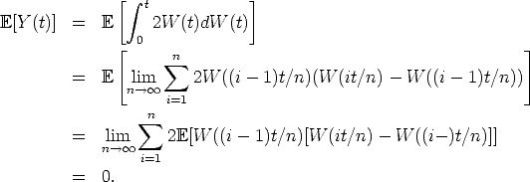
Stochastic Process: Motivation
Therefore, the expected value, or mean, of the summation will be zero:
But the mean of Y (t) = W(t)² is t which is definitely not zero! The two stochastic processes don’t agree even in the mean, so something is not right! If we want to keep the integral definition and limit processes, then the rules of calculus will have to change.

Slide 82
Stochastic Processes: Applications (1)
We saw several systems expressed as differential equations:
  Example: Population growth ( dN/dt = a(t)N(t) )
However, in real world applications, several factors introduce a random factor in such models:
  a(t) = b(t) + σ(t) x “Noise” = b(t) + σ(t) ε(t),
  where ε(t) is a stochastic process that represents the source of randomness (for example, “white noise”)
A simple differential equation becomes a stochastic differential equation.

Slide 83
Stochastic Processes: Applications (2)
Other applications where stochastic processes are used :
  Filtering problems (Kalman filter)
    Minimize the expected estimation error for a system state.
  Optimal Stopping Theorem
  Financial Mathematics
    Theory of option pricing uses the differential heat equation applied to a geometric Brownian motion (e^{μt+σW(t)}).

Slide 84
Stochastic calculus: Introduction(1)
Let us consider:
  dx/dt = b(t,x) + σ(t,x)ε(t)
  White noise assumptions on ε(t) would make ε(t) discontinuous.
    This is bad news.
  Hence, we consider the discrete version of the equation:
    x_{k + 1} - x_{k} = b(t_{k},x_{k})∆t_{k} + σ(t_{k},x_{k}) ε(t_{k})∆t_{k} (x_{k} = x(t_{k},ω) )
    We can make white noise assumptions on B_{k} where
    ∆B_{k} = ε(t_{k})∆t_{k.}
    It turns out that B_{k} can only be the Brownian motion

Slide 85
Stochastic calculus: Introduction(2)
Now we have another problem:
  x(t) = ∑ b(t_{k},x_{k})∆t_{k} + ∑σ(t_{k},x_{k}) ∆B_{k}
  As ∆t_{k} → 0, ∑ b(t_{k},x_{k})∆t_{k} → time integral of b(t,x)
What about ∑σ(t_{k},x_{k}) ∆B_{k} ?
  Hence, we need to find expressions for “integral” and “differentiation” of a function of stochastic process.
Again, we have a problem.
    Brownian motion is continuous, but not differentiable (Riemnann integrals will not work!)
    Stochastic Calculus provides us a mean to calculate “integral” of a stochastic process but not “differentiation”.
  It makes sense as most stochastic processes are not differentiable.

Slide 86
Stochastic calculus: Introduction(3)
We use the definition of “integral” of deterministic functions as a base:
  ∫ σ(t,ω) dB = ∑ σ(t_{k},ω) ∆B_{k} , where t_{k} є [t_{k},t_{k + 1}) as
  t_{k + 1} – t_{k} → 0.
However, we cannot chose any t_{k} t_{k} є [t_{k},t_{k + 1}].
  Example: if t_{k} = t_{k}, then E(∑ B_{k} ∆B_{k}) = 0.
  Example: if t_{k} = t_{k + 1}, then E(∑ B_{k} ∆B_{k}) = t.
Hence, we need to be careful in choosing t_{k}

Slide 87
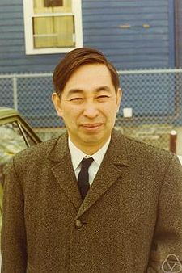
Stochastic calculus: Ito and Stratonovich
Two choices for t_{k} are popular:-
  If t_{k} = t_{k} , then it is called Ito’s integral.
  If t_{k} = ( t_{k} + t_{k + 1} )/2, then it is called Stratonovich integral.
We will concentrate on Ito’s integral as it provides computational and conceptual simplicity.
  Ito’s and Stratonovich integrals differ by a simple time integral only.
Kiyoshi Itō (1915–2008)

Slide 88
Stochastic calculus: Ito’s Theorem (1)
For a given f(t,ω) if :
  1. f(t,ω) is F_{t} adapted (“a process that cannot look into the future”)
    f(t,ω) can be determined by t and values of Brownian motion B_{t}(ω) up to t.
      B_{t/2}(ω) is F_{t} adapted but B_{2t}(ω) is not F_{t} adapted.
  2. E(∫f²(t,ω) dt ) < ∞ (Expected energy is bounded)
Then
∫ f(t, ω) dB_{t}(ω) = ∑ Φ(t_{k}, ω) (B_{k + 1} - B_{k}) and
E(|∫ f(t, ω) dB_{t}(ω)|² ) = E(∫f²(t,ω) dt ) (Ito isometry)
=> the integral f(t, ω) dB can be defined. f(t, ω) is said to be B-integrable
(integrable =bounded integral)
  Φ(t , ω) are called elementary functions.
    Their values are constant in the interval [t_{k},t_{k + 1}]
    E(∫|f(t, ω) - Φ(t,ω)|²dt ) → 0 (Difference in expected energy is insignificant)

Slide 89
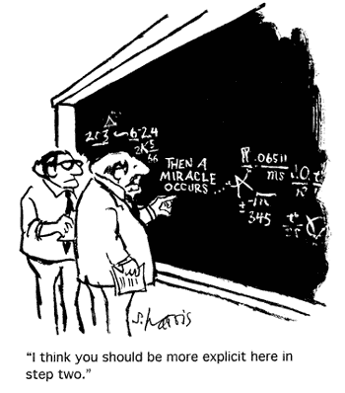

Slide 90
Stochastic calculus: Ito’s Theorem (2)
If f(t,ω)= B(t,ω) =>select Φ(t,ω) = B(t_{k},ω) when tє [t_{k},t_{k + 1})
  Then, we have: ∫B(t,ω) dB(t,ω) = ∑ B(t_{k},ω) (B(t_{k + 1},ω) - B(t_{k},ω))
  Some algebra (recalling 2b(a-b)=a²-b²-(a-b)²):
    (1) B(t_{k},ω) (B(t_{k + 1},ω) - B(t_{k},ω))=½ [B²(t_{k+1},ω)- B²(t_{k},ω) – (B(t_{k +1},ω) – B(t_{k},ω))²]
    (2) B²(t_{k+1},ω) - B²(t_{k},ω) = (B(t_{k +1},ω) – B(t_{k},ω))² +2 B(t_{k},ω) (B(t_{k + 1},ω) - B(t_{k},ω))
    => B²(t) - B²(0) = ∑ B²(t_{k+1},ω) - B²(t_{k},ω)
    (3) lim _{∆t→0} ∑ [ (B(t_{k + 1},ω) – B(t_{k},ω))²] = T (quadratic variation property of B(t))
    ∫B(t,ω) dB(t,ω) = lim _{∆t→0} ∑ [B²(t_{k+1},ω)- B²(t_{k},ω) - (B(t_{k + 1},ω) –
    - B(t_{k},ω))²] =B²(t,ω)/2 – t/2.
    Note: Ito’s integral gives us more than the expected B²(t,ω)/2. This is due to the time-variance of the Brownian motion.

Slide 91
Stochastic calculus: Ito’s Theorem (3)
Simple properties of Ito’s integrals:
- ∫[a X(t,ω) + b Y(t,ω)] dB(t) = ∫a X(t,ω) dB(t) + ∫ b Y(t,ω)dB(t)
- E[∫a X(t,ω) dB(t)] = 0
- ∫a X(t,ω) dB(t) is F_{t} measurable

Slide 92
Stochastic calculus: Ito’s Process (1)
For a general process x(t,ω), how do we define integral ∫f(t,x) dx?
  If x can be expressed by a stochastic differential equation, we can calculate ∂f(t,x).
Definition:
An Ito’s process is a stochastic process on (Ω,F,P), which can be represented in the form:
x(t,ω) = x(0) + ∫ μ(s) ds + ∫ σ(s)dB(s)
where μ and σ may be functions of x and other variables. Both are processes with finite (square) Riemann integrals.
Alternatively, we can say x(t,ω) is called an Ito’s process if
  dx(t) = μ(t) dt + σ(t) dB(t).

Slide 93
Stochastic calculus: Ito’s Process (1)
Ito’s Formula
Let x(t,ω) be an Ito process: dx(t) = μ(t) dt + σ(t) dB(t).
Let f(t,x) be a twice continuously differentiable function (in particular all second partial derivatives are continuous functions).
Then, f(t,x) is also an Ito process and
∂f(t,x) = (df/dt) dt + (df/dx) dx(t) + ½d²f/dx² (dx(t))²
= [(df/dt) + (df/dx) μ(t) + ½d²f/dx² σ²(t)]dt + (df/dx) σ(t) dB(t)
Note: Ito processes is closed under twice continuously differentiable transformations.
Useful rules: dt*dt = dt*dB(t) = dB(t)*dt =0
dB(t)*dB(t) = (dB(t))² = dt

Slide 94
Stochastic calculus: Ito’s Process (2)
Check:
Let B(t,ω) =X(t) (think of μ = 0, σ = 1), then define:
f(t,ω) = B²(t,ω)/2.
Now,
∂(B²(t,ω)/2) = 0 dt + B(t,ω) dB(t)+ ½d²f/dx² (dB(t))²
= B(t,ω) dB(t)+ ½.dt
=> B²(t,ω)/2 = ∫ B(t,ω).dB_{t} + ∫ ½.dt
    or ∫ B(t,ω).dB_{t} = B²(t,ω)/2 - t/2

Slide 95
Stochastic calculus: Ito’s Process (3)
Example:
Let f(t,ω) = e^{tB(t)}.
Now,
∂(f(t,ω)) = e^{tB(t)}.B(t) dt + t e^{tB(t)} dB(t) + ½t² e^{tB(t)} (dB(t))²
= e^{tB(t)}.(B(t) + ½t²) dt + t e^{tB(t)} dB(t)
Example: Z(t) = f(t,ω) = e^{rt+σB(t)}.
Now,
∂(f(t,ω)) = Z(t).r dt + σ Z(t) dB(t) + ½ σ² Z(t) dt
= (r + ½ σ²) Z(t) dt + σ Z(t) dB(t)

Slide 96
Stochastic calculus: Application
Let S(t), a stock price, follow a geometric Brownian motion: dS(t) = μ S(t) dt + σ S(t) dB(t).
The payoff of an option f(S,T) is known at T.
Applying Ito’s formula:
d(f(S,t)) = (df/dt) dt + (df/dS) dS(t) + ½d²f/dS² (dS(t))²
= (df/dt) dt + (df/dS) [μ S(t) dt + σ S(t) dB(t)] + ½d²f/dS² (dS(t))²
= [(df/dt) + μS(t) (df/dS) + ½d²f/dS² σ²S(t)²]dt + (df/dS) σS(t)dB(t)
Form a (delta-hedge) portfolio: hold one option and continuously trade in the stock in order to hold (–df/dS) shares. At t, the value of the portfolio:
π(t) = f(S,t) – S(t) df/dS

Slide 97
Stochastic calculus: Application
Let R be the accumulated profits from the portfolio. Then, over the time period [t, t + dt], the instantaneous profit or loss is:
dR = df(S,t) –df/dS dS(t)
Substituting using Ito’s formula for df(S,t) and for dS(t), we get:
dR = [(df/dt) + ½ d²f/dS² σ² S(t)²] dt
Note: This is not a SDE (dB(t) has dissappeared: riskless portfolio!)
Since there is no risk, the rate of return of the portfolio should be r, the rate on a riskless asset.

Slide 98

Stochastic calculus: Application
That is,
dR = r π(t) dt = r [f(S,t) – S(t) df/dS] dt
=> r [f(S,t) – S(t) df/dS] dt = [(df/dt) + ½ d²f/dS² σ² S(t)²] dt
=> (df/dt) + ½ d²f/dS² σ² S(t)² + r S(t) df/dS – r f(S,t)=0
This is the Black-Scholes PDE. Given the boundary conditions for a call option, C(S,t), it can be solved using the standard methods.
Boundary conditions:
C(0,t)=t for all t
C(S,t)→S, as S →∞.
C(S,T)=max(S-K,0) K=strike price

Slide 99
Stochastic calculus: Solving a stochastic DE
Make a guess (Hope you are lucky!)
Example: We are asked to solve the stochastic DE:
dZ(t) = σ Z(t) dB(t).
We need an inspired guess, so we try: Y(t)=e^{rt+σB(t)}
with SDE: dZ(t) = (r +1/2 σ²) Z(t) dt + σ Z(t) dB(t).
Replace in given SDE:
=>(r +1/2 σ²) Z(t) dt + σ Z(t) dB(t) = σ Z(t) dB(t).
=> r = - 1/2 σ²
Solution: Y(t)=exp(- 1/2 σ² t + σ dB(t)) (This solution is called the Dolèan’s exponential of Brownian motion.)
Note: SDE with solutions are rare.

