Slide 1
Information Diffusion with Time-variant Popularity and Geographical Locality
Hongxian Sun
Jun. 7,2012

Slide 2
Motivation
What happens in social networks
nothing but information diffusion
Practical application
targeted advertising
demand prediction for online media

Slide 3
Related Work I: Epidemic Models
Many epidemic models
describe the propagation of information in networks where any two nodes can share information
Epidemic spreading in scale-free networks
1. valid expression of social tie topology
2. two assumptions
time cost for a transfer is exponentially distributed
the spreaders distribute evenly in the whole network
3. the results are too descriptive

Slide 4
Related Work II: Social Influence Models
Linear Influence Model[1]
1. the influence function describes how many subsequent infections can be attributed by the influence of a node
2. essentially a machine learning method
3. no analytical description of the diffusion dynamic can be obtained.
Local Mean-Field Model[2]
1. study the final population to purchase certain product given that any node has certain probability to purchase by itself and nodes can persuade each other probabilistically with their influence
2. using local mean filed technique to obtain the final population that purchase the product.
[1] J. Yang and J. Leskovec, “Modeling Information Diffusion in Implicit Networks,” ICDM 2010
[14] Y. Li and B. Zhao, “On Modeling Product Advertisement in Large Scale Online Social Networks,” TON 2011.

Slide 5
Related Work III: Age-dependent Branching Process Model
The diffusion of Content with Constant Popularity
1. the basic equation
2. the mean functions: expected cascade size at any time t
3. the probability of extinction
4. final cascade size
5. asymptotic temporal behavior completely determined by
r, the expected number of decendents of a node
J. L. Iribarren and E. Moro, “Branching dynamics of viral information spreading,” Physical Review E 2011

Slide 6
Diffusion with Time-variant Popularity
System Description
We consider a large-scale social network where a seed node shares a piece of new content at time 0. Some of its friends will notice the information after some response delay, get interested in the content also and decide to share. The information from these viral nodes will continue propagating, reaching other viral nodes. The process ultimately results in an information sharing cascade.
Basic Methodology
time-dependent branching process

Slide 7
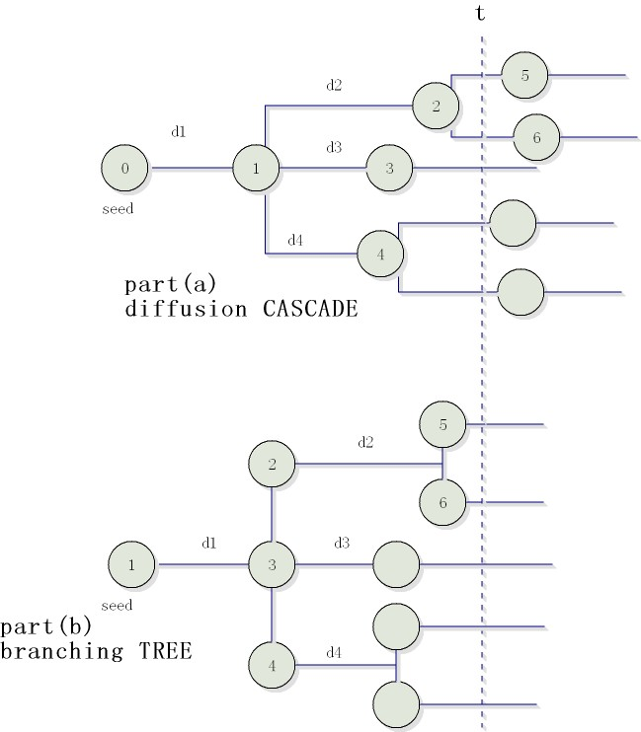
Mapping Diffusion CASCADE to Branching TREE
A node is born at the end of the response period.
A node is born at the beginning of its lifetime.
At time t, the number of nodes in the diffusion cascade corresponds to the inactive nodes in the branching tree

Slide 8





Degree distribution of the seed node
Degree distribution of viral nodes
Probability Generating Function(pgf)
degree distribution of viral nodes
Expected progeny number at time t

Slide 9
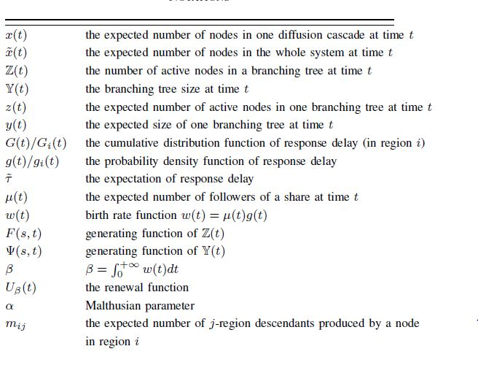

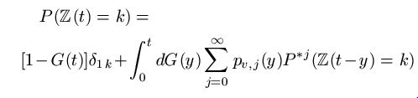

The Basic Equation
The study of temporal branching processes often starts with the construction of an integral equation satisfied by the generating function of Z(t):
An important argument
The basic equation

Slide 10
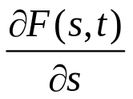


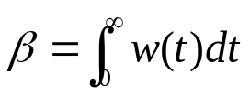
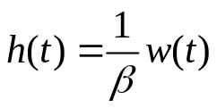
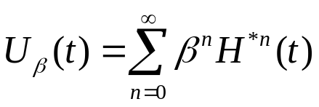
The mean function
By proving that z(t) is a bounded limit of as s approaches 1, we establish the mean equation
byproducts
1. birth rate function
2. a dominant parameter
3. a new pdf , corresponds to cdf H(t)
4. renewal function

Slide 11







Branching tree size
Renewal Equation
for distribution H(t), if , then the equation
has a solution
So

Slide 12


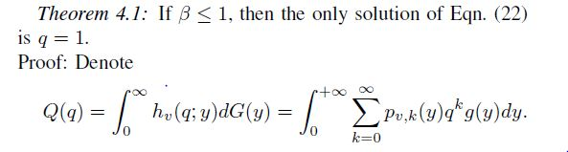


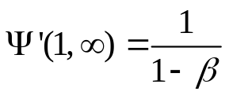
The problem of extinction
Expected final cascade size when

Slide 13







Asymptotic Behavior
The Malthusian Parameter

Slide 14
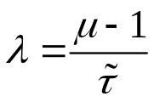



Traditional Epidemic Models
Consider the constant popularity case where
, infection rate
The number of active sharers at time t
The cascade size
For heavy tailed G(t), the difference is significant.

Slide 15
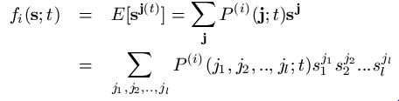

Diffusion with Geographical Locality
The progeny number distribution of nodes in different regions may be different. (l regions)
the popularity variant is homogenous across regions

Slide 16

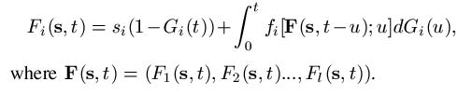
The Basic Equation
The number of active nodes
the generating function of Z(t) provided that the cascade starts from one node in region i:
Basic equation

Slide 17


The Mean Function
Kimmel [3]:
set up the framework to study general time-dependent branching process, which gives the system of integral equations satisfied by the mean functions.
We further show that this equation set is solvable, obtaining a explicit form
[3] M. Kimmel, “The point-process approach to age-and time-dependent branching processes,” Advances in Applied Probability, vol. 15, no. 1, 1983.

Slide 18

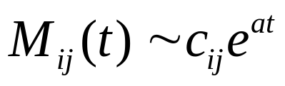
The probability of extinction
Let q_{i} be the possibility that a cascade starting from a node in region i stop growing eventually. Then q_{i} = F_{i}(0;∞)
According to the basic equation
The asymptotic behavior
For the constant popularity case, with some assumptions we can prove

Slide 19
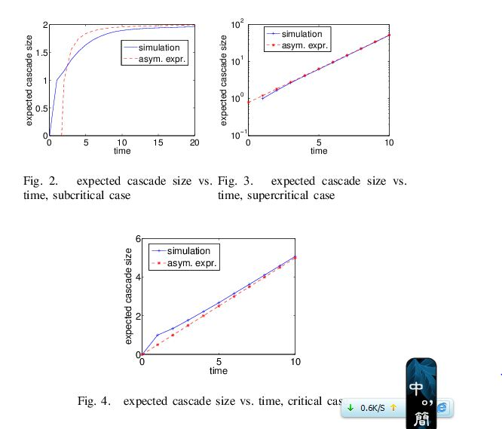
Simulations
Asymptotic expressions for cascade size

Slide 20
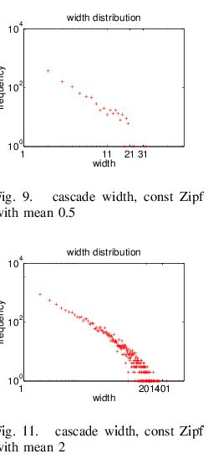
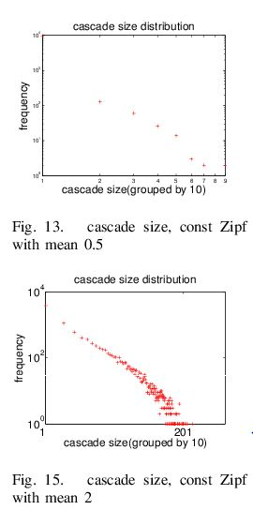
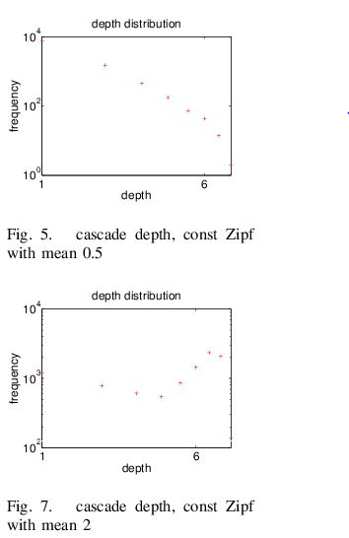
Cascade Topology

Slide 21
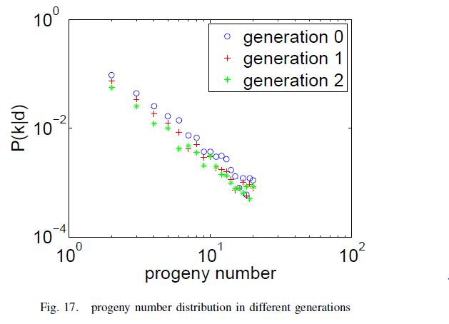
Correlation between short-term and long-term cascade size
cascade size at time t=4
cascade size at time t = 20
Stage Dependence
Spearman’s rank correlation coefficient: 0.9459

Slide 22
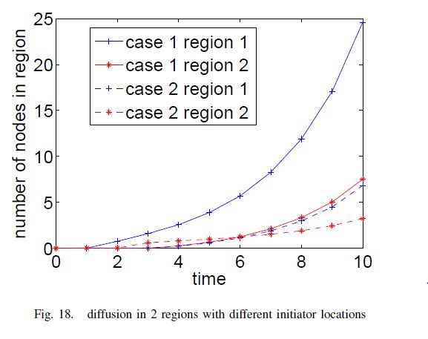
Geographical Locality

