Slide 1
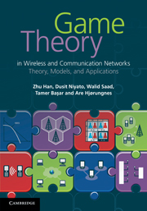
Game Theory in Wireless and Communication Networks: Theory, Models, and Applications
Lecture 2
Bayesian Game
Zhu Han, Dusit Niyato, Walid Saad,
Tamer Basar, and Are Hjorungnes

Slide 2
Overview of Lecture Notes
Introduction to Game Theory: Lecture 1
Noncooperative Game: Lecture 1, Chapter 3
Bayesian Game: Lecture 2, Chapter 4
Differential Game: Lecture 3, Chapter 5
Evolutional Game : Lecture 4, Chapter 6
Cooperative Game: Lecture 5, Chapter 7
Auction Theory: Lecture 6, Chapter 8
Game Theory Applications: Lecture 7, Part III
Total Lectures are about 8 Hours

Slide 3
Overview of Bayesian Game
Static Bayesian Game
Extensive Form
Detailed Example: Cournot Duopoly with incomplete information
Application in wireless networks
  Packet Forwarding
  K-Player Bayesian Water-filling
  Channel Access
  Bandwidth Auction
Summary

Slide 4
What is Bayesian Game?
Game in strategic form
Complete information(each player has perfect information
regarding the element of the game)
Iterated deletion of dominated strategy, Nash equilibrium:
solutions of the game in strategic form
Bayesian Game
A game with incomplete information
Each player has initial private information, type.
- Bayesian equilibrium: solution of the Bayesian game

Slide 5





Bayesian Game
Definition (Bayesian Game)
A Bayesian game is a strategic form game with incomplete information. It consists of:
- A set of players N={1, …, n} for each i∈N
- An action set
- A type set
- A probability function,
- A payoff function,
- The function p_{i} is what player i believes about the types of the other players
- Payoff is determined by outcome A and type

Slide 6





Bayesian Game
Definition
Bayesian game is finite if , , and are all finite
Definition(pure strategy, mixed strategy)
Given a Bayesian Game , A pure strategy for player i is a function which maps player i’s type into its action set
A mixed strategy for player i is

Slide 7


Bayesian Equilibrium
Definition(Bayesian Equilibrium)
A Bayesian equilibrium of a Bayesian game is a mixed strategy profile , such that for every player i∈N and every type , we have
- Bayesian equilibrium is one of the mixed strategy profiles
which maximize the each players’ expected payoffs for each type.
This equilibrium is the solution of the Bayesian game. This equilibrium means the best response to each player’s belief about the other player’s mixed strategy.

Slide 8
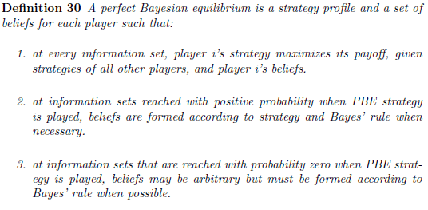
Bayesian Dynamic Game
Perfect Bayesian equilibrium demands optimal subsequent play
Belief system

Slide 9
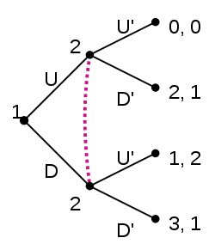
Simple Example
Information is imperfect since player 2 does not know what player 1 does when he comes to play. If both players are rational and both know that both players are rational, play in the game will be as follows according to perfect Bayesian equilibrium:
Player 2 cannot observe player 1's move. Player 1 would like to fool player 2 into thinking he has played U when he has actually played D so that player 2 will play D' and player 1 will receive 3. In fact, there is a perfect Bayesian equilibrium where player 1 plays D and player 2 plays U' and player 2 holds the belief that player 1 will definitely play D (i.e player 2 places a probability of 1 on the node reached if player 1 plays D). In this equilibrium, every strategy is rational given the beliefs held and every belief is consistent with the strategies played. In this case, the perfect Bayesian equilibrium is the only Nash equilibrium.

Slide 10
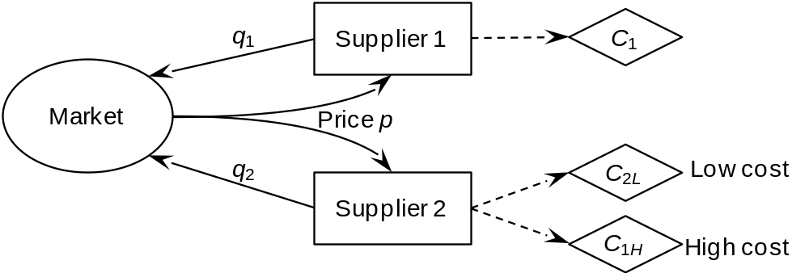



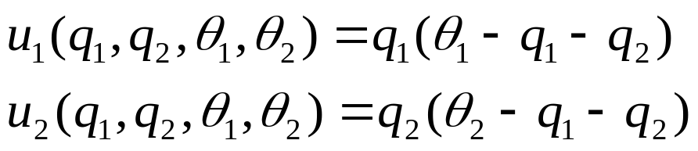
Examples ー Cournot Duopoly
Cournot Duopoly model
Players (2 firms):
Action set (outcome of firms):
Type set:
Probability function:
Profit function:

Slide 11
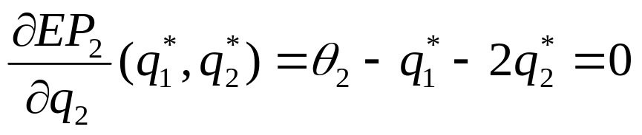

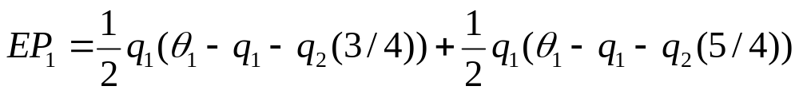
Examples ー Cournot Duopoly
Bayesian equilibrium for pure strategy
The Bayesian equilibrium is a maximal point of expected
payoff of firm 2, EP₂:
- The expected payoff of player 1, EP₁, is given as follows:

Slide 12
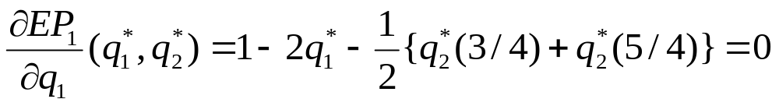
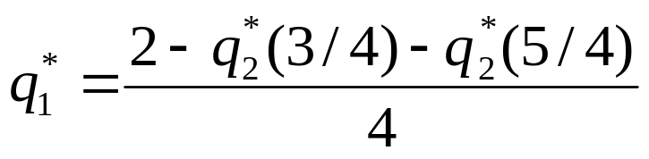
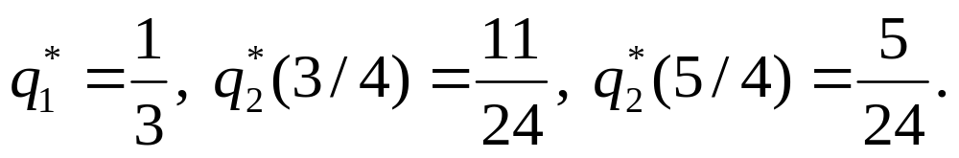
Examples ー Cournot Duopoly
Bayesian equilibrium is also the maximal point of expected payoff EP₁:
Solving above equations, we can get Bayesian equilibrium as follows:

Slide 13
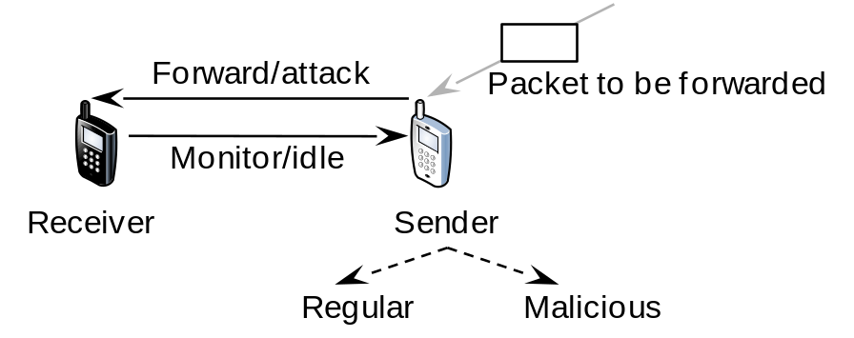


Example: Packet Forwarding
System Model
  Sender type regular or malicious
  Pay off: malicious vs. regular
  GA: attack success; CA: cost of attack; CF: cost of forwarding; CM: cost of monitoring
Mixed strategy
  Sender malicious: attack with a certain probability
  Sender regular: forward packet
  Receiver: monitor with a certain probability

Slide 14

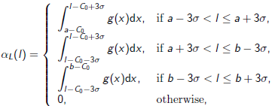

Example: K-Player Bayesian Water-filling
Waterfilling game
  R: rate; P: power; h: channel gain
But, the user type, i.e. the channel gain, is a random variable
  Shadowing fading, for example
Path loss probability function as the belief of the other users
The best response is

Slide 15
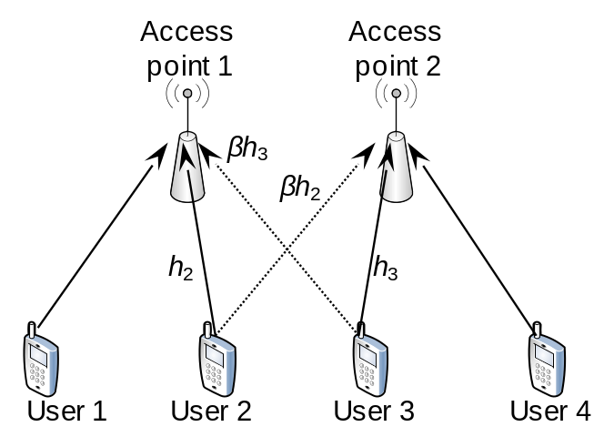




Example: Channel Access
System Model
  Interference channel
  Rate
  Utility
  Game
  Bayesian since do not know the other’s channel (or type)
Threshold strategy
  Interpretation of opportunistic spectrum access from the game theory point of view

Slide 16
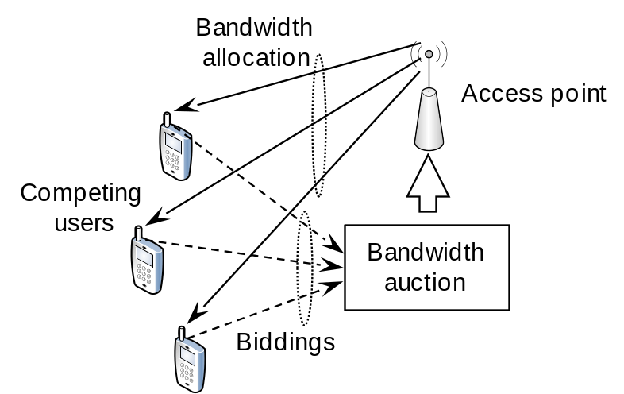


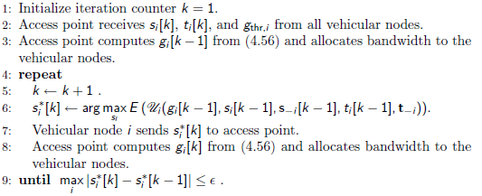
Example: Bandwidth Auction
System Model
  Allocated bandwidth
  S bid, B overall bandwidth, U: utility
  t time duration of connection, local
  information, assuming
Bayesian game, iterative algorithm

Slide 17
Summary
Games with incomplete information (i.e., Bayesian game) can be used to analyze situations where a player does not know the preference (i.e., payoff) of his opponents.
This is a common situation in wireless communications and networking where there is no centralized controller to maintain the information of all users. Also, the users may not reveal the private information to others.
The detail of Bayesian game framework was studied in detail.
Examples of this game are given

