Slide 1
Random Gossiping in Opportunistic Contact Networks(I)
Albert Hongxian Sun
Jan. 26, 2011

Slide 2


新年快乐！归途顺利！

Slide 3
Classical Gossip Process
Model
n users, 1 message
In every time slot, every informed user contacts another user (target) chosen uniformly at random from the set of all users and pushes the message to this user.
Let Y_{t} be the number of informed users. Y₀ = 1.
{Y_{t}} is the Classical Gossip Process.
*Based on Sujay Sanghavi, Bruce Hajek, and Laurent Massoulie, Gossiping with Multiple Messages, INFOCOM 2007.
Most proofs are hard to follow so I mainly present some remarkable results.

Slide 4

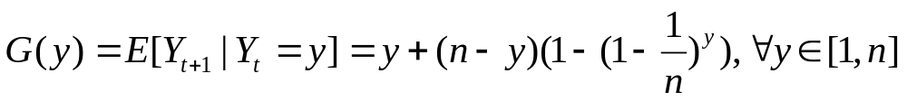

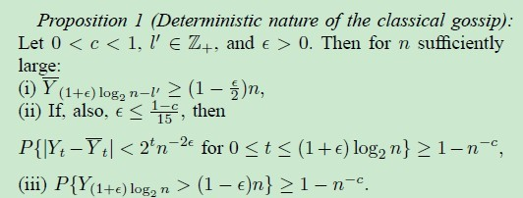
A Deterministic Approximation
{Y_{t}} can be approximated by a deterministic process
Consider
Define , then

Slide 5

Gossiping with Multiple Messages
Motivation
P2P piece selection
Speedup:
Actions
pull: the user selects a piece it does not currently possess and requests it from the target.
push: the user selects a piece it possesses, and transmits it to the target.
Pulled by multiple users
Hard constraints: one piece per time slot.
Soft constraints: multiple pieces per slot.

Slide 6
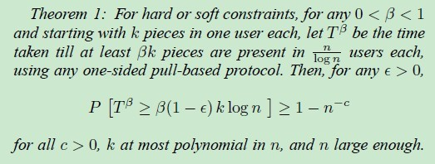


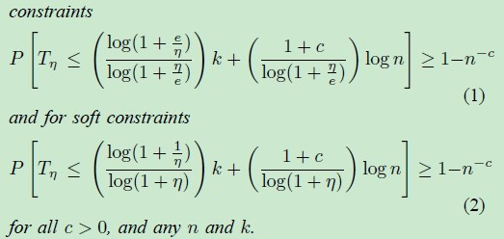
Some Remarkable Results
Pull-based protocols are inefficient in the beginning
They are very efficient at the end period~~

Slide 7
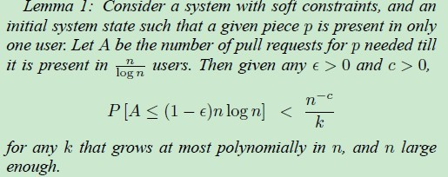
Proof of Theorem 1
The dissemination of each piece is independent of each other with soft constraints. So we look into the propagation of one piece first.
Note at most n pull requests occur every time slot. We can get a lower bound on time required by a lower bound on the total number of pull requests required.
It turns out:

Slide 8

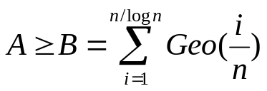
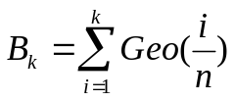
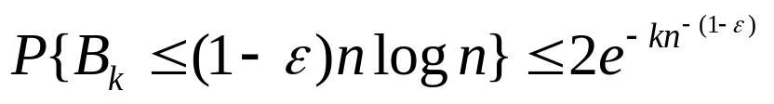
Proof of Lemma 1
An observation: number of pull requests can be minimized if they are in strict chronological order. In this condition, requests will be needed for occupancy to jump from i to i+1.
So, ,
Denote and we want to show
The famous Coupon Collector’s Problem
To take out the remaining k different coupons out of n coupons with replacement in condition that we found the other n-k ones already.
The authors did derive the bound in a very tricky way…☺

Slide 9


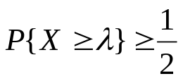



The probability equals to the that of finding the missing k types of coupons with a random sample of size
Hey, how about a sample of size N where N ~ Pois( )?
For Poissonian R.V.s whose mean is not very small, we have
. Again it requires a nontrivial proof while a direct and simple argument is that the mean of Poisson R.V.s is about
This suggests that
n different types are equal so the expected number of each type in the sample is .The probability of a type of coupon appears in N samples is
So Q.E.D.

Slide 10
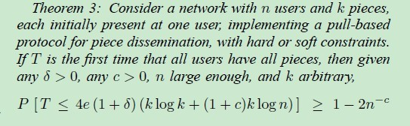
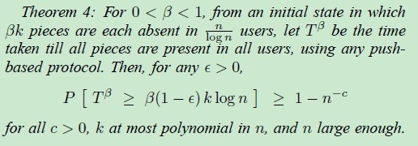
The overall performance of pull-base protocols are bounded.
Not true for push-based protocols
Push-based protocols are inefficient in the end.

Slide 11
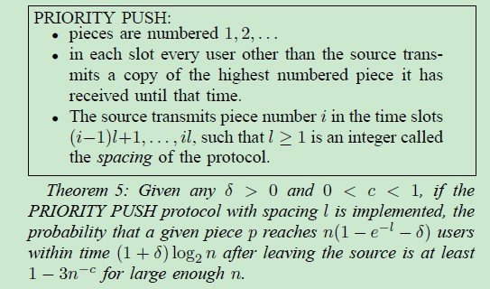
Priority Push
The completion time of an arbitrary Push-based protocols is unbounded.
But…
So we are able to combine Priority Push and a random pull protocol together to develop a hybrid one which can disseminate k pieces with high success probability using around
9k + 2log(n) time, hard constraints
3.2k + 2log(n)time, soft constraints

Slide 12
Opportunistic Contact Networks
share information
Internet. What else?
Bluetooth and Wi-Fi connectivity
direct & opportunistic content exchange
Haggle Project http://code.google.com/p/haggle/
Existing works
we are all friends?
Realistic constraint of friendship
how about the QoS?

Slide 13
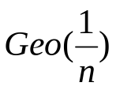


Gossiping in Opportunistic Contact Networks
Classical Random Gossip analysis:
assumes that the inter-contact time between any two users
follows
contact duration is exactly 1 time slot.
These discrete-time results should be easy to be transformed into a continuous time version, with becoming
Reality in opportunistic contact networks
selection based on friendship
choices limited by physical locations
frequency of contacts
new challenges

Slide 14
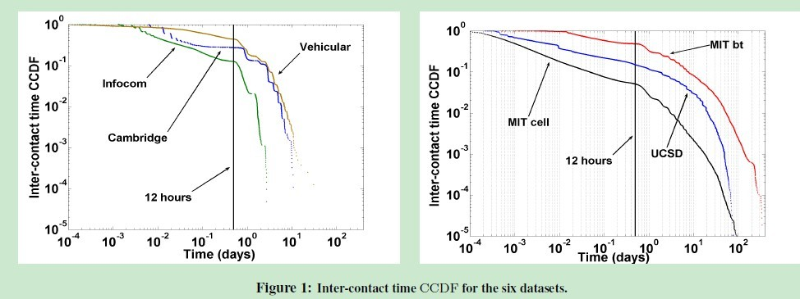
Inter-contact Time
Graphs from T. Karagiannis et al, Power Law and Exponential Decay of Inter-Contact Times between Mobile Devices. MobiCom’07

Slide 15
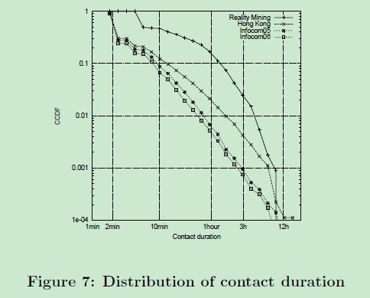
Contact Duration
A. Mtibaa et al. Diameter of Opportunistic Mobile Networks. CoNEXT’07

Slide 16
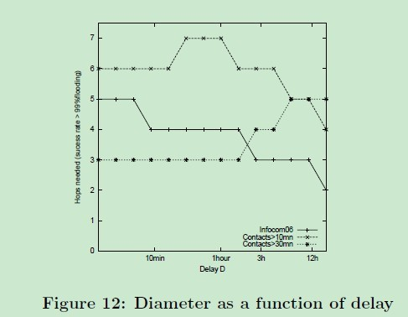

Diameter
Diameter is defined as the number of hops required to find a path connecting any two nodes with a high probability which also satisfies certain time constraint.
considerably smaller than the results obtained in previous study of gossip.( )

Slide 17
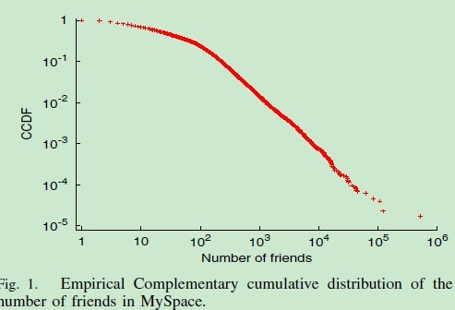
Number of Friends
B. Ribeiro et al. On MySpace Account Spans and Double Pareto-Like Distribution of Friends, INFOCOM 2010

