Slide 1

Network Content Distribution and Storage
June 8, 2010
Dah Ming Chiu
Chinese University of Hong Kong

Slide 2
Outline
Give an introduction to network content distribution, especially P2P content distribution
Describe various mathematical models of P2P content distribution systems, including our work and important related works

Slide 3
Content distribution in Internet
Examples: YouTube, WorldCup, Movies…
One important difference with traditional paradigm: Video-on-Demand
Cisco prediction: 90% of bandwidth will be used by videos

Slide 4
Multicast
Conventional wisdom
Efficient: content traverses each link once
Shortcomings:
  Synchronized viewing: not as flexible as VoD
  Single-tree, or fixed trees: may not provide sufficient capacity
In use today for IPTV, in “walled garden” networks, at the edge. E.g. PCCW NOW TV

Slide 5
Video streaming and CDN
A well developed technology over packet networks, widely deployed over Internet
Client-server solution: does not scale
Most deployments using CDN
Content Delivery Networks
  E.g. Akamai
  Redirects user requests to proxy servers
  Costs: servers, bandwidth, management

Slide 6
Peer-to-peer networks
“Self managed” CDN
  Peers/users serving as proxy servers as well
Multiple-tree content distribution
  Content is divided into chunks (or sub-streams), each flowing through a different tree
  Multi-tree distribution can maximize throughput
  In many p2p networks, the trees are built “on-demand”, achieving good load balance (this aspect is better than CDN)
source
1
2
3
4
5
6
7
8

Slide 7
Analogy
Circuit switching vs packet switching
  The former emulates the phone network
  Packet switching more “chaotic”, but redefined networking
Multicast (fixed-trees) approach emulates TV broadcasting, a bit like “circuit switching”
The P2P approach to content distribution is playing the role of “packet switching” for content distribution

Slide 8
Interesting research problems
Streaming capacity
  What is the minimum makespan for all peers to receive a file
  What is the maximum throughput to all peers
How to achieve the capacity
  Homogeneous peers (same uplink bandwidth)
  Heterogeneous peers
  Dynamic peer behaviors (arrival, channel churns)
  Multiple channels case

Slide 9
Uplink sharing model
Mundinger 2005
  J. Mundinger, R. Weber, and G. Weiss. Optimal Scheduling of Peer-to-Peer File Dissemination. Journal of Scheduling, 11(2):105-120, 2007
  Assumes only peer uplinks are bottlenecks
    A common assumption by most models
  For a single message, it is the “broadcasting problem”, a classic scheduling problem
  Can derive solutions for small M (file size) and N (peer population)
  Can derive asymptotic solutions for large M (fluid approximation)

Slide 10
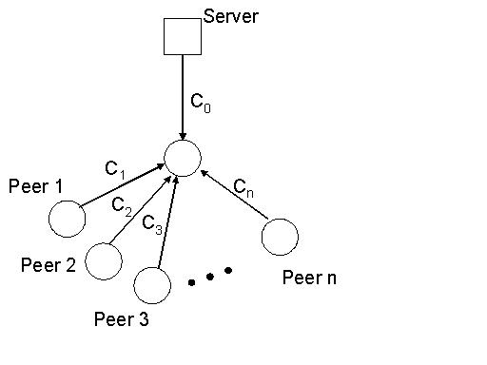

Streaming capacity

Slide 11
Proof
Simple to see rate is bounded by the equation
To achieve the rate, show it by construction: using a sequence of 1-hop and 2-hop trees
C₀
C₀
C_{n}
C_{n}
C₁
C₁
C₂
C₃
C₂
C₃
1-hop tree
2-hop tree

Slide 12
More general cases
When there are helper nodes
When the nodes in trees have degree bounds
When the uplinks are not the only bottlenecks
Other contributors:
  MSRA group: Jin Li, Phil Chow, MH Chen etc
  Princeton: Mung Chiang et al

Slide 13
Can network coding help?
DM Chiu, RW Yeung, JQ Huang and B Fan, "Can Network Coding Help in P2P Networks" Invited paper in Second Workshop of Network Coding, April 2006
Under uplink sharing model, network coding will not help achieve higher throughput, because the bound already achieves min-cut for the graph
Discussed possible help by network coding in making the scheduling problem easier

Slide 14
Practical P2P Systems
BitTorrent (2003)
Coolstreaming (2005)
PPLive VoD (2007)
Y Huang, ZJ Fu, DM Chiu, JCS Lui and C Huang, "Challenges, Design and Analysis of a Large-scale P2P VoD System", ACM Sigcomm 2008
ASTRI’s P2P Platform (2009-)
  Consultant

Slide 15
Basic architecture
Use meta file to describe content
Use “tracker” to introduce a peer to multiple other peers (note similarity/diff with CDN)
Local peer tries to download chunks from multiple neighbors (belongs to multiple trees)
Select peers based on content availability, and service rate (dynamic tree building, and load balancing)

Slide 16
Structured vs unstructured
Structured = static tree(s) used
Unstructured = distribution trees are built based on content availability or service rate
  The well-known systems are all “unstructured”: e.g. BT, Coolstreaming, PPLive, ASTRI
  Recall the “packet switching analogy”
Why unstructured?
  Adapt to user behavior
  Load balancing

Slide 17
P2P file downloading vs streaming
P2P file downloading, e.g. BT
  Peers share a file
  Need to minimize delay (makespan)
P2P streaming, e.g. Coolstreaming
  Peers share a (shifting) window of content
  Need to maximize “continuity” = continuous playback
Multi-purpose platforms: PPLive, ASTRI
Progressive downloading

Slide 18
Assumptions in modeling
Homogeneous vs heterogeneous peers
  In terms of uplink bandwidth
Static vs dynamic peer population
  If dynamic, e.g. Poisson arrival
Single vs multiple channels / files / sessions
  If multiple channels, peers may change channels
E.g. Mundinger’s model: Heterogeneous peers, static population, single file (mostly)

Slide 19
Important models
The dynamic peer model (Qiu & Srikant, Sigcomm 2004)
The dynamic and heterogeneous peer model (Fan, Chiu & Lui, ICNP 2006)
The coupon model (Massoulie & Vojnovic, Sigmetrics 2005 best paper)
The simple p2p streaming model (Zhou, Chiu & Lui, ICNP 2007)
The multi-channel decoupling model (Wu, Liu & Ross, Infocom 2009 best paper)
The replication model (ICNP 2010?)

Slide 20
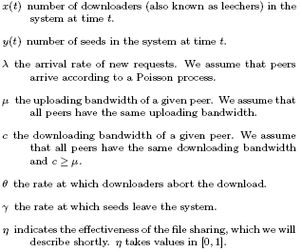
The dynamic peer model
Qiu and Srikant, “Modeling and performance analysis of BitTorrent-like peer-to-peer networks”, ACM Sigcomm 2004
In Mundinger’s model:
a constant n
a constant 1
0
Constant C_{i}
Unbounded
0
this is assumed to be 1

Slide 21




A fluid model of population
System equations
In steady state:
where
η>0 assumed

Slide 22

Downloading time
Apply Little’s Law
Average number of peers who will complete downloads
Average rate downloads are completed
Average downloading time
where

Slide 23
Observations
T is not dependent on arrival rate λ!
When sharing efficiency η increases, T decreases
When seeders departure rate γ increases, T increases
Initially, when downloading rate c increases, T decreases, but c is large enough (uplinks become bottleneck), c no longer affects T
Same observation about peer uplink rate μ
Normally c > μ for a given peer; but if γ < μ, then there will be abundant uplink capacity (due to helpers), and downlink will be the bottleneck

Slide 24
Effect of sharing efficiency η
In the capacity equation (Mundinger), η=1 is assumed
The analysis so far assumes 0<η<1
When η=0, (no sharing by downloaders), two cases:
  If rate of seeds leaving (γ) is less than the rate a seed can help a peer download a file (μ), then the system is limited by the downloading capacity: T = 1/c
  If otherwise:
  This equation means y will decrease to 0, and the system dies.
  Note, in this model, there is no “server”, only seeders.

Slide 25
Stability
It is not sufficient to derive a steady state population by setting dx/dt = dy/dt = 0
Must also show that the system will converge to the steady state
  See detailed discussion of local stability in paper…

Slide 26
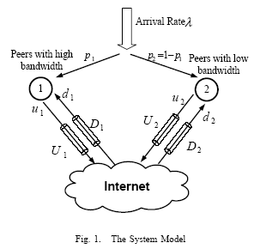
The dynamic and heterogeneous peer model
B Fan, DM Chiu and J Lui, “The delicate tradeoffs in BitTorrent-like file sharing protocol design”, ICNP 2006, IEEE/ACM Transactions on Networking, 2008
Similar to Qiu & Srikant’s model
But multiple classes of peers
  Arrival rate
  Uplink capacity
  Downlink capacity
  “fat” and “thin” peers if 2 classes
No seeders

Slide 27

Feasible rate allocation space
Any u and d satisfying

Slide 28




Performance metric 1: average downloading time
In steady state:
Number of type i peers:
Total upload capacity:
C=λ⇨
c_{i}=u_{i}/d_{i} ⇨
c_{i} is the “share ratio” of peer i
Download time of type i peers:

Slide 29


Performance metric 2: fairness
“Fairness index”
It can be applied to any quantity x. In this case, let x_{i} = c_{i}
Therefore, fairness index:

Slide 30
Tradeoff
Each rate allocation (u,d) yields a different T and F
The space of different strategies and achievable (T,F)
Consider three specific allocations:
  Optimal downloading time
  Optimal fairness
    in terms of share ratio
  Max-min rate allocation
    Equalize the downloading rate of all peers, unless it is limited by the downlink capacity

Slide 31


Optimizing downloading time
Problem definition:
Note:
  assuming uploading rate = uplink capacity
  “Smaller” type number means higher uplink capacity
Applying standard Lagrange multiplier methods and KKT conditions:
  Type 1 peer gets less downloading rate proportionally speaking
  Type 1 peer may even get less downloading rate than “thin” peers

Slide 32
Optimizing fairness
This means equalizing the share ratios:
Therefore
By same Lagrange multiplier methods:

Slide 33

Max-min rate allocation
Problem definition:
Can use the “water filling algorithm” to find the solution.
If none of the downlinks are bottlenecks:

Slide 34
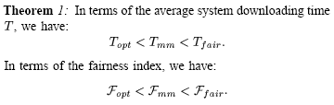
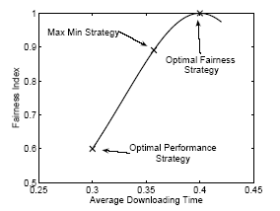
Compare the results
Since we have the closed form results for these cases:
The concept of “Pareto optimal”, or non-inferior allocations

Slide 35
Apply it to distributed algorithms
Rate allocation analysis so far assumes knowledge only available in centralized algorithms
Examples of distributed algorithms found in BT:
  Tit-for-tat
  This yields the most fair rate allocation, in equilibrium.
  Peers form clusters
  Random
    This gives a solution similar to max-min
    Each peer gets average uploading rate in steady state
Possible to adopt a weighted average of the two
  Select n_{s} neighbors using “tit-for-tat”, and n_{a} neighbors randomly

Slide 36
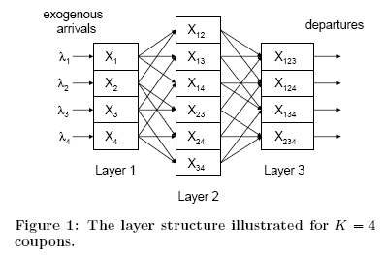
The coupon model
Massoulie and Vojnovic, “Coupon Replication Systems”, ACM Sigmetrics 2005, Best paper
K = number of “coupons”
c = a subset of coupons, there are 2^{K} subsets
X_{c} = number of peers holding coupons in c
When a peer arrives, it is given a random coupon i with probability λ_{I} / λ

Slide 37
Modeling peer and chunk selection
Peers belong to types
e.g. there are X₁₂ type-{1,2} peers
In each time slot
a type-c peer A selects a type-s peer B
If s\c is not empty, A downloads a random piece from s\c
else A gets nothing in this time slot
Two types of peer selections considered:
layered – s is of same size as c
flat – s can be any type

Slide 38



The Markov Chain
A huge Markov chain model
State is X = {X_{c}(t)} for c index all subsets of {1,2…,K}
E.g. K = 4
X = {X₁,X₂,X₃,X₄,X₁₂,X₁₃,X₁₄,X₂₃,X₂₄,X₃₄,X₁₂₃,X₁₂₄,X₁₃₄,X₂₃₄} ∈ Ζ¹⁴
Transition probability

Slide 39
Results from the coupon model
Assume large population regime
  Let arrival rate increase to infinity
  Population size can be expressed in differential equations
  Applying “Mean Field Theory” as in statistical physics
Stability
  This is expected from the less detailed model by Qiu & Srikant
  Note, there is definitely sharing in this model
Bounds on sojourn times
  Flat case: T ≤ K + O(√K) for large K
  Layered case: 1 < T_{i} ≤ K/(K-1) for each layer i

Slide 40
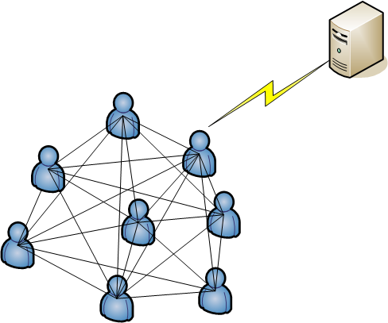
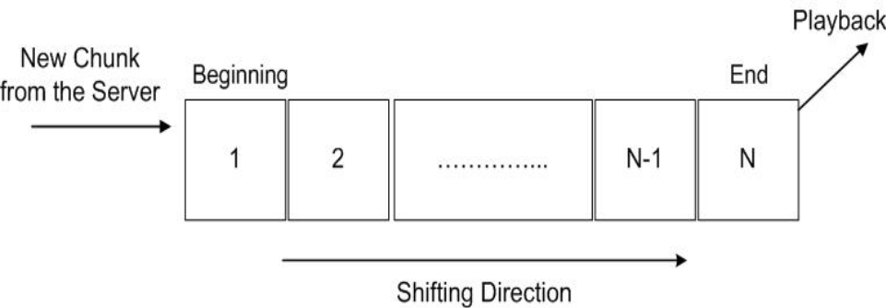
A Simple model for P2P Streaming
YP Zhou, DM Chiu and J Lui, “A simple model for p2p streaming”, IEEE ICNP 2007, accepted by IEEE/ACM Transactions on Networking

Slide 41
Server push and peer playback
M homogeneous peers
Each has a playback buffer
In each time slot, the server uploads one peer with probability 1/M
Without P2P network
“continuity” = p(n)
= 1/M
p(i) is the marginal probability for buffer I
  Compare to the state in Coupon model (N vs 2^{N})
server
1/M
playback
1 2 …………… n
1/M
1 2 …………… n
… M peers
1/M
1 2 …………… n

Slide 42
Sliding window
Each peer’s buffer is a sliding window
In each time slot, each peer downloads from a random neighbor
q(i) = the probability Buf[i] gets filled
p(1)=1/M p(n)=?
time=t
1 2 …………… n
sliding window
t+1
1 2 …………… n
p(1)=1/M p(i+1) = p(i) + q(i)
q(i) = w(i)*h(i)*s(i)
  w(i) = peer wants to fill Buf[i]
  h(i) = the selected peer has the content for Buf[i]
  s(i) = Buf[i] determined by chunk selection strategy

Slide 43
Chunk selection strategies
Greedy
try to fill the empty buffer closest to playback
Rarest First
try to fill the empty buffer for the newest chunk
since p(i) is an increasing function, this means “Rarest First”

Slide 44
Chunk selection strategy - cont
Greedy
p(i+1) = p(i) + p(i) (1- p(i)) (1- p(1) - p(n) + p(i+1))
Rarest first
p(i+1) = p(i) + p(i) (1- p(i))²
Also studied
  continuous forms for these difference equations
  simulation

Slide 45
Which strategy is better?
What do you mean by “better”?
  Playback continuity: p(n) as large as possible
  Start-up latency: Σ p(i) /R as small as possible, for given streaming rate R
Given buffer size (n) and large peer population (M)
“Rarest first” is better in continuity!
Greedy is better in start-up latency

Slide 46
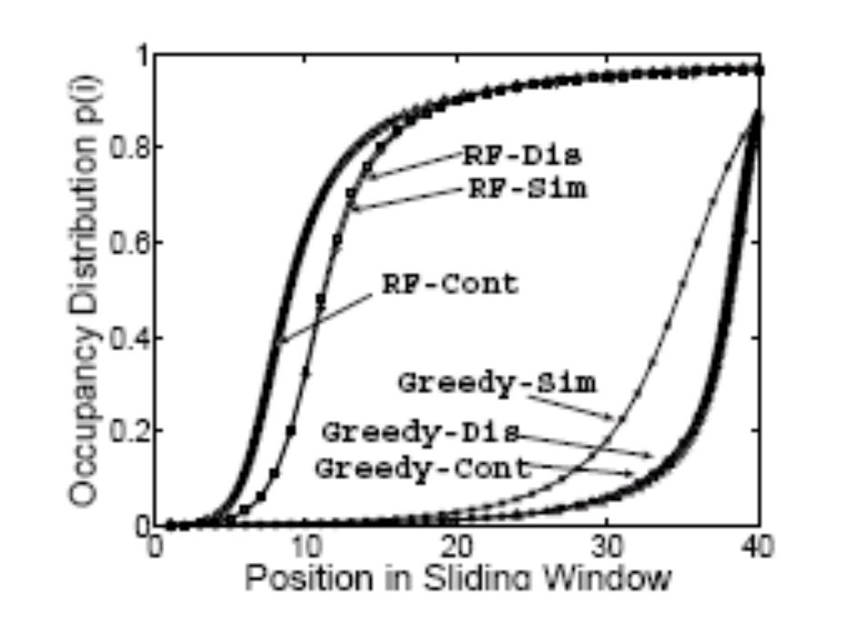
Numerical result
M=1000
N=40
In simulation,
  # neighbors=60
  Uploads at most 2 in each time slot

Slide 47
Mixed strategy
Partition the buffer into [1,m] and [m+1,n]
Use RF for [1,m] first
If no chunks available for download by RF, use Greedy for [m+1,n]
Difference equations become
p(1) = 1/M
p(i+1) = p(i) + p(i) (1- p(i))² for i = 1,…,m-1
p(i+1) = p(i) + p(i) (1- p(i))(1- p(m)- p(n) + p(i+1)) for i = m, … n-1

Slide 48
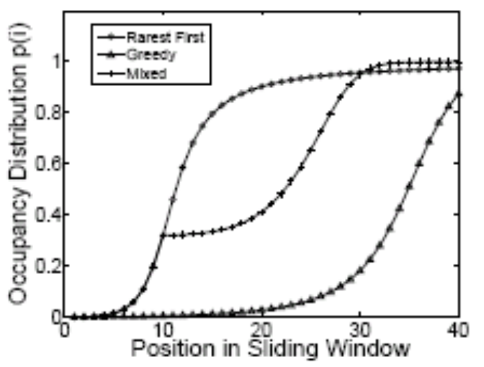
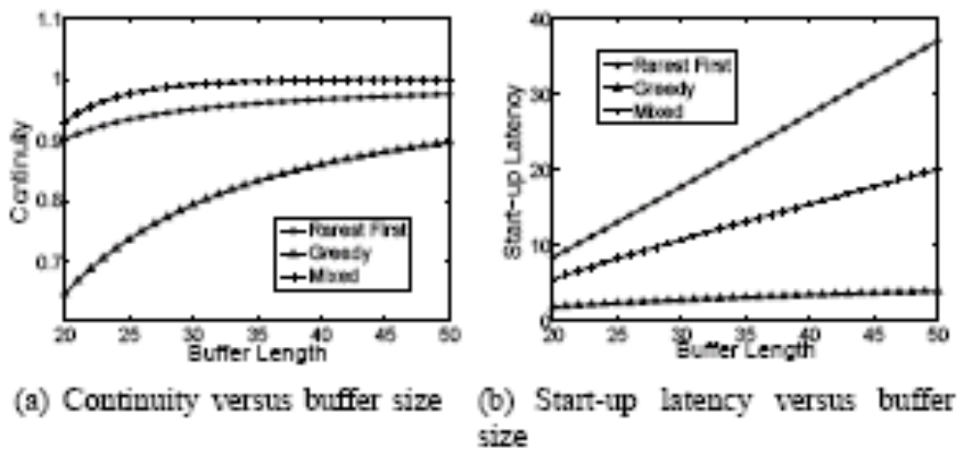
Comparison
For different buffer sizes
Mixed achieves better continuity than both RF and Greedy
Mixed has better start-up latency than RF

Slide 49
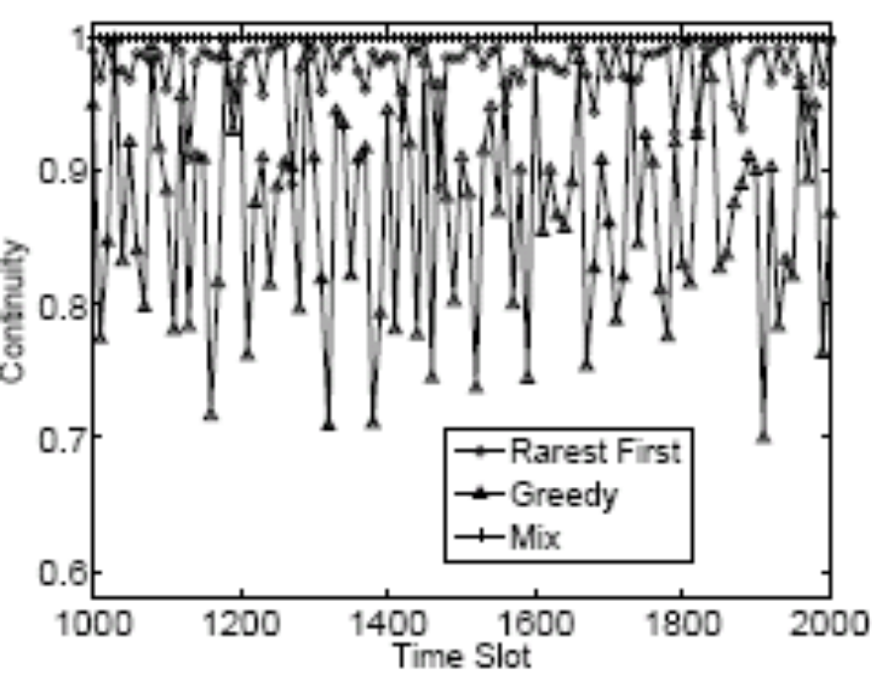
Closer look with simulation
Simulate 2000 time slots
Continuity is the average of all peers
Continuity for Mixed is more consistent, as well highest

Slide 50
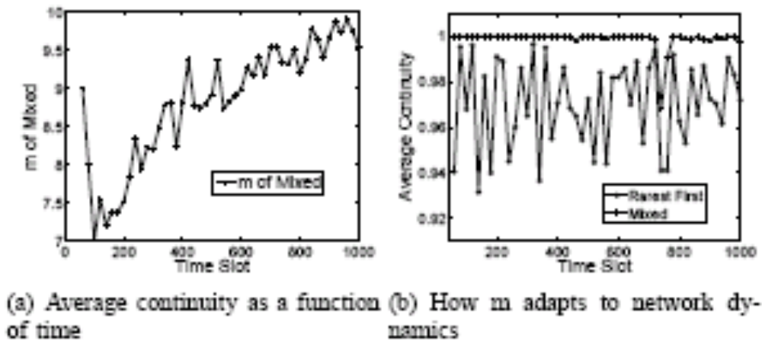
Adapting m to unknown population
Adjust m so that p(m) achieves a target probability (e.g. 0.3)
In simulation study, 100 new peers arrive every 100 slots
m adapts to a larger value as population increases

Slide 51

The multi-channel decoupling model
D Wu, Y Liu and K Ross, “Queuing Network Models for Multi-Channel P2P Live Streaming Systems”, Infocom 2009 Best Paper
New Rule: each peer is assigned to semi-permanent distribution groups; independent of what it is viewing.
channel 1
substream1
channel1
substream2
channel2
substream1
channel2
substream2
C
F
3
6
A
D
1
4
B
E
2
5
viewers
1
2
3
4
5
6
A
B
C
D
E
F

Slide 52
Performance results from queue analysis
PS = probability of system wide universal streaming
Given peer uplink distribution and other parameters, e.g. number of peers, number of channels, playback rate etc, derive “critical value”
If critical value < 1, PS goes to 1, else the opposite
It is similar to if rho < 1, queuing system is stable

Slide 53
The p2p replication model
A bit similar to the decoupling model
Instead of model for real-time streaming, it is designed to allocate contents to peers for storage
The goal is to minimize server load
Many interesting results, submitted to ICNP 2010, stay tuned!

Slide 54
Why do we need these models?
Check if system scales
Get insight on how system works
Understand trade-offs in design
This is what academics do!

Slide 55
Take home
P2P content distribution and storage platforms work in practice
For content distribution, it is a bit like “packet switching” to data networking
Many interesting analytical models for studying these systems

