Slide 1

How to Give a Good Talk
Arnaud Legout
INRIA, Sophia Antipolis
EPI Planète
Email: arnaud.legout@inria.fr
cel-00529505, version 2
November 2010
This work is licensed under the Creative Commons
BY-NC-SA License. To view a copy of this license, visit http://creativecommons.org/licenses/by-nc-sa/3.0/

Slide 2
Focus of This Talk
Broadly applicable advices for any kind of talks
Some specifics for
  Scientific talks
    Talk at a conference
    Invited talk
Variations not addressed here for
  Courses
  Non-scientific talks
Arnaud Legout © 2010

Slide 3
Credit
How to give a bad talk?
  Credit: David A. Patterson, Rolf Riedi, John Ousterhout, Tom Anderson
  Browse google for an instance of the presentation
http://www.nanog.org/talkpointers.html
How to give a good research talk
  Simon Peyton Jones, Microsoft Research, Cambridge
Arnaud Legout © 2010

Slide 4
Credit
Colleagues
  Much better to be ashamed in front of a colleague than in front of 300 peers
The wonderful and awful presentations I attended
Many thanks to TCCC mailing list people who helped me fix typos in the slides and made good suggestions
Arnaud Legout © 2010

Slide 5
Can You Trust Me?
Make your own opinion
  Attend presentations
  Mimic presentations you understand/like
    Big plus if it is not your field
Never ever consider simplicity and clarity as a proof of weakness
Never forget that you can violate the rules if you have a very good reason to do so
Arnaud Legout © 2010

Slide 6
Outline
Why should you bother doing talks?
How to structure your talk?
How to make your slides?
How to give your talk?
Great talks examples
Arnaud Legout © 2010

Slide 7
Presentations are a fundamental part of research excellence
Arnaud Legout © 2010

Slide 8
Research and Marketing
The best researchers in the world learned how to sell their work
  To the community
    Visibility, impact
  To students
    Attract graduate students
  To commissions
    Funding, promotion
  To the public
    Increase attraction of your field, Fame
Arnaud Legout © 2010

Slide 9
Goals of a Presentation
Give the audience the intuition of your idea
Make the audience eager
  To read your paper
  To ask you questions
  To discuss with you
Build relationship
Create a reputation
Get feedback
Arnaud Legout © 2010

Slide 10
Goals of a Presentation
Show you can make great presentations
  Big plus in a career
  Conversely, a poor presentation can kill an application to a new position
Arnaud Legout © 2010

Slide 11
Outline
Why should you bother doing talks?
How to structure your talk?
How to make your slides?
How to give your talk?
Great talks examples
Arnaud Legout © 2010

Slide 12
Adapt to the Audience
The entire audience must understand your talk
  It is better to explain notions a part of the audience already knows than to lose another part of the audience during the talk
Do not overestimate the knowledge of the audience in your field
Arnaud Legout © 2010

Slide 13
Do Not Present Too Much
Common pitfall
  “I did a lot and I will present every single bit of my work. They will be impressed”
    That shows you are unable to deliver a message
Do not hesitate to cut your results
It is better to present 10% of your work that the audience understands than 90% that nobody understands
Arnaud Legout © 2010

Slide 14
Do Not Present Too Much
The audience will remember at most one single message
  Don’t sell more, but sell it well
Yes, it is marketing
  Useless to do great research if nobody knows about it
Arnaud Legout © 2010

Slide 15
Give a Structure to Your Talk
Give a background
  Adapt to the audience
  Adapt the technical granularity of your presentation
Motivate your work
  Why is the subject important and interesting?
Focus of your work
  What is this presentation/work about in a single sentence? What is the problem?
Arnaud Legout © 2010
Notes:
Background is all the audience need to understand your talk

Slide 16
Give a Structure to Your Talk
Show methodology and tools
Show results
  Clearly show your contributions
Conclude with a summary of contributions
  Impact of this work
  Future work rarely makes sense unless you are really planning future work
Arnaud Legout © 2010

Slide 17
Give a Structure to Your Talk
Give an outline
  You can give it first before or after (better) the background
  Repeat the outline before each new part
  Use color to show where you are
Make clear the structure of your talk to the audience
  No suspense
Arnaud Legout © 2010

Slide 18
Give a Structure to Your Talk
No need to go deep into related work (unless it is a survey)
  Your contributions must be the core
  But, be prepared to discuss related work
Arnaud Legout © 2010

Slide 19
Alternate Structures
You need to know what you are doing
  More original means more risks
Alternate questions and answers
  Gerard Berry’s way
  Appropriate for tutorials and general talks
  Less appropriate for technical talks
Arnaud Legout © 2010

Slide 20
Alternate Structures
No slides
  Need to be a very strong speaker
  Need a very well structured presentation
  Need a very high effort from the audience
    You must transmit energy
  Some (lazy) people don’t like such presentation
Arnaud Legout © 2010

Slide 21
Make Summaries
For each important result
At the end of each part of your talk
Clearly show the take home messages
Arnaud Legout © 2010

Slide 22
Anticipate Q&A
Prepare backup slides
  Very impressive when it works
  You can put technical details or results you did not have time to address in them
Be prepared to answer questions
  Rehearse with colleagues
  Be prepared to hard answer questions
Arnaud Legout © 2010

Slide 23
Outline
Why should you bother doing talks?
How to structure your talk?
How to make your slides?
How to give your talk?
Great talks examples
Arnaud Legout © 2010

Slide 24
Use Slide Numbers
How do you know which slide it is over 30?
  “The slide whose title is ‘Use Slide Numbers’”
  “The slide after ‘Presentation Guidelines’”
  “I don’t remember, go back, again, again, again, again, stop… yes this one!”
Used to ask questions and to practice
At least 20 pt
  Even at the back someone may ask a question
Arnaud Legout © 2010

Slide 25
Use non-serif fonts (times)
Serif fonts are hard to read
  Line width is not uniform
  Thin lines may not render well with all projector types
  Hard to read from the back
Use
  Comics: looks modern, but might look childish
  Arial: looks formal, but might be boring
Arnaud Legout © 2010

Slide 26
Use non-serif fonts (comics)
Serif fonts hard to read
  Line width is not uniform
  Thin lines may not render well with all projector types
  Hard to read from the back
Use
  Comics: looks modern, but might look childish
  Arial: looks formal, but might be boring
Arnaud Legout © 2010

Slide 27
Use non-serif fonts (Arial)
Serif fonts hard to read
  Line width is not uniform
  Thin lines may not render well with all projector types
  Hard to read from the back
Use
  Comics: looks modern, but might look childish
  Arial: looks formal, but might be boring
Arnaud Legout © 2010

Slide 28
The Ban Comic Sans Campaign
Some people hate the comic sans font
  http://bancomicsans.com
Reasons
  Ubiquitous
  Childish, immature, naïve, etc.
    Inappropriately used (e.g., military)
  May be, because it comes from Microsoft
Arnaud Legout © 2010

Slide 29
The Ban Comic Sans Campaign
What to do
  Be aware you might upset the audience
    Is it worth taking the risk?
  Don’t use it for a job application
I use it in my lectures
  Looks less scary than Arial for students
    It is subjective
I like it
  Here again it is subjective
Arnaud Legout © 2010

Slide 30
Use Large Fonts
Font must be larger than 20pt (here it is 32pt)
Font must be larger than 20pt (here it is 24pt)
Font must be larger than 20pt (here it is 20pt)
Font must be larger than 20pt (here it is 18pt)
Font must be larger than 20pt (here it is 16pt)
Font must be larger than 20pt (here it is 14pt)
Where do you stop to read it from the back?
  Consider poor projectors, poor screens, poor eyes
Arnaud Legout © 2010

Slide 31
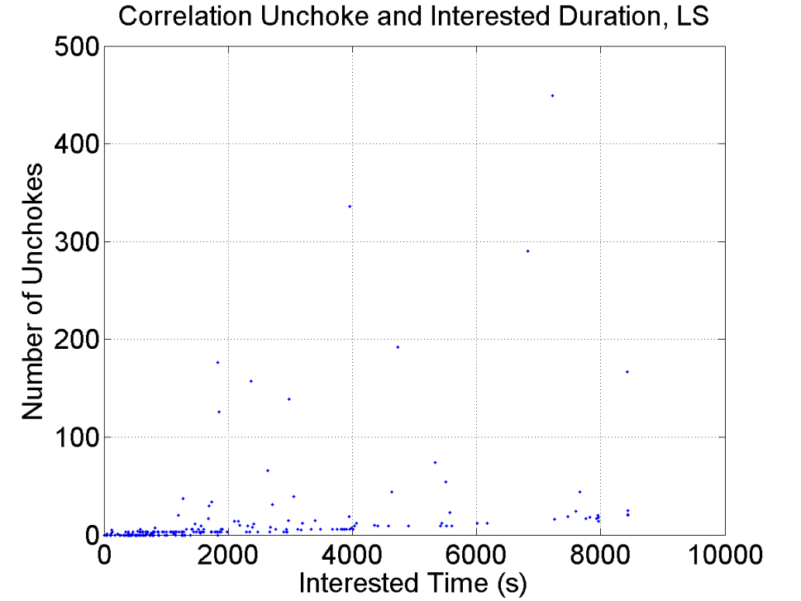
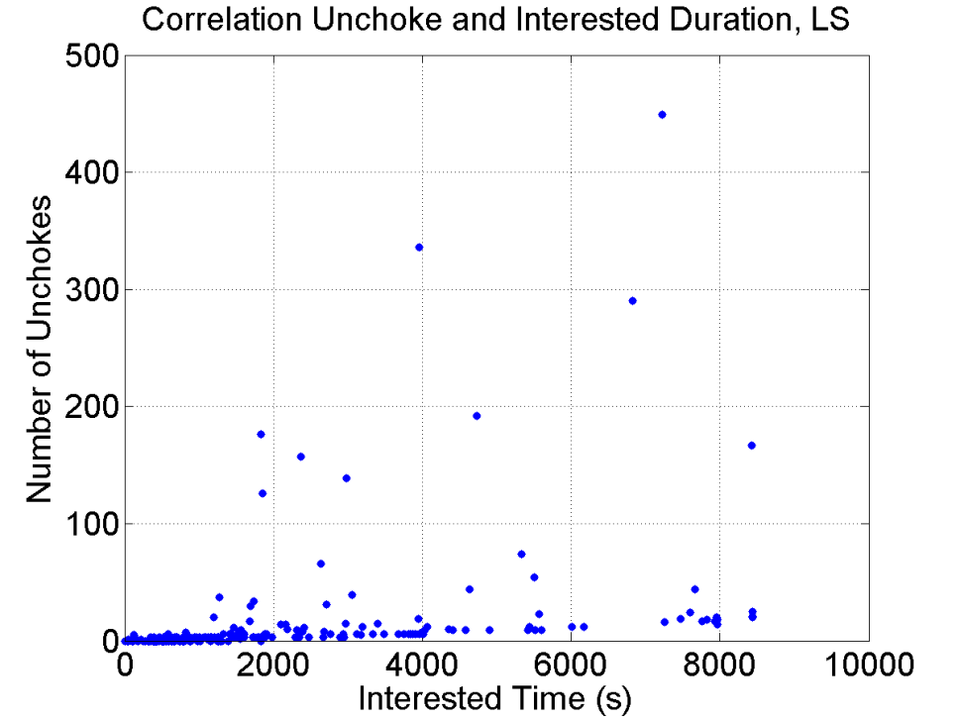
Show Readable Figures
Use large symbols
Arnaud Legout © 2010

Slide 32
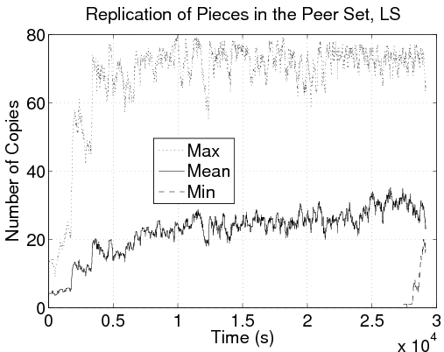
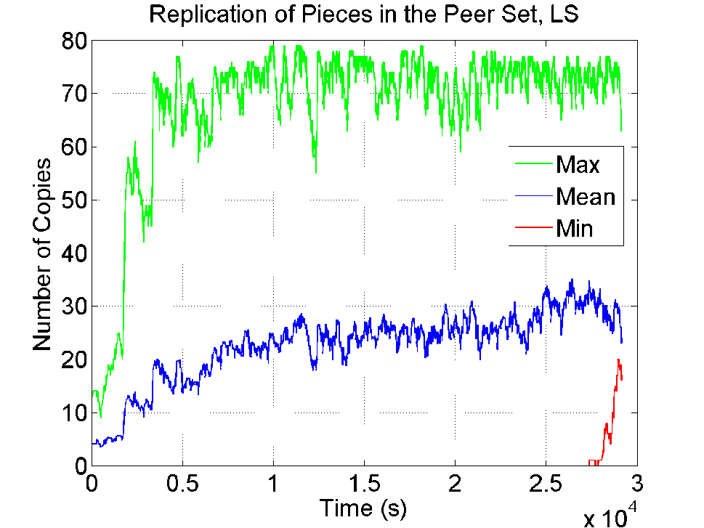
Show Readable Figures
Use thick solid lines and colors
Arnaud Legout © 2010

Slide 33
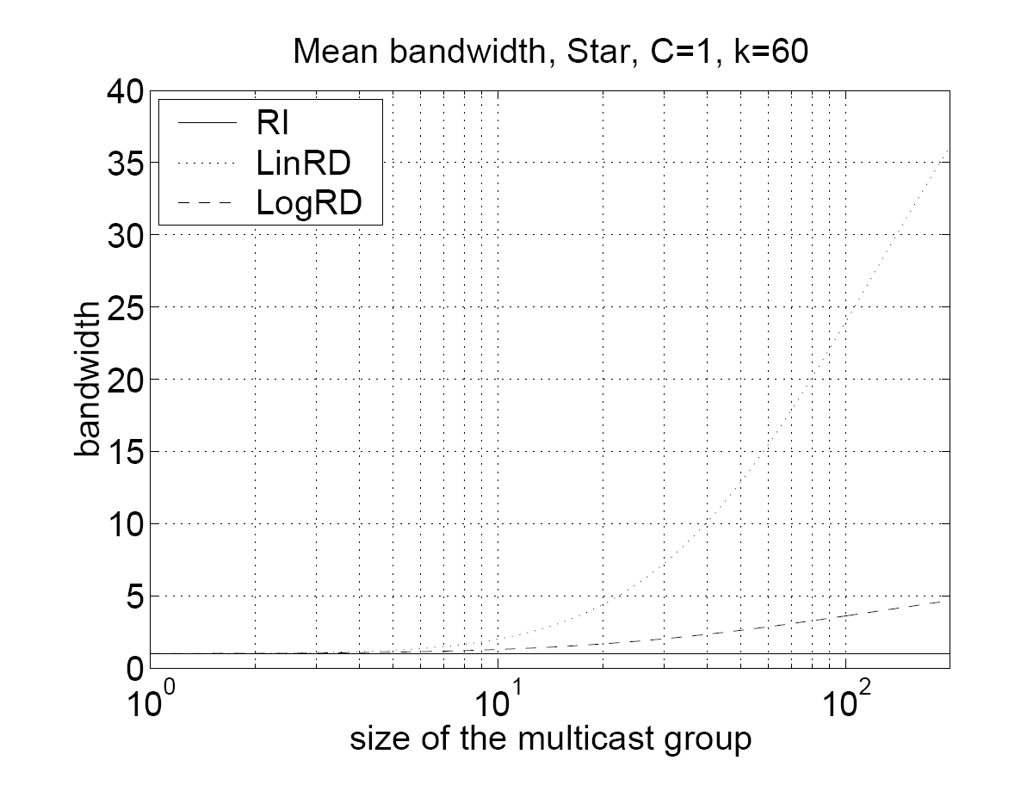
Show Readable Figures
Do not use the camera ready figures
  Often unreadable on slides
Arnaud Legout © 2010

Slide 34
Be Concise
Do not write complete sentences as they make your message obfuscated in long lines of text
Never forget that nobody can read your slides and listen to you at the same time unless you are reading what is in your slides. But, you must not read your slides, this is boring
Omit technical details, there is no chance to explain everything in a single presentation. Instead, you should make the audience eager to read your work
Do not believe complexity will impress your audience, it will simply make you look unable to express your idea
Arnaud Legout © 2010

Slide 35
Be Concise
Write small sentences
Do not compete with your slides
  You give the message, the slides support it
Do not dig into details
  Just deliver a message
  Give a preview of your work/paper
Be simple in your explanations
Arnaud Legout © 2010

Slide 36
Use Illustrations
Make your point clear and simple
Give a mental image people are more likely to remember
Always use a figure instead of a table
Arnaud Legout © 2010

Slide 37
Use Illustrations
Prior to distribution
  Content split multiple pieces
  Metainfo file created by the content provider
To join a torrent
  Peer P retrieves metainfo file from a well-known website
  P contacts the tracker
  The tracker responds back with a peer set of randomly selected peers
  P contacts peers in this set and start requesting different pieces of the content
Arnaud Legout © 2010

Slide 38

Use Illustrations
coolContent.torrent
Web server
random peer set
Tracker
coolContent.xvid
P1
P2
P3
Arnaud Legout © 2010

Slide 39
How Many Colors?
No more than three colors on a slide
  Here I have four
Use easy to distinguish colors like dark
  Blue, Red, and Green
Use colors to emphasize an important word
  May be used to remind you to develop keypoints
Arnaud Legout © 2010
Notes:
What is green for?

Slide 40
How Many Colors?
No more than three colors on a slide
  Here I have three
Use easy to distinguish colors like dark
  Blue, Red, and Black
Use colors to emphasize an important word
  May be used to remind you to develop keypoints
Arnaud Legout © 2010
Notes:
One color for the title, one for the text, and one to stress words.
You may use more colors, but in this case you have to explain the meaning of each color (in this case is it really clearer to use colors)

Slide 41
Background Colors
Never use light colors or low contrast
  They may not render well
No
Never use light colors or low contrast
  They may not render well
No
Never use light colors or low contrast
  They may not render well
Yes
Never use light colors or low contrast
  They may not render well
Yes
Arnaud Legout © 2010

Slide 42
Colors and Projectors
The universal rule
  Projectors never render colors as you expect
Be prepared to
  Red that looks pink or orange
  Blue that looks purple
  Yellow that is invisible (never use yellow)
Never use colors that are too close
  Dark green, red, and blue is the safe side
Arnaud Legout © 2010

Slide 43





Do Not Over Illustrate
Do not use
  Irrelevant illustrations
  Weak metaphors
  Animated images
Arnaud Legout © 2010
Notes:
The case of a student using the image of a missile launcher targeting the BitTorrent logo
Reused the large missile launcher image everywhere
Using a road map on the left half of each outline slides (mac feature) leaving me wondering what is was for.

Slide 44
Do Not Over Animate
It is disturbing
Annoying
Useless
You cannot keep the audience focused
Arnaud Legout © 2010

Slide 45

Use Semantic Animations
Use with caution
Arnaud Legout © 2010

Slide 46
Use Enlightening Animations
Animations must make complex idea simple to grasp
No magic, it is a lot of work to make
Here are two examples
Arnaud Legout © 2010

Slide 47
Use Enlightening Animations: P2P case
P2P
Client-server
Arnaud Legout © 2010

Slide 48
Use Enlightening Animations: Sieve of Eratosthenes
A number is prime if it can only be divided by 1 or by itself
2 3 4 5 6 7 8 9 10 11
12 13 14 15 16 17 18 19 20 21
22 23 24 25 26 27 28 29 30 31
32 33 34 35 36 37 38 39 40 41
42 43 44 45 46 47 48 49 50 51
52 53 54 55 56 57 58 59 60 61
62 63 64 65 66 67 68 69 70 71
Credit: G. Berry, Collège de France, 25/01/08

Slide 49
Use Enlightening Animations: Sieve of Eratosthenes
2 3 4 5 6 7 8 9 10 11
12 13 14 15 16 17 18 19 20 21
22 23 24 25 26 27 28 29 30 31
32 33 34 35 36 37 38 39 40 41
42 43 44 45 46 47 48 49 50 51
52 53 54 55 56 57 58 59 60 61
62 63 64 65 66 67 68 69 70 71
Credit: G. Berry, Collège de France, 25/01/08

Slide 50
Use Enlightening Animations: Sieve of Eratosthenes
2 3 4 5 6 7 8 9 10 11
12 13 14 15 16 17 18 19 20 21
22 23 24 25 26 27 28 29 30 31
32 33 34 35 36 37 38 39 40 41
42 43 44 45 46 47 48 49 50 51
52 53 54 55 56 57 58 59 60 61
62 63 64 65 66 67 68 69 70 71
Credit: G. Berry, Collège de France, 25/01/08

Slide 51
Use Enlightening Animations: Sieve of Eratosthenes
2 3 4 5 6 7 8 9 10 11
12 13 14 15 16 17 18 19 20 21
22 23 24 25 26 27 28 29 30 31
32 33 34 35 36 37 38 39 40 41
42 43 44 45 46 47 48 49 50 51
52 53 54 55 56 57 58 59 60 61
62 63 64 65 66 67 68 69 70 71
Credit: G. Berry, Collège de France, 25/01/08

Slide 52
Use Enlightening Animations: Sieve of Eratosthenes
2 3 4 5 6 7 8 9 10 11
12 13 14 15 16 17 18 19 20 21
22 23 24 25 26 27 28 29 30 31
32 33 34 35 36 37 38 39 40 41
42 43 44 45 46 47 48 49 50 51
52 53 54 55 56 57 58 59 60 61
62 63 64 65 66 67 68 69 70 71
Credit: G. Berry, Collège de France, 25/01/08

Slide 53
Be neaT
Do YOU like
    slides with sppell check erors
    Inconsistant:
      Capitalisation
      Bullet.
      Struture,
      font;
    Ugly slides
    poor use of symbol !!!
  Poor layout
Arnaud Legout © 2010

Slide 54
Be Neat
Do you like
  Slides with spell check errors
  Inconsistent
    Capitalization
    Bullets
    Structure
    Font
  Ugly slides
  Poor use of symbols
  Poor layout
Arnaud Legout © 2010

Slide 55
No Punctuation Mark.
No punctuation mark:
  At the end of sentences:
    Period (.) ,
    Colon (:),
    Semi-colon (;),
    Comma (,).
  Apart from:
    Question marks (?),
    Exclamation marks (!).
Arnaud Legout © 2010

Slide 56
No Punctuation Mark
No punctuation mark
  At the end of sentences
    Period (.)
    Colon (:)
    Semi-colon (;)
    Comma (,)
  Apart from
    Question marks (?)
    Exclamation marks (!)
Arnaud Legout © 2010

Slide 57
Use Meaningful Titles
The title should summarize the slide content
Do not use a same title with an increasing number
  Introduction 1/5
  Introduction 2/5
  Etc.
Poor variant “cont.”
Arnaud Legout © 2010

Slide 58
Outline
Why should you bother doing talks?
How to structure your talk?
How to make your slides?
How to give your talk?
Great talks examples
Arnaud Legout © 2010

Slide 59
Never Use Laser Pointer
Always disturbing
  Aren’t you shaking?
Show you are lazy
  Use neat animations
    Works in any case
    Safe side
  Use colors, shapes
  Use your hand if you can touch the screen in last resort (not always possible)
Arnaud Legout © 2010

Slide 60
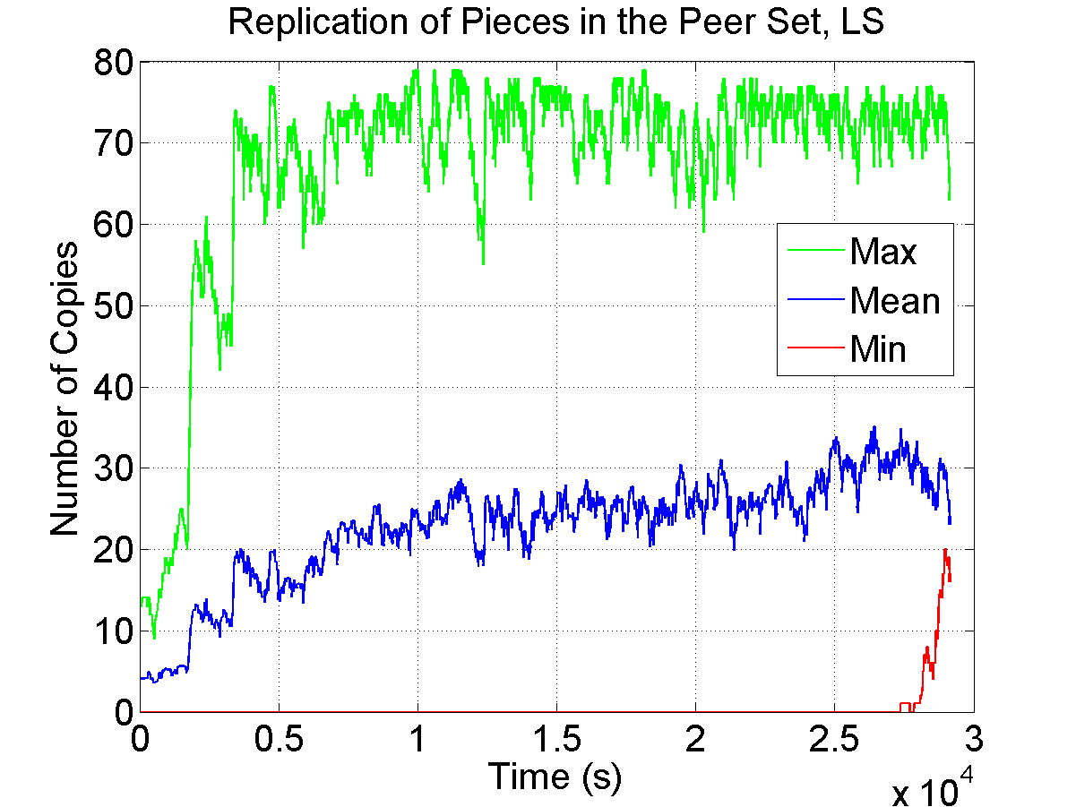
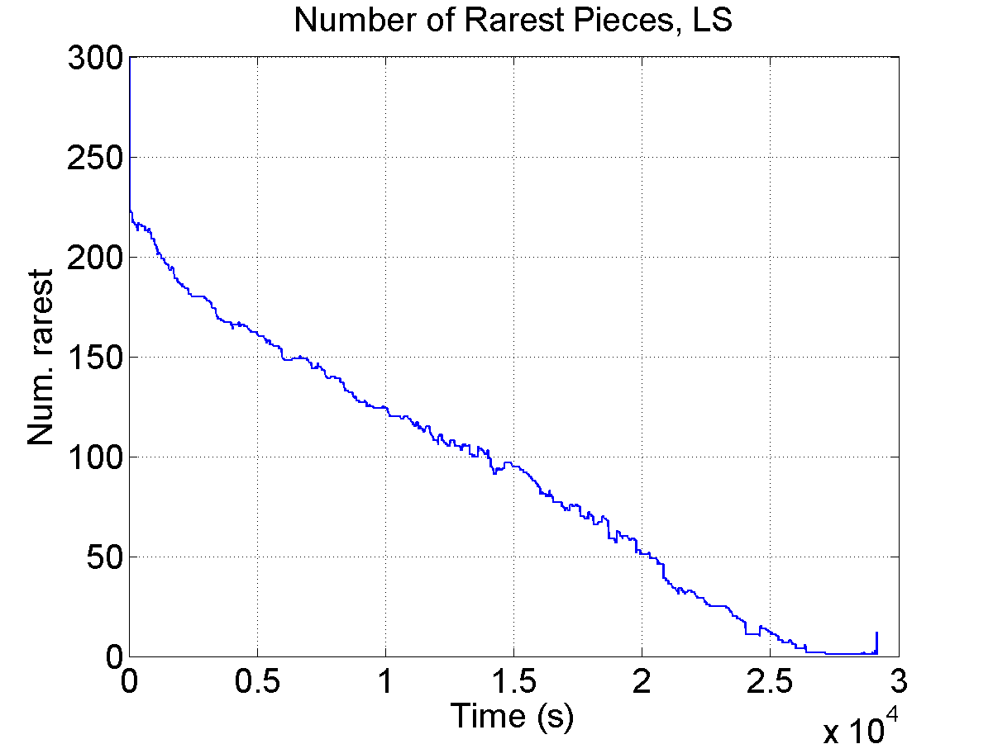
Never Use Laser Pointer
36kB/s
Arnaud Legout © 2010

Slide 61
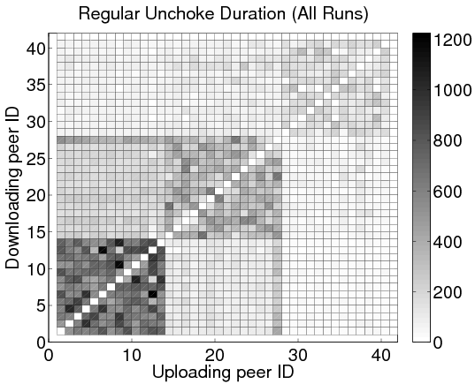
Never Use Laser Pointer
Three-class scenario, averaged over all 13 runs
Seed max upload speed: 200kB/s
We see clusters per class
Two artifacts
  Slow class squares are darker since peers take longer to complete
  Peer 27 slower than other peers in its class (problem with a PlanetLab node): Reciprocates mainly with the slow leechers
19
20
slow
medium
fast
Peer 27
seed
Arnaud Legout © 2010

Slide 62
Explain All Slides
Never present a slide you do not explain in details
  Always drop a slide if you present it for less than 30 seconds
  Spend time on complex figures or drop them
  Spend time on equations or drop them
  Talk on transition slides (e.g., outline reminders) or drop them
    Use transition to summarize the previous part and introduce the next one
Arnaud Legout © 2010

Slide 63
Minimum Explanation
For each figure you must
  Give the x-axis
  Give the y-axis
  Give the legend
  Explain all symbols
Arnaud Legout © 2010

Slide 64
Minimum Explanation
For each equation you must
  Explain all variables and parameters
If you cannot
  Drop the figure or the equation, otherwise is will be useless
Arnaud Legout © 2010

Slide 65
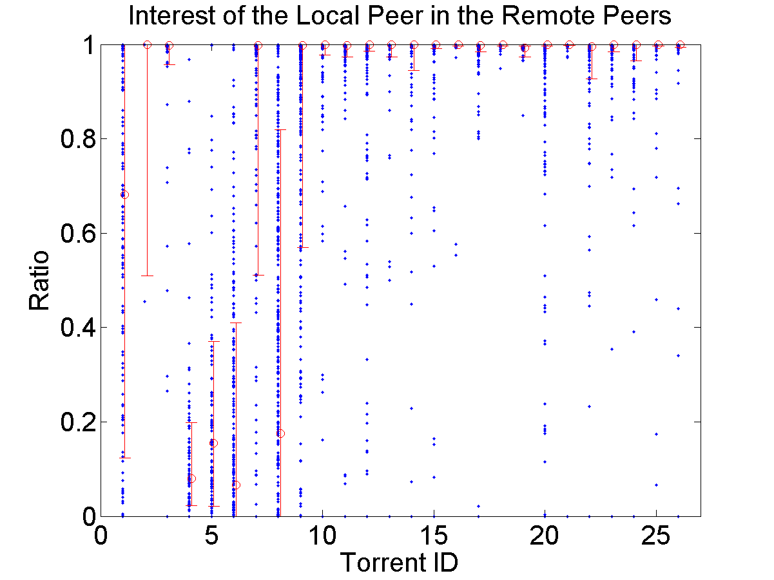
Example for a Figure
High peer availability
0 to 1 seed
3 to 12612 seeds
Increasing peer availability
80th
Low peer availability
50th
20th
Increasing number of seeds
Arnaud Legout © 2010
Notes:
This is not a graphical art presentation

Slide 66
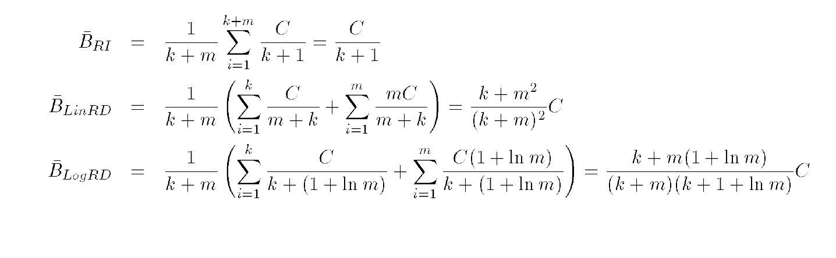
Example for an Equation
Arnaud Legout © 2010
Notes:
You will not look more clever if you show equations and don’t explain them

Slide 67

But, Prefer the Figure to the Equation
Arnaud Legout © 2010

Slide 68
Be Redundant
Repeat several times
  I’m going to explain…
  My explanation is…
  I just explained…
Never too much redundancy
Arnaud Legout © 2010

Slide 69
Never Go Back
It is bad habit to go back to a previous slide
  If you forgot something, just tell it
  If you need a previously shown image, add it again
Navigating within slides will lose your audience
Arnaud Legout © 2010

Slide 70
Never Exceed Your Allocated Time
This is a lack of respect for the audience and the next speakers
  Not admissible, not professional
Should never happen if you are well prepared
Arnaud Legout © 2010
Notes:
Case of infocom best paper award that was still speaking after 45 minutes (20 minutes talk including questions)
I just remind the pain

Slide 71
Never Exceed Your Allocated Time
In case you feel you will exceed the allocated time
  Drop slides
  No problem to drop a full part
  Never drop summary of contributions
  Never stop in the middle of somewhere
Arnaud Legout © 2010

Slide 72
One Slide Every Two Minutes
Usually everybody agrees
Now count
  10 minutes means 5 slides
  20 minutes means 10 slides
  How many slides do you have for a 20 minutes talk?
Arnaud Legout © 2010

Slide 73
One Slide Every Two Minutes
You can violate this rule if
  You have time to explain in details all slides
  You will not exceed your allocated time
  You will not speak much faster
Hard to spend on average per slide
  less than 1 minute (really short)
  more than 3 minutes (start to be boring)
Arnaud Legout © 2010

Slide 74
Use a Watch
On a room wall, in front of you
  You can see it, but not the audience
On your desk
  Digital one with large enough numbers
On PowerPoint
  Presenter mode
    Very convenient, you can get comments and a few slides before and after the current one
Arnaud Legout © 2010

Slide 75
For Long Talks
Several hours to several days
  Make summary at the end of each part
    Every hours and after each break
  Involve the audience
    “Jon, what do you remember from the last hour?”
    “Jim, can you in few words explain me this part?”
    But, don’t be too pushy: it is not an exam!
Arnaud Legout © 2010

Slide 76
Q&A
Reformulate questions
  Make sure you understood them
  Make sure everybody hear them
Be concise in your answer
Do not start a discussion
  “I propose to continue this interesting discussion during the break. Another question?”
Arnaud Legout © 2010

Slide 77
Q&A
Never bluff or lie
Acknowledge when you don’t have the answer
  “Thank you for that point, I don’t have an answer now. We will definitely look at it.”
  “I don’t know this article, but it looks similar to what we did. Can you send me the pointer?”
    Never forget to send back your answer by email
Arnaud Legout © 2010

Slide 78
Q&A
Questions might be
  Aggressive
  Stupid (most of the time, such questions show you made a poor presentation)
  Hard to answer
  Showing you are wrong
In any case never
  Lie, aggress, or complain
Arnaud Legout © 2010
Notes:
complain: it is not my fault, I had a problem with my laptop/supervisor/family/etc.

Slide 79
Q&A
During a conference, if you don’t understand the question
  Try to reformulate based on what you got
  If after one try you still don’t understand it
    Ask the session chair
  If after two tries nobody got it
    Don’t start a discussion at that point
    Propose to take it off-line after the talk
Arnaud Legout © 2010

Slide 80
Use Your Body
Use eye contact
  Do not stare (no more than 10 seconds)
  Do not avert or switch fast
Use your hands
  To support visually what you say
You can walk, but
  Do not stand in front of your slides
  Do not walk along a line
  Walk on a triangle and stop at each vertex
Arnaud Legout © 2010
Notes:
Show how to merge to sets with hands (ant rostrow)
Show how to designate two users (one per hand)

Slide 81
Use Your Voice
Repeat several times major messages
Make a short pause before each important message
  Pauses are even more effective than raising voice
Vary your voice level
Never read your slides or notes
Arnaud Legout © 2010

Slide 82
Show Enthusiasm
If you don’t show enthusiasm presenting you own work, do you really believe that the audience will be enthusiastic
  Listening to you
  Reading your work
  Inviting you
  Discussing with you
Arnaud Legout © 2010

Slide 83
Use a Second Screen
Do not look at your slides on the primary screen
  You must not show your back to the audience
  Hard to keep the eye contact this way
Use instead a second screen (in clone or extended view)
  Place it appropriately
    Stay in front of the audience when you look at the slides
  Hard to see you are looking at the slides
Arnaud Legout © 2010

Slide 84
Practice
Best speakers are the ones who practice the most
  No improvisation or spontaneity
  To look spontaneous you even need to practice more
Stand up and speak with loud voice to practice
  Practice at least once using a projector
Practice with colleagues (once well trained)
The shorter the talk the more you have to practice
Be prepared to answer hard/aggressive questions
Arnaud Legout © 2010

Slide 85
Practice
To prepare a 20 minutes talk
  Three days for a first version of the slides
  Around 10 rehearsal in front of my desk
  Around 5 “in situation” rehearsal
    Final version of the slides
    Stand up
    Speak loud
    May use a real projector
    Stringent time constraint
    In front of colleagues
Arnaud Legout © 2010

Slide 86
Practice vs. Energy
How to project energy if you lost it during rehearsals?
  Don’t repeat the day of your presentation and only once the day before
  Sleep well the night before
  Convert your stress into energy
Arnaud Legout © 2010

Slide 87
Practice vs. Energy
Practice permits to control the energy
  Theatre actors performing on stage every day have to project a lot of energy
    The more they perform, the more the energy they project is appropriate
  The less you practice the more you will use your energy to
    Keep the focus
    Find what to say
    Fight against your stress
Arnaud Legout © 2010

Slide 88
Practice and Experienced Speakers
Experienced means +50 presentations or +100 hours of presentations
  If it is not your case, you will never practice too much
  If you are that experienced, you will probably not have time to practice that much
    Your experience will compensate a lack of practice
    But, if you have a tight schedule and want to impress, you will have to practice anyway
Arnaud Legout © 2010

Slide 89
Dress Well
Always dress better than the audience
  Show that you respect the audience
  If you don’t care for your presentation or of the audience, how will you dress?
    As every day!
But, do not be overdressed
  Ask the dressing convention of your community/audience
Arnaud Legout © 2010

Slide 90
Avoid Bad Surprises
Ask weeks before your talk to your session chair or organizer
  Talk duration, questions duration
  Presence of a projector
  If you have a laptop
    Can you use it or do you have to use the computer of the conference?
  If you don’t have a laptop
    Is there a computer that you can use?
    Which OS, which version of PowerPoint, PDF only?
Arnaud Legout © 2010

Slide 91
Avoid Bad Surprises
Ask weeks before your talk to your session chair or organizer
  Audience
    If it is a well known conference, better ask your colleagues/advisor
    If it is not a regular talk at a conference (tutorial, interview, visit, etc.) you must ask
Arnaud Legout © 2010

Slide 92
Avoid Bad Surprises
Make backup copies of your slides on two different supports
  Don’t put everything in a same luggage
Make copies in several versions
  PowerPoint 2007, PowerPoint 2000, pdf (lose your animations), etc.
Make your slides available on-line
Check that all copies are the last version of your presentation
Arnaud Legout © 2010

Slide 93
Avoid Bad Surprises
Introduce yourself to the session chair or organizer well before your talk begins
  Might be hard to find during big conferences
Arrive early in the conference room
  Don’t hesitate to move chairs or tables to make you more comfortable
Arnaud Legout © 2010

Slide 94
Avoid Bad Surprises
Test your presentation
  Go through all slides to see if everything is ok
    Must check colors and animations
Test the remote controller
  Batteries
Arnaud Legout © 2010

Slide 95
Avoid Bad Surprises
If you use your laptop
  Restart it half an hour before your presentation
  Stop all applications
    Avoid popups
  Stop wifi
    Avoid system update popups or reboot
  Use a power cable
  Deactivate sleep mode, screen saver
Arnaud Legout © 2010

Slide 96
Some Facts on the Audience
They want to be elsewhere
  Early in the morning
    In their bed
  Around noon
    Eating
  Early in the afternoon
    Sleeping near a swimming pool
  Late in the afternoon
    Dinner or social event
  In the middle
    Waiting for the coffee break
Arnaud Legout © 2010

Slide 97
Some Facts on the Audience
They don’t know you
They don’t know your work
They don’t know your field
They have no reason to like your work
They have no reason to listen to you
Arnaud Legout © 2010

Slide 98
Some Facts on the Audience
They have already ingested boring presentations
They are laptop addicts
  They are reading their emails, browsing the web, reading online newspapers, skyping, etc.
You have to wake them up and catch their attention
Arnaud Legout © 2010

Slide 99
How to react to…?
People you lost
  You lost them, so work for the ones you haven’t lost yet
  Don’t repeat what you feel the lost audience didn’t get
    You will lose the last ones that follow you
Nasty people (aggressive, commenting…)
  Focus on other people
  Don’t give them the opportunity to disrupt you even more
Arnaud Legout © 2010

Slide 100
Outline
Why should you bother doing talks?
How to structure your talk?
How to make your slides?
How to give your talk?
Great talks examples
Arnaud Legout © 2010

Slide 101
Wonderful Examples
General talks (not scientific)
  Randy Pausch Last Lecture (in english)
    How to communicate passion?
    Try http://www.youtube.com/watch?v=ji5_MqicxSo
    Or search google for “Randy Pausch Last Lecture”
Arnaud Legout © 2010

Slide 102
Wonderful Examples
General talks (not scientific)
  Michel Serres aux 40 ans de l’INRIA (in french)
    How to keep the audience focused during one hour without any slides and sitting at a chair?
    Try http://www.inria.fr/40ans/forum/video.fr.php
    On the same site you will find horrible presentations
Arnaud Legout © 2010

Slide 103
Wonderful Examples
Scientific talks
  Gerard Berry (Collège de France)
    In French: http://www.college-de-france.fr/default/EN/all/cha_inf2009/Lecon_inaugurale_du_19_novembr.jsp
    More talks (some in English) here: http://www-sop.inria.fr/members/Gerard.Berry/
Arnaud Legout © 2010

Slide 104
Wonderful Examples
Watch talks on http://www.ted.com/
  Extremely high quality standard
  Elizabeth Gilbert on nurturing creativity
    http://www.ted.com/talks/elizabeth_gilbert_on_genius.html
Arnaud Legout © 2010

Slide 105
Thank you!
Put here title and contact
Everything that facilitates access to your work
  Email, URL, etc.
How to Give a Good Talk
Arnaud Legout
arnaud.legout@inria.fr

