Slide 1
ISP Friendly or Foe?
Making P2P Live Streaming ISP-aware
Fabio Picconi and Laurent Massoulie
Appeared in ICDCS’09

Slide 2
Outline
Background
Design of ISP-friendly Scheme
  Design Principles and Rationale
  Overlay Construction
  Dynamic Unchoke
Problems
Emulation and Experiment

Slide 3
Background
Current P2P systems: network agnostic → generating large volumes of unnecessary inter-ISP traffic
Recent work has shown the benefits of ISP-awareness on file sharing applications → How about living streaming?
Optimizing P2P live streaming systems is harder to design: data diffusion in short delays

Slide 4
Design of ISP-friendly Scheme
Design Principles and Rationale
[Principles]
1. Simplicity and low diffusion delays over traffic optimality
2. Decentralized mechanisms based on local peer decisions
3. Mesh-based systems
4. Using tracker to keep lists of active peers and network cost between two IP addresses

Slide 5
Design of ISP-friendly Scheme
Design Principles and Rationale
[Rationale (Mechanisms)]
1. Randomized two-level overlay construction : Primary overlay and secondary overlay
peer selection strategy
2. Dynamic unchoke for secondary overlay links

Slide 6
Design of ISP-friendly Scheme
Overlay Construction
Each peer keeps two peer lists:
  subset of random peers;
  subset of random low-cost peers.
Half connection attempts to peers from the random peer list; half to peers from low-cost peer list.
Whether to build an edge (connection)?
primary overlay links: network cost and upload or download rate
secondary overlay links: upload or download rate.

Slide 7
Design of ISP-friendly Scheme
Dynamic Unchoke of Secondary Overlay Links
how to adapt secondary receive rate:
  Early starvation signals (ESS): a peer generates an ESS whenever a chunk has not been received half-way to the deadline.
  Given an interval T_{noess}, during this time:
  if ESS is observed, increase secondary rate
  if no ESS is observed, decrease secondary rate

Slide 8
Problems
How to decide whether to create an edge after connection attempts is not clearly described;
How to realize unchoke algorithms is not clearly described.

Slide 9
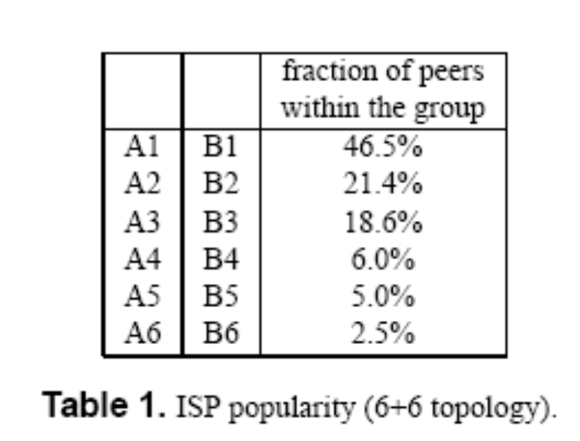
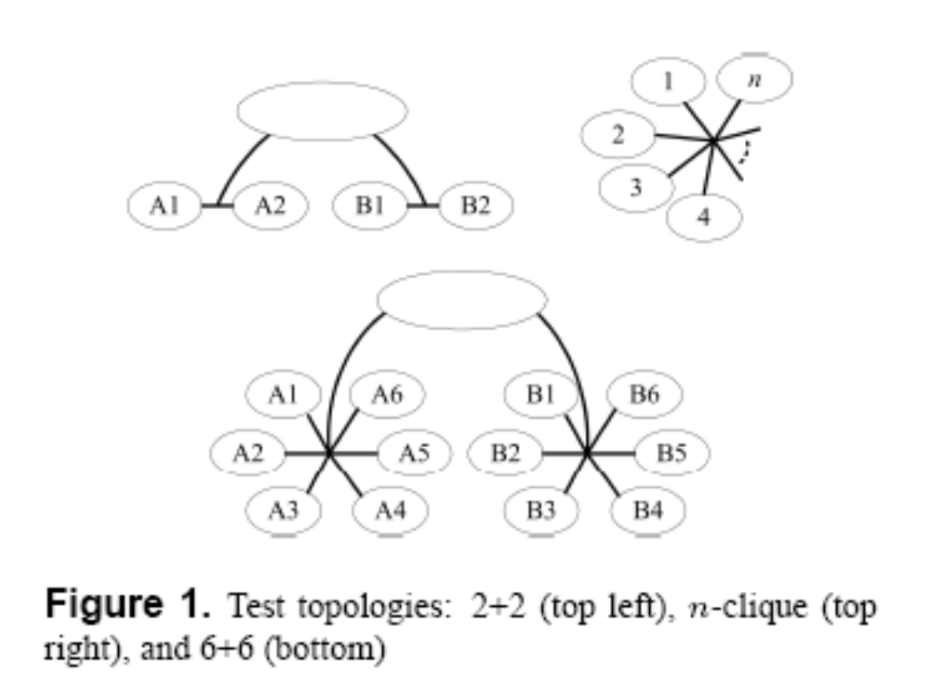
Emulation and Experiment
Test Topologies:
2+2 and N-clique:
clients are distributed uniformly in the groups;

Slide 10
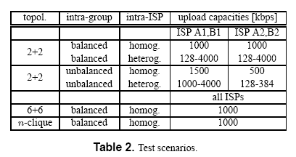
Emulation and Experiment
Bandwidth Distribution in the Topologies:

Slide 11
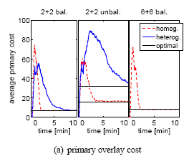
Network Emulation
The convergence of primary overlay links

Slide 12
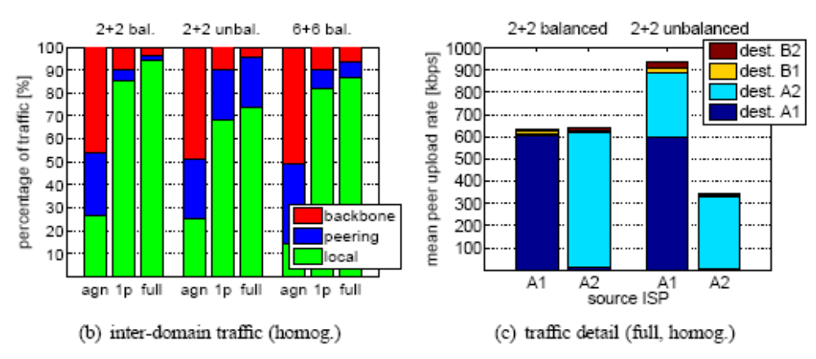
Network Emulation
Traffic pattern:
agn: ISP-agnostic network;
1p: a secondary of only a single peer without rate limiting

Slide 13
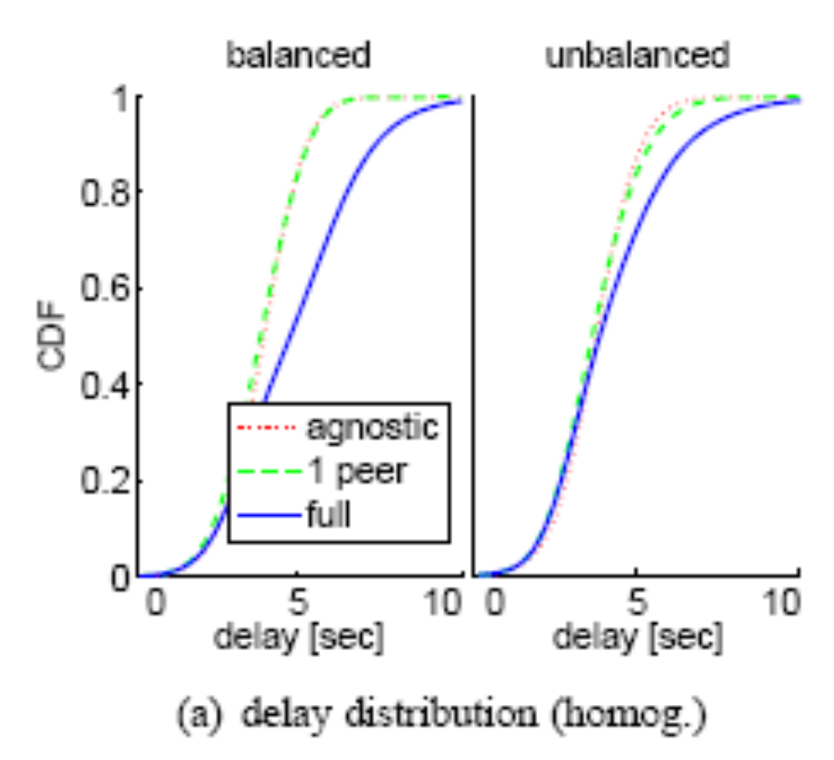
Network Emulation
Delay distribution
The unchoke mechanism increases the diffusion delay to the mid-buffer position

Slide 14
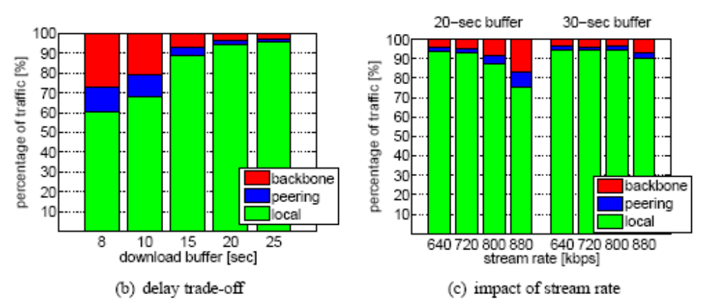
Network Emulation
Impact of buffer size, stream rate, time to trigger ESS
(use 2+2 balanced homogeneous scenario)
Buffer size’s , stream rate’s impact on traffic pattern

Slide 15
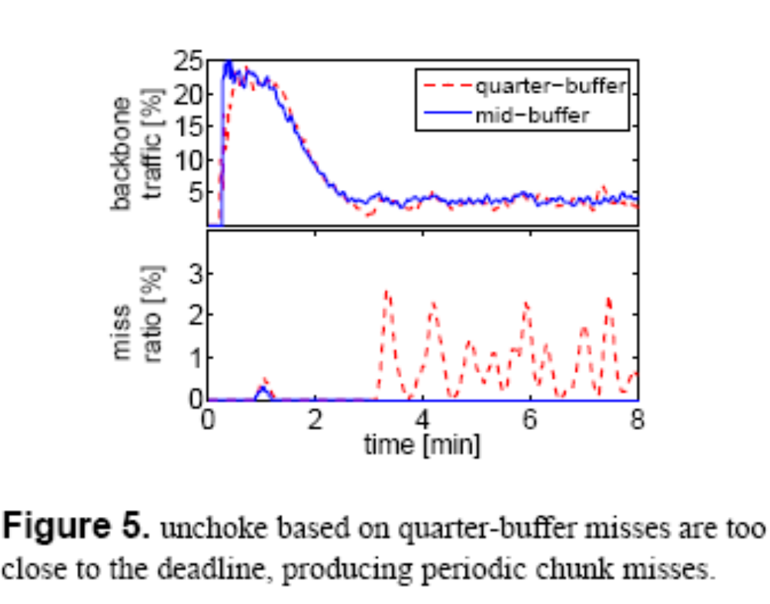
Network Emulation
Mid-buffer vs. quarter-buffer

Slide 16
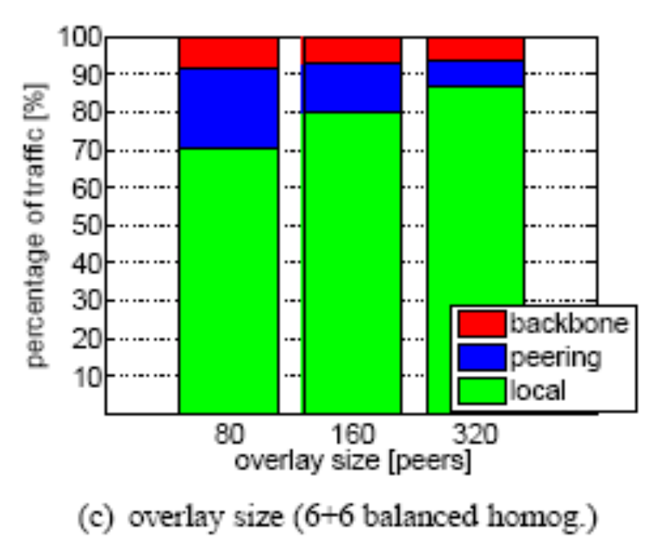
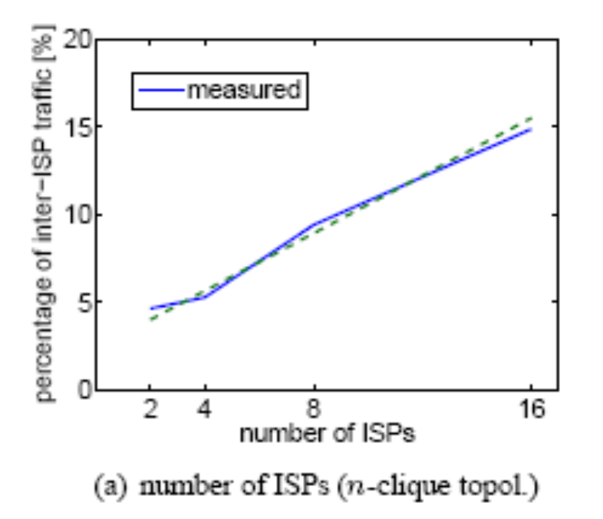
Network Emulation
Impact of number of peers and ISPs

Slide 17
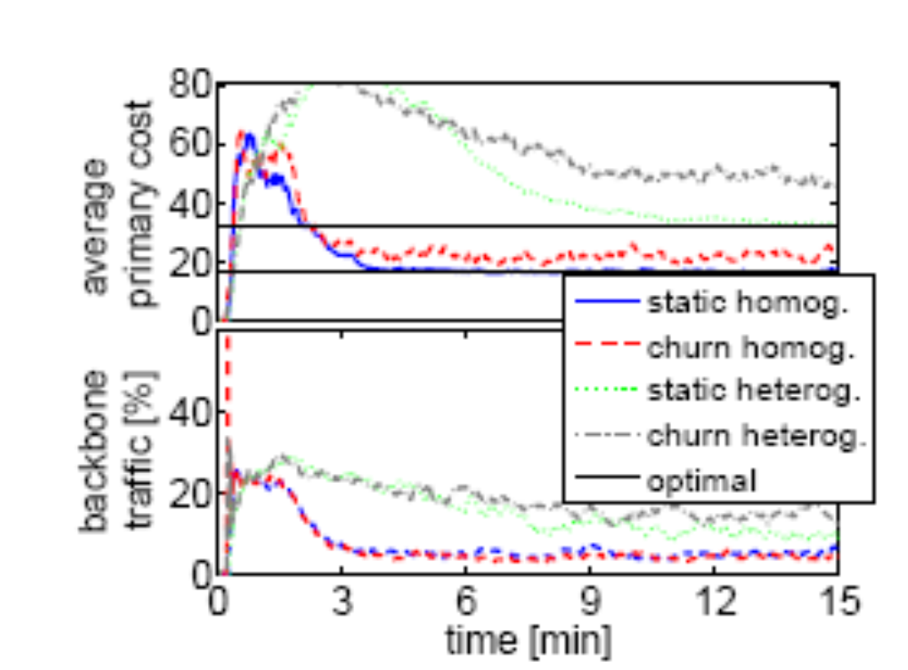
Network Emulation
Impact of churn:

Slide 18
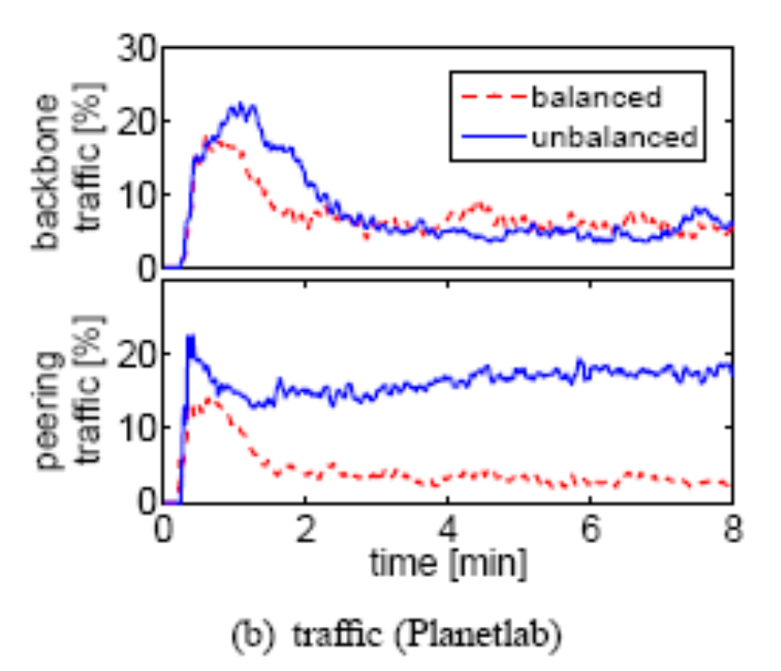
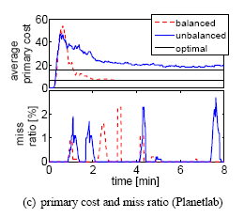
Planetlab Experiments
2+2 homogeneous scenarios

Slide 19
Thank You!

