Slide 1
A Cost-aware Elasticity Provisioning System for the Cloud
Introduction
Algorithms
Unused Section Space 1
Unused Section Space 2
Appear in ICDCS 2011
Written by U. Sharam etc. from UMass and IBM
Kingfisher system
Experiment
Private cloud
Comments
Public cloud

Slide 2
Introduction
background
The slides after this divider will be grouped into a section and given the label you type above. Feel free to move this slide to any position in the deck.

Slide 3

This paper appeared in ICDCS 2011
Short version appeared in mini INFOCOM’2011
Authors: Upendra Sharma, Prashant Shenoy (From UMass) Sambit Sahu and Anees Shainkh (From IBM Watson Research Center)

Slide 4

Given several available configurations, which one to choose?
  Not priced linearly with server capacity
How to transfer between different configurations?
  Fluctuation of requests
  Available transition methods: replication, migration and resizing
Notes:
Given flexible choices, which one is better?

Slide 5

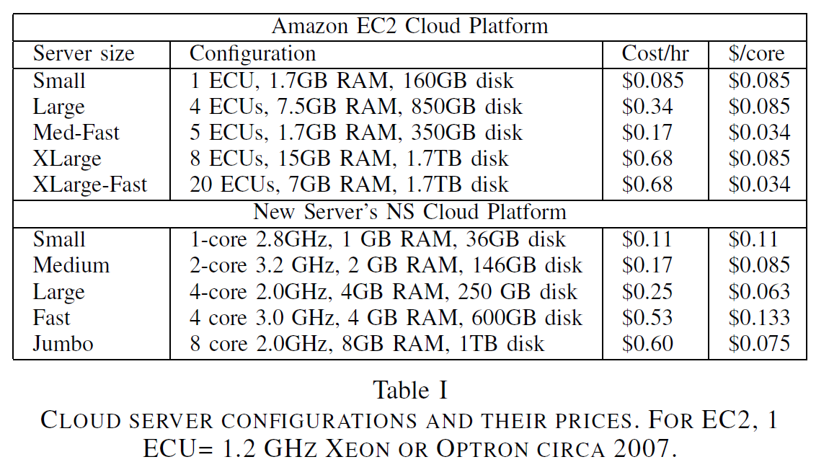

Slide 6

Choose the most cost-effective transition mechanism
  Replication, migration, resizing
Choose the most cost-effective configuration
  Find the cheapest one to meet performance requirement.

Slide 7

Differentiate infrastructure cost and transition cost
Formulate the problem as an integer linear program (ILP)
Prototype implementation and experiments on public and private clouds

Slide 8
Algorithms
pptPlex Section Divider
The slides after this divider will be grouped into a section and given the label you type above. Feel free to move this slide to any position in the deck.

Slide 9

Three problems to resolve:
  When to invoke the algorithm
    Proactive: invoked by predictor
    Reactive: invoked by thresholds on resource utilization
  How to determine server capacities
    In this paper, the authors employ benchmark to estimate the maximum server capacity

Slide 10
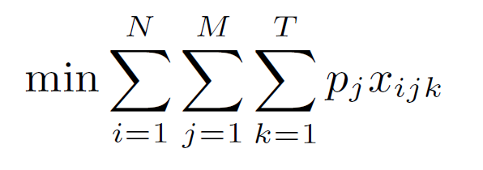
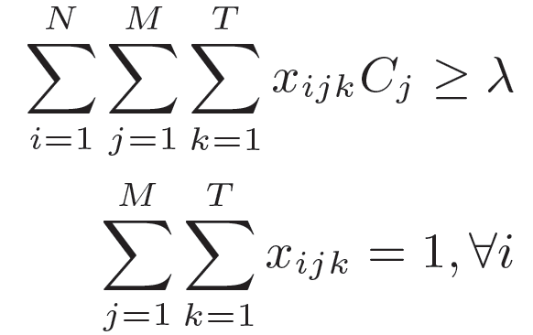




How to determine server configurations
  Two optimization problems:
    Infrastructure cost
Subject to
Where is an integer variable showing whether server i is transformed into server-type j using a method k ( replication, migration), and denotes capacity and the infrastructure cost of server type j respectively. M is the number of different types of servers. And means the peak workload which capacity needs to be provisioned.

Slide 11
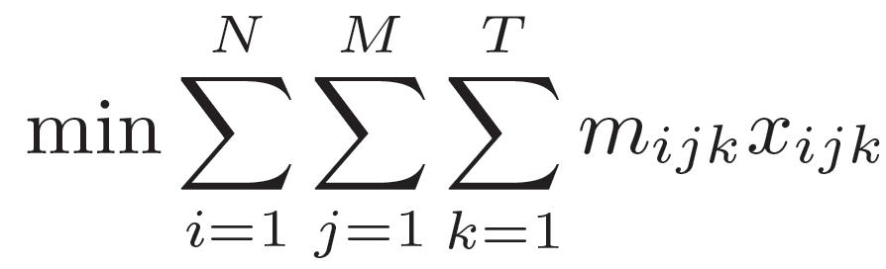

How to determine server configurations
  Two optimization problems:
    Transition cost
Subject to the same constrains
Where is the cost of transforming server i into server-type j using a method k ( replication, migration etc )

Slide 12

The authors use a greedy heuristic with a worst case bound of 2 for an approximate solution for ILP[1]
[1] J. Csirik, J. B. G. Frenk, M. Labb´e, and S. Zhang, “Heuristics for the 0–1 min-knapsack problem,” Acta Cybern., vol. 10,no. 1-2, pp. 15–20, 1991

Slide 13
Kingfisher system
pptPlex Section Divider
The slides after this divider will be grouped into a section and given the label you type above. Feel free to move this slide to any position in the deck.

Slide 14


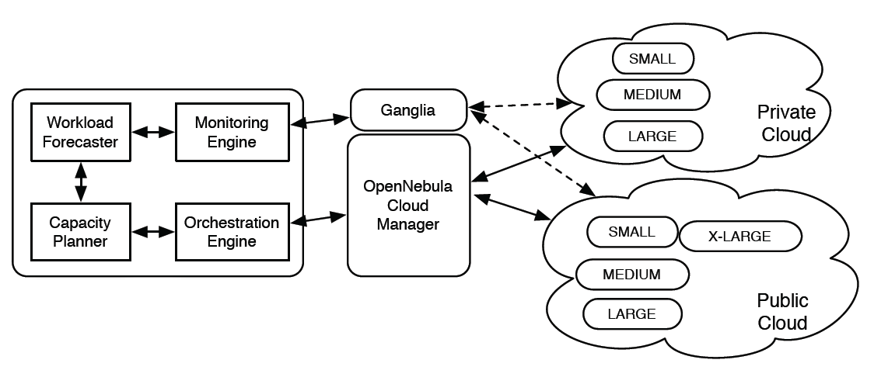

Slide 15
Monitoring Engine: track the application workload
Workload Forecaster: use workload statistics gathered by monitoring engine to predict future workloads.
Capacity Planner: based on predicted information, it solves ILP mentioned previously to get the optimal configuration scheme.
Orchestration Engine: do the transition plan

Slide 17
Ganglia: work with monitoring engine, to gather workload information
Cloud Manager: to specify the server type to use for each configuration

Slide 18
Experiment
pptPlex Section Divider
The slides after this divider will be grouped into a section and given the label you type above. Feel free to move this slide to any position in the deck.

Slide 19

Private cloud: virtualized Xen/Linux-based cluster.
Public cloud: Amazon’s EC2
Workload: TPC-W application, comprising of a Tomcat application tier and a MySQL database tier.

Slide 20

Resource Cost-aware v.s. Resource Cost-oblivious with replication (CA-R v.s. CO-R)
Adding migration method into previous comparison, We write them as CA-RM v.s. CO-RM
Transition Cost-aware v.s. Transition Cost-oblivious with replication and migration (TA-RM v.s. TO-RM)

Slide 21

Configure TPC-W in a single VM
Run this VM on various types of servers in private and public clouds
Increase the requests until the utilization of server is full and new requests will be rejected.
Then we get Cj values in the optimization

Slide 22
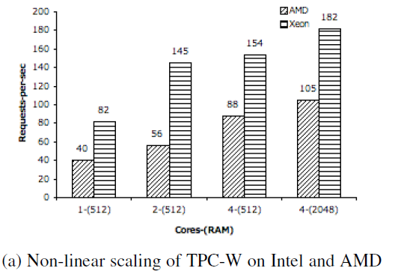
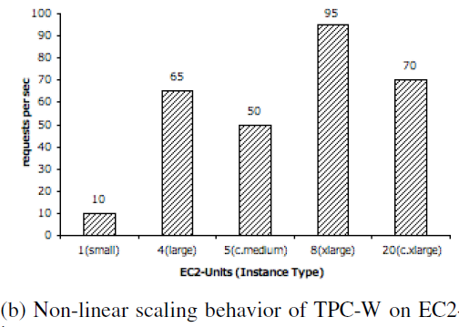

Slide 23
Private cloud
pptPlex Section Divider
The slides after this divider will be grouped into a section and given the label you type above. Feel free to move this slide to any position in the deck.

Slide 24

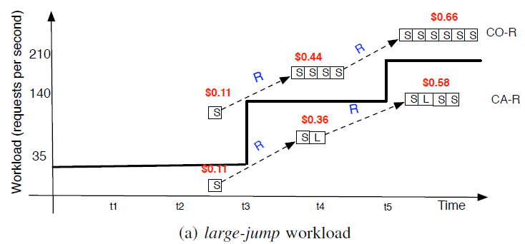
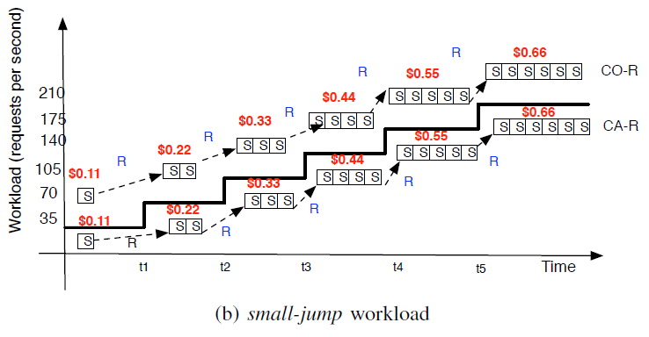
CA-R vs CO-R

Slide 25
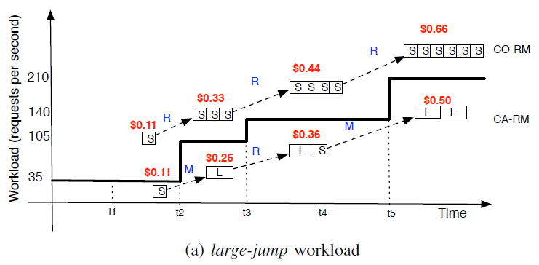
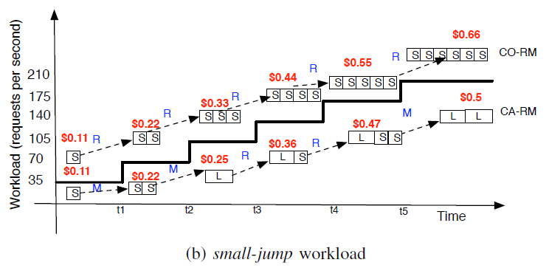
CA-RM vs CO-RM

Slide 26
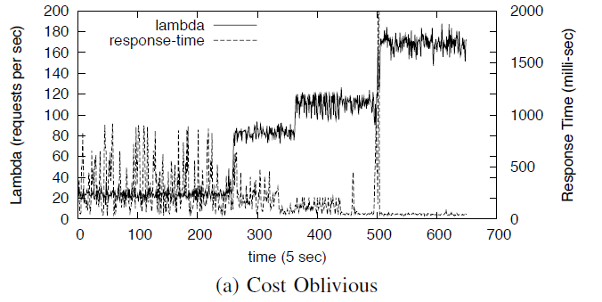
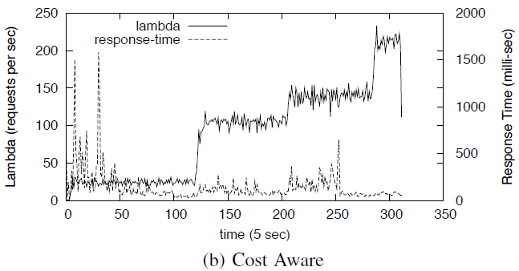
CA-RM vs CO-RM on performance

Slide 27

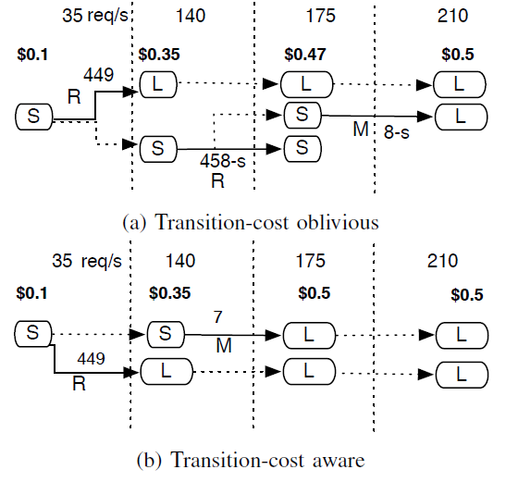
TA-RM vs TO-RM
Solid lines means a configuration change, while dotted lines indicate no change

Slide 28
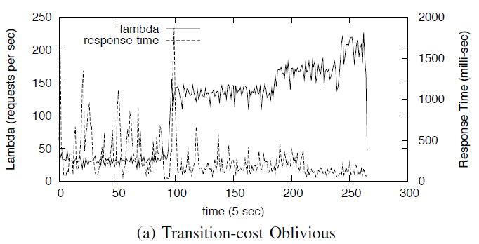
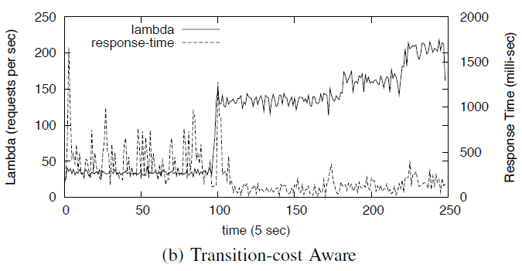
TA-RM vs TO-RM on performance

Slide 29
Public cloud
pptPlex Section Divider
The slides after this divider will be grouped into a section and given the label you type above. Feel free to move this slide to any position in the deck.

Slide 30

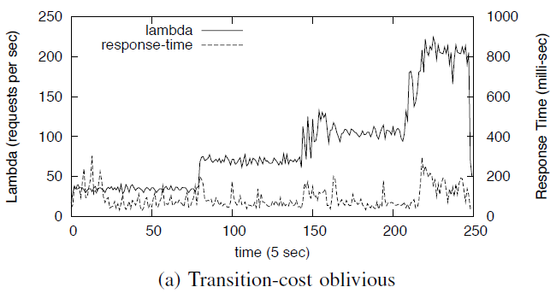
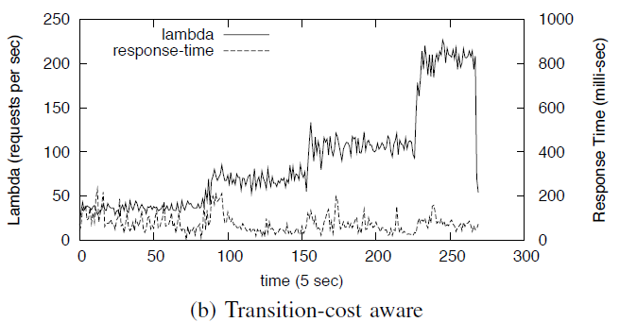
Transition-cost aware vs Transition-cost oblivious

Slide 31
Comments
pptPlex Section Divider
The slides after this divider will be grouped into a section and given the label you type above. Feel free to move this slide to any position in the deck.

Slide 32

The implementation of prototype
Comparison of different cases in experiments to demonstrate the validation
Benchmark of real cloud platforms.

Slide 33

The ILP didn’t consider the bandwidth cost
The prototype seems to fail to address the issue of combining private and public clouds

