Slide 1
Mean-field Technique:
Approximating Many-Particle Systems
Hongxian Sun, Albert
Jun. 1, 2011

Slide 2
‘mean’-’field’?
‘mean’
Averaging, makes sense when the system is large
‘field’
Interactions among particles in a region
‘mean – field’
study a typical particle by averaging the effect of all other particles, neglecting the massive microscopic details.
more a way of thinking than an applicable theoretical framework

Slide 3
Limitations
Rigor
rigorous only under very strict conditions -- equal role
mathematical proofs are generally very hard…
A posteriori Effectiveness
set up a model with mean-field method and verify with measurements
Simple
a simple way to study dynamic many-particle systems
but, we can’t be too creative using this technique

Slide 4

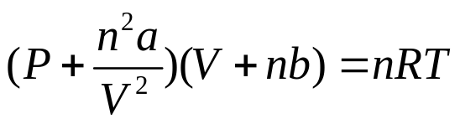
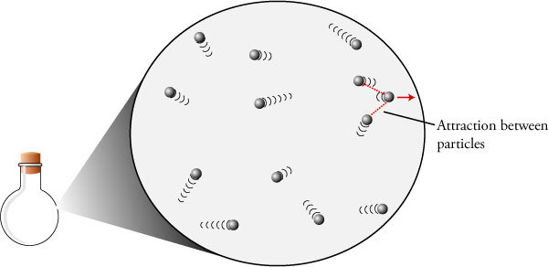
A Simple Example
-- Van der Waals Gas Equation
the Ideal Gas Law
no interaction among particles !
particles take no space!
the Van der Waals Gas Equation

Slide 5
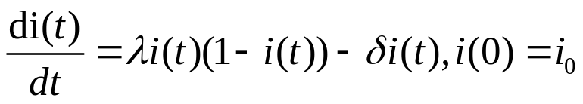



Classical SIS Epidemic Model
The population is divided into 2 categories. One is susceptible and the other infected.
Mean-field Nature
no details
: simplest approximation of the contact pattern
Critical Behavior
epidemic dies out eventually
whole population infected

Slide 6
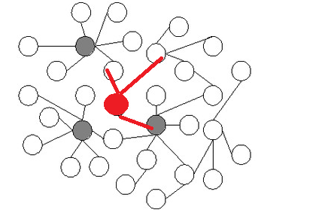
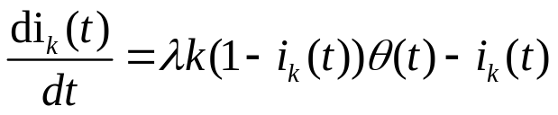


Message Propagation in Scale-free Networks
SIS model is used to study the message propagation in Scale-free networks.
Here is the probability at time t that an edge emanating from an susceptive node (ignorant) with k links points to a infected node (spreader).
We can prove the critical value of to be 0 for the message to reach a stable portion of people in the steady state.
Nekovee, M. et al., (2007), Theory of rumour spreading in complex social networks. Physica A: Statistical Mechanics and its Applications, 374(1), 457-470
Pastor-Satorras, R. et al., (2001). Epidemic Spreading in Scale-Free Networks. Physical Review Letters, 86(14), 3200-3203

Slide 7


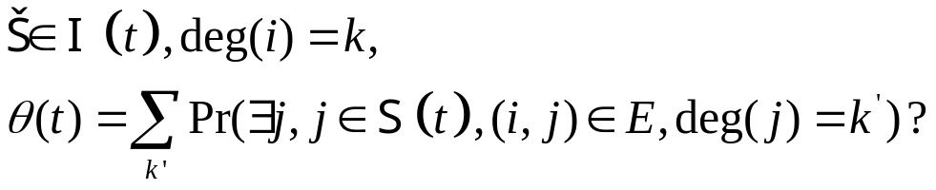
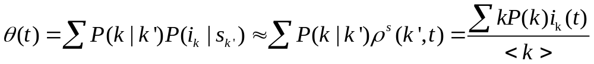
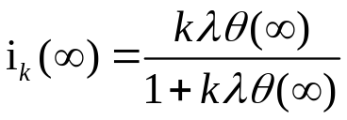
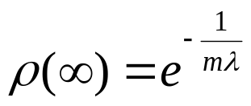
the Threshold Behavior
Define G=(V,E)
classify nodes according to degrees
set of spreaders, set of ignorants,
Considering the stable solution of the ode, we also have
For a BA network we get .Critical value is 0.

