Slide 1
A Unified Framework Modeling Information Diffusion in Online Social Networks
Hongxian Sun

Slide 2

Important and Interesting
Question:
How does information unfold in OSNs?
Application:
A large portion of video views in video sharing sites come from OSNs. Understanding information propagation may help demand prediction and content placement.

Slide 3
System Description
General Description
We consider a large-scale social network where a seed node shares a piece of new content at time 0. Some of its friends will notice the information after some response delay, get interested in the content also and decide to share. The information from these viral nodes will continue propagating, reaching other viral nodes. The process ultimately results in an information sharing cascade.

Slide 4
Questions and Assumptions
Questions
How many users will a content reach after some time?
Will the message stop being propagated?
If the process does stop, what is the final size of the cascade?
Assumption
1. One user will share the same content only once.
2. At one time a content will only be shared by a very limited number of friends of a user.

Slide 5
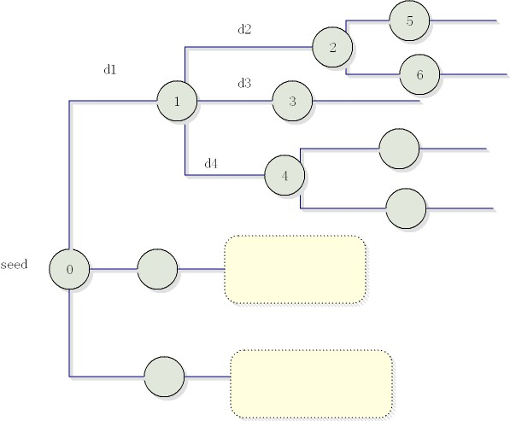
t
Popularity:
Constant or time-variant?
Response delay
The number of progenies

Slide 6
Constant Popularity Diffusion
Distribution of the number of progenies
i.i.d. among all nodes (Gaussian || power-law)
does not change with time
Distribution of the response delay
i.i.d distributed according to some power-law, G(t)
Methodology
the age-dependent branching process framework
independent

Slide 7
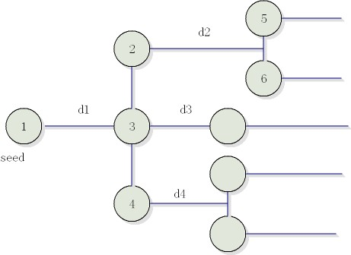
Standard Branching Process
At time 0 there’s only one cell, cell 1. It lives for time t₁, and then gives birth to progenies cell 1, cell 2 ,…, cell n₁ and dies. These new cells live for time t₂, t₃,…, t_{n1,} and give birth to their successors and die… Call died nodes inactive and living nodes active.
Detailed Mathematical Analysis is applicable to this standard branching process

Slide 8
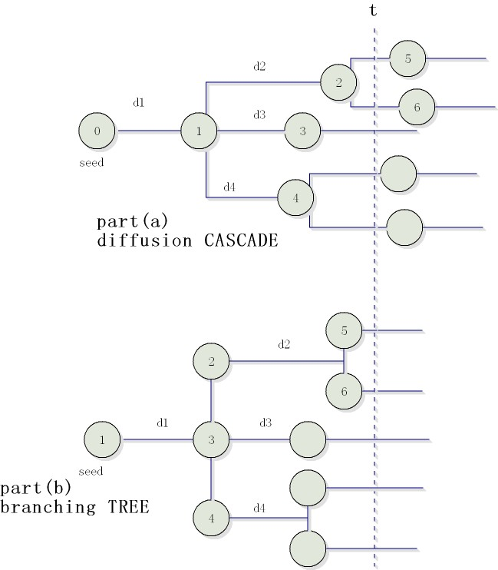
Mapping Diffusion CASCADE to Branching TREE
A node is born at the end of the response period.
A node is born at the beginning of its lifetime.
At time t, the number of nodes in the diffusion cascade corresponds to the inactive nodes in the branching tree

Slide 9
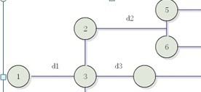

Analyzing Branching Tree
An observation
Let Z(t) be the number of active nodes in the tree at time t. Let be τ be the life time (response delay) of the initial node and consider a time t > τ. The principle of the first generation holds
i.i.d copies of the same process

Slide 10


For the tree size Y(t), we have similar result
For R.V. X taking values in {0,1,2…}, Define a generating function

Slide 11


We can establish integral functions for the generating functions of Z(t), Y(t). They are denoted as F(s,t) and Ψ(s,t):
With the help of renew theory, one can study the two equations to get:
1. the probability that a cascade eventually stops growing
2. the expected final size of a cascade provided it eventually stops growing
3. the expression of the average cascade size at any time t.

Slide 12

Decaying Popularity Branching Dynamics
When the distribution of the number of progenies depends on time, we can still construct the basic equation satisfied by
the generation function of Z(0,t).
We do not have many analytical results in this case.

Slide 13
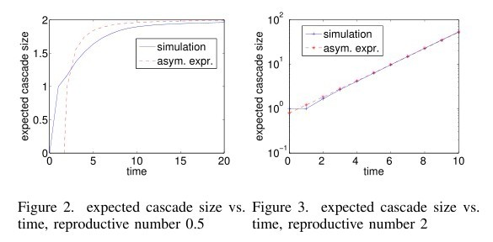
Simulation I. Verify Asymptotic Results
The expected cascade size at any time t

Slide 14
Simulation II. Cascade Properties
Distribution of cascade depth, width and size.
Simulation results fit the existing measurement results very well.

Slide 15
Possible Extensions
Consider the progeny number distribution in a social-influence perspective
The concurrent spreading of multiple contents

