Slide 1

Pricing as optimal scheduling and incentive mechanism
Xuanjia Qiu
2010-1-20

Slide 2

What is price?
Clearing-market prices are aligned with demand and supply.
  For the seller, the marginal cost of producing one more product
  The amount of cost one is willing to pay for getting one more product

Slide 3
What can we do using prices
Incentive engineering
  Algorithmic mechanism design
Resource allocation (scheduling)

Slide 4
Incentive engineering
Multi-agent systems.
  Internet and many application on Internet
Cooperative vs. non-cooperative (selfish)
Selfish but rational – maximize its utility
Equilibrium and Price of anarchy (PoA)

Slide 5
Resource allocation (scheduling)
Scheduling is the process of deciding how to commit resources between a variety of possible tasks.
Traditional resource allocation methods
  Optimization – centralized
Can we do it in a distributed way?
Application:
  Network-friendly resource allocation (e.g., ISP friendly)
  Channel allocation in wireless networks
  Grid/PlanetLab (“Tycoon: Market-based resource allocation”)

Slide 6
Implicit price vs. explicit price
Implicit price
  Bittorrent
  Shadow price in dual decomposition of convex optimization problems

Slide 7
Questions need to answer when using price
What should we price?
  Bandwidth?
  File?
How to decide price (Price discovery)?
  Distributed or centralized?
  Auction, Tatonnement process?
Does equilibrium exist?
Price dispersion
How out-of-equilibrium prices are updated?

Slide 8
Introduction to a paper related to price
Christina Aperjis, Michael J. Freedman, Ramesh Johari, “Peer-assisted content distribution with prices”, ACM CoNEXT 2008

Slide 9
Outline of the paper
Bilateral exchange vs. multilateral exchange
Pricing schemes comparison
User incentive (robustness)
ISP-friendiliness
Client mechanism
System design issues
Simulation

Slide 10
Bilateral exchange vs. multilateral exchange
Bilateral barter-based system implicitly encode prices through their rate reciprocation mechanism
A significant advantage of explicit per-peer prices is that they enable fast peer discovery. In contrast, implicit price, such as BT uses, have long discovery times.

Slide 11
Pricing schemes comparison
What exactly to price?
  A price per peer (PP)
  A price per file (PF)
  A price per peer per file (PPF)

Slide 12
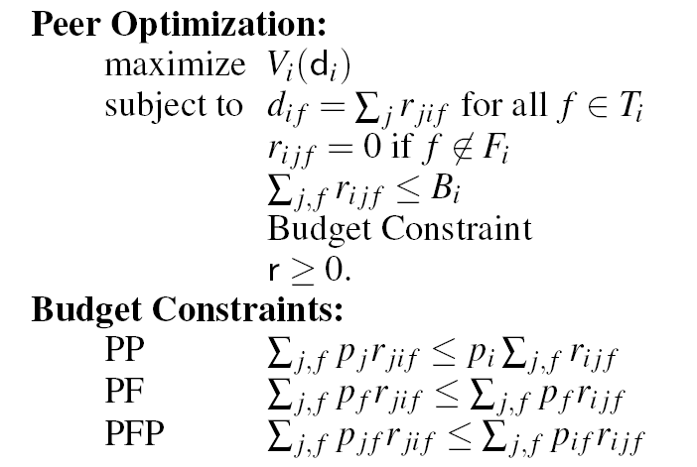

Slide 13
PF is worse than PP
PP is equivalent to PPF in equilibrium
PP’s advantage:
  pricing leads to a natural service discipline for uploading files
  Demand and supply expression is easier for PP than PFP
    Demand– the sum of all received rate requests
    supply– the upload capacity of his access link

Slide 14
Price information discovered via existing architectures similar to BT trackers or even DHTs – one price per peer leads to simple price update implementation
The use of currency provides an incentive for users to remain available after downloading

Slide 15
User incentive (robustness)
Users are incentivized both to contribute a high percentage of their high upload capacity and to share high value content.
We can expect network prices to reflect congestion
“Market power” cannot significantly increase profit.
Users are incentivized to upload after downloading in order to increase their budget/fund

Slide 16
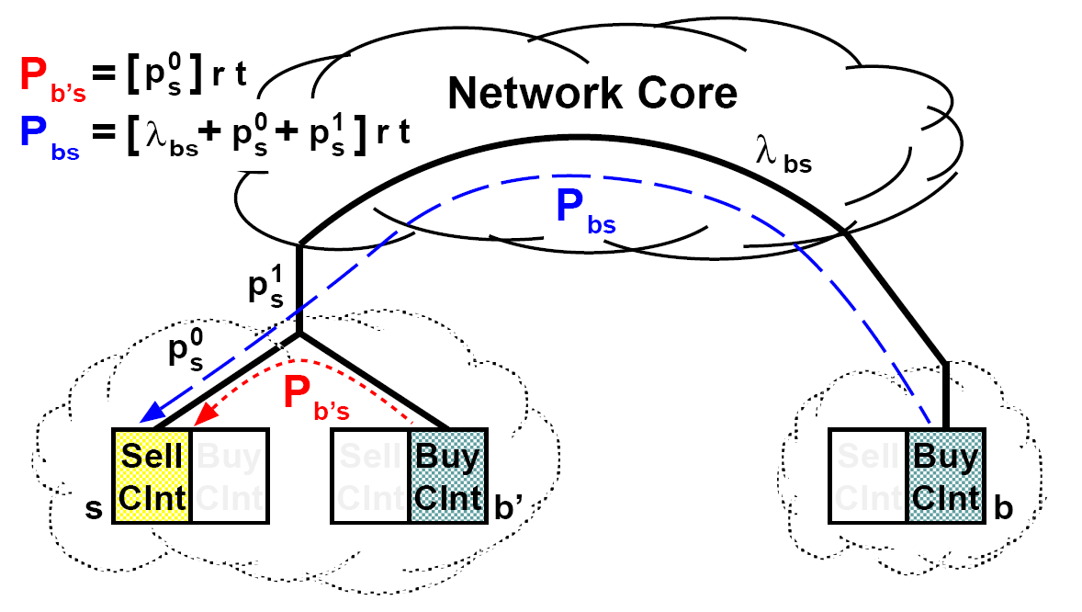
ISP friendly

Slide 17
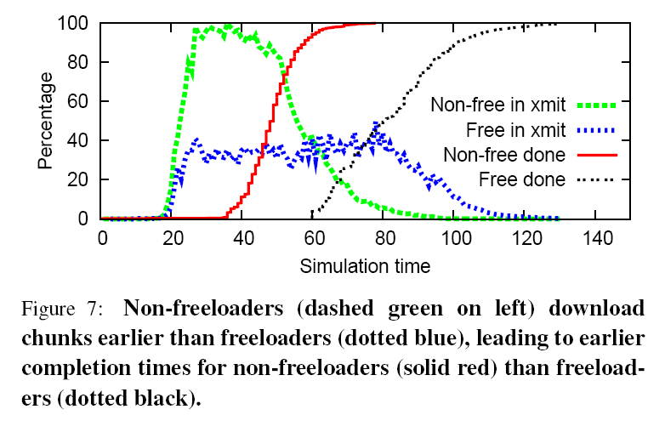
Selected simulation results

Slide 18
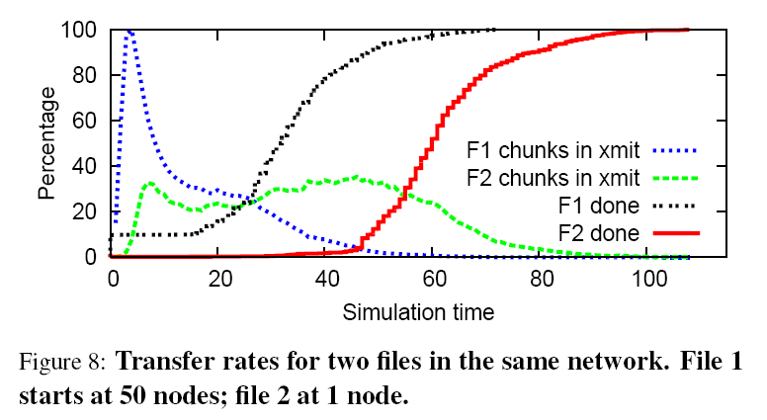

Slide 19
