Slide 1
Stochastic Network Optimization
(a 1-day short course)
λ
a
1
b
d
c
Michael J. Neely
University of Southern California
http://www-rcf.usc.edu/~mjneely/

Slide 2
Lectures based on the following text:
L. Georgiadis, M. J. Neely, L. Tassiulas, Resource Allocation
And Cross-Layer Control in Wireless Networks, Foundations
And Trends in Networking, vol. 1, no. 1, pp. 1-144, 2006.
Free PDF download of text on the following web pages:
http://www-rcf.usc.edu/~mjneely/
A hardcopy can be ordered for around $50 from NOW publishers:

Slide 3
A brief history of Lyapunov Drift for Queueing Systems:
Lyapunov Stability:
Tassiulas, Ephremides [91, 92, 93]
P. R. Kumar, S. Meyn [95]
McKeown, Anantharam, Walrand [96, 99]
Kahale, P. E. Wright [97]
Andrews, Kumaran, Ramanan, Stolyar, Whiting [2001]
Leonardi, Mellia, Neri, Marsan [2001]
Neely, Modiano, Rohrs [2002, 2003, 2005]
Joint Stability with Utility Optimization was the Big Open
Question until:
Tsibonis, Georgiadis, Tassiulas [infocom 2003] (special structure net,
linear utils)
Neely, Modiano [thesis 2003, infocom 2005] (general nets and utils)
Eryilmaz, Srikant [infocom 2005] (downlink, general utils)
Stolyar [Queueing Systems 2005] (general nets and utils)

Slide 4
Lyapunov drift for joint stability and performance
optimization:
Neely, Modiano [2003, 2005] (Fairness, Energy)
Georgiadis, Neely, Tassiulas [NOW Publishers, F&T, 2006]
Neely [Infocom 2006, JSAC 2006] (“Super-fast” delay tradeoffs)
Alternate Approaches to Stoch. Performance Optimization:
Tsibonis, Georgiadis, Tassiulas [2003] (special structure net,
linear utils)
Eryilmaz, Srikant [2005] (Fluid Model Transformations)
Stolyar [2005] (Fluid Model Transformations)
Lee, Mazumdar, Shroff [2005] (Stochastic Gradients)
Lin, Shroff [2004] (Scheduling for static channels)

Slide 5
Lyapunov drift for joint stability and performance
optimization:
Neely, Modiano [2003, 2005] (Fairness, Energy)
Georgiadis, Neely, Tassiulas [NOW Publishers, F&T, 2006]
Neely [Infocom 2006, JSAC 2006] (“Super-fast” delay tradeoffs)
Alternate Approaches to Stoch. Performance Optimization:
Tsibonis, Georgiadis, Tassiulas [2003] (special structure net,
linear utils)
Eryilmaz, Srikant [2005] (Fluid Model Transformations)
Stolyar [2005] (Fluid Model Transformations)
Lee, Mazumdar, Shroff [2005] (Stochastic Gradients)
Lin, Shroff [2004] (Scheduling for static channels)
Yields Explicit Delay Tradeoff Results!

Slide 6
Network Model --- The General Picture
λ_{ij}
Flow Control
Decision Rij(t)
own
other
3 Layers:
Flow Control (Transport)
Routing (Network)
Resource Alloc./Sched. (MAC/PHY)
*From: Resource Allocation and Cross-Layer Control in Wireless Networks by
Georgiadis, Neely, Tassiulas, NOW Foundations and Trends in Networking, 2006

Slide 7
Network Model --- The General Picture
own
other
3 Layers:
Flow Control (Transport)
Routing (Network)
Resource Alloc./Sched. (MAC/PHY)
*From: Resource Allocation and Cross-Layer Control in Wireless Networks by
Georgiadis, Neely, Tassiulas, NOW Foundations and Trends in Networking, 2006

Slide 8
Network Model --- The General Picture
own
other
“Data Pumping Capabilities”:
(μ_{ij}(t)) = C(I(t), S(t))
Control Action
(Resource
Allocation/Power)
Channel
State
Matrix
3 Layers:
Flow Control (Transport)
Routing (Network)
Resource Alloc./Sched. (MAC/PHY)
I(t) I
*From: Resource Allocation and Cross-Layer Control in Wireless Networks by
Georgiadis, Neely, Tassiulas, NOW Foundations and Trends in Networking, 2006

Slide 9
DIVBAR for Mobile Networks
= Stationary Node
= Locally Mobile Node
= Fully Mobile Node
= Sink

Slide 10
DIVBAR for Mobile Networks
= Stationary Node
= Locally Mobile Node
= Fully Mobile Node
= Sink

Slide 11
DIVBAR for Mobile Networks
= Stationary Node
= Locally Mobile Node
= Fully Mobile Node
= Sink

Slide 12
DIVBAR for Mobile Networks
= Stationary Node
= Locally Mobile Node
= Fully Mobile Node
= Sink

Slide 13
DIVBAR for Mobile Networks
= Stationary Node
= Locally Mobile Node
= Fully Mobile Node
= Sink

Slide 14
DIVBAR for Mobile Networks
= Stationary Node
= Locally Mobile Node
= Fully Mobile Node
= Sink

Slide 15
DIVBAR for Mobile Networks
= Stationary Node
= Locally Mobile Node
= Fully Mobile Node
= Sink

Slide 16
DIVBAR for Mobile Networks
= Stationary Node
= Locally Mobile Node
= Fully Mobile Node
= Sink

Slide 17
DIVBAR for Mobile Networks
= Stationary Node
= Locally Mobile Node
= Fully Mobile Node
= Sink

Slide 18
DIVBAR for Mobile Networks
= Stationary Node
= Locally Mobile Node
= Fully Mobile Node
= Sink

Slide 19
DIVBAR for Mobile Networks
= Stationary Node
= Locally Mobile Node
= Fully Mobile Node
= Sink

Slide 20
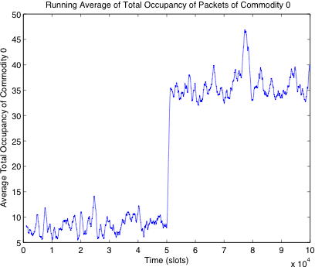
Application 3: Mesh Networks
Communiation Pairs: 0 1, 2 3, … , 8 9
Halfway through the simulation, node 0 moves (non-ergodically)
from its initial location to its final location. Node 9 takes a Markov
Random walk.
0
1
2
8
7
4
6
3
5
9
Full throughput is maintained throughout, with noticeable delay
increase (at “new equilibrium”), but which is independent of mobility
timescales.

Slide 21
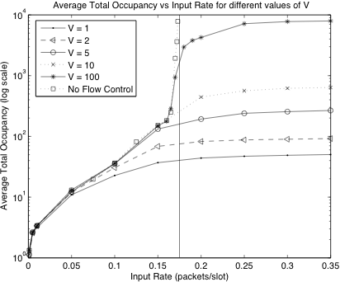
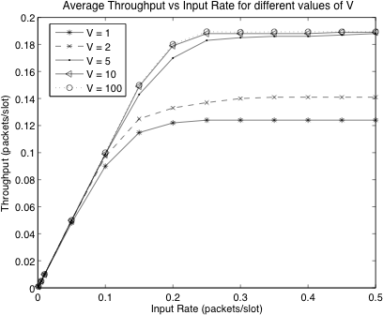
More simulation results for the mesh network:
Flow control included (determined by parameter V)

Slide 22
Course Outline:
Intro and Motivation (done)
Magic of Telescoping Sums
Discrete Time Queues
4. Stability and Capacity Regions
5. Lyapunov Drift
Max-Weight Algorithms for Stability
(imperfect scheduling, robust to non-ergodic traffic)
(downlinks, backpressure, multi-hop, mobile)
Lyapunov Drift with Performance Optimization
8. Energy Problems
Virtual Queues and Power Constraints
General Constrained Optimization
11. Other Utilities: Flow control and Fairness
12. Modern Network Models

Slide 23
A (very un-impressive) “Magic Trick”:
5
12
1
11
-3
8
9
7
?

Slide 24
A (very un-impressive) “Magic Trick”:
5
12 - 5 = 7
12
1
11
-3
8
9
7
?

Slide 25
A (very un-impressive) “Magic Trick”:
5
12 - 5 = 7
11 - 12 = -1
12
1
11
-3
8
9
7
?

Slide 26
A (very un-impressive) “Magic Trick”:
5
12 - 5 = 7
11 - 12 = -1
8 - 11 = -3
12
1
11
-3
8
9
7
?

Slide 27
A (very un-impressive) “Magic Trick”:
5
12 - 5 = 7
11 - 12 = -1
- 11 = -3
? - 8 = ??
12
1
11
-3
8
9
7
?

Slide 28
A (very un-impressive) “Magic Trick”:
5
12 - 5 = 7
11 - 12 = -1
- 11 = -3
? - 8 = ??
7 - ? = ??
12
1
11
-3
8
9
7
?

Slide 29
A (very un-impressive) “Magic Trick”:
5
12 - 5 = 7
11 - 12 = -1
- 11 = -3
? - 8 = ??
- ? = ??
9 - 7 = 2
12
1
11
-3
8
9
7
?

Slide 30
A (very un-impressive) “Magic Trick”:
5
12 - 5 = 7
11 - 12 = -1
- 11 = -3
? - 8 = ??
- ? = ??
- 7 = 2
-3 - 9 = -12
12
1
11
-3
8
9
7
?

Slide 31
A (very un-impressive) “Magic Trick”:
5
12 - 5 = 7
11 - 12 = -1
- 11 = -3
? - 8 = ??
- ? = ??
- 7 = 2
-3 - 9 = -12
1 - (-3) = 4
12
1
11
-3
8
9
7
?

Slide 32
A (very un-impressive) “Magic Trick”:
5
12 - 5 = 7
11 - 12 = -1
- 11 = -3
? - 8 = ??
- ? = ??
- 7 = 2
-3 - 9 = -12
1 - (-3) = 4
5 - 1 = 4
12
1
11
-3
8
9
7
?

Slide 33
A (very un-impressive) “Magic Trick”:
5
12 - 5 = 7
11 - 12 = -1
- 11 = -3
? - 8 = ??
- ? = ??
- 7 = 2
-3 - 9 = -12
1 - (-3) = 4
5 - 1 = 4
12
1
11
-3
8
9
7
?

Slide 34
A (very un-impressive) “Magic Trick”:
5
12 - 5 = 7
11 - 12 = -1
- 11 = -3
2 - 8 = -6
- 2 = 5
- 7 = 2
-3 - 9 = -12
1 - (-3) = 4
5 - 1 = 4
0
12
1
11
-3
Zero!
8
9
7
?=2

Slide 35
A (very un-impressive) “Magic Trick”:
5
12 - 5 = 7
11 - 12 = -1
- 11 = -3
2 - 8 = -6
- 2 = 5
- 7 = 2
-3 - 9 = -12
1 - (-3) = 4
5 - 1 = 4
0
12
1
11
-3
Zero!
8
9
7
?=2

Slide 36
A (very un-impressive) “Magic Trick”:
5
12 - 5 = 7
11 - 12 = -1
- 11 = -3
2 - 8 = -6
- 2 = 5
- 7 = 2
-3 - 9 = -12
1 - (-3) = 4
5 - 1 = 4
0
12
1
11
-3
Zero!
8
9
7
?=2

Slide 37
A (very un-impressive) “Magic Trick”:
5
12 - 5 = 7
11 - 12 = -1
- 11 = -3
2 - 8 = -6
- 2 = 5
- 7 = 2
-3 - 9 = -12
1 - (-3) = 4
5 - 1 = 4
0
12
1
11
-3
Zero!
8
9
7
?=2

Slide 38
A (very un-impressive) “Magic Trick”:
5
12 - 5 = 7
11 - 12 = -1
- 11 = -3
2 - 8 = -6
- 2 = 5
- 7 = 2
-3 - 9 = -12
1 - (-3) = 4
5 - 1 = 4
0
12
1
11
-3
Zero!
8
9
7
?=2

Slide 39
Fact (Telescoping Sums):
Let t {0, 1, 2, 3, …}
Let f(t) be any function of discrete time t
Define: Δ(t) = f(t+1) - f(t) (difference)
Then: Δ(τ) = f(M) - f(0)
M-1
τ=0
f(1)-f(0) + f(2)-f(1) + f(3)-f(2)+…
Δ(0)
Δ(1)
Δ(2)
Δ(Μ−2)
Δ(Μ−1)
0
1
2
3
M-2
M-1
M

Slide 40
A single discrete time queue:
U(t)
A(t)
μ(t)
Discrete time t = {0, 1, 2, …}
U(t) = Queue Backlog (“Unfinished Work”)
at time t [units = “bits,” real number]
A(t) = Arrivals during slot t
μ(t) = Transmission rate on slot t (bits/slot)

Slide 41
A single discrete time queue:
U(t)
A(t)
μ(t)
Discrete time t = {0, 1, 2, …}
U(t) = Queue Backlog (“Unfinished Work”)
at time t [units = “bits,” real number]
A(t) = Arrivals during slot t
μ(t) = Transmission rate on slot t (bits/slot)
*Alternate Units: U(t) = packets (integer), μ(t) = packets/slot

Slide 42
A single discrete time queue:
U(t)
A(t)
μ(t)
Dynamic Equation:
U(t+1) = max[U(t) - μ(t), 0] + A(t)

Slide 43
A single discrete time queue:
U(t)
A(t)
μ(t)
Dynamic Equation:
U(t+1) = max[U(t) - μ(t), 0] + A(t)
<OR>
U(t+1) = U(t) - μ(t) + A(t)

Slide 44
A single discrete time queue:
U(t)
A(t)
μ(t)
Dynamic Equation:
U(t+1) = max[U(t) - μ(t), 0] + A(t)
<OR>
U(t+1) = U(t) - μ(t) + A(t)
(where μ(t) = ?? )

Slide 45
A single discrete time queue:
U(t)
A(t)
μ(t)
Dynamic Equation:
U(t+1) = max[U(t) - μ(t), 0] + A(t)
<OR>
U(t+1) = U(t) - μ(t) + A(t)
(where μ(t) = min[μ(t) , U(t)] )

Slide 46
U(t)
A(t)
μ(t)
U(t+1) = U(t) - μ(t) + A(t)
U(t+1) - U(t) = A(t) - μ(t)
=>
(*)
Basic Sample Path Equality (t₁ < t₂):
t₂-1
t₂-1
U(t₂) - U(t₁) = A(τ) - μ(τ)
τ=t₁
τ=t₁
Proof: Use equation (*) with the telescoping sums fact.

Slide 47
A(t)
μ(t)
U(t)
Important Sample Path Equality and Inequalities:
t₂-1
t₂-1
U(t₂) - U(t₁) = A(τ) - μ(τ)
τ=t₁
τ=t₁
t₂-1
t₂-1
>
=>
U(t₂) - U(t₁) A(τ) - μ(τ)
τ=t₁
τ=t₁
t-1
t-1
>
=>
U(t) A(τ) - μ(τ)
(if U(0) = 0)
τ=0
τ=0

Slide 48
A(t)
μ(t)
U(t)
A(t), μ(t) are Discrete time Stochastic Processes
(t = {0, 1, 2, …})
Queue Stability:
A discrete time queue U(t) is strongly stable
if:
t-1
1
lim sup
E{U(τ)}
<
t
t
τ=0

Slide 49
A(t)
μ(t)
U(t)
A(t), μ(t) are Discrete time Stochastic Processes
(t = {0, 1, 2, …})
call this “stability” for simplicity
Queue Stability:
A discrete time queue U(t) is strongly stable
if:
t-1
1
lim sup
E{U(τ)}
<
t
t
τ=0
Define this as U

Slide 50
A(t)
μ(t)
U(t)
Theorem: If μ(t) < μ_{max} for all t, and if U(t)
is strongly stable, then:
lim
E{U(t)}
= 0
t
t
Proof: See Appendix D of:
M. J. Neely, “Energy Optimal Control for Time
Varying Wireless Networks,” IEEE Transactions
on Information Theory, vol. 52, no. 7, July 2006.

Slide 51
A(t)
μ(t)
U(t)
Corollary: Suppose μ(t) < μ_{max} for all t, and:
t-1
(1)
lim
1
E{μ(τ)} = μ_{av}
t
t
τ=0
t-1
(2)
lim
1
E{Α(τ)} = λ
t
t
τ=0
Then if U(t) is strongly stable, we must have:
>
μ_{av}
Necessary Condition
for Stability (intuitive)
λ

Slide 52
A(t)
μ(t)
U(t)
Proof: We know that (assuming U(0)=0):
t-1
t-1
>
U(t) A(τ) - μ(τ)
τ=0
τ=0
-Take Expectations…

Slide 53
A(t)
μ(t)
U(t)
Proof: We know that (assuming U(0)=0):
t-1
t-1
>
E{U(t)} E{A(τ)} - E{μ(τ)}
τ=0
τ=0
-Take Expectations
-Divide by t…

Slide 54
A(t)
μ(t)
U(t)
Proof: We know that (assuming U(0)=0):
t-1
t-1
E{U(t)}
t
1
1
>
E{A(τ)} - E{μ(τ)}
t
t
τ=0
τ=0
-Take Expectations
-Divide by t
-Take limits…

Slide 55
A(t)
μ(t)
U(t)
Proof: We know that (assuming U(0)=0):
t-1
t-1
E{U(t)}
t
1
1
>
E{A(τ)} - E{μ(τ)}
t
t
τ=0
τ=0
>
0 λ - μ_{av}
-Take Expectations
-Divide by t
-Take limits

Slide 56
A(t)
μ(t)
U(t)
*Corollary (Alternate form):
Suppose μ(t) < μ_{max} for all t. Then if U(t) is
strongly stable, we must have:
t-1
lim inf
1
>
E{μ(τ) - A(τ)} 0
t
t
τ=0
*Holds in cases when time averages of A(t) and/or μ(t)
do not necessarily exist. Proof = similar (exercise).

Slide 57
Thus (assuming λ, μ_{av} are defined):
>
μ_{av}
is a necessary condition for stability.
λ
A(t) ~ λ
μ(t) ~ μ_{av}
U(t)
We want a sufficient condition for stability
(need more structure on A(t), μ(t)…)

Slide 58
Arrival Process A(t) is admissible with rate λ if:
1
t-1
lim
E{A(t)} = λ
t
t
τ=0
2
E{A(t)² | H(t)} A_{max}
>
(some A_{max} < )
For any δ>0, there is a T such that for any t₀:
T-1
E{ } λ + δ
1
A(t₀+τ) | H(t₀)
>
T
τ=0
t
H(t) = Past History up to time t

Slide 59
Server Process μ(t) is admissible with rate μ if:
1
t-1
lim
E{μ(t)} = μ
t
t
τ=0
>
(some μ_{max} < )
μ(t) μ_{max} for all t
For any δ>0, there is a T such that for any t₀:
T-1
E{ } μ − δ
1
A(t₀+τ) | H(t₀)
>
T
τ=0
t
H(t) = Past History up to time t

Slide 60
Fact: iid probabilistic splitting (with probability p)
of an admissible process A(t) with rate λ yields
an admissible process of rate pλ.
A(t) ~ λ
A_{split}(t) ~ pλ
p
1-p
A_{split}(t) = A(t) with
prob p, 0 else.
Proof: Simple Exercise

Slide 61
A(t)
μ(t)
U(t)
Theorem (Queue Stability): Suppose that
A(t) is admissible with rate λ
μ(t) is admissible with rate μ
Then:
>
(a) λ μ is necessary for stability of U(t)
(b) λ < μ is sufficient for stability of U(t)

Slide 62
A(t)
μ(t)
U(t)
Theorem (Queue Stability): Suppose that
A(t) is admissible with rate λ
μ(t) is admissible with rate μ
Then:
>
(a) λ μ is necessary for stability of U(t)
(b) λ < μ is sufficient for stability of U(t)
[Proof of (b): T-slot Lyapunov drift, Lemma 4.4 of text]

Slide 63
Definition: A network of queues is
strongly stable if all individual queues
are strongly stable.

Slide 64
A simple routing problem for two queues:
U₁(t)
μ₁
A(t)
(admissible,
rate λ)
U₂(t)
μ₂
Rules:
(1) Every slot t, must put all new A(t) arrivals
of that slot to either queue 1 or queue 2.
(2) Must make decision immediately (no
data storage at the decision point).

Slide 65
A simple routing problem for two queues:
U₁(t)
μ₁
A(t)
(admissible,
rate λ)
U₂(t)
μ₂
Definition: The Capacity Region Λ is the
closure of the set of all rates λ for which
a stabilizing routing algorithm exists
(subject to the given rules).

Slide 66
A simple routing problem for two queues:
U₁(t)
μ₁
A(t)
(admissible,
rate λ)
U₂(t)
μ₂
>
>
Claim: Λ = {λ | 0 λ μ₁ + μ₂}
0
μ₁ + μ₂
λ

Slide 67
A simple routing problem for two queues:
U₁(t)
μ₁
A(t)
(admissible,
rate λ)
U₂(t)
μ₂
>
>
Claim: Λ = {λ | 0 λ μ₁ + μ₂}
Must show 2 things:
(i)
λ < μ₁+ μ₁ sufficient
(ii)
λ < μ₁+ μ₁ necessary
0
μ₁ + μ₂
λ

Slide 68
U₁(t)
μ₁
A(t)
(admissible,
rate λ)
U₂(t)
μ₂
Proof of Necessity: Under any routing algorithm
we must have (for all slots t):
t-1
>
U₁(t) + U₂(t)
A(τ) - (μ₁ + μ₂)t
τ=0
Take Expectations…

Slide 69
U₁(t)
μ₁
A(t)
(admissible,
rate λ)
U₂(t)
μ₂
Proof of Necessity: Under any routing algorithm
we must have (for all slots t):
t-1
>
E{U₁(t) + U₂(t)}
E{A(τ)} - (μ₁ + μ₂)t
τ=0
Take Expectations
Divide by t…

Slide 70
U₁(t)
μ₁
A(t)
(admissible,
rate λ)
U₂(t)
μ₂
Proof of Necessity: Under any routing algorithm
we must have (for all slots t):
t-1
>
1
E{U₁(t) + U₂(t)}
E{A(τ)} - (μ₁ + μ₂)
t
t
τ=0
Take Expectations
Divide by t
Take limits…

Slide 71
U₁(t)
μ₁
A(t)
(admissible,
rate λ)
U₂(t)
μ₂
Proof of Necessity: Under any routing algorithm
we must have (for all slots t):
t-1
>
1
E{U₁(t) + U₂(t)}
E{A(τ)} - (μ₁ + μ₂)
t
t
τ=0
>
lim
E{U₁(t) + U₂(t)}
λ - (μ₁ + μ₂)
t
t
Must be 0 if stable!

Slide 72
U₁(t)
μ₁
A(t)
(admissible,
rate λ)
U₂(t)
μ₂
Proof of Sufficiency: Suppose λ < μ₁ + μ₂.
Must construct a stabilizing routing policy.
Any ideas?

Slide 73
U₁(t)
μ₁
A(t)
(admissible,
rate λ)
U₂(t)
μ₂
Proof of Sufficiency: Suppose λ < μ₁ + μ₂.
Must construct a stabilizing routing policy.
Probabilistic (iid) splitting will suffice for this proof:
Every slot t:
-Put A(t) in queue 1 with probability μ₁ /(μ₁ + μ₂)
-Put A(t) in queue 2 with probability μ₂ /(μ₁ + μ₂)

Slide 74
λμ₁
U₁(t)
μ₁
(μ₁ + μ₂)
λ
λμ₂
U₂(t)
μ₂
(μ₁ + μ₂)
Proof of Sufficiency: Suppose λ < μ₁ + μ₂.
Must construct a stabilizing routing policy.
Probabilistic (iid) splitting will suffice for this proof:
Every slot t:
-Put A(t) in queue 1 with probability μ₁ /(μ₁ + μ₂)
-Put A(t) in queue 2 with probability μ₂ /(μ₁ + μ₂)
Then both queues are stable.

Slide 75
Other definitions of stability in the literature:
t-1
1
lim sup
E{U(τ)}
<
(strongly
stable)
t
t
τ=0
t-1
lim
1
lim sup
Pr[U(τ) > M] = 0
M
t
t
τ=0
lim
E{U(t)}
(mean rate
stable)
= 0
t
t

Slide 76
Sample path variations on definitions of stability:
t-1
1
lim sup
U(τ)
<
(w.p.1)
t
t
τ=0
t-1
lim
1
lim sup
1{U(τ) > M} = 0
M
t
t
τ=0
(w.p.1)
lim
U(t)
= 0
(w.p.1)
(rate stable)
t
t

Slide 77
Other definitions of stability in the literature:
t-1
1
lim sup
E{U(τ)}
<
(strongly
stable)
t
t
τ=0
t-1
lim
1
Pr[U(t) > M] = 0
lim sup
M
t
t
τ=0
lim
E{U(t)}
(mean rate
stable)
= 0
t
t
Note: All these definitions give the same capacity
region Λ for single and multi-queue networks!

Slide 78
A(t)
μ(t)
U(t)
Example of a “Bad” definition of stability:
(Bad) Definition: Suppose we say a queue U(t)
is stable if it empties infinitely often (so that
U(t)=0 for arbitrarily large t).
Corresponding Definition for Networks:
A network of queues is stable if all individual
queues are stable (according to the above
definition of stability).

Slide 79
U₁(t)
μ₁
A(t)
(admissible,
rate λ)
U₂(t)
μ₂
What is the capacity region Λ for the simple
2-queue routing problem under this (bad)
definition of stability? (where a queue
is stable if it empties infinitely often)
>
…Why?
Claim: Λ = {λ | 0 λ < }
0
μ₁ + μ₂
λ

Slide 80
U₁(t)
μ₁
A(t)
(admissible,
rate λ)
U₂(t)
μ₂
(bad def.) Stable = Empties Infinitely Often
Must find a routing algorithm that stabilizes
both queues for any finite λ.
>
…Why?
Claim: Λ = {λ | 0 λ < }
0
μ₁ + μ₂
λ

Slide 81
U₁(t)
μ₁
A(t)
(admissible,
rate λ)
U₂(t)
μ₂
(bad def.) Stable = Empties Infinitely Often
Route to queue 1 until queue 2 empties,
then switch, vice versa!
>
…Why?
Claim: Λ = {λ | 0 λ < }
0
μ₁ + μ₂
λ

Slide 82
Course Outline:
Intro and Motivation (done)
Magic of Telescoping Sums
Discrete Time Queues
4. Stability and Capacity Regions
5. Lyapunov Drift
Max-Weight Algorithms for Stability
(imperfect scheduling, robust to non-ergodic traffic)
(downlinks, backpressure, multi-hop, mobile)
Lyapunov Drift with Performance Optimization
8. Energy Problems
Virtual Queues and Power Constraints
General Constrained Optimization
11. Other Utilities: Flow control and Fairness
12. Modern Network Models

Slide 83
Lyapunov Drift for Multi-Queue Systems
Let U(t) = (U₁(t), U₂(t), …, U_{K}(t)) be a vector
of queue backlogs that evolve in discrete time
according to some probability law.
Let L(U(t)) be a non-negative function of U(t),
called a Lyapunov function.
U(t) = (U₁(t), …, U_{K}(t))

Slide 84
Lyapunov Drift for Multi-Queue Systems
For this course, we use quadratic Lyapunov
functions:
K
L(U(t)) =
2
U_{i}(t)
i=1
U(t) = (U₁(t), …, U_{K}(t))

Slide 85
Lyapunov Drift for Multi-Queue Systems
For this course, we use quadratic Lyapunov
functions:
K
L(U(t)) =
2
U_{i}(t)
i=1
Useful Properties:
L(0) = 0 iff
network empty
L(U) “large” implies
“network congested”
L(U) small implies
all queues small.
U₂
U₁

Slide 86
Lyapunov Drift for Multi-Queue Systems
For this course, we use quadratic Lyapunov
functions:
K
L(U(t)) =
2
U_{i}(t)
i=1
Definition: The 1-slot conditional
Lyapunov Drift Δ(U(t)) is defined:
Δ(U(t)) = E{L(U(t+1)) - L(U(t))| U(t)}
*[better notation: Δ(U(t), t) ]

Slide 87
Theorem (Lyapunov Drift for Stability):
Let L(U) be a non-negative function of U.
Suppose there are positive constants B, ε such
that for all t and all U(t):
K
Δ(U(t))
>
B - ε
U_{i}(t)
i=1
Then all queues are strongly stable, and:
t-1
K
B
lim sup
1
>
E{U_{i}(τ)}
t
ε
t
τ=0
i=1
denote this as:
K
U_{i}
i=1

Slide 88
K
Δ(U(t))
>
B - ε
U_{i}(t)
i=1
Intuition: If the above condition holds, then for
any δ>0, we have:
K
B+δ
Δ(U(t))
>
−δ
whenever
U_{i}(t)
>
ε
i=1
U₂
U₁ + U₂ =
B+δ
Negative drift region
ε
U₁

Slide 89
K
Δ(U(t))
>
B - ε
U_{i}(t)
i=1
Intuition: If the above condition holds, then for
any δ>0, we have:
K
B+δ
Δ(U(t))
>
−δ
whenever
U_{i}(t)
>
ε
i=1
U₂
U₁ + U₂ =
B+δ
Negative drift region
ε
U₁

Slide 90
K
Δ(U(t))
>
B - ε
U_{i}(t)
i=1
Intuition: If the above condition holds, then for
any δ>0, we have:
K
B+δ
Δ(U(t))
>
−δ
whenever
U_{i}(t)
>
ε
i=1
U₂
U₁ + U₂ =
B+δ
Negative drift region
ε
U₁

Slide 91
Δ(U(t)) = E{L(U(t+1)) - L(U(t))| U(t)}
K
Δ(U(t))
>
B - ε
U_{i}(t)
(*)
i=1
Proof (Lyapunov drift): Eq. (*) implies:
E{L(U(t+1)) - L(U(t))| U(t)}
K
>
B - ε
U_{i}(t)
i=1
Take Expectations of Both sides (iterated expect…)
(with respect to distribution of U(t),
use fact: E{E{X|Y}} = E{X})

Slide 92
Δ(U(t)) = E{L(U(t+1)) - L(U(t))| U(t)}
K
Δ(U(t))
>
B - ε
U_{i}(t)
(*)
i=1
Proof (Lyapunov drift): Eq. (*) implies:
E{L(U(t+1))} - E{L(U(t))}
K
>
B - ε
E{U_{i}(t)}
i=1
Take Expectations of Both sides (iterated expect.)
Use Magic of Telescoping Sums…
M-1
τ=0

Slide 93
Δ(U(t)) = E{L(U(t+1)) - L(U(t))| U(t)}
K
Δ(U(t))
>
B - ε
U_{i}(t)
(*)
i=1
Proof (Lyapunov drift): Eq. (*) implies:
E{L(U(M))} - E{L(U(0))}
M-1
K
>
MB - ε
E{U_{i}(t)}
τ=0
i=1
Take Expectations of Both sides (iterated expect.)
Use Magic of Telescoping Sums
Use non-negativity of L(U)…

Slide 94
Δ(U(t)) = E{L(U(t+1)) - L(U(t))| U(t)}
K
Δ(U(t))
>
B - ε
U_{i}(t)
(*)
i=1
Proof (Lyapunov drift): Eq. (*) implies:
- E{L(U(0))}
M-1
K
>
MB - ε
E{U_{i}(t)}
τ=0
i=1
Take Expectations of Both sides (iterated expect.)
Use Magic of Telescoping Sums
Use non-negativity of L(U) Divide by Mε…

Slide 95
Δ(U(t)) = E{L(U(t+1)) - L(U(t))| U(t)}
K
Δ(U(t))
>
B - ε
U_{i}(t)
(*)
i=1
Proof (Lyapunov drift): Eq. (*) implies:
- E{L(U(0))}
1
εM
1
M-1
K
>
B -
E{U_{i}(t)}
ε
M
τ=0
i=1
Take Expectations of Both sides (iterated expect.)
Use Magic of Telescoping Sums
Use non-negativity of L(U) Divide by Mε

Slide 96
Δ(U(t)) = E{L(U(t+1)) - L(U(t))| U(t)}
K
Δ(U(t))
>
B - ε
U_{i}(t)
(*)
i=1
Proof (Lyapunov drift): Eq. (*) implies:
- E{L(U(0))}
1
Rearrange
terms
εM
1
M-1
K
>
B -
E{U_{i}(t)}
ε
M
τ=0
i=1
Take Expectations of Both sides (iterated expect.)
Use Magic of Telescoping Sums
Use non-negativity of L(U) Divide by Mε

Slide 97
Δ(U(t)) = E{L(U(t+1)) - L(U(t))| U(t)}
K
Δ(U(t))
>
B - ε
U_{i}(t)
(*)
i=1
Proof (Lyapunov drift): Eq. (*) implies:
M-1
K
B
E{L(U(0))}
1
E{U_{i}(t)}
>
+
M
ε
εM
τ=0
i=1
B
K
>
U_{i}
ε
i=1
Take the limsup as t

Slide 98
Applications of the Lyapunov Drift Theorem:
A(t)
μ(t)
U(t)
Application 1: Prove the λ < μ sufficiency theorem:
λ < μ is sufficient for stability of U(t)
We’ll consider the special case when:
μ(t) i.i.d. over slots, E{μ(t)} = μ
A(t) i.i.d. over slots, E{Α(t)} = λ (where λ < μ)
Ε{Α(t)²} = Ε{Α²}
[General non-i.i.d. case proved in Lemma 4.4 of text]

Slide 99
Claim:
λ < μ U(t) is stable
=>
A(t)
μ(t)
U(t)
Proof (iid case): Define L(U(t)) = U(t)²
U(t+1) = max[U(t) - μ(t), 0] + A(t)
(*)
Useful fact: If queueing law (*) holds, then
>
U(t+1)² U(t)² + A(t)² + μ(t)²
- 2U(t)[μ(t) - A(t)]
Because (max[U - μ, 0])² <= (U-μ)²

Slide 100
Claim:
λ < μ U(t) is stable
=>
A(t)
μ(t)
U(t)
Proof (iid case): Define L(U(t)) = U(t)²
>
U(t+1)² U(t)² + A(t)² + μ(t)²
- 2U(t)[μ(t) - A(t)]
Take conditional expectations given U(t)…

Slide 101
Claim:
λ < μ U(t) is stable
=>
A(t)
μ(t)
U(t)
Proof (iid case): Define L(U(t)) = U(t)²
>
U(t+1)² U(t)² + A(t)² + μ(t)²
- 2U(t)[μ(t) - A(t)]
>
E{U(t+1)²|U(t)} U(t)² + E{A²} +E{μ²}
- 2U(t)[μ − λ]
Take conditional expectations given U(t)

Slide 102
Claim:
λ < μ U(t) is stable
=>
A(t)
μ(t)
U(t)
Proof (iid case): Define L(U(t)) = U(t)²
>
U(t+1)² U(t)² + A(t)² + μ(t)²
- 2U(t)[μ(t) - A(t)]
>
E{U(t+1)²|U(t)} U(t)² + E{A²} +E{μ²}
- 2U(t)[μ − λ]
>
=>
Δ(U(t)) E{A²} +E{μ²} - 2U(t)[μ − λ]

Slide 103
We have:
B
ε>0
>
Δ(U(t)) E{A²} +E{μ²} - U(t)2[μ − λ]
Recall Lyapunov Drift Theorem:
K
If:
Δ(U(t))
>
B - ε
U_{i}(t)
i=1
B
Then:
K
U_{i}
>
i=1
ε
E{A²} + E{μ²}
Thus:
U
>
2[μ − λ]
(iid A(t), μ(t))

Slide 104
E{A²} + E{μ²}
U
>
(iid case)
2[μ − λ]
U
λ
μ
E{A²} + E{μ²}
Little’s Theorem: W
>
2 λ[μ − λ]

Slide 105
>
E{A²} + E{μ²}
U
(iid case)
2[μ − λ]
Idea for general admissible A(t), μ(t) (non iid)
case:
Define the T-slot Lyapunov drift (T>0, integer):
Δ(U(t)) = E{L(U(t+T)) - L(U(t)) | U(t)}
Delay and backlog expression given in text (Lemma 4.4).
Roughly, backlog bound increased by an amount T proportional
to time required to reach “near steady state”

Slide 106
Application of Lyapunov drift to the simple
Routing Problem:
μ(t) i.i.d. over slots
U₁(t)
μ₁(t)
A(t)
i.i.d. rate λ
U₂(t)
μ₂ (t)
U_{K}(t)
μ_{Κ}(t)
Control Variables: Choose {A_{i}(t)} for each t so that:
A₁(t) + A₂(t) + … + A_{K}(t) = A(t) (routing constraint)

Slide 107
Application of Lyapunov drift to the simple
Routing Problem:
μ(t) i.i.d. over slots
U₁(t)
μ₁(t)
A(t)
i.i.d. rate λ
U₂(t)
μ₂ (t)
If λ interior to Λ:
For some ε>0, {p_{i}}:
λp_{i} + ε < μ_{i} (all i)
p₁+…+ p_{K} = 1
U_{K}(t)
μ_{Κ}(t)
Can easily show:
Capacity region = Λ = {λ | 0 < λ < μ₁ + … + μ_{K}}

Slide 108
μ₁(t)
U₁(t)
If λ interior to Λ:
For some ε>0, {p_{i}}:
λp_{i} + ε < μ_{i} (all i)
p₁+…+ p_{K} = 1
A(t)
μ₂ (t)
U₂(t)
μ_{Κ}(t)
U_{K}(t)
A₁(t) + A₂(t) + … + A_{K}(t) = A(t) (routing constraint)
By Fact , there exists a stationary randomized
routing policy A_{i}*(t) such that:
E{A_{i}*(t)} = λp_{i} < μ_{i} − ε
(Just Choose A_{i}*(t) = A(t) with prob p_{i}, A_{j}*(t) = 0 all other j )
However, let’s build a dynamic policy…

Slide 109
μ₁(t)
U₁(t)
If λ interior to Λ:
For some ε>0, {p_{i}}:
λp_{i} + ε < μ_{i} (all i)
p₁+…+ p_{K} = 1
A(t)
μ₂ (t)
U₂(t)
μ_{Κ}(t)
U_{K}(t)
Let’s build a dynamic policy via Lyapunov drift:
K
2
L(U(t))=
U_{i}(t) , Δ(U(t))= E{L(U(t+1))-L(U(t))|U(t)}
i=1
U_{i}(t+1) = max[U_{i}(t) - μ_{i}(t), 0] + A_{i}(t)
>
U_{i}(t+1)² U_{i}(t)² + A_{i}(t)² + μ_{i}(t)²
- 2U_{i}(t)[μ_{i}(t) - A_{i}(t)]
Sum over all i,
Take expectations…

Slide 110
μ₁(t)
U₁(t)
If λ interior to Λ:
For some ε>0, {p_{i}}:
λp_{i} + ε < μ_{i} (all i)
p₁+…+ p_{K} = 1
A(t)
μ₂ (t)
U₂(t)
μ_{Κ}(t)
U_{K}(t)
>
Δ(U(t)) E{A²}+E{μ₁²+…+ μ_{K}²}
- 2 U_{i}(t)E{μ_{i}(t) - A_{i}(t)|U(t)}
K
i=1
μ(t) i.i.d. over slots
E{μ_{i}(t)|U(t)} = μ_{i}

Slide 111
μ₁(t)
U₁(t)
If λ interior to Λ:
For some ε>0, {p_{i}}:
λp_{i} + ε < μ_{i} (all i)
p₁+…+ p_{K} = 1
A(t)
μ₂ (t)
U₂(t)
μ_{Κ}(t)
U_{K}(t)
>
Δ(U(t)) E{A²}+E{μ₁²+…+ μ_{K}²}
- 2 U_{i}(t)μ_{i} + 2E{ U_{i}(t)A_{i}(t)|U(t)}
K
K
i=1
i=1
DYNAMIC POLICY: Choose {A_{i}(t)} to minimize RHS.
K
Minimize: U_{i}(t)A_{i}(t)
i=1
Subject to: A₁(t) + A₂(t) + … + A_{K}(t) = A(t)

Slide 112
Fact: Let f(X, I) be a function of a random
variable X and a control decision I (where I I).
We want to choose I such that:
E{f(X, I)} is minimized.
We can observe the random X before
choosing I I . Then the minimizing policy
is to choose I*_{X} I that minimizes f(X, I).
Proof: We know f(X, I*_{X}) >= f(X, I),
thus: E{f(X, I*_{X})} >= E{f(X, I)}

Slide 113
μ₁(t)
U₁(t)
If λ interior to Λ:
For some ε>0, {p_{i}}:
λp_{i} + ε < μ_{i} (all i)
p₁+…+ p_{K} = 1
A(t)
μ₂ (t)
U₂(t)
μ_{Κ}(t)
U_{K}(t)
>
Δ(U(t)) E{A²}+E{μ₁²+…+ μ_{K}²}
- 2 U_{i}(t)μ_{i} + 2E{ U_{i}(t)A_{i}(t)|U(t)}
K
K
i=1
i=1
DYNAMIC POLICY: Choose {A_{i}(t)} to minimize RHS.
K
Join-the-
Shortest Queue!
(JSQ)
Minimize: U_{i}(t)A_{i}(t)
i=1
Subj. to: A₁(t) + A₂(t) + … + A_{K}(t) = A(t)

Slide 114
μ₁(t)
U₁(t)
If λ interior to Λ:
For some ε>0, {p_{i}}:
λp_{i} + ε < μ_{i} (all i)
p₁+…+ p_{K} = 1
A(t)
μ₂ (t)
U₂(t)
μ_{Κ}(t)
U_{K}(t)
JSQ
>
Δ (U(t)) E{A²}+E{μ₁²+…+ μ_{K}²}
- 2 U_{i}(t)μ_{i} + 2E{ U_{i}(t)A_{i} (t)|U(t)}
K
K
JSQ
i=1
i=1
Given current queue backlog, JSQ minimizes the
RHS over all alternative routing decisions that can
be implemented on slot t! (Let A_{i}*(t) be any other…)

Slide 115
μ₁(t)
U₁(t)
If λ interior to Λ:
For some ε>0, {p_{i}}:
λp_{i} + ε < μ_{i} (all i)
p₁+…+ p_{K} = 1
A(t)
μ₂ (t)
U₂(t)
μ_{Κ}(t)
U_{K}(t)
JSQ
>
Δ (U(t)) E{A²}+E{μ₁²+…+ μ_{K}²}
- 2 U_{i}(t)μ_{i} + 2E{ U_{i}(t)A_{i} (t)|U(t)}
K
K
*
i=1
i=1
Given current queue backlog, JSQ minimizes the
RHS over all alternative routing decisions that can
be implemented on slot t! (Let A_{i}*(t) be any other…)

Slide 116
μ₁(t)
U₁(t)
If λ interior to Λ:
For some ε>0, {p_{i}}:
λp_{i} + ε < μ_{i} (all i)
p₁+…+ p_{K} = 1
A(t)
μ₂ (t)
U₂(t)
μ_{Κ}(t)
U_{K}(t)
JSQ
>
Δ (U(t)) E{A²}+E{μ₁²+…+ μ_{K}²}
- 2 U_{i}(t)μ_{i} + 2 U_{i}(t)E{A_{i} (t)|U(t)}
K
K
*
i=1
i=1
Given current queue backlog, JSQ minimizes the
RHS over all alternative routing decisions that can
be implemented on slot t! (Let A_{i}*(t) be any other…)

Slide 117
μ₁(t)
U₁(t)
If λ interior to Λ:
For some ε>0, {p_{i}}:
λp_{i} + ε < μ_{i} (all i)
p₁+…+ p_{K} = 1
A(t)
μ₂ (t)
U₂(t)
μ_{Κ}(t)
U_{K}(t)
JSQ
>
Δ (U(t)) E{A²}+E{μ₁²+…+ μ_{K}²}
- 2 U_{i}(t)μ_{i} + 2 U_{i}(t)E{A_{i} (t)|U(t)}
K
K
*
i=1
i=1
Recall: By Fact , there exists a stationary
randomized routing policy A_{i}*(t) such that:
E{A_{i}*(t)} = λp_{i} < μ_{i} − ε

Slide 118
μ₁(t)
U₁(t)
If λ interior to Λ:
For some ε>0, {p_{i}}:
λp_{i} + ε < μ_{i} (all i)
p₁+…+ p_{K} = 1
A(t)
μ₂ (t)
U₂(t)
μ_{Κ}(t)
U_{K}(t)
JSQ
>
Δ (U(t)) E{A²}+E{μ₁²+…+ μ_{K}²}
- 2 U_{i}(t)μ_{i} + 2 U_{i}(t)E{A_{i} (t)|U(t)}
K
K
*
i=1
i=1
Recall: By Fact , there exists a stationary
randomized routing policy A_{i}*(t) such that:
*
E{A_{i}*(t)} = λp_{i} < μ_{i} − ε
E{A_{i} (t)|U(t)}=
Independent of queue backlog!

Slide 119
μ₁(t)
U₁(t)
If λ interior to Λ:
For some ε>0, {p_{i}}:
λp_{i} + ε < μ_{i} (all i)
p₁+…+ p_{K} = 1
A(t)
μ₂ (t)
U₂(t)
μ_{Κ}(t)
U_{K}(t)
JSQ
>
Δ (U(t)) E{A²}+E{μ₁²+…+ μ_{K}²}
- 2 U_{i}(t)μ_{i} + 2 U_{i}(t)(μ_{i} − ε)
K
K
i=1
i=1
Recall: By Fact , there exists a stationary
randomized routing policy A_{i}*(t) such that:
*
E{A_{i}*(t)} = λp_{i} < μ_{i} − ε
E{A_{i} (t)|U(t)}=
Independent of queue backlog!

Slide 120
μ₁(t)
U₁(t)
If λ interior to Λ:
For some ε>0, {p_{i}}:
λp_{i} + ε < μ_{i} (all i)
p₁+…+ p_{K} = 1
A(t)
μ₂ (t)
U₂(t)
μ_{Κ}(t)
U_{K}(t)
JSQ
>
Δ (U(t)) E{A²}+E{μ₁²+…+ μ_{K}²}
- 2 U_{i}(t)μ_{i} + 2 U_{i}(t)(μ_{i} − ε)
K
K
i=1
i=1
Recall: By Fact , there exists a stationary
randomized routing policy A_{i}*(t) such that:
*
E{A_{i}*(t)} = λp_{i} < μ_{i} − ε
E{A_{i} (t)|U(t)}=
Independent of queue backlog!

Slide 121
μ₁(t)
U₁(t)
If λ interior to Λ:
For some ε>0, {p_{i}}:
λp_{i} + ε < μ_{i} (all i)
p₁+…+ p_{K} = 1
A(t)
μ₂ (t)
U₂(t)
μ_{Κ}(t)
U_{K}(t)
JSQ
>
Δ (U(t)) E{A²}+E{μ₁²+…+ μ_{K}²}
- 2 ε U_{i}(t)
K
i=1
By Lyapunov drift theorem…
E{A²}+E{μ₁²+…+ μ_{K}²}
K
>
=>
U_{i}
i=1
2ε

Slide 122
An extended routing problem:
μ₁(t)
U₁(t)
A₁(t)
μ₂ (t)
U₂(t)
A₂(t)
μ_{j}(t)
μ_{j+1}(t)
U_{j+1}(t)
μ_{j+2} (t)
A_{S}(t)
U_{j+2}(t)
μ_{Κ}(t)
U_{K}(t)

Slide 123
μ₁(t)
A₁(t)
μ₂ (t)
A₂(t)
μ_{j}(t)
μ_{j+1}(t)
μ_{j+2} (t)
A_{S}(t)
μ_{Κ}(t)
Capacity Region Λ
(lots of linear constraints)
ε
ε

Slide 124
U_{i}(t+1) = max[U_{i}(t) - μ_{i}(t), 0] + A_{si}(t)
s
Exercise: Show…
K
>
Δ(U(t)) B - 2 U_{i}(t)μ_{i}
i=1
K
+ E{ U_{i}(t) A_{si}(t) | U(t)}
s
i=1
Minimize RHS: Individual JSQ! (decoupled by user)
Prove thruput-optimality by showing it performs better than any stationary-randomized (queue independent) algorithm A_{si}*(t).

Slide 125
U_{i}(t+1) = max[U_{i}(t) - μ_{i}(t), 0] + A_{si}(t)
s
Exercise: Show…
K
>
Δ(U(t)) B - 2 U_{i}(t)μ_{i}
i=1
K
+ E{ U_{i}(t) A_{si}(t) | U(t)}
s
i=1
Minimize RHS: Individual JSQ!
Alternative alg: E{ A_{si}*(t)} = μ_{i} - ε
s

Slide 126
U_{i}(t+1) = max[U_{i}(t) - μ_{i}(t), 0] + A_{si}(t)
s
Exercise: Show…
K
>
Δ(U(t)) B - 2 U_{i}(t)μ_{i}
i=1
K
+ 2 U_{i}(t)(μ_{i} - ε )
i=1
Minimize RHS: Individual JSQ!
Alternative alg: E{ A_{si}*(t)} = μ_{i} - ε
s

Slide 127
μ₁(t)
A₁(t)
μ₂ (t)
A₂(t)
μ_{j}(t)
μ_{j+1}(t)
μ_{j+2} (t)
A_{S}(t)
μ_{Κ}(t)
(1) The Stationary Randomized Alg:
Advantages:
-No Queue Backlog
Needed
Disavantages:
-Need to know statistics
-Pre-compute rate splits
-Centralized
-Cannot adapt

Slide 128
μ₁(t)
A₁(t)
μ₂ (t)
A₂(t)
μ_{j}(t)
μ_{j+1}(t)
μ_{j+2} (t)
A_{S}(t)
μ_{Κ}(t)
(1) The Dynamic (Drift Minimizing) Alg:
Advantages:
-No a-priori rate splits
-No knowledge of statistics
-Decentralized
-Adapts easily to changes
-Better Delay
Disadvantages:
Queue Backlog needed
every slot

Slide 129
μ₁(t)
A₁(t)
μ₂ (t)
A₂(t)
μ_{j}(t)
μ_{j+1}(t)
μ_{j+2} (t)
A_{S}(t)
μ_{Κ}(t)
(1) The Dynamic (Drift Minimizing) Alg:
Advantages:
-No a-priori rate splits
-No knowledge of statistics
-Decentralized
-Adapts easily to changes
-Better Delay
Disadvantages:
-Queue Backlog needed
every slot

Slide 130
Robust to Non-Ergodic Traffic Variation:
Arrivals i.i.d. E{A(t)} = λ(t), but λ(t) changes
arbitrarily every slot
ε
ε
λ(t)

Slide 131
Robust to Non-Ergodic Traffic Variation:
Arrivals i.i.d. E{A(t)} = λ(t), but λ(t) changes
arbitrarily every slot
K
K
>
+ E{ U_{i}(t)A_{si}*(t)}
Δ(U(t)) B- 2 U_{i}(t)μ_{i}
i=1
s
i=1
(μ_{i} - ε )
regardless of t
ε
ε
λ(t)

Slide 132
Robust to Non-Ergodic Traffic Variation:
Arrivals i.i.d. E{A(t)} = λ(t), but λ(t) changes
arbitrarily every slot
K
K
>
+ E{ U_{i}(t)A_{si}*(t)}
Δ(U(t)) B- 2 U_{i}(t)μ_{i}
i=1
s
i=1
(μ_{i} - ε )
regardless of t
ε
ε
λ(t)

Slide 133
Robust to Non-Ergodic Traffic Variation:
Arrivals i.i.d. E{A(t)} = λ(t), but λ(t) changes
arbitrarily every slot
K
K
>
+ E{ U_{i}(t)A_{si}*(t)}
Δ(U(t)) B- 2 U_{i}(t)μ_{i}
i=1
s
i=1
(μ_{i} - ε )
regardless of t
ε
ε
λ(t)

Slide 134
Robust to Non-Ergodic Traffic Variation:
Arrivals i.i.d. E{A(t)} = λ(t), but λ(t) changes
arbitrarily every slot
K
K
>
+ E{ U_{i}(t)A_{si}*(t)}
Δ(U(t)) B- 2 U_{i}(t)μ_{i}
i=1
s
i=1
(μ_{i} - ε )
regardless of t
ε
ε
λ(t)

Slide 135
μ₁(t)
A₁(t)
μ₂ (t)
A₂(t)
μ_{j}(t)
μ_{j+1}(t)
μ_{j+2} (t)
A_{S}(t)
μ_{Κ}(t)
(1) The Dynamic (Drift Minimizing) Alg:
Advantages:
-No a-priori rate splits
-No knowledge of statistics
-Decentralized
-Adapts easily to changes
-Better Delay
Disadvantages:
-Queue Backlog needed
every slot
Not Necessary!

Slide 136
Let U_{si}(t) be the source s estimate of queue
backlog U_{i}(t).
Assume: |U_{si}(t) - U_{i}(t)| < σ
K
K
JSQ
>
A_{si}(t)U_{si}(t) A_{si}(t)U_{si}(t)
s
i=1
s
i=1
K
JSQ
>
A_{si}(t)U_{si}(t)
+ σ A_{tot}(t)
s
i=1
Thus…

Slide 137
K
K
JSQ
>
A_{si}(t)U_{si}(t)
A_{si}(t)U_{si}(t)
+ σ A_{tot}(t)
s
i=1
s
i=1
K
>
=>
Δ(U(t)) B + σλ_{tot} - 2 U_{i}(t)μ_{i}
i=1
K
+ 2 U_{i}(t)(μ_{i} - ε )
i=1
Thus: Backlog estimates do not affect throughput.
Only Increase delay according to σλ_{tot}

Slide 138
Method for General Stability Problems with
Lyapunov Drift:
Define L(U) = U_{i}²
Compute Lyap Drift: Δ(U(t)) B + RHS
Design Alg. To minimize RHS
Show RHS RHS*
(where RHS* corresponds to a stationary randomized
algorithm over which stability can be achieved)
i
>
>

Slide 139
Properties of the Resulting Min Drift Algorithm
(for general networks):
>
+ σ
Δ(U(t)) B + RHS
Also stabilizes for non-i.i.d. traffic/channels/mobility.
Robust to Changes in System Statistics (non-ergodic)
Can use out-of-date queue backlog info (delay tradeoff…)
Also: “Imperfect Scheduling” for γRHS solutions,
get within factor γ of the capacity region.
Proof of these 4 properties, see: M. J. Neely, “Dynamic Power Allocation
And Routing for Satellite and Wireless Networks with Time Varying
Channels,” Ph.D. Dissertation, Mass. Inst. Tech, 2003. [Also NOW text]

Slide 140
Imperfect Scheduling Result (γRHS solutions) of
Recent Interest for distributed MAC Design!
>
+ σ
Δ(U(t)) B + RHS
Λ
γΛ
See also alternate techniques for imperfect scheduling results:
Lin, Shroff [Infocom 2005] (factor of 2 results via MSM)
Chaporkar, Kar, Sarkar [Allerton 2005]
Wu, Srikant [CDC 2005, INFOCOM 2006]

Slide 141
Imperfect Scheduling Result (γRHS solutions) of
Recent Interest for distributed MAC Design!
>
+ σ
Δ(U(t)) B + RHS
Also:
DARPA CB-MANET
Λ
γΛ
See also alternate techniques for imperfect scheduling results:
Lin, Shroff [Infocom 2005] (factor of 2 results via MSM)
Chaporkar, Kar, Sarkar [Allerton 2005]
Wu, Srikant [CDC 2005, INFOCOM 2006]

Slide 142
Course Outline:
Intro and Motivation (done)
Magic of Telescoping Sums
Discrete Time Queues
4. Stability and Capacity Regions
5. Lyapunov Drift
Max-Weight Algorithms for Stability
(imperfect scheduling, robust to non-ergodic traffic)
(downlinks, backpressure, multi-hop, mobile)
Lyapunov Drift with Performance Optimization
8. Energy Problems
Virtual Queues and Power Constraints
General Constrained Optimization
11. Other Utilities: Flow control and Fairness
12. Modern Network Models

Slide 143
Example System with Scheduling Constraints
(Opportunistic Scheduling):
S₁(t) {ON, OFF}
A₁(t) ~ λ₁
A₂(t) ~ λ₂
S₂(t) {ON, OFF}
I_{i}(t) = Control Decision (0/1), I₁(t) + I₂(t) = 1
{
1 if S_{i}(t) = ON and I_{i}(t)=1
0 if S_{i}(t) = OFF
μ_{i}(t) =

Slide 144
S₁(t) {ON, OFF}
A₁(t) ~ λ₁
A₂(t) ~ λ₂
S₂(t) {ON, OFF}
Let q_{i} = Pr[S_{i}(t) = ON] (S₁(t), S₂(t) indep. for simplicity)
λ₂
q₂
λ₁+ λ₂ = q₁ + (1-q₁) q₂
Λ
q₁
λ₁

Slide 145
S₁(t) {ON, OFF}
A₁(t) ~ λ₁
A₂(t) ~ λ₂
S₂(t) {ON, OFF}
U_{i}(t+1) = max[U_{i}(t) - μ_{i}(t), 0] + A_{i}(t)
K
K
Δ(U(t)) B- 2E{ U_{i}(t)μ_{i}(t)| U(t)}
>
+ E U_{i}(t)λ_{i}
i=1
i=1
{
1 if S_{i}(t) = ON and I_{i}(t)=1
0 if S_{i}(t) = OFF
μ_{i}(t) =
=>
LCQ Alg!
LCQ = “Longest Connected Queue”
[Tassiulas, Ephremides Trans. Information Theory 1993]

Slide 146
S₁(t) {ON, OFF}
A₁(t) ~ λ₁
A₂(t) ~ λ₂
S₂(t) {ON, OFF}
LCQ Algorithm is robust:
λ₂
q₂
λ₁+ λ₂ = q₁ + (1-q₁) q₂
λ(t)
q₁
λ₁

Slide 147
S₁(t) {ON, OFF}
A₁(t) ~ λ₁
A₂(t) ~ λ₂
S₂(t) {ON, OFF}
LCQ Algorithm is robust:
λ₂
q₂
λ₁+ λ₂ = q₁ + (1-q₁) q₂
λ(t)
q₁
λ₁

Slide 148
S₁(t) {ON, OFF}
A₁(t) ~ λ₁
A₂(t) ~ λ₂
S₂(t) {ON, OFF}
LCQ Algorithm is robust:
λ₂
q₂
λ₁+ λ₂ = q₁ + (1-q₁) q₂
λ(t)
q₁
λ₁

Slide 149
S₁(t) {ON, OFF}
A₁(t) ~ λ₁
A₂(t) ~ λ₂
S₂(t) {ON, OFF}
LCQ Algorithm is robust:
λ₂
q₂
λ₁+ λ₂ = q₁ + (1-q₁) q₂
λ(t)
q₁
λ₁

Slide 150
General Multi-Hop Networks (links (a,b)):
1
N
3
S(t) = S₁
4
5
2
S(t) = Topology State at time t
(possibly varying channels, node locations)

Slide 151
General Multi-Hop Networks (links (a,b)):
1
N
3
S(t) = S₂
4
5
2
S(t) = Topology State at time t
(possibly varying channels, node locations)

Slide 152
General Multi-Hop Networks (links (a,b)):
1
N
3
S(t) = S₃
4
5
2
S(t) = Topology State at time t
(possibly varying channels, node locations)

Slide 153
General Multi-Hop Networks (links (a,b)):
1
N
3
S(t) = S₄
5
2
4
S(t) = Topology State at time t
(possibly varying channels, node locations)

Slide 154
General Multi-Hop Networks (links (a,b)):
1
N
3
S(t) = S₅
5
2
4
S(t) = Topology State at time t
(possibly varying channels, node locations)

Slide 155
General Multi-Hop Networks (links (a,b)):
1
N
3
S(t) = S₆
5
2
4
S(t) = Topology State at time t
(possibly varying channels, node locations)

Slide 156
General Multi-Hop Networks (links (a,b)):
1
N
3
S(t) = S₇
5
2
4
S(t) = Topology State at time t
(possibly varying channels, node locations)

Slide 157
General Multi-Hop Networks (links (a,b)):
1
N
3
S(t) = S₈
5
2
4
S(t) = Topology State at time t
(possibly varying channels, node locations)

Slide 158
General Multi-Hop Networks (links (a,b)):
1
N
3
S(t) = S₉
5
2
4
S(t) = Topology State at time t
(possibly varying channels, node locations)

Slide 159
General Multi-Hop Networks (links (a,b)):
1
N
3
S(t) = S₉
5
2
4
S(t) = Topology State at time t
(possibly varying channels, node locations)
I(t) = General Network-Wide Resource Allocation
Decision (Power, Servers, Frequency Bands, etc.)
Constraint: I(t) I
μ(t) = (μ_{ab}(t)) = C(I(t), S(t)) (matrix valued)
C(I(t), S(t)) = General Transmission Rate Function

Slide 160
General Multi-Hop Networks (links (a,b)):
1
N
3
S(t) = S₉
5
2
4
control decision
topology state
μ(t) = (μ_{ab}(t)) = (C_{ab}(I(t), S(t)))
C(I(t), S(t)) = “Data Pumping” Ability of Network
over one-hop links
Controller (Resource Allocation):
Observe S(t), Make decision I(t) I

Slide 161
Examples: Static Wireline Network
1
N
3
5
2
4
(C_{ab}(I(t), S(t))) = (C_{ab})
constant function:
-no S(t) variation
-no I(t) resource allocation

Slide 162
Examples: Wireless Downlink with Fading Channels
S₁(t) {ON, OFF}
A₁(t) ~ λ₁
A₂(t) ~ λ₂
S₂(t) {ON, OFF}
{
C_{i}(I(t), S(t)) =
1 if S_{i}(t) = ON and I_{i}(t)=1
0 if S_{i}(t) = OFF
I
= {(I₁, I₂) | I_{i} {0, 1}, I₁ + I₂ = 1}

Slide 163
Examples: Static Wireless Network with Scheduling
2
N
No S(t) variation
4
1
3
5
I(t) = Network-wide Server Scheduling Decision
I(t) I = {Link Activation Sets}
{
μ_{ij}(t) if link (I,j) part of I(t)
0 else
C_{ij}(I(t)) =
This is the Model of the seminal Tassiulas, Ephremides 1992,
Which introduced MWM and Backpressure!

Slide 164
Examples: Static Wireless Network with SINR
2
I(t) = P(t) P
N
4
1
No S(t) variation
3
5
α_{ij}P_{i}(t)
SINR_{ij}(t) =
N_{j} + α_{kj}P_{k}(t)
k = i
C_{ij}(I(t), S(t)) = log(1 + SINR_{ij}(P))

Slide 165
Examples: Mobile Wireless Network with SINR
I(t) = P(t) P
2
N
4
S(t) = Topology State
1
3
Model from Neely,
Modiano, Rohrs
[JSAC 2005]
5
C_{ij}(I(t), S(t)) = f_{ij}(SINR_{ij}(P(t), S(t)))
Example f() rate-power curve:
Modulation
Bits/Symbol
SIR/Symbol
f(SINR)
2 PAM
1
.25Δ²
Bit Rate
4 QAM
2
.50Δ²
16 QAM
4
1.25Δ²
SINR
64 QAM
6
5.25Δ²

Slide 166
Examples: Mobile Wireless Network with SINR
I(t) = P(t) P
2
N
4
S(t) = Topology State
1
3
Model from Neely,
Modiano, Rohrs
[JSAC 2005]
5
C_{ij}(I(t), S(t)) = f_{ij}(SINR_{ij}(P(t), S(t)))
Example f() rate-power curve:
Modulation
Bits/Symbol
SIR/Symbol
f(SINR)
2 PAM
1
.25Δ²
Bit Rate
4 QAM
2
.50Δ²
16 QAM
4
1.25Δ²
SINR
64 QAM
6
5.25Δ²

Slide 167
Examples: Mobile Wireless Network with SINR
I(t) = P(t) P
2
N
4
S(t) = Topology State
1
3
Model from Neely,
Modiano, Rohrs
[JSAC 2005]
5
C_{ij}(I(t), S(t)) = f_{ij}(SINR_{ij}(P(t), S(t)))
Example f() rate-power curve:
Modulation
Bits/Symbol
SIR/Symbol
f(SINR)
2 PAM
1
.25Δ²
Bit Rate
4 QAM
2
.50Δ²
16 QAM
4
1.25Δ²
SINR
64 QAM
6
5.25Δ²

Slide 168
Examples: Mobile Wireless Network with SINR
I(t) = P(t) P
2
N
4
S(t) = Topology State
1
3
Model from Neely,
Modiano, Rohrs
[JSAC 2005]
5
C_{ij}(I(t), S(t)) = f_{ij}(SINR_{ij}(P(t), S(t)))
Example f() rate-power curve:
Modulation
Bits/Symbol
SIR/Symbol
f(SINR)
2 PAM
1
.25Δ²
Bit Rate
4 QAM
2
.50Δ²
16 QAM
4
1.25Δ²
SINR
64 QAM
6
5.25Δ²

Slide 169
Examples: Mobile Wireless Network with SINR
I(t) = P(t) P
2
N
4
S(t) = Topology State
1
3
Model from Neely,
Modiano, Rohrs
[JSAC 2005]
5
C_{ij}(I(t), S(t)) = f_{ij}(SINR_{ij}(P(t), S(t)))
Example f() rate-power curve:
Modulation
Bits/Symbol
SIR/Symbol
f(SINR)
2 PAM
1
.25Δ²
Bit Rate
4 QAM
2
.50Δ²
16 QAM
4
1.25Δ²
SINR
64 QAM
6
5.25Δ²

Slide 170
Examples: Mobile Wireless Network with SINR
I(t) = P(t) P
2
N
4
S(t) = Topology State
1
3
Model from Neely,
Modiano, Rohrs
[JSAC 2005]
5
C_{ij}(I(t), S(t)) = f_{ij}(SINR_{ij}(P(t), S(t)))
Example f() rate-power curve:
Modulation
Bits/Symbol
SIR/Symbol
f(SINR)
2 PAM
1
.25Δ²
Bit Rate
4 QAM
2
.50Δ²
16 QAM
4
1.25Δ²
SINR
64 QAM
6
5.25Δ²

Slide 171
Examples: Mobile Wireless Network with SINR
I(t) = P(t) P
2
4
N
S(t) = Topology State
1
3
Model from Neely,
Modiano, Rohrs
[JSAC 2005]
5
C_{ij}(I(t), S(t)) = f_{ij}(SINR_{ij}(P(t), S(t)))
Example f() rate-power curve:
Modulation
Bits/Symbol
SIR/Symbol
f(SINR)
2 PAM
1
.25Δ²
Bit Rate
4 QAM
2
.50Δ²
16 QAM
4
1.25Δ²
SINR
64 QAM
6
5.25Δ²

Slide 172
Examples: Mobile Wireless Network with SINR
I(t) = P(t) P
2
4
N
S(t) = Topology State
1
3
Model from Neely,
Modiano, Rohrs
[JSAC 2005]
5
C_{ij}(I(t), S(t)) = f_{ij}(SINR_{ij}(P(t), S(t)))
Example f() rate-power curve:
Modulation
Bits/Symbol
SIR/Symbol
f(SINR)
2 PAM
1
.25Δ²
Bit Rate
4 QAM
2
.50Δ²
16 QAM
4
1.25Δ²
SINR
64 QAM
6
5.25Δ²

Slide 173
Examples: Mobile Wireless Network with SINR
I(t) = P(t) P
4
2
N
S(t) = Topology State
1
3
Model from Neely,
Modiano, Rohrs
[JSAC 2005]
5
C_{ij}(I(t), S(t)) = f_{ij}(SINR_{ij}(P(t), S(t)))
Example f() rate-power curve:
Modulation
Bits/Symbol
SIR/Symbol
f(SINR)
2 PAM
1
.25Δ²
Bit Rate
4 QAM
2
.50Δ²
16 QAM
4
1.25Δ²
SINR
64 QAM
6
5.25Δ²

Slide 174
Examples: Mobile Wireless Network with SINR
I(t) = P(t) P
4
2
N
S(t) = Topology State
1
3
Model from Neely,
Modiano, Rohrs
[JSAC 2005]
5
C_{ij}(I(t), S(t)) = f_{ij}(SINR_{ij}(P(t), S(t)))
Example f() rate-power curve:
Modulation
Bits/Symbol
SIR/Symbol
f(SINR)
2 PAM
1
.25Δ²
Bit Rate
4 QAM
2
.50Δ²
16 QAM
4
1.25Δ²
SINR
64 QAM
6
5.25Δ²

Slide 175
Other Examples:
C_{ij}(I(t), S(t))
I(t) can include OFDM frequency band
selection, etc.
I = {I_{ij}} , I_{ij} = {Red, Green, Blue}
i
j

Slide 176
General Multi-Hop Problem:
1
N
3
λ₂
⁽³⁾
5
2
4
λ₂
^{(N)}
λ₂
⁽³⁾
λ₂
^{(N)}
A_{i}^{(c)}(t) = Exogenous data arriving to source i on slot t
destined for node c (“commodity c data”)
λ_{i}
Assume A_{i}^{(c)}(t) admissible with rate
^{(c)}
Simplest case: Assume time independence,
so E{A_{i}^{(c)}(t) } =
λ_{i}
^{(c)}

Slide 177
General Routing and Transmission Scheduling:
link (a,b)
A closeup
view at
timeslot t
a
b
a
b
= “Red Commodity”
Timeslotted system t = {0, 1, 2, …}
U_{i}^{(c)}(t) = Queue Backlog at node i of commodity c
(i.e., final destination = node c)

Slide 178
General Routing and Transmission Scheduling:
link (a,b)
A closeup
view at
timeslot t
a
b
a
b
= “Red Commodity”
Every Slot t, observe S(t) (topology) and U(t) (backlogs)
Resource Allocation: Choose I(t) I
Determines transmission rates μ_{ij}(t) = C_{ij}(I(t), S(t))
Routing: Choose μ_{ij}^{(c)}(t) (routing decisions) such that:
μ_{ij}^{(c)}(t)
>
μ_{ij}(t)
c

Slide 179
Lyapunov Drift Analysis:
L(U(t)) =
(U_{n}^{(c)}(t))²
n, c
>
U_{n}^{(c)}(t+1) max[U_{n}^{(c)}(t) - μ_{nb}^{(c)}(t), 0]
b
+ A_{n}^{(c)}(t) + μ_{an}^{(c)}(t)
a
Exogenous arrivals
Endogenous arrivals

Slide 180
Lyapunov Drift Analysis:
>
U_{n}^{(c)}(t+1) max[U_{n}^{(c)}(t) - μ_{nb}^{(c)}(t), 0]
b
+ A_{n}^{(c)}(t) + μ_{an}^{(c)}(t)
a
>
Δ(U(t)) B + 2 U_{n}^{(c)}(t)λ_{n}^{(c)}
n, c
- 2 U_{n}^{(c)}(t)E{ μ_{nb}^{(c)}(t) - μ_{nb}^{(c)}(t) | U(t)}
n, c
b
b
Switch the sums

Slide 181
Lyapunov Drift Analysis:
>
U_{n}^{(c)}(t+1) max[U_{n}^{(c)}(t) - μ_{nb}^{(c)}(t), 0]
b
+ A_{n}^{(c)}(t) + μ_{an}^{(c)}(t)
a
>
Δ(U(t)) B + 2 U_{n}^{(c)}(t)λ_{n}^{(c)}
n, c
- 2 U_{n}^{(c)}(t)E{ μ_{nb}^{(c)}(t) - μ_{nb}^{(c)}(t) | U(t)}
n, c
b
b
Switch the sums
-2E{
| U(t)}
μ_{ab}^{(c)}(t)[U_{a}^{(c)}(t) - U_{b}^{(c)}(t)]
a,b,c
Maximize this every slot t!

Slide 182
Given U(t), S(t), schedule to maximize:
μ_{ab}^{(c)}(t)[U_{a}^{(c)}(t) - U_{b}^{(c)}(t)]
a,b,c
W_{ab}^{(c)}(t) = Differential Backlog
W_{ab}*(t) = max differential backlog (over all c)
c_{ab}*(t) = the optimal commodity for (a,b) link
link (a,b)
A closeup
view at
timeslot t
a
b
a
b
= Optimal Commodity for link (a,b)
on slot t (maximizes diff. backlog)

Slide 183
Resource Allocation: Observe S(t), W*(t). Choose I(t) to:
C_{ab}(I(t), S(t)) W_{ab}*(t)
, s.t. I(t) I
Max:
a,b
Routing: Send commodity c_{ab}*(t) data over link (a,b),
with rate μ_{ab}(t) = C_{ab}(I(t), S(t)). (if not enough, idle fill)
W_{ab}*(t) = max differential backlog (over all c)
c_{ab}*(t) = the optimal commodity for (a,b) link
link (a,b)
A closeup
view at
timeslot t
a
b
a
b
= Optimal Commodity for link (a,b)
on slot t (maximizes diff. backlog)

Slide 184
Define: Capacity Region Λ is the closure of the set of all
data rate matrices (λ_{i}^{(c)}) that can be stabilized by some
Routing and Resource allocation algorithm for the
given network structure C(I(t), S(t)).
λ₂
λ₁

Slide 185
Theorem: If (λ_{i}^{(c)}) is strictly interior to Λ, then the
dynamic routing policy (“DRPC”) stabilizes the
network and yields:
B
>
U_{n}^{(c)}
2ε
n, c
λ₂
ε
ε
(λ_{i}^{(c)}+ε) Λ
λ
λ₁

Slide 186
Theorem: If (λ_{i}^{(c)}) is strictly interior to Λ, then the
dynamic routing policy (“DRPC”) stabilizes the
network and yields:
B
>
U_{n}^{(c)}
2ε
n, c
λ₂
-Robust to changes
-Can take out-of-date
queue backlog
-Imperfect scheduling
γRHS γΛ
λ
=>
λ₁

Slide 187
Theorem: If (λ_{i}^{(c)}) is strictly interior to Λ, then the
dynamic routing policy (“DRPC”) stabilizes the
network and yields:
B
>
U_{n}^{(c)}
2ε
n, c
λ₂
-Robust to changes
-Can take out-of-date
queue backlog
-Imperfect scheduling
γRHS γΛ
λ
=>
λ₁

Slide 188
Theorem: If (λ_{i}^{(c)}) is strictly interior to Λ, then the
dynamic routing policy (“DRPC”) stabilizes the
network and yields:
B
>
U_{n}^{(c)}
2ε
n, c
λ₂
-Robust to changes
-Can take out-of-date
queue backlog
-Imperfect scheduling
γRHS γΛ
=>
λ
λ₁

Slide 189
Theorem: If (λ_{i}^{(c)}) is strictly interior to Λ, then the
dynamic routing policy (“DRPC”) stabilizes the
network and yields:
B
>
U_{n}^{(c)}
2ε
n, c
λ₂
-Robust to changes
-Can take out-of-date
queue backlog
-Imperfect scheduling
γRHS γΛ
λ
=>
λ₁

Slide 190
Implementation 1: A Mobile Wireless Network Under Dynamic Routing
and Power Control (DRPC), [Neely, Modiano, Rohrs JSAC 2005]
-10 Wireless Mobiles
-Markov Random Walks
-Omnidirectional Radiation
-Transmission Rate is a function
of Signal-to-Interference Ratio
(SIR) as below.
Modulation
Bits/Symbol
SIR/Symbol
f(SIR)
2 PAM
1
.25Δ²
Bit Rate
4 QAM
2
.50Δ²
16 QAM
4
1.25Δ²
64 QAM
6
5.25Δ²
SIR

Slide 191
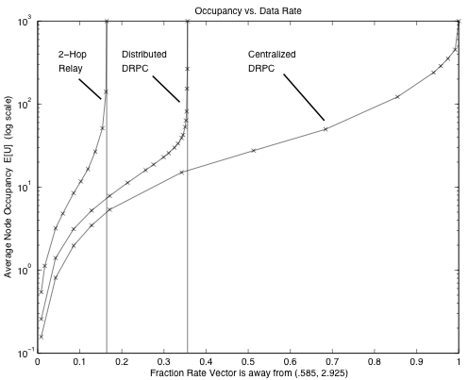
Average Number of Packets/Node versus Exogenous Arrival
Rate lambda for:
-2-hop Relay [Grossglausser, Tse TON 2002]
-DRPC Centralized, Distributed [Neely, Modiano, Rohrs JSAC 2005]
Total Avg. Backlog
Rate λ of each source

Slide 192
Course Outline:
Intro and Motivation (done)
Magic of Telescoping Sums
Discrete Time Queues
4. Stability and Capacity Regions
5. Lyapunov Drift
Max-Weight Algorithms for Stability
(imperfect scheduling, robust to non-ergodic traffic)
(downlinks, backpressure, multi-hop, mobile)
Lyapunov Drift with Performance Optimization
8. Energy Problems
Virtual Queues and Power Constraints
General Constrained Optimization
11. Other Utilities: Flow control and Fairness
12. Modern Network Models

Slide 193
Lyapunov Drift with Performance Optimization (Motivation):
λ₂
S₁(t) {ON, OFF}
λ₁
λ₂
S₂(t) {ON, OFF}
λ₁
Additional flow control decisions!
L
general concave
utility functions
of thruput
Maximize: g_{i}(r_{i})
Subject to: r Λ
0 < r_{i} < λ_{i}
i=1

Slide 194
Lyapunov Drift with Performance Optimization (Motivation):
λ₂
S₁(t) {ON, OFF}
λ₁
λ₂
S₂(t) {ON, OFF}
λ₁
Additional flow control decisions!
L
general concave
utility functions
of thruput
Maximize: g_{i}(r_{i})
Subject to: r Λ
0 < r_{i} < λ_{i}
i=1

Slide 195
A brief history of Lyapunov Drift for Queueing Systems:
Lyapunov Stability:
Tassiulas, Ephremides [91, 92, 93]
P. R. Kumar, S. Meyn [95]
McKeown, Anantharam, Walrand [96, 99]
Kahale, P. E. Wright [97]
Andrews, Kumaran, Ramanan, Stolyar, Whiting [2001]
Leonardi, Mellia, Neri, Marsan [2001]
Neely, Modiano, Rohrs [2002, 2003, 2005]
Joint Stability with Utility Optimization was the Big Open
Question until:
Tsibonis, Georgiadis, Tassiulas [infocom 2003] (special structure net,
linear utils)
Neely, Modiano [thesis 2003, infocom 2005] (general nets and utils)
Eryilmaz, Srikant [infocom 2005] (downlink, general utils)
Stolyar [Queueing Systems 2005] (general nets and utils)

Slide 196
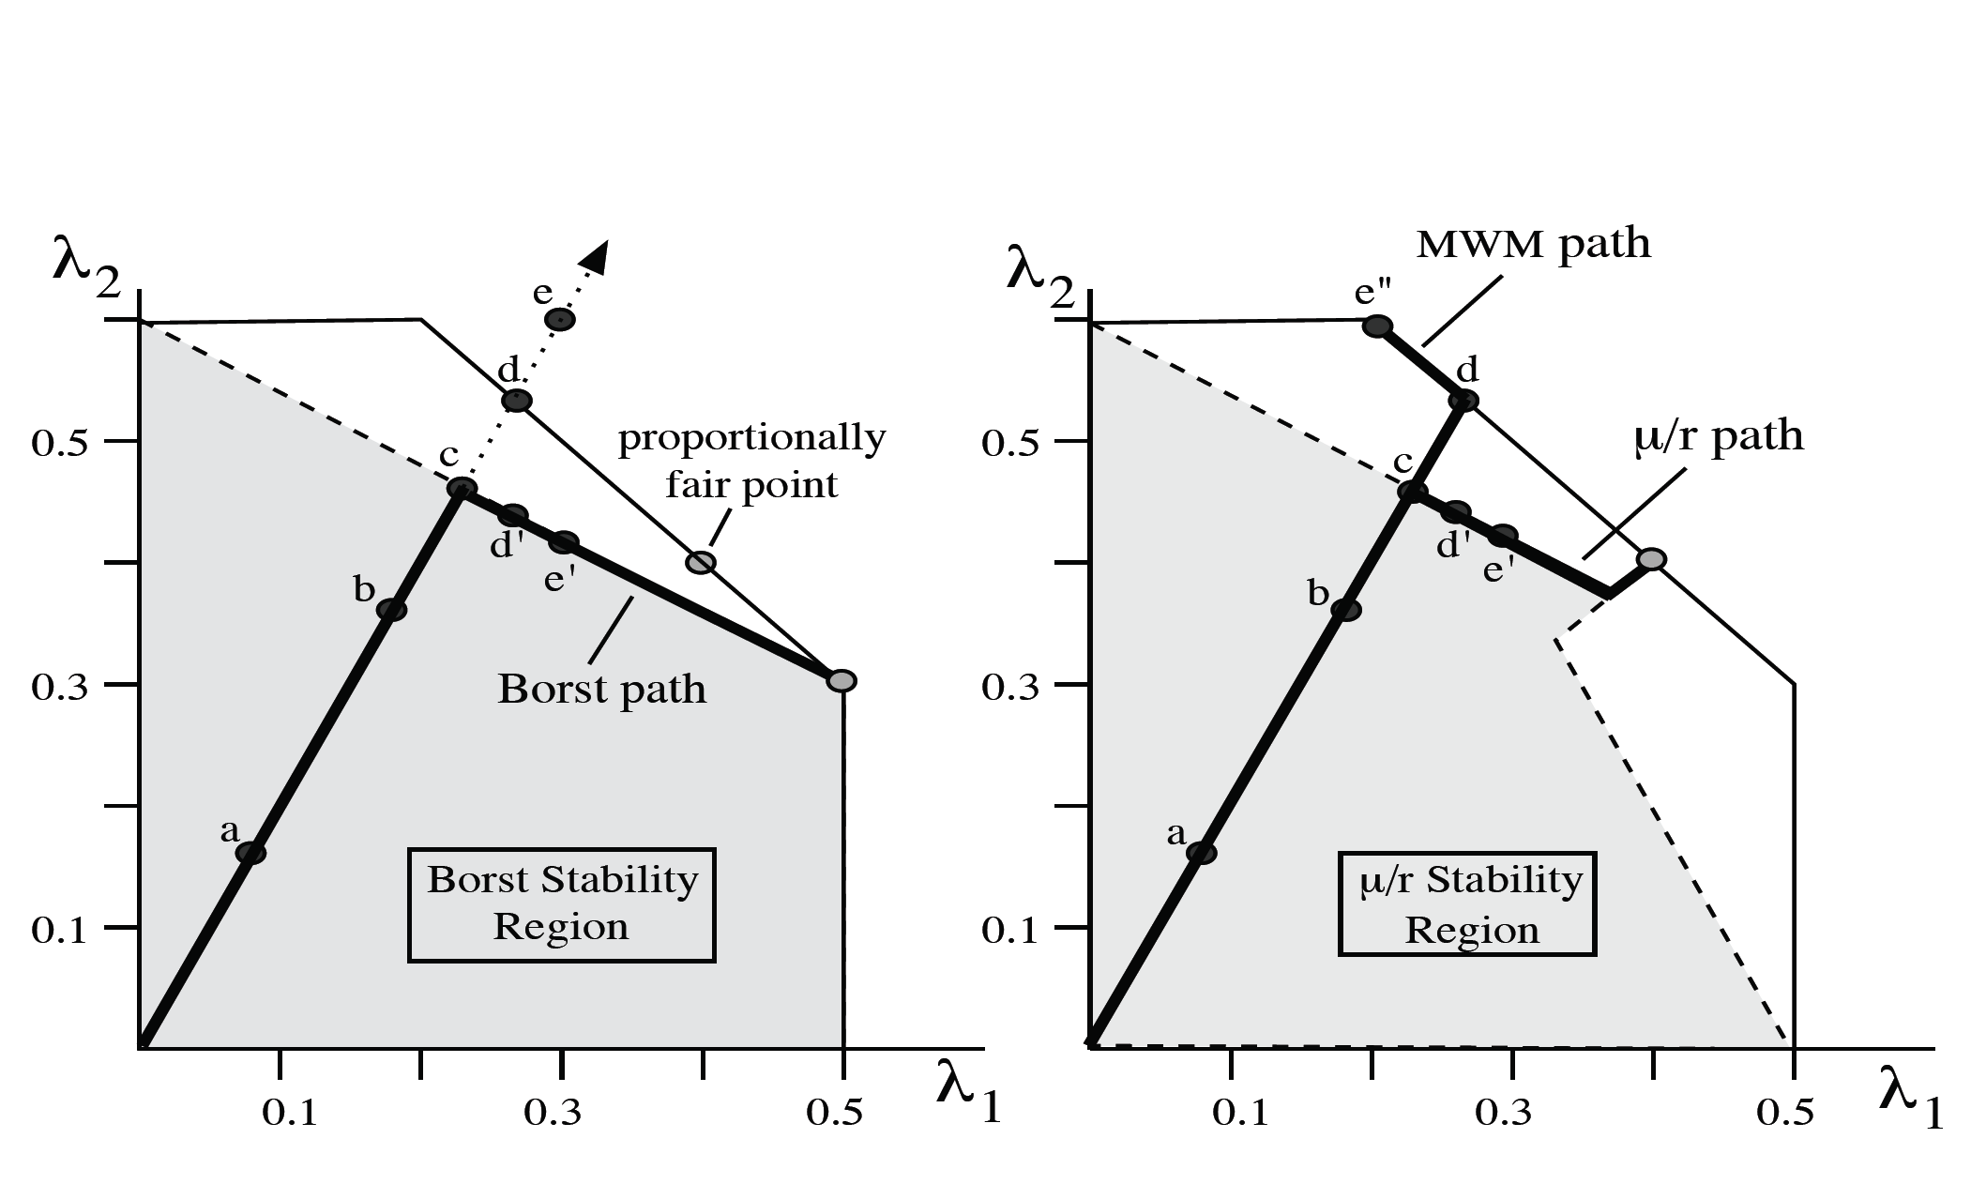
Comparison of previous algorithms:
Tassiulas Alg. MWM (max U_{i}μ_{i})
Borst Alg. [Borst Infocom 2003] (max μ_{i}/μ_{i})
Tse Alg. [Tse 97, 99, Kush 2002] (max μ_{i}/r_{i})
Curves from [Neely, Modiano, Li, INFOCOM 2005]

Slide 197
Lyapunov drift for joint stability and performance
optimization:
Neely, Modiano [2003, 2005] (Fairness, Energy)
Georgiadis, Neely, Tassiulas [NOW Publishers, F&T, 2006]
Neely [Infocom 2006, JSAC 2006] (“Super-fast” delay tradeoffs)
Alternate Approaches to Stoch. Performance Optimization:
Tsibonis, Georgiadis, Tassiulas [2003] (special structure net,
linear utils)
Eryilmaz, Srikant [2005] (Fluid Model Transformations)
Stolyar [2005] (Fluid Model Transformations)
Lee, Mazumdar, Shroff [2005] (Stochastic Gradients)
Lin, Shroff [2004] (Scheduling for static channels)

Slide 198
Lyapunov drift for joint stability and performance
optimization:
Neely, Modiano [2003, 2005] (Fairness, Energy)
Georgiadis, Neely, Tassiulas [NOW Publishers, F&T, 2006]
Neely [Infocom 2006, JSAC 2006] (“Super-fast” delay tradeoffs)
Alternate Approaches to Stoch. Performance Optimization:
Tsibonis, Georgiadis, Tassiulas [2003] (special structure net,
linear utils)
Eryilmaz, Srikant [2005] (Fluid Model Transformations)
Stolyar [2005] (Fluid Model Transformations)
Lee, Mazumdar, Shroff [2005] (Stochastic Gradients)
Lin, Shroff [2004] (Scheduling for static channels)
Yields Explicit Delay Tradeoff Results!

Slide 199
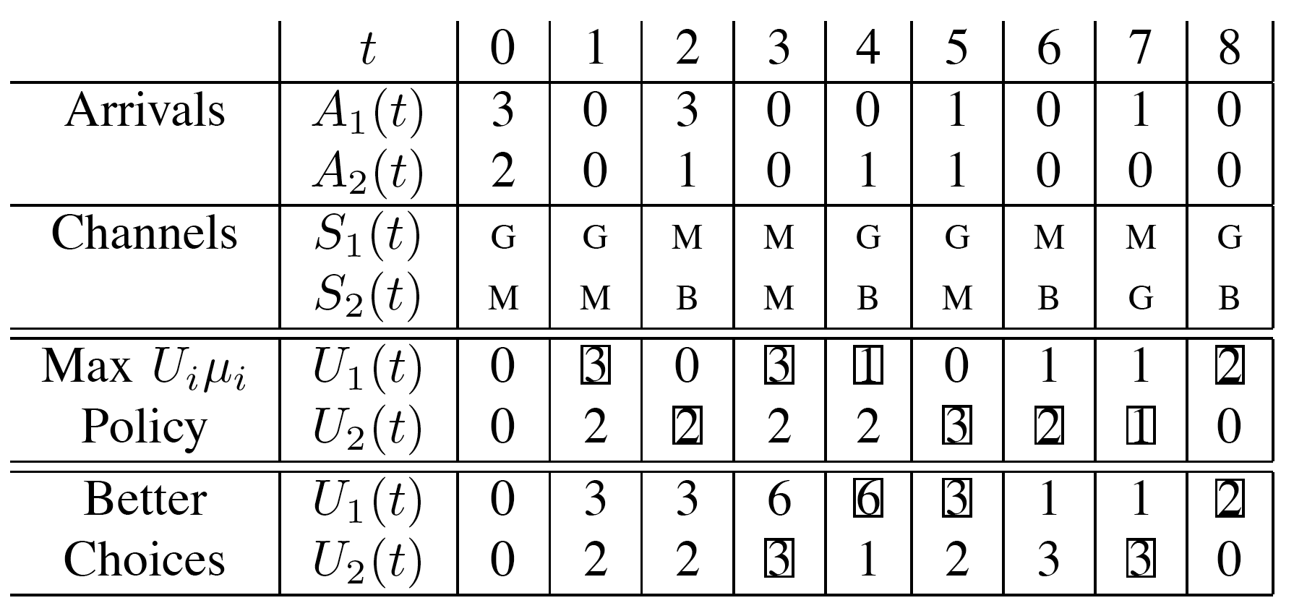
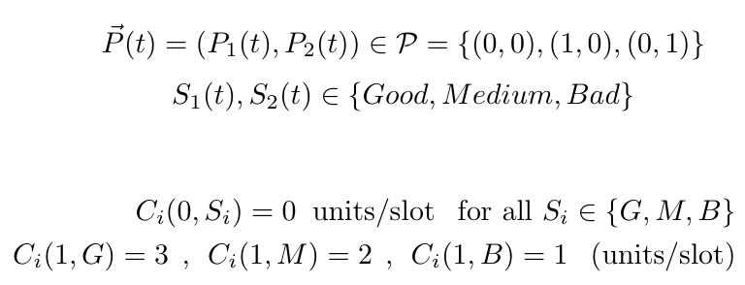
A₁(t)
A₂(t)
μ₁(t)
μ₂(t)
Example: Can either be idle, or allocate 1 Watt to a single queue.
Assume identical rate-power functions for i = 1, 2:

Slide 200
Lyapunov Optimization -- The theory:
Let U(t) be a discrete time vector process that
evolves according to some probability law. Let
f(t) and g(t) be related stochastic processes. If
there is a non-negative function L(U) such that
for all U(t), t, we have:
>
Δ(U(t)) E{g(t)| U(t)} - E{f(t)| U(t)}
Then:
t-1
t-1
1
>
1
E{L(U(0))}
E{f(τ)}
E{g(τ)}
+
t
t
t
τ=0
τ=0

Slide 201
Lyapunov Optimization -- The theory:
Let U(t) be a discrete time vector process that
evolves according to some probability law. Let
f(t) and g(t) be related stochastic processes. If
there is a non-negative function L(U) such that
for all U(t), t, we have:
>
Δ(U(t)) E{g(t)| U(t)} - E{f(t)| U(t)}
Then:
t-1
t-1
lim inf
1
>
lim inf
1
E{f(τ)}
E{g(τ)}
t
t
t
t
τ=0
τ=0

Slide 202
Lyapunov Optimization -- The theory:
Let U(t) be a discrete time vector process that
evolves according to some probability law. Let
f(t) and g(t) be related stochastic processes. If
there is a non-negative function L(U) such that
for all U(t), t, we have:
>
Δ(U(t)) E{g(t)| U(t)} - E{f(t)| U(t)}
Then:
t-1
t-1
lim sup
1
>
lim sup
1
E{f(τ)}
E{g(τ)}
t
t
t
t
τ=0
τ=0

Slide 203
Proof:
>
Δ(U(t)) E{g(t)| U(t)} - E{f(t)| U(t)}
>
Ε{L(U(t+1))} - Ε{L(U(t))} E{g(t)} - E{f(t)}
M-1
M-1
Ε{L(U(M))}-Ε{L(U(0))}
>
E{g(τ)} -
E{f(τ)}
τ=0
τ=0
M-1
M-1
E{f(τ)}
>
E{g(τ)} + Ε{L(U(0))}
=>
τ=0
τ=0

Slide 204
Theorem: Let U(t) = Vector Queue Process. Let
L(U) be a non-negative function. Let x(t) > x_{min} be a
penalty process, let V>0. If for all t, U(t) we have:
Δ(U(t))+VE{x(t)|U(t)}
>
B - E{h(U(t))|U(t)} + Vx*
for some constant B, some non-neg function h(), and
some target penalty x*, then:
t-1
limsup
1
>
E{h(U(τ))}
B + V(x* - x_{min})
t
t
τ=0
limsup
t-1
1
>
x* + B/V
t
E{x(τ)}
t
τ=0

Slide 205
Δ(U(t))+VE{x(t)|U(t)}
>
B - E{h(U(t))|U(t)} + Vx*
Δ(U(t))
>
B + Vx* - VE{x(t) + h(U(t))|U(t)}
g(t)
f(t)
t-1
1
=>
VE{x(τ) + h(U(τ))}
>
B + Vx*
t
τ=0
t-1
1
>
=>
E{h(U(τ))}
B + V(x* - x_{min})
t
τ=0
t-1
1
>
x* + B/V
=>
E{x(τ)}
t
τ=0

Slide 206
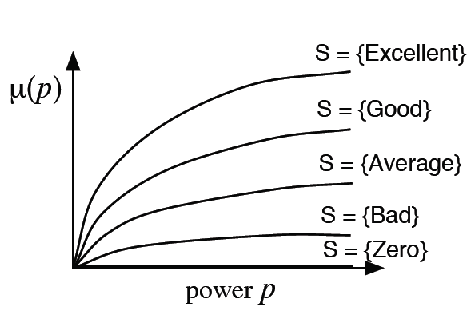
Example: One-Hop Net with C(I(t), S(t)).
Penalty process x(I(t)). Channels S(t) iid over t
S={Totally Awesome}
A₁(t)
A₂(t)
A_{K}(t)
C₁(I(t), S(t))
C₂(I(t), S(t))
C_{K}(I(t), S(t))
Objective: Stabilize all queues with minimum time
average penalty.

Slide 207
Example: One-Hop Net with C(I(t), S(t)).
Penalty process x(I(t)). Channels S(t) iid over t
A₁(t)
A₂(t)
A_{K}(t)
ε
ε
C₁(I(t), S(t))
C₂(I(t), S(t))
C_{K}(I(t), S(t))
Assume optimality can be achieved over the class of
stationary randomized policies that choose I*(t) as a
(possibly random) function of S(t) only (not queue backlog).
(True for penalty processes of power expenditure, etc.)

Slide 208
Example: One-Hop Net with C(I(t), S(t)).
Penalty process x(I(t)). Channels S(t) iid over t
A₁(t)
A₂(t)
A_{K}(t)
ε
ε
C₁(I(t), S(t))
C₂(I(t), S(t))
C_{K}(I(t), S(t))
Assume that (λ + ε) Λ. Consider stat. alg for (λ + ε).
Then: E{C(I*(t), S(t))} λ + ε
>
Min avg. penalty
To stabilize λ + ε
E{x(I*(t))} = x*(ε)

Slide 209
A₁(t)
A₂(t)
A_{K}(t)
C₁(I(t), S(t))
C₂(I(t), S(t))
C_{K}(I(t), S(t))
Dynamic Policy: use L(U) = (1/2) U_{k}²
k
>
Δ(U(t)) B + U_{k}(t)λ_{k}
k
- U_{k}(t)E{C_{k}(I(t),S(t))| U(t)}
k

Slide 210
Recall: From Lyap Opt. Theorem, we want to get:
Δ(U(t))+VE{x(t)|U(t)}
>
B - E{h(U(t))|U(t)} + Vx*
Dynamic Policy:
>
Δ(U(t)) B + U_{k}(t)λ_{k}
k
- U_{k}(t)E{C_{k}(I(t),S(t))| U(t)}
k

Slide 211
Recall: From Lyap Opt. Theorem, we want to get:
Δ(U(t))+VE{x(t)|U(t)}
>
B - E{h(U(t))|U(t)} + Vx*
Dynamic Policy:
>
Δ(U(t))+VE{x(I(t))|U(t)} B + U_{k}(t)λ_{k}
k
- U_{k}(t)E{C_{k}(I(t),S(t))| U(t)}+ VE{x(I(t))|U(t)}
k
Minimize RHS

Slide 212
Recall: From Lyap Opt. Theorem, we want to get:
Δ(U(t))+VE{x(t)|U(t)}
>
B - E{h(U(t))|U(t)} + Vx*
Dynamic Policy:
>
Δ(U(t))+VE{x(I(t))|U(t)} B + U_{k}(t)λ_{k}
k
- U_{k}(t)E{C_{k}(I(t),S(t))| U(t)}+ VE{x(I(t))|U(t)}
k
>
B + U_{k}(t)λ_{k}
k
- U_{k}(t)E{C_{k}(I*(t),S(t))| U(t)}+ VE{x(I*(t))|U(t)}
k
I*(t) = Stationary Randomized Policy

Slide 213
Recall: From Lyap Opt. Theorem, we want to get:
Δ(U(t))+VE{x(t)|U(t)}
>
B - E{h(U(t))|U(t)} + Vx*
Dynamic Policy:
>
Δ(U(t))+VE{x(I(t))|U(t)} B + U_{k}(t)λ_{k}
k
- U_{k}(t)E{C_{k}(I*(t),S(t))| U(t)}+ VE{x(I*(t))|U(t)}
k
I*(t) = Stationary Randomized Policy
>
E{C(I*(t), S(t))} λ + ε
E{x(I*(t))} = x*(ε)

Slide 214
Recall: From Lyap Opt. Theorem, we want to get:
Δ(U(t))+VE{x(t)|U(t)}
>
B - E{h(U(t))|U(t)} + Vx*
Dynamic Policy:
>
Δ(U(t))+VE{x(I(t))|U(t)} B - U_{k}(t)ε
+ Vx*(ε)
k
>
E{C(I*(t), S(t))} λ + ε
E{x(I*(t))} = x*(ε)

Slide 215
Recall: From Lyap Opt. Theorem, we want to get:
Δ(U(t))+VE{x(t)|U(t)}
>
B - E{h(U(t))|U(t)} + Vx*
>
Dynamic Policy: (assume x(I(t)) 0)
>
Δ(U(t))+VE{x(I(t))|U(t)} B - U_{k}(t)ε
+ Vx*(ε)
k
B + Vx*(ε)
>
=>
U_{k}
ε
k
limsup
1
t-1
E{x(τ)}
>
x*(ε) + B/V
t
t
τ=0

Slide 216
B + Vx*(ε)
>
U_{k}
ε
k
limsup
1
t-1
E{x(τ)}
>
x*(ε) + B/V
t
t
τ=0
Holds for any ε such
That:
0 ε ε_{max}
ε
>
>
ε
Take opposite extremes for ε to optimize the bounds!

Slide 217
B + Vx*(ε)
B + Vx_{max}
>
U_{k}
ε
ε_{max}
k
limsup
1
t-1
E{x(τ)}
>
x*(ε) + B/V
x* + B/V
t
t
τ=0
Holds for any ε such
That:
0 ε ε_{max}
ε
>
>
ε
Take opposite extremes for ε to optimize the bounds!

Slide 218
What is the policy?
- U_{k}(t)E{C_{k}(I(t),S(t))| U(t)}+ VE{x(I(t))|U(t)}
k
Minimize RHS
Policy [Neely Infocom 05, IT 06]: Observe U(t), S(t)
U_{k}(t)C_{k}(I(t),S(t)) - Vx(I(t))
Max:
k
Subject to: I(t) I

Slide 219
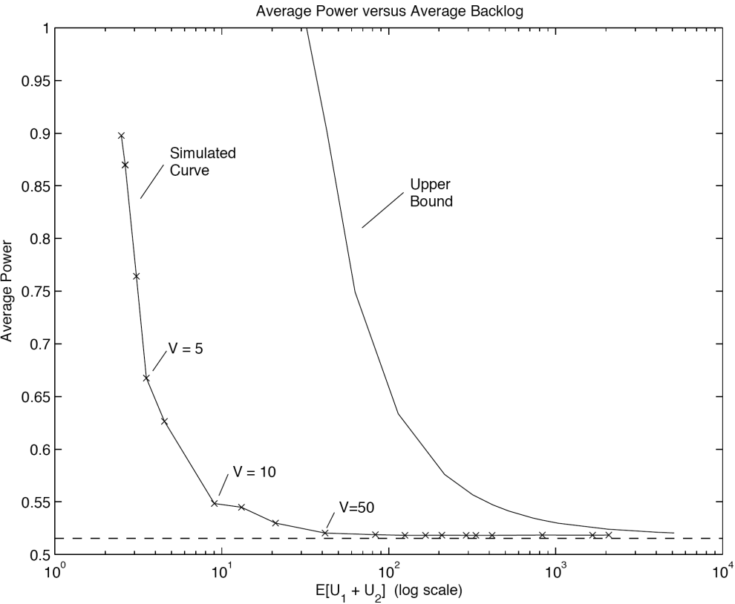
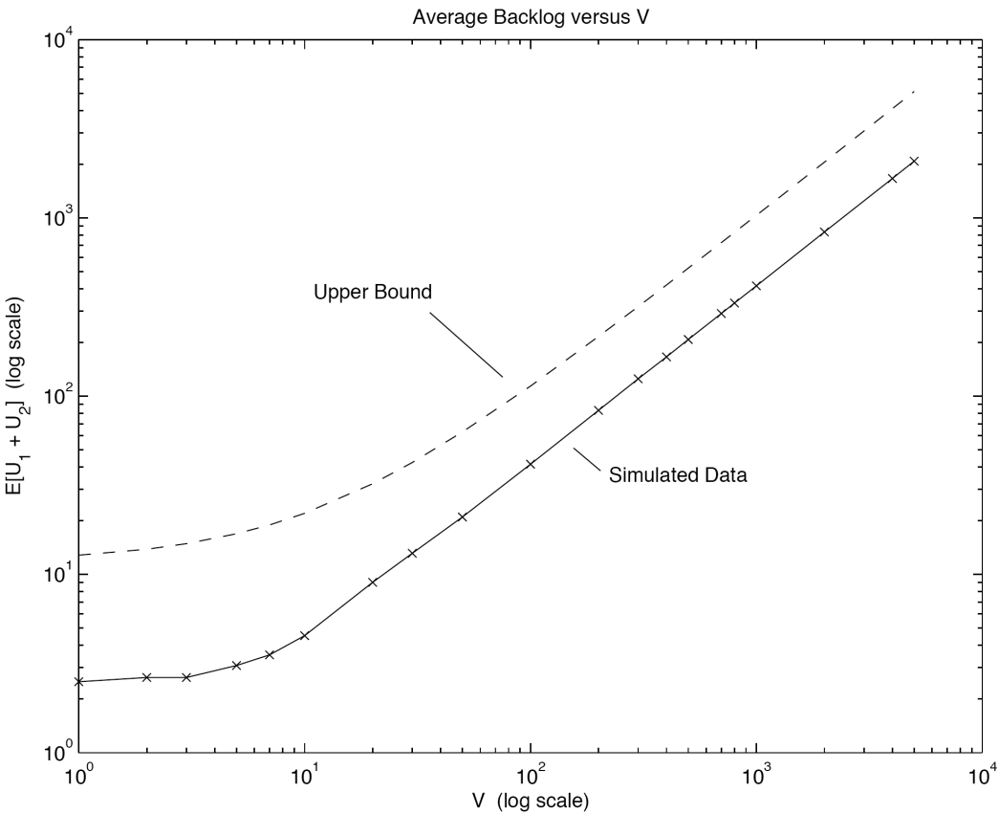
Example Simulation:
Two-queue downlink
with {G, M, B} channels
A₁(t)
A₂(t)
Av Power
V
μ₁(t)
μ₂(t)
Av Backlog

Slide 220
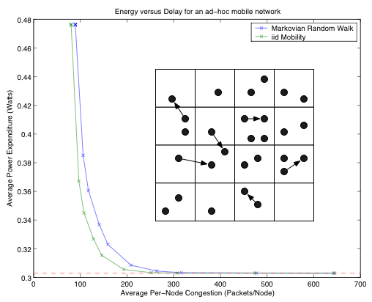
Multi-Hop Example Simulation:
Average Power
Average Backlog

Slide 221
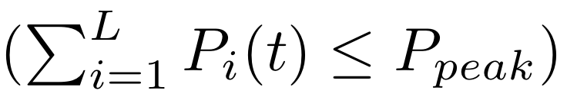
Lyapunov Optimization -- Virtual Queues:
λ₁
(i) Peak power constraint:
P(t) Π
λ₂
Λ = Region of all supportable input rate vectors λ
Consider Maximizing Throughput Subject to Peak and
Average Power Constraints.

Slide 222
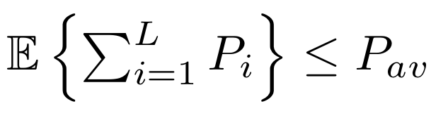
Lyapunov Optimization -- Virtual Queues:
λ₁
(i) Peak power constraint:
P(t) Π
(ii) Avg. power constraint:
λ₂
Λ = Region of all supportable input rate vectors λ
Consider Maximizing Throughput Subject to Peak and
Average Power Constraints.

Slide 223
Lyapunov Optimization -- Virtual Queues:
λ₁
(i) Peak power constraint:
P(t) Π
(ii) Avg. power constraint:
λ₂
Λ = Region of all supportable input rate vectors λ
Consider Maximizing Throughput Subject to Peak and
Average Power Constraints.

Slide 224
To remove the average power constraint
,
we create a virtual power queue with backlog X(t).
L
Dynamics:
X(t+1) = max[X(t) - P_{av}, 0] + P_{i}(t)
i=1
A₁(t)
A₂(t)
A_{L}(t)
L
P_{i}(t)
i=1
C₁(I(t), S(t))
C₂(I(t), S(t))
C_{K}(I(t), S(t))
P_{av}
Observation: If we stabilize all original queues and the virtual power
queue subject to only the peak power constraint , then
the average power constraint will automatically be satisfied.
P(t) Π

Slide 225
Control policy: [EECA, Neely IT 06] Show case when Π restricts
power options to full power to one queue, or idle (general case in paper).
A₁(t)
A₂(t)
A_{L}(t)
μ₁(t)
μ₂(t)
μ_{L}(t)
Choose queue i that maximizes:
U_{i}(t)μ_{i}(t) - X(t)P_{tot}
Whenever this maximum is positive. Else, allocate no power at all.
Then iterate the X(t) virtual power queue equation:
L
X(t+1) = max[X(t) - P_{av}, 0] + P_{i}(t)
i=1

Slide 226
Performance of Energy Constrained Control Alg. (ECCA):
Theorem: Finite buffer size B, input rate λ Λ or λ Λ
(r₁*,…, r_{L}*) = optimal
vector
(r₁, …, r_{L}) = achieved
thruput vec.
L
r_{i}
L
r_{i}*
(a) Thruput:
- C/(B - A_{max})
i=1
i=1
(b) Total power expended over any interval (t₁, t₂)
P_{av}(t₂-t₁) + X_{max}
where C, X_{max} are constants independent of rate vector and channel
statistics.
C = (A_{max}² + P_{peak}² + P_{av}²)/2

Slide 227
Course Outline:
Intro and Motivation (done)
Magic of Telescoping Sums
Discrete Time Queues
4. Stability and Capacity Regions
5. Lyapunov Drift
Max-Weight Algorithms for Stability
(imperfect scheduling, robust to non-ergodic traffic)
(downlinks, backpressure, multi-hop, mobile)
Lyapunov Drift with Performance Optimization
8. Energy Problems
Virtual Queues and Power Constraints
General Constrained Optimization
11. Other Utilities: Flow control and Fairness
12. Modern Network Models

Slide 228
Let y(t) = -x(t) = Reward process!
Theorem: Let U(t) = Vector Queue Process. Let
L(U) be a non-negative function. Let x(t) > x_{min} be a
penalty process, let V>0. If for all t, U(t) we have:
Δ(U(t))+VE{x(t)|U(t)}
>
B - E{h(U(t))|U(t)} + Vx*
for some constant B, some non-neg function h(), and
some target penalty x*, then:
t-1
limsup
1
>
E{h(U(τ))}
B + V(x* - x_{min})
t
t
τ=0
limsup
t-1
1
>
x* + B/V
t
E{x(τ)}
t
τ=0

Slide 229

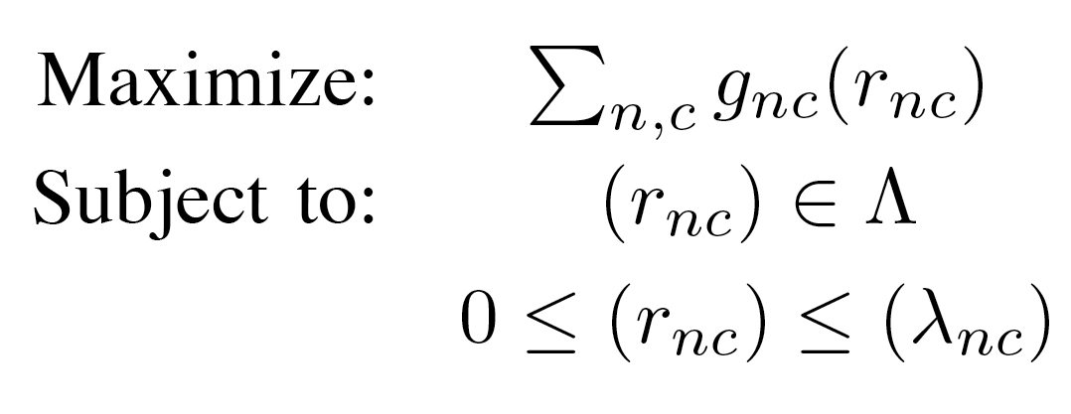
Goal: Develop joint flow control, routing, resource allocation
wired network
λ₁
sensor network
wireless
8
5
0
1
9
6
λ₉₁
2
λ₉₃
3
7
4
λ₄₈
λ₄₂
λ_{n}^{(c)}
R_{n}^{(c)}(t)
U_{n}^{(c)}(t)
λ₂
Λ = Capacity region (considering all routing, resource alloc. policies)
g_{nc}(r_{nc}) = concave utility functions
util
r

Slide 230
Comparison of previous algorithms:
MWM (max U_{i}μ_{i})
Borst Alg. [Borst Infocom 2003] (max μ_{i}/μ_{i})
Tse Alg. [Tse 97, 99, Kush 2002] (max μ_{i}/r_{i})

Slide 231
wired network
sensor network
wireless
8
5
0
1
9
6
λ₉₁
2
λ₉₃
3
7
4
λ₄₈
λ₄₂
λ_{n}^{(c)}
R_{n}^{(c)}(t)
U_{n}^{(c)}(t)
Approach: Put all data in a reservoir before sending into
network. Reservoir valve determines R_{n}^{(c)}(t) (amount
delivered to network from reservoir (n,c) at slot t).
Optimize dynamic decisions over all possible valve
control policies, network resource allocations, routing
to provide optimal fairness.

Slide 232
Part 1: Optimization with infinite demand
wired network
sensor network
wireless
λ₁
8
5
0
1
9
6
λ₉₁
2
λ₉₃
3
7
4
λ₄₈
λ₄₂
λ_{n}^{(c)}
R_{n}^{(c)}(t)
U_{n}^{(c)}(t)
λ₂
Assume all active sessions infinitely backlogged
(general case of arbitrary traffic treated in part 2).

Slide 233
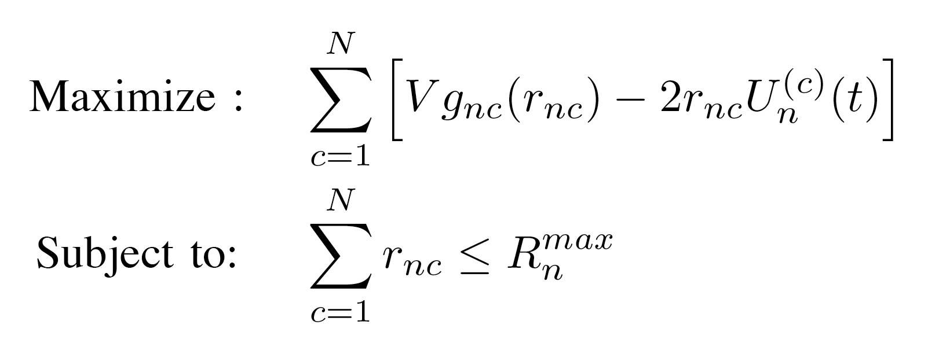
Cross Layer Control Algorithm (CLC1):
Flow Control: At node n, observe queue backlogs U_{n}^{(c)}(t)
for all active sessions c.
λ_{n}^{(c1)}
R_{n}^{(c1)}(t)
Rest of Network
λ_{n}^{(c2)}
R_{n}^{(c2)}(t)
U_{n}^{(c)}(t)
(where V is a parameter that affects network delay)

Slide 234
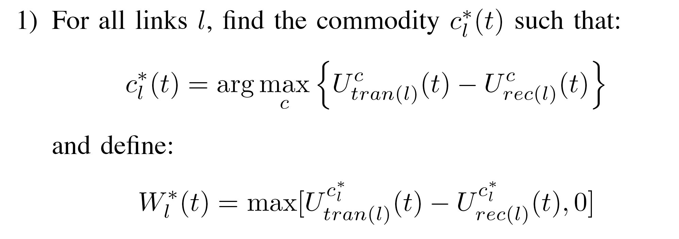
(2) Routing and Scheduling:
link l
c_{l}*(t) =
(
(similar to the original Tassiulas differential backlog
routing policy [1992])
(3) Resource Allocation: Observe channel states S(t). Allocate
resources to yield rates μ(t) such that:
Maximize:
W_{l}*(t)μ_{l}(t)
Such that:
μ(t) Γ_{S(t)}
l

Slide 235
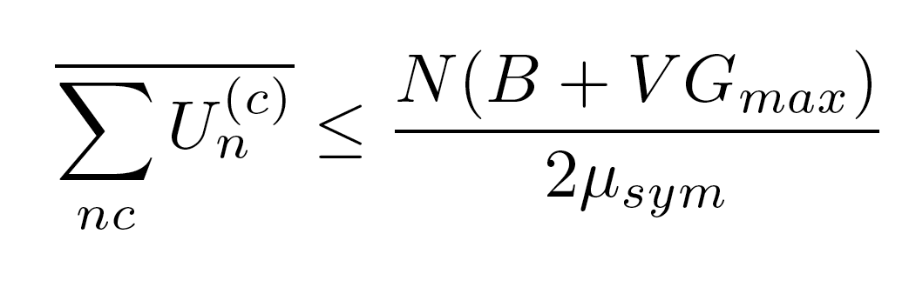
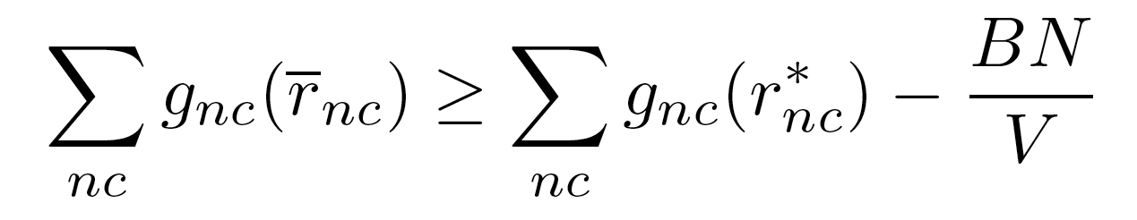
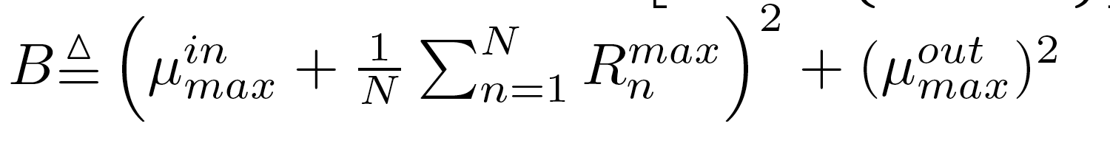
Theorem: If channel states are i.i.d., then for any V>0
and any rate vector λ (inside or outside of Λ),
λ₁
μ_{sym}
optimal point r *
μ_{sym}
Avg. delay:
Fairness:
(where
)

Slide 236
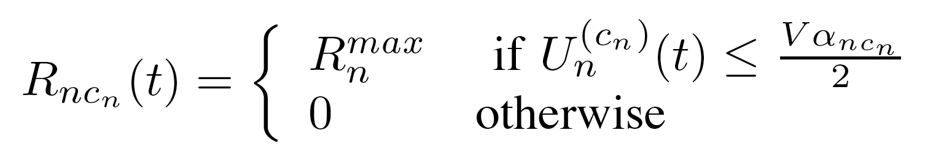
Special cases:
(for simplicity, assume only 1 active session per node)
1. Maximum throughput and the threshold rule
Linear utilities: g_{nc}(r) = α_{nc} r
λ_{n}^{(c)}
R_{n}^{(c)}(t)
U_{n}^{(c)}(t)
(threshold structure similar to Tsibonis [Infocom 2003] for
a downlink with service envelopes)

Slide 237
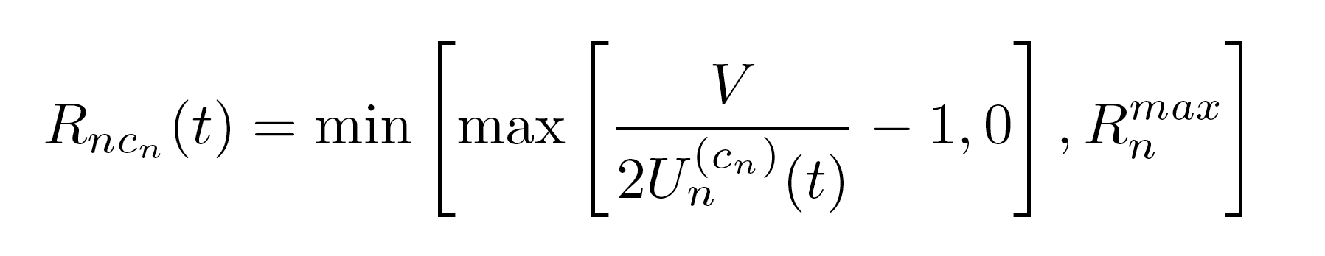
(2) Proportional Fairness and the 1/U rule
logarithmic utilities: g_{nc}(r) = log(1 + r_{nc})
R_{n}^{(c)}(t)
λ_{n}^{(c)}
U_{n}^{(c)}(t)

Slide 238
Mechanism Design and Network Pricing:
greedy users…each naturally solves the following:
Maximize: g_{nc}(r) - PRICE_{nc}(t)r
Such that :
0 r R_{max}
This is exactly the same algorithm if we use the following
dynamic pricing strategy:
PRICE_{nc}(t) = U_{nc}(t)/V

Slide 239
Framework for Stochastic Network Optimization with
General Utilities/Costs, Penalties/Rewards: (Ch 5 of text)
[See also Stolyar 05 via fluid models]
U(t) = Vector queue backlog process
x(t) = Vector process of “penalties”
y(t) = Vector process of “rewards”
f(x) convex cost , g(y) concave utility
q(x) vector function, convex in each dimension
p(y) vector function, concave in each dimension

Slide 240
Framework for Stochastic Network Optimization with
General Utilities/Costs, Penalties/Rewards: (Ch 5 of text)
[See also Stolyar 05 via fluid models]
U(t) = Vector queue backlog process
x(t) = Vector process of “penalties”
y(t) = Vector process of “rewards”
Maximize: g( y ) - f( x )
Subject to: q( x ) b₁
p( y ) b₂
Queue Stability
>
>

Slide 241
Maximize: g( y ) - f( x )
Subject to: q( x ) b₁
p( y ) b₂
Queue Stability
>
>
Maximizing a function of a time average is different
from maximizing a time average of a function!
Technique: Virtual Queues: Introduce new constraint (and queue):
Z(t)
y(t)
γ(t)
Auxiliary
variables
reward vector

Slide 242
g( γ ) - f( x )
Maximize: g( y ) - f( x )
Subject to: q( x ) b₁
p( y ) b₂
Queue Stability
>
and
>
y γ
>
Maximizing a function of a time average is different
from maximizing a time average of a function!
Technique: Virtual Queues: Introduce new constraint (and queue):
Z(t)
y(t)
γ(t)
Auxiliary
variables
reward vector

Slide 243
DIVBAR
source 1
source 2
source 3
-Multi-Node Wireless Network (possibly mobile)
-Operates in slotted time (t = 0, 1, 2, …)
-Broadcast Advantage [Wieselthier,Nguyen,Ephremides 99]
-Channel Errors
-Time Varying Transmission Success
Probabilities q_{ab}(t)
Example: Suppose Source 1 transmits…

Slide 244
a
1
b
d
c
source 1
source 2
source 3
-Multi-Node Wireless Network (possibly mobile)
-Operates in slotted time (t = 0, 1, 2, …)
-Broadcast Advantage [Wieselthier,Nguyen,Ephremides 99]
-Channel Errors
-Time Varying Transmission Success
Probabilities q_{ab}(t)
Example: Suppose Source 1 transmits…
There are 4 possible receivers…

Slide 245
a
1
b
d
c
source 1
source 2
source 3
-Multi-Node Wireless Network (possibly mobile)
-Operates in slotted time (t = 0, 1, 2, …)
-Broadcast Advantage [Wieselthier,Nguyen,Ephremides 99]
-Channel Errors
-Time Varying Transmission Success
Probabilities q_{ab}(t)
Example: Suppose Source 1 transmits…
Each with different success probs…

Slide 246
a
1
b
d
c
source 1
source 2
source 3
-Multi-Node Wireless Network (possibly mobile)
-Operates in slotted time (t = 0, 1, 2, …)
-Broadcast Advantage [Wieselthier,Nguyen,Ephremides 99]
-Channel Errors
-Time Varying Transmission Success
Probabilities q_{ab}(t)
Example: Suppose Source 1 transmits…
Only 3 successfully receive…

Slide 247
a
1
b
d
c
source 1
source 2
source 3
-Multi-Node Wireless Network (possibly mobile)
-Operates in slotted time (t = 0, 1, 2, …)
-Broadcast Advantage [Wieselthier,Nguyen,Ephremides 99]
-Channel Errors
-Time Varying Transmission Success
Probabilities q_{ab}(t)
Multi-Receiver Diversity!

Slide 248
a
1
b
d
c
source 1
source 2
source 3
Fundamental Questions:
1) How to Fully Utilize Multi-Receiver Diversity?
2) How to Maximize Throughput? Minimize Av. Power?
3) How to choose which node takes charge of the packet?
4) Should we allow redundant forwarding of different
copies of the same packet?
5) How to schedule multiple traffic streams?

Slide 249
GeRaF:
a
1
b
d
c
source 1
A Hot Topic Area:
Zorzi and Rao: “Geographic Random Forwarding”
(GeRaF) [IEEE Trans. on Mobile Computing, 2003].
Biswas and Morris: “Extremely Opportunistic Routing”
(EXOR) [Proc. of Sigcomm, 2005].
Baccelli, et. al. [IEEE Trans. Information Theory 2006]

Slide 250
GeRaF:
a
1
b
d
c
source 1
A Hot Topic Area:
Zorzi and Rao: “Geographic Random Forwarding”
(GeRaF) [IEEE Trans. on Mobile Computing, 2003].
“Closest-to-Destination” Heuristic
Biswas and Morris: “Extremely Opportunistic Routing”
(EXOR) [Proc. of Sigcomm, 2005].
Baccelli, et. al. [IEEE Trans. Information Theory 2006]

Slide 251
GeRaF:
a
e
1
b
d
c
source 1
A Hot Topic Area:
Zorzi and Rao: “Geographic Random Forwarding”
(GeRaF) [IEEE Trans. on Mobile Computing, 2003].
“Closest-to-Destination” Heuristic
Biswas and Morris: “Extremely Opportunistic Routing”
(EXOR) [Proc. of Sigcomm, 2005].
Baccelli, et. al. [IEEE Trans. Information Theory 2006]

Slide 252
possible deadlock
GeRaF:
a
e
1
b
d
c
source 1
A Hot Topic Area:
Zorzi and Rao: “Geographic Random Forwarding”
(GeRaF) [IEEE Trans. on Mobile Computing, 2003].
“Closest-to-Destination” Heuristic
Biswas and Morris: “Extremely Opportunistic Routing”
(EXOR) [Proc. of Sigcomm, 2005].
Baccelli, et. al. [IEEE Trans. Information Theory 2006]

Slide 253
h₃
h₄
h₂₂
h₁
h₂
EXOR:
a
h₂₃
h₂₄
h₆
h₅
h₂₁
h₇
h₁₄
h₁₆
h₁
h₂₅
1
b
h₁₁
h₁₅
h₁₉
h₁₉
h₂₀
d
h₉
h₁₇
h₈
h₁₃
c
h₁₂
h₁₈
source 1
h₁₀
A Hot Topic Area:
Zorzi and Rao: “Geographic Random Forwarding”
(GeRaF) [IEEE Trans. on Mobile Computing, 2003].
“Closest-to-Destination” Heuristic
Biswas and Morris: “Extremely Opportunistic Routing”
(EXOR) [Proc. of Sigcomm, 2005].
“Fewest Expected Hops to Destination” Heuristic
(using a traditional shortest path based on error probs)

Slide 254
How to achieve thruput and energy optimal routing?
A Big Challenge: Complexity!
Example: Suppose a node transmits a packet, and
there are k potential receivers…
1
2
3
k
Then there are 2^{k} possible outcomes. An optimal
algorithm must specify a contingency plan for each
possible outcome.

Slide 255
How to achieve thruput and energy optimal routing?
A Big Challenge: Complexity!
Example: Suppose a node transmits a packet, and
there are k potential receivers…
1
2
3
k
Then there are 2^{k} possible outcomes. An optimal
algorithm must specify a contingency plan for each
possible outcome.

Slide 256
How to achieve thruput and energy optimal routing?
A Big Challenge: Complexity!
Example: Suppose a node transmits a packet, and
there are k potential receivers…
1
2
3
k
Then there are 2^{k} possible outcomes. An optimal
algorithm must specify a contingency plan for each
possible outcome.

Slide 257
How to achieve thruput and energy optimal routing?
A Big Challenge: Complexity!
Example: Suppose a node transmits a packet, and
there are k potential receivers…
1
2
3
k
Then there are 2^{k} possible outcomes. An optimal
algorithm must specify a contingency plan for each
possible outcome.

Slide 258
How to achieve thruput and energy optimal routing?
A Big Challenge: Complexity!
Example: Suppose a node transmits a packet, and
there are k potential receivers…
1
2
3
k
Then there are 2^{k} possible outcomes. An optimal
algorithm must specify a contingency plan for each
possible outcome.

Slide 259
How to achieve thruput and energy optimal routing?
A Big Challenge: Complexity!
Example: Suppose a node transmits a packet, and
there are k potential receivers…
1
2
3
k
Then there are 2^{k} possible outcomes. An optimal
algorithm must specify a contingency plan for each
possible outcome.

Slide 260
1
2
3
k
Further Challenges:
How to Handle Multiple Simultaneous Transmissions?
How to Handle Multiple Traffic Sessions?
How to Handle Mobility and/or Time Varying
Channel Success Probabilities?

Slide 261
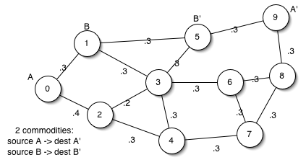
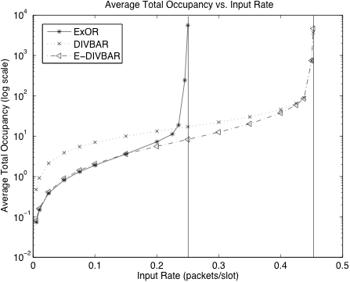
DIVBAR Results
ExOR
[Biswas, Morris 05]
DIVBAR, E-DIVBAR
[Neely, Urgaonkar
2006]

Slide 262
DIVBAR Results
ExOR
[Biswas, Morris 05]
DIVBAR, E-DIVBAR
[Neely, Urgaonkar
2006]

Slide 263
DIVBAR Results
ExOR
[Biswas, Morris 05]
DIVBAR, E-DIVBAR
[Neely, Urgaonkar
2006]

Slide 264
ExOR
[Biswas, Morris 05]
DIVBAR, E-DIVBAR
[Neely, Urgaonkar
2006]

Slide 265

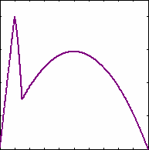
The Optimality of Two Prices: Maximizing Revenue in a Stochastic Network
Φ(cost(t), S(t))
AP
Larger Network
Profit
F(M(t),p(t))
Price
Allerton 2007
Longbo Huang
Michael J. Neely
University of Southern California
*Sponsored in part
by the DARPA IT-
MANET Program

Slide 266
The Revenue Maximization Problem for an Access Point (AP)
AP
Users
Larger Net
Q(t)
Users: -Want to connect to Larger Net via AP
-Send Data to AP in reaction to price p(t)
AP: -Wants to Maximize Time Average Revenue
-Sets a price p(t) every slot t
-Must transmit data (incurring its own cost)

Slide 267
Motivation: We want to solve a general stochastic
Max Revenue problem for wireless service providers
Previous Work: (Utility Optimization via “prices”)
-MacKie-Mason, Varian [JSAC 1995]
-Kelly [1997]
-Low, Lapsley [TON 1999]
Price = Lagrange Multiplier
(Used only to facillitate the utility optimization)

Slide 268
Motivation: We want to solve a general stochastic
Max Revenue problem for wireless service providers
Previous Work (Max Revenue):
[Paschalidis, Tsitsiklis: TON 2000]
Dynamic Programming
[Acemoglu, Ozdaglar: CDC 2004]
[Basar, Srikant: INFOCOM 2002]
[Marbach, Berry: INFOCOM 2002]
Downlinks
Static
Optimization
[Keon, Anadalingam, TON 2003]
[Zhang, Dey, Tan, INFORMS 2007]
Max Revenue
with Qos
[Musacchio, Walrand: TON 2006]
[Lam, Chiu, Lui: Trans. On Computers 2007]
Game Theory
AP pricing

Slide 269
Motivation: We want to solve a general stochastic
Max Revenue problem for wireless service providers
Previous Work (Max Revenue):
[Paschalidis, Tsitsiklis: TON 2000]
Dynamic Programming
[Acemoglu, Ozdaglar: CDC 2004]
[Basar, Srikant: INFOCOM 2002]
[Marbach, Berry: INFOCOM 2002]
Downlinks
Static
Optimization
[Keon, Anadalingam, TON 2003]
[Zhang, Dey, Tan, INFORMS 2007]
Max Revenue
with Qos
[Musacchio, Walrand: TON 2006]
[Lam, Chiu, Lui: Trans. On Computers 2007]
Game Theory
AP pricing
Typical Prior Assumptions:
Time invariant system
(2) Concave Utility/Demand
function
(3) ‘‘One shot”,No queueing
However, we have:
Stochastic Wireless Net.
General (non-concave) Demand Function
(3) Queueing
Need new models &
new algorithms !!

Slide 270
Network Model:
R(t)
Q(t)
Time Slotted System: t = {0, 1, 2, ….}
User “Demand State” M(t):
-Models “willingness-to-pay”
-Examples: i) M(t) = # users at time t , ii) M(t) = {LOW, MED, HIGH}
User “Demand Function” F(M(t), p(t)):
F: (M(t), p(t)) E{R(t)} = Expected Arriving Data
in reaction to M(t), p(t)
Channel State S(t) and rate-cost function:
Φ(cost(t), S(t)) = μ(t) = Transmission rate (bits/slot)

Slide 271
R(t)
Q(t)
Assumptions on Demand State M(t):
M(t) is Markovian: finite state space, ergodic
AP knows current value of M(t) on each slot t
AP does not necessarily know transition
or steady state probabilities
4. R(t) = Random Arrivals, E{R(t)} = F(M(t), p(t)) , R(t) < R_{max}
R(t) is conditionally indep of past given M(t), p(t)
M(t)

Slide 272
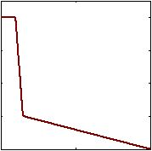
R(t) = Random Arrivals,
E{R(t)} = F(M(t), p(t))
R(t)
Q(t)
Assumptions on Demand Function F(M(t), p(t)):
-F(M, p) is continuous over p for all M
(possibly non-linear, non-concave)
E[R(t)]
-p(t) P = Compact Set of Feasible
Prices (possibly discrete)
-Assume 0 < p(t) < p_{max}
-AP knows Demand Function F(m, p)
Price
Example: If M(t) = # users, then F(M(t), p(t)) might be M(t)F(p(t))

Slide 273
R(t)
Q(t)
Assumptions on S(t) and Rate-Cost Function:
-S(t) is Markovian (finite state space, ergodic)
-AP knows current value of S(t)
-AP does not necessarily know transition probabilities
or steady state probabilities.
μ(t) = Φ(cost(t), S(t)) (general, continuous)
cost(t) C = Compact Set
Assume there is a max transmission rate μ_{max}.
Φ(cost(t),S(t))
Cost(t)

Slide 274
If the AP wants to admit new data, it gives an “OPEN MARKET” signal (Z(t) = 1). It chooses a price p(t) and informs the users. Users react by sending packets.
Demand Function:
E[R(t)] =F(M(t),P(t))
Price $P(t)
AP
Larger Network
E[R(t)]
Arrival R(t)
Business Decision: Z(t)=1
Price

Slide 275
If the AP doesn’t want to admit new data, it sends a “CLOSED” signal (Z(t)=0). Users will NOT send any packets.
Demand Function:
E[R(t)] =F(M(t),P(t))
CLOSED
AP
Mesh Network
E[R(t)]
Arrival 0
Business Decision: Z(t)=0
Price

Slide 276
-The AP queues the data (Q(t) = backlog).
-Observes channel state S(t).
-Makes Resource Allocation decision cost(t) C.
-Transmission rate = μ(t) = Φ(cost(t), S(t))
Z(t)R(t)
Q(t)
Φ(cost(t),S(t))
Partially controlled Arrival Rate
Controlled Departure Rate
Φ(cost(t),S(t))
Instantaneous Profit:
Profit(t) = Z(t)R(t)p(t) - cost(t)
Goal: Maximize Time Average Profit
while maintaining queue stability
Cost(t)

Slide 277
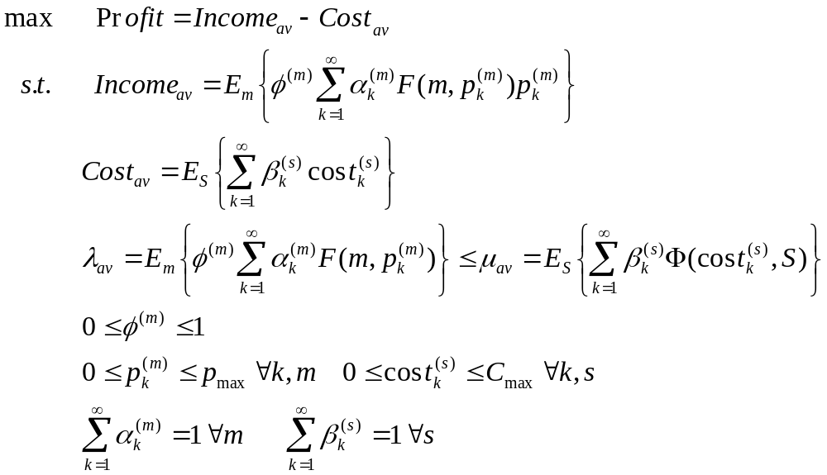
The optimum avg. profit can be obtained with exact steady state distribution information for M(t) and S(t)
Theorem: (Max Profit with Stability)
The max average profit Profit* is the solution to the max problem
Immediate corollary: A stationary
randomized STAT* algorithm achieves
the optimum avg. profit.
Proved by using
Caratheodory’s thm

Slide 278
The Optimality of Two Prices Theorem
Theorem:
λ*= avg. rate of STAT*, Income*=avg. income of STAT*
For each M(t)=m, exists 2 business-price points (Z₁(m), p₁(m)), (Z₂(m), p₂(m)), and probabilities q₁(m) & q₂(m) s.t.
λ*= E_{m}[q₁(m) F(m, p₁(m)) + q₂(m) F(m, p₂(m))]
Income*=E_{m}[q₁(m) p₁(m) F(m, p₁(m)) + q₂(m) p₂(m) F(m, p₂(m))]
Proof :
Caratheodory’s thm + its extension
+ Continuity of F(m,p)
pF(m,p)
For any F(m,p) demand function, AP can maximize its revenue by using two prices per M(t)
(0,0)
F(m,p)

Slide 279
Proof Sketch for special case when:
-price set P is topologically connected (ex: 0 < p < p_{max})
-only one M(t) state, so F(M(t), p(t)) = F(p(t))
Stationary Randomized Algorithm from Theorem 1 yields:
λ* = E{Z(t)F(p(t))}
Income* = E{Z(t)p(t)F(p(t))}
Thus, point (λ* , Income*) is in the convex hull of the 2-d set:
Ω = { ( ZF(p) ; ZpF(p) ) | Z in {0, 1}, p in P}
Thus, (λ* , Income*) can be achieved by a convex combination
of at most 3 points in Ω. But…

Slide 280
The point (λ* , Income*) is in the convex hull of the 2-d set:
Ω = { ( ZF(p) ; ZpF(p) ) | Z in {0, 1}, p in P}
Extension to Caratheodory’s Theorem (Hanner, Radstrom 1951):
If Ω is the union of at most two connected components, then any point
in the convex hull can be achieved by a convex combination of at
most 2 points in Ω.

Slide 281
The point (λ* , Income*) is in the convex hull of the 2-d set:
Ω = { ( ZF(p) ; ZpF(p) ) | Z in {0, 1}, p in P}
Extension to Caratheodory’s Theorem (Hanner, Radstrom 1951):
If Ω is the union of at most two connected components, then any point
in the convex hull can be achieved by a convex combination of at
most 2 points in Ω.

Slide 282
The point (λ* , Income*) is in the convex hull of the 2-d set:
Ω = { ( ZF(p) ; ZpF(p) ) | Z in {0, 1}, p in P}
Extension to Caratheodory’s Theorem (Hanner, Radstrom 1951):
If Ω is the union of at most two connected components, then any point
in the convex hull can be achieved by a convex combination of at
most 2 points in Ω.

Slide 283
The point (λ* , Income*) is in the convex hull of the 2-d set:
Ω = { ( ZF(p) ; ZpF(p) ) | Z in {0, 1}, p in P}
Ω = {(0, 0)} U {( F(p) ; pF(p)) | p in P}
Image of a connected set through a continuous function is connected!

Slide 284
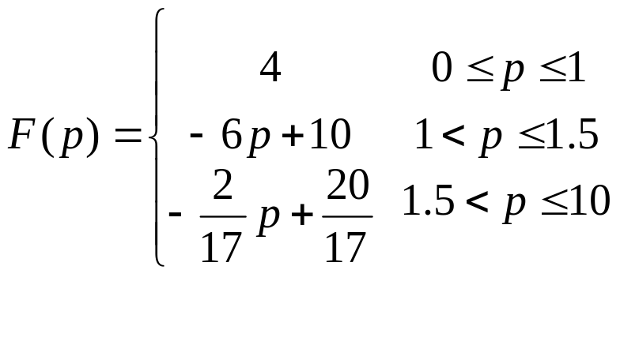
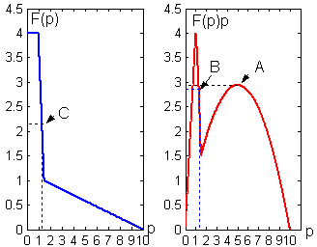
This example shows that using a single price does NOT always lead to optimal average profit, thus the number Two is tight
Constant
μ=2.28
Q(t)
Single price with constant Z(t)=1
P*=5 at A=(5,50/17)
Profit_{Single}= 50/17≈2.9412
λ_{A} = 10/17 ≈0.5882<<2.28 !!
Single price with varying Z(t)
Profit_{single}≤3.42
A=(5,50/17) B=(1.2867,2.9285) C=(1.2867,2.28)

Slide 285
This example shows that using a single price does NOT always lead to optimal average profit, thus the number Two is tight
Constant
μ = 2.28
A choice of 2 prices: p1=31/30 & p2=5, each with prob. 0.5
Q(t)
Profit_{Two}= 0.5F(p1)p1+0.5F(p2)p2
= 0.5*(3.8*31/30+5*10/17)
≈ 3.4339
> Profit_{Single}
λ_{A} = 0.5F(p1)+0.5F(p2)
= 0.5*(3.8+10/17)
≈ 2.1941<2.28
Single price not always enough.
Need Two prices!
A=(5,50/17) B=(1.2867,2.9285) C=(1.2867,2.28)

Slide 286
This example shows that using a single price does NOT always lead to optimal average profit, thus the number Two is tight
Constant
μ = 2.28
A choice of 2 prices: p1=31/30 & p2=5, each with prob. 0.5
Q(t)
Profit_{Two}= 0.5F(p1)p1+0.5F(p2)p2
= 0.5*(3.8*31/30+5*10/17)
≈ 3.4339
> Profit_{Single}
λ_{A} = 0.5F(p1)+0.5F(p2)
= 0.5*(3.8+10/17)
≈ 2.1941<2.28
Using p1=1 & p2=5.15,
max Profit_{av}= 3.4676
A=(5,50/17) B=(1.2867,2.9285) C=(1.2867,2.28)

Slide 287
Our dynamic Pricing and Transmission Scheduling Algorithm PTSA achieves the optimum average profit
PTSA: For a control parameter V (affects a delay tradeoff)…
Admission Control: Observe M(t) & Q(t), choose
P(t)=argmax _{p in P} [ VpF(M(t),p)-2Q(t)F(M(t),p) ]
Whenever the maximum is positive, Z(t)=1,announce P(t);
Else Z(t)=0,send “CLOSED”
Cost/Transmission: Observe S(t) & Q(t), choose
Cost(t)=argmax _{cost in C} [2Q(t)Φ(cost,S(t)) - Vcost(t)]

Slide 288
Our dynamic Pricing and Transmission Scheduling Algorithm PTSA achieves the optimum average profit
PTSA: For a control parameter V (affects a delay tradeoff)…
Admission Control: Observe M(t) & Q(t), choose’
P(t)=argmax _{p in P} [ VpF(M(t),p)-2Q(t)F(M(t),p) ]
Whenever the maximum is positive, Z(t)=1,announce P(t);
Else Z(t)=0,send “CLOSED”
Note: For F(m,p)=mF(p), the AP
can choose p(t) without info of M(t)
Demand-Blind Pricing!

Slide 289
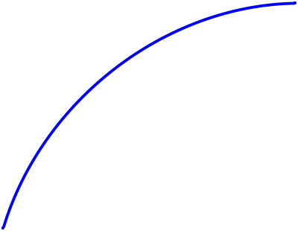
Performance of the joint Pricing and Transmission Scheduling Algorithm (PTSA)
Theorem:
Backlog Bound: Q(t) ≤Qmax = VPmax+Rmax
Achieved Average Profit: Profit_{PTSA}≥ Profit*- O(logV/V)
Profit*
Qmax
V

Slide 290
Proof Technique: Use General Framework for
Stochastic Network Optimization developed in:
L. Georgiadis , M. J. Neely, and L. Tassiulas,
“Resource Allocation and Cross-Layer Control in Wireless
Networks,” Foundations and Trends in Networking,
Vol. 1, no. 1, pp.1-144, 2006.
Available via free download at : http://www-rcf.usc.edu/~mjneely/www
or on NOW Publishers Webpage as free issue (vol. 1 in series).
Plug for my UCSD Talk:
ITA “Short Course” on stochastic network optimization:
Friday, October 5, 2007
CAL-IT2
9am-5pm
http://ita.ucsd.edu/events.php

Slide 291
Simulation setup of PTSA
Recall:
4
F(p)
0
price
10
Constant Φ(cost(t),S(t))=2.28 with no cost; constant M(t)=m
Arrival: (1) R(t) = F(m,p(t)) – deterministic case
(2) R(t) = 2F(m,p(t)) with prob. ½ Bernoulli
0 else -random case

Slide 292
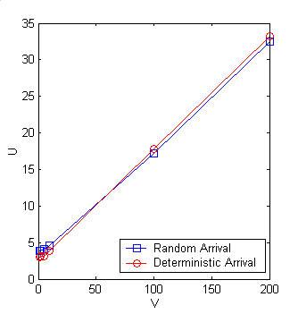
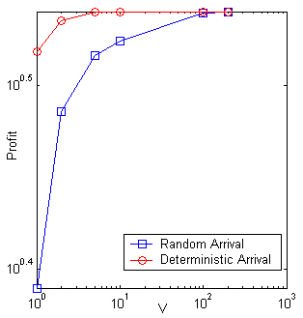
Simulation results of PTSA
Backlog
Avg. Profit
average queue backlog

Slide 293
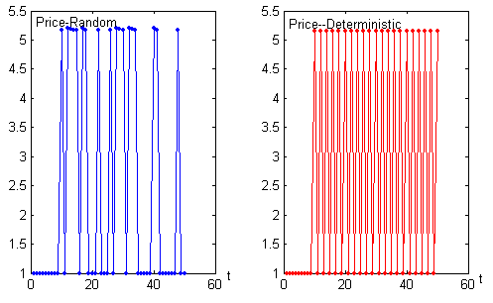
Simulation results of PTSA
Prices chosen by PTSA: “Two-value” phenomenon

Slide 294
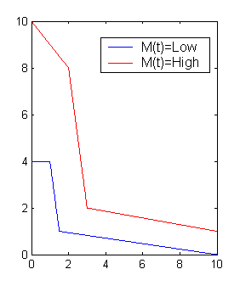
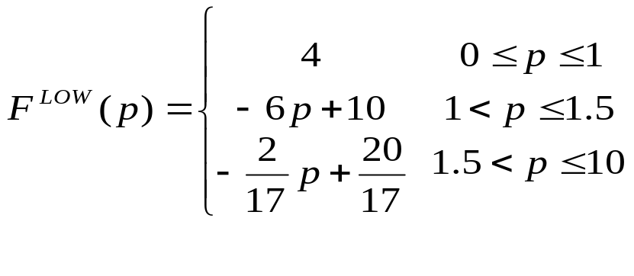
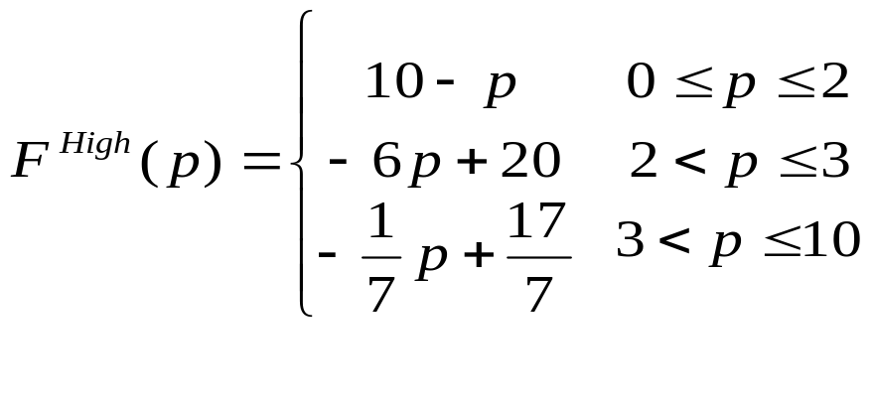
More simulation results of PTSA
Setup: Two Demand states, {High, Low}
Constant service rate 2.28 with zero cost
0.4
0.6
Low
High
0.6
0.4

Slide 295
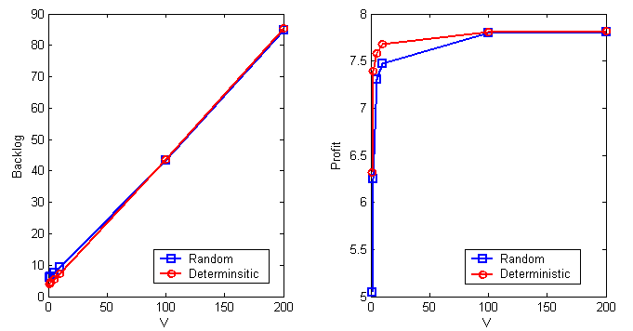
More simulation results of PTSA

Slide 296
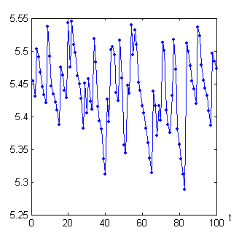
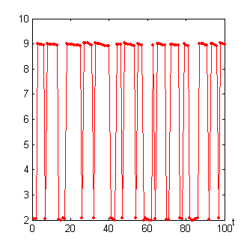
More simulation results of PTSA
Prices chosen when M(t)=Low
Prices chosen when M(t)=High
Aggregate rate 0.2704
Aggregate income 1.4601
Aggregate rate 2.0096
Aggregate income 6.3508
PTSA finds the optimum share

Slide 297
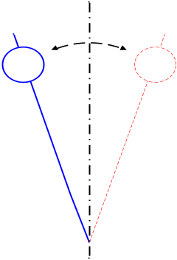
This work characterizes the max avg. profit of APs in wireless mesh nets and offers a revenue maximizing algorithm
The max avg. profit &‘‘The Optimality of Two Prices” Theorem
Joint Pricing and Transmission Scheduling Algorithm (PTSA)
Questions or Comments?

