Slide 1
Towards Correct Network Virtualization
Wang Xiaoke

Slide 2
Outline
Background: Openflow Switch
One-to-many mapping
Supporting Examples
Per-packet Consistency & End-to-end Correctness
Lessons learned

Slide 3
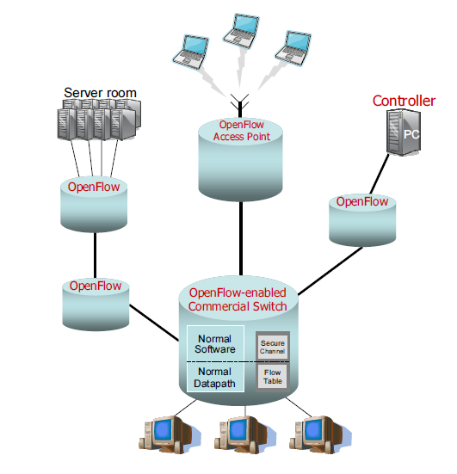
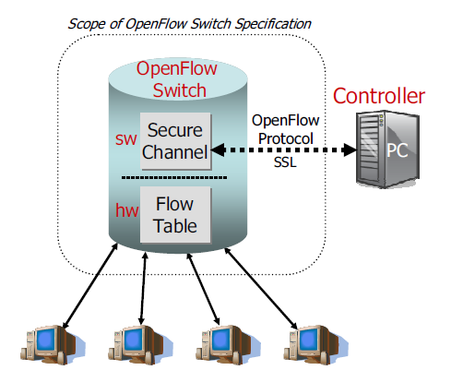
Openflow Switch(1)

Slide 4
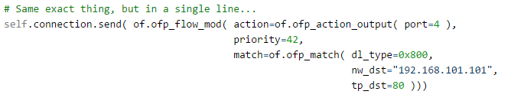
Openflow Switch(2)
cookie | duration_sec | duration_nsec | table_id | priority | n_packets | n_bytes | idle_timeout | hard_timeout
0 | 7s | 639000000 | 0 | 65535 | 2 | 196 | 10 | 30
proto | in_port | dl_vlan | dl_src | dl_dst | nw_src | nw_dst | actions
icmp | 1 | 0xffff | 00:00:00: 00:00:01 | 00:00:00: 00:00:02 | 10.0.0.1 | 10.0.0.2 | output:2
flow entry
The switch will install a flow entry which matches the IP packet whose destination ip address is 192.168.101.101 and tcp port is 80 and send out the packet to port 4

Slide 5
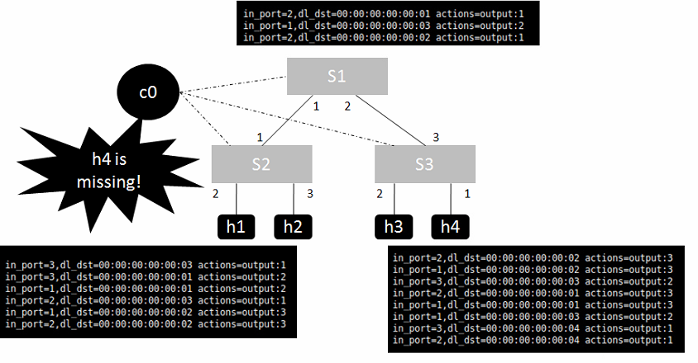

Openflow Switch(3)

Slide 6
One-to-many Mapping
Definition:
  a single abstraction using a distributed set of physical networking elements
Benefits:
  enables a “scale-out” approach to network design
Use case:
  host-hypervisors provide virtual switches. VM migration requires the target VM connected to the same virtual network used by the source VM
  One network functionality mapped to multiple physical elements to meet its performance and scalability needs
  Rule or flow table entries caching schemes, where topologically-mapped “rule caches” at multiple locations in the network concurrently handle traffic for enhancing performance
Virtual Switch
=
P1
P2
P3

Slide 7
Example 1: Logical Firewall
goal:
permits an external server to talk to an internal client if and only if the client has sent a request to the server.
match: dest ip=ip1
action: send to c0 & send to port 3
S1
1
2
3
packet:
ip2-ip1
packet:
ip2-ip1
packet:
ip2-ip1
2.2
2.1
1
c0
client
server
ip2
ip1
2.3
4.2
install a flow entry matching ip1 and send to port 1
packet:
ip1-ip2
4
install a flow entry matching ip1 and drop it
3
packet:
ip1-ip2
4.1
2
S2
1
3
S1 and S2 altogether form a logic virtual switch

Slide 8
Example 2: Network Address Translation
goal:
an active connection will be closed if
the external server doesn't send a packet for (say) 60 seconds
match: dest ip=ip2
action: send to port 1
timeout: 60
S1
send to S1 for 70s
send to S2 for 70s
send to S1 Fail!
1
2
3
c0
client
server
ip2
ip1
2
S2
1
3
match: dest ip=ip2
action: send to port 1
timeout: 60

Slide 9
Per-packet Consistency Is Not Enough(1)
per-packet (or per-flow) consistency: every packet (or flow) traversing the network is processed by exactly one global network configuration and never by a mix of two (or more) configurations
S2
S1
S4
S3
server

Slide 10
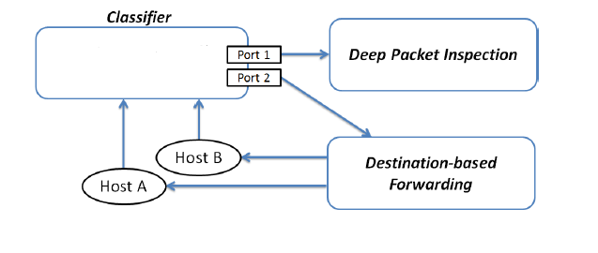
Per-packet Consistency Is Not Enough(2)
A: label=1 fwd(1)
A: label=2 fwd(2)
B: label=1 fwd(1)

Slide 11
End-to-end Correctness
Root-cause: forwarding decision has some dependency on the history, the sequence of previous ‘send’ and ‘receive’ events.
This new model could be permissive of occasional packet-loss, of random forwarding, and of reordering of some packets but in a low probabilities like 0.2%.
No dependency between “send actions” of a flow table entry is observable in the absence of ordered channels.
Ordering of two send actions of a flow table entry is observable if and only if the first send event is sending a packet over an ordered channel.

Slide 12
Lessons Learned
do experiment and analyze results
think beyond a flow (event chaining)

