Slide 1
On the Efficiency of Collaborative Caching in ISP-aware P2P Networks
Talker: Xuanjia Qiu
Mar. 9, 2011

Slide 2
Origin
Publication venue:
  INFOCOM 2011
Authors:
  HKUST: Jie Dai, Bo Li, Fanming Liu
  UoT: Baochun Li
  HUST: Hai Jin

Slide 3
Outline
Background
Features of this paper
Model and analysis
Evaluation

Slide 4
Background
Why inter-ISP traffic reduction is an important problem
Existing approaches to reduce inter-ISP traffic
This paper proposes:
  Cache server within each ISP
  Benefits:
    Costly transit traffic is reduced
    latency of each package is reduced
  Challenges:
    Cache server resource allocation under storage and bandwidth constraints

Slide 5
Features of this paper
Simple model
  Lots of ideal assumptions
  With simple mathematics

Slide 6
Traffic model
Known parameters:
  number of concurrent users in the whole system: x
  the streaming rate of each channel
  the file size of each channel: f_i
  in-degree of each peer (same as out-degree): a constant d_{in}
Known distribution:
  Channel popularity distribution
  ISP user distribution

Slide 7
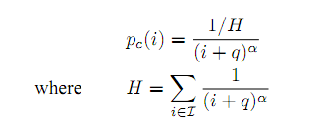
Channel popularity distribution
  the probability that any online user is currently accessing to the video channel)
  Zipf-mandelbrot distribution, defined as
    indices of channels are ordered by their popularity

Slide 8

ISP user distribution
  the probability that any online user is currently in ISP k
  Defined as:
    indices of ISPs are ordered by their popularity

Slide 9
Other assumptions:
  Each channel has the same streaming length, thus size of video channel only depends on its streaming rate

Slide 10
Framework and approaches
Framework:
  Model the inter-ISP traffic without cache servers
  Optimization of resource allocation on cache servers
  Consider the ISP-peering
Approaches:
  Calculate:
    the number of concurrent users of channel i :
    the number of concurrent users of channel i in ISP k
  Inter-traffic
    locality-unaware peer selection
    Locality-aware peer selection: hyper-geometric distribution

Slide 11


the number of concurrent users of channel i
the number of concurrent users of channel i in ISP k

Slide 12

Inter-ISP traffic
Locality-unaware peer selection
  neighboring peers are evenly distributed among all candidate peers
    the number of neighbors from different ISPs is decided mainly by the ISP user population)
  Hyper-geometric distribution

Slide 13
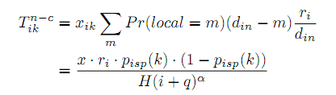
Locality-unaware peer selection (cont.)

Slide 14
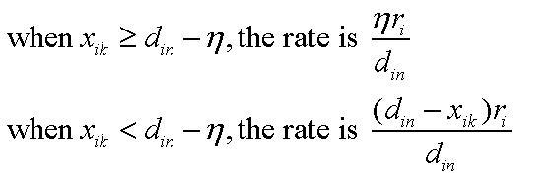
Inter-ISP traffic
Locality-aware peer selection
  Assume each peer has ή external links
  Calculate estimated inter-ISP traffic rate per peer:

Slide 15
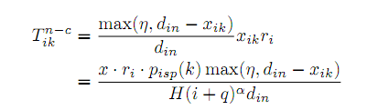
Locality-aware peer selection (cont.)

Slide 16


Locality-unaware vs. Locality-aware
Locality-unaware
Locality-aware
Difference

Slide 17
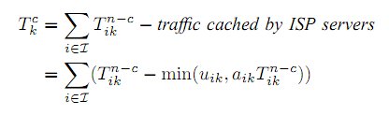
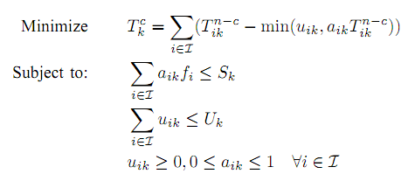
Caching resource allocation
Constraints on the storage capacity and uploading bandwidth capacity

Slide 18
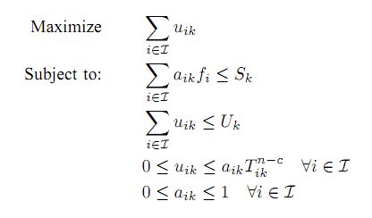

Slide 19
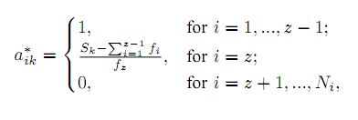
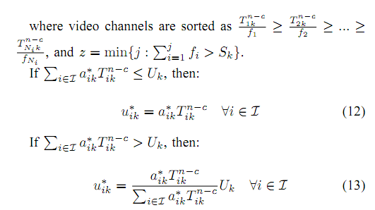
Solution

Slide 20
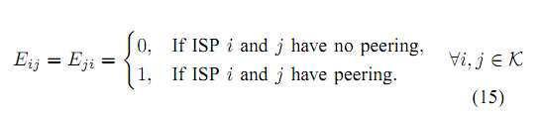

ISP peering
ISP peering relation matrix:
Number of peers in channel i that belong to ISP k or peering ISPs of ISP k:

Slide 21
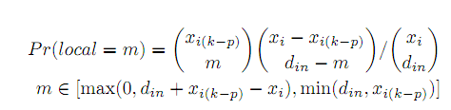


Transit traffic

Slide 22
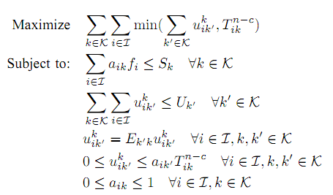
Resource allocation:

Slide 23
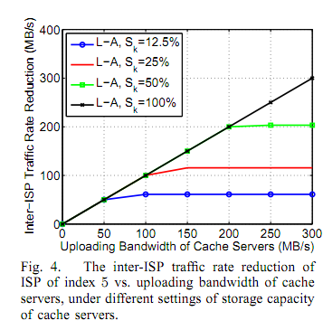
Selected results of performance evaluation
We can see the relationship between storage bottleneck and bandwidth bottleneck

Slide 24
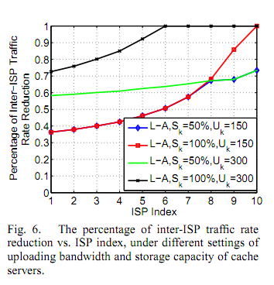

Slide 25
Critics of the paper
Some estimation is quite rough, e.g.,
  The expected global inter-ISP traffic is not equal to the simply summing up of expected inter-ISP traffic of all ISPs
    the random variables are correlated

