Slide 1
Deep Diving into BitTorrent Locality

Slide 2
Survey on related work
Deep Diving into BitTorrent Locality, Ruben Cuevas Rumin et al., infocom2011.
  System parameters
  Modeling
    Percentage of localized unchokes and unlocalized unchokes
    BitTorrent traffic matrix
  Measurement
    Demographics of BitTorrent
  Experiments
    Locality-biased overlays
    Impact of Locality on ISPs & Users

Slide 3
System parameters
BitTorrent
  Multiple torrents across multiple ISPs
    V(T): the set of BitTorrent nodes participating in torrent T.
    V(A,T): the subset of V(T) that belongs to ISP A.
    k: the number of unchoked neighbors.
    W: the size of neighborhood.
  Speed distribution in different ISPs.

Slide 4
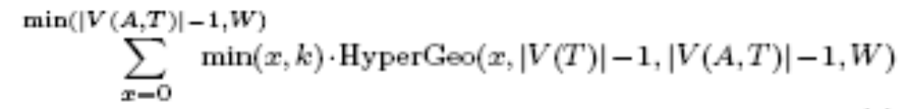
Random overlay & Locality overlay
Localized unchokes under random overlay
  Sparse mode
    Sparse mode: for nodes participating in torrent T, the nodes outside A have dissimilar speeds with nodes within A.
    Stratification effect in BitTorrent.
    So, if a peer in A has x local nodes as neighbors, it will unchoke min(x, k) local nodes.
    The expected number of localized unchokes is:

Slide 5

Random overlay & Locality overlay
    Taking the expected value of localized unchokes, the condition for Random to localize well in sparse mode:
  Dense mode:
    Dense mode: for nodes participating in torrent T, the nodes outside A have similar speeds with nodes within A.
    Stratification doesn’t localize traffic inside A.
    So, if a peer in A has x local nodes as neighbors, it will unchoke k*x/W local nodes in expectation.
    Substituting min(x, k) with k*x/W, the expected number of localized unchokes is:

Slide 6
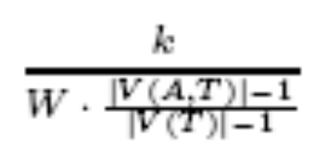
Random overlay & Locality overlay
Localized unchokes under locality:
  Locality mechanism: provide each peer as many local neighbors as possible. In sparse mode, as |V(A,T)|-1 >= k, all unchokes are localized; in dense mode, as |V(A,T)|-1 >= W, all unchokes are localized.
  The expected improvement factor in sparse mode (in the case with |V(A,T)|-1 >= k):

Slide 7
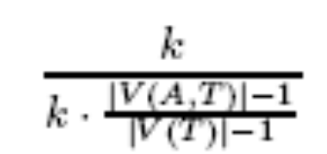
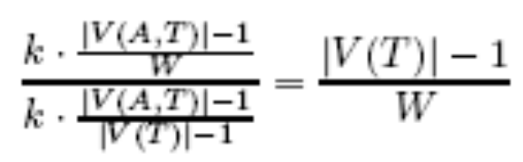
Random overlay & Locality overlay
  The expected improvement factor in dense mode:
    The case with |V(A,T)|-1 >= W
    The case with |V(A,T)|-1 <W

Slide 8
Measurement: Demographics of BitTorrent
Measurement methodology:
  A custom crawler scrapes a torrent indexing site to obtain .torrent meta information files.
  The crawler queries repeatedly the trackers and uses the gossip protocol to obtain all the IP addresses.
  Map the gathered IP addresses to ISPs and countries using the MaxMind database.
  The crawler also obtains the number of seeders and leechers in each torrent.

Slide 9
Measurement: Demographics of BitTorrent
High level characterization of the dataset
  The cdf of the number of nodes in a torrent
  The cdf of the number of active nodes in a ISP.
  The cdf of the number of distinct torrents in a ISP.
Speed agnostic bounds for the measured demand demographics
  With the measured demographics and the model for localized unchokes, we can get the cdf of the percentage of local unchokes.

Slide 10
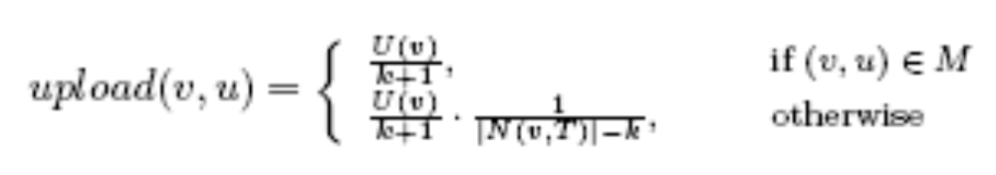
BitTorrent Traffic Matrices
Each node is assigned an upload speed according to the speed distribution.
Use b-matching to get pairs of nodes (the set of M) that unchoke each other:
Modeling Seeders:
  Uniform policy: all neighbors of servers get an equal share.
  Proportional policy: neighbors get an allotment in proportion to their speed.

Slide 11
Experiments
Experiment methodology:
  Input to the experiments:
    Demographics
    Speed distributions
    Seeder/leecher ratios
  Traffic matrix computation
  Performance metrics:
    Transit traffic reduction compared to random
    User QoS reduction

Slide 12
Experiments
6 largest ISPs:
  The upload speeds of US1, US2, US3 are larger than those of EU1, EU2, EU3; the speeds are median values got from Ookla.

Slide 13
Experiments
Results:
  Comparing overlays:
    Three overlay construction strategies: Local only if faster (LOIF); Locality; Strict
    LOIF and Locality don’t bound the number of inter-AS links.
    Strict permits 1 inter-AS overlay link per torrent for a given link.
    The results show:
      LOIF reduces the transit traffic without deteriorating user QoS. The reduction is not much and the user QoS may be improved;
      Locality reduces more transit traffic than LOIF. The QoS of ISPs with large speed is improved, the QoS of ISPs with small speed is deteriorated.
      About 50% of transit traffic that can not be reduced by locality is due to the unlocalizable torrents (which have few local nodes in ISP A).
      Strict can reduce the transit traffic of unlocalizable torrents. But the QoS of nodes downloading unlocalizable torrents drops by almost 99%

Slide 14
Conclusions
The calculation of the number of local unchokes under random overlay and locality overlay is clear. But the calculation of traffic matrices under these overlays is not clear (which needs to consider nodes’ speed distribution).
The results of comparing overlays show
  LOIF is a win-win strategy for ISPs and users.
  Locality strategy improves the QoS of ISP with large speed, deteriorate the QoS of ISP with small speed.
  Unlocalizable torrents are responsible for the transit traffic that can not be reduced by locality.
  Strict strategy drops the QoS of nodes downloading unlocalizable torrents by 99%.

