Slide 1
Discrete-Event Simulation:
A First Course
Steve Park and Larry Leemis
College of William and Mary

Slide 2
Technical Attractions of Simulation*
Ability to compress time, expand time
Ability to control sources of variation
Avoids errors in measurement
Ability to stop and review
Ability to restore system state
Facilitates replication
Modeler can control level of detail
*Discrete-Event Simulation: Modeling, Programming, and Analysis by G. Fishman, 2001, pp. 26-27

Slide 3
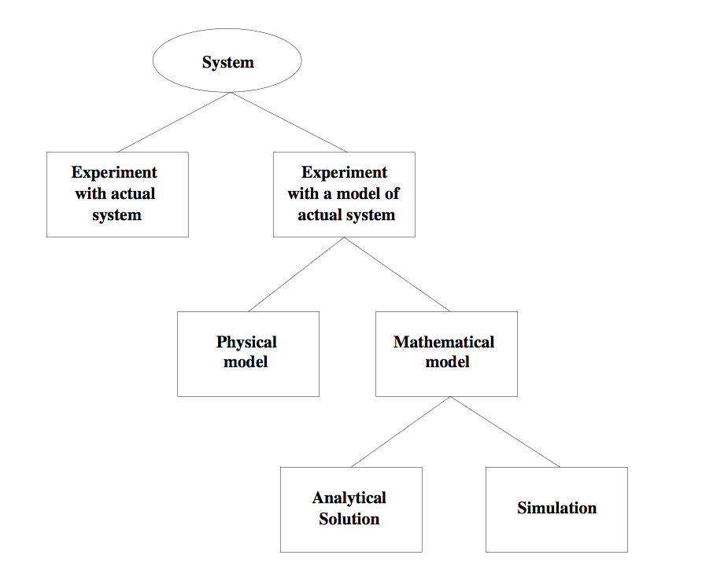
Ways To Study A System*
*Simulation, Modeling & Analysis (3/e) by Law and Kelton, 2000, p. 4, Figure 1.1

Slide 4
Introduction
What is discrete-event simulation?
  Modeling, simulating, and analyzing systems
  Computational and mathematical techniques
Model: construct a conceptual framework that describes a system
Simulate: perform experiments using computer implementation of the model
Analyze: draw conclusions from output that assist in decision making process
We will first focus on the model

Slide 5
Characterizing a Model
Deterministic or Stochastic
  Does the model contain stochastic components?
  Randomness is easy to add to a DES
Static or Dynamic
  Is time a significant variable?
Continuous or Discrete
  Does the system state evolve continuously or only at discrete points in time?
  Continuous: classical mechanics
  Discrete: queuing, inventory, machine shop models
Notes:
All systems have some level of randomness
Static: lottery
Continuous: diffeq

Slide 6
Definitions
Discrete-Event Simulation Model
  Stochastic: some state variables are random
  Dynamic: time evolution is important
  Discrete-Event: significant changes occur at discrete time instances
Monte Carlo Simulation Model
  Stochastic
  Static: time evolution is not important

Slide 7
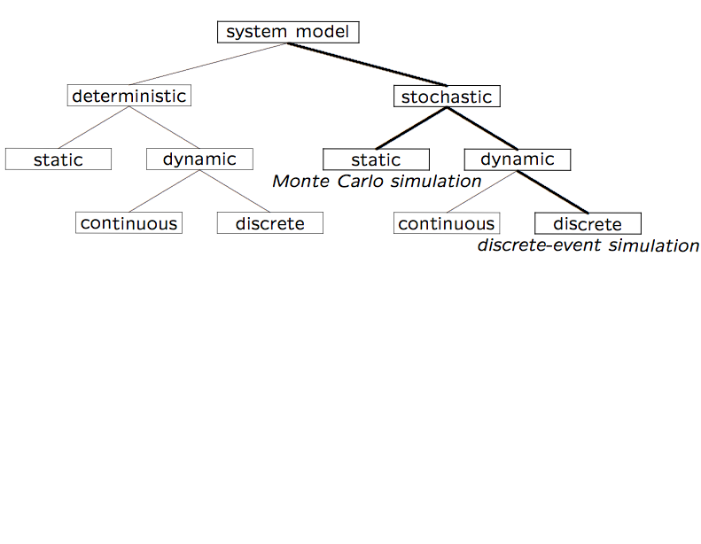
Model Taxonomy
Notes:
DDC: Newton’s cooling law
SDC: Pizza oven with random opens/closes

Slide 8
DES Model Development
Algorithm 1.1 — How to develop a model:
  Determine the goals and objectives
  Build a conceptual model
  Convert into a specification model
  Convert into a computational model
  Verify
  Validate
Typically an iterative process

Slide 9
Three Model Levels
Conceptual
  Very high level
  How comprehensive should the model be?
  What are the state variables, which are dynamic, and which are important?
Specification
  On paper
  May involve equations, pseudocode, etc.
  How will the model receive input?
Computational
  A computer program
  General-purpose PL or simulation language?

Slide 10
Verification vs. Validation
Verification
  Computational model should be consistent with specification model
  Did we build the model right?
Validation
  Computational model should be consistent with the system being analyzed
  Did we build the right model?
  Can an expert distinguish simulation output from system output?
Interactive graphics can prove valuable

Slide 11
A Machine Shop Model
150 identical machines:
  Operate continuously, 8 hr/day, 250 days/yr
  Operate independently
  Repaired in the order of failure
  Income: $20/hr of operation
Service technician(s):
  2-year contract at $52,000/yr
  Each works 230 8-hr days/yr
How many service technicians should be hired?

Slide 12
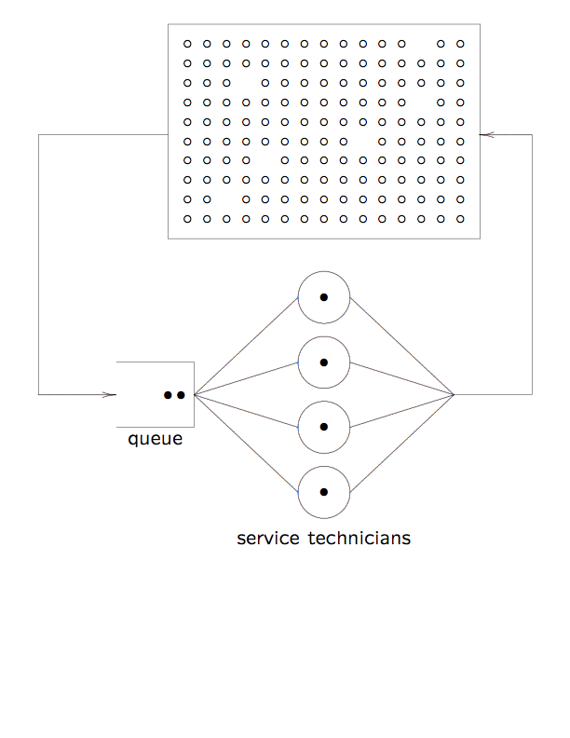
System Diagram
Notes:
Movement of machines is conceptual, as is queue

Slide 13
Algorithm 1.1.1 Applied
Goals and Objectives:
  Find number of technicians for max profit
  Extremes: one techie, one techie per machine
Conceptual Model:
  State of each machine (failed, operational)
  State of each techie (busy, idle)
  Provides a high-level description of the system at any time
Specification Model:
  What is known about time between failures?
  What is the distribution of the repair times?
  How will time evolution be simulated?

Slide 14
Algorithm 1.1 Applied
Computational Model:
  Simulation clock data structure
  Queue of failed machines
  Queue of available techies
Verify:
  Software engineering activity
  Usually done via extensive testing
Validate:
  Is the computational model a good approximation of the actual machine shop?
  If operational, compare against the real thing
  Otherwise, use consistency checks

Slide 15
Observations
Make each model as simple as possible
  Never simpler
  Do not ignore relevant characteristics
  Do not include extraneous characteristics
Model development is not sequential
  Steps are often iterated
  In a team setting, some steps will be in parallel
  Do not merge verification and validation
Develop models at three levels
  Do not jump immediately to computational level
  Think a little, program a lot (and poorly);
  Think a lot, program a little (and well)

Slide 16
Simulation Studies
Algorithm 1.1.2 — Using the resulting model:
  Design simulation experiments
    What parameters should be varied?
    Perhaps many combinatoric possibilities
  Make production runs
    Record initial conditions, input parameters
    Record statistical output
  Analyze the output
    Use common statistical analysis tools (Ch. 4)
  Make decisions
  Document the results

Slide 17
Algorithm 1.1.2 Applied
Design Experiments
  Vary the number of technicians
  What are the initial conditions?
  How many replications are required?
Make Production Runs
  Manage output wisely
  Must be able to reproduce results exactly
Analyze Output
  Observations are often correlated (not independent)
  Take care not to derive erroneous conclusions

Slide 18
Algorithm 1.1.2 Applied
Make Decisions
  Graphical display gives optimal number of technicians and sensitivity
  Implement the policy subject to external conditions
Document Results
  System diagram
  Assumptions about failure and repair rates
  Description of specification model
  Software
  Tables and figures of output
  Description of output analysis
DES can provide valuable insight about the system

Slide 19
Programming Languages
General-purpose programming languages
  Flexible and familiar
  Well suited for learning DES principles and techniques
  E.g.: C, C++, Java
Special-purpose simulation languages
  Good for building models quickly
  Provide built-in features (e.g., queue structures)
  Graphics and animation provided
  E.g.: Arena, Promodel

Slide 20
Terminology
Model vs. Simulation (noun)
  Model can be used WRT conceptual, specification, or computational levels
  Simulation is rarely used to describe the conceptual or specification model
  Simulation is frequently used to refer to the computational model (program)
Model vs. Simulate (verb)
  To model can refer to development at any of the levels
  To simulate refers to computational activity
Meaning should be obvious from the context

Slide 21
Looking Ahead
Begin by studying trace-driven single server queue
Follow that with a trace-driven machine shop model

