Slide 1
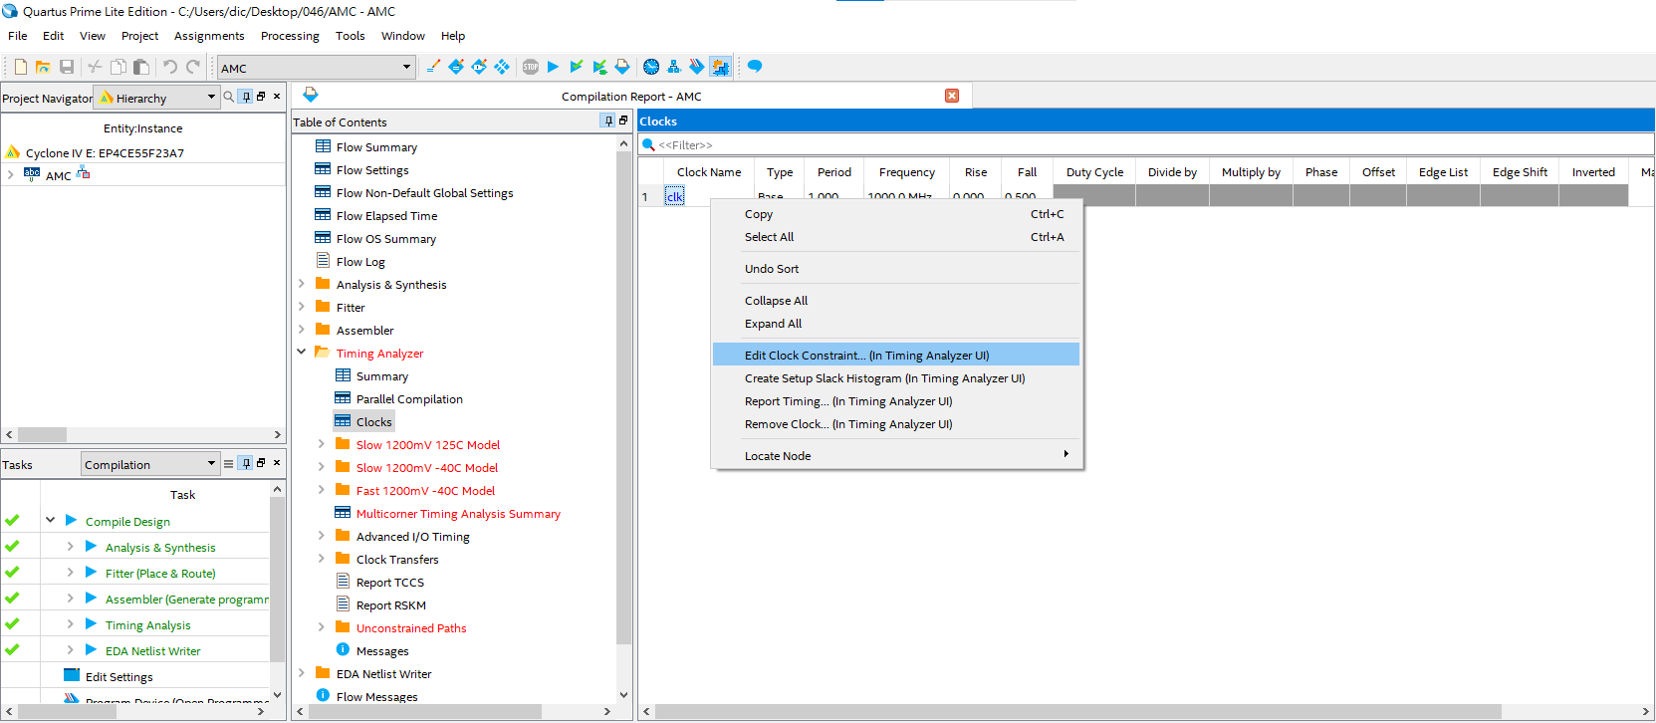
修改 clk constraints
Table of contents > Timing Analyzer > clocks
2. Right Click
3. Click
1. Click

Slide 2
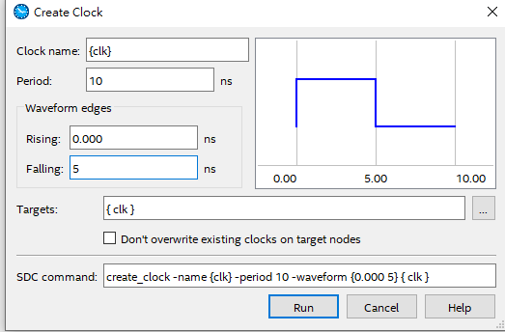
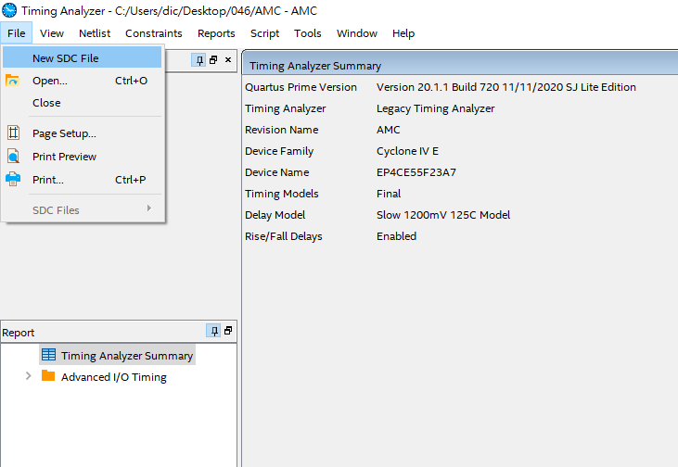
4.Click
1. Modify cycle period
2. Half of the cycle period
3. Copy command
Click

Slide 3
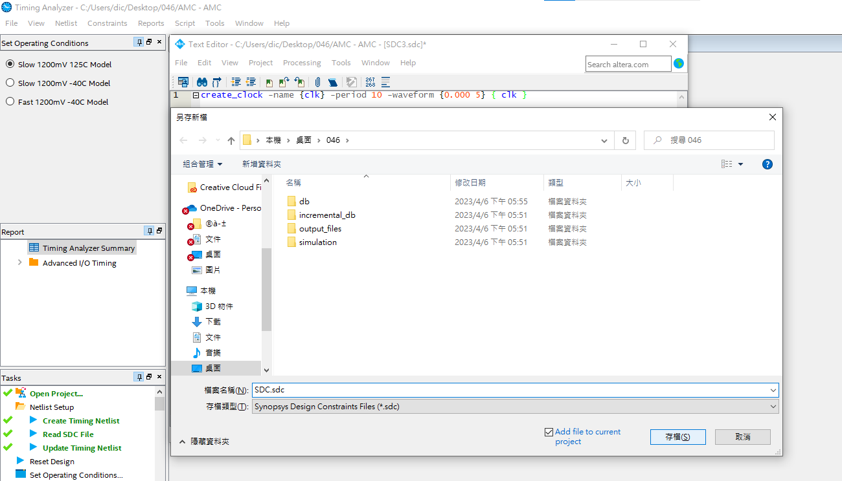
Table of contents > Timing Analyzer > clocks
Paste command and save sdc file
Click

Slide 4
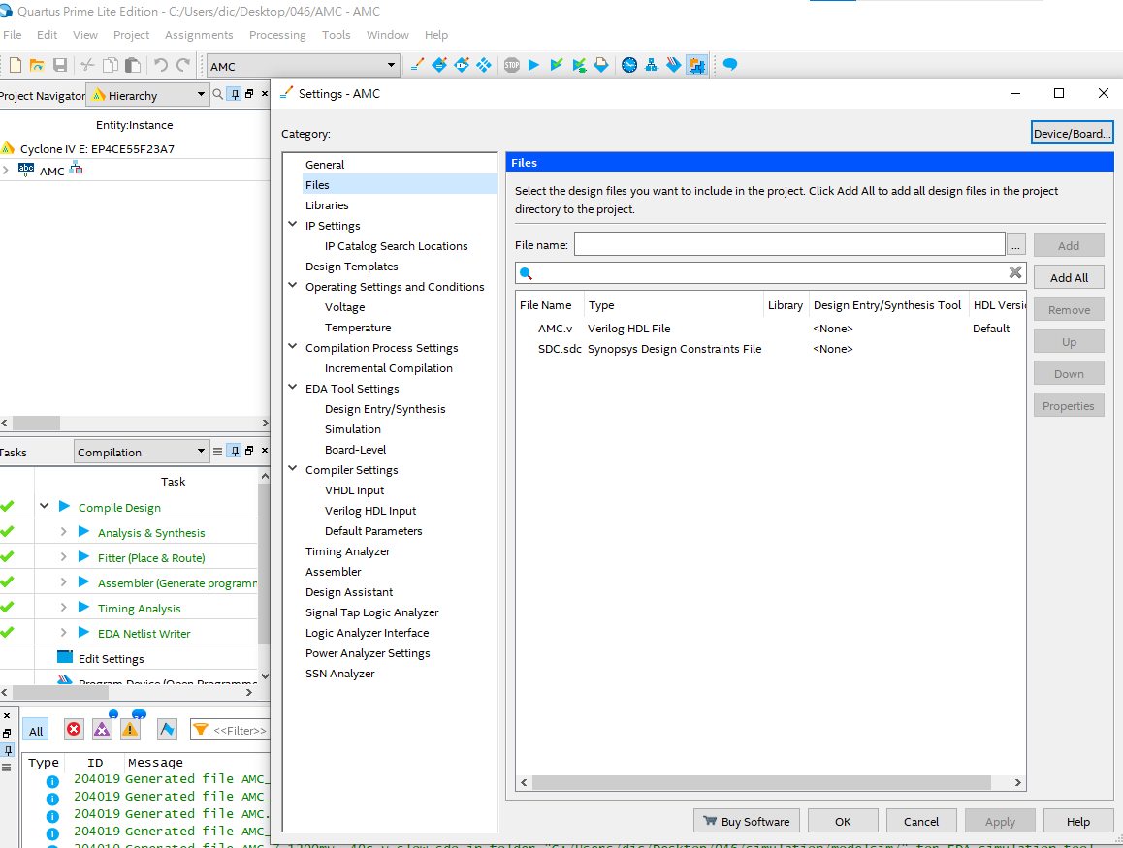
Assignment > Settings > Files
Check if the newly created SDC file is inside. If it is not, please manually add it.

Slide 5
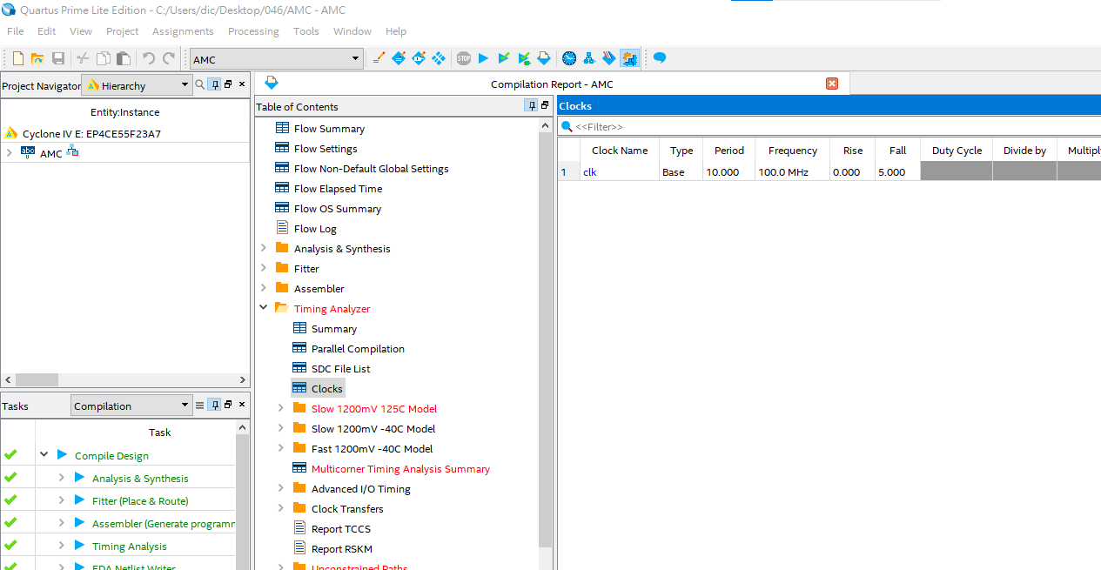
After recompiling, clock has been modified.

