Slide 1
MSc DISSERTATION · CASA, UCL
↘
Testing a Flow-Based Definition of Gentrification
↗
Cascading flows in London, from Census origin–destination data, 2011–2021
Yujing (Olivia) Xing
Does tracking who moves recover what attribute methods call gentrification?
It doesn’t as an equivalence — but the mechanisms behind the failure separate gentrification’s subtypes.
Notes:
[30s] The classic theory says gentrification IS a flow phenomenon - a cascade of moves down the deprivation hierarchy. I take that seriously: I adopt the cascade as a candidate flow-based definition, measure it across London between the 2011 and 2021 censuses, and test whether it recovers what attribute-based methods call gentrification. As an equivalence it fails - but unpooling the cascade into measurable mechanisms turns the failure into the most interesting result: the flow lens separates gentrification's subtypes. That's the arc of the talk.

Slide 2
MOTIVATION
Why follow the movers?
WHY? Why measure gentrification through moves, rather than who lives there?
1
The classic chain — Affluent residents move in; poorer residents are pushed down the hierarchy (Marcuse 1985). If the theory is right, the cascade IS a definition of gentrification.
2
Mechanism inferred, not observed — Most studies infer the cascade from neighbourhood attributes; almost none analyse origin–destination migration flows directly, at whole-city scale, with open data.
3
Direct evidence is inconsistent — Mover-level studies do not consistently support a strong downward cascade (Freeman et al. 2024; Ding et al. 2016) — so the definition deserves a test, not an assumption.
Caveat up front: these are area-to-area flows — “from a wealthier area” is not “a wealthier person”.
RESULT Adopt the cascade as a candidate definition — and test it. → First, make the cascade measurable.
2
Notes:
[55s] The intuition is old and respectable - Marcuse's chain displacement: gentrification radiates outward as a chain of moves. But it has only ever been assumed, never tested at whole-city scale with open flow data - and the few direct mover-level tests find the cascade weak or mixed. So I don't assert the definition; I adopt it as a candidate and test it. One caveat up front: I measure area-to-area flows - 'from a wealthier area' is not 'a wealthier person'. So: how do we make the cascade measurable?

Slide 3
METHODOLOGY · 1 OF 4
One fixed ladder, four elementary flows
WHY? What does the classic chain look like on a deprivation ladder?
HOW — FIX THE RULER
EVERY CROSS-DECILE MOVE IS ONE OF FOUR FLOWS
D10
IMD 2010, held still for both censuses.
Change = movement, not re-ranking.
IMD 2019 never builds the classifier — it stays reserved as the independent outcome (non-circular).
IW
inflow from wealthier areas
OW
outflow to wealthier areas
OP
outflow to poorer areas
IP
inflow from poorer areas
D1
CASCADE = IW + OP
wealthier in, poorer out-and-down — the chain’s signature
COUNTER = OW + IP
the mirror direction · lateral (same-decile) moves cross no hierarchy
DATA · all open, anonymised — 982 London MSOAs · Census OD flows 2011 & 2021 (Nomis) · IMD 2010 & 2019
RESULT Four flows on one fixed ladder. → Which direction carries a neighbourhood’s turnover?
3
Notes:
[45s] The design choice everything rests on: the deprivation ruler is held still at 2010 for both census years - so change between censuses is attributable to movement, not re-ranking, and IMD 2019 stays entirely on the outcome side, keeping validation non-circular by construction. On that ladder, every move that crosses the hierarchy is one of four elementary flows: the cascade pair - inflow-from-wealthier, outflow-to-poorer - and the mirror counter pair. 982 MSOAs, open OD data. Which direction carries an area's turnover? That's the classifier.

Slide 4
METHODOLOGY · 2 OF 4
The classifier: churn → a flow-regime typology
WHY? Which direction of ladder-crossing movement carries an area’s turnover?
AXIS 1 · Cascade Dominance
Cascade_Churn / (Cascade + Counter churn)
which direction carries the deprivation-crossing churn — churn adds flows, after Dennett & Stillwell (2008)
AXIS 2 · Cross-Decile Share
(Cascade + Counter churn) / Total migration
how much turnover engages the ladder at all — lateral moves stay in the denominator
Cascade-led
dominance > 0.52
Symmetric
0.48 – 0.52
Counter-led
dominance < 0.48
Lateral
cross-decile share < P25
Cascade-led = more affluent inflow and poorer outflow than the counter direction — the classic mechanism, operational.
RESULT Cascade-led is the candidate definition, made testable. → But London is not a vacuum: which ruler, and which flows?
4
Notes:
[35s] The main classifier - everything else supports or diagnoses it. Churn adds the flows in each direction, following Dennett & Stillwell. Two axes: cascade dominance - which direction carries the deprivation-crossing churn - and cross-decile share - how much of total turnover engages the ladder at all. Four regimes; cascade-led is the candidate definition made operational. But London is not a vacuum - which ruler, and which flows?

Slide 5
METHODOLOGY · 3 OF 4
Three frames — London-only stays the core
WHY? London is not a vacuum: so which ruler, and which flows?
A
B
C
CORE
ISOLATES RE-RANKING
ADDS BOUNDARY EFFECTS
London-internal flows
London-relative ladder
London-internal flows
National ladder
+ external flows
National ladder
A → B changes only the ruler · B → C adds only external moves
— every cross-frame contrast is attributable to exactly one mechanism.
~69% of London MSOAs sit below national D6: the national ladder compresses London, so Frame A stays the faithful gentrification lens; C is context.
RESULT The instrument is built. → How would we know whether cascade really equals gentrification?
5
Notes:
[30s] A naive London-vs-national comparison confounds changing the ruler with adding external moves. The three-frame design separates them: B minus A is pure re-ranking; C minus B is pure external flows. And because 69% of London sits below national decile 6, the national ladder squashes London - so London-only Frame A stays the core lens. Keep the external channel in mind. The instrument is built; how would we know whether cascade equals gentrification?

Slide 6
METHODOLOGY · 4 OF 4
Three independent checks — on two clocks
WHY? How would we know whether cascade really equals gentrification?
1 · Outcome
IMD percentile change, 2010 → 2019
did deprivation actually improve?
2 · Attribute
Yee & Dennett (2022)
the established classification, labels built on 2001–2011 change
3 · Composition
Occupational ascent, SOC 1–3
professionalisation of residents, after D. Smith (2022)
THE TWO CLOCKS — because Yee’s labels describe 2001–2011 change:
2011 flows = CONCURRENT VALIDATION
flows measured in the window the labels describe
2021 flows = PERSISTENCE TEST
does the alignment survive a decade on? (never “2021 flows vs 2011 labels”)
RESULT Three instruments, one hypothesis, two clocks. → What happens when you check.
6
Notes:
[40s] If cascade really equals gentrification, three independently built yardsticks should agree: the outcome check - did deprivation improve, 2010 to 2019; the attribute check - Yee & Dennett's classification; the composition check - occupational ascent in SOC 1 to 3. And one design point that pre-empts an obvious objection: Yee's labels are built on 2001-to-2011 change, so the two census years answer different questions - 2011 is concurrent validation, 2021 is a decade-later persistence test. We never validate 2021 flows against 2011-era labels. The next four slides are what happens when you check.

Slide 7
FINDINGS · 1 OF 4
Cascade ≠ Attribute-defined Gentrification
WHY? Does cascade-led recover attribute-defined gentrification?
16
25
197
areas where both agree
Yee-GEN & cascade-led
attribute-only
Yee-GEN, no cascade
flow-only
cascade, no Yee-GEN
The IMD kicker
Yee-GEN alone: +0.043 IMD gain · Yee-GEN + cascade: only +0.017.
Cascade is not the engine of measured gentrification.
The twist
The flow method’s own IMD signal sits in the counter direction; the rare agreement is 2011, inner London.
Occupational ascent concurs (independent, ρ ≈ +0.02).
RESULT Cascade ≠ attribute gentrification. → A bare null? — or did “cascade-led” pool different mechanisms?
7
Notes:
[60s] The first check. Of the areas either method flags, only 16 agree; 25 are attribute-only, 197 flow-only. The IMD kicker: Yee's gentrifying areas improve on deprivation, but adding a cascade signal on top weakens the gain - cascade is not the engine of measured gentrification. And the twist: the flow method's own deprivation signal lives in the counter direction; the only agreement is classic 2011 inner London. Occupational ascent tells the same story. Now - is that a bare null? Or did 'cascade-led' pool genuinely different mechanisms into one label? That suspicion drives the next step.

Slide 8
FINDINGS · 2 OF 4
Unpooling the cascade: a time-symmetric mechanism tree
WHY? Is “cascade-led” one mechanism — or several wearing one label?
HOW — split every cascade-led area on two measured properties, identically in both years: inflow share (≥ 0.25, a threshold sitting in an empirical gap both years) and, for outflow cascades, external-arm share (≥ 0.5); frame-robustness (Frame A ∧ C) separates the residual.
counts: 2011 → 2021
inflow-driven
inflow ≥ 0.25 ∧ frame-robust
56 → 13
the gentrification arm collapses
frame-sensitive
inflow ≥ 0.25, not robust
57 → 14
honest residual, reported not narrated
outflow-external
inflow < 0.25, ext arm ≥ 0.5
19 → 78
×4.1 · 100% outer — the exodus
outflow-internal
inflow < 0.25, ext arm < 0.5
81 → 90
stable backdrop · national-ladder artefact
Only 8 MSOAs are inflow-driven in both years — incl. Camden 026 & Tower Hamlets 010, the cascade-dominance extremes of the whole city.
RESULT Four mechanisms, not one — and 2021’s cascade is an outward exodus, not relocation. → Re-ask the Yee question at leaf level.
8
Notes:
[70s] So we unpool. Every cascade-led area is split by two measured properties, applied identically to both years: how much of its cascade churn is the arrival arm - inflow share, threshold 0.25, which sits in an empirical gap in both years - and for outflow cascades, whether the poorer-bound out-moves leave London - external-arm share at 0.5. Four leaves. The inflow-driven gentrification arm collapses from 56 to 13. The external-majority outflow class explodes 19 to 78 - times four, all outer London - the pandemic exodus, emerging rather than relocating. Internal-majority outflow is the stable backdrop, a national-ladder artefact. And only eight areas hold the inflow-driven class in both years - including Camden 026 and Tower Hamlets 010, the cascade-dominance extremes of the city. With four mechanisms instead of one, we can re-ask the Yee question properly - at leaf level.

Slide 9
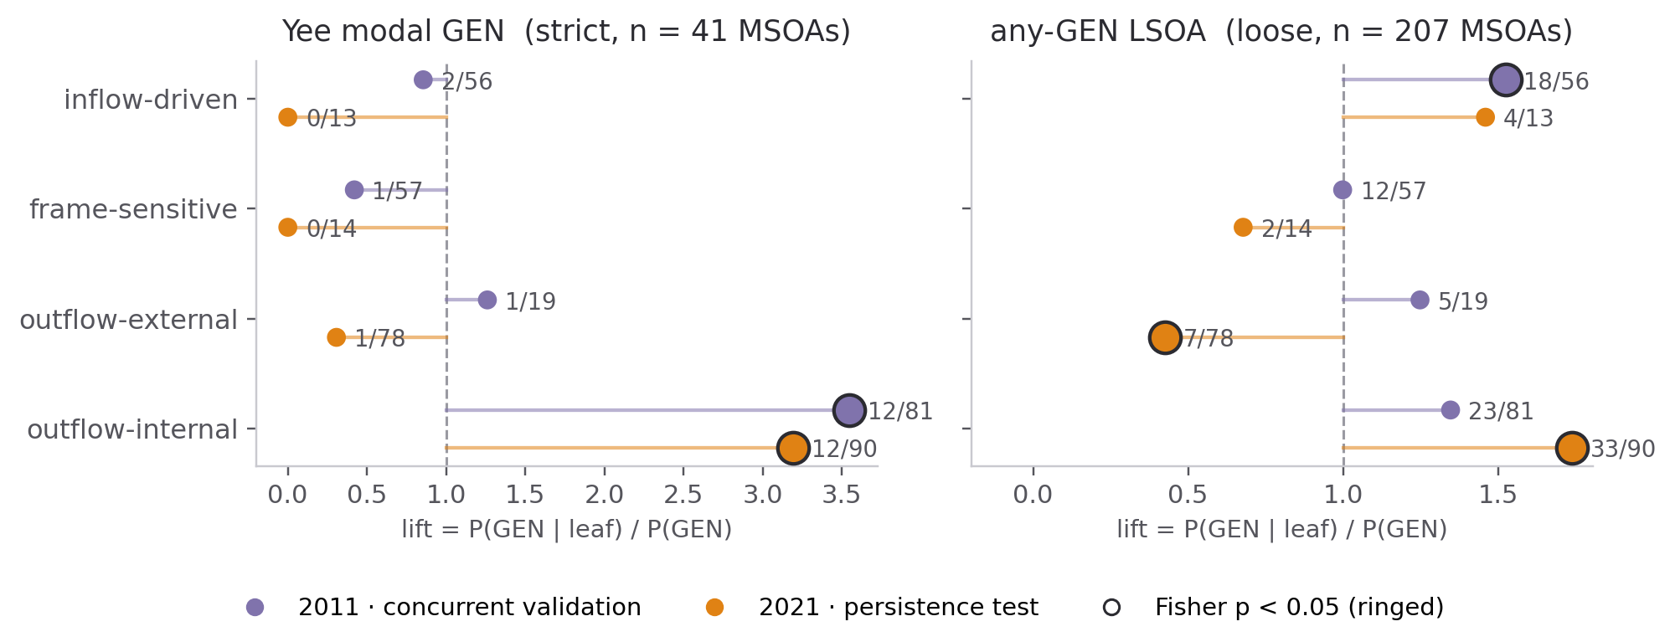
FINDINGS · 3 OF 4
The leaf-level test: where does Yee’s GEN actually live?
WHY? Does GEN concentrate in the inflow-driven leaf, as the candidate predicts?
HOW — enrichment: lift = P(GEN | leaf) / P(GEN), Fisher’s exact test, BH-corrected.
outflow-internal modal-GEN lift 3.55 → 3.19 — the only cell significant on BOTH clocks
inflow-driven loose lift 1.52, concurrent only (p = .043, fails BH) — does not persist
exodus (outflow-ext.) GEN-depleted, lift 0.43 (p = .006) — not gentrification moving out
counter-led GEN-depleted on both clocks — the anti-gentrification direction
RESULT The prediction fails — GEN lives in the internal-outflow branch. → Why would gentrifying areas sit in the OUTFLOW arm?
9
Notes:
[70s] The sharper hypothesis: Yee's GEN should concentrate in the inflow-driven leaf. We test with enrichment - the lift of P(GEN given leaf) over the base rate, Fisher's exact test, BH-corrected; V and ARI are retired because a 71% Stable base swamps them at these sample sizes. The result rejects the prediction, informatively. Inflow-driven shows only a modest loose signal in the concurrent test, which fails correction and does not persist. The strong, correction-robust signal is outflow-internal: strict-GEN lift 3.55 concurrent, 3.19 in the persistence test - the only cell significant on both clocks. The exodus class is GEN-depleted - external corroboration it isn't gentrification relocating. Counter-led is depleted throughout. So gentrifying areas sit in the outflow branch. Why? Yee's own subtypes answer.

Slide 10
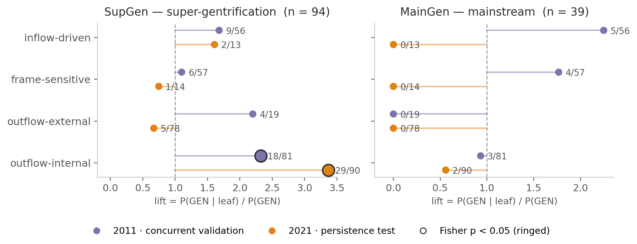
FINDINGS · 4 OF 4
Gentrification’s subtypes separate by mechanism
WHY? Why do attribute-gentrifying areas sit in the outflow branch?
SupGen ≈ outflow-internal
lift 2.32 → 3.37 (q < 1e-9) — strengthens across the decade. Prime London’s displacement arm (K&C, Westminster).
MainGen ≈ inflow-driven
lift 2.25, concurrent only (n = 39, underpowered); gone by 2021. The arrival arm (Tower Hamlets, Hackney, Southwark).
Honest caveat
the ladder ceiling: top deciles cannot be inflow-led, so SupGen can only show its cascade through outflow — part substance, part construction.
Mainstream gentrification is the inflow cascade; super-gentrification is the internal displacement cascade; the exodus is neither. MargGen aligns with no leaf.
RESULT Two lenses see the same city — through different arms of the cascade. → So what survives as a definition?
10
Notes:
[75s] The punchline. Yee's Class-3 subtypes decompose the puzzle. Super-gentrification - Kensington & Chelsea, Westminster, already-prime areas - aligns with the internal-outflow cascade, lift 2.3 concurrent rising to 3.4 in the persistence test at q below ten-to-the-minus-nine: the strongest alignment in the whole analysis, and the only one that strengthens over the decade. That's the displacement arm: cascade churn dominated by poorer-bound out-moves within London. Mainstream gentrification - Tower Hamlets, Hackney, Southwark - aligns with the inflow-driven cascade, concurrently only, modest and underpowered, gone by 2021. One honest caveat: the ladder ceiling - top-decile areas cannot be inflow-led, so super-gentrified areas can only express a cascade through the outflow arm; the claim is that they show exactly that signature, strongly, on both clocks - not that super-gentrification causes outflow. So the two lenses see the same city, through different arms. What survives as a definition?

Slide 11
CONCLUSION
Fails as an equivalence — survives as a signature
1 · Measurement decoupling
Attributes measure who is there; flows measure how the hierarchy is reshuffled. Cascade alone cannot define gentrification.
2 · Temporal shock
The same cascade number is produced by opposite processes — 2021’s is a one-off pandemic exodus, GEN-depleted under every definition.
THE REFINED DEFINITION — a candidate for future testing
Gentrification’s flow is not mere cascade churn, but a persistent, inflow-led, inner-London cascade that coincides with attribute ascent — supported for the mainstream subtype, in the concurrent window, at modest effect size.
Broadly: the flow lens measures hierarchy restructuring; gentrification is a set of specific signatures within it — mainstream in the arrival arm, super-gentrification in the displacement arm.
11
Notes:
[50s] Back to the title. Does a flow-based definition hold? As an equivalence - no, for two reasons: flows and attributes measure different objects, and 2021 shows the same cascade number produced by an exodus. But the test sharpens rather than merely negates. What survives is a conditional definition: a persistent, inflow-led, inner-London cascade coinciding with attribute ascent - now with its scope stated honestly: supported for the mainstream subtype, in the concurrent window, at modest effect size, offered as a candidate for future testing. Broadly, the flow lens measures restructuring; gentrification is a set of signatures within it - mainstream in the arrival arm, super-gentrification in the displacement arm.

Slide 12
CONTRIBUTION & LIMITATIONS
What this adds — and what it can’t say
CONTRIBUTIONS
LIMITATIONS
1
An open-data, whole-city flow lens — directly examines the cascade mechanism with public census OD + IMD data across London.
Ecological — area of origin is a noisy proxy for a mover’s wealth — which itself explains the decoupling.
Temporal mismatch — flows 2011→2021; IMD 2010→2019; Yee labels 2001–2011 — hence the two-clock framing.
2
A mechanism tree that separates gentrification’s subtypes — mainstream = arrival arm; super-gentrification = displacement arm — invisible to the pooled comparison.
Ladder ceiling — top deciles cannot be inflow-led; the SupGen alignment is part substance, part construction.
3
A three-frame decomposition — attributes every cross-frame contrast to re-ranking or external flows, pre-empting the obvious objections.
Lockdown census — March-2021 suppression and imputation degrade the flow estimates.
RESULT Stated plainly, so they don’t come back as objections. → Next: case-study chapter & spatial characterisation of the divergence.
12
Notes:
[35s] Three contributions: an open-data, reproducible whole-city flow lens; a mechanism tree that turns a null into anatomy - mainstream in the arrival arm, super-gentrification in the displacement arm; and the three-frame decomposition that attributes every contrast to one mechanism. Limitations stated plainly: the ecological limit, which itself explains the decoupling; the temporal mismatches, handled by the two-clock framing; the ladder ceiling, which is why the SupGen claim is worded carefully; and lockdown-census measurement. Next steps: deepen the case studies and characterise the divergence spatially.

Slide 13
KEY REFERENCES
Thank you
Questions welcome
Butler, T. & Lees, L. (2006). Super-gentrification in Barnsbury, London. Trans. Inst. Br. Geogr. 31(4).
Dennett, A. & Stillwell, J. (2008). Population turnover and churn. Population Trends 134.
Ding, L., Hwang, J. & Divringi, E. (2016). Gentrification and residential mobility. Reg. Sci. Urban Econ. 61.
Freeman, L., Hwang, J., Haupert, T. & Zhang, S. (2024). Urban Affairs Review 60(1).
Marcuse, P. (1985). Gentrification, abandonment and displacement. J. Urban & Contemp. Law 28.
Smith, D. (2022). Tracking gentrification in London and Manchester using 2021 Census occupational class data. CityGeographics.
Yee, J. & Dennett, A. (2022). Stratifying and predicting gentrification in London. Trans. Inst. Br. Geogr. 47(3).
13
Notes:
[10s] Thanks - happy to take questions. (Total target: ~9.5 minutes.)

Slide 14
APPENDIX · BACKUP FOR Q&A
Four neighbourhoods, four mechanisms
WHY? From the EDA-11 case studies — alluvial panels available; each pair instantiates one claim.
A · GENUINE CASCADE
Camden 026 · Tower Hamlets 010
inflow-driven in both years (2 of only 8 city-wide); affluent-in AND poorer-out both thick, frame-robust. Yee-modal Stable — the flow lens sees what attributes miss.
B · CASCADE → COUNTER
Southwark 003 · Islington 008 · Wandsworth 035
IMD keeps improving, yet flows flip counter-led by 2021 — the decoupling made visible (Finding 1).
C · LADDER ARTEFACT
Harrow 008 · Harrow 029
outflow-internal: ext arm 0.43/0.41 — the poorer outflow stays within London; from national D8, 69% of London counts as poorer. Not exodus.
D · LITERAL EXODUS
Kingston 019 · Croydon 044
outflow-external: near-zero inflow, majority of out-moves leave London. One 2011-baseline member, one emergent by 2021 (Finding 2).
RESULT C and D share near-zero inflow; only the out-arm destination differs — “exodus” is measured, not relabelled. → Counter-led floods the inner core between panels (280 → 452).
14
Notes:
[Backup - not part of the 10 minutes.] If asked for concrete examples: Camden 026 and Tower Hamlets 010 are what a real flow-defined cascade looks like - both arms thick, robust across frames, both censuses; only eight areas in London hold the class twice, and note all eight are Yee-modal Stable - the flow lens sees restructuring the attribute lens can't. Southwark 003, Islington 008 and Wandsworth 035 keep improving on IMD while flows flip counter - the decoupling made visible. Harrow 008 and 029 are the national-ladder artefact - most poorer-bound out-moves stay inside London. Kingston 019 and Croydon 044 carry the literal exodus - one baseline member, one emergent. C and D share near-zero inflow shares; only the destination of the out-arm differs, which is the proof that exodus is measured, not relabelled.

