Slide 1
MSc DISSERTATION · CASA, UCL
D7
Where do they go?
D5
D3
Testing whether migration flows explain gentrification in London
Census origin–destination data, 2011 & 2021 · 982 London MSOAs · IMD deprivation ladder
D1
Yujing (Olivia) Xing
Mini-conference · July 2026
Notes:
[60s] Classic theory says gentrification IS a flow phenomenon - a cascade of moves down the deprivation hierarchy: the affluent arrive, existing residents are pushed to more deprived areas. But where do they go?
In this study, I adopt the cascade as a candidate flow-based definition, measure it across London between the 2011 and 2021 censuses, and test whether it recovers what attribute-based methods call gentrification.
Spoiler for the arc: as an equivalence it fails, but we have more interesting result: the flow lens separates gentrification's subtypes.

Slide 2
MOTIVATION
Why follow the movers?
1
The classic chain
Affluent residents move in; poorer residents are pushed down the hierarchy (Marcuse 1985).
2
Mechanism inferred, not observed
Most studies infer the cascade from neighbourhood attributes;
Few analyse origin–destination migration flows directly, at whole-city scale, with open data.
3
Direct evidence is inconsistent
Mover-level studies do NOT consistently support a strong downward cascade (Ding et al. 2016; Freeman et al. 2024)
Can migration flows themselves define gentrification?
IDEA Treat the cascade as a hypothesis rather than an assumption.
2
Notes:
[60s] The intuition of cascade is old and respectable. Marcuse's chain displacement: gentrification radiates outward as a chain of moves. Most studies infer this chain from neighbourhood change rather than observing migration directly at whole-city scale with open, flow data. And the few direct mover-level tests find the cascade weak or mixed.
So as we said, we want to test this hypothesis. One caveat up front: I measure area-to-area flows - 'from a wealthier area' is not 'a wealthier person'. So: how do we make the cascade measurable and testable?

Slide 3
METHODOLOGY · 1 OF 3
Making the cascade measurable
least deprived
inflow from wealthier
outflow to wealthier
D10
IW
OW
CASCADE
= IW + OP
wealthier in,
poorer out-and-down
D8
D6
focal area
fixed decile
D4
D2
COUNTER
= OW + IP
the mirror direction
D1
OP
IP
most deprived
outflow to poorer
inflow from poorer
IMD 2010, held fixed for both censuses
Data: all open & anonymised — 982 London MSOAs · Census OD flows 2011 & 2021 (Nomis) · IMD 2010
TAKEAWAY We can now measure the cascade directly.
3
Notes:
[60s] The design choice everything rests on this deprivation ruler with IMD 2010 data, held for both census years - so change between censuses is attributable to movement, not re-ranking. We later put IMD 2019 on the outcome side, keeping validation non-circular by construction.
On this ladder, every move that crosses the hierarchy is one of four elementary flows. The cascade pair is the classic chain's signature - inflow-from-wealthier plus outflow-to-poorer. The counter pair is the mirror.
Now, with 982 MSOAs, all open OD data, we can measure the cascade directly.
Next: how to test the cascade and how do we know which direction carries an area's turnover?

Slide 4
METHODOLOGY · 2 OF 3
Making the cascade testable
1 · CLASSIFY EVERY AREA
2 · THREE FRAMES
3 · THREE INDEPENDENT CHECKS
Cascade dominance
which direction carries the ladder-crossing churn (Dennett & Stillwell 2008)
Cross-decile share
how much turnover engages the ladder at all
A
London flows · London ladder
CORE lens
Outcome
IMD percentile change, 2010 → 2019
Did deprivation actually improve?
B
London flows · national ladder
isolates re-ranking
Attribute
Yee & Dennett (2022)
Agreed with established attribute classification?
Cascade-led
Symmetric
C
+ external flows · national ladder
adds boundary effects
Composition
Occupational ascent
Any rise in SOC major groups 1–3?
Counter-led
Lateral
~69% of London sits below national D6, so Frame A stays the faithful lens.
Cascade-led = the candidate definition
(made operational)
If cascade = gentrification, all three should agree.
TAKEAWAY Cascade-led is the testable candidate.
4
Notes:
[75s] The classifier: churn adds the flows in each direction, following Dennett & Stillwell.
Two axes - cascade dominance, which direction carries the deprivation-crossing churn, and cross-decile share, how much turnover engages the ladder at all.
(Thresholds: dominance 0.52/0.48, share below P25 = lateral - happy to detail in questions.)
Four regimes; cascade-led is the candidate definition made operational.
But London is not a vacuum, so we separate data with three frames:
A, London flows on a London ladder, the core lens;
B changes only the ladder to national, isolating re-ranking;
C adds external flows.
B minus A is pure re-ranking, C minus B is pure external migration - every cross-frame contrast is attributable to exactly one mechanism.
And validation: if cascade equals gentrification, three independently built yardsticks should agree - the IMD outcome check, Yee and Dennett's attribute classification, and occupational ascent. One design point: Yee's labels are built on 2001-to-2011 change, so 2011 is concurrent validation and 2021 is a decade-later persistence test.

Slide 5
METHODOLOGY · 3 OF 3
Separating mechanism
Cascade-led
cascade inflow share ≥ 0.25 ?
(an empirical gap, both years)
YES — inflow cascades
NO — outflow cascades
frame-robust (A & C) ?
external-arm share ≥ 0.5 ?
(do they leave London?)
inflow-driven
Gentrification candidates
frame-sensitive
Not frame-robust residuals
outflow-internal
Outflows stay within London
outflow-external
Outflows leave London
TAKEAWAY Every cascade-led area lands in exactly one leaf, applied identically to 2011 and 2021.
5
Notes:
[50s] 'Cascade-led' could be one mechanism or several wearing one label - so every cascade-led area is split on two measured properties, applied identically in both years. First: how much of its cascade churn is the arrival arm - inflow share, threshold 0.25, which sits in an empirical gap in both years.
Inflow cascades then split by frame-robustness - do they survive in Frames A and C.
Outflow cascades split by where the poorer-bound out-moves go: external-arm share at 0.5 - do they leave London or stay inside it.
Four leaves. That's the whole toolkit: one classifier, three frames, three yardsticks, four mechanism leaves.
Now - let’s see what happens when you check.

Slide 6
FINDINGS · 1 OF 4
Flow and attribute definitions only partly overlap
16
25
197
areas where both agree
Yee-GEN and cascade-led
attribute-only
Yee-GEN, no cascade
flow-only
cascade-led, no Yee-GEN
The IMD kicker — adding a cascade signal on top of Yee-GEN weakens, not strengthens, the deprivation gain.
The twist — the flow method's own deprivation signal sits in the counter direction; the rare agreement is 2011, inner London. Occupational ascent concurs.
TAKEAWAY The two lenses measure different things — but is “cascade-led” one mechanism, or several wearing one label?
6
Notes:
[80s] First check.
Of the areas either method flags as its version of gentrification, only 16 agree; 25 are attribute-only, 197 are flow-only.
The IMD kicker: Yee's gentrifying areas improve on deprivation - plus 0.043 percentile gain - but with a cascade signal on top the gain drops to 0.017. So cascade is not the engine of measured gentrification.
And the twist: the flow method's own deprivation signal lives in the counter direction; the only place the two methods agree is classic 2011 inner-London gentrification. Occupational ascent tells the same story.
“Counter”? Is that a bare null? Or did 'cascade-led' pool genuinely different mechanisms into one label? The tree from the methodology lets us check.

Slide 7
FINDINGS · 2 OF 4
Cascade-led changes dramatically over the decade
2011
2021
inflow-driven
56
inflow-driven
13
frame-sensitive
57
frame-sensitive
14
outflow-internal
81
outflow-internal
90
outflow-external
19
outflow-external
78
Genuine inflow-driven cascade collapses.
External-outflow quadruples
Internal-outflow stays remarkably stable
TAKEAWAY Identical cascade statistics — produced by very different underlying processes.
7
Notes:
[85s] Now the tree pays off. Same classification, both censuses - and the composition of 'cascade-led' transforms.
The inflow-driven leaf, the genuine gentrification arm, collapses from 56 areas to 13. Frame-sensitive falls with it.
The external-majority outflow class explodes from 19 to 78 - times four point one, one hundred percent outer London - the pandemic exodus, emerging rather than relocating.
And internal-outflow barely moves, 81 to 90 - the stable backdrop of within-London reshuffling on a national ladder.
Only eight areas hold the inflow-driven class in both years - including Camden 026 and Tower Hamlets 010, the cascade-dominance extremes of the whole city.
Now the story becomes more interesting - the same cascade statistic is produced by a very different underlying process in 2021 than in 2011.
Which of these mechanisms actually corresponds to gentrification? That's the next test.

Slide 8
FINDINGS · 3 OF 4
Which mechanism actually corresponds to gentrification?
Where does Yee's GEN actually live? (enrichment vs base rate, Fisher-tested, BH-corrected — numbers spoken, not shown)
outflow-internal
✔✔ Strong enrichment
the only cell significant on BOTH 2011 and 2021
inflow-driven
✔ Weak enrichment
concurrent only — does not persist
outflow-external (exodus)
✘ GEN-depleted
not gentrification moving out — external corroboration
counter-led
✘ GEN-depleted
the anti-gentrification direction, both clocks
TAKEAWAY Attribute-defined gentrification lives in the internal-OUTFLOW branch — why?
8
Notes:
[70s] The sharper hypothesis: if the candidate definition is right, Yee's GEN should concentrate in the inflow-driven leaf.
We test with enrichment (the lift of P(GEN given leaf) over the base rate, Fisher's exact test, BH-corrected). The prediction fails, informatively.
Inflow-driven shows only a loose concurrent signal. The strong, correction-robust signal is outflow-internal, and is the only cell significant on both clocks.
The exodus class is not gentrification, but relocating outward. And counter-led is obviously the anti-gentrification direction.
So gentrifying areas sit in the outflow branch. Why would that be? Yee's own subtypes answer.

Slide 9
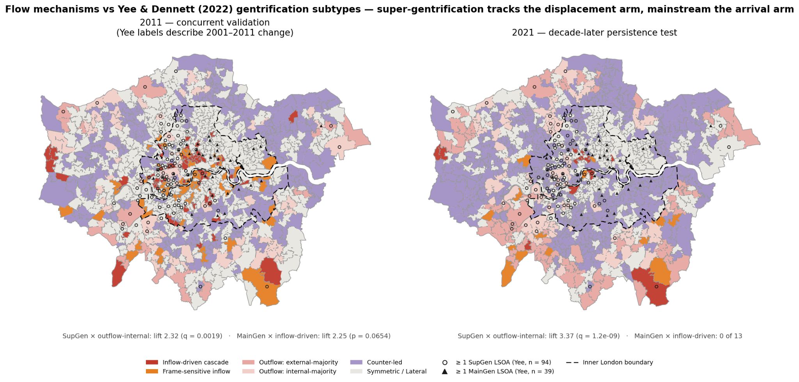
FINDINGS · 4 OF 4
Different gentrification subtypes occupy different flow mechanisms
Mainstream gentrification
Inflow-driven
Super gentrification
Internal-outflow
NOT gentrification
External-outflow
TAKEAWAY Two lenses see the same city through different arms of the cascade.
9
Notes:
[100s] Yee's Class-3 subtypes decompose the puzzle, and they occupy visibly different parts of the city and of the tree.
Super-gentrification aligns with the internal-outflow cascade, already-prime areas like Kensington & Chelsea, Westminster. This is the strongest and only strengthening alignment in the whole analysis. That's the displacement arm: cascade churn dominated by poorer-bound out-moves within London.
Mainstream gentrification aligns with the inflow-driven cascade - areas like Tower Hamlets, Hackney, Southwark. These are concurrent only, and gone by 2021.
Marginal gentrification aligns with no leaf.
One honest caveat is about the ladder ceiling. Top-decile areas cannot be inflow-led, so super-gentrified areas can only express a cascade through the outflow arm; the claim is that they show exactly that signature, strongly, on both clocks - not that super-gentrification causes outflow.
From here, we have Two lenses, same city, different arms. So what survives as a definition?

Slide 10
CONCLUSION
So, where do they go?
1 · Cascade ≠ Gentrification.
2 · Identical cascade values can arise from different mechanisms.
3 · “Where people go” depends on flow mechanisms, not simply origins/destinations.
Gentrification is better characterised by a persistent, inflow-led, inner-London cascade, coinciding with attribute ascent.
Gentrification is best understood as a set of migration mechanisms.
10
Notes:
[60s] Back to the title: where do they go - and does following them define gentrification?
As an equivalence, no, for two reasons: flows and attributes measure different objects, and 2021 shows the same cascade number produced by an exodus. But the test sharpens rather than merely negates. The line to remember: cascade is not gentrification - but the cascade with our tree mechanisms reveals gentrification.
What survives is a conditional definition: a persistent, inflow-led, inner-London cascade coinciding with attribute ascent - stated honestly: supported for the mainstream subtype, in the concurrent window, at modest effect size - with super-gentrification living in the displacement arm.

Slide 11
CONTRIBUTION & LIMITATIONS
What this adds — and what it can't say
CONTRIBUTIONS
LIMITATIONS
1
A framework that separates re-ranking, external migration, and genuine cascade processes.
Ecological — area of origin is a noisy proxy for a mover's wealth — which itself explains the decoupling.
2
A mechanism tree that separates gentrification's subtypes — mainstream in the arrival arm, super-gentrification in the displacement arm.
Temporal mismatch — flows 2011→2021; IMD 2010→2019; Yee labels 2001–2011 — hence the two-clock framing.
An open-data, reproducible, whole-city flow lens — public census OD + IMD across all of London.
Ladder ceiling — top deciles cannot be inflow-led; the SupGen alignment is part substance, part construction.
3
Lockdown census — March-2021 suppression and imputation degrade the flow estimates.
TAKEAWAY Stated plainly, so they don't come back as objections. Next: case-study chapter & spatial characterisation of the divergence.
11
Notes:
[40s] Three contributions: a framework that separates re-ranking, external migration and genuine cascade processes; a mechanism tree that turns a null into anatomy - mainstream in the arrival arm, super-gentrification in the displacement arm; and an open-data, reproducible whole-city flow lens. Limitations stated plainly: the ecological limit, which itself explains the decoupling; the temporal mismatches, handled by the two-clock framing; the ladder ceiling, which is why the super-gentrification claim is worded carefully; and lockdown-census measurement. Next steps: deepen the case studies and characterise the divergence spatially.

Slide 12
Thank you
Questions welcome
KEY REFERENCES
Dennett, A. & Stillwell, J. (2008). Population turnover and churn. Population Trends 134.
Ding, L., Hwang, J. & Divringi, E. (2016). Gentrification and residential mobility. Reg. Sci. Urban Econ. 61.
Freeman, L., Hwang, J., Haupert, T. & Zhang, S. (2024). Urban Affairs Review 60(1).
Marcuse, P. (1985). Gentrification, abandonment and displacement. J. Urban & Contemp. Law 28.
Smith, D. (2022). Tracking gentrification in London and Manchester using 2021 Census occupational class data. CityGeographics.
Yee, J. & Dennett, A. (2022). Stratifying and predicting gentrification in London. Trans. Inst. Br. Geogr. 47(3).
12
Notes:
[10s] Thanks - happy to take questions. (Total target: ~9:40, leaving buffer.)

Slide 13
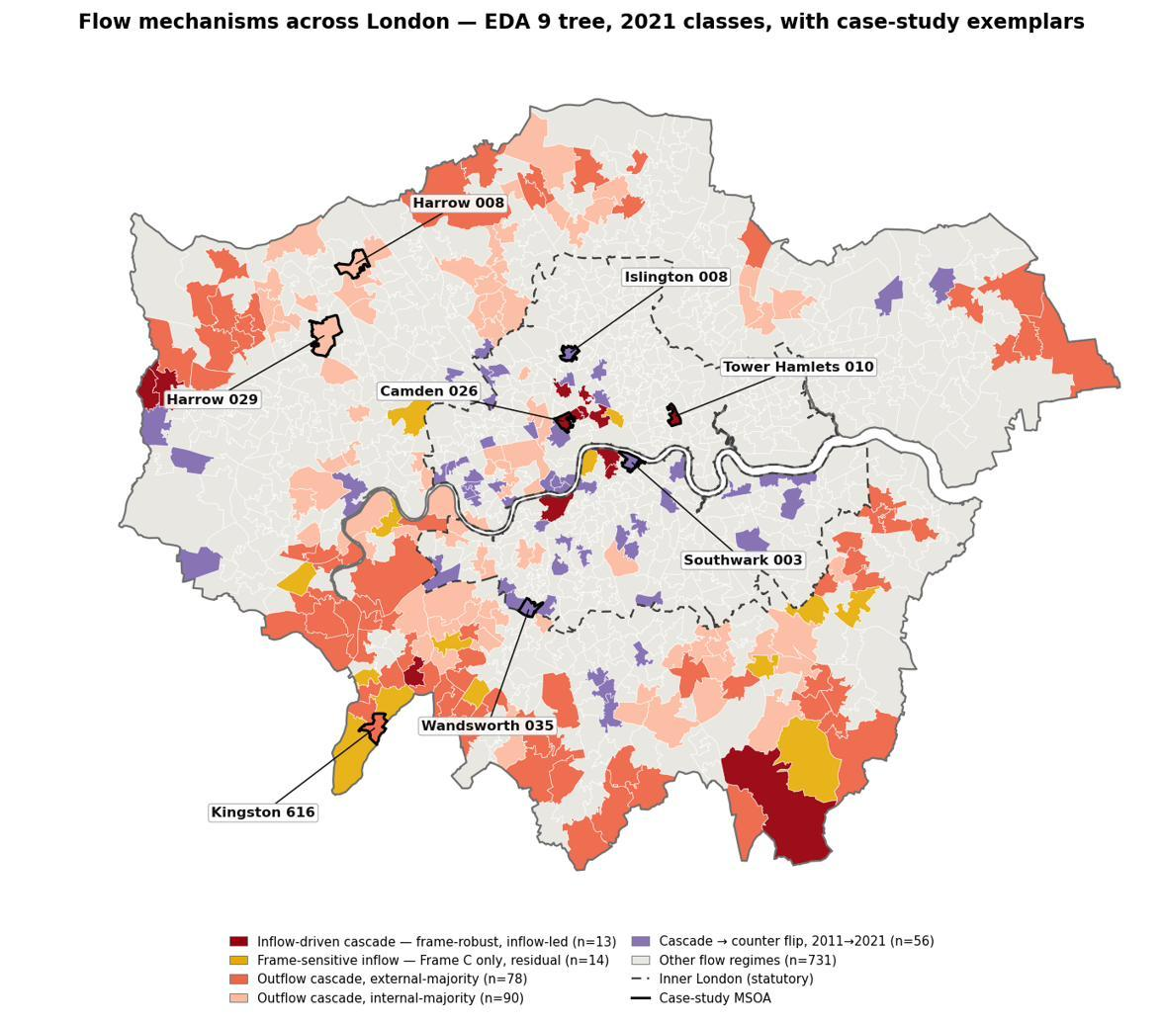
APPENDIX · BACKUP FOR Q&A
Four neighbourhoods, four mechanisms
A · Genuine cascade
B · Cascade → counter
Camden 026 · Tower Hamlets 010
inflow-driven in both years (2 of only 8 city-wide); both arms thick, frame-robust. Yee-modal Stable — the flow lens sees what attributes miss.
Southwark 003 · Islington 008 · Wandsworth 035
IMD keeps improving, yet flows flip counter-led by 2021 — the decoupling made visible (Finding 1).
C · London-contained outflow
D · Literal exodus
Harrow 008 · Harrow 029
outflow-internal (ext arm 0.43 / 0.41): poorer outflow stays within London — a structural feature of the national ladder, not exodus.
Kingston 019 · Croydon 044
outflow-external: near-zero inflow, majority of out-moves leave London. One baseline member, one emergent by 2021 (Finding 2).
C and D share near-zero inflow — only the out-arm destination differs: “exodus” is measured, not relabelled.
13
Notes:
[Backup - not part of the 10 minutes.] If asked for concrete examples: Camden 026 and Tower Hamlets 010 are what a real flow-defined cascade looks like - both arms thick, robust across frames, both censuses; only eight areas in London hold the class twice, and all eight are Yee-modal Stable. Southwark 003, Islington 008 and Wandsworth 035 keep improving on IMD while flows flip counter - the decoupling made visible. Harrow 008 and 029 are London-contained outflow - most poorer-bound out-moves stay inside London; from national D8, 69% of London counts as poorer - a structural feature of the national ladder, not an error and not exodus. Kingston 019 and Croydon 044 carry the literal exodus. C and D share near-zero inflow; only the destination of the out-arm differs - the proof that exodus is measured, not relabelled.

