Slide 1
MSc DISSERTATION · CASA, UCL
D7
Where do they go?
→
D5
→
Testing whether migration flows explain gentrification in London
D3
→
Census origin–destination data, 2011 & 2021 · 982 London MSOAs · IMD deprivation ladder
D1
Yujing (Olivia) Xing
Supervised by Professor Adam Dennett
Mini-conference · July 2026

Slide 2
MOTIVATION
Why follow the movers?
1
The classic chain
Affluent residents move in; poorer residents are pushed down the hierarchy (Marcuse 1985).
Can migration flows themselves define gentrification?
2
Mechanism inferred, not observed
Most studies infer the cascade from neighbourhood attributes; few analyse origin–destination migration flows directly, at whole-city scale, with open data.
IDEA:
Treat the cascade as a hypothesis rather than an assumption.
3
Direct evidence is inconsistent
Mover-level studies do NOT consistently support a strong downward cascade (Ding et al. 2016; Freeman et al. 2024).
2

Slide 3
METHODOLOGY · 1 OF 3
Making the cascade measurable
least deprived
wealthier ↑
D10
IW
inflow from wealthier
OW
outflow to wealthier
CASCADE churn
= IW + OP
wealthier in, poorer out-and-down
COUNTER churn
= OW + IP
the mirror direction
D8
D6
focal area
CLASSIFY EVERY AREA
Cascade dominance
which direction carries the ladder-crossing churn (Dennett & Stillwell 2008)
Cross-decile share
how much turnover engages the ladder at all
Cascade-led
Symmetric
D4
D2
OP
outflow to poorer
IP
inflow from poorer
Counter-led
Lateral
↓ poorer
D1
Cascade-led = the candidate definition,
made operational
most deprived
Data: all open & anonymised — 982 London MSOAs · Census OD flows 2011 & 2021 (Nomis) · IMD 2010 deciles, held fixed for both censuses
TAKEAWAY We can now measure the cascade directly — and “cascade-led” is the candidate definition.
3

Slide 4
METHODOLOGY · 2 OF 3
Separating mechanisms
THREE FRAMES
MECHANISM TREE
Cascade-led
A
London flows · London ladder
CORE lens
cascade inflow share ≥ 0.25 ?
(an empirical gap, both years)
B
London flows · national ladder
isolates re-ranking
YES — inflow cascades
NO — outflow cascades
frame-robust (A & C) ?
external-arm share ≥ 0.5 ?
(do they leave London?)
C
+ external flows · national ladder
adds boundary effects
yes
no
no
yes
inflow-driven
gentrification candidates
frame-sensitive
not frame-robust residuals
outflow-internal
outflows stay within London
outflow-external
outflows leave London
~69% of London sits below national D6,
so Frame A stays the faithful lens.
TAKEAWAY Every cascade-led area lands in exactly one leaf — applied identically to 2011 and 2021.
4

Slide 5
METHODOLOGY · 3 OF 3
How do we know whether the cascade works?
1
2
3
OUTCOME
ATTRIBUTE
COMPOSITION
IMD percentile change,
2010 → 2019
Yee & Dennett (2022)
Occupational ascent
Smith (2022)
Did deprivation actually improve?
Agreed with established attribute classification?
Any rise in SOC major groups 1–3?
Cascade = Gentrification ⟹ All three should agree.
TAKEAWAY “Cascade-led” is the testable candidate — judged by three independent lenses.
5

Slide 6
FINDINGS · 1 OF 4
Flow and attribute definitions only partly overlap
cascade-led
the flow definition
The IMD kicker
Adding a cascade signal on top of Yee-GEN weakens, not strengthens the deprivation gain.
197
flow-only
cascade-led, no Yee-GEN
25
attribute-only
Yee-GEN, no cascade
The twist
The flow method's own deprivation signal sits in the counter direction
The rare agreement is 2011, inner London.
16
both agree
Occupational ascent concurs
Yee-GEN
the attribute definition
TAKEAWAY The two lenses measure different things — but is “cascade-led” one mechanism, or several wearing one label?
6

Slide 7
FINDINGS · 2 OF 4
Cascade-led changes dramatically over the decade
2011
2021
Genuine inflow-driven cascade collapses
56 → 13
inflow-driven
56
inflow-driven
13
frame-sensitive
57
→
frame-sensitive
14
External-outflow quadruples
19 → 78
outflow-internal
81
outflow-internal
90
outflow-external
19
outflow-external
78
Internal-outflow stays remarkably stable
81 → 90
TAKEAWAY Identical cascades produced by very different underlying processes.
7

Slide 8
FINDINGS · 3 OF 4
Which mechanism actually corresponds to gentrification?
Where does Yee and Dennett's GEN actually live?
outflow-internal
✔✔ Strong enrichment
the only cell significant on BOTH 2011 and 2021
inflow-driven
✔ Weak enrichment
concurrent only — does not persist
outflow-external (exodus)
✘ GEN-depleted
not gentrification moving out — external corroboration
counter-led
✘ GEN-depleted
the anti-gentrification direction, both clocks
TAKEAWAY Attribute-defined gentrification lives in the internal-OUTFLOW branch — why?
8

Slide 9
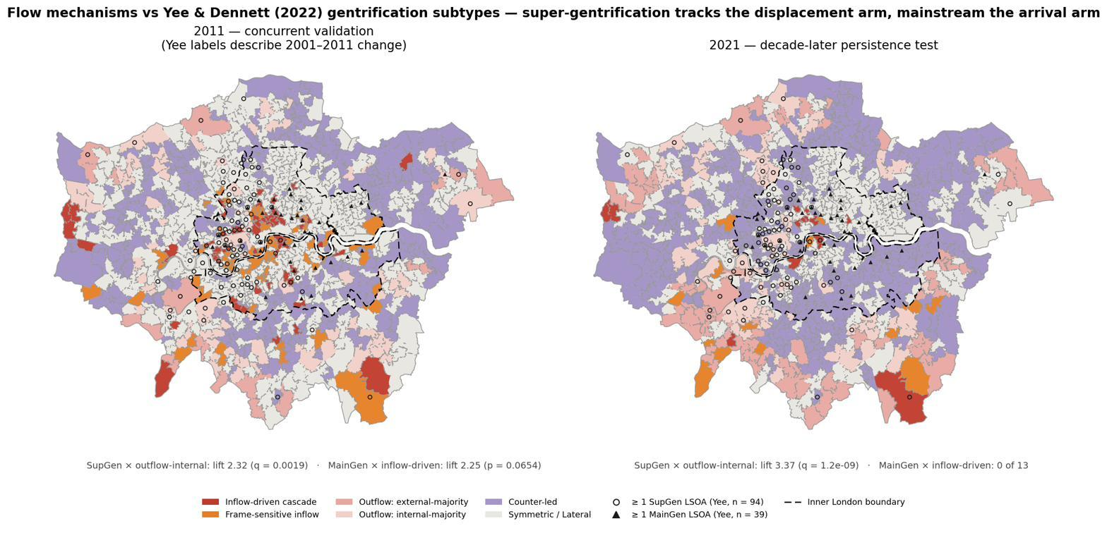
FINDINGS · 4 OF 4
Different gentrification subtypes occupy different flow mechanisms
Mainstream gentrification
inflow-driven
Super gentrification
internal-outflow
NOT gentrification
external-outflow
TAKEAWAY Two lenses see the same city through different arms of the cascade.
9

Slide 10
CONCLUSION
So, where do they go?
1
2
3
Cascade ≠ gentrification.
Identical cascade values can arise from different mechanisms.
“Where people go” depends on flow mechanisms.
Gentrification is better characterised by a persistent, inflow-led, inner-London cascade, coinciding with attribute ascent.
The same statistic hides arrival, displacement and exodus processes.
Not simply origins and destinations.
“Where” is a position on the ladder.
Gentrification is best understood as a set of migration mechanisms.
10

Slide 11
CONTRIBUTION & LIMITATIONS
What this adds — and what it can't say
CONTRIBUTIONS
LIMITATIONS
1
A framework that separates re-ranking, external migration, and genuine cascade processes.
Ecological — area of origin is a noisy proxy for a mover's wealth — which itself explains the decoupling.
Temporal mismatch — flows 2011→2021; IMD 2010→2019; Yee labels 2001–2011 — hence the two-clock framing.
Ladder ceiling — top deciles cannot be inflow-led; the SupGen alignment is part substance, part construction.
Lockdown census — March-2021 suppression and imputation degrade the flow estimates.
2
A mechanism tree that separates gentrification's subtypes — mainstream in the arrival arm, super-gentrification in the displacement arm.
3
An open-data, reproducible, whole-city flow lens — public census OD + IMD across all of London.
TAKEAWAY Stated plainly, so they don't come back as objections. Next: case-study chapter & spatial characterisation of the divergence.
11

Slide 12
Thank you
Questions welcome
KEY REFERENCES
Dennett, A. & Stillwell, J. (2008). Population turnover and churn. Population Trends 134.
Ding, L., Hwang, J. & Divringi, E. (2016). Gentrification and residential mobility. Reg. Sci. Urban Econ. 61.
Freeman, L., Hwang, J., Haupert, T. & Zhang, S. (2024). Urban Affairs Review 60(1).
Marcuse, P. (1985). Gentrification, abandonment and displacement. J. Urban & Contemp. Law 28.
Smith, D. (2022). Tracking gentrification in London and Manchester using 2021 Census occupational class data. CityGeographics.
Yee, J. & Dennett, A. (2022). Stratifying and predicting gentrification in London. Trans. Inst. Br. Geogr. 47(3).
12

Slide 13
APPENDIX · BACKUP FOR Q&A
Four neighbourhoods, four mechanisms
A · Genuine cascade
B · Cascade → counter
Camden 026 · Tower Hamlets 010
Southwark 003 · Islington 008 · Wandsworth 035
inflow-driven in both years (2 of only 8 city-wide); both arms thick, frame-robust. Yee-modal Stable — the flow lens sees what attributes miss.
IMD keeps improving, yet flows flip counter-led by 2021 — the decoupling made visible (Finding 1).
C · London-contained outflow
D · Literal exodus
Harrow 008 · Harrow 029
Kingston 019 · Croydon 044
outflow-internal (ext arm 0.43 / 0.41): poorer outflow stays within London — a structural feature of the national ladder, not exodus.
outflow-external: near-zero inflow, majority of out-moves leave London. One baseline member, one emergent by 2021 (Finding 2).
C and D share near-zero inflow — only the out-arm destination differs: “exodus” is measured, not relabelled.
13

Slide 14
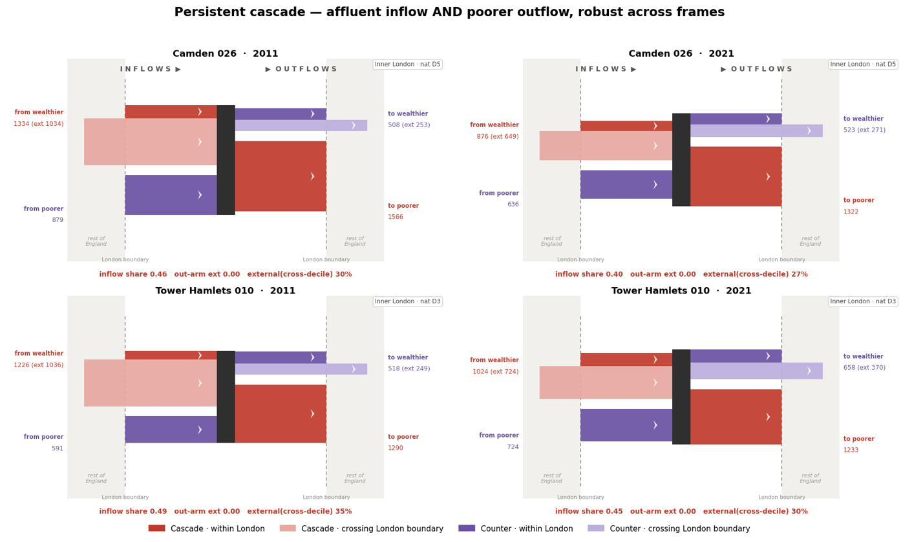
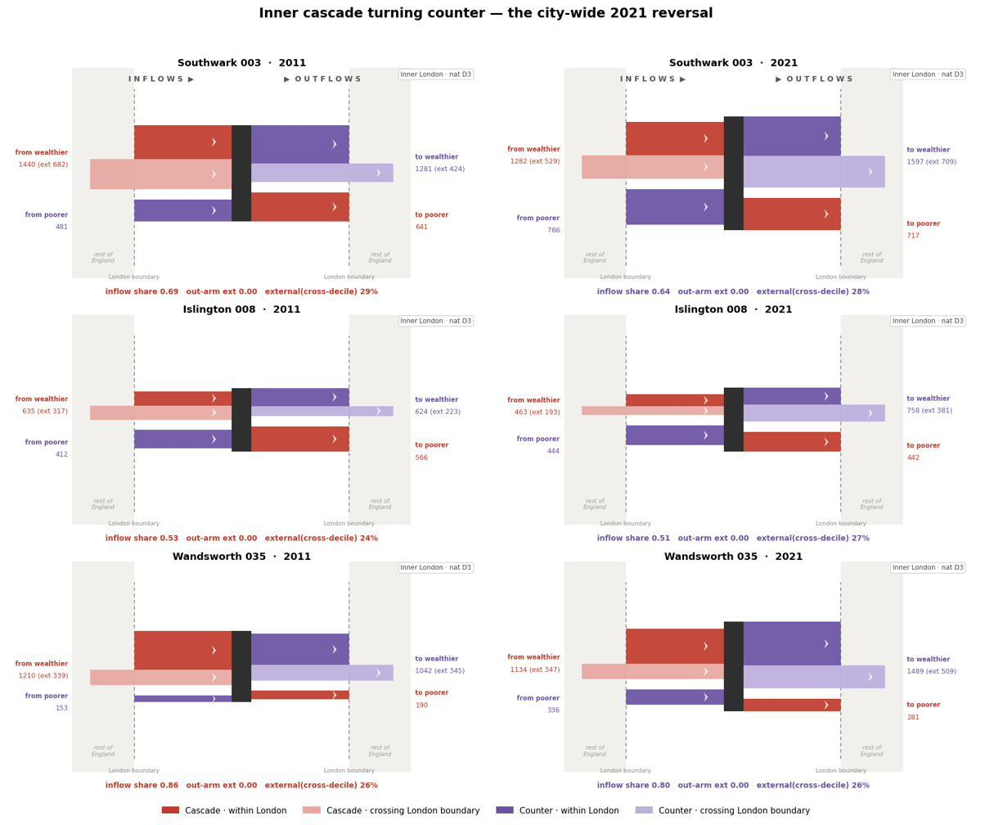
APPENDIX · ALLUVIAL PLOTS
Case flows A & B
A · Persistent cascade — Camden 026 · Tower Hamlets 010
B · Cascade → counter — Southwark 003 · Islington 008 · Wandsworth 035
14

Slide 15
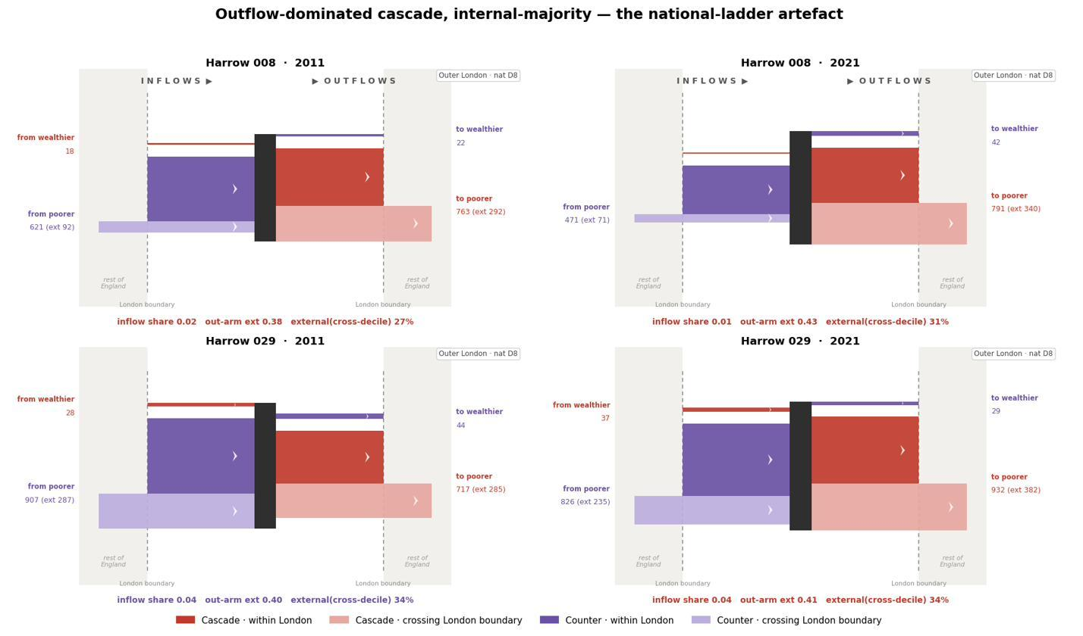
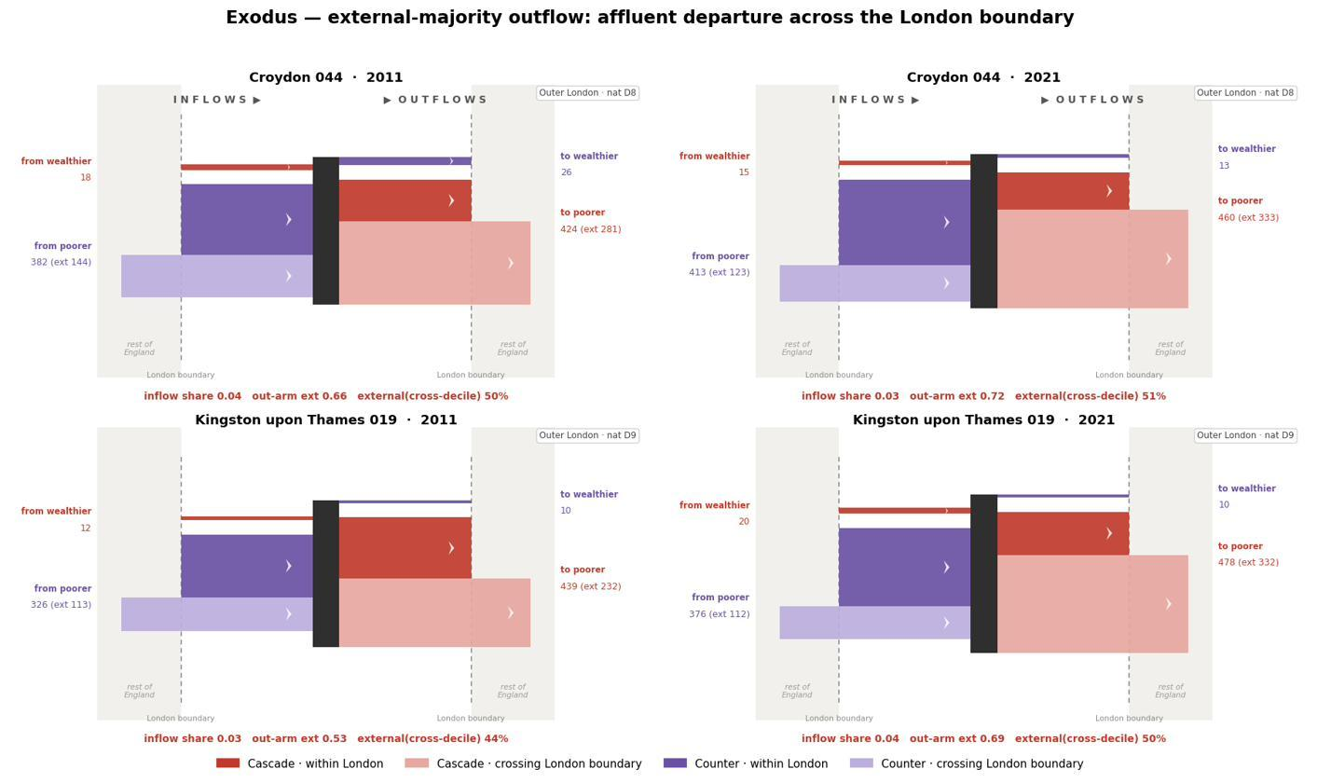
APPENDIX · ALLUVIAL PLOTS
Case flows C & D
C · Ladder artefact (outflow-internal) — Harrow 008 · Harrow 029
D · Literal exodus (outflow-external) — Kingston 019 · Croydon 044
15

