Slide 1
MSc DISSERTATION · CASA, UCL
Testing a Flow-Based Definition of Gentrification
Cascading flows in London, from Census origin–destination data, 2011–2021
Does tracking who moves recover what attribute methods call gentrification?
↘
Yujing (Olivia) Xing
↗
Notes:
[30s] The classic theory says gentrification IS a flow phenomenon — a cascade of moves down the deprivation hierarchy. I take that seriously: I adopt the cascade as a candidate flow-based definition of gentrification, measure it across London between the 2011 and 2021 censuses, and test whether it recovers what attribute-based methods call gentrification. It doesn't — and what survives the test is a sharper, conditional definition. That's the arc of the talk.

Slide 2
MOTIVATION
Why follow the movers?
WHY? Why measure gentrification through moves, rather than who lives there?
1
The classic chain — Affluent residents move in; poorer residents are pushed down the hierarchy (Marcuse 1985).
2
Mechanism inferred, not observed — Most studies use neighbourhood attributes to infer the cascade process, rather than analysing origin-destination migration flows directly.
3
Direct evidence is inconsistent — Mover-level studies do not consistently support a strong downward cascade mechanism (Freeman et al. 2024; Ding et al. 2016).
THE TEST
With the cascade as a candidate, does the flow-based definition recover attribute-defined gentrification?
2
Notes:
[60s] The intuition is old and respectable — Marcuse's chain displacement: gentrification radiates outward as a chain of moves. If that theory is right, the cascade IS a definition of gentrification. But it has only ever been assumed, never tested at whole-city scale with open flow data — and the few direct mover-level tests find the cascade weak or mixed. So I don't assert the definition; I adopt it as a candidate and test it: does the cascade recover attribute-defined gentrification? One caveat up front: I measure area-to-area flows — 'from a wealthier area' is not 'a wealthier person'.

Slide 3
METHODOLOGY · 1 OF 6
A deprivation ladder fixed at 2010
D10 · least deprived
WHY? Why hold the deprivation ladder still across both censuses?
Change = movement
Any 2011 → 2021 difference reflects how people moved — not neighbourhoods being re-ranked underneath them.
Non-circular validation
IMD 2019 is never used to build the classifier — it stays reserved as an independent outcome.
D1 · most deprived
DATA are all open, anonymised
982 London MSOAs
Census Origin–Destination flows, 2011 & 2021 (Nomis)
IMD 2010 & 2019
FIXED · IMD 2010
3
Notes:
[45s] The one design choice everything rests on: the deprivation ruler is held still at 2010 for both census years.
Two reasons: 1) change between censuses is then attributable to movement, not re-ranking; and 2) IMD 2019 stays entirely on the outcome side, so the later validation is non-circular by construction.
I deliberately accept a stale ladder to avoid a bigger problem: circularly redefining neighbourhood status while measuring movement.
Units: 982 MSOAs, with Camden 024/025 merged to match 2021.

Slide 4
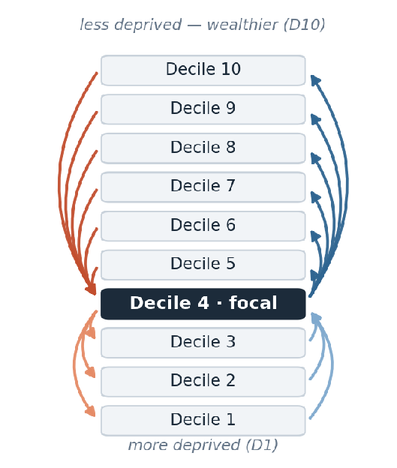
METHODOLOGY · 2 OF 6
Every cross-decile move becomes one of four flows
WHY? What does the classic chain look like on the deprivation ladder?
IW - Inflow from Wealthier areas
arriving from less-deprived deciles
OW - Outflow to Wealthier areas
leaving to less-deprived areas
OP - Outflow to Poorer areas
leaving to more-deprived deciles
IP - Inflow from Poorer areas
arriving from more-deprived areas
CASCADE = IW + OP wealthier in, poorer out-and-down
COUNTER = OW + IP the reverse direction
Lateral moves (same decile) cross no hierarchy. Area-to-area flows, not individual movers.
4
Notes:
[45s] Here is the ladder from the last slide, with the moves drawn on it. Take a focal area — decile 4. Every move that crosses the hierarchy is one of four elementary flows. On the left, the cascade pair: inflow-from-wealthier arriving from any less-deprived decile, and outflow-to-poorer leaving to any more-deprived decile — wealthier in, poorer out-and-down, the classic chain's signature. On the right, the mirror pair: outflow-to-wealthier and inflow-from-poorer — the counter direction. Lateral moves within the same decile cross no hierarchy, so they sit outside both pairs for now — they come back in the typology. And again: these are area-to-area flows, not individual movers.

Slide 5
MAIN DIAGNOSTIC
METHODOLOGY · 3 OF 6
Churn → A restructuring typology
WHY? Which direction of ladder-crossing movement carries an area's turnover?
MEASURE — churn (addition)
Cascade_Churn = IW + OP
Counter_Churn = OW + IP
after Dennett & Stillwell (2008)
CLASSIFY — two axes
Cascade_Dominance =
Cascade_Churn / (Cascade_Churn + Counter_Churn)
which direction carries the churn
Cross_Decile_Share =
(Cascade_Churn + Counter_Churn) / Total_Migration
how much turnover crosses the ladder (lateral moves stay in the denominator)
Counter-led
dominance < 0.48
Symmetric
0.48 – 0.52
Cascade-led
dominance > 0.52
Lateral
cross-decile share < P25
Cascade-led = more affluent inflows and poorer outflows, than the counter
This is the operational version of the classic gentrification mechanism.
5
Notes:
[45s] this typology is the first and the MAIN classifier; everything else in the methodology supports or diagnoses it.
Churn adds the flows in each direction, following Dennett & Stillwell.
Two axes classify each area:
cascade dominance — cascade churn as a share of all cross-decile churn, so 0.5 means perfectly balanced
and cross-decile share — how much of total turnover engages the ladder at all, with lateral moves kept in the denominator.
Together they give four regimes, and cascade-led is the candidate definition made operational: that is the type the validation tests. The sign matrix on the next slide is a secondary diagnostic.

Slide 6
SECONDARY DIAGNOSTIC — for 2021
METHODOLOGY · 4 OF 6
Net flows → A sign-concordance matrix
WHY? Which way does the area sort on balance — and do its two directions agree?
Net_Counter (OW − IP)
+
−
MEASURE — net (subtraction)
Net_Cascade = IW − OP
Net_Counter = OW − IP
Upward Hub
both directions
Net receiver
gains movers from both directions
+
Net_Cascade (IW − OP)
Net exporter
loses movers in both directions
Downward Hub
both directions
Diagonal = concordant
Off-diagonal = divergent
−
6
Notes:
[40s] this one is a SECONDARY diagnostic, genuinely different from the previous one. The churn typology answers the research question; this matrix helps to understand the balance between flows in 2 opposite directions.
Net flows subtract: which way does the area sort on balance? Two signs give four regimes.
Diagonal cells are concordant — upward-connected hubs or downward-connected hubs.
Off-diagonal cells are divergent — a net receiver gains from both directions; a net exporter loses in both.

Slide 7
METHODOLOGY · 5 OF 6
Three frames — London-only stays the core
WHY? London is not a vacuum — so which ruler, and which flows?
A
London-internal flows
London-relative ladder
CORE
B
London-internal flows
National ladder
isolates re-ranking
C
+ external flows
National ladder
adds boundary effects
A → B: change the ladder only B → C: add external flows only
~69% of London MSOAs sit below national D6
The national ladder compresses London, so Frame A stays the faithful gentrification lens.
7
Notes:
[45s] A naive London-vs-national comparison confounds two things: changing the ruler and adding external moves.
The three-frame design separates them — B minus A is pure re-ranking, C minus B is pure external flows.
And because 69% of London sits below national decile 6, the national ladder squashes most of London into one band
so if we want to explore more details in those more deprived London MSOAs, London-only Frame A stays the core lens, with C as complementary context.
The one big 2021 change in the external channel is the surge of London-to-outside moves — remember that.

Slide 8
METHODOLOGY · 6 OF 6
Three independent checks
WHY? How would we know whether cascade really equals gentrification?
1
Outcome
2
Attribute
3
Composition
IMD percentile change, 2010 → 2019
Did deprivation actually improve?
Yee & Dennett (2022)
The established attribute-based gentrification classification.
Occupational ascent
Rise in SOC major groups 1–3, after Dr Duncan Smith.
If cascade = gentrification, three yardsticks built independently of the flow metrics should agree.
8
Notes:
[35s] The validation logic: if cascade really equals gentrification, three independently built yardsticks should agree with the typology. The outcome check — did deprivation actually improve, 2010 to 2019. The attribute check — Yee & Dennett's classification. The composition check — occupational ascent in SOC 1–3, replacing the non-comparable NS-SeC. Three instruments, one hypothesis. The next two slides are what happens when you check.

Slide 9
FINDINGS · 1 OF 2
Cascade ≠ Attribute-defined gentrification
16
25
197
areas where both agree
Yee-GEN & cascade-led
attribute-only
Yee-GEN, no cascade
flow-only
cascade, no Yee-GEN
The IMD kicker
Yee-GEN alone: +0.043 IMD gain
Yee-GEN + cascade: only +0.017
Cascade does not reinforce gentrification.
The twist
The flow method's own IMD signal sits in the counter direction, not the cascade.
The rare agreement: 2011, inner London only.
9
Notes:
[75s] The centrepiece. Of the areas either method flags as its version of gentrification, only 16 agree; 25 are attribute-only, 197 are flow-only.
The IMD kicker: Yee's attribute-gentrifying areas improve on deprivation — but adding a cascade signal on top weakens the gain, so cascade is not the engine of measured gentrification.
And the twist: the flow method's own deprivation signal lives in the counter direction, and the only place the methods agree is classic 2011 inner-London gentrification. Occupational ascent tells the same story.
(Spearman rho of +0.02, fully independent).

Slide 10
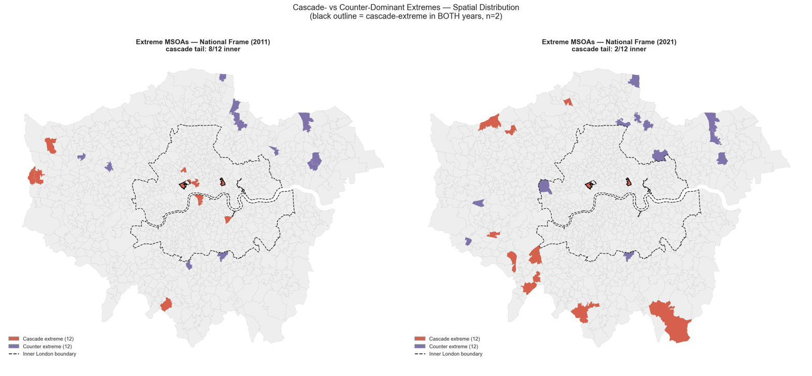
FINDINGS · 2 OF 2
2021's cascade is an exodus, not relocation
+51%
external outflow,
2011 → 2021
53 → 116
net-exporter MSOAs
85%
of 2021 cascade-led areas are outer London
Cascade extremes shift inner → outer by 2021 (orange); persistence is rare.
2011 · gentrification — the inflow arm
inflow share 40–93% · persistent · inner cores
2021 · exodus — the outflow arm
inflow share 1–35% · episodic · outer ring
10
Same headline metric, opposite processes — the inflow share separates them.
Notes:
[75s]
The temporal reason the equivalence fails.
On the map: in 2011 the cascade-extreme tail is inner — Camden, Southwark, Islington, Tower Hamlets. By 2021 it flips to outer high-decile boroughs — Kingston, Harrow, Richmond, Barnet, Sutton — with almost no persistence.
Why? Cascade churn is an addition, so The same cascade number is produced by opposite processes: in 2011 people arrive from wealthier areas; in 2021 people leave for cheaper places outside London. In Harrow, the cascade is 99 percent outflow by 2021.
That's affluent residents leaving for cheaper places outside London:
Considering COVID, we assume this is more likely the pandemic exodus, not gentrification relocating outward. Specifically, External outflow up 51 percent, net exporters more than doubled, 85 percent of 2021 cascade-led areas are outer London.
the same headline number can come from opposite arms. In 2011 the extremes are the inflow arm: 40 to 93 percent of cascade churn is people arriving from wealthier areas — genuine affluent in-migration. In 2021 the outer extremes are the outflow arm: inflow share collapses to 1–35 percent — Harrow's cascade is 99 percent outflow.
Caveat: the lockdown census both caused this and degraded measurement.

Slide 11
CONCLUSION
The definition fails as an equivalence
1
Measurement decoupling
2
Temporal shock
Cascade alone cannot define gentrification.
Attributes - who is there;
Flows - how the hierarchy is reshuffled.
The same cascade is produced by opposite processes.
2021's is a one-off pandemic exodus.
THE REFINED DEFINITION — a candidate for future testing
Gentrification's flow is not merely cascade churn, but a persistent, inflow-led cascade that coincides with attribute ascent, at inner London.
Broadly, the flow lens measures hierarchy restructuring; Gentrification is one specific signature within it.
11
Notes:
[50s] So back to the title: does a flow-based definition of gentrification hold?
As an equivalence — cascade equals gentrification — no, for two reasons: 1) flows and attributes measure different processes, and 2) 2021 shows the same cascade number can be produced by an exodus.
But the test doesn't just negate; it sharpens. Where the methods DO agree — persistent, inflow-led cascade plus attribute ascent, inner London 2011 — is a defensible conditional definition:
raw churn is not enough, the direction, the arm, and persistence all have to be specified.
With only 16 convergent areas I offer it as a candidate signature for future testing, not a validated definition.
Broadly, the flow lens measures restructuring; gentrification is one signature within it.

Slide 12
CONTRIBUTION
What this adds
An open-data, whole-city flow lens
Directly examines the cascade mechanism using publicly available census OD and IMD data across London.
1
A clearer test of the cascade hypothesis
Shows where flow-based and attribute-based interpretations converge or diverge.
2
A three-frame decomposition
Separates neighbourhood re-ranking from external migration, attribute each cross-frame transition to a distinct mechanism.
3
12
Notes:
[35s] Three contributions.
1. method: an open-data, reproducible, whole-city flow lens on gentrification.
2. substance: the divergence between the two methods is itself the finding, those disagreement areas are what attribute methods can't see, and the decoupling converges with the best recent micro-data work.
3. design: the three-frame decomposition pre-empts the obvious objections by attributing every change to re-ranking or external flows.

Slide 13
LIMITATIONS
What this can't say
Ecological
Area of origin is a noisy proxy for a mover's wealth.
(This also explains the decoupling.)
Temporal mismatch
Flows are 2011 → 2021;
IMD outcomes are 2010 → 2019.
Historical deprivation hierarchy
A 2010 baseline is less representative by 2021.
Lockdown census
March-2021 suppression and imputation degrade the flow estimates.
13
Notes:
[35s] Stated plainly so they don't come back as objections. The big one — the ecological limit — actually explains the decoupling: area origin is a noisy proxy for mover wealth, so flows and attributes needn't align. Then the temporal mismatch, the stale 2010 ladder, and lockdown measurement degradation. Next step for results and discussion: characterise the divergence cells spatially and deepen the case studies.

Slide 14
KEY REFERENCES
Thank you
Questions welcome
Reference List
Dennett, A. & Stillwell, J. (2008). Population turnover and churn. Population Trends 134.
Ding, L., Hwang, J. & Divringi, E. (2016). Gentrification and residential mobility. Reg. Sci. Urban Econ. 61.
Freeman, L., Hwang, J., Haupert, T. & Zhang, S. (2024). Urban Affairs Review 60(1).
Marcuse, P. (1985). Gentrification, abandonment and displacement. J. Urban & Contemp. Law 28.
Smith, D. (2022). Tracking gentrification in London and Manchester using the 2021 Census occupational class data. CityGeographics.
Yee, J. & Dennett, A. (2022). Stratifying and predicting gentrification in London.
14
Notes:
[10s] Thanks — happy to take questions. (Total target: ~9.5 minutes.)

