Slide 1
MSc DISSERTATION · DEPARTMENTAL MINI-CONFERENCE
A Flow-Based Definition of Gentrification
↓
Analyzing socio-economic displacement in London using Census Origin–Destination data, 2011–2021
Does tracking who moves recover what attribute methods call gentrification?
↑
Xing · Data: Census OD (Nomis, Open Geography) · IMD (GOV.UK)
Notes:
Title. One line: I measure gentrification by tracking the actual movement of people across London's deprivation hierarchy between the 2011 and 2021 censuses, and I test whether that flow lens agrees with the usual attribute-based way of detecting gentrification. Spoiler: it mostly doesn't — and that's the finding.

Slide 2
MOTIVATION
The assumption this study puts to the test
The classic chain
What this measures — and what it doesn't
Gentrification is read as a cascade: affluent residents move in, and poorer residents are pushed down the deprivation hierarchy.
Area-level restructuring along a deprivation ladder — a candidate signature of displacement pressure, not gentrifiers themselves.
“From a wealthier area” ≠ “a wealthier person.”
Richly theorised — Marcuse's (1985) chain displacement — but rarely tested at whole-city scale with open flow data.
Recent direct tests find the downward cascade weak or mixed (Ding et al. 2016; Freeman et al. 2024).
THE QUESTION
Does a flow lens recover what attribute-based methods call gentrification?
Notes:
Set up the load-bearing assumption. The intuition — and it's an old, respectable one from Marcuse — is that gentrification radiates outward as a chain of moves, so if you follow the flows you've found gentrification. Two caveats I state up front so no one thinks I'm over-claiming: I measure area-level restructuring, not individual gentrifiers; and a move from a wealthier AREA doesn't mean a wealthier PERSON. The question is whether the flow lens lines up with attribute methods.

Slide 3
1
METHODOLOGY · 1 OF 5
Data, and a deprivation ladder fixed at 2010
Unit 982 London MSOAs (Camden 024/025 merged in 2021).
D10 · least deprived
Flows Census Origin–Destination migration, 2011 & 2021 (Nomis, Open Geography).
FIXED · 2010
Ladder IMD 2010 aggregated to MSOA, ranked into wealth deciles — 10 = least deprived, 1 = most deprived.
Access Entirely secondary, anonymised, open data.
D1 · most deprived
Why fix the ladder? So change between censuses reflects movement, not re-ranking — and so IMD 2019 stays reserved as an independent outcome the typology never sees. The validation is non-circular by construction.
Notes:
The one design choice everything rests on: the deprivation ruler is held still at 2010 across both census years. Two reasons — any change 2011 to 2021 is then attributable to how people moved, not to neighbourhoods being re-ranked underneath them; and it keeps the 2019 IMD entirely on the outcome side, so when I later validate against 2010–2019 deprivation change the classifier isn't being marked against data it already used. The cost — an eleven-year-stale ladder — I'll flag at the end.

Slide 4
2
METHODOLOGY · 2 OF 5
Every cross-decile move becomes one of four flows
↘
IW — Inflow from Wealthier
arriving from a less-deprived decile
↗
OW — Outflow to Wealthier
leaving to a less-deprived decile
↓
OP — Outflow to Poorer
leaving to a more-deprived decile
↑
IP — Inflow from Poorer
arriving from a more-deprived decile
MSOA
CASCADE = IW + OP
wealthier in, poorer out-and-down
COUNTER-CASCADE = OW + IP
the reverse direction
These are area-to-area flows across the ladder — not statements about individual movers.
Notes:
The classic chain has a signature: wealthier arriving, poorer leaving downward. I split every hierarchy-crossing move into four elementary flows. The two orange ones — inflow-from-wealthier and outflow-to-poorer — make up the cascade. The two blue ones make up the counter direction. Again: area-to-area, not individual movers.

Slide 5
3
METHODOLOGY · 3 OF 5
From flows to a typology: balance × intensity
NET (subtraction) → balance
Net_Cascade = IW − OP
which direction wins
CHURN (addition) → intensity
CFI_Churn = IW + OP
volume of reshuffling — after Dennett & Stillwell (2008)
Two axes build the typology: Cascade Dominance = churn_cascade ⁄ (churn_cascade + churn_counter) · Cross-Decile Share = how much churn crosses the hierarchy at all.
Counter-led
Dominance < 0.48
Symmetric
0.48 – 0.52
Cascade-led
Dominance > 0.52
Lateral — Cross-Decile Share below the 25th percentile: the neighbourhood barely engages the hierarchy at all.
Notes:
From the four flows I build two summaries per family: the NET (subtraction) says which direction wins; the CHURN (addition) says how much reshuffling there is regardless of net — that additive move follows Dennett and Stillwell's churn measure, capturing volume of turnover, which is known to track deprivation at small scales. Two axes then define four regimes. Cascade-led is the one the classic assumption equates with gentrification — that's the equation the rest of the talk tests.

Slide 6
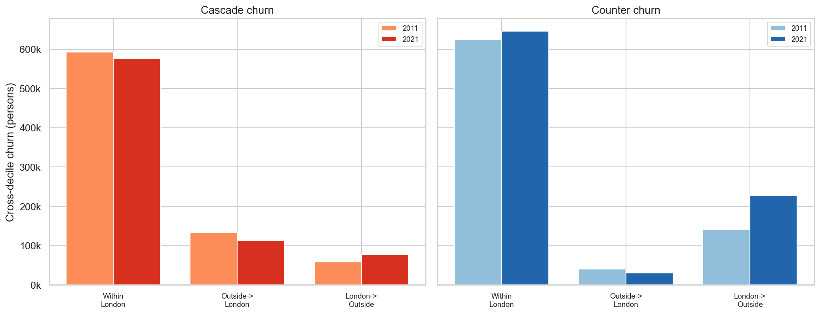
4
METHODOLOGY · 4 OF 5
Three frames — and why London-only is the core
Frame | Flows | Ladder | Role
A | London-internal | London-relative | CORE
B | London-internal | National | isolates re-ranking
C | London + external | National | complementary
Reclassification = B − A (same flows, new ladder)
External flows = C − B
(same ladder, added flows)
Within-London flows dominate both directions; the one big 2021 change is the surge in London→outside moves — the exodus signal.
~69% of London sits below national D6 — the national ladder compresses most of London into one band, so A stays the faithful gentrification lens.
Notes:
A naïve London-vs-national comparison confounds two things: changing the ruler and adding external moves. Frame B separates them, so I can attribute every change to re-ranking or to external flows. That's why London-only stays the core — it's the ruler on which moving up within London still means gentrification, since most of London sits low on the national scale. External flows aren't discarded: fig 20b shows within-London dominates the volume, but the big 2021 change is the London-to-outside surge — small channel, big shock — which is the pandemic exodus.

Slide 7
5
METHODOLOGY · 5 OF 5
Testing the assumption against three independent checks
Flow typology
1
IMD percentile change
2010 → 2019 — did the area's deprivation actually improve?
2
Yee & Dennett (2022)
attribute-based gentrification classification
3
Occupational ascent
Duncan-style change in SOC major groups 1–3
If cascade really equals gentrification, these should line up.
Notes:
To test the equivalence I don't just describe the flows — I put the flow typology head-to-head against two independent attribute-based gentrification measures, and against whether the area's deprivation actually improved on IMD. If cascade equals gentrification, all three should agree. The next two slides are what happens when you check.

Slide 8
FINDINGS · 1
Cascade ≠ gentrification
58
149
155
areas where both agree
(GEN & cascade-led)
attribute-only
(Yee-GEN, no cascade)
flow-only
(cascade, no Yee-GEN)
Cramér's V = 0.10 · Adjusted Rand Index = 0.005 — the two schemes agree no better than random labels.
The IMD kicker
The twist
Yee-GEN alone → +0.043 IMD gain. Yee-GEN + cascade → only +0.017.
Adding cascade doesn't reinforce gentrification.
The flow method's IMD signal lives in the counter direction — not the cascade one. The rare agreement is confined to 2011 inner London.
Notes:
The centrepiece. Of the areas either method flags as its version of gentrification, only 58 agree, while 149 are attribute-only and 155 are flow-only. Cramér's V of 0.10 and an Adjusted Rand Index of essentially zero say the two schemes agree no better than random. And the IMD check: Yee's attribute-gentrifying areas improve on deprivation, but adding a cascade signal on top actually weakens the gain — so cascade is not the engine of measured gentrification. The twist: the flow method's own deprivation signal sits in the counter direction, and the only place the two methods agree is classic 2011 inner-London gentrification.

Slide 9
FINDINGS · 2
2021's cascade signal is an exodus, not relocation
+51%
53→116
85%
external outflow from
London, 2011 → 2021
net-exporter MSOAs
(+119%, national frame)
of 2021 cascade-led
areas are outer London
Real gentrification cascade
Pandemic exodus
high inflow share · small gap between frames · persistent · inner cores (Camden, Tower Hamlets)
low inflow share · large gap between frames · episodic · outer ring (Kingston, Harrow, Richmond, Sutton)
Caveat: the March 2021 census was taken under lockdown, which both caused the suburban shift and degraded migration measurement — the within-London decline shouldn't be over-read.
Notes:
The second reason the equivalence fails is temporal. In 2021 the cascade-led areas shift from inner to outer London — 85% are outer — external outflow is up over 50%, and net-exporter neighbourhoods more than double. But this isn't gentrification relocating to the suburbs; it's a COVID-era affluent exodus. My diagnostic rule separates them: real gentrification has high inflow share, a small gap across reference frames, and persists in the inner cores; the exodus has low inflow share, a large frame gap, and is episodic in the outer ring. Important caveat: the lockdown census both caused this and degraded the measurement, so I don't over-read the within-London numbers.

Slide 10
CONCLUSION
Why cascade and gentrification don't imply each other
1
2
Measurement decoupling
Flows and attributes capture different processes — one is who is there, the other is how the hierarchy is being reshuffled.
Temporal shock
2021's flows are dominated by a one-off pandemic exodus, not gentrification relocating outward.
CONTRIBUTION
An open-data, whole-city flow lens plus a three-frame decomposition. The divergence cells — where flows and attributes disagree — are exactly what attribute methods miss, and the decoupling converges with recent mover-level findings (Freeman et al. 2024).
Takeaway: a flow lens doesn't detect gentrification worse — it measures a different process, and reveals what attributes overlook.
Notes:
Pull it together. The classic equivalence fails on two axes: conceptually, flows and attributes measure different things; and temporally, 2021 is a one-off shock. The contribution is an open-data, reproducible, whole-city flow lens with a decomposition that pre-empts the obvious objections — and the divergence between the two methods is itself the finding, converging with the best recent micro-data work. The line I'd leave the room with: the flow lens isn't a worse gentrification detector, it's a different instrument.

Slide 11
LIMITATIONS & WHAT'S NEXT
What this can't say — and where it goes
Aggregation / ecological — area-of-origin deprivation is a noisy proxy for a mover's wealth — no individual data.
Key references
Temporal mismatch — flows are 2011/2021; the IMD outcome is 2010→2019.
Marcuse, P. (1985). J. Urb. & Contemp. Law 28.
Dennett & Stillwell (2008). Population Trends 134.
Yee & Dennett (2022).
Ding, Hwang & Divringi (2016). Reg. Sci. Urban Econ. 61.
Freeman, Hwang, Haupert & Zhang (2024). Urban Affairs Rev. 60(1).
Reades, Lees, Hubbard & Lansley (2023). EPA 55(4).
Aging ladder — a 2010 baseline is eleven years stale by 2021 — a decade of gentrification is scored on old deprivation.
Lockdown measurement — 2021 census suppression / imputation degrades the flow estimates.
Thank you · questions welcome
Notes:
Limitations, stated plainly so they don't get raised as objections. The big one — aggregation — actually explains the decoupling: area origin is a noisy proxy for mover wealth, so flows and attributes needn't align. Temporal mismatch, the stale 2010 ladder, and lockdown measurement degradation round it out. Then thanks and questions.

