Slide 1
MSc DISSERTATION · CASA
A Flow-Based Definition of Gentrification
↓
Analyzing socio-economic displacement in London using Census Origin–Destination data, 2011–2021
Does tracking who moves recover what attribute methods call gentrification?
↑
Yujing (Olivia) Xing
Notes:
I measure gentrification by tracking the actual movement of people across London's deprivation hierarchy between the 2011 and 2021 censuses, and I test whether that flow lens agrees with the usual attribute-based way of detecting gentrification.
it mostly doesn't — and that's the finding.

Slide 2
MOTIVATION
The assumption this study puts to the test
The classic chain
What this measures — and what it doesn't
Gentrification is read as a cascade: affluent residents move in, and poorer residents are pushed down the deprivation hierarchy.
Area-level restructuring along a deprivation ladder — a candidate signature of displacement pressure, not gentrifiers themselves.
“From a wealthier area” ≠ “a wealthier person.”
Richly theorised — Marcuse's (1985) chain displacement — but rarely tested at whole-city scale with open flow data.
Recent direct tests find the downward cascade weak or mixed (Ding et al. 2016; Freeman et al. 2024).
THE QUESTION
Does a flow lens recover what attribute-based methods call gentrification?
Notes:
The intuition — and it's an old, respectable one from Marcuse — is that gentrification radiates outward as a chain of moves, so if you follow the flows you've found gentrification. Two caveats I state up front so no one thinks I'm over-claiming: I measure area-level restructuring, not individual gentrifiers; and a move from a wealthier AREA doesn't mean a wealthier PERSON. The question is whether the flow lens lines up with attribute methods.

Slide 3
1
METHODOLOGY · 1 OF 5
Data, and a deprivation ladder fixed at 2010
Unit 982 London MSOAs (Camden 024/025 merged in 2021).
D10 · least deprived
Flows Census Origin–Destination migration, 2011 & 2021 (Nomis, Open Geography).
FIXED · 2010 IMD
Ladder IMD 2010 aggregated to MSOA, ranked into wealth deciles — 10 = least deprived, 1 = most deprived.
Access Entirely secondary, anonymised, open data.
D1 · most deprived
Why fix the ladder? So change between censuses reflects movement, not re-ranking — and so IMD 2019 stays reserved as an independent outcome the typology never sees. The validation is non-circular by construction.
Notes:
The one design choice everything rests on: the deprivation ruler is held still at 2010 across both census years.
Two reasons for this design — any change 2011 to 2021 is then attributable to how people moved, not to neighbourhoods being re-ranked underneath them; and it keeps the 2019 IMD entirely on the outcome side, so when I later validate against 2010–2019 deprivation change the classifier isn't being marked against data it already used. The cost — an eleven-year-stale ladder — I'll flag at the end.

Slide 4
2
METHODOLOGY · 2 OF 5
Every cross-decile move becomes one of four flows
↘
IW — Inflow from Wealthier
arriving from a less-deprived decile
↗
OW — Outflow to Wealthier
leaving to a less-deprived decile
↓
OP — Outflow to Poorer
leaving to a more-deprived decile
↑
IP — Inflow from Poorer
arriving from a more-deprived decile
MSOA
CASCADE = IW + OP
wealthier in, poorer out-and-down
COUNTER-CASCADE = OW + IP
the reverse direction
These are area-to-area flows across the ladder — not statements about individual movers.
Notes:
The classic chain has a signature: wealthier arriving, poorer leaving downward. I split every hierarchy-crossing move into four elementary flows.
The two orange ones make up the cascade — inflow-from-wealthier and outflow-to-poore.
The two blue ones make up the counter direction.
Again: area-to-area, not individual movers.

Slide 5
5
METHODOLOGY · 3 OF 6
From churn to a restructuring typology
THE QUESTION Which direction of hierarchy-crossing movement carries an area's turnover?
MEASURE — churn (addition)
CLASSIFY — two axes
Cascade_Churn = IW + OP
Counter_Churn = OW + IP
after Dennett & Stillwell (2008)
Cascade Dominance — which direction carries the churn
Cross-Decile Share — how much turnover crosses the ladder at all
THE ANSWER — four regimes
Counter-led · Dominance < 0.48
Symmetric 0.48 – 0.52
Cascade-led · Dominance > 0.52
Lateral — Cross-Decile Share below P25: barely engages the hierarchy.
This is the typology the validation tests. Net flows answer a different question — next →
Notes:
Design question first: churn asks about the CHARACTER of turnover — which direction of hierarchy-crossing movement carries the volume. Measure: the addition family, Cascade_Churn = IW + OP and Counter_Churn = OW + IP, following Dennett & Stillwell's additive churn principle, adapted to flows that cross the deprivation ladder. Classify on two axes: Cascade Dominance (which direction carries the churn) and Cross-Decile Share (how much turnover engages the ladder at all). The answer is four regimes: Counter-led below 0.48, Symmetric in the band, Cascade-led above 0.52 — and Lateral where cross-decile exchange sits below the 25th percentile. Cascade-led is what the classic assumption equates with gentrification, and this typology is what the validation tests. Bridge: churn asks about character; net flows ask which way the area sorts on balance — next slide.

Slide 6
6
METHODOLOGY · 4 OF 6
From net flows to a sign-concordance matrix
THE QUESTION Which way does the area sort, on balance — and do its two directions agree?
Net_Counter (OW − IP)
+
−
MEASURE — net (subtraction)
Throughflow node
connected upward, both directions
Net receiver
gains movers from both directions
Net_Cascade = IW − OP
Net_Counter = OW − IP
+
Net_Cascade (IW − OP)
THE ANSWER — two signs, four regimes.
Diagonal = concordant
Off-diagonal = divergent
Net exporter
loses movers in both directions
Downward sink
connected downward, both directions
−
Notes:
Design question first: net asks which way the area sorts ON BALANCE — and whether its two directions agree. The subtraction family: Net_Cascade is wealthier-in minus poorer-out; Net_Counter is wealthier-out minus poorer-in. The two signs give a second classification, genuinely different from the churn typology. Diagonal cells are concordant — both nets point the same way: a throughflow node connected upward, or a downward sink, its mirror. Off-diagonal cells are divergent: a net receiver gains movers from both directions; a net exporter loses movers in both directions. Diagonal vs off-diagonal is the Sign_Concordance variable. Hold one cell: the net exporter, bottom-left — that's where 2021's exodus lives, and we count exactly those MSOAs in Findings 2. (The fully annotated matrix is in the dissertation.)

Slide 7
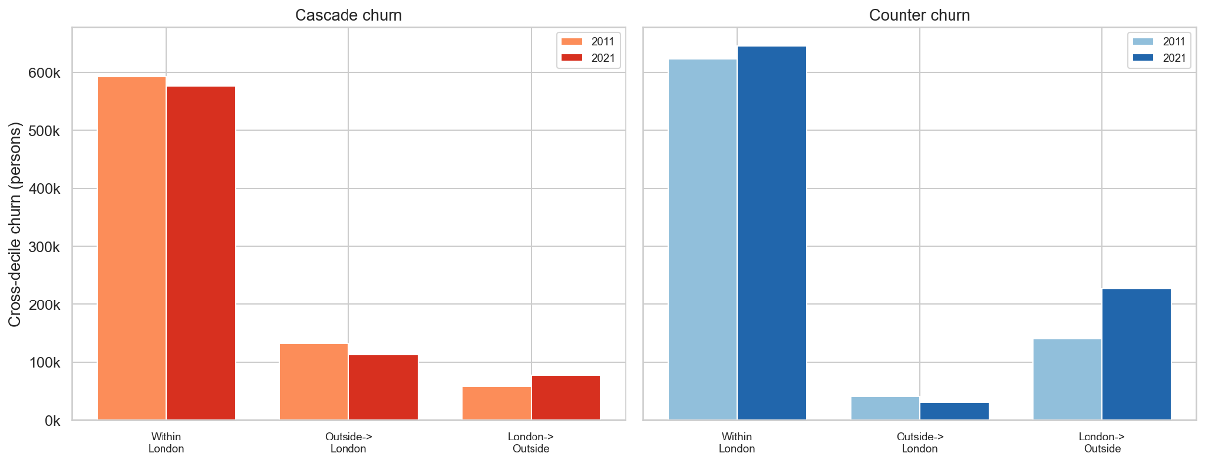
4
METHODOLOGY · 4 OF 5
Three frames — and why London-only is the core
Frame | Flows | Ladder | Role
A | London-internal | London-relative | CORE
B | London-internal | National | Isolates re-ranking
C | London + external | National | Complementary
Reclassification = B − A (same London-only flows, new ladder)
External flows = C − B (same national ladder, added external flows)
Within-London flows dominate both directions; the one big 2021 change is the surge in London→outside moves — the exodus signal.
~69% of London sits below national D6 — the national ladder compresses most of London into one band, so A stays the faithful gentrification lens.
Notes:
A naïve London-vs-national comparison confounds two things: changing the ruler and adding external moves. Frame B separates them, so I can attribute every change to re-ranking or to external flows. That's why London-only stays the core — it's the ruler on which moving up within London still means gentrification, since most of London sits low on the national scale. External flows aren't discarded: fig 20b shows within-London dominates the volume, but the big 2021 change is the London-to-outside surge — small channel, big shock — which is the pandemic exodus.

Slide 8
8
METHODOLOGY · 6 OF 6
Testing the assumption against three independent checks
THE QUESTION If cascade really equals gentrification, three independent yardsticks should agree.
Flow typology
Cascade-led
Counter-led
Symmetric
Lateral
IMD percentile change, 2010 → 2019
did the area's deprivation actually improve?
1
Yee & Dennett (2022)
attribute-based gentrification classification
2
Occupational ascent
rise in SOC major groups 1–3, Duncan-style
3
The next two slides are what happens when we check →
Notes:
The question drives the design: if cascade really equals gentrification, then three yardsticks built independently of the flow metrics should agree with the typology. Check one — the outcome check: IMD percentile change, 2010 to 2019, did the area's deprivation actually improve? Constructed entirely on the outcome side; the classifier never sees it. Check two — the attribute check: Yee & Dennett's 2022 gentrification classification. Check three — the composition check: occupational ascent, a Duncan-style rise in SOC major groups 1–3, replacing the non-comparable NS-SeC. Three independent instruments, one hypothesis. The next two slides are what happens when you check.

Slide 9
FINDINGS · 1
Cascade ≠ Gentrification
16
25
197
areas where both agree
(GEN & cascade-led)
MSOAs attribute-only
(Yee-GEN, no cascade)
MSOAs flow-only
(cascade, no Yee-GEN)
Cramér's V = 0.10 · Adjusted Rand Index = 0.005 — the two schemes agree no better than random labels.
The IMD kicker
The twist
Yee-GEN alone → +0.043 IMD gain.
Yee-GEN + cascade → only +0.017.
Adding cascade doesn't reinforce gentrification.
The flow method's IMD signal lives in the counter direction, not the cascade one.
The rare agreement is confined to 2011 inner London.
Notes:
The centrepiece. Of the areas either method flags as its version of gentrification, only 58 agree, while 149 are attribute-only and 155 are flow-only. Cramér's V of 0.10 and an Adjusted Rand Index of essentially zero say the two schemes agree no better than random. And the IMD check: Yee's attribute-gentrifying areas improve on deprivation, but adding a cascade signal on top actually weakens the gain — so cascade is not the engine of measured gentrification. The twist: the flow method's own deprivation signal sits in the counter direction, and the only place the two methods agree is classic 2011 inner-London gentrification.

Slide 10
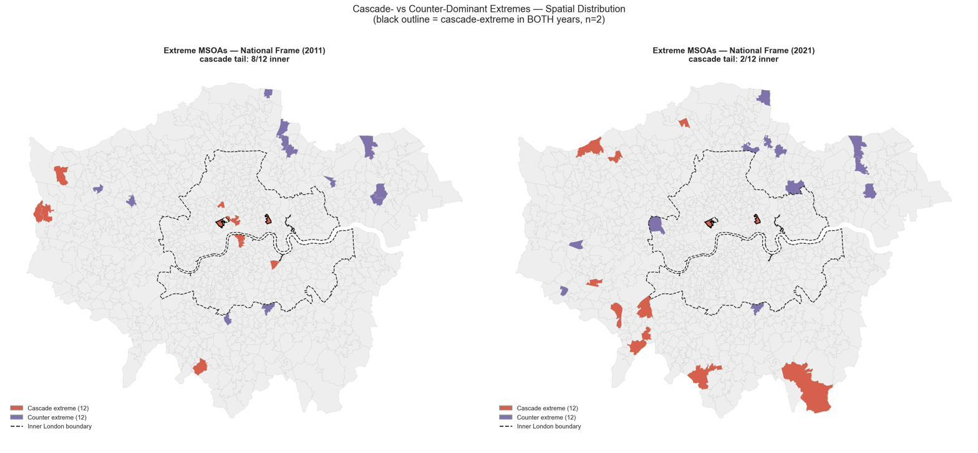
10
FINDINGS · 2
2021's cascade signal is an exodus, not relocation
+51% external outflow 2011→21 · 53 → 116 net-exporter MSOAs · 85% of 2021 cascade-led areas are outer London
One metric, two arms: Cascade_Churn = IW + OP
Gentrification — the inflow arm
IW dominates:
Inflow share 40–93%
Persistent
Inner cores (Camden, Tower Hamlets)
Exodus — the outflow arm
OP dominates:
Inflow share 1–35% (Harrow 1%)
Episodic, 2021 only, not in 2011
Outer ring
“Net exporters”
Cascade extremes shift inner (2011) → outer (2021); persistence is rare.
The inflow share is what separates the two processes. Caveat: the March 2021 lockdown census both caused the shift and degraded measurement.
Notes:
The temporal reason the equivalence fails. The map: in 2011 the cascade-extreme tail is 8-of-12 inner — Camden, Southwark, Islington, Tower Hamlets — and by 2021 it has flipped to outer high-decile boroughs: Kingston, Harrow, Richmond, Barnet, Sutton. Almost no black outlines: persistence is rare. The key point is the two arms. Cascade churn is an addition — Inflow_Wealthier plus Outflow_Poorer — so the SAME headline number can be produced by opposite processes. In 2011 the extremes are the inflow arm: 40–93% of cascade churn is people arriving from wealthier areas — genuine affluent in-migration into inner London. In 2021 the outer extremes are almost entirely the outflow arm: inflow share collapses to 1–35% — Harrow's cascade is 99% outflow. That's affluent residents leaving down the national ladder for cheaper places outside London: the pandemic exodus, not gentrification relocating outward. And these outer extremes are exactly the net-exporter cell of the sign matrix — 53 to 116 MSOAs, external outflow up 51%, 85% of 2021 cascade-led areas outer. Caveat: the lockdown census both caused this and degraded measurement, so I don't over-read within-London numbers.

Slide 11
CONCLUSION
Why cascade and gentrification don't imply each other
1
2
Measurement decoupling
Flows and attributes capture different processes — one is who is there, the other is how the hierarchy is being reshuffled.
Temporal shock
2021's flows are dominated by a one-off pandemic exodus, not gentrification relocating outward.
CONTRIBUTION
An open-data, whole-city flow lens plus a three-frame decomposition. The divergence cells — where flows and attributes disagree — are exactly what attribute methods miss, and the decoupling converges with recent mover-level findings (Freeman et al. 2024).
Takeaway: a flow lens doesn't detect gentrification worse — it measures a different process, and reveals what attributes overlook.
Notes:
Pull it together. The classic equivalence fails on two axes: conceptually, flows and attributes measure different things; and temporally, 2021 is a one-off shock. The contribution is an open-data, reproducible, whole-city flow lens with a decomposition that pre-empts the obvious objections — and the divergence between the two methods is itself the finding, converging with the best recent micro-data work. The line I'd leave the room with: the flow lens isn't a worse gentrification detector, it's a different instrument.

Slide 12
LIMITATIONS & WHAT'S NEXT
What this can't say — and where it goes
Aggregation / ecological — area-of-origin deprivation is a noisy proxy for a mover's wealth — no individual data.
Key references
Temporal mismatch — flows are 2011/2021; the IMD outcome is 2010→2019.
Marcuse, P. (1985). J. Urb. & Contemp. Law 28.
Dennett & Stillwell (2008). Population Trends 134.
Yee & Dennett (2022).
Ding, Hwang & Divringi (2016). Reg. Sci. Urban Econ. 61.
Freeman, Hwang, Haupert & Zhang (2024). Urban Affairs Rev. 60(1).
Reades, Lees, Hubbard & Lansley (2023). EPA 55(4).
Aging ladder — a 2010 baseline is eleven years stale by 2021 — a decade of gentrification is scored on old deprivation.
Lockdown measurement — 2021 census suppression / imputation degrades the flow estimates.
Thank you · questions welcome
Notes:
Limitations, stated plainly so they don't get raised as objections. The big one — aggregation — actually explains the decoupling: area origin is a noisy proxy for mover wealth, so flows and attributes needn't align. Temporal mismatch, the stale 2010 ladder, and lockdown measurement degradation round it out. Then thanks and questions.

