Slide 1
Event Summarization for System Logs
Yexi Jiang

Slide 2


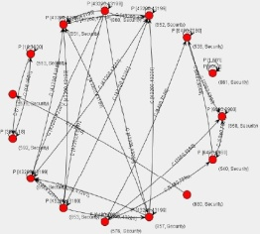
Introduction
Why summarize?
Traditional data mining algorithm output too many patterns that may be overwhelming for user to analysis.
Properties of event summarization
Brevity and accuracy.
Global data description.
Local pattern identification.
Parameter free.

Slide 3
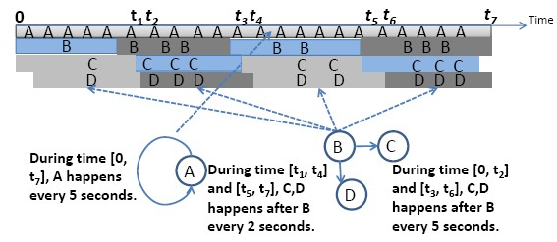
Existing Summarization Solutions
Capture the periodic pattern and correlation pattern simultaneously.
Contains more temporal details.
Different event types can have different pattern boundaries.

Slide 4
Disadvantage of Existing Solution
Bad scalability
Unable to handle tens of thousand or more records
No support for further mining tasks
Query
Visualization
Compression

Slide 5
New Solution
Advantages
More efficient
Support multiple analysis functionality
More intuitive
Modules
Dependency Identification
Dependency Graph Generation
Dependency Query

Slide 6
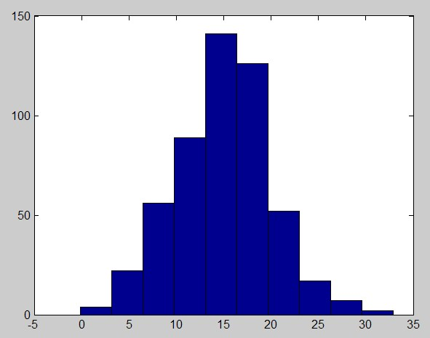
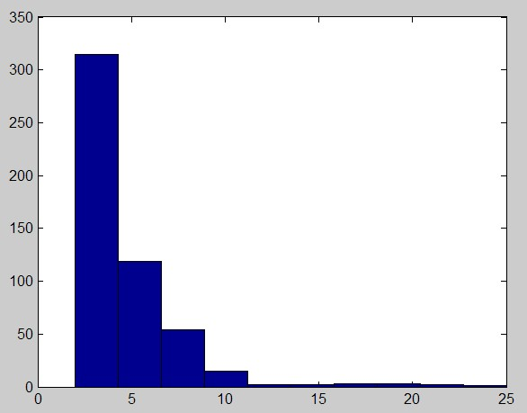
Dependency Identification
How to identify dependency?
Interval distribution: The interval of two dependent events should be constant.
Independent Dependent
Requirement for algorithm: Simple and Fast.

Slide 7
Dependency Graph
Summarize the event logs with graph.
Node: Event type.
Edge: Dependency.
B
A
C
D
E

Slide 8
Dependency Query
Given a dependency query, return all the dependencies that satisfy the query.
Concrete relationship query.
Fuzzy relationship query.
Structure-based query.
B
A
C
D
E
A
B
A
B
*
B
A
B
C
B
*
*
A
B
C
B
D
E

Slide 9
End
Visualization…
Data Compression…

